Slide 1
The Rotary Club of Louisville Suburban
Wednesday Meeting
February 13, 2019
11:30 – 1:00 pm
http://lousuburbanrotary.org
www.facebook.com/The Rotary Club of Louisville Suburban

Slide 2
The Rotary Club of Louisville Suburban
Sandra Lovell, President
Glenn R. Gilbert, Director & Past President
Allan D. Morgan, Vice President & President Elect
Neil Watkins, Treasurer
Don Gosser, Secretary
Skip F. Thorpe, Sergeant-at-Arms
Robert E. Herzfeld, Director & Chair of Compliance
Michael Parker, Director & Chair of Rotary Foundation
Mark Wilson, Director & Chair of Member Fellowship
Greg Scheller, Director & Chair of Louisville Suburban Rotary Charitable Foundation, Inc.

Slide 3
Welcome to Rotary
Opening
Welcome to Members and Guests
Opening Prayer
Special Concerns and Intentions
Pledge of Allegiance

Slide 4
Welcome to Rotary
Rotary Four Way Test
Is it the truth?
Is it fair to all concerned?
Will it build goodwill and better friendships?
Will it be beneficial to all concerned?
God Bless America
Introductions

Slide 5
Announcements
Speaker: Jeff O’Brien, Louisville Metro Government, Director of Development
Lt. Gov. Visit - Thanks to David Owen
DACdb Training: Wed, 2/20/19, 11 am
Thanks to George Weber for Newsletter
Spelling Bee Contest Outcome

Slide 6
Announcements
Speech Contest Update – March 6
Rotary Foundation Updates:
Yearly $100 Donation
Water Step
Dictionaries
Grants
Interim Report

Slide 7
Announcements
Thunder Over Louisville Raffle Tickets
Fundraising
Member Announcements & Good News
Other Announcements.
Weekly Ticket Drawing

Slide 8
Planned Social Events
Filson Historical Society - March
Kentucky Derby Festival - April / May
Locust Grove - May
Churchill Downs Racing - May
Horse Farm Visit - June
Old Friends Equine - June

Slide 9
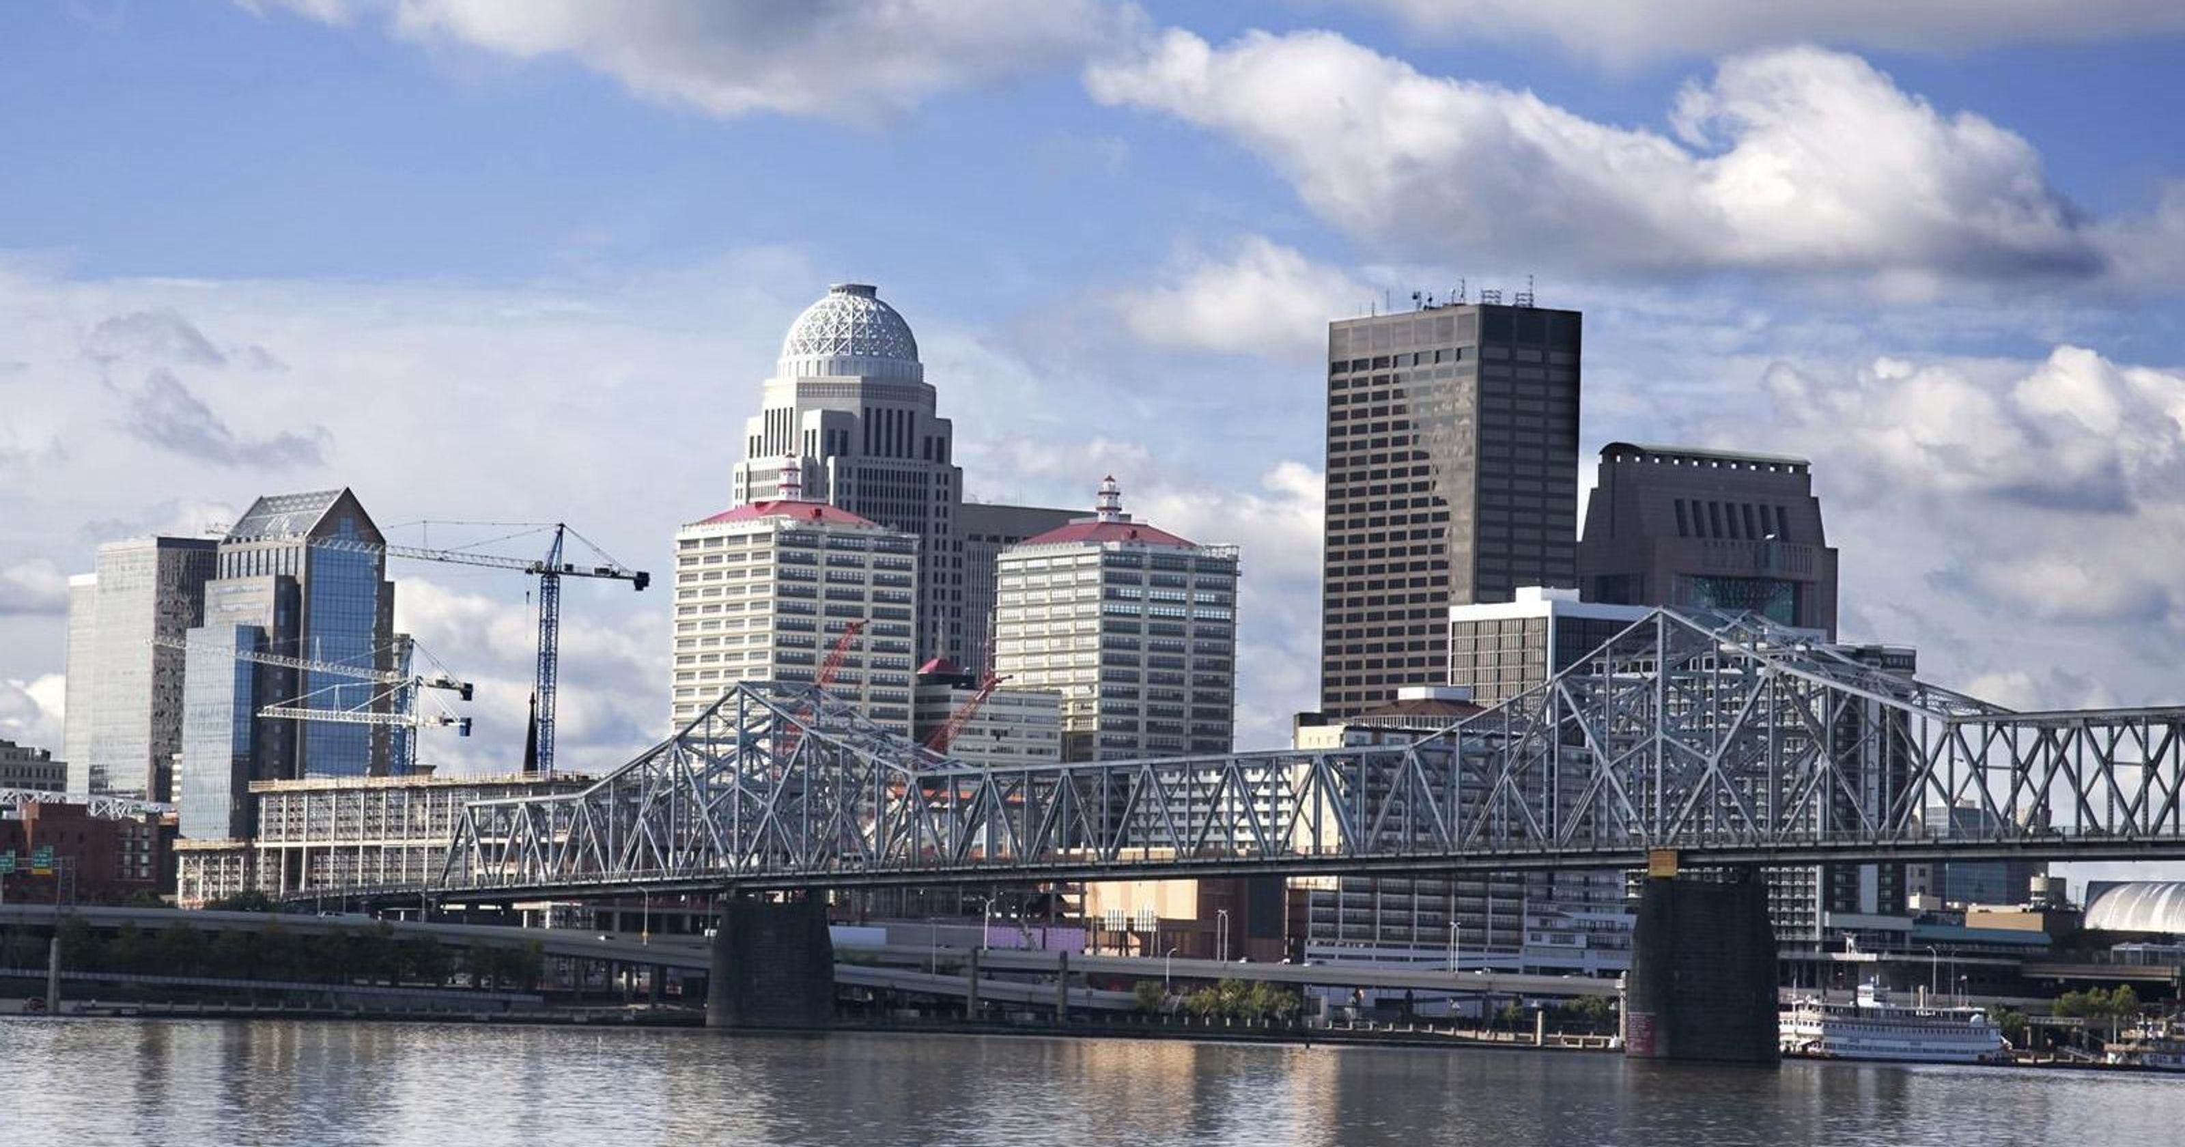
Speaker - Jeff O’Brien Louisville Metro Government Director of Develop Louisville

