Slide 1
Scheduled Speakers
Rotary Club of Louisville Suburban
------------
Scheduled Speakers
from
February to July

Slide 2
Scheduled Speakers
Scheduled Speakers List:
As shown on DACdb
Send requests and details to Sandy
Next open dates are in July
February 20 - KY Colonels Organization
February 27- Thunder Over Louisville

Slide 3
Scheduled Speakers
March 6 - 2019 Rotary Speech Contest
March 13 - Nat. Veteran Wheelchair Games
March 20 - Rebecca Boone's Story
March 27- 2019 Kentucky Derby Festival
April 3 - The Kosovo Experience

Slide 4
Scheduled Speakers
April 10 - YMCA Presentation
April 17- Kentucky Derby Time - Horses
April 24 - Honor Flight for May 28, 2019
May 1 - 2019 Kentucky Derby Party
May 8 - New Drivers Licenses

Slide 5
Scheduled Speakers
May 15 - Steve Magre, TBD
May 22 - Memorial Day Celebration
May 29 - Team Rubicon – Disaster Support
June 5 - Rudell Stitch, The Forgotten Boxer
June 12 - SOS (Supplies Over Seas)

Slide 6
Scheduled Speakers
June 19 - The Louisville Zoo Update
June 26 - Changing of the Guard. Actual date, time and location to be determined.
If you have a speaker please let
Sandy Lovell know to scheduled.

Slide 7
Planned Social Events
Filson Historical Society
Locust Grove
Churchill Downs
Old Friends Equine Retirement Farm
Lexington Horse Farm
Kentucky Derby Festival Activities
….. and more
Let Mike King know if you have an event.

Slide 8
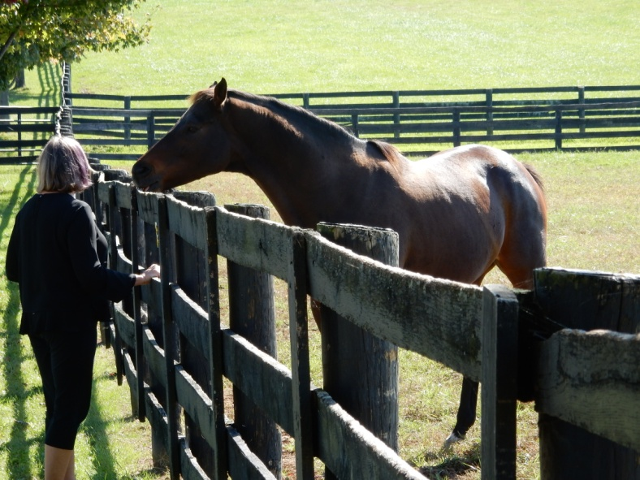
Previous Social Events
Old Friends Equine
Old Friends Equine

Slide 9
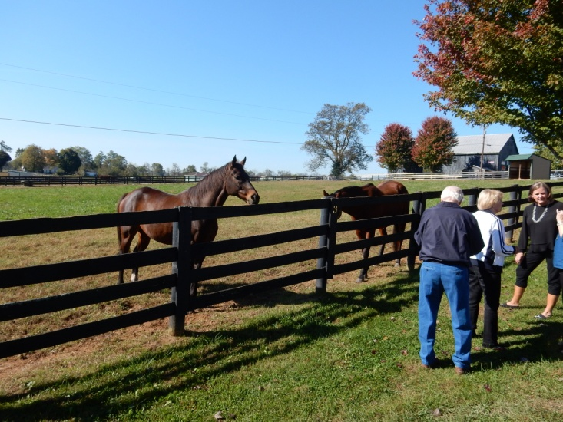
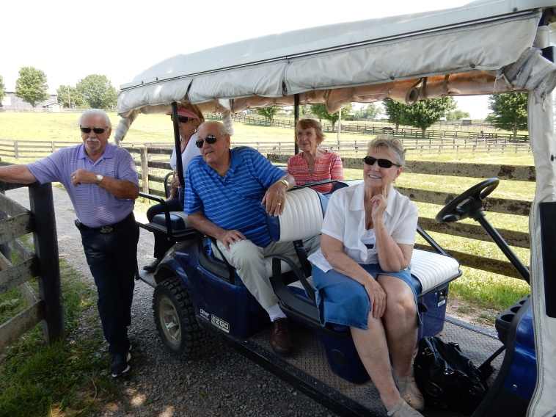
Previous Social Events
Old Friends Equine

Slide 10
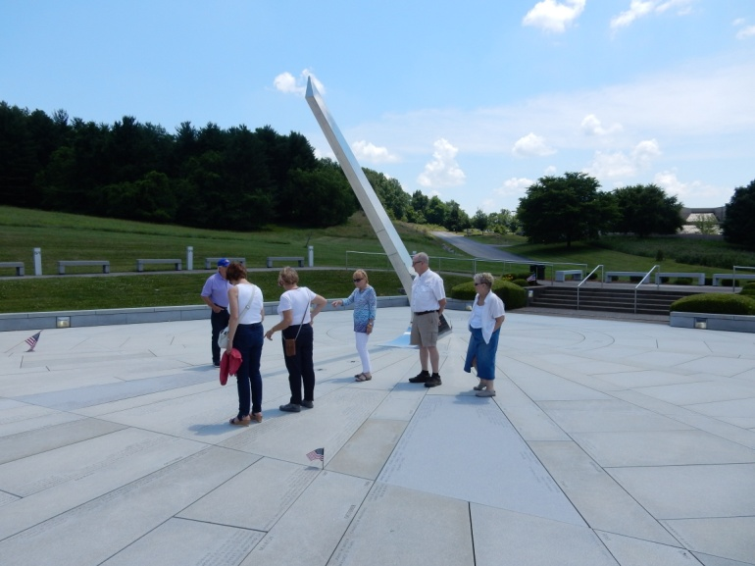
Previous Social Events
KY Vietnam Veterans Memorial
Old Friends Equine

Slide 11
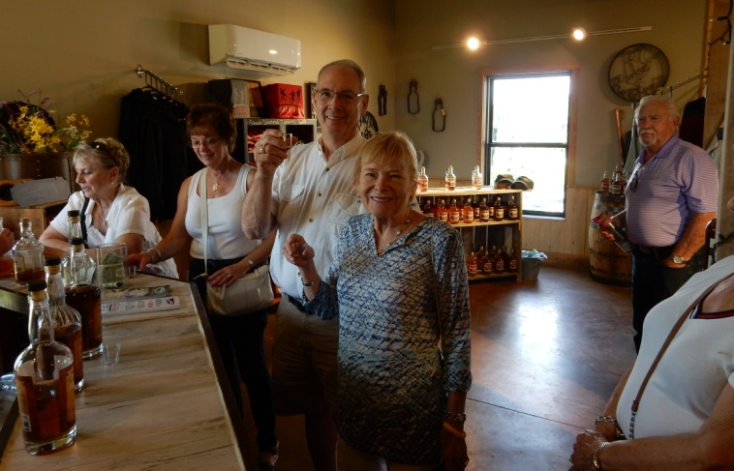
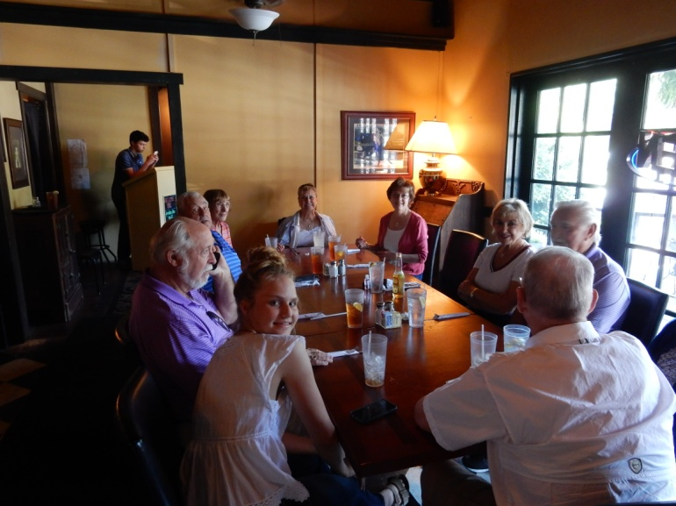
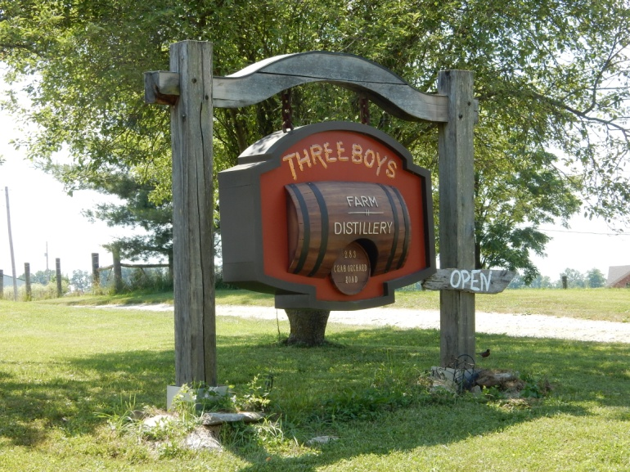
Previous Social Events
Midway, KY for Lunch
Three Boys Distillery

Slide 12
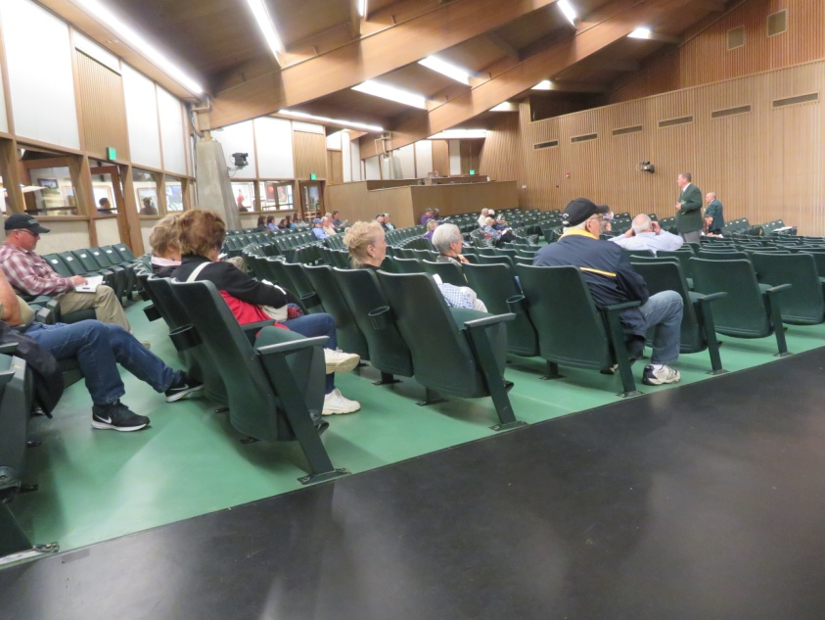
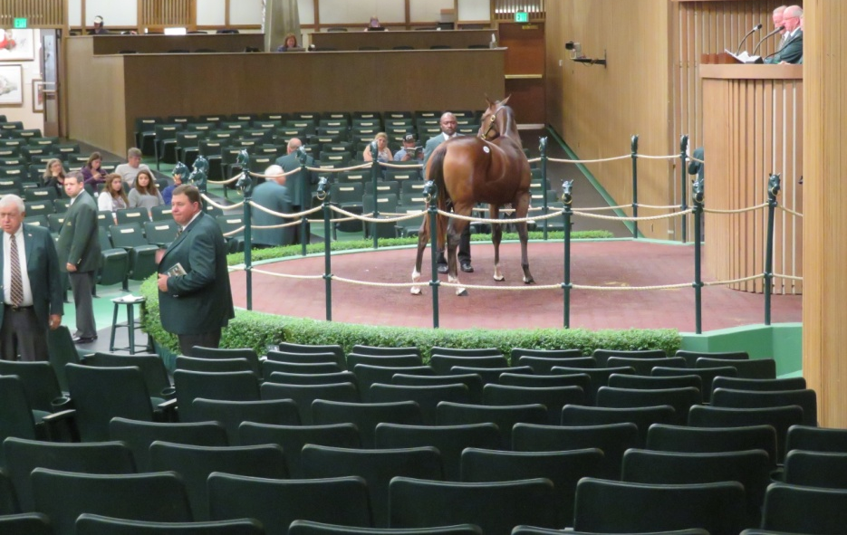
Previous Social Events
Keeneland Horse Sales

Slide 13
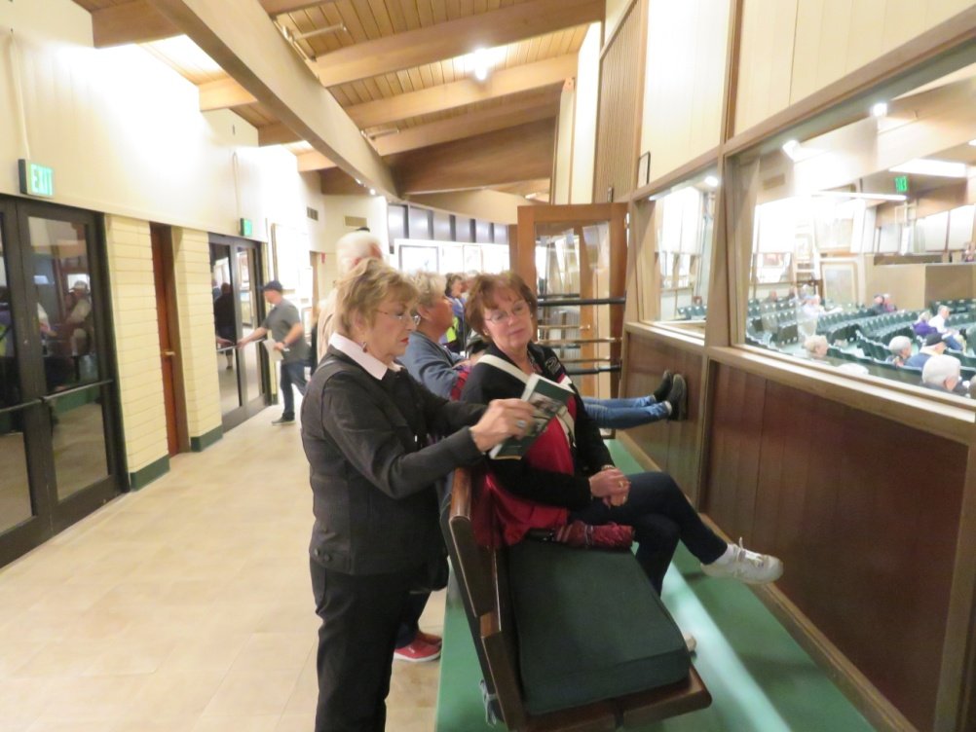
Previous Social Events
Keeneland Horse Sales

Slide 14
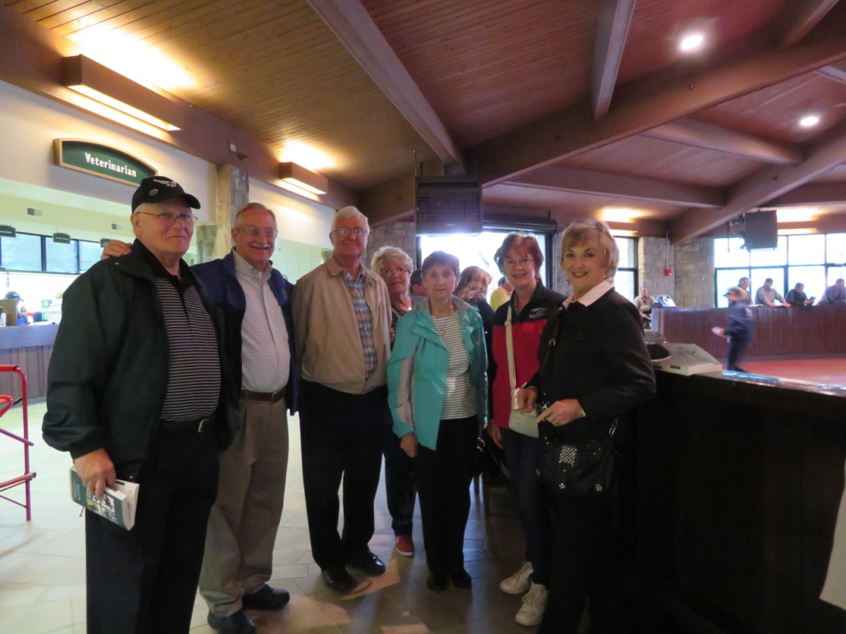
Previous Social Events
Keeneland Horse Sales

Slide 15
Social Events
Come Join in the Fun!

