Slide 1
The Rotary Club of Louisville Suburban
Martin Luther King Jr. Celebration
Wednesday Meeting
January 23, 2019
11:30 – 1:00 pm
http://lousuburbanrotary.org
www.facebook.com

Slide 2
The Rotary Club of Louisville Suburban
Sandra Lovell, President
Glenn R. Gilbert, Director & Past President
Allan D. Morgan, Vice President & President Elect
Neil Watkins, Treasurer
Don Gosser, Secretary
Skip F. Thorpe, Sergeant-at-Arms
Robert E. Herzfeld, Director & Chair of Compliance
Michael Parker, Director & Chair of Rotary Foundation
Mark Wilson, Director & Chair of Member Fellowship
Greg Scheller, Director & Chair of Louisville Suburban Rotary Charitable Foundation, Inc.

Slide 3
Welcome to Rotary
Opening Prayer – A.W. Buie
Pledge of Allegiance – Yvette Livers
Rotary Four Way Test – Sandra Lovell
Is it the TRUTH?
Is it FAIR to all concerned?
Will it build GOODWILL and BETTER FRIENDSHIPS?
Will it be BENEFICIAL to all concerned?

Slide 4
Welcome to Rotary
God Bless America – Dale Breitenstein
Announcements and Introductions
Special Guest:
Lt. Governor Jenean Hampton
Remembering Martin Luther King Jr.

Slide 5
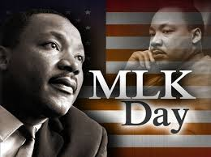
January 15, 1929 - April 4, 1968

Slide 6
Martin Luther King Jr. Week
Remembers him as a family man, citizen and a leader in the Civil Rights movement.
Recognizes and appreciates the changes he championed to make the world a better place.
It also honors all pioneers of civil rights and that their sacrifices have not been forgotten.
Reminds us of the responsibility he handed us to embrace diversity and fairness to all.

Slide 7
“I’ve Been to the Mountaintop”

Slide 8
Remembrance
Continue the efforts to help others and be involved with our community and the world.
Keep history alive while working to change and improve in the future.
Celebrate the life of Martin Luther King Jr. by following the Rotary Mission, Objectives, Services and Four Way Test.

Slide 9
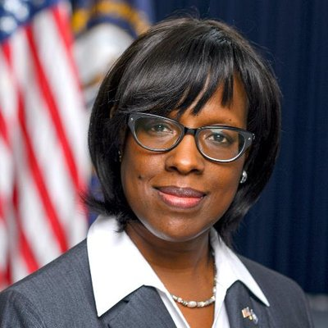
Lt. Governor
Jenean Hampton

Slide 10
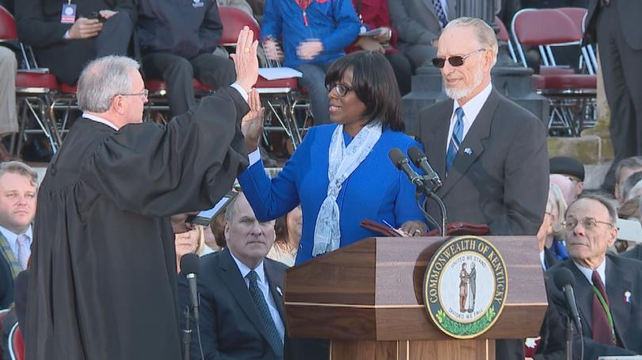
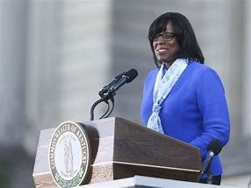
Lieutenant Governor
of Kentucky

Slide 11
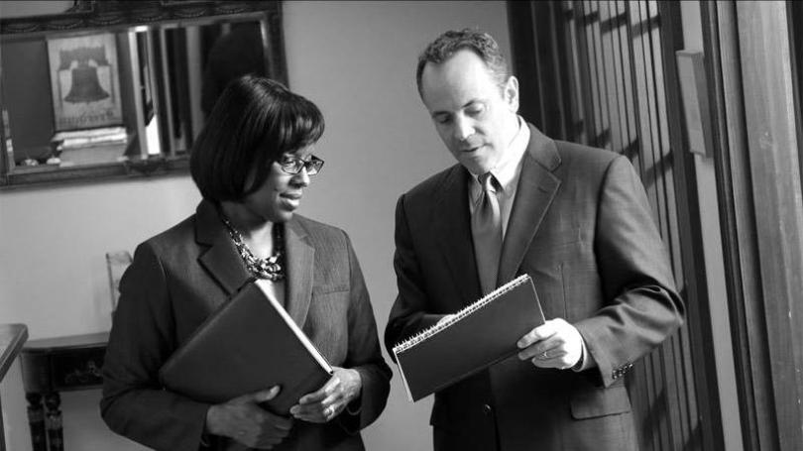
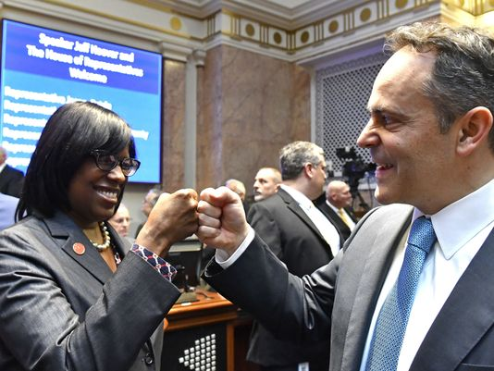
Managing the Affairs of Kentucky

Slide 12
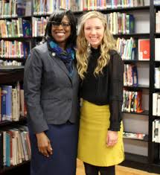
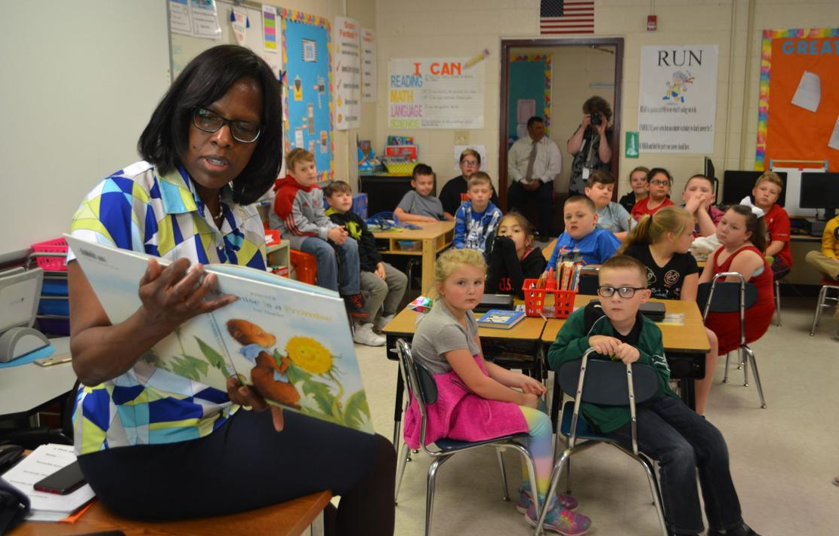
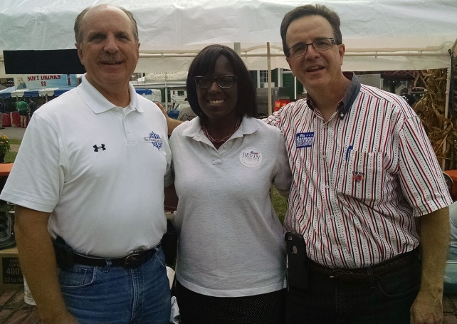
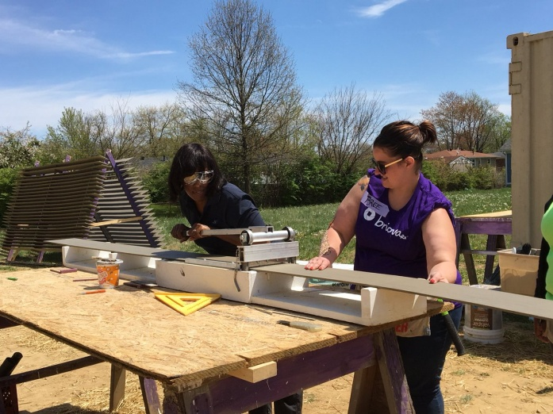
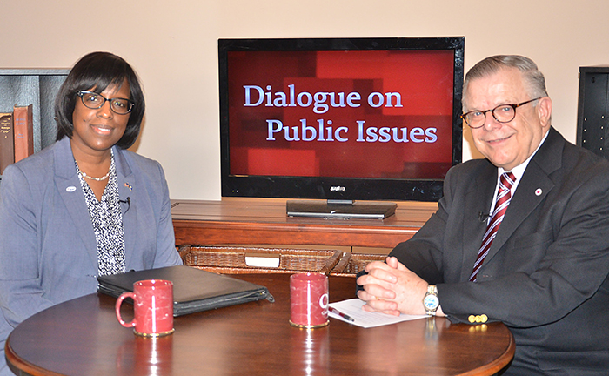
Involved in the
Community

Slide 13
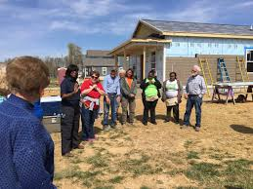
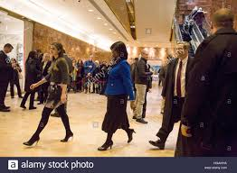
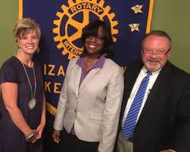
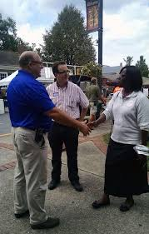
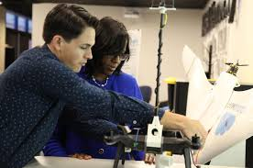
Business Leader and
Friend of Rotary

Slide 14
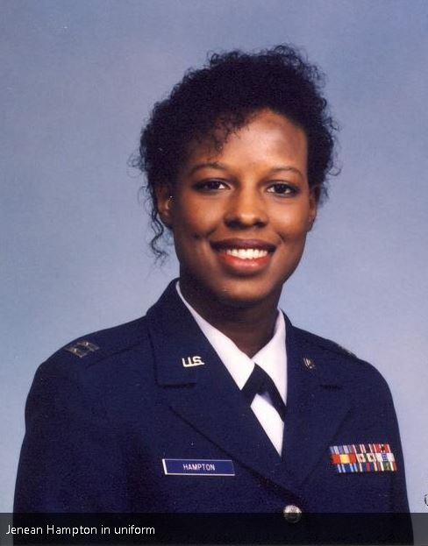
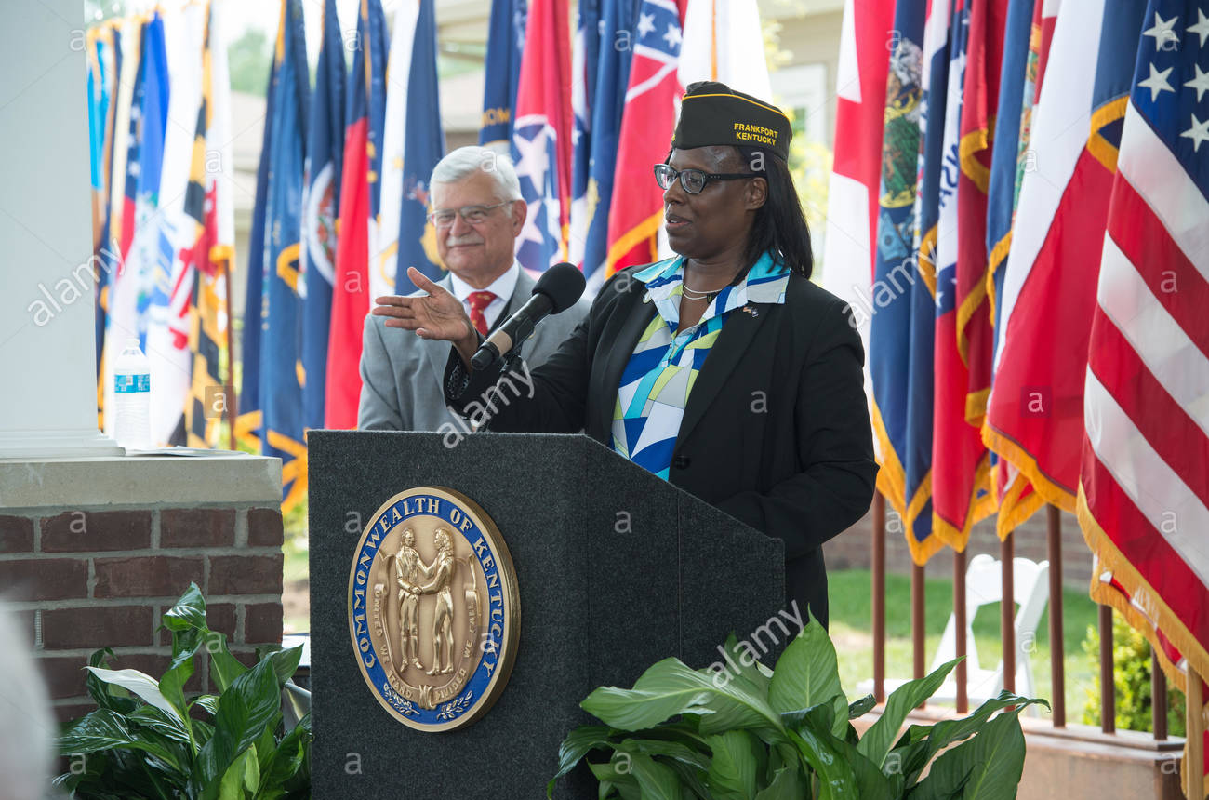
Air Force Veteran -
Operation Desert Storm

Slide 15
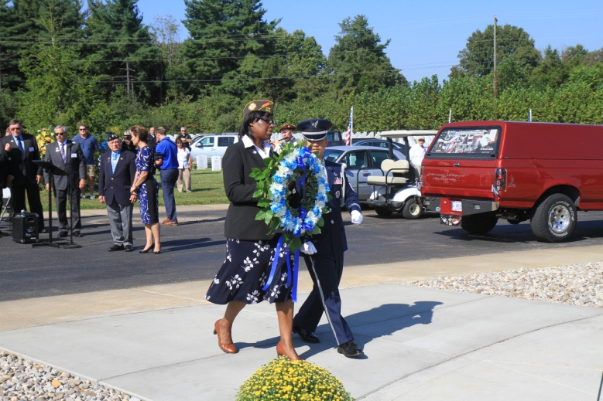
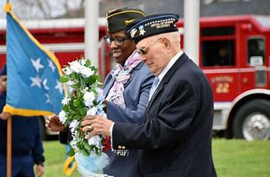
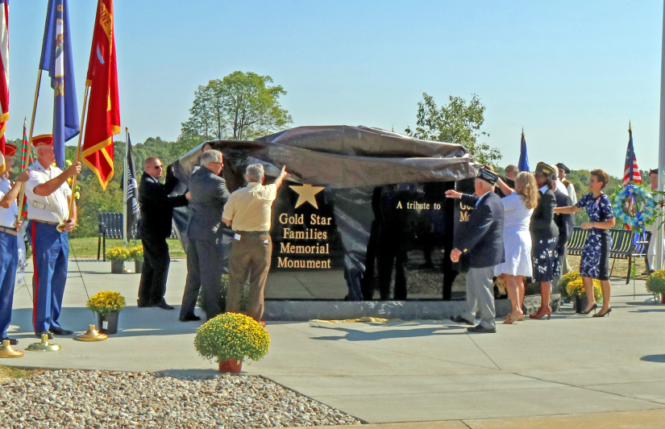
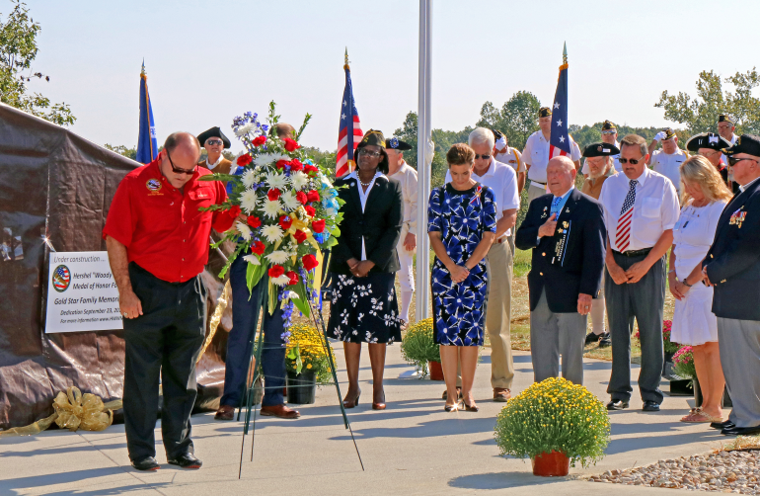
Remembering the Fallen
and Their Families

Slide 16
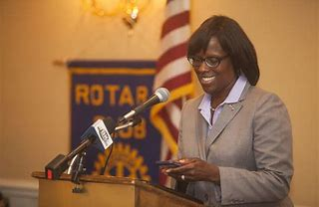
Lt. Governor
Jenean Hampton

