Slide 1
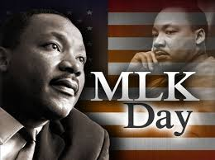
January 23, 2019

Slide 2
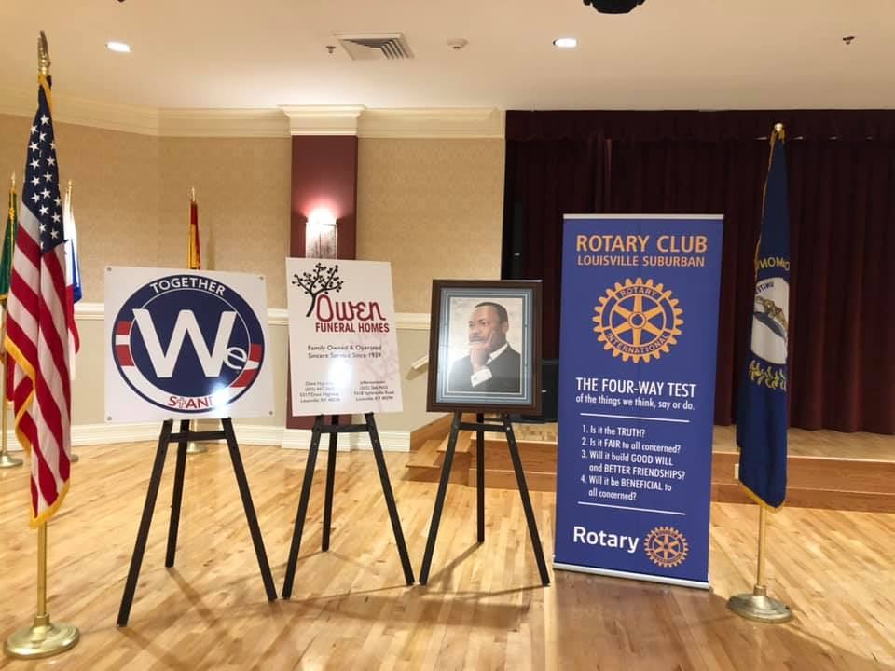
MLK Day Celebration Beautiful Display by AW

Slide 3
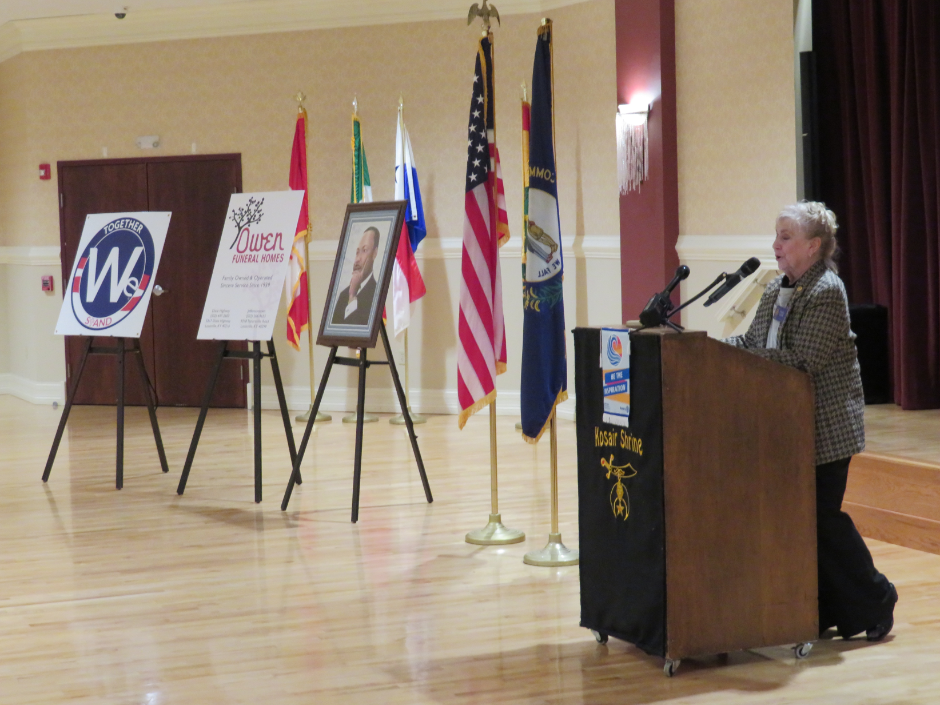
MLK Day Celebration Sandy Starting Meeting

Slide 4
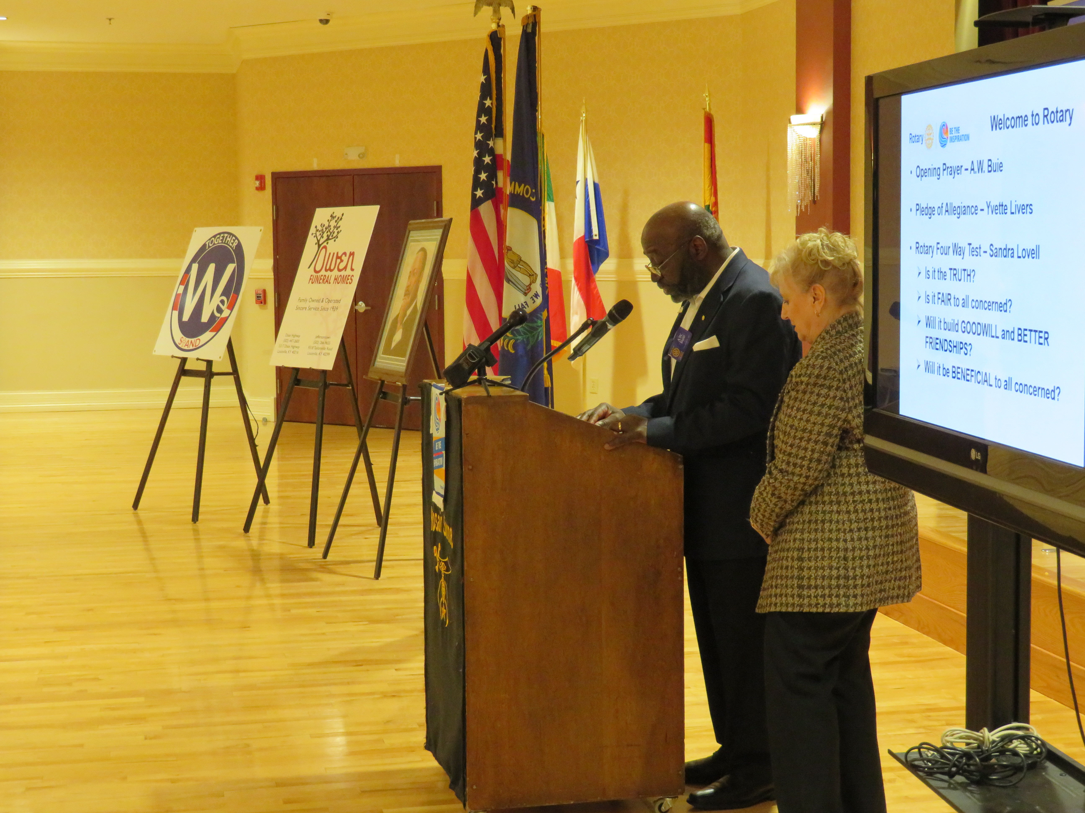
MLK Day Celebration AW Giving Invocation

Slide 5
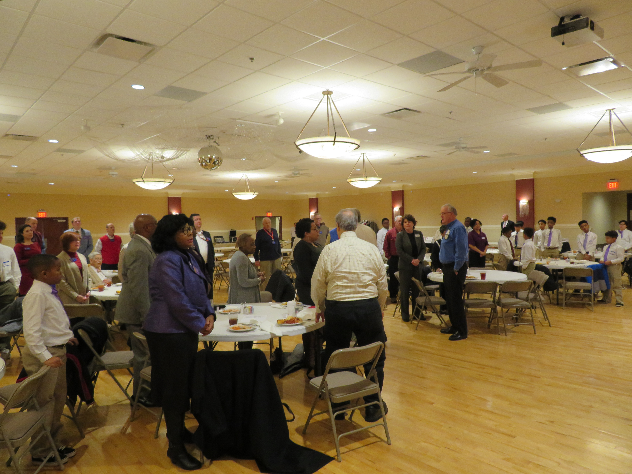
MLK Day Celebration Yvette and Dale, Pledge & Song

Slide 6
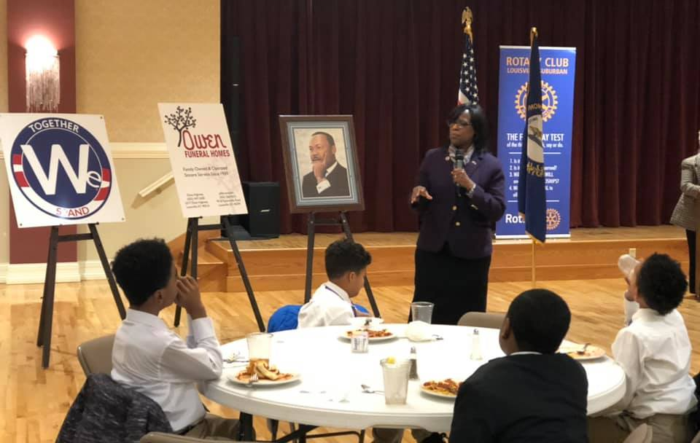
MLK Day Celebration Lt. Gov. Jenean Hampton

Slide 7
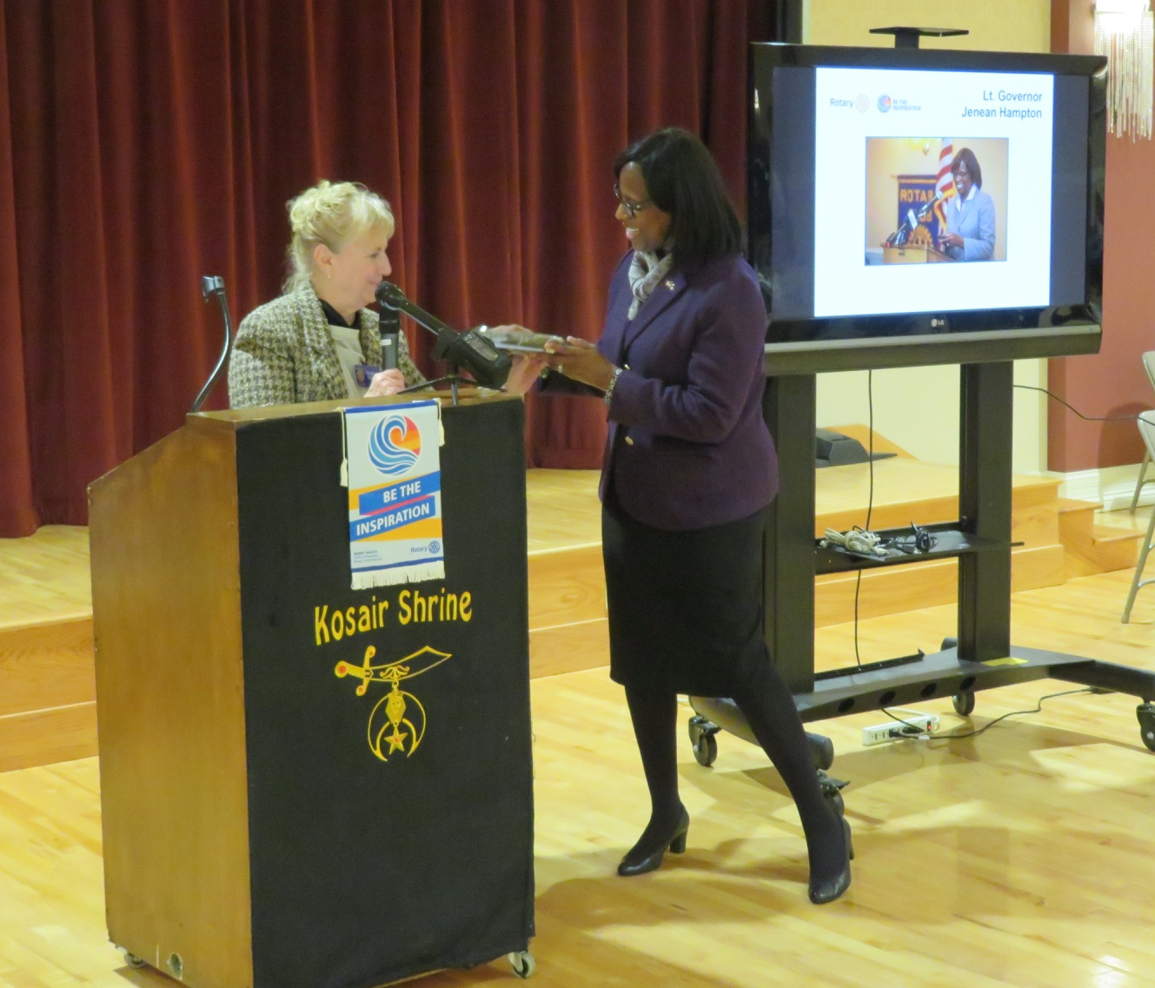
MLK Day Celebration Presentation to Lt. Gov.

Slide 8
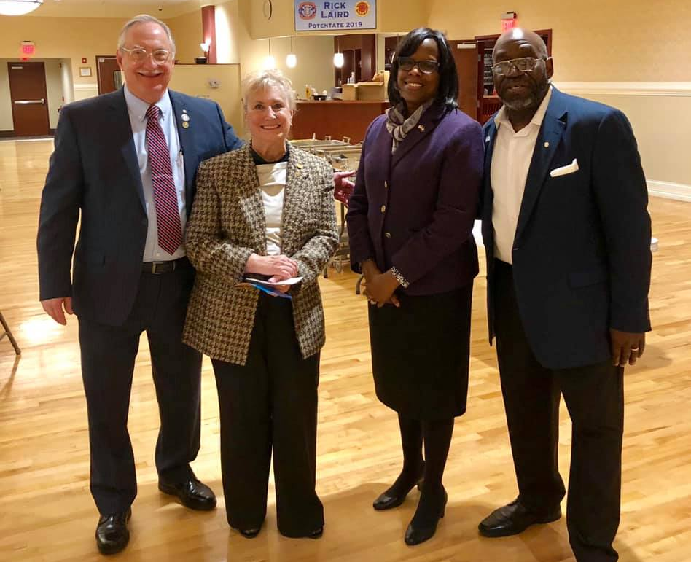
MLK Day Celebration After the Meeting
Mike, Sandy, Lt. Gov. Hampton and AW
Lt. Gov, Sandy, John Miles

