Slide 1
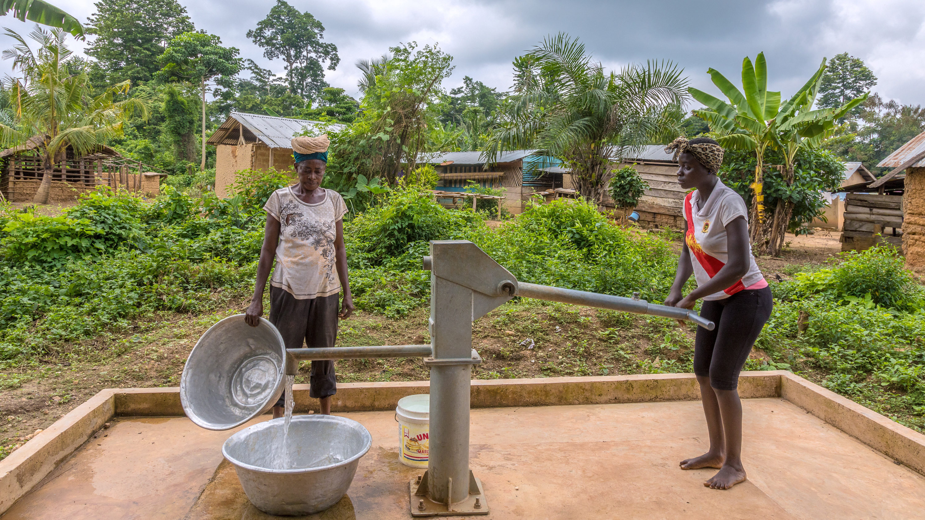

WORLD FUND SEMINAR
Title Page Option

Slide 2
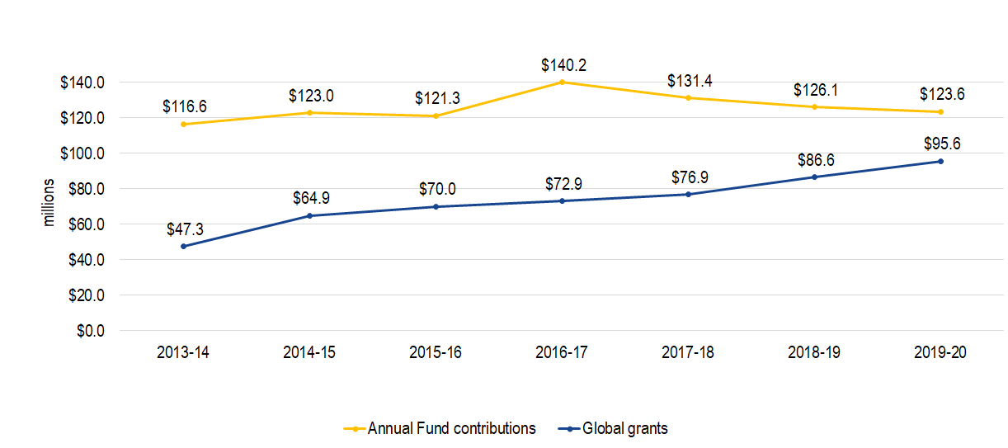
BACKGROUND
GLOBAL GRANT GROWTH AND ANNUAL FUND CONTRIBUTIONS​
6%
102%
US $

Slide 3
WORLD FUND POLICY CHANGES
EFFECTIVE 1 JULY 2021
Decision 1: District Designated Fund (DDF) contributions to PolioPlus will be matched at 50%.
Decision 2: Reduce the World Fund match of DDF from 100% to 80% for global grants.
Decision 3: 5% of the current year Annual Fund-SHARE contributions will be taken equally from the World Fund and DDF to help fund operating expenses. DDF generated from Annual Fund – SHARE contributions will not be impacted until 1 July 2024.
Decision 4: Effective 1 July 2026, any rollover DDF not used within the previous five Rotary years can be donated to a select menu of Foundation funds and programs; otherwise, it will automatically be reassigned to the World Fund.

Slide 4

DECISION 1: DDF contributions to PolioPlus will be matched at 50%
Example scenario:
Advocacy
DDF
to PolioPlus
50% World Fund Match
+
+
Gates Foundation
Match
$90,000
for polio
eradication
$20,000
$10,000
$60,000

Slide 5
Decision 2: Reduce the World Fund match of DDF from 100% to 80% for global grants
Example scenario:
DDF contribution to Global Grant
80% World Fund Match
Advocacy
+
$36,000
for global grant
$20,000
$16,000

Slide 6
Decision 3: 5% of the current year Annual Fund-SHARE contributions will be taken equally from the World Fund and DDF to help fund operating expenses.
CURRENT
AFTER 1 JULY 2021
$100
Annual Fund – SHARE
contribution
$100
Annual Fund – SHARE
contribution
$45
World Fund
$5
Operating Expenses
$50
District Designated
Funds
$47.50
World Fund
$47.50
District Designated
Funds
$5
Operating Expenses
Notes:
Decision 3: DDF generated from Annual Fund – SHARE contributions will not be impacted until 1 July 2024

Slide 7
Decision 4: Limit rollover DDF to five years.
 | 2020-21 | 2021-22 | 2022-23 | 2023-24 | 2024-25 | 2025-26
New DDF |  | $50,000 | $50,000 | $50,000 | $50,000 | $50,000
Rollover DDF |  | $20,000 | $30,000 | $35,000 | $30,000 | $20,000
DDF Spent |  | -$40,000 | -$45,000 | -$55,000 | -$60,000 | -$65,000
Rollover Remaining | $20,000 | $20,000 $10,000 | $20,000 $10,000 $5,000 | $15,000 $10,000 $5,000 $0 | $5,000 $10,000 $5,000 $0 $0 | $0 $0 $5,000 $0 $0 $0
Key: |  | 1 year old | 2 years old | 3 years old | 4 years old | 5 years old

Slide 8


What if DDF is unused after 5 years?
Areas of Focus
Disaster Response
Endowment Fund
PolioPlus
Rotary Peace Centers
World Fund*
$
Rollover District Designated Funds
£
€
Rollover District Designated Funds
¥
*If a program is not selected by the District, it will default to World Fund

Slide 9
FINANCIAL IMPACT
Action | Annual Impact
No longer provide a World Fund match for cash contributions to global grants Effective 1 July 2020 | $7.0 million
District Designated Fund (DDF) contributions to PolioPlus will be matched at 50%. Effective 1 July 2021 | $5.0 million
Reduce the World Fund match of DDF from 100% to 80% for global grants. Effective 1 July 2021 | $6.3 million
Subtotal—starting 1 July 2021 | $18.3 million
5% of the current year Annual Fund-SHARE contributions will be taken equally from the World Fund and DDF to help fund operating expenses. Effective for contributions received starting 1 July 2021 | $3.0 million
Total- starting 1 July 2024 | $21.3 million

Slide 10
Endowment fund history

Slide 11
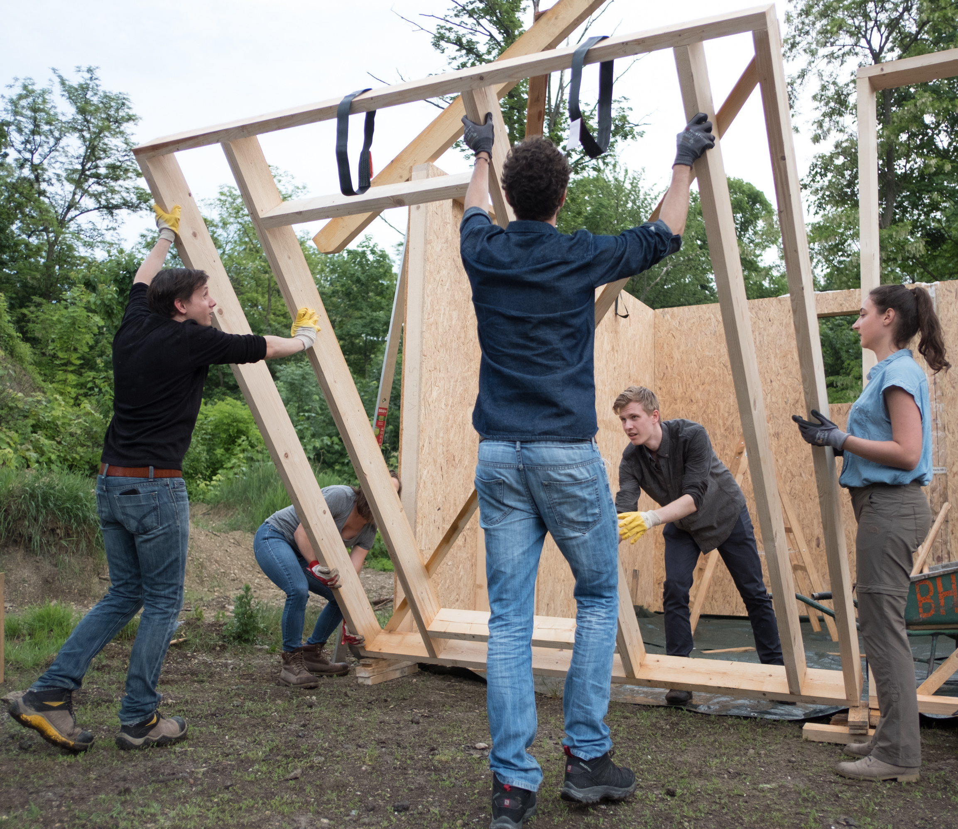
How can you help?
Celebrate the success of global grants
Use existing District Designated Funds
Increase Annual Fund contributions
Create your own legacy with a
gift to the Endowment

Slide 12
QUESTIONS?

