Slide 1
New Member Orientation
Speaker Introduction
Attendees Introduction

Slide 2
Rotary International (RI)
The Rotary Club of ____is part of an international service organization

Slide 3
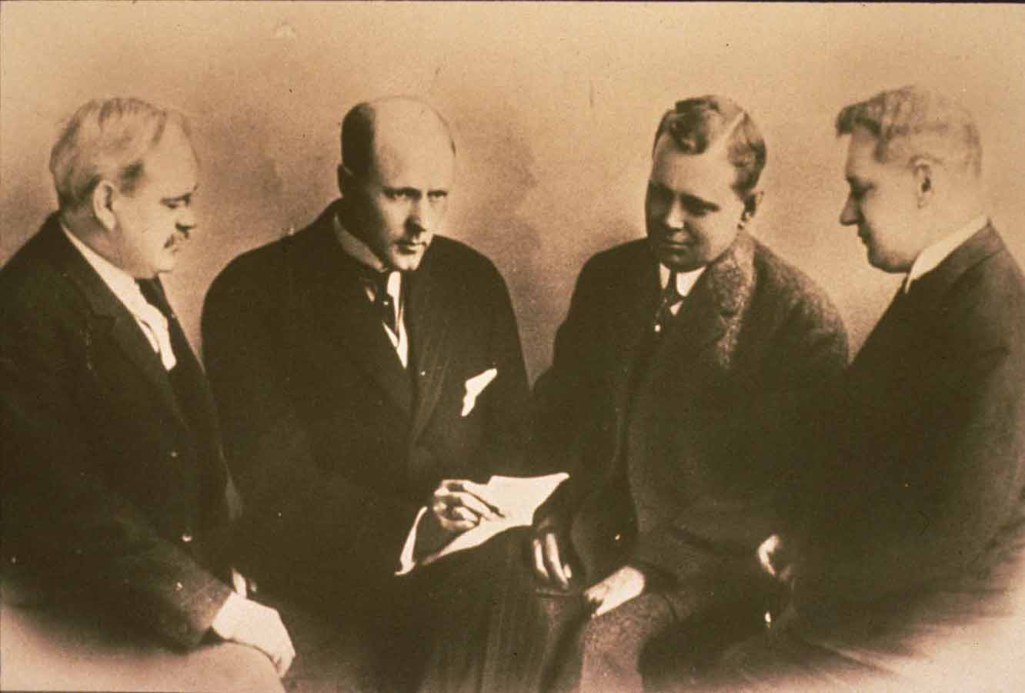
Started in Chicago in 1905 by Paul Harris
Brought together a group of professionals to exchange ideas and form meaningful friendships
Four men started meeting for lunch, weekly, rotating the meetings from office to office
Thus the
name Rotary

Slide 4
Official Mottoes of Rotary
Rotary’s official mottoes are Service Above Self and One Profits Most Who Serves Best. These mottoes date back to the early days of Rotary. “Service Above Self” was inspired in 1911 at the second convention of the National Association of Rotary Clubs of America in Portland, Oregon. During a convention outing, the president of the Rotary Club of Minneapolis, Ben Collins talked with a Seattle Rotarian about the proper way to organize a Rotary club, offering the principle his club had adopted: Service, Not Self. Paul Harris who was also on the boat trip joined the conversation and Harris asked Collins to address the convention and the phrase Service, Not Self was met with great enthusiasm. It was at the 1950 RI Convention in Detroit that the slightly modified version was formally approved as one of the official mottoes of Rotary: Service Above Self. The 1989 Council on Legislation established Service Above Self as the principal motto of Rotary because it best conveys the philosophy of unselfish volunteer service
Service Above Self
Principal motto because it best conveys the philosophy of unselfish volunteer service
One Profits Most Who Serves Best

Slide 5
Guiding Principles
Object of Rotary
The Four-Way Test
Avenues of Service

Slide 6
Object of Rotary
The Object of Rotary is to encourage and foster the ideal of service as a basis of worthy enterprise and, in particular, to encourage and foster:
FIRST: The development of acquaintance as an opportunity for service;
SECOND: High ethical standards in business and professions; the recognition of the worthiness of all useful occupations; and the dignifying of each Rotarian’s occupation as an opportunity to serve society;
THIRD: The application of the ideal of service in each Rotarian’s personal, business, and community life;
FOURTH: The advancement of international understanding, goodwill, and peace through a world fellowship of business and professional persons united in the ideal of service.

Slide 7
The Four-Way Test
The Four-Way Test is a nonpartisan and nonsectarian ethical guide for Rotarians to use for their personal and professional relationships. Many clubs recite this at every club meeting.
Of the things we think, say or do
Is it the TRUTH?
Is it FAIR to all concerned?
Will it build GOODWILL and BETTER FRIENDSHIPS?
Will it be BENEFICIAL to all concerned?
Notes:
In 1932, The Four-Way Test was developed by Herbert Taylor, a Rotary Club of Chicago member and 1954-55 RI president, to guide his attempt to save a faltering aluminum company. Rotary later adopted it, and it underscores Rotary’s value of integrity.

Slide 8
Avenues of Service
We channel our commitment to service at home and abroad through five Avenues of Service, which are the foundation of club activity.
Club Service focuses on making clubs strong. A thriving club is anchored by strong relationships and an active membership development plan.
Vocational Service calls on every Rotarian to work with integrity and contribute their expertise to the problems and needs of society.
Community Service encourages every Rotarian to find ways to improve the quality of life for people in their communities and to serve the public interest.
International Service exemplifies our global reach in promoting peace and understanding. We support this service avenue by sponsoring or volunteering on international projects, seeking partners abroad, and more.
Youth Service recognizes the importance of empowering youth and young professionals through leadership development programs such as Rotaract, Interact and Rotary Youth Leadership Awards.

Slide 9
Structure
Rotary is made up of three parts:
OUR CLUBS
35,000+ clubs worldwide
Over 1.2 million members
Zones & Districts
(Zone 30 District 6710)

Slide 10
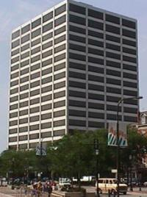
ROTARY INTERNATIONAL
Administrative arm of clubs
Headquarters in Evanston, IL
District 6710’s District
Governor is an RI officer
One Rotary Center
Evanston, Illinois

Slide 11
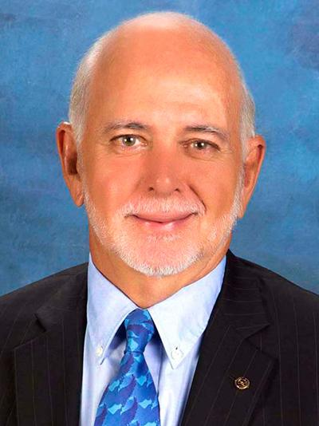
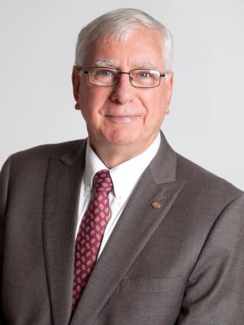
Rotary International President
Stephanie Urchick
RI President
2024-2025
Weekly Chronicles
2017 - 2018 Club Positions
Nancy Mieure, President
Diana Thomason, President-Elect
Heidi Shultz, Vice President
Yvonne Vogt, Secretary
Deana Wright, Treasurer
James Gallimore, Director
Mignon Pittman, Director
Carmen Garland, Director
Kenny Roth, Director
Mark Welch, Past President
Vernon Gantt, Parliamentarian
Tony Earls, Bulletin Editor
Steven Hunter, Sergeant at Arms
Rotary Club of Murray
P.O. Box 411
Murray, KY 42071
www.murrayrotary.org
CLUB 3742
DISTRICT 6710
www.rotary.org
www.rotarydistrict6710.org
INTERNATIONAL PRESIDENT
Ian H.S. Riseley
DISTRICT GOVERNOR
Missy Eckenberg
ASSISTANT GOVERNOR
Randall D. Fox
“Service Above Self”
The Rotary Club of Murray has been serving our community since 1924.

Slide 12
THE ROTARY FOUNDATION
Endowment dedicated to
“Doing good in the world”
Has spent more than $3.7 billion on
life-changing, sustainable grant projects that help people in need around the world
Made possible by contributions from Rotarians (Paul Harris Fellows)
Notes:
The Rotary Foundation is made possible by our contributions. (Paul Harris Fellows)

Slide 13
Rotary Foundation
Consists of 4 Parts:
Annual Fund
Permanent Fund Endowment
Polio Plus
Domestic and International Grants & Peace Fellowships
Annual Fund - Foundation donations banked for 3 years and then returned to the District donating the funds to fund Grants from the District. • EREY •
Permanent Fund Endowment - Earnings provides a steady and secure supplement to Annual Fund. Donations must be PF specified and $1,000 or more.
Notes:
The Rotary Foundation is made possible by our contributions. (Paul Harris Fellows)

Slide 14
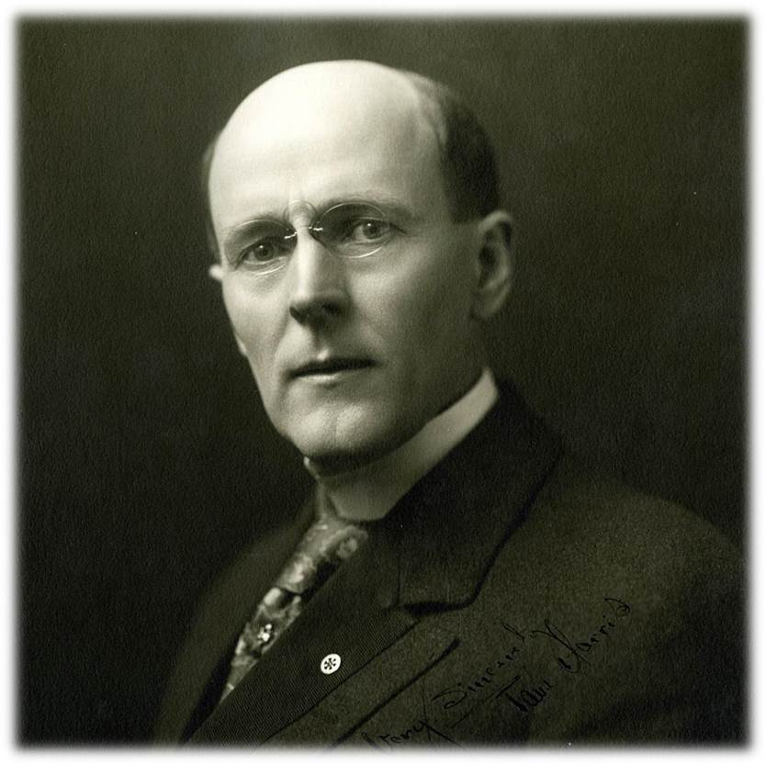
Paul Harris Fellow
The Paul Harris Fellow recognition
acknowledges individuals who
contribute, or who have contributions
made in their name, of $1,000 to The
Rotary Foundation
Rotary established the recognition in 1957 to encourage and show appreciation for substantial contributions to what was then the Foundation’s only program, Rotary Foundation Fellowships for Advanced Study, the precursor to Ambassadorial Scholarships.

Slide 15
Polio Plus
Rotary is dedicated to the total eradication of Polio from the Earth through mass vaccinations world wide.
Launched in 1985, has now vaccinated more than 2.5 Billion children in 122 countries.
Founding member of Global Polio Eradication Initiative with WHO, CDC, UNICEF, etc.
Bill & Melinda Gates Foundation
*Since 2013, the Gates Foundation has matched every $1 Rotary commits to polio eradication 2-to-1

Slide 16
Rotary Foundation
Is a 4 Star Charity.
2021 Charity Navigator score is 100 out of 100 in: Finance, Accountability, Transparency, Leadership, Culture & Community
14 Consecutive years
Notes:
The Rotary Foundation is made possible by our contributions. (Paul Harris Fellows)

Slide 17
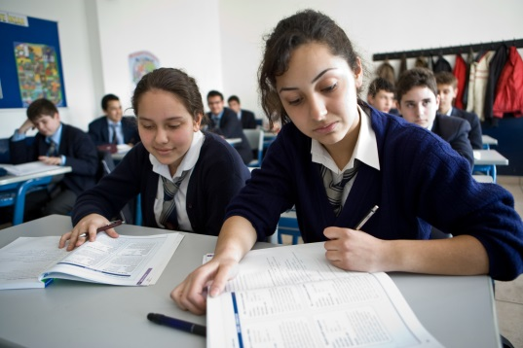
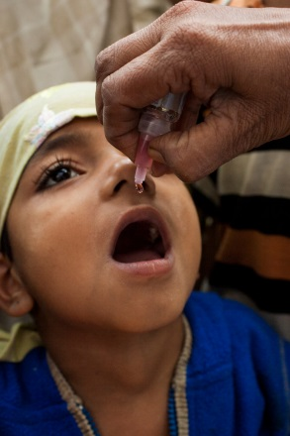
Domestic & International Grants
Our Causes:
Peacebuilding & Conflict Prevention
Disease Prevention & Treatment
Water, Sanitation & Hygiene
Maternal & Child Health
Basic Education & Literacy
Economic & Community Development
Protecting the Environment

Slide 18
Rotary District 6710
55 Clubs
12 Areas
Over 2400 Members

Slide 19
2024 - 25 Rotary District 6710 Leadership
District Governor (DG) - Dale Leatherman,
Vice-Governor - David L. Weller
District Governor Elect (DG Elect) - Ridley Dorsey
District Governor Nominee (DG Nominee) - Sherrill Smith
Immediate Past Governor (iPDG) - Tom Reed II
Assistant Governor (AG) - ____________
District Parliamentarian - Douglas Myers
District Admin Assistant - Leigh Perry
District Training Coordinator - Jayne Crisp
District Grant Chair - Ralph Young

Slide 20
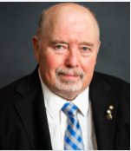
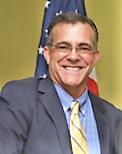
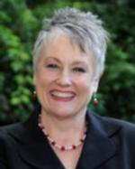
2024 - 2025 District Leaders
Dale Leatherman, DG
James Gallimore, Assistant DG
Leigh Perry, Admin Assistant

Slide 21
The Rotary Club of
________
About
Our Club

Slide 22
Rotary Club of ____
Club Chartered in —
Past District Governors
Meets
Currently has — members.

Slide 23
Club Leadership
President - _____
President Elect - ______
Past President - ______
Foundation - ________
Service - ______
Treasurer - ______
Secretary - _______

Slide 24
Make-up Meeting Information
Local Clubs
Local Club - at noon on Tuesday at The Keg
Other local club - at noon on first 4 Wednesdays at the Library. No meeting on a 5th Wednesday.
Other local club - at noon on Thursday at Citizen’s Bank Community room

Slide 25
Service

Slide 26
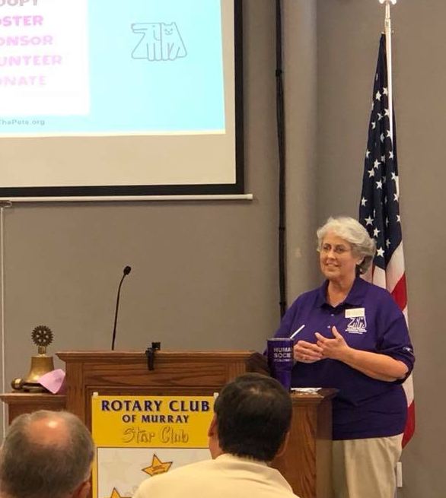
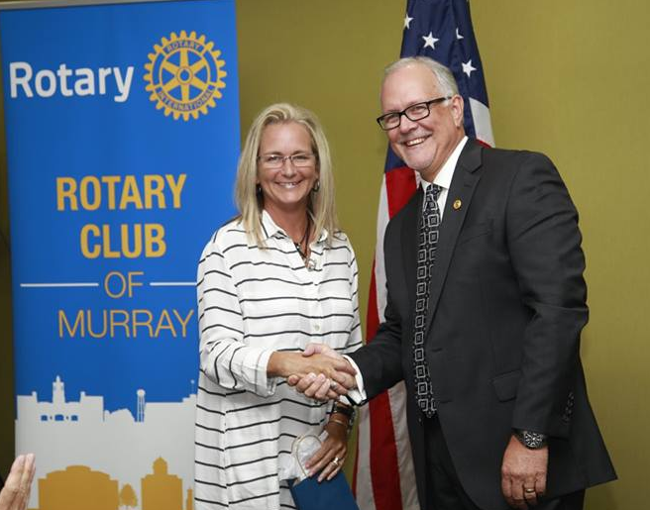
Club Service
Serve as Club Officer
Serve on a Committee
Attend/set up meetings and events
Program
Sponsor or Mentor a new member
Public Relations
Make-up meetings
Notes:
Annual Banquet: Recognize a club member as the Rotarian of the Year / Honor someone from the Community with the Humanitarian Award for Service Above Self

Slide 27
Rotary Club Board
Behind the scenes heart of the club
May be authorized by the club to take action for the club
Usually consists of the following officers:
President
Past President
President Elect
Treasurer
Secretary
Membership Chair
Service Chair
Public Affairs Chair
And any others the President sees fit to include

Slide 28
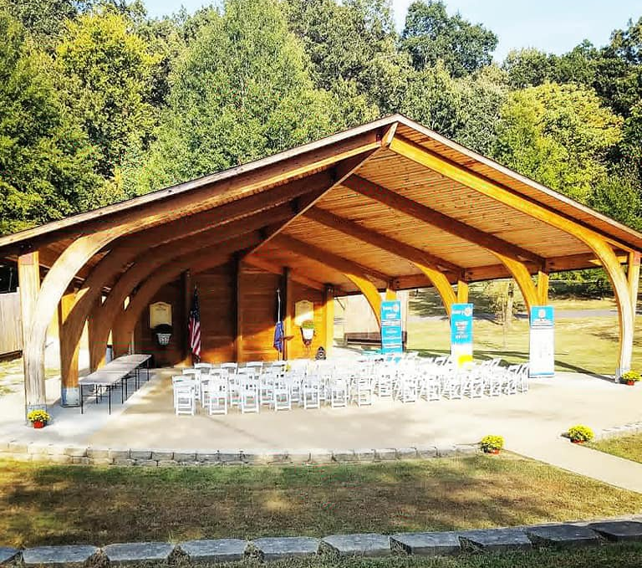
Community Service
Exemplify the 4 Way Test in your work and life
Scholarships
Club specific Service Projects in your community
Club specific community activities
Volunteering

Slide 29
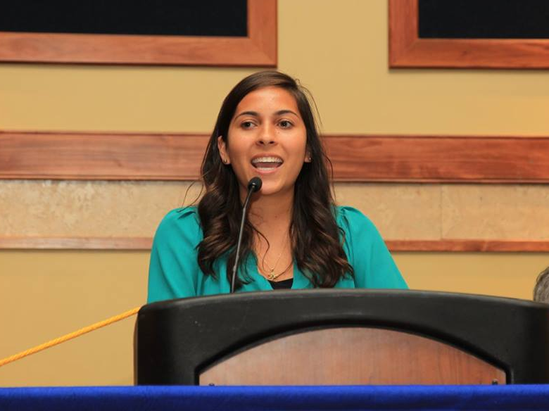
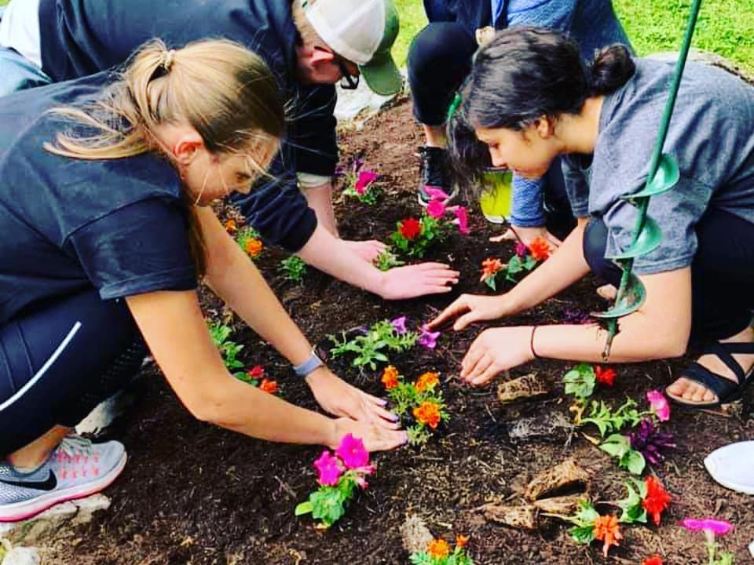
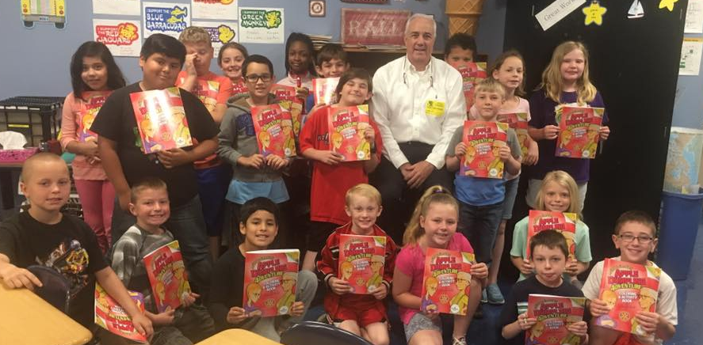
Youth Service
RYLA
Speech Contest
Rotaract
Interact

Slide 31
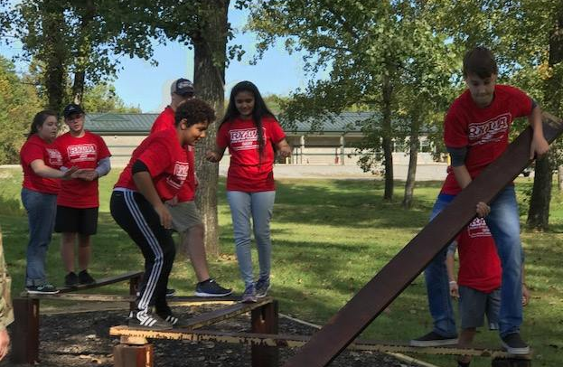
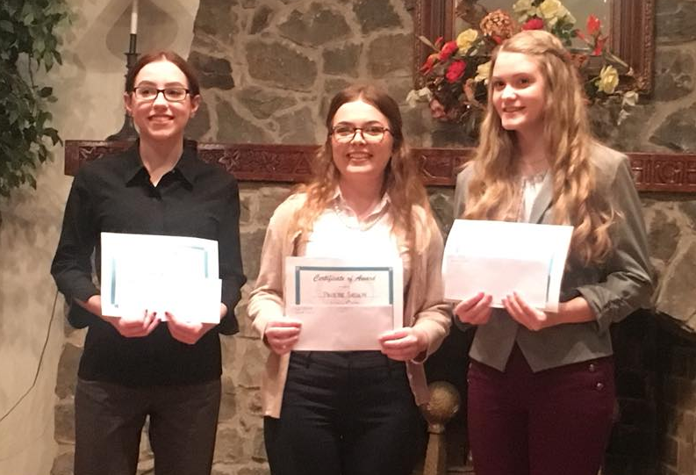
Vocational and
International Service
Career Development
Rotary Foundation Global Grants
World Service & Exchanges
District Speech Tournament
Local event before February
Winners receive $200 & $100
1st Place winner advances to sectional
Recruit contestants
$2,00o total potential if win District

Slide 32
How Much Does it Cost?
Dues: usually paid quarterly, vary by club depending on what is included.
What is covered by Dues?
Weekly Meal
District Dues
Rotary International Dues
Rotary Magazine Subscription
Other club specific items

Slide 33
Miscellaneous Costs & Expenses
Fines - vary by club,
refer to your Seargent At Arms
Happy Dollars
Donations to Projects
Invited guests meal cost
District or Club Event costs
Donations to the Foundation
EREY

Slide 34
Expectations of New Club Members
Serve your community by exemplifying Rotary
Participate in Club Projects & Activities
Attend Weekly Meetings and Social events
Pay Dues in a Timely Manner
Support the Rotary Foundation ( achieving EREY )
Practice the Four Way Test in Your Personal & Professional Life
Put Service Above Self
Notes:
Make-ups; Additional Information about our Local Foundation: MRF for Families & Children

Slide 35
Your Expectations
Rotary is an international membership organization made up of people who share a passion for and commitment to enhancing communities and improving lives across the world. Rotary clubs exist in almost every country. Our members change lives locally and connect with other clubs to work on international projects that address today’s most pressing challenges. Being a member is an opportunity to take action and make a difference, and it brings personal rewards and lifelong friendships in the process.
Think about why you
joined Rotary?
Set your own goals,
Then work to achieve them.

Slide 36
Some Ways to Get Involved
Introduce yourself to two new people each week
Participate in a service project
Join a committee
Attend a club board meeting
Attend a district meeting, training or convention
Create a My Rotary account
Take an online course in the Learning Center
Invite a friend to a meeting
Attend a meeting in a neighboring Club

Slide 37
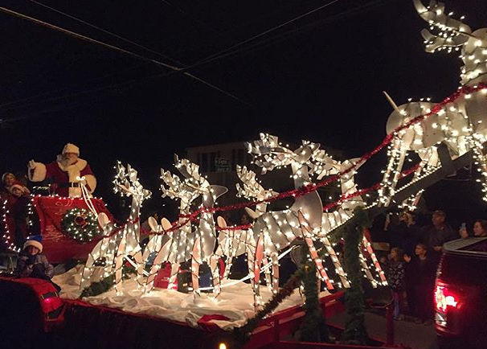
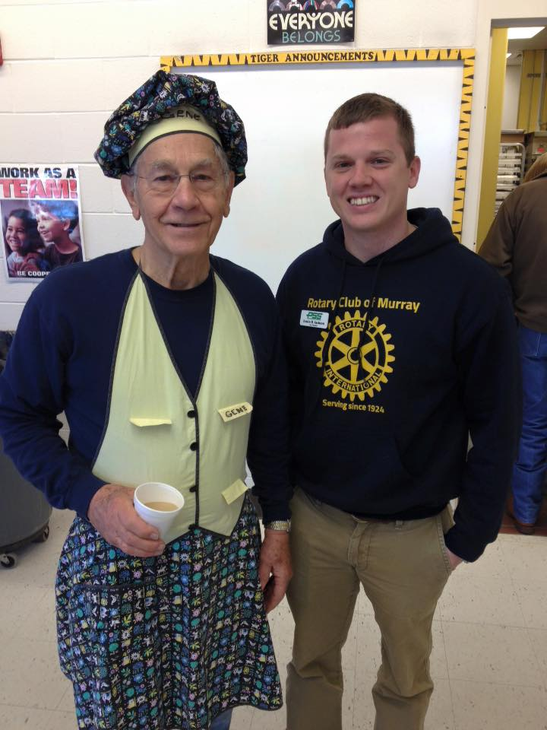
BENEFITS OF MEMBERSHIP
Professional Development & Personal Growth
Opportunity to Serve
Make a Difference in the Lives of Others
Build your Network
Fun and Fellowship
Build Lifelong Friendships
Attend Rotary club meetings anywhere in the world
Make International Connections in a Worldwide Org.

Slide 38
Rotary Resources
Club Facebook page: search club name
Club Website:_________
District 6710 news email: Spectrum
District Website: rotarydistrict6710.org
MyRotary: myrotary.org
+ Learning Center - Online courses
DACdb.org (District & Club Database)
Rotary International Website: rotary.org
Rotarian Magazine

Slide 39
Welcome to the _______
Rotary Club !
We’re Glad You’re Here!Questions?

