Slide 1
TRF CADRE OF TECHNICAL ADVISERS

Slide 2

Who are the Cadre?
A group of volunteer Rotarians
Possess professional expertise in Rotary’s areas of focus
Notes:
The Cadre is a group of volunteer Rotarians that possess professional expertise in one of Rotary’s areas of focus, as well as auditing. The mission of the Cadre is to strengthen the impact of Rotary’s grants by assisting Rotarians planning projects and safeguarding Foundation funds.
Cadre are not appointed positions. Any Rotarian with the requisite experience can apply to become a Cadre member. In order to apply to become a Cadre member, individuals must be a current, active member of a functioning Rotary club, be in good standing with TRF and RI, have two years of professional experience in one of the seven areas of focus or financial auditing, and complete certain courses in the Learning Center.

Slide 3
Cadre Global Membership
500+ members
More than 500 Rotarians from over 75 different countries
Notes:
There are more than 500 Cadre members from over 75 different countries.

Slide 4
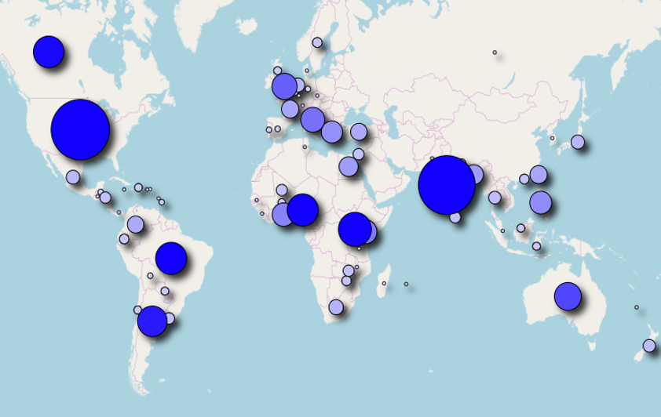
Notes:
This graph displays a representation of where the Foundation’s Cadre members live. The bigger the circle the larger the concentration of Cadre members.

Slide 5
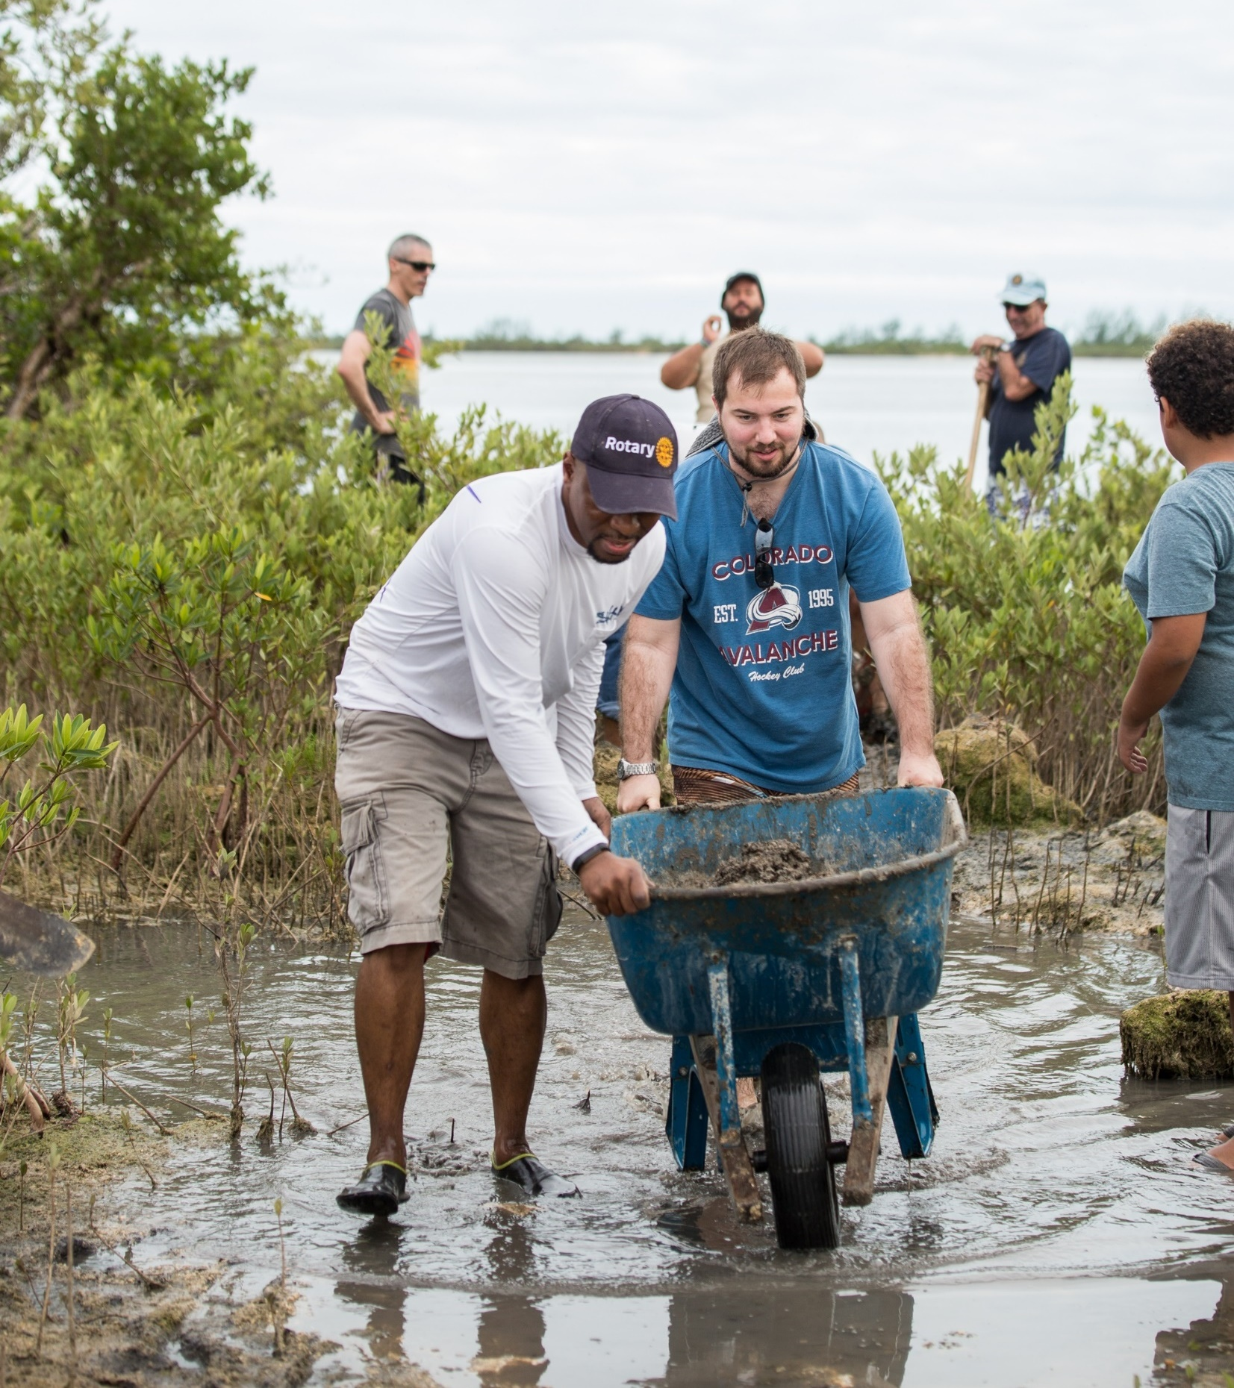
subhead
Role of the cadre
Notes:
Now that we have a better idea of who the Cadre are, let’s talk about their roles.

Slide 6
Role of the cadre
Assist TRF with grant evaluation
Help Rotary members plan and implement projects
Notes:
The main roles of the Cadre are to assist TRF with the evaluation of Rotary Grants and help Rotary members with the planning and implementation of humanitarian projects, including global grants.

Slide 7
How does the cadre assist The Rotary Foundation?
Review grant applications
Visit project sites
Perform programmatic audits
Notes:
Cadre assist TRF with the evaluation of Rotary grants by reviewing grant applications, visiting project sites to evaluate project implementation, and performing programmatic audits to ensure proper stewardship of Foundation funds. TRF Cadre reviews are required for global grant applications requesting more than US$50,000 from the World Fund. Cadre expertise is also utilized in other organizational programs, such as Programs of Scale.

Slide 8
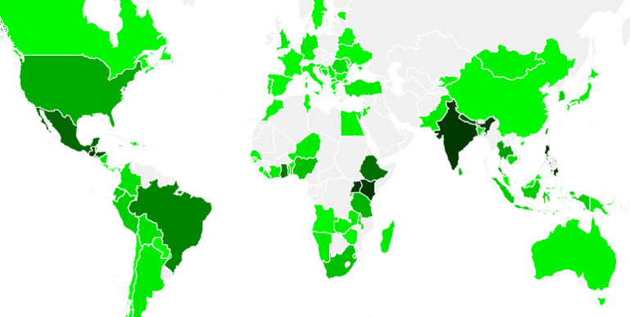
Cadre SITE VISIT Activity (2015-20)
Notes:
Throughout the 2015-20 Rotary years, Cadre visited more than 900 projects in over 100 countries. Of these visits, the most took place in India (224), followed by Guatemala and the Philippines (both 37), Uganda (36) and Kenya (35)

Slide 9
Technical and regional expertise
Project planning and implementation
Grant application process
How can the cadre assist rotary members in your districts?
Technical and regional expertise
Project planning and implementation
Grant application process
Notes:
As we’ve just seen, Cadre members are an invaluable resource to TRF in evaluating projects and ensuring stewardship of Foundation funds. However, Cadre are not only a resource for TRF. Cadre have instrumental knowledge and expertise that Rotary members at the club, district and regional level can leverage.
The Cadre has technical and regional expertise as well as expertise in project planning and implementation, and with the global grant application process.
By assisting clubs with the initial planning of global grants, cadre members can guide grant sponsors towards creating sustainable projects from the start. The following slides will provide more detail on how Rotary members can utilize the Cadre to improve their projects.

Slide 10
Professional Expertise
Professional experts in all seven areas of focus
Available to provide technical and regional expertise
Serve as project resource during planning and implementation phase
Notes:
The Cadre comprises of professional experts in all seven areas of focus, as well as financial auditing. Each Cadre member has a unique specialization that can help Rotarians with project design. For example, whether a club is designing a micro credit project or a cancer prevention project, there is a Cadre member with relevant expertise who can provide project design support.
Planning an international service project requires a firm understanding of the project sector as well as foundational knowledge of the region the project is taking place. The Cadre connects clubs planning projects with access to trustworthy and regionally applicable technical expertise which allows projects to have a better chance of success.

Slide 11
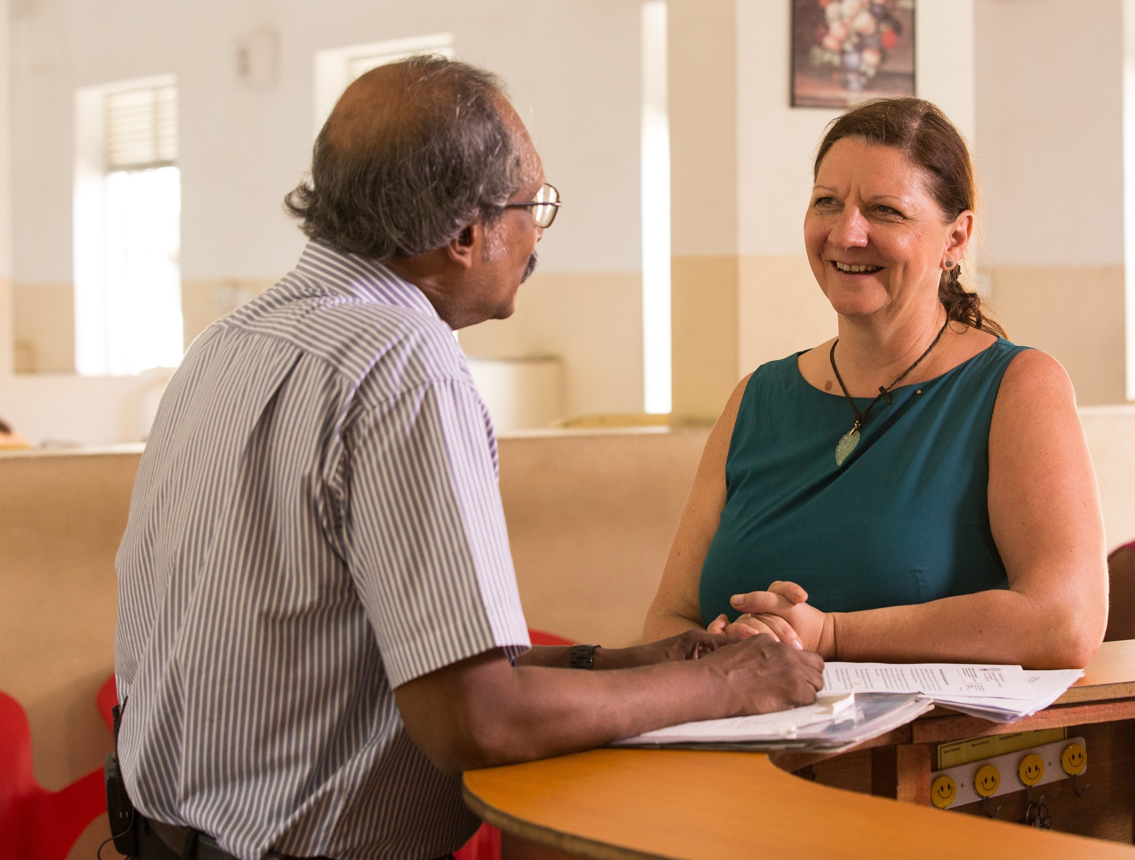
Project planning
Community assessments
Area of focus questions
Notes:
The Cadre can also provide guidance and training on project planning and implementation topics such as:
Community Assessments: Community Assessments help host Rotary members better understand the needs of a community. Community assessments are the foundation of project sustainability. They guarantee that the people to benefit from the project have a voice in the project from the beginning.
Cadre members can encourage Rotarian hosts to establish relationships and have discussions with project beneficiaries, and then guide Rotary members towards the most appropriate community assessments for the area.
Area of focus questions. With professional expertise within Rotary’s areas of focus, Cadre can help solve technical project concerns and provide guidance to Rotary members on the area of focus requirements for global grants.

Slide 12

Project planning
Monitoring and evaluation
Project sustainability
Notes:
Monitoring and Evaluation: Cadre members can guide Rotary members towards establishing strong project objectives and clear project measures, and encourage them to maintain trusting relationships with beneficiaries so that if there is a problem – and all projects encounter problems - they will hear about it directly from the beneficiaries. Such relationships are important to help Rotarians in their oversight of the cooperating organization.
Elements of Planning Sustainable Projects: Cadre members can assist host Rotarians in considering other elements of project planning, such as using local materials; identifying local funding sources; providing training, education and community outreach; and motivating beneficiaries to take ownership.

Slide 13
Grant Application process
Advise on global grant requirements
Provide support through application process
Notes:
Lastly, Cadre members can provide direct support with the grant application process. Applying for a global grant is a laborious process and can be overwhelming for clubs that are applying for the first time.
In addition to their professional experience, Cadre also have extensive knowledge of the global grant model and its requirements. Cadre can guide sponsors through the global grant application process and help them understand how to meet requirements for global grants, including the programmatic requirements each area of focus has. Area of Focus fit is a common reason for global grants to be declined. Utilizing the Cadre early in the project planning process can help clubs better align their projects to the area of focus requirements for global grants.

Slide 14
CADRE ORGANIZATION
Technical sector
Regionally
Notes:
The Cadre and its members are organized by area of focus, or technical sector, as well as regionally, which helps foster collaborative efforts.

Slide 15

Technical sector
FINANCIAL AUDITING
Notes:
Cadre are organized in eight technical sector groups, one per each area of focus plus financial auditing.
Each of the eight groups is led by technical coordinators. Technical coordinators have extensive technical and project development experience, as well as strong familiarity with the Cadre and Foundation programs. They serve as leaders and mentors to Cadre members and consult with Foundation staff as needed on projects within their areas of expertise.

Slide 16
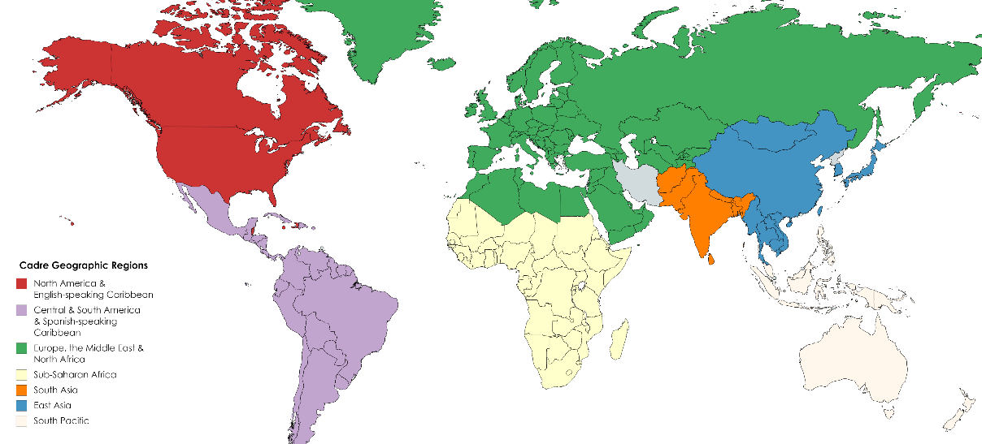
Geographic Regions
Notes:
In addition to being organized by technical sector, Cadre are now also organized regionally. Regional organization not only strengthens local connections between Cadre members, but also helps to develop relationships between Cadre and regional and district leaders. There are seven geographic regions that are supported by the Cadre. Each region is led by a Cadre regional organizer who focuses on building relationships between the Cadre and their region’s club, district and regional leaders.

Slide 17
Cadre Leadership Directory
cadre@rotary.org
Notes:
If you have any questions about today’s presentation, or would like help in connecting with Cadre in your region, please contact a Cadre leader in your area by using the Cadre Leadership Directory found on My Rotary (linked in current slide) or email Foundation staff at Cadre@rotary.org

