Slide 1
District 6710 Grant Management Seminar 2022-2023
Presenters:
Rick Harned, District Rotary Foundation Chair, 2016-2022
Ralph Young, District Grants Subcommittee Chair, 2018-2022

Slide 2
District Grants - Basics
Local OR International
Funded by Club and DDF (District funds)
District funds are disbursed AFTER Final Report is approved.
Require Active Rotarian Engagement
District match reflects Club contributions to Annual Fund – SHARE
Must be Completed in less than 1 year

Slide 3
To Apply for a District Grant, A Club Must:
Have Qualified for Grants before the Current Year Starts
Be Current on all Dues and Tax Obligations
Complete a Club Memo of Understanding (MOU)
Have Entered a Giving Goal for the Annual Fund on Rotary Club Central and named a Club Foundation Chair
In DACdb, Name at least 2 officers to approve grant applications for the Club

Slide 4
Planning Your District Grant Project - 1
All applications and reports will be done on DaCdb.
At least two project leaders / contacts will be required on the application
If there is a Cooperating Organization, an MoU with it will be required

Slide 5
Planning Your District Grant Project - 2
Develop a budget with as much detail as possible; plan for hands-on involvement by your members and for publicity.
Club must have named two signatories who approve grants for the club.
Engage your Grant Mentor early in the process
Remember that the deadline for submitting grant applications is always August 31 of the Rotary year.

Slide 6
How Much Money Can We Get from the District?
This is based on your club’s support of the Rotary Foundation Annual Fund in the previous TWO Rotary years.
The District looks at the first $2,000 your club puts into the project.
If your club averages $100 per member in giving (“Star Club” for 2 years), you can get up to $3,000 per project - $1.50 for each $1.00 the club invests.
If your average support has been between $75 and $100 per member, you can get dollar-for dollar – up to $2,000
If your support has been less than $75 per member, you get $0.75 per dollar – up to $1,500 maximum.

Slide 7
DDF Support of Your Projects
The greater your Club’s support of the Annual Fund - SHARE, the better your match for your district projects.
If your project is completed under budget, your district match will be reduced in proportion to your club contribution.
Clubs can apply for up to TWO district grants each year.

Slide 8
Examples of District Funding Model
SUPPOSE: Club has averaged $80 per member in giving to the Annual Fund for the past 2 years, so qualifies for $1 to $1 match up to $2,000.
To do a project costing $5,000 total, the club must invest $5,000, of which the District will reimburse $2,000.
To do a project costing $2,000, the club must invest $2,000, the District will reimburse $1,000.
IF the actual total cost of the project is only $1,800, the District will supply $900, to match the club’s $900, even if the grant was approved for $1,000.

Slide 9
Approval Process for District Grants
After the District Subcommittee receives grants (By August 31!!), it reviews them and sends valid grants to the Rotary Foundation for final approval.
Clubs and grant contacts are notified by Pmail as soon as Foundation approval is received.
NO Funds can be spent on a grant before it is formally approved by the Rotary Foundation!

Slide 10
If More Money is Requested than We Have…
First Priority Applications will be reviewed together. If there is enough money, Second Priority Grants will be reviewed. A Club can submit up to two applications each year.
If there is not enough money to fund all grants in a priority group, then…
Applications will be graded on four criteria:
Club per-capita support for the Rotary Foundation Annual Fund – SHARE
Number of Rotarians involved hands-on in the project
Publicity plan for the project
Innovativeness of the project
The Criteria for grading are in the District Grant Guidelines document, available in DACdb Documents.

Slide 11
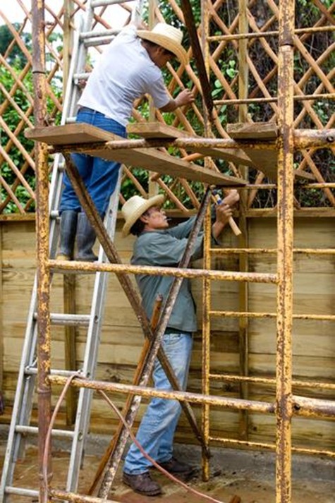
Reporting Requirements for District Grants
All Reporting will also be on DACdb
Progress Reports are due by February 15
Final Reports are due by May 31 (unless an extension is requested and granted) or 30 days after project completion
Funds are released to Clubs after Final Report is reviewed and accepted

Slide 12
District Grants - Summary
Foundation funds are available to help your club do good in your community and elsewhere.
Your active support of the Rotary Foundation enables us all to do more good wherever we are.
Qualifying for Foundation programs helps you with club projects, with helping your students get scholarships, and with developing skills for promoting peace.
What else do you need for your club to make a real difference in your community?

Slide 13
How to Apply for a District Grant
on DACdb

Slide 14
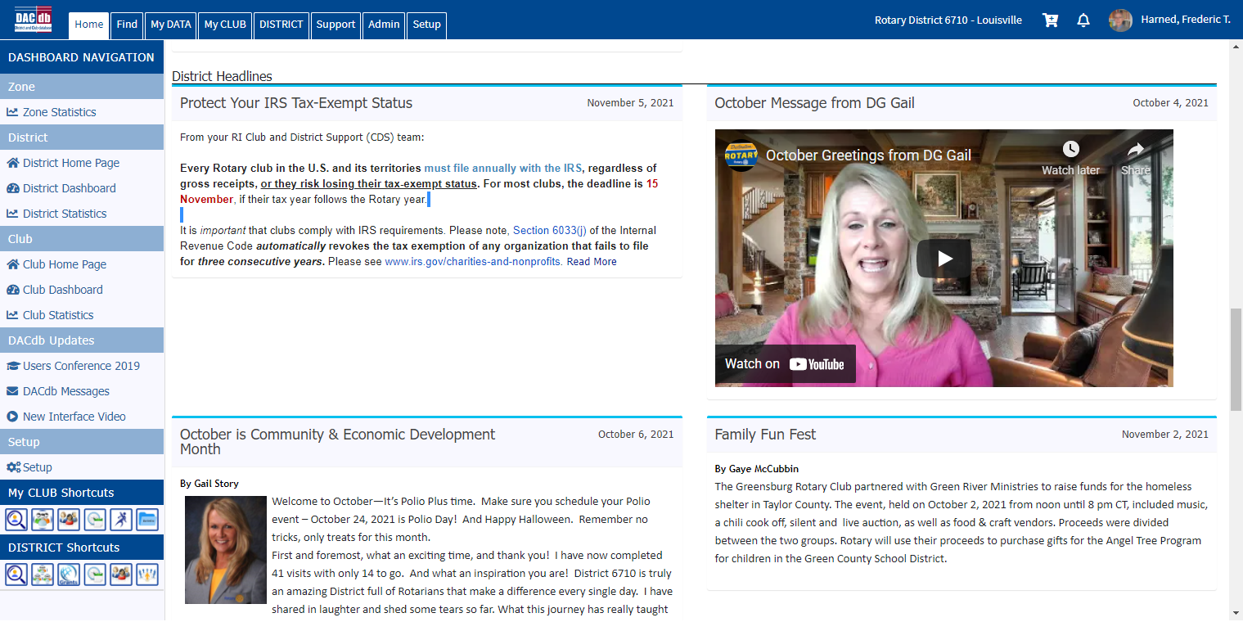
Confirm that Your Club is Qualified
Confirm that you have met your club’s requirements for proposing a District Grant project.
Log into DACdb. You will see the District’s Home page, with 5-7 tabs at the top.

Slide 15
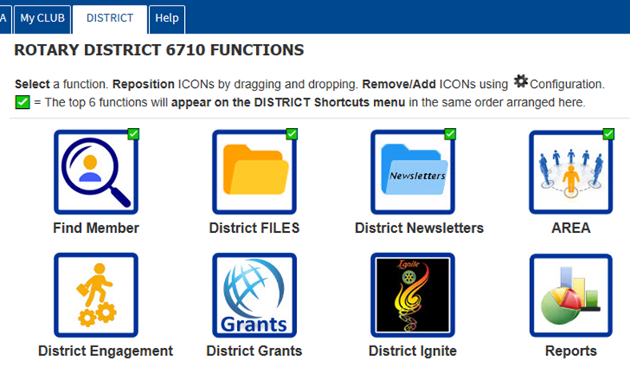
Find the Grants Module
Select the District Tab to see the available icons, one of which is Grants. You may have to add this icon.
Selecting the Grants icon will take you to a Grants Overview page

Slide 16
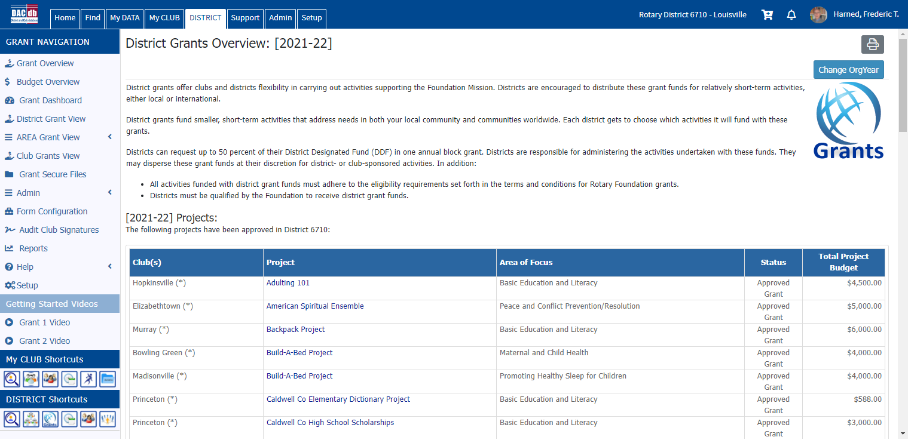
The Grants Overview Page
On the Overview page, make sure it shows the correct Rotary year (until June 30, 2022, it will show 2021-2022). Use the ChangeOrgYear button in the upper right to change to 2022-2023.

Slide 17
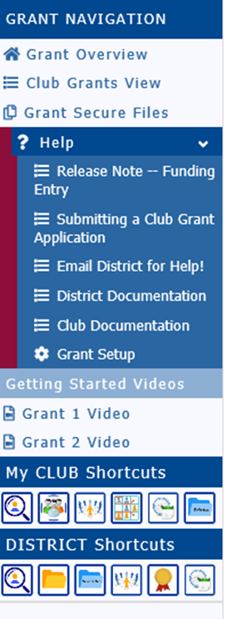
Where to Find Help
The Help Menu on the Grant Navigation Column has Instruction Documents
The “Grant 1 Video” will walk you through the Application process.
And your Grant Mentor can help!

Slide 18
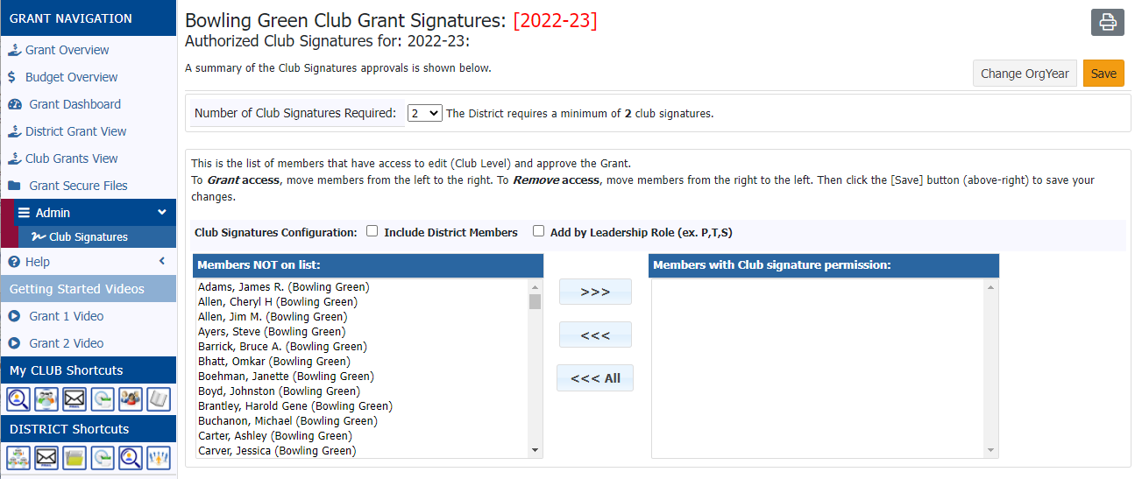
Naming Club Signatories
A Club Officer must login and, using the “Admin” link, name at least two members who can approve the grant in the club’s name.

Slide 19
Starting the Application
The “Club Grants View” has a long button for beginning a new grant application.

Slide 20
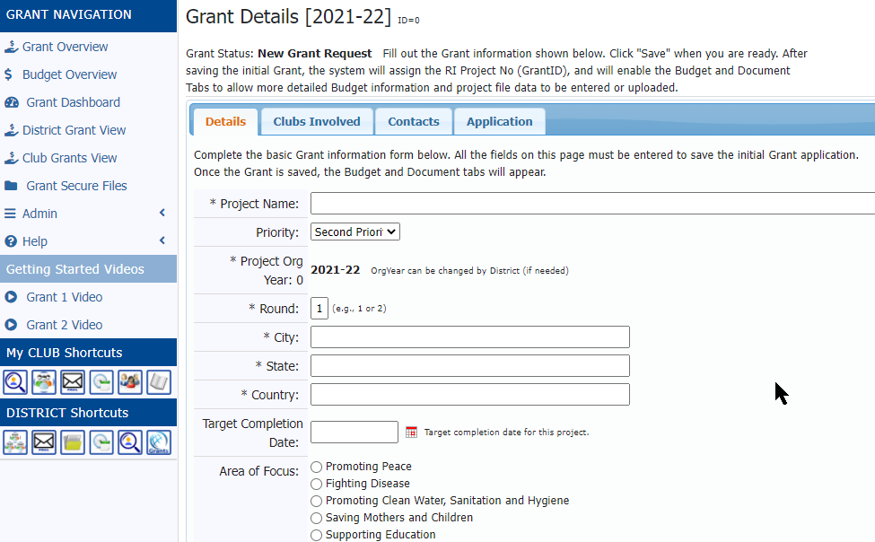
The First Grant Form
The New Grant Form has Four Tabs for Information

Slide 21
Certifications Required to Save Draft
Note that the draft cannot be saved until three certification boxes on the Application page are checked:
To edit the saved draft, select the pencil icon next to the project name. Any Club member can edit the draft.

Slide 22
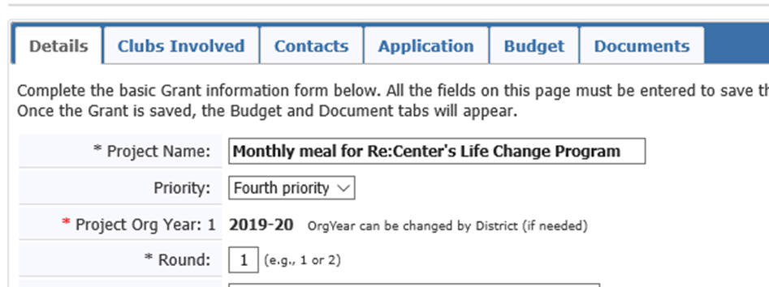
Save Your Draft
Saving your Draft Grant will cause two new tabs to appear – Budget and Documents
Budget asks for details on income and expenses for the grant – and must balance!
Documents is where you can upload documents such as your MoU, expense receipts, photos, and where your interim and final reports will appear.

Slide 23
Remember – the Icons Allow Actions!
The Pencil icon allows you to edit or add information to the Draft. The Project Name will not!
The Red “X” will delete the Draft.
The Notepad allows Admins to send you information.

Slide 24
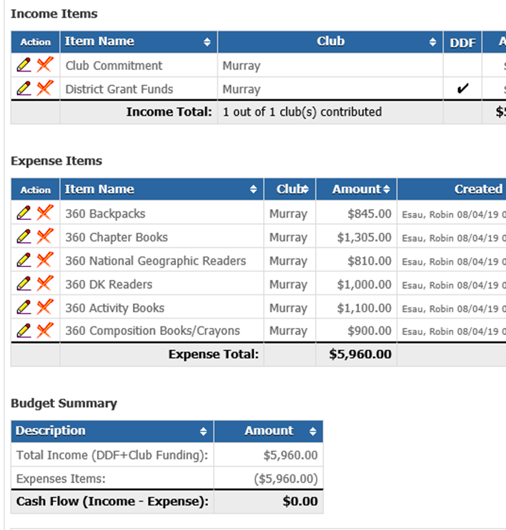
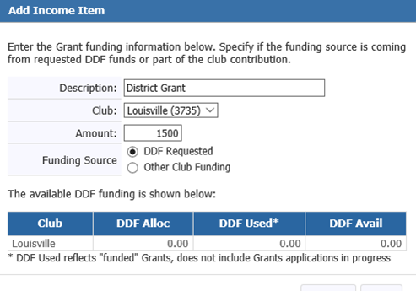
Budgets Should be Detailed!

Slide 25
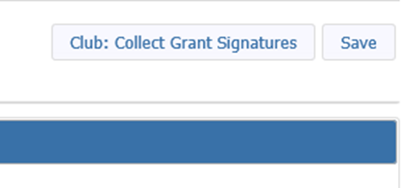
Collect Club Signatures
When you are satisfied with the draft, select the “Club: Collect Grant Signatures” button in the upper right.
This causes two new tabs to appear
Activity Log – lists every action taken on an application
Signature Log – lists names of all who have signed off on the application
After a club leader “signs” an application, no changes can be made unless it is reverted to Draft status – which will wipe out the previous signatures so that they will have to be redone.

Slide 26
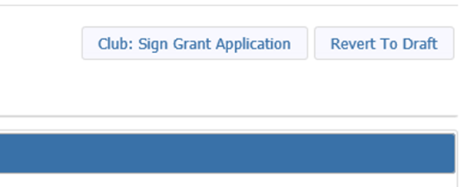
Signing the Application
District subcommittee members – including your Grant Mentor - can help you improve your application – if you ask them! Changes are more of a problem after the draft is submitted for club signatures.
Club officers “sign” the grant by:
Logging into DACdb, finding the grant in Club Grants, and selecting the pencil icon. Two signatures are required!
Then clicking the “Club: Sign Grant Application” button; or they can put it back into Draft status.

Slide 27
Submit the Grant to the District
When two Club Officers have “signed” the application, they can then submit it to the District – again, by clicking a button.
Three Grants Subcommittee Members must approve before the grant is added to the list for Foundation approval. This step adds two more tabs to the grant – space for you to write an Interim Report and a Final Report – which MUST be submitted before the funds are distributed.

Slide 28
Approval by the Foundation
When the District receives notice that the Rotary Foundation has approved its block grant, THEN Presidents of all clubs applying for grants will be notified by email – AND ONLY THEN can they begin working the grant and making purchases.
THEN the Application process is complete! And you can begin your real Rotary work!

Slide 29
You Have Completed the Seminar!
Questions?

