Slide 1
District 6710 Grant Management Seminar 2022-2023
Presenters:
Rick Harned, District Rotary Foundation Chair, 2016-2022
Ralph Young, District Grants Subcommittee Chair, 2018-2022

Slide 2
Remember How Annual Fund Gifts Are Used?
After investment for 3 years, funds go into 2 buckets:
50% WORLD FUND 50% DISTRICT DESIGNATED FUND
Available for Global Grants, Scholarships, Peace Fellowships, Vocational Training Teams
al Grants, Scholarships, etc.
DDF Match for Global Grants, Scholarships
50% of DDF can go to District Grants
Global Grants use Funds from Both Buckets!

Slide 3
How the Grant Funding Works
Suppose your club has identified a project that has a budget of $30,000 (the minimum size).
IF your club (and others) can contribute $11,000
The District(s) will match with DDF 11,000
The World Fund matches DDF $0.80 for $1 8,800
TOTAL $30,800
Club dollars are multiplied nearly 3 times!! - And they don’t have to
come from just one club or one district!
Notes:
Clubs can participate in a Global Grant for as little as $100 - when you join together with other clubs.

Slide 4
How to Apply for a Global Grant
Log into My Rotary at Rotary.org (NOT DACdb!)
Hover your cursor over The Rotary Foundation
Select Grant Center
Notes:
Global Grant applications are done on-line at https://rotary.org. Logging in to My Rotary is required. Then you can navigate to the Grant Center.

Slide 5
Requirements for All Grants
Application will require minimum 3-person committee in both sponsor clubs to manage project.
The Project Budget should be as detailed as possible, and match the funding committed.
The application automatically calculates the available World Fund contribution, based on Club and District contributions.
If a “Cooperating Organization” is involved, an MoU must be signed by all parties.
Any Conflicts of Interest must be confronted and disclosed.
Notes:
A conflict of interest exists whenever a Rotarian benefits financially or personally from a grant. The benefit might be direct to a Rotarian or indirect, to an associate of the Rotarian. If one exists, it must be disclosed in the application.

Slide 6
Managing the Grant
The Foundation will require the lead club to establish a bank account used only for this project. It will collect all funding and deposit it in this account.
All expenditures must be documented, and records retained for reporting for at least five years.
Detailed Reports must be submitted to the Foundation at least every 12 months. All expenses must be documented.
Notes:
These points should be expanded on separate slides.

Slide 7
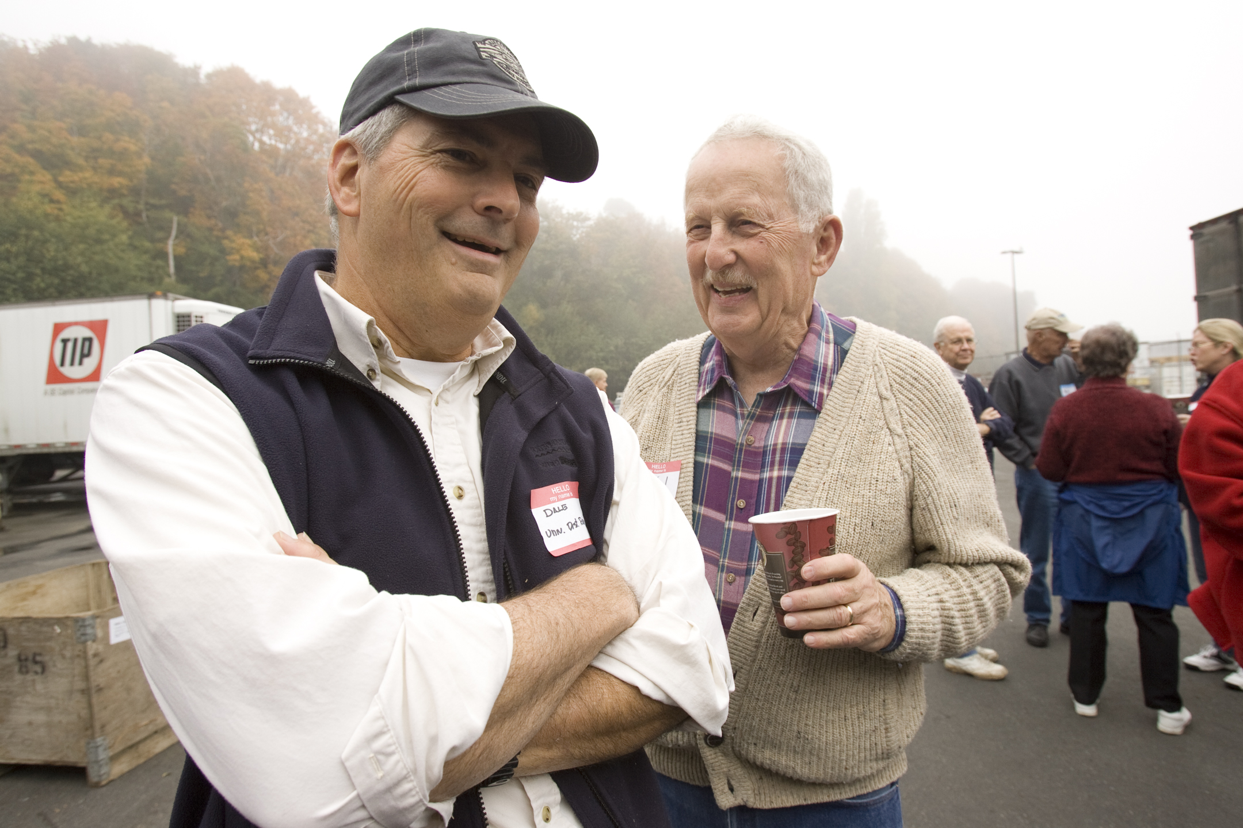
Plan to Evaluate the Project
Needed for reporting
Improves future projects
Is based on goals
Is ongoing
Identifies successes

Slide 8
Global Grants - Summary
Global Grants are rewarding and demanding – but are accessible to all qualified clubs, big and small.
Global Grants require international cooperation – and offer an opportunity for lasting friendships!
At least 3 Global Grant projects in the USA are being developed by Heart 2 Heart districts and Mexican clubs.
Global Grants can include funding for Rotary signage and publicity – and their stories should be told, following Rotary’s signage requirements.
Lots of assistance is available from the Foundation, your District Leadership, and Heart 2 Heart.

Slide 9
You Have Almost Completed the Seminar!
Questions?

