Slide 1
District 6710 Grant Management Seminar 2022-2023
Presenters:
Rick Harned, District Rotary Foundation Chair, 2016-2022
Ralph Young, District Grants Subcommittee Chair, 2018-2022

Slide 2
Global Grant Basics
International – 2 Clubs in Different Countries
Minimum 3 – person team in each Club
Sustainable, Longer-Term
Total Budget $30 K or more
Address at least One of the Seven Areas of Focus
Separate Bank Account
Financial Management Plan

Slide 3
How do you get Started with Global Grants?
Clubs in our District have many opportunities for you to participate
Prospect/Goshen has many clubs taking part in their Haiti Cervical Cancer projects
Paducah has led water projects in Mexico and school projects in Africa
Louisville has multiple water, sanitation, & health projects in Central and South America and in Africa
Murray is taking the lead on a project in Mexico
Other US Clubs can help you learn the ropes!
It is easy to start making connections!

Slide 4
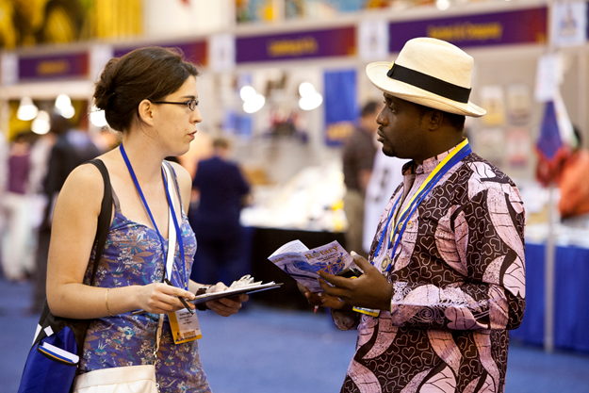
Finding a Project to Do
Visit Clubs when you travel
Friendship Exchanges
Attend a Project Fair
Heart 2 Heart Program
Facebook
Join a Fellowship or RAG
Rotary International Convention
www.matchinggrants.org/global
Notes:
You can find an International partner club without leaving home – start by participating in a Grant managed by another Club, in our District or in another District. Our District did its first Friendship Exchange to India in 2019 – more are on tap. The Heart 2 Heart program links clubs and districts in Zones 30-31 with Districts in Mexico – and has a long history of good projects that you can visit. Project Fairs are a special opportunity starting this year – a District Grant can help cover travel costs! Rotary Fellowships and Action Groups link Rotarians worldwide who share interests or professions.

Slide 5
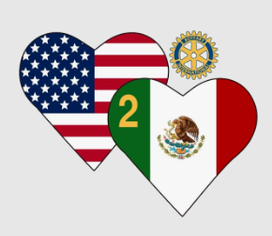
Heart 2 Heart Unites US and Mexican Rotarians
Since 2004, Rotarians in Zones 30 and 31 have connected with Rotarians in Mexico Districts 4140 and 4170 to do multiple health, education, water, and housing projects.
H2H sponsors a project tour every November to see work needed and work accomplished.
Your District 6710 leaders can connect you so that you can meet key players and see the work first-hand.

Slide 6
A Heart 2 Heart Project in Kentucky
Global Grant led by London, KY Rotary

Slide 7
A Community Assessment is Required
Assessing your target community’s strengths, weaknesses, needs, and assets is an essential first step in planning an effective project. Methods may include:
A project is unlikely to be sustainable without active community involvement!
Notes:
The best way to understand what a community really needs is to ask them. Rotary has required a systematic community assessment for Global Grants since the 2018-2019 Rotary Year. Your partner club can play a key role here. It is the first step to assure the project is sustainable.

Slide 8
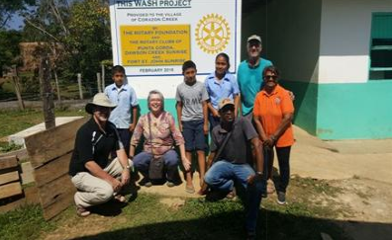
Plan for Sustainability
For Rotary, sustainability means providing long-term solutions to community problems that community members themselves can and will support after the grant funding ends. The community assessment is the first step.
Sustainability implies:
Training for project management & maintenance
Use of local materials and supplies
Local funding for project maintenance
Measurement of project outcomes

Slide 9
Project Must Fit At Least One Area of Focus
Water, Sanitation, & Hygiene
Maternal & Child Health
Disease Prevention and Treatment
Basic Education & Literacy
Community Economic Development
Peacebuilding & Conflict Prevention
Supporting the Environment
Notes:
Clear descriptions of what each Area of Focus encompasses are in the documents to be downloaded.

Slide 10
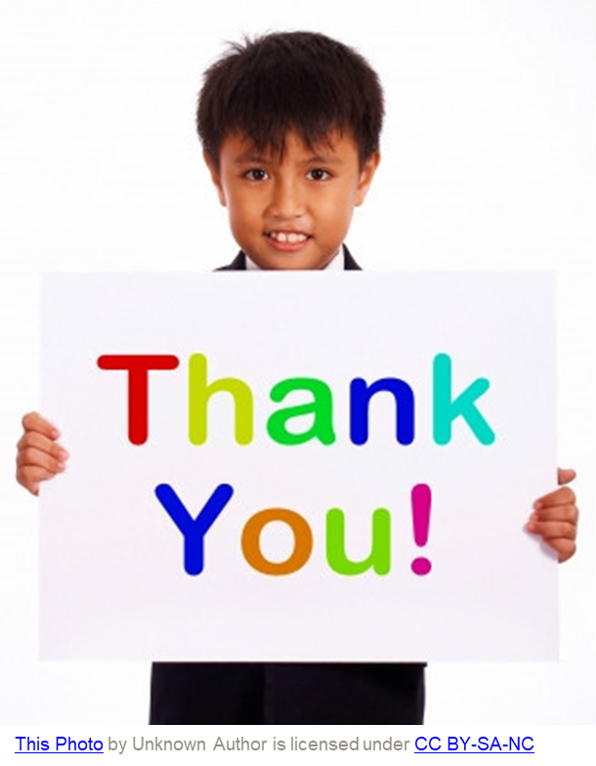
You Have Almost Completed the Seminar!
Questions?

