Slide 1
District 6710 Grant Management Seminar 2022-2023
Presenters:
Rick Harned, District Rotary Foundation Chair, 2016-2022
Ralph Young, District Grants Subcommittee Chair, 2018-2022

Slide 2
Why this Seminar?
It is a Requirement to Allow your Club to participate in Foundation Grant Programs
To Share How these Programs can Benefit Your Club
To Train on Planning, Applying for, and Managing District or Global Grants
To Communicate Foundation Expectations for Stewardship and the required Memorandum of Understanding

Slide 3
Key Foundation Requirements
Clubs Must Qualify to Participate
Seminar Completion – 1 or 2 Members EVERY Year
Sign and Submit MoU EVERY Year
Be Current on Dues and Reports on Previous Grants
Name a Foundation Chair and Have Giving Goals in Rotary Club Central
Clubs Must Understand the 7 Areas of Focus
Clubs Must Practice Good Stewardship
Recognize the Importance of Community Involvement

Slide 4
Good Stewardship Means…
Ensure that Projects:
Have Proper Financial Controls
Keep a Good Paper Trail
Meet the Needs of Beneficiaries
Fulfill Grant Objectives
Offer Learning Opportunities
Enhance Rotary’s Reputation

Slide 5
Keys to Project Design
Community Assessment: What is Needed?
Involve Club Members – Organize a Team
Draft a Realistic and Detailed Budget
Set Measurable Goals
Plan for Sustainability
Plan for Evaluation and Share Learning

Slide 6
Where Does the Money Come From?
Giving
Annual Fund – SHARE
Endowment Fund
Polio Plus
Disaster Response Fund
Rotarians Everywhere

Slide 7
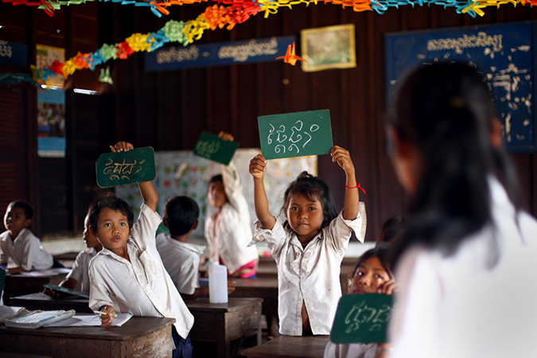
Why Give?
Because we can see the good it does!
Because we can help DO the good it does!
Because the Foundation is Top-Notch in Quality Ratings for Efficiency and Transparency

Slide 8
Active Projects are Good for Our Clubs
Activity Attracts and Keeps Members
Our Communities Can See What We Do
Our Young People Can Benefit

Slide 9
How Annual Fund – SHARE $$ Come Back
After Investment for 3 years, Funds are split 50-50 to:
World Fund
District Designated Fund (DDF)
Available for Global Grants, Scholarships, Peace Fellowships, Vocational Training Teams
DDF Match for Global Grants, Scholar-ships
50% of DDF can go to District Grants

Slide 10
How can My Club Use Foundation Grants?
Global Grants – Large, International Projects
District Grants – Smaller, Short-Term Projects
Nominations – Scholarships, Peace Fellows
This Program will cover Global & District Grants!

Slide 11
You Have Almost Completed the Seminar!
Questions?

