Slide 1

District 6710 Grant Management Seminar 2024-2025
Presenters:
Ralph Young, District Rotary Foundation Chair, 2022-2024
Jenn Wininger, District Grants Subcommittee Chair, 2022-2024

Slide 2
Why this Seminar?
It is a Requirement to Allow your Club to participate in Rotary Foundation Grant Programs
To Share How these Programs can Benefit Your Club
To Train on Planning, Applying for, and Managing District or Global Grants
To Communicate Foundation Expectations for Stewardship and the required Memorandum of Understanding

Slide 3
Key Foundation Requirements
Clubs Must Qualify to Participate
  Seminar Completion – 1 or 2 Members EVERY Year
  Sign and Submit Club MoU EVERY Year
  Be Current on Dues and Reports on Previous Grants
  Name a Foundation Chair and Have Giving Goals in Rotary Club Central
Clubs Must Understand the 7 Areas of Focus
Clubs Must Practice Good Stewardship
Recognize the Importance of Community & Rotarians Involvement

Slide 4
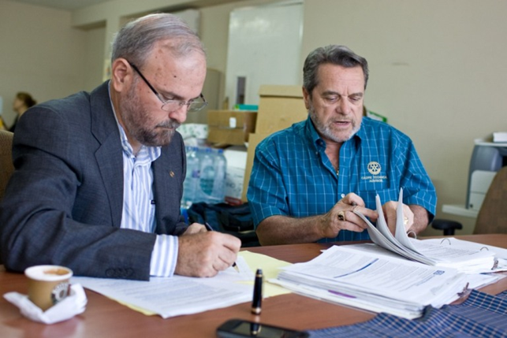
Good Stewardship Means…
Ensure that Projects:
Have Proper Financial Controls
Keep a Good Paper Trail
Meet the Needs of Beneficiaries
Fulfill Grant Objectives
Offer Learning Opportunities
Enhance Rotary’s Reputation

Slide 5

Keys to Project Design
Community Assessment: What is Needed?
Involve Club Members – Organize a Team
Draft a Realistic and Detailed Budget
Set Measurable Goals
Plan for Sustainability
Plan for Evaluation and Share Learning

Slide 6
Why Give?
Active Projects are Good for Our Clubs
Activity Attracts and Keeps Members
Our Communities Can See What We Do
Our Young People Can Benefit

Slide 7




Where Does the Money Come From?
Giving
Annual Fund – SHARE
Endowment Fund
Polio Plus
Disaster Response Fund
Rotarians Everywhere

Slide 8
How Annual Fund – SHARE $$ Come Back
After Investment for 3 years, Funds are split 50-50 to:
World Fund
District Designated Fund (DDF)
Available for Global Grants, Scholarships, Peace Fellowships, Vocational Training Teams
DDF Match for Global Grants, Scholar-ships
50% of DDF can go to District Grants

Slide 9
How can My Club Use Foundation Grants?
Global Grants – Large, International Projects
District Grants – Smaller, Short-Term Projects
Nominations – Scholarships, Peace Fellows
Disaster Relief Grants
This Program will cover Global & District Grants!

Slide 10
Global Grant Basics
  International – 2 Clubs in Different Countries
  Minimum 3 – person team in each Club
  Sustainable, Longer-Term
  Total Budget $30 K or more
  Address at least One of the Seven Areas of Focus
  Separate Bank Account
  Financial Management Plan

Slide 11
How do you get Started with Global Grants?
Clubs in our District have many opportunities for you to participate
  Prospect/Goshen - Cervical Cancer projects in Haiti
  Paducah – Education projects in Zambia
  Louisville has water, sanitation, & health projects in Central & South America and in Africa
  South Oldham County – Education project in Ghana
  Campbellsville – Education project in Mongolia
  Partnerships among clubs is encouraged!
The District International Service Committee meets every month via Zoom to discuss projects

Slide 12
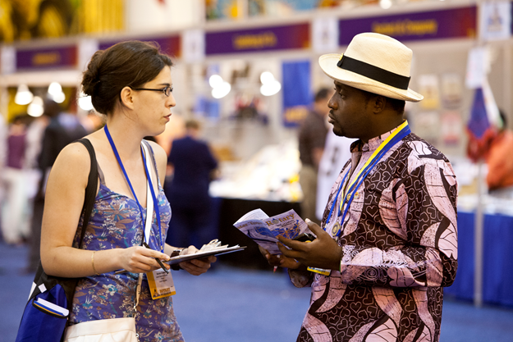
Finding a Project to Do
Visit Clubs when you travel
Friendship Exchanges
Attend a Project Fair
Social media
Join a Fellowship or Rotary Action Group
Rotary International Convention
www.matchinggrants.org/global
Notes:
You can find an International partner club without leaving home – start by participating in a Grant managed by another Club, in our District or in another District. Our District did its first Friendship Exchange to India in 2019 – more are on tap. The Heart 2 Heart program links clubs and districts in Zones 30-31 with Districts in Mexico – and has a long history of good projects that you can visit. Project Fairs are a special opportunity starting this year – a District Grant can help cover travel costs! Rotary Fellowships and Action Groups link Rotarians worldwide who share interests or professions.

Slide 13

Project Must Fit At Least One Area of Focus
Water, Sanitation, & Hygiene
Maternal & Child Health
Disease Prevention and Treatment
Basic Education & Literacy
Community Economic Development
Peacebuilding & Conflict Prevention
Supporting the Environment
Notes:
Clear descriptions of what each Area of Focus encompasses are in the documents to be downloaded.

Slide 14
Global Grant Project Requirements
Community Assessment – identify the needs
Plan for Sustainability – how will the project continue
Financial management plan – how will the funds be managed

Slide 15
Remember How Annual Fund Gifts Are Used?
After investment for 3 years, funds go into 2 buckets:
50% WORLD FUND 50% DISTRICT DESIGNATED FUND
Available for Global Grants, Scholarships, Peace Fellowships, Vocational Training Teams
al Grants, Scholarships, etc.
DDF Match for Global Grants, Scholarships
50% of DDF can go to District Grants
Global Grants use Funds from Both Buckets!

Slide 16
How the Global Grant Funding Works
Suppose your club has identified a project that has a budget of $30,000 (the minimum size).
IF your club (and others) can contribute $11,000
The District(s) will match with DDF 11,000
The World Fund matches DDF $0.80 for $1 8,800
TOTAL $30,800
Club dollars are multiplied nearly 3 times!! - And they don’t have to
come from just one club or one district!
Notes:
Clubs can participate in a Global Grant for as little as $100 - when you join together with other clubs.

Slide 17
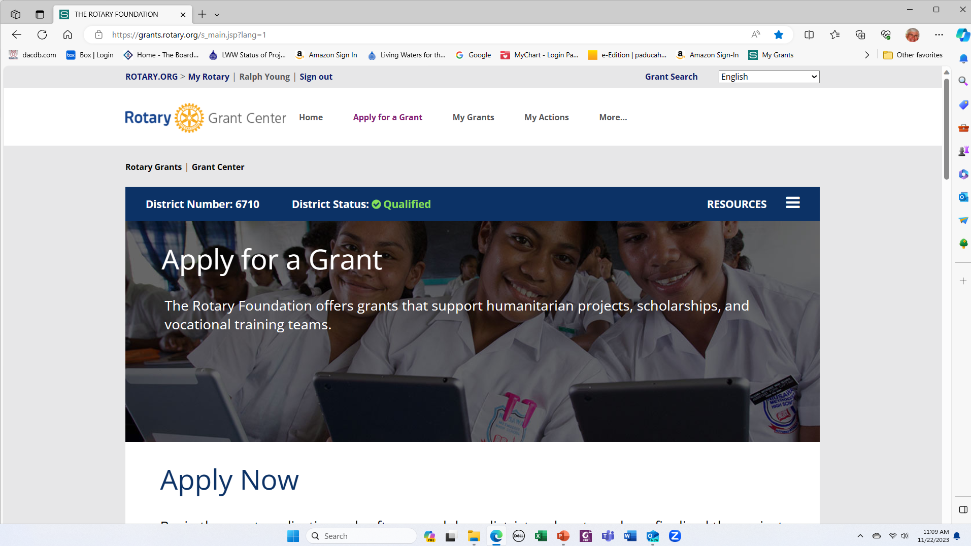
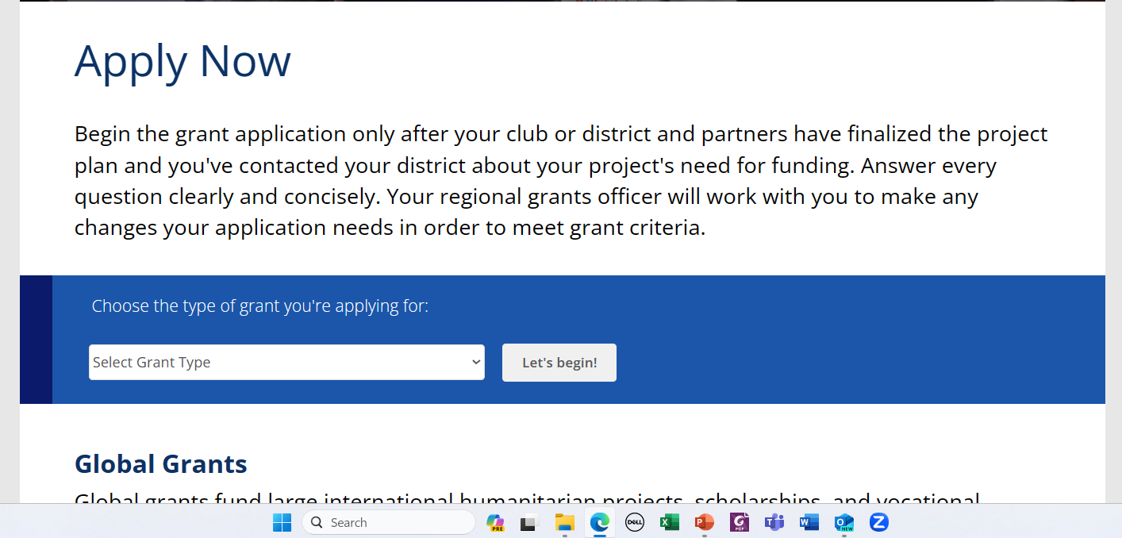
How to Apply for a Global Grant
Log into My Rotary at Rotary.org (NOT DACdb!)
Select Grant Center
Notes:
Global Grant applications are done on-line at https://rotary.org. Logging in to My Rotary is required. Then you can navigate to the Grant Center.

Slide 18
Requirements for All Grants
Application will require minimum 3-person committee in both sponsor clubs to manage project.
The Project Budget should be as detailed as possible, and match the funding committed.
  The application automatically calculates the available World Fund contribution, based on Club and District contributions.
If a “Cooperating Organization” is involved, an MoU must be signed by all parties.
Any Conflicts of Interest must be confronted and disclosed.
Notes:
A conflict of interest exists whenever a Rotarian benefits financially or personally from a grant. The benefit might be direct to a Rotarian or indirect, to an associate of the Rotarian. If one exists, it must be disclosed in the application.

Slide 19
Managing the Grant
The Foundation will require the lead club to establish a bank account used only for this project. It will collect all funding and deposit it in this account.
All expenditures must be documented, and records retained for reporting for at least five years.
Detailed Reports must be submitted to the Foundation at least every 12 months. All expenses must be documented.
Plan to evaluate the project after completion – Lessons Learned
Plan to tell the story of your project to Rotarians, clubs, and others
Notes:
These points should be expanded on separate slides.

Slide 20
Global Grants - Summary
Global Grants are rewarding and demanding – but are accessible to all qualified clubs, big and small.
Global Grants require international cooperation – and offer an opportunity for lasting friendships!
Global Grants can include funding for Rotary signage and publicity – and their stories should be told, following Rotary’s signage requirements.
Assistance is available from the Foundation and your District Leadership.

Slide 21
District Grants - Basics
Local OR International
Funded by Club and DDF (District funds)
  District funds are disbursed AFTER Final Report is approved.
Require Active Rotarian Engagement
District match reflects Club contributions to Annual Fund – SHARE
Must be Completed in less than 1 year

Slide 22
To Apply for a District Grant, A Club Must:
Have Qualified for Grants before the Current Year Starts
Be Current on all Dues and Tax Obligations
Complete a Club Memo of Understanding (MOU)
Have Entered a Giving Goal for the Annual Fund on Rotary Club Central and named a Club Foundation Chair
In DACdb, Name at least 2 officers to approve grant applications for the Club

Slide 23
Planning Your District Grant Project
All applications and reports will be done on DACdb.
At least two project leaders / contacts will be required on the application
If there is a Cooperating Organization, an MoU between the club and organization will be required

Slide 24
Planning Your District Grant Project
Develop a budget with as much detail as possible; plan for hands-on involvement by your members and for publicity.
Club must have named two signatories who approve grants for the club.
Remember that the deadline for submitting grant applications is always August 31 of the Rotary year.

Slide 25
How Much Money Can We Get from the District?
This is based on your club’s support of the Rotary Foundation Annual Fund in the previous TWO Rotary years.
The District looks at the first $2,000 your club puts into the project.
  If your club averages $100 per member in giving (“Star Club” for 2 years), you can get up to $3,000 per project - $1.50 for each $1.00 the club invests.
  If your average support has been between $75 and $100 per member, you can get dollar-for dollar – up to $2,000
  If your support has been less than $75 per member, you get $0.75 per dollar – up to $1,500 maximum.

Slide 26
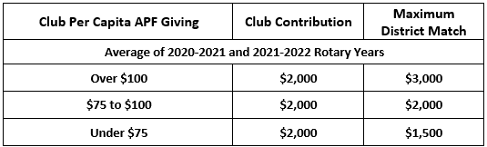
DDF Support of Your Projects
The greater your Club’s support of the Annual Fund - SHARE, the better your match for your district projects.
If your project is completed under budget, your district match will be reduced in proportion to your club contribution.
Clubs can apply for up to TWO district grants each year.

Slide 27
Examples of District Funding Model
SUPPOSE: Club has averaged $80 per member in giving to the Annual Fund for the past 2 years, so qualifies for $1 to $1 match up to $2,000.
To do a project costing $5,000 total, the club must invest $5,000, of which the District will reimburse $2,000.
To do a project costing $2,000, the club must invest $2,000, the District will reimburse $1,000.
IF the actual total cost of the project is only $1,800, the District will supply $900, to match the club’s $900, even if the grant was approved for $1,000.

Slide 28
Approval Process for District Grants
Clubs must enter District Grant applications into DACdb by August 31st.
District Grant Subcommittee reviews and approves the applications on DACdb.
District Grant Subcommittee applies for a District Block Grant (DBG) from The Rotary Foundation (TRF).
TRF approves the DBG and awards the District Designated Funds (DDF) to the District.
NO Funds can be spent on a grant before it is formally approved by the Rotary Foundation!

Slide 29
If More Money is Requested than We Have…
  First Priority Applications will be reviewed together. If there is enough money, Second Priority Grants will be reviewed. A Club can submit up to two applications each year.
  If there is not enough money to fund all grants in a priority group, then…
  Applications will be graded on four criteria:
    Club per-capita support for the Rotary Foundation Annual Fund – SHARE
    Number of Rotarians involved hands-on in the project
    Publicity plan for the project
    Innovativeness of the project
The Criteria for grading are in the District Grant Guidelines document, available in DACdb Documents.

Slide 31
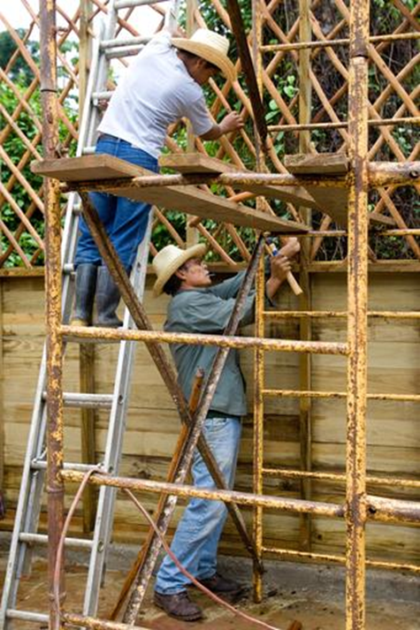
Reporting Requirements for District Grants
All Reporting will also be on DACdb
Progress Reports are due by February 15
Final Reports are due by May 31 (unless an extension is requested and granted) or 30 days after project completion
Funds are released to Clubs after Final Report is reviewed and accepted

Slide 32
2024 Key Dates – District 6710 Grants Process
Date | Activity Due
February 15, 2024 | Interim reports for 2023 – 2024 district grant projects by exception.
May 31, 2024 | Final reports for 2023 – 2024 district grant projects – completed and approved by club officers in DACdb.
June 28, 2024 | Club MOU’s and addendums completed, approved by Club officers, and filed with District 6710 Foundation Committee.
July 1, 2024 | Club donations to the Annual Fund complete to determine Star Clubs and District Matching criteria.
August 30, 2024 | All district grant applications for 2024 – 2025 entered into DACdb and approved by club officers.

Slide 33
District Grants - Summary
Foundation funds are available to help your club do good in your community and elsewhere.
Your active support of the Rotary Foundation enables us to serve wherever we are.
Qualifying for Foundation programs helps you with club projects, with helping your students get scholarships, and with developing skills for promoting peace.
What else do you need for your club to make a real difference in your community?

Slide 34
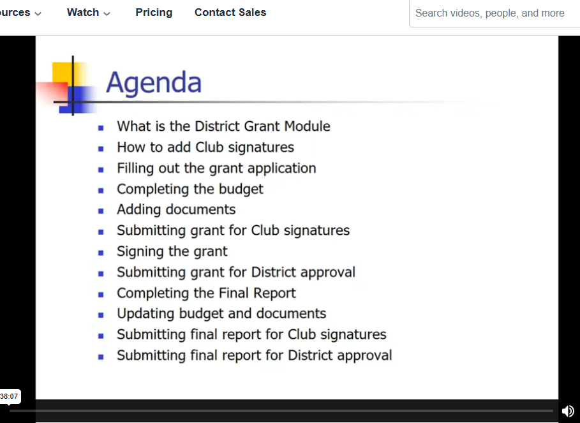
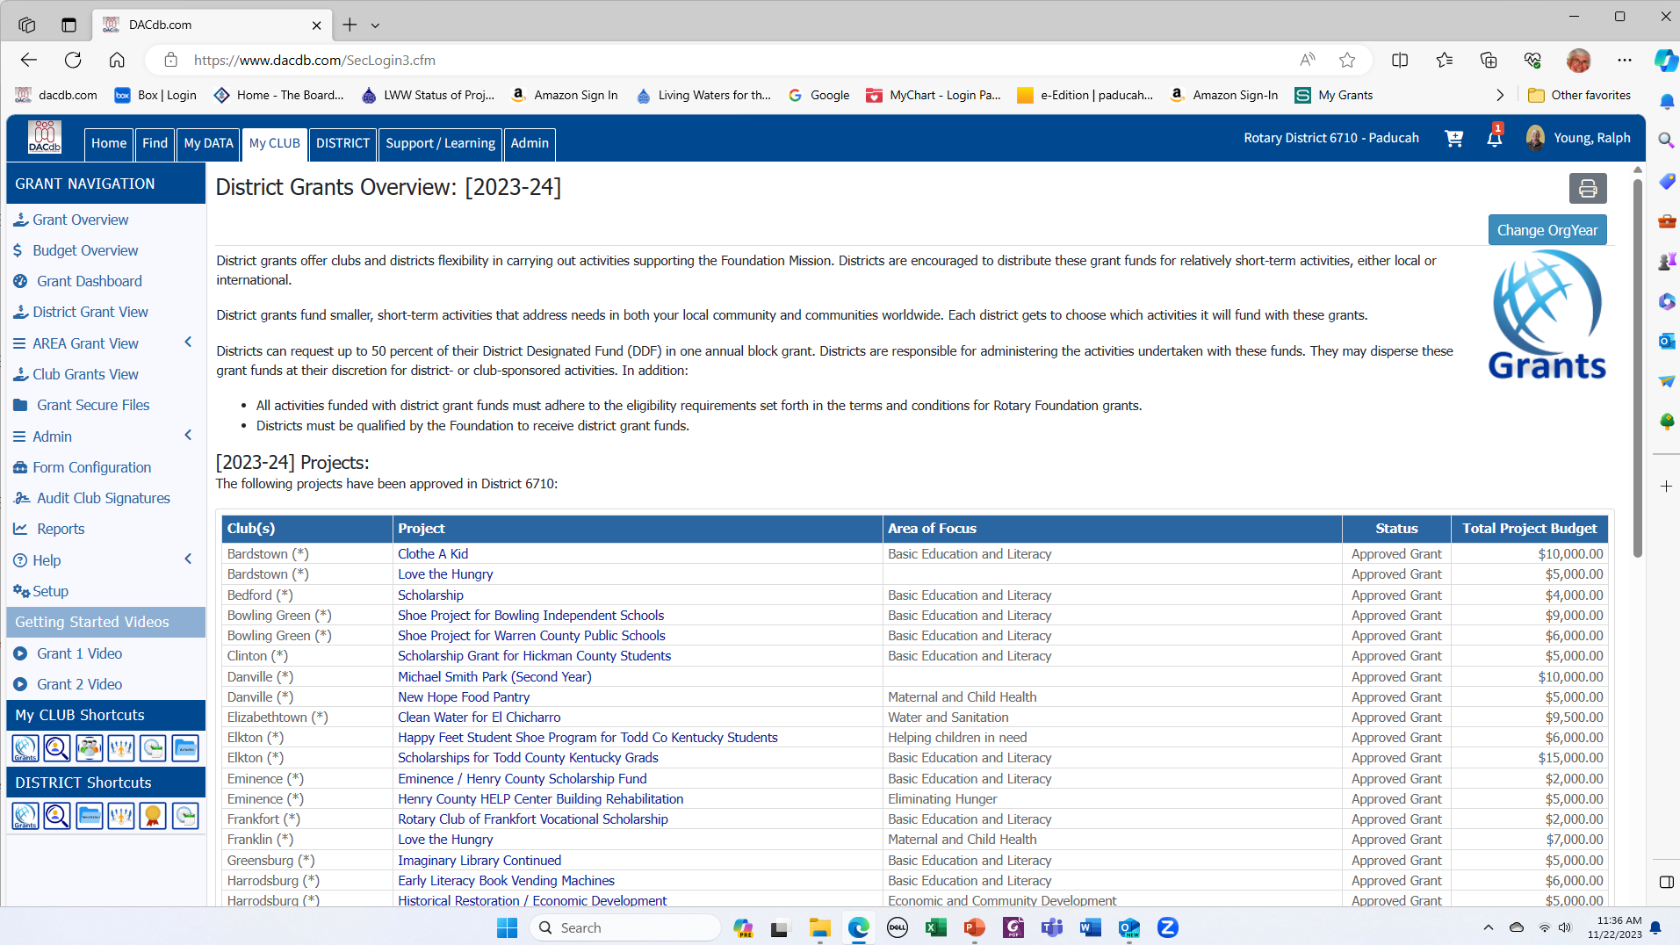
How to Apply for a District Grant
on DACdb – Grant 1 Video

Slide 35
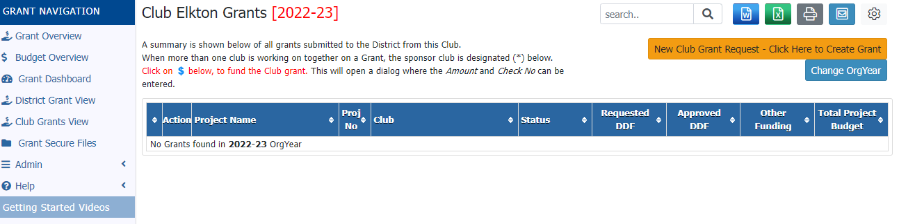
Starting the Application
The “Club Grants View” has a long button for beginning a new grant application.

Slide 36
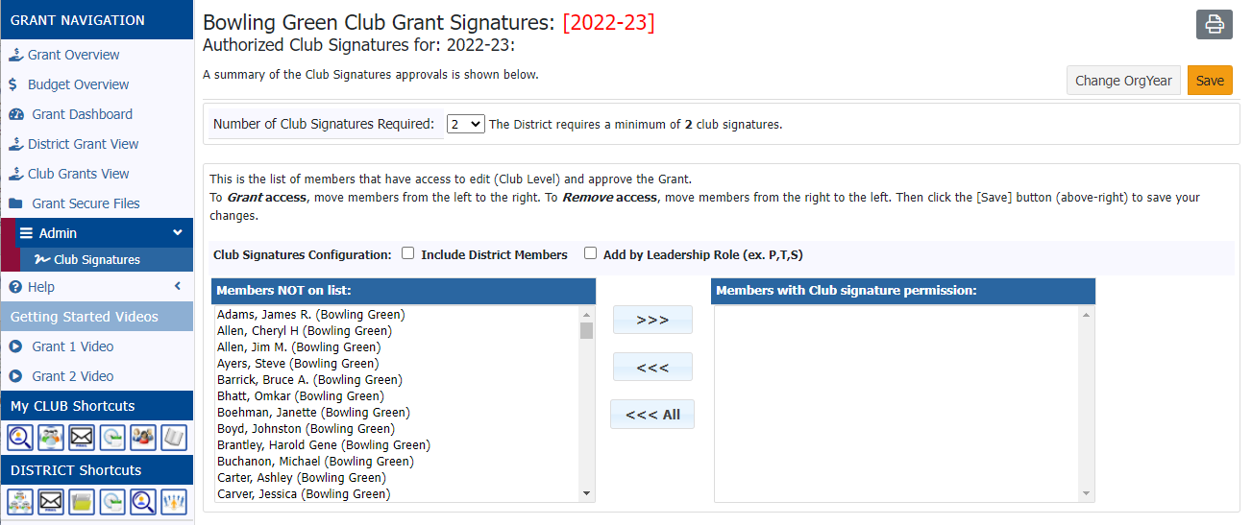
Naming Club Signatories
A Club Officer must login and, using the “Admin” link, name at least two members who can approve the grant in the club’s name.

Slide 37
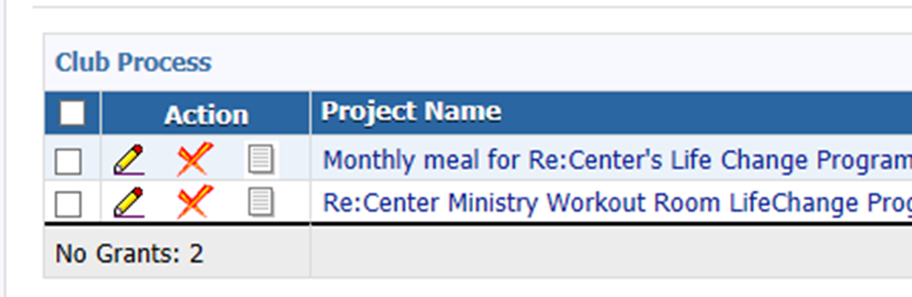
Remember – the Icons Allow Actions!
The Pencil icon allows you to edit or add information to the Draft. The Project Name will not!
The Red “X” will delete the Draft.
The Notepad allows Admins to send you information.

Slide 38
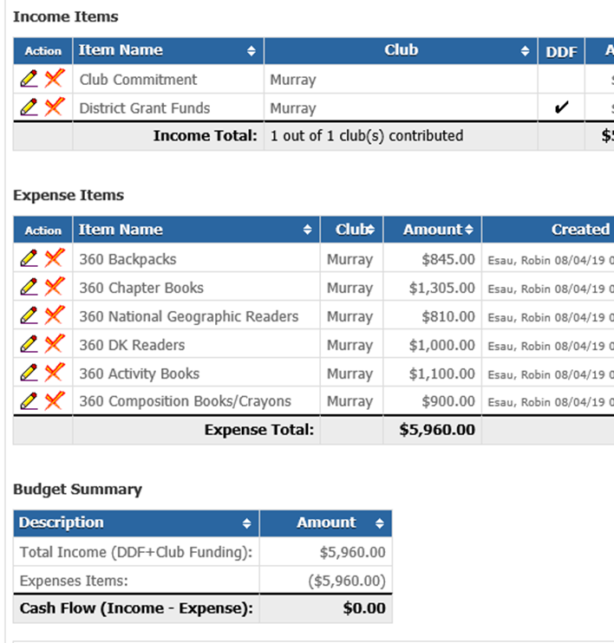
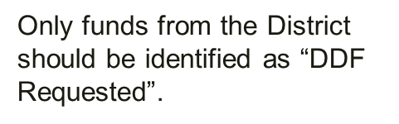
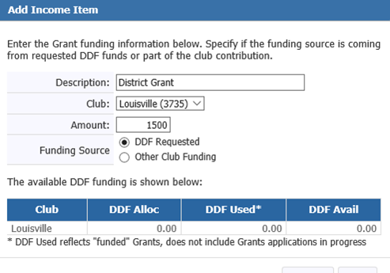

Budgets Should be Detailed!

Slide 39
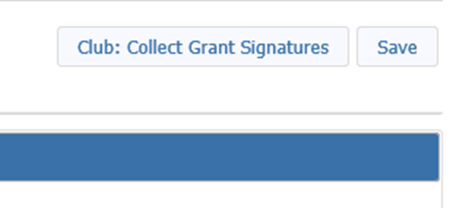
Collect Club Signatures
When you are satisfied with the draft, select the “Club: Collect Grant Signatures” button in the upper right.
  This causes two new tabs to appear
    Activity Log – lists every action taken on an application
    Signature Log – lists names of all who have signed off on the application
  After a club leader “signs” an application, no changes can be made unless it is reverted to Draft status – which will wipe out the previous signatures so that they will have to be redone.

Slide 40
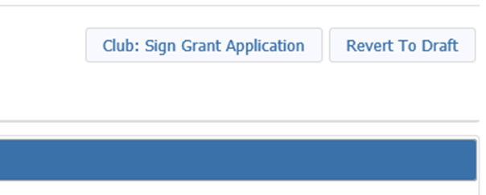
Signing the Application
District subcommittee members – including your Grant Mentor - can help you improve your application – if you ask them! Changes are more of a problem after the draft is submitted for club signatures.
Club officers “sign” the grant by:
  Logging into DACdb, finding the grant in Club Grants, and selecting the pencil icon. Two signatures are required!
  Then clicking the “Club: Sign Grant Application” button; or they can put it back into Draft status.

Slide 41
Submit the Grant to the District
When two Club Officers have “signed” the application, they can then submit it to the District – again, by clicking a button.
Three Grants Subcommittee Members must approve before the grant is added to the list for Foundation approval. This step adds two more tabs to the grant – space for you to write reports.
An Interim Report is only required if something has changed with your project.
A Final Report MUST be submitted before the DDF reimbursement funds are distributed.

Slide 42
Approval by the Foundation
When the District receives notice that the Rotary Foundation has approved its block grant, THEN Presidents of all clubs applying for grants will be notified by email – AND ONLY THEN can they begin working the grant and making purchases.
THEN the Application process is complete! And you can begin your real Rotary work!

Slide 43

You Have Completed the Seminar!
Questions?

