Slide 1
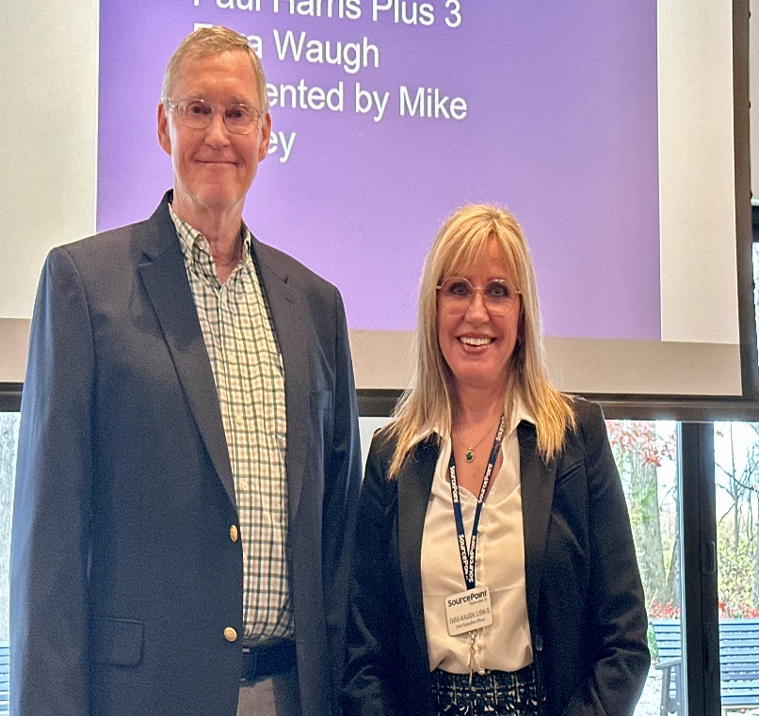
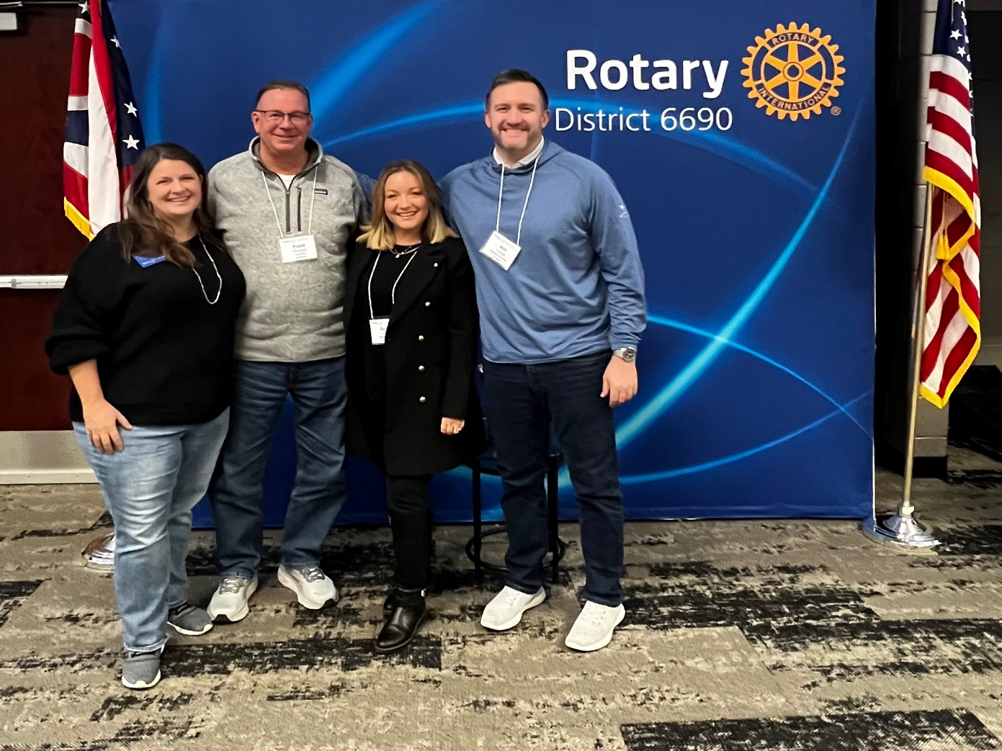

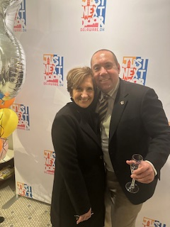
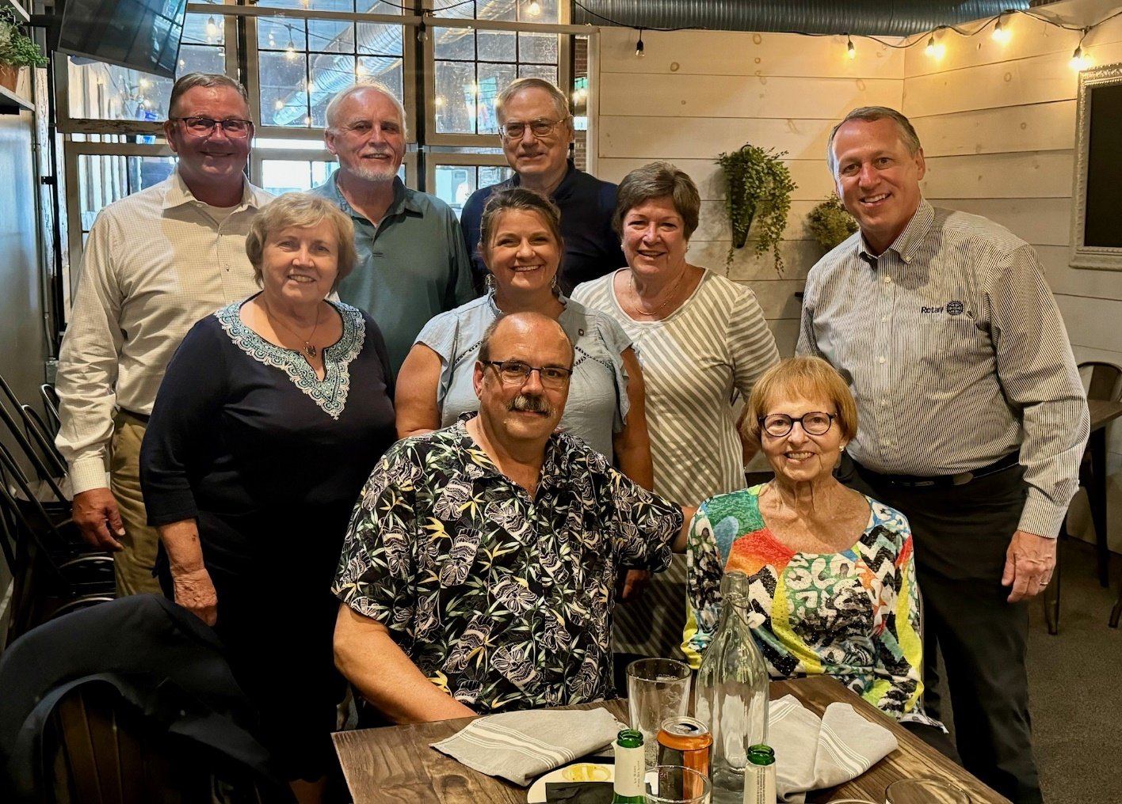
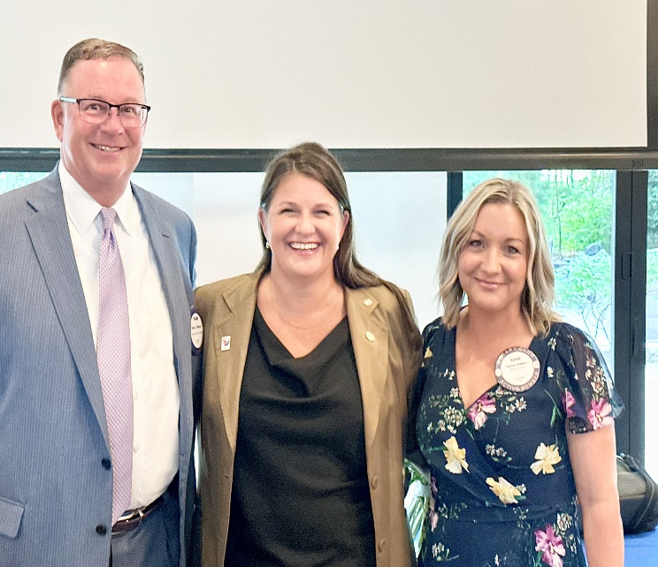

Rotary Weekly Meeting may 12th

Slide 2


Invocation/Inspiration adam moore
Pledge of Allegiance
joe pemberton
Greeters-Kerry joseph and jay shuter
Dessert Exchange –
Annette fleming

Slide 3

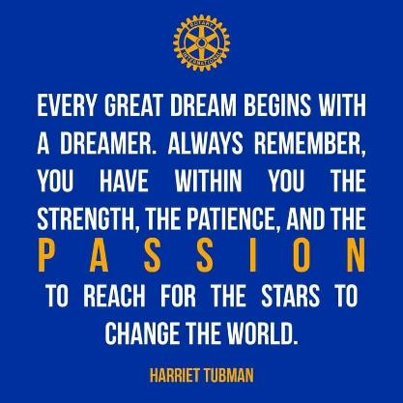
VISITING ROTARIANS
AND GUESTS
Josie Bair
Eve Helenberger

Slide 4

CLUB ANNOUNCEMENTS
Taste of Downtown Delaware Tuesday June 17th, 2025 Sponsorships opportunities are available. Auction items please!
Diane ticket sales TODD
Current game will play out as is
After next winner we will limit the marble’s to 25 plus the white one, so 26 total
Capped out at $599 so no taxes
Other club announcements

Slide 5
CLUB ANNOUNCEMENTS
B
No meeting on May 26th Memorial Day
Board Meeting next Monday May 19th
Past President Dinner is Thursday June 12th Old Dog at 5 PM, please rsvp to Frank
Kerry Joseph – volunteer needs
Club transition dinner on Thursday July 10th at Henmick’s 5- 8 pm Hog Roast chaired by Claire JJolliff
Other club announcements

Slide 6
For new members who have joined since fall we will do the $10 polio match if they joined 125. Contributions have to be made by June 2. If they gave since Oct I will get the names from the anticipator . For new ones, Preferably with checks at the door so we can get the list and match done by June 3
Joe Evans - trailhead cleanup / cookout this Thursday May 15. Will also have a rain day backup
Upcoming summer polio fundraiser at buckeye lake, papa boos July 12

Slide 7
OWL Program
Delaware Rotary Foundation by Mike Ringle
Mmike

Slide 8

SERGEANT
AT ARMS
David A. Hejmanowski

Slide 9
rotary scholarship winners by joe pemberton and jim gaskill

Slide 10
Mr. Jason Alford by Alice Frazier

Slide 11
Ms. Kate Vonderwell by Gina Grote

Slide 12
Ms. Zoey Morse by Scott Cubberly

Slide 13
Ms. Gabriella Sarbaugh by Jim Gaskill

Slide 14
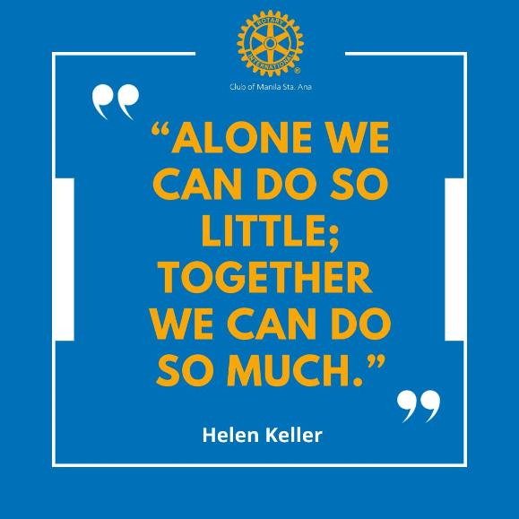
Pieces of Eight
¼ Delaware Rotary Foundation
¼ Scholarship Fund
¼ to the Pot
¼ to the Winner

Slide 15
Next meeting is: may 19th ohio consumers council by connie skinner

Slide 16

Is it the Truth?
The FOUR WAY TEST
Of the things we think, say, or do
Will it build goodwill and better friendships?
Will it be beneficial to all concerned?
Is it Fair to all concerned?

Slide 17
THANK YOU

