Slide 1
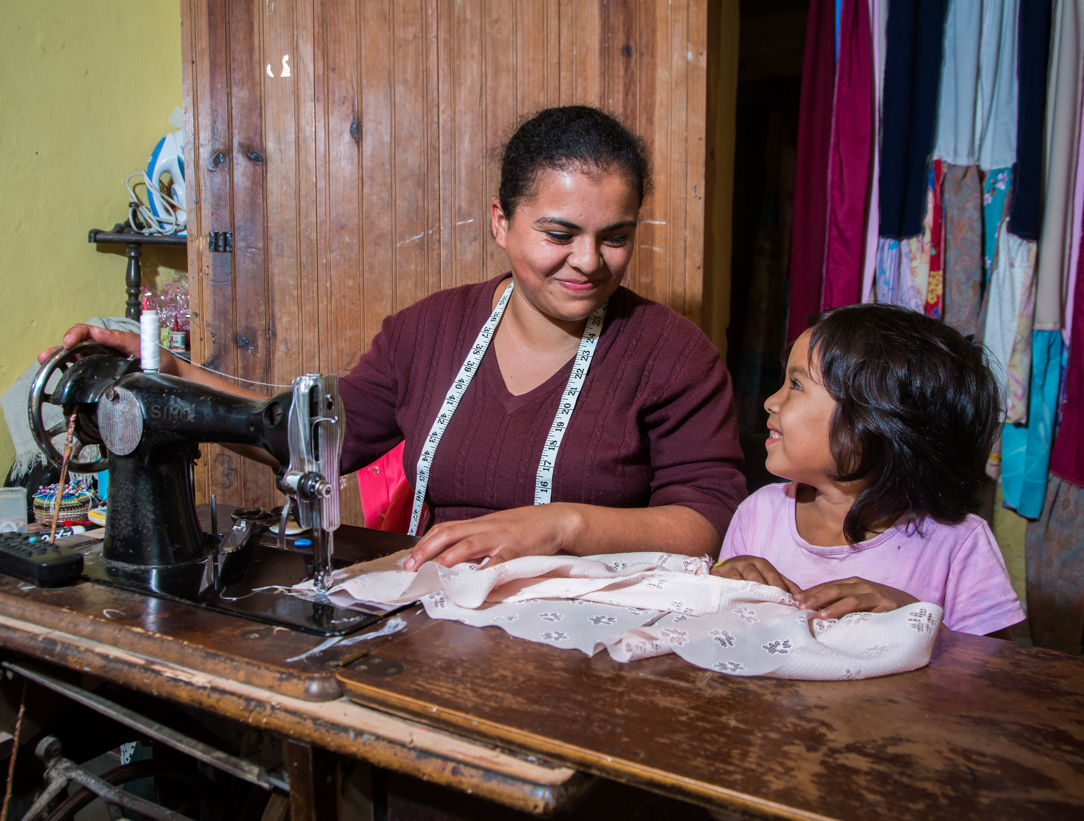
ROTARY GRANTS

Slide 2
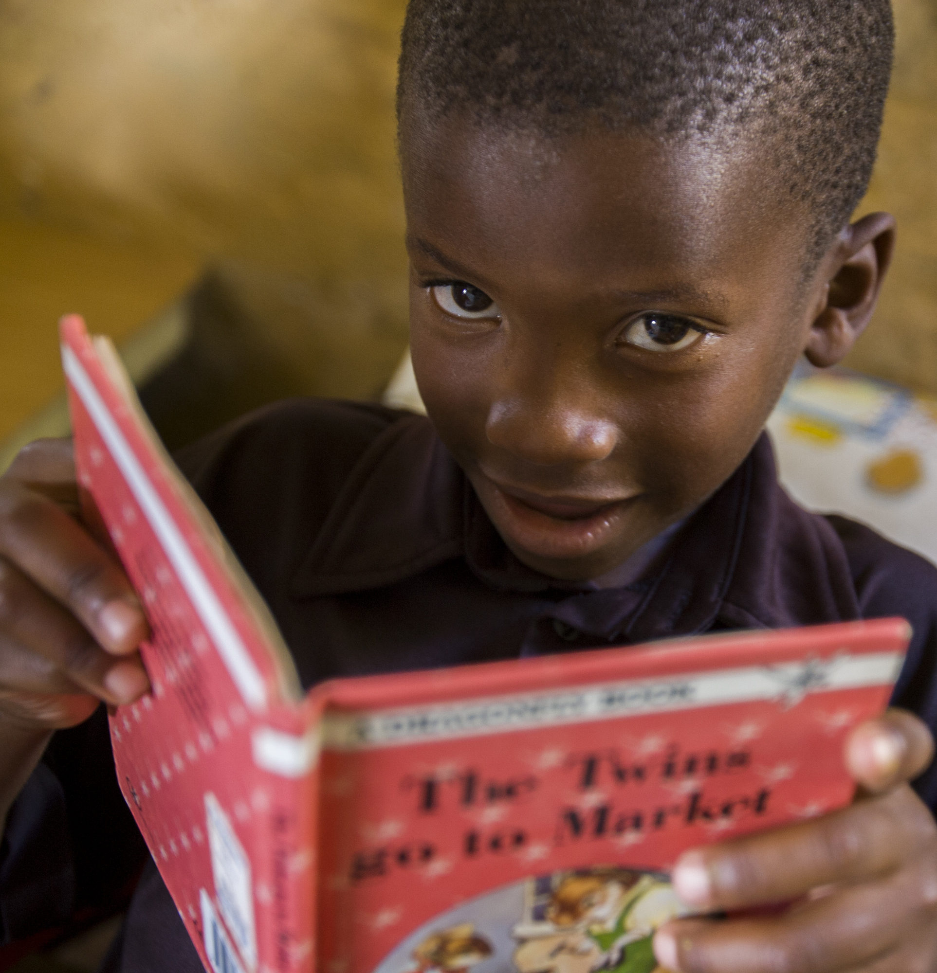
ROTARY GRANTS
Global grants
District grants
Notes:
The Rotary Foundation offers grants that support a wide variety of projects, scholarships, and training that Rotarians are doing around the world. There are two types of grants available: district grants and global grants.

Slide 3
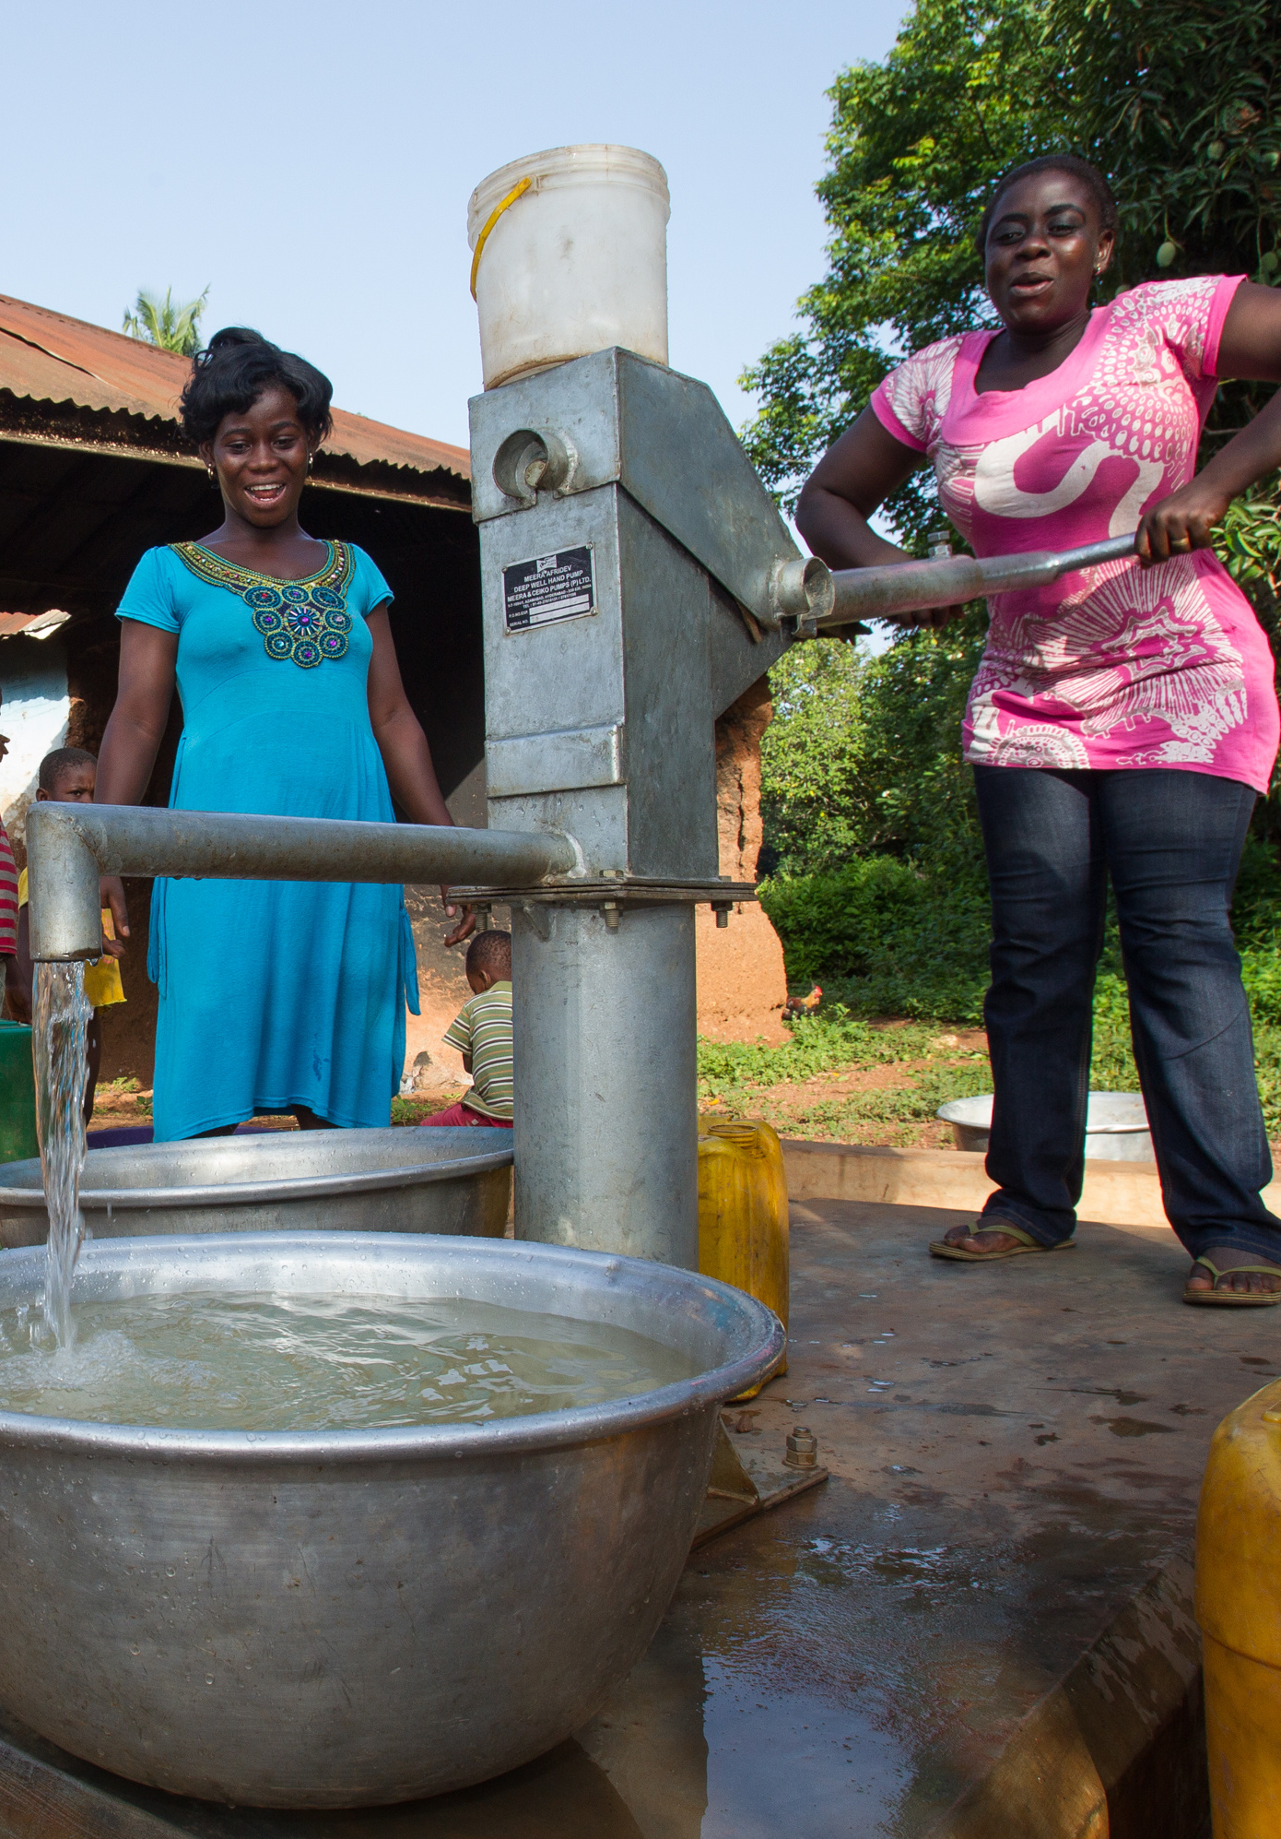
GLOBAL GRANTS
Large, long-term projects
Sustainable, measurable outcomes
Alignment with areas of focus
International partnership
$30,000 minimum budget
World Fund match
Notes:
Global grants support large international activities with sustainable, measurable outcomes in Rotary’s areas of focus. A key feature of global grants is partnership, between the district or club where the activity is carried out and a district or club in another country. Both sponsors must be qualified before they can submit an application.
The minimum budget for a global grant activity is $30,000. The Foundation’s World Fund provides a minimum of $15,000 and maximum of $200,000. Clubs and districts contribute District Designated Funds (DDF) and/or cash contributions that the World Fund matches. DDF is matched at 100% and cash is matched at 50%.
Global grants can support humanitarian projects, scholarships, and vocational training teams. Global grant scholarships support international graduate and post-graduate study for a period of 1-4 years. Global grant vocational training teams support groups of professionals to travel abroad to provide or receive training.

Slide 4

AREAS OF FOCUS
Peace and conflict prevention/resolution
Disease prevention and treatment
Water and sanitation
Maternal and child health
Basic education and literacy
Economic and community development
Notes:
We have identified specific causes to target to maximize our local and global impact. Through global grants we help clubs focus their service efforts in the following areas:
Peace and conflict prevention/resolution
Disease prevention and treatment
Water and sanitation
Maternal and child health
Basic education and literacy
Economic and community development

Slide 5
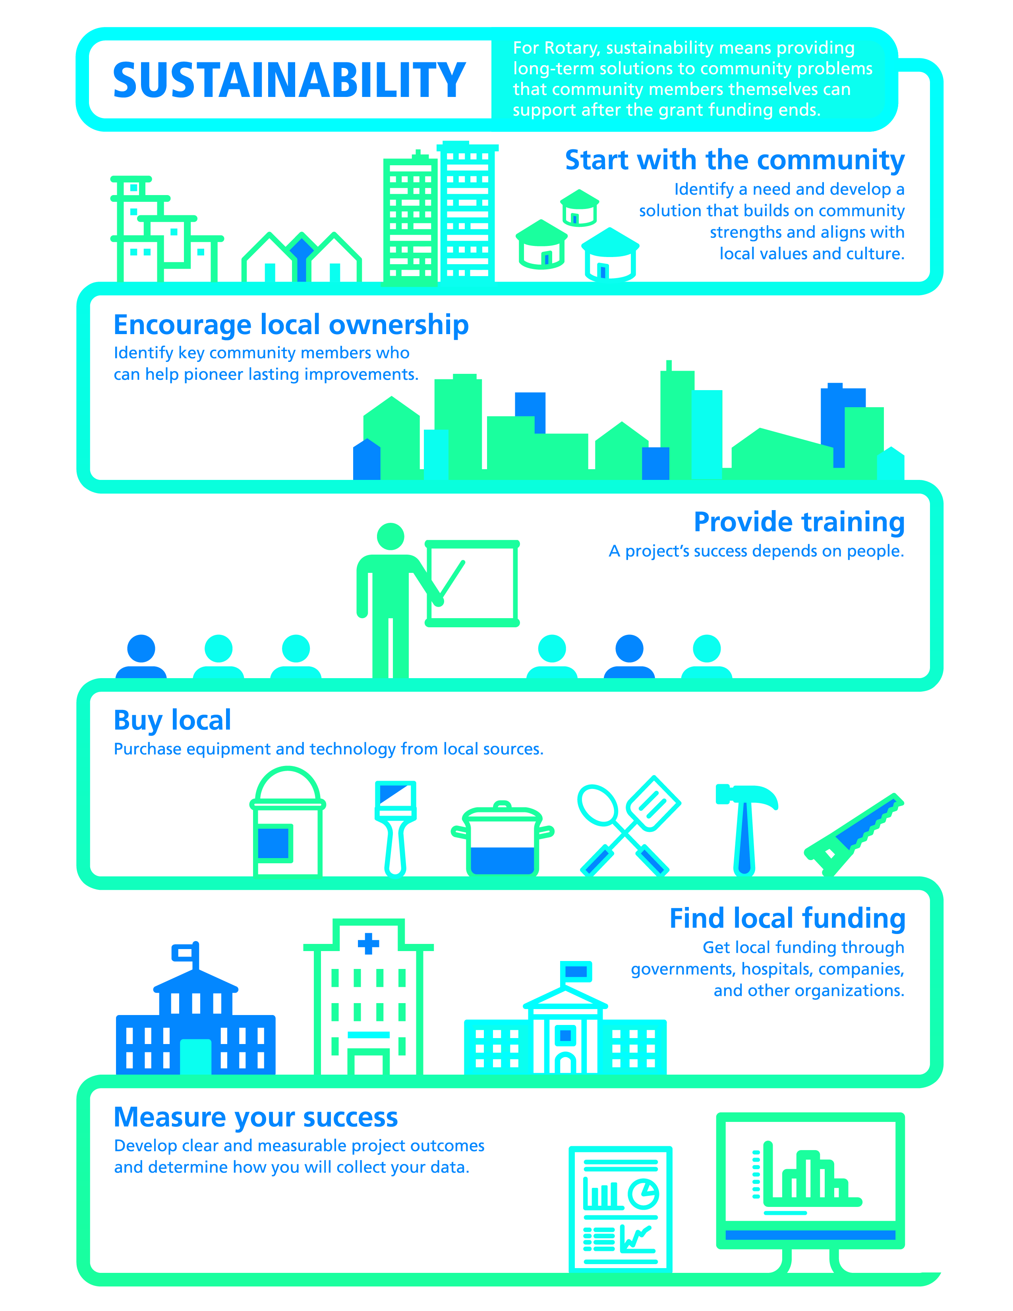
SUSTAINABILITY
Sustainability means different things to different organizations.
For Rotary, sustainability means providing long-term solutions to community needs that the beneficiaries can maintain after grant funding ends.
Notes:
Sustainability means different things to different organizations. For Rotary, sustainability means providing long-term solutions to community needs that the beneficiaries can maintain after grant funding ends.
To help Rotary members understand what we mean by sustainability, we’ve identified six steps that can help to ensure the long-term sustainability of a project.

Slide 6
STEP #1
Notes:
The most important place to start when designing a sustainable project is with the community. The Rotary club in the location where the project will take place, what we call the host sponsor, should work with members of the benefiting community to identify a need and develop a solution that builds on community strengths and aligns with local values and culture. Rotary has a wonderful resource document that can help you in this process. It’s called Community Assessment Tools and it is available on Rotary’s website.

Slide 7
STEP #2
Notes:
The next step in developing a sustainable project is to encourage local ownership of the project. It’s a true sign of a project’s success when community members embrace the project as their own. Empowering community members to assess their needs and plan projects that address them leads to the most effective projects and the most sustainable outcomes. Identify key community members who can help pioneer lasting improvements.

Slide 8
STEP #3
Notes:
The third step is to provide training. A project’s success depends on people. By providing training, education, and community outreach, you strengthen beneficiaries’ ability to meet project objectives. You should confirm that a plan is in place to transfer knowledge to new beneficiaries. It works best when you collaborate with local organizations to provide this training.

Slide 9
STEP #4
Notes:
Step #4 is to buy local. Purchase equipment and technology from local sources whenever possible. Make sure that spare parts are available locally, too. It is ideal to build capacity, that is, provide training, so that community members can operate, maintain, and repair equipment on their own. You should always compensate your project’s vendors appropriately so they have an incentive to continue providing supplies.

Slide 10
STEP #5
Notes:
The next step is to find local funding. Getting funding from local governments, hospitals, companies, and other organizations integrates your project into the local community and supports your project’s long-term success.

Slide 11
STEP #6
Notes:
The last step is to measure your success. First, gather data before you begin the project to determine where you are starting from. Include clear and measurable outcomes in your project plan, and decide how you’ll collect data throughout your project and afterward. Maintaining a strong relationship with the community can help you collect data and also address any issues that the data bring to light. More information about monitoring and evaluation can be found in the Global Grant Monitoring and Evaluation Supplement which is available online.

Slide 12
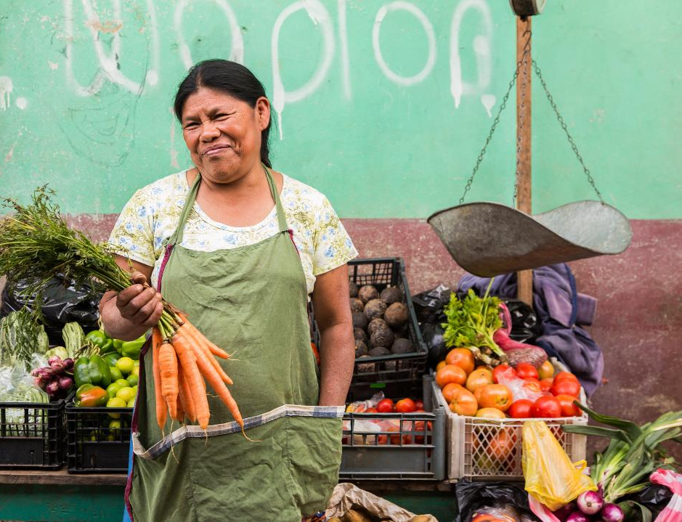
Humanitarian Projects
Notes:
Using a global grant, Rotary clubs in Honduras and the US worked together to provide micro loans to women in rural Honduras. The women are organized into lending groups and receive small loans and business training, allowing them to start small businesses and increase their household income.

Slide 13
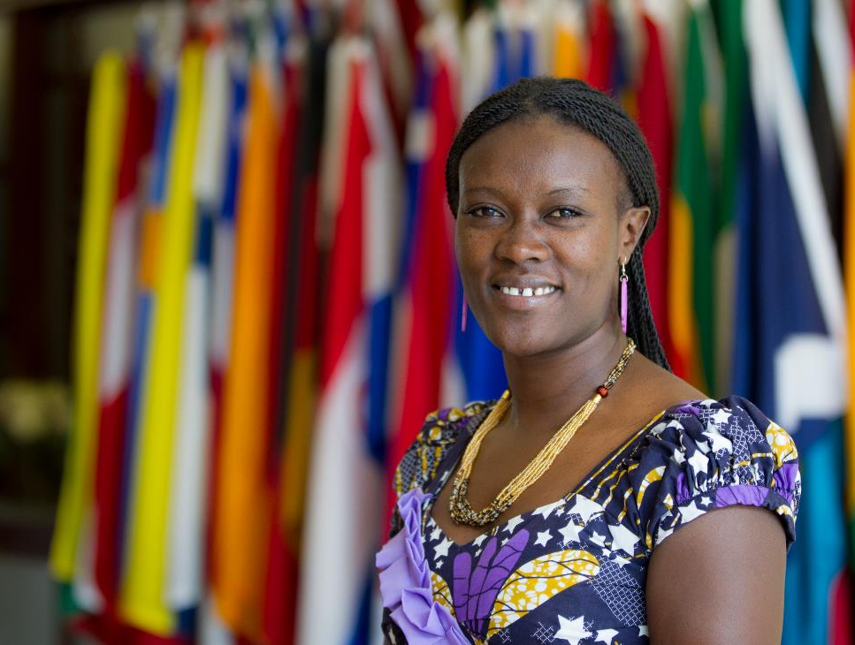
Scholarships
Notes:
Supported by Rotary clubs in Kenya and the United States, Monica Kinyua received a global grant scholarship to earn a Master’s degree in Peace Studies at the University of San Diego in the United States. After completing her studies, she joined forced with her twin sister to start the Children’s Peace Initiative in Kenya to end fighting and build friendships between children from different tribes.

Slide 14
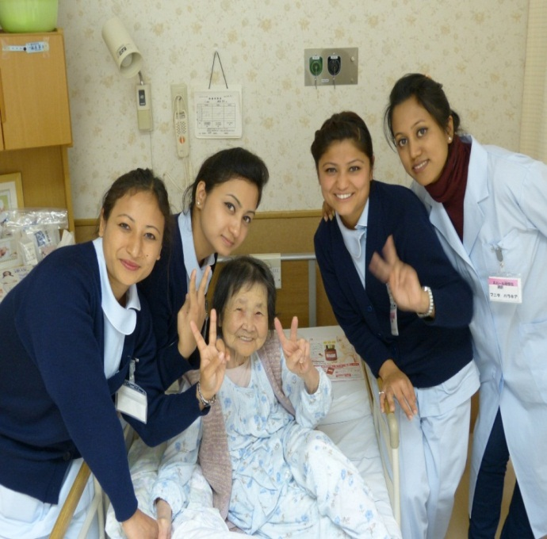
Vocational Training Teams
Notes:
Rotary clubs in Nepal and Japan used a global grant to send a team of health professionals from Nepal to Japan to receive training on emergency care and dialysis treatment.

Slide 15
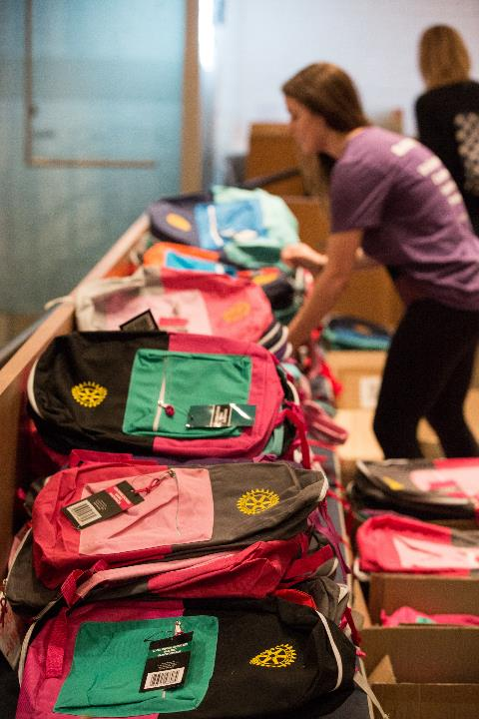
DISTRICT GRANTS
Small-scale, short-term
Local or international activities
Aligned with the Foundation’s mission
Single grant awarded annually
Notes:
Now that we’ve talked about global grants, I’d like to shift gears and talk about the other type of grant that’s available from The Rotary Foundation: district grants.
District grants fund small-scale, short-term activities that address needs in your community and communities abroad. Each district chooses which activities it will fund with these grants. You can use district grants to fund a variety of district and club projects and activities.
You have a lot of freedom to customize your service projects. There aren’t many restrictions, as long as your district grant supports the mission of The Rotary Foundation, which is to enable Rotarians to advance world understanding, goodwill, and peace through the improvement of health, the support of education, and the alleviation of poverty. Districts must be qualified before they can administer district grants.
Districts may use up to 50 percent of their District Designated Fund to receive one district grant annually. This percentage is calculated based on the amount of DDF generated from a district’s Annual Fund giving three years prior, including Endowment Fund earnings. You aren’t required to request the full amount available. Districts receive this funding as a lump sum and then distribute it to their clubs.
District grant funding can support local service projects, international humanitarian projects, scholarships and vocational exchanges. Unlike global grant scholars, district grants can support scholarships at any level of study and for any study area. Similarly, vocational exchanges funded by district grants have great flexibility and don’t need to align with any specific topic area or provide formal training.

Slide 16

Notes:
Rotarians in District 4420 (part of Sao Paulo, Brazil) used district grant funds to begin Project READ (Reading and Education Center) to provide reading rooms for children in poor communities. The project equips each center with books and toys that encourage reading among children ages 5-12. A local monitor supervises each reading room and tutors students.

Slide 17

Notes:
With the help of district grant funding, Rotarians, Rotaractors and community members in California packed school supplies that will be distributed to children in Mexico.

Slide 18
GLOBAL GRANT VS. DISTRICT GRANT
 | Global grant | District grant
Cost | $30,000 min. | No max. or min.
Funding | World Fund, DDF, cash | DDF
Application | Online | Managed by district
Area of focus | Project aligns with area(s) of focus | No area of focus requirement
Partnership | Host and international partnership | No partnership required
Sustainability | Required | Not required
Measurability | Required | Not required
Scholarships | Graduate and post-graduate | No study level requirement
Notes:
To help with distinguishing between the two grant types, we have a summary chart that highlights the differences between the grant types.

Slide 19
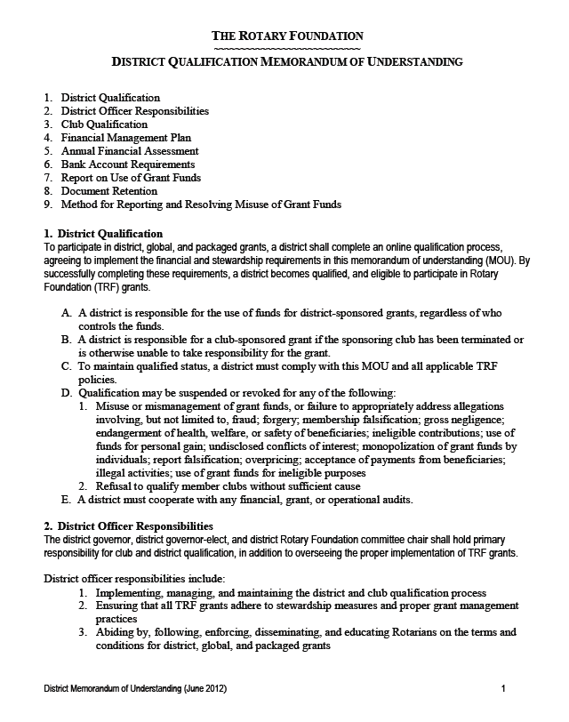
DISTRICT QUALIFICATION
District leaders complete qualification process online annually
Agree to implement MOU
Conduct grant management seminars for clubs
Notes:
Districts must become qualified in order to receive grant funding from The Rotary Foundation. The online qualification process helps ensure that your district understands your financial responsibilities, including stewardship, and is prepared to take them on. Qualification must be completed each year.
Becoming qualified is simple. Your district governor, governor-elect, and Rotary Foundation chair should:
Read through the district qualification memorandum of understanding (MOU) on the grants application tool, answer a series of questions, and agree to the MOU
Conduct grant management seminars for clubs

Slide 20
CLUB QUALIFICATION
Agree to implement the club MOU
Send club member to grant management seminar sponsored by the district
Complete any other district requirements
Notes:
Clubs that want to apply for global grants must also be qualified. Districts are responsible for qualifying their clubs each year. To become qualified, your president and president-elect must:
Agree to implement the club qualification MOU
Send at least one club member to a grant management seminar held by your district
Complete any additional steps that your district requires
Your club must qualify each year if you plan to apply for global grants.

Slide 21
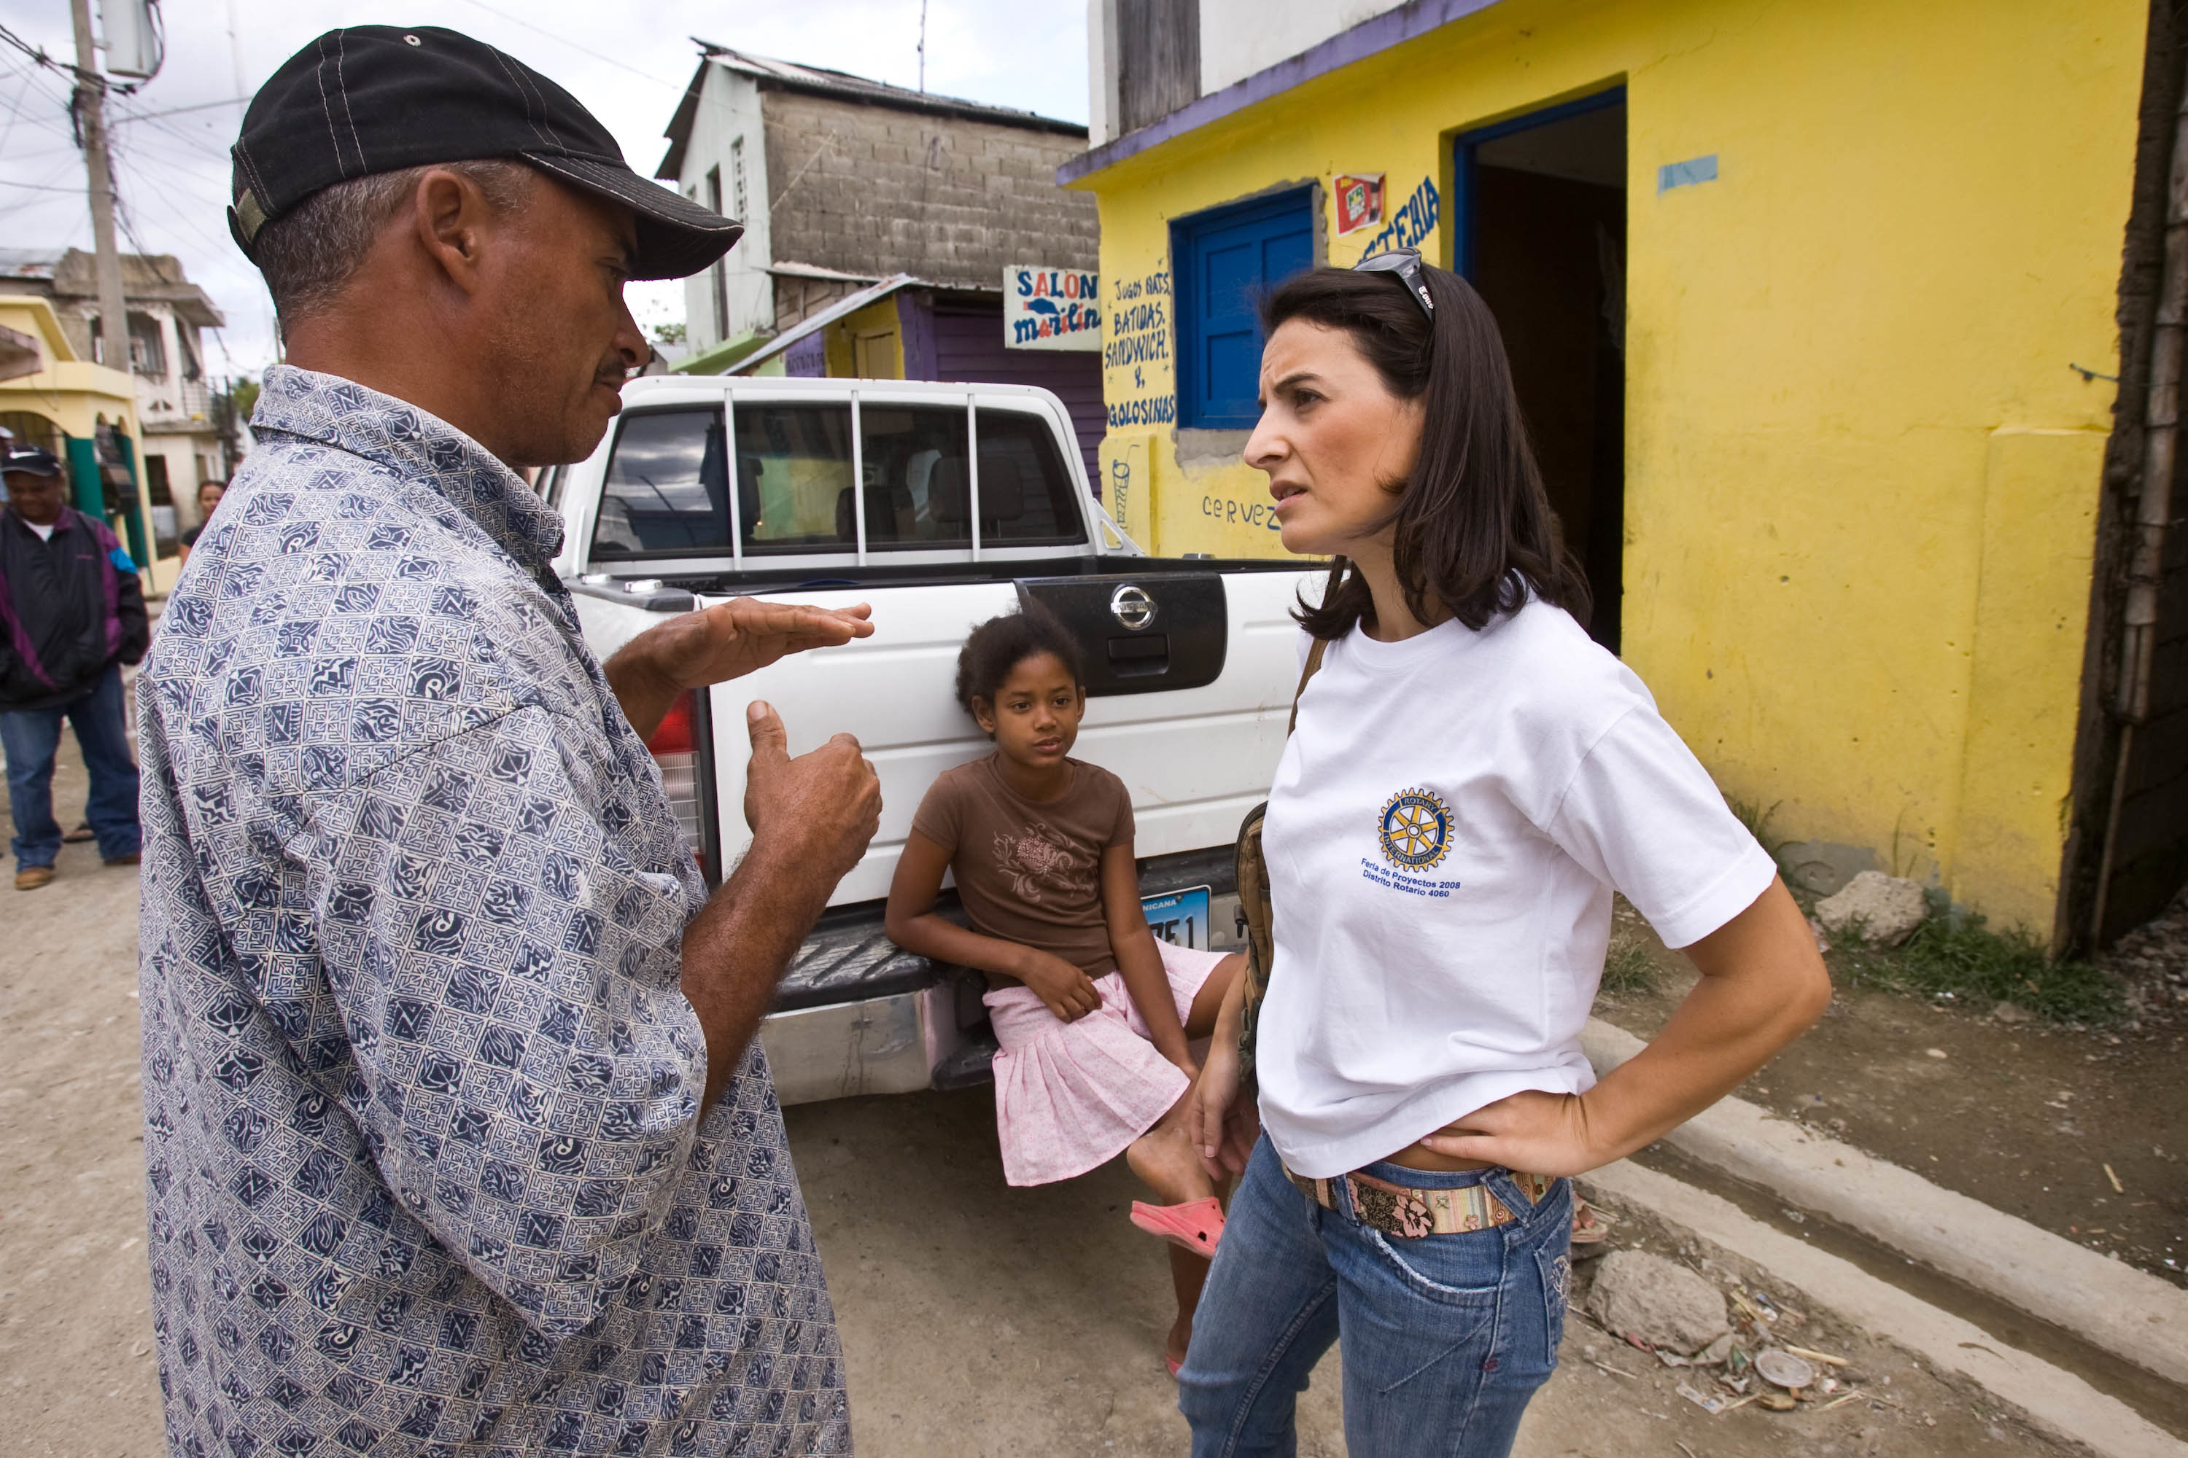
WHAT IS A COMMUNITY ASSESSMENT?
Examines strengths, weaknesses, needs, assets
Helps to identify relevant opportunities for projects
Notes:
Now, let’s revisit a topic that was mentioned earlier in this presentation—community assessments. A community assessment is one of the first steps that should be taken before beginning a grant-funded project. A community assessment explores your community’s strengths, weaknesses, needs, and assets is an essential first step in planning an effective project. By taking time to learn about your community, you can discover the most relevant opportunities for projects and maximize your club’s ability to make a meaningful impact.
Starting 1 July, any club or district that applies for a global grant to support a humanitarian project or a vocational training team must conduct a community assessment first and include the results in their grant application.

Slide 22
BENEFITS
Increased understanding of community dynamics
Helps you make decisions about service priorities
Builds valuable relationships
Encourages community member participation
Helps to build trust, community ownership and sustainability
Notes:
A community assessment can help you get a better understanding of the dynamics of your community and help both you and the beneficiaries make important decisions about service priorities. Even if you’re actively involved in your community, an assessment can reveal additional strengths and opportunities for growth. Perhaps you’ll find a new way to address a known issue. Before you start an assessment, consider what you specifically want to learn about your community. An effective assessment will reveal things you did not know before. Doing an assessment also helps you build valuable relationships and encourages community members to actively participate in making lasting improvements. It’s a critical first step in creating trust, community ownership, and sustainability.

Slide 23
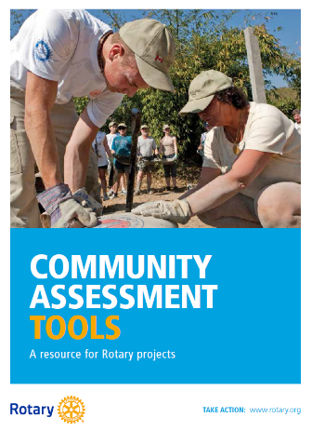
ASSESSMENT TOOLS
Community meeting
Survey
Interview
Focus group
Asset inventory
Community mapping
Notes:
Having casual conversations with just one or two people isn’t an effective way of finding out what a community needs. Assessments should be systematic, involve a wide variety of community stakeholders and beneficiaries, and engage them in a meaningful way.
Here are six assessment methods that you can use. They aren’t exclusive. You can combine or adapt them to best suit your club’s resources and the preferences of the people you wish to engage with.
More information about these assessment methods can be found in Rotary’s Community Assessment Tools guide on My Rotary.

Slide 24
TIPS
Remain open minded
Choose participants carefully
Include overlooked or marginalized groups
Consider yourself an outsider
Don’t promise a project before you make a decision
Notes:
Here are some general tips when you’re conducting a community assessment:
Remain open minded. Don’t presume you know what the community needs.
Choose participants carefully. Consider the makeup of the community and ensure that you include a diverse cross-section of relevant groups (e.g., gender, age, ethnicity, religion, income level, vocations).
Include overlooked or marginalized groups. Women, young people, the elderly, and religious or ethnic minorities are often overlooked. Keep the community’s social dynamics in mind and provide a forum where they feel comfortable sharing their views.
Consider yourself an outsider. Even if the community you want to work with is local, find a well-connected individual, group, or organization that can introduce you to your target stakeholder groups.
Don’t promise a project before you make a decision. But do assure participants that you’ll let them know what your club decides. Invite them to take part in any future activities.

Slide 25
2016-17 STATISTICS – DISTRICT GRANTS
 | Approved | World Fund | Total Funding
District grants | 494 | N/A | $27,084,971
Total program awards*: | $25.8 million
Average grant amount: $54,828
*Program awards include payments for grants, accruals for approved grants that have not yet been paid, currency exchange gains and losses, and return of funds and write-offs for closed, canceled, or relinquished grants.

Slide 26
2016-17 STATISTICS – GLOBAL GRANTS
 | Approved | World Fund | Total Funding
Global grants | 1,260 | $35,166,791 | $84,519,313
Total program awards*: | $72.9 million
Average grant amount: $67,079
Global grant activity type | Number of grants |  | Area of focus | Number of grants
Humanitarian | 973 |  | BEL | 174
Humanitarian/Scholar/VTT | 1 |  | DPT | 426
Humanitarian/VTT | 52 |  | ECD | 190
Scholar | 196 |  | MCH | 89
VTT | 38 |  | PCPR | 81
 |  |  | WAS | 300
*Program awards include payments for grants, accruals for approved grants that have not yet been paid, currency exchange gains and losses, and return of funds and write-offs for closed, canceled, or relinquished grants.

Slide 27

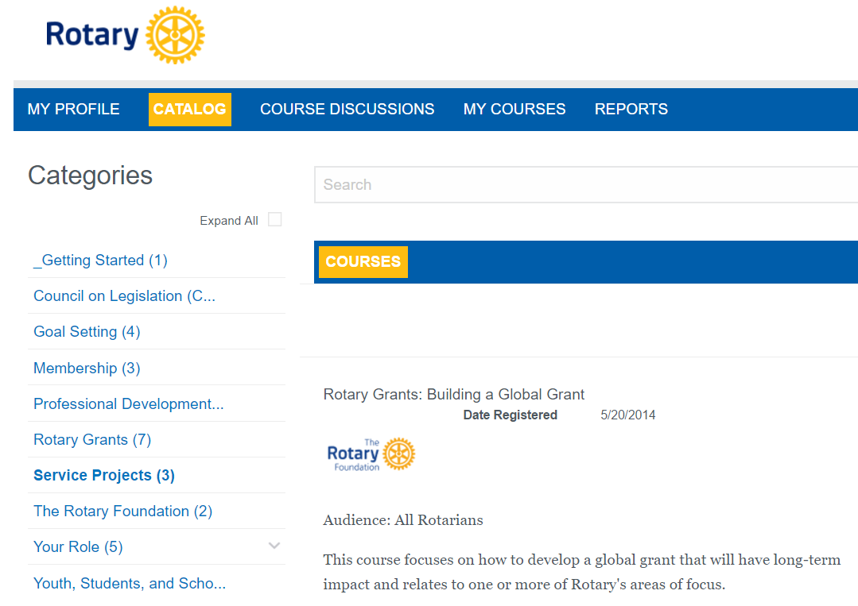
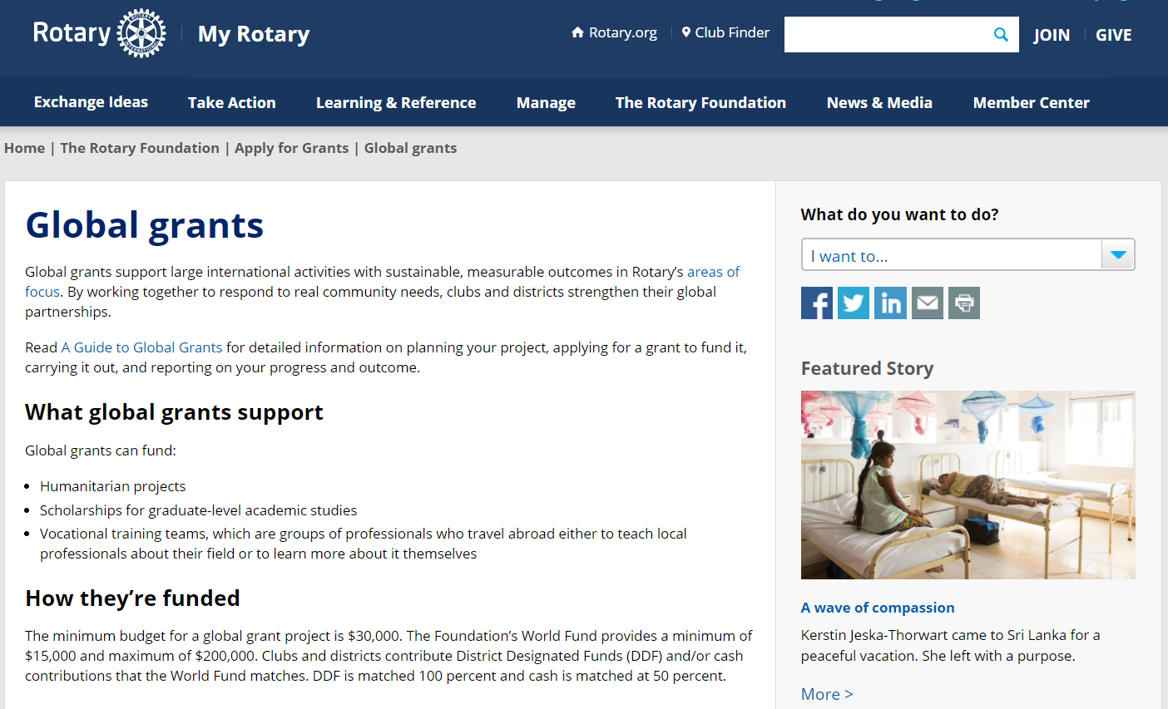
RESOURCES
Notes:
We have a number of resources available to help you take full advantage of grant opportunities.
First and foremost, I encourage you to read A Guide to Global Grants. This helpful manual includes everything you need to know to get started with global grants.
Rotary’s website has a wealth of general and detailed information about grants.
The learning center offers training resources to help you apply for Foundation grants.

Slide 28
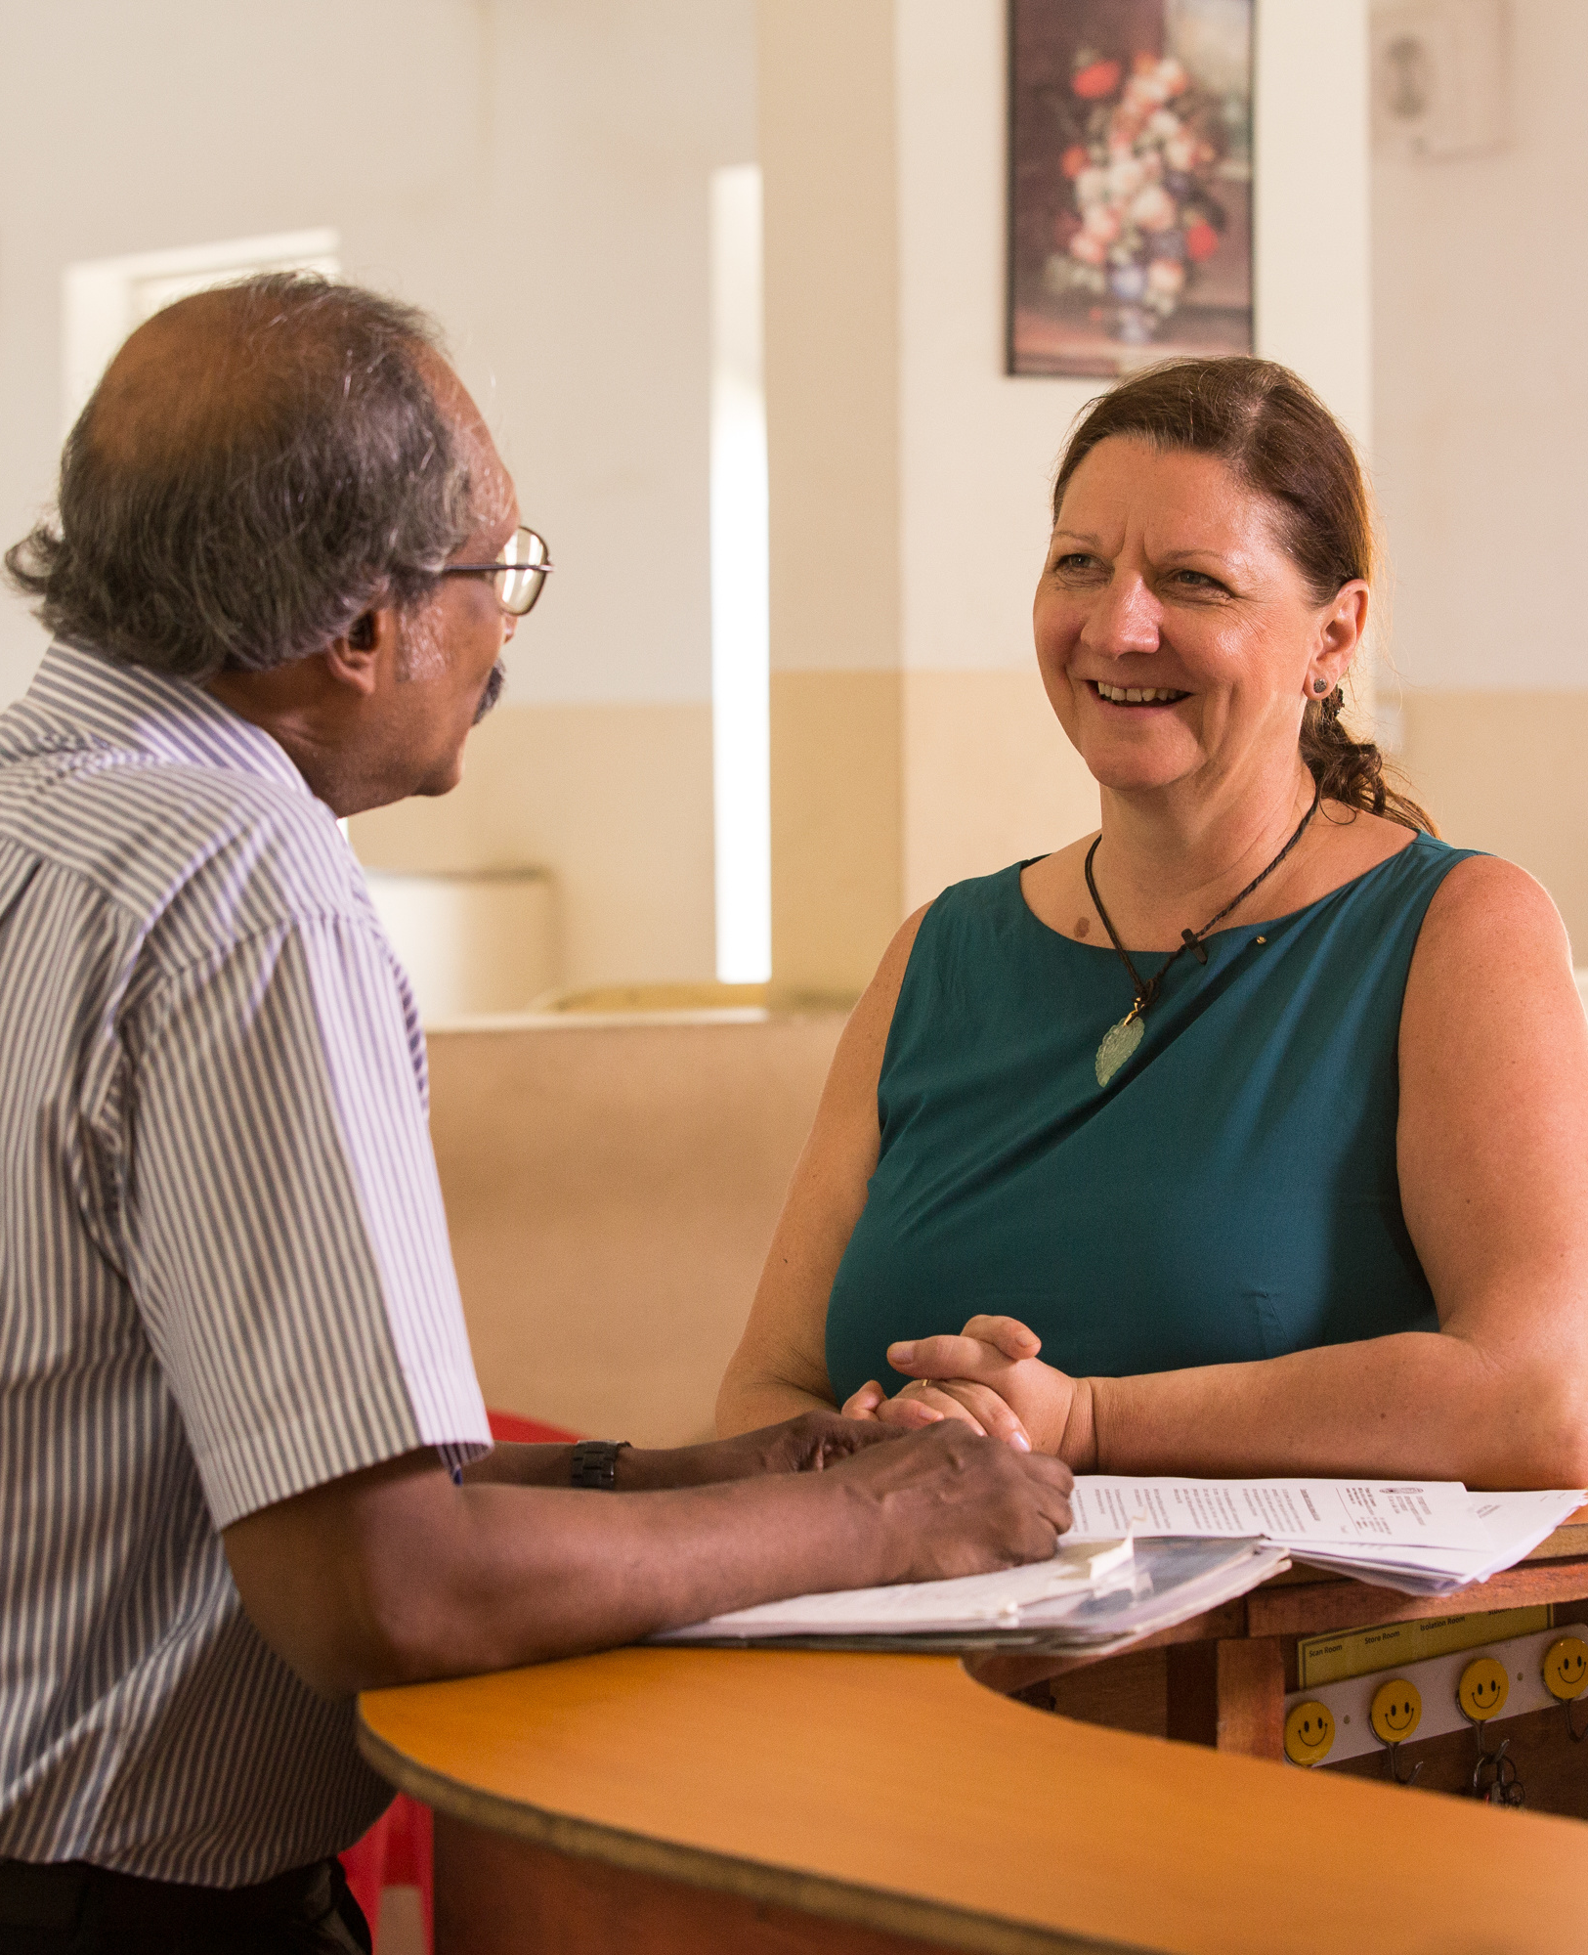
RESOURCES FOR FINDING PARTNERS
Rotary Ideas
Rotary discussion groups
Rotarian Action Groups
Intercountry committees
Project Fairs
Rotary Fellowships
Notes:
Collaboration between international partners is a key feature of global grants. Thanks to the Rotary network, it’s possible to work toward a common goal with Rotarians from other countries, which offers a wonderful opportunity to promote peace in the world. Project partners can also provide valuable financial resources, technical expertise, and management experience. Plus, international partners can offer differing ideas and strategies, leading to more effective problem-solving and innovation.
We have lots of resources to help you find a partner:
Rotary Ideas, a platform that allows you to request partners, materials, or international support and contributions
Rotary discussion groups, a forum for clubs to exchange project ideas and request assistance
Rotarian Action Groups, members and others who are experts in a particular field and who help club and district projects
Intercountry committees, networks of Rotary clubs or districts in two or more countries working together on service projects, sponsoring new clubs, or other activities
Project Fairs, regional events that Rotary districts host to encourage international friendship and collaboration
Rotary Fellowships, independent, social groups that share an interest in a hobby, recreational activity or profession

Slide 29
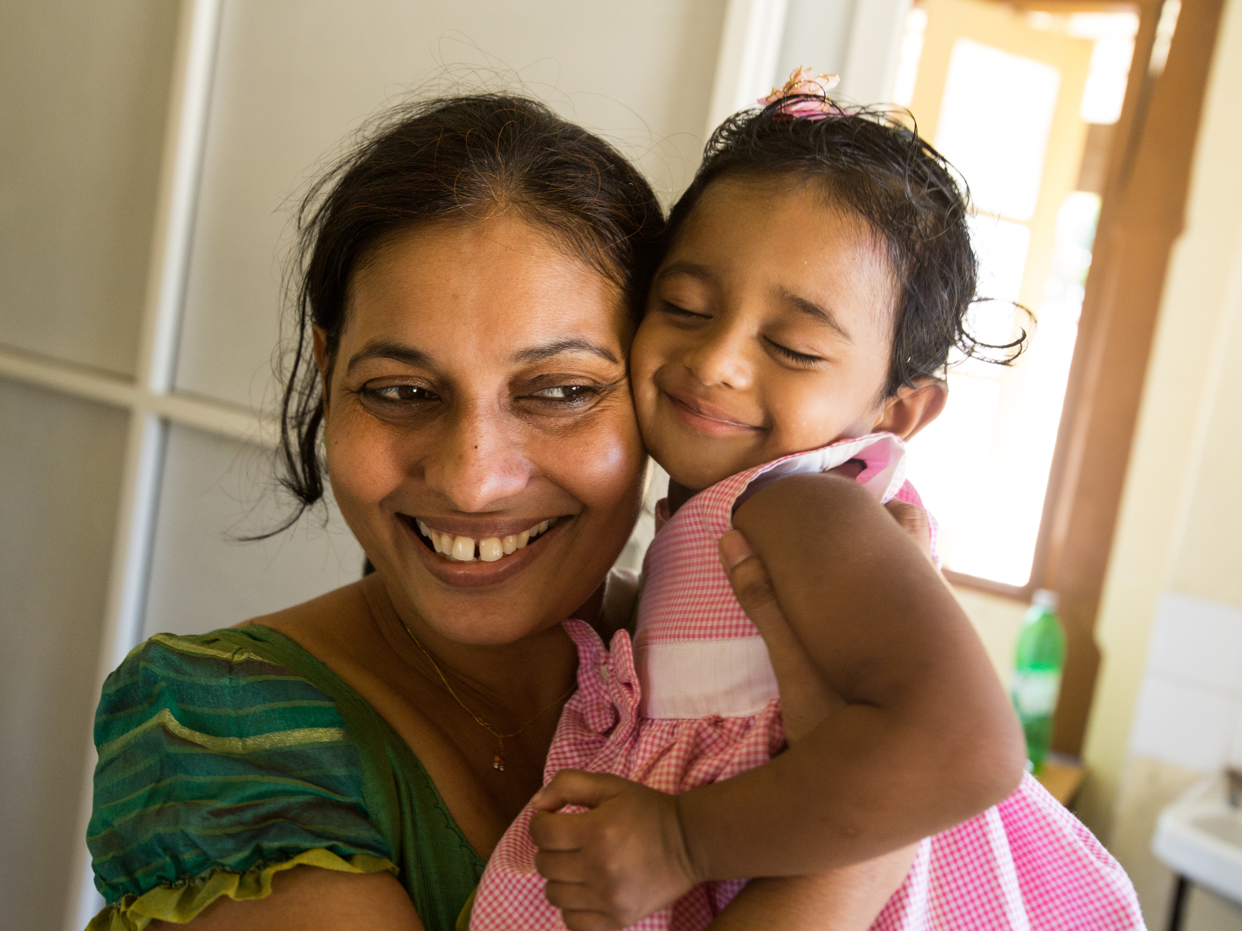
Questions?

