Slide 1
Moment for Rotary
Elyria Rotary Club
Title Page Option

Slide 2
Rotary International
Presidents
Visits to Elyria
5

Slide 3
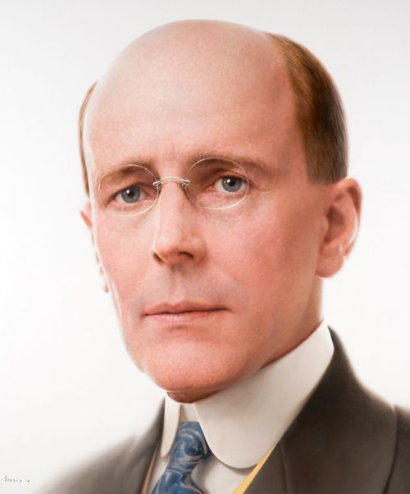
Paul Harris
The founder of Rotary visited Elyria Rotary several times for meetings on the Ohio Crippled Society.

Slide 4
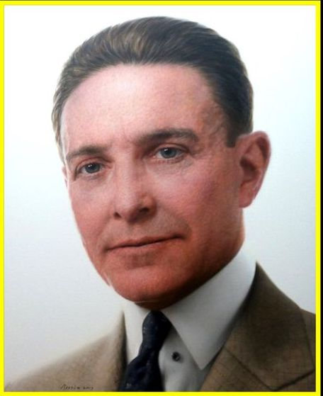
Arch Klumph
Member of the Cleveland Rotary Club and RI President in 1916.
Sam Squires

Slide 5
Cliff Dochterman
Keynote Speaker at Elyria Rotary’s 75th Celebration in 1993.
Fraternity brothers of Speedy Amos and Jim Johnson at Ohio Wesleyan.

Slide 6
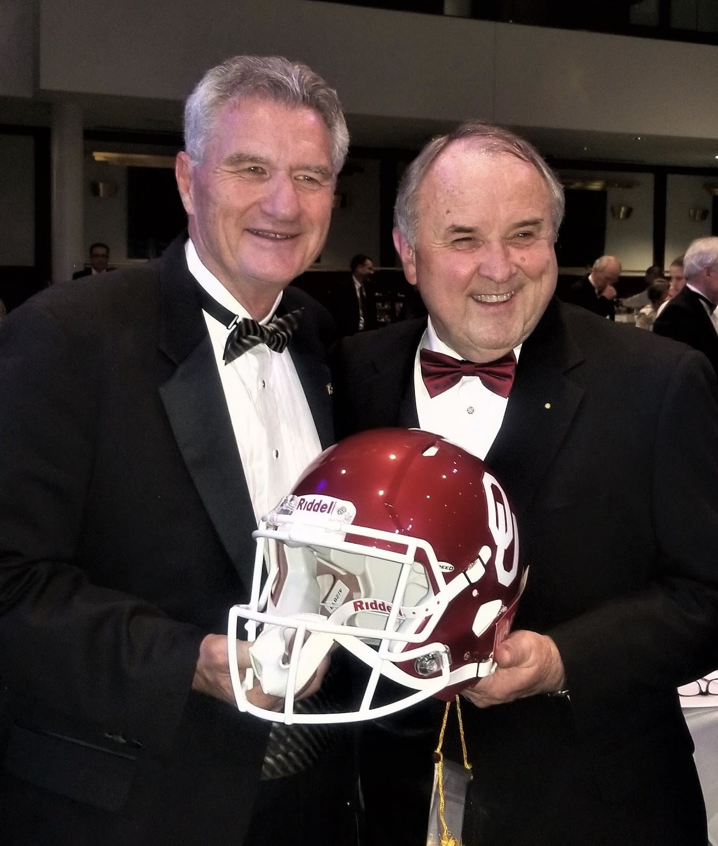
Ron Burton
Keynote Speaker at Elyria Rotary’s 100th Celebration in 2018.

Slide 7
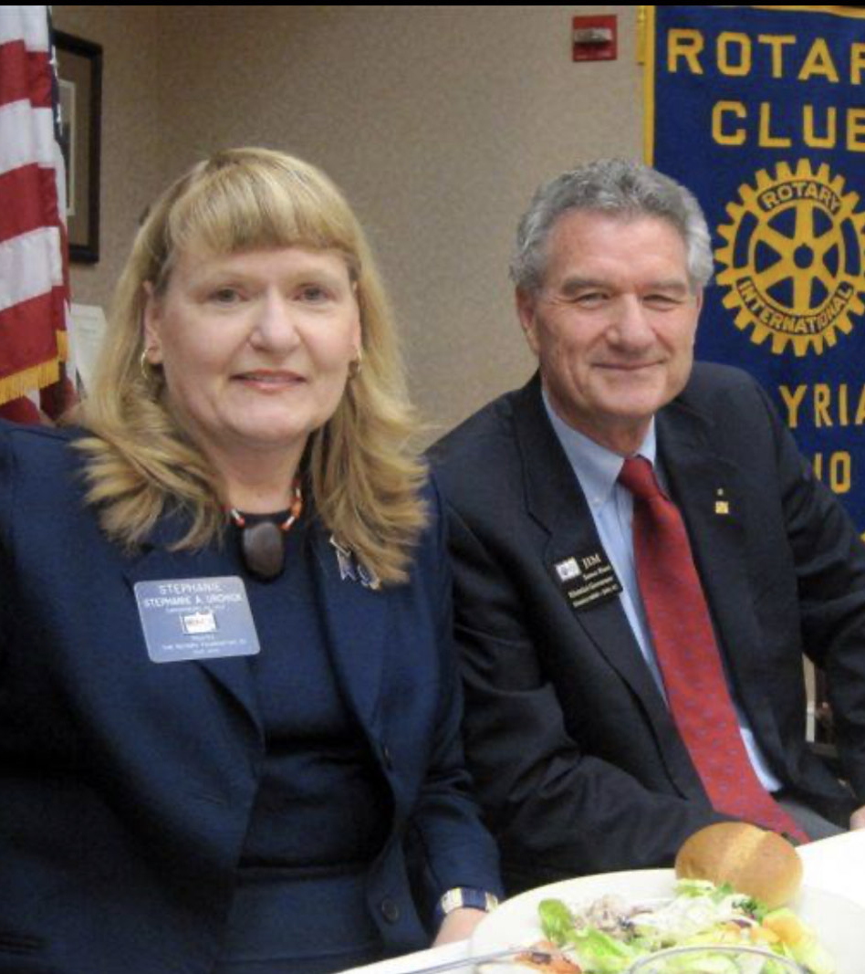
Stephanie Urchick
President-Elect
Rotary International President 2024-25
Club speaker in 2014

Slide 8
The Odds
126
1.4 Million Members
46,000 Clubs

