Slide 1
GRANT MANAGEMENT SEMINAR
DISTRICT 6580
WELCOME
Notes:
Welcome to the 2017-2018 Grants Management Seminar. Participation in this webinar will qualify you for DGE Sue Wright’s 2018-2019 Rotary Year which begins July 1.

Slide 2
16 District Grants Awarded for 2017-18
Bloomington shade structure for a school playground
Bloomington North supplies & transportation for Girl’s Inc. camp
Bloomington Sunrise furnish a conference room for CASA
Brazil benches for community beautification
Clarksville equipment for students on ‘Dangers of drinking while impaired’
Columbus Sunrise security cameras for domestic violence shelter
Evansville computers & games for library in Tizimin (inter)
Franklin cement for classes for disadvantaged students
Notes:
During our current Rotary year 16 clubs in our district received matching grants. Many of these club projects have not been completed yet. Here are some of the projects that are making a difference in your communities…..
Bloomington $3000 shade structure for a school playground
Bloomington North $2500 supplies and transportation for a camp for Girl’s Inc.
Bloomington Sunrise $1500 furnish a conference room for CASA
Brazil $3000 benches for community beautification
Clarksville $500 equipment for classes for students on ‘Dangers of drinking while impaired’
Columbus Sunrise $2690 security cameras for domestic violence shelter
Evansville $2000 computers and games for library in Tizimin (inter)
Franklin $3000 cement for structure for classes for disadvantaged students
Greenwood $3000 furnishing kitchen for home for pregnant teens
Jasper $1000 supplies for stream clean up and recycle project
Jeffersonville $3000 water fountain for city park
Madison $2000 computer hardware and software for Big Brothers/Sisters
Seymour $2000 workout equipment for community trails
Vincennes $1500 books and materials for Little Free Libraries of Vincennes
Warrick county $3000 signage and equipment for trails at Angel Mounds
Washington $3000 supplies for Community Center for Four River Services
As you can see, many of these projects involved coordination and cooperation with other city or county agencies or other service organizations and highlight the good we can do by working together.

Slide 3
16 District Grants Awarded Cont’d.
Greenwood furnishing kitchen for home for pregnant teens
Jasper supplies for stream clean up and recycle project
Jeffersonville water fountain for city park
Madison computer hardware & software for Big Brothers/Sisters
Seymour workout equipment for community trails
Vincennes books & materials for Little Free Libraries of Vincennes
Warrick county signage and equipment for trails at Angel Mounds
Washington supplies for Community Center for Four River Services
Notes:
This year, 16 clubs in our district received matching grants. Among other things, those dollars enabled:
Bloomington $3000 shade structure for a school playground
Bloomington North $2500 supplies and transportation for a camp for Girl’s Inc.
Bloomington Sunrise $1500 furnish a conference room for CASA
Brazil $3000 benches for community beautification
Clarksville $500 equipment for classes for students on ‘Dangers of drinking while impaired’
Columbus Sunrise $2690 security cameras for domestic violence shelter
Evansville $2000 computers and games for library in Tizimin (inter)
Franklin $3000 cement for structure for classes for disadvantaged students
Greenwood $3000 furnishing kitchen for home for pregnant teens
Jasper $1000 supplies for stream clean up and recycle project
Jeffersonville $3000 water fountain for city park
Madison $2000 computer hardware and software for Big Brothers/Sisters
Seymour $2000 workout equipment for community trails
Vincennes $1500 books and materials for Little Free Libraries of Vincennes
Warrick county $3000 signage and equipment for trails at Angel Mounds
Washington $3000 supplies for Community Center for Four River Services
As you can see, many of these projects involved coordination and cooperation with other city or county agencies or other service organizations and highlight the good we can do by working together.

Slide 4
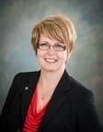
Welcome
    Moderator
    District Foundation Chair
    PDG Laura Carie
Notes:
Good evening, I am Past District Governor and District Foundation Chair Laura Carie
The grant training in webinar format has been so well received that we will continue with this format until technology provides us an even better way to bring this material to you. You should have received an email directing you to retrieve a copy of the slides which will be available after this program. The supporting documents are also on the District web site at www.rotary6580.org. If you have not retrieve those you can do so after the completion of the webinar.
If you are having technical issues you can e-mail or call Shari Sherman at 812-486-7637.
The webinar is divided into sections and there will be a short quiz at the completion of each section to ensure that you understand the material presented.

Slide 5
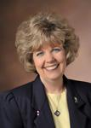
Welcome
    Annual Fund Chair
    PDG Peggy Peter
Notes:
Our 3 presenters for tonight are Past District Governor and current Annual Fund Chair, Peggy Peter.

Slide 6
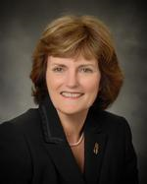
Welcome
    District Grants Chair
    PDG Bettye Dunham
Notes:
Past District Governor and current District Grants Chair, Bettye Dunham

Slide 7
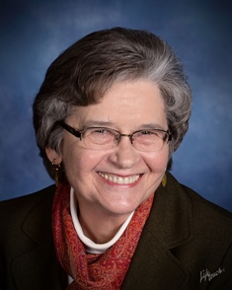
Welcome
    District Governor
    Judy Bush
Notes:
And our District Governor Judy Bush.
As you can see these presenters bring a lot of experience and knowledge to the table.

Slide 8
PURPOSE
Impact of The Rotary Foundation
Understanding The Rotary Foundation
Understand how to manage District grants
Learn stewardship expectations
Prepare clubs to implement the MOU
Qualify clubs to receive grant funds
Understand why grant funds are available
Notes:
The goal of this webinar is the help you understand the impact of the Rotary Foundation, increase your understanding of The Rotary Foundation, explain how to manage your district grants, help you understand what is expected of you, explain what forms need to be completed and help you to better understand the district grant process and of course, to qualify your club to receive a district grant.

Slide 9
AGENDA
Introduction and Impact of The Rotary Foundation – Laura Carie
Designing a Grant Project—Peggy Peter
Applying for and Implementing a Grant – Bettye Dunham
Oversight and Reporting—Judy Bush
Notes:
Our agenda for tonight is as follows:
Peggy will be discussing the design of a grant,
Bettye will be discussing the application process and implementation of a grant and
Judy will be finishing up with oversight and the reporting requirements.
I will be providing a little background on the Foundation, assisting with the section quiz and generally trying to keep out of everybody’s way in the process

Slide 10
Introduction
Notes:
As you are probably aware, we are have just celebrated the 100th anniversary of the creation of The Rotary Foundation through the 2016-17 year. So before we jump into tonight’s program, we thought it would be nice to share some information about the Foundation which helps us serve so many people throughout the world.
From its first contribution of $26.50, the Foundation’s assets have grown to approximately $1 billion, and $3.95 billion have been spent on programs and projects, transforming millions of lives across the globe.
over 3 billion children have been immunized against polio, reducing cases of the disease by 99.9 percent.
More than 900 Rotary Peace Fellows have been trained to resolve conflict, deal with the aftermath of war, and promote peace.
Hundreds of thousands of people now enjoy access to clean water, heath care, and education, thanks to Foundation humanitarian projects.

Slide 11

Contribution History
250
^{millions of dollars}
200
150
100
50
0
1917
1949-50
1954-55
1959-60
1964-65
1969-70
1974-75
1979-80
1984-85
1989-90
1994-95
2004-05
2009-10
2014-15
1948-49
1999-2000
Notes:
The Foundation’s assets grew slowly over its first 30 years. At the end of the 1947-48 Rotary year, it had received only about $2 million in contributions since 1917.
Today, the Foundation’s assets stand at more than $1 billion. What led to such a remarkable increase in donations?

Slide 12
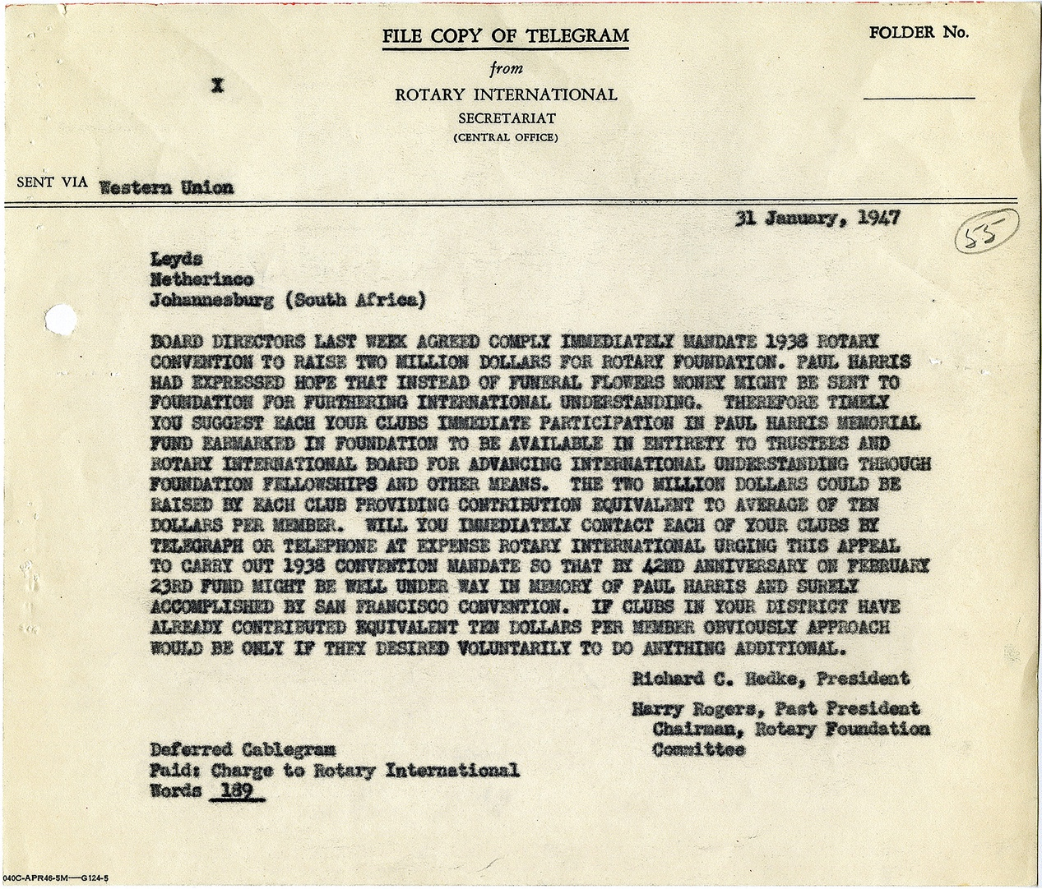

Contribution History
“Paul Harris had expressed hope that instead of funeral flowers money might be sent to [the] Foundation
for furthering international understanding.”
Notes:
It began in 1947, when Paul Harris died after a prolonged illness. Rotary’s beloved founder had told friends that if they wanted to honor him, they should donate to the Foundation. So Rotary established a special fund for the contributions that flooded headquarters as news of Paul’s death spread.
In just 18 months, the Foundation received $1.3 million. Contributions continued to increase over the years, and they first topped $1 million in a single year in 1965.
At the 1978 convention in Tokyo, Rotary announced a two-year 75th anniversary fund, which would receive more than $7.2 million.
In 2004, the Foundation started the Every Rotarian, Every Year campaign to stimulate giving to the Annual Fund, which supports Foundation grants. In 2014-15, that fund received a record $123 million in contributions.
District grants

Slide 13

EVERY ROTARIAN, EVERY YEAR
$140.1 million given to the Annual Fund
1,260 Global Grants approved
$111.5 million invested in humanitarian grants
Countless lives changed
Notes:
District and global grants are possible because Rotarians supported the Foundation and participated in our grants program.
Several years ago, we started a campaign for the Annual Fund called Every Rotarian, Every Year.
This campaign is based on the simple idea that if every Rotarian gave SOMETHING, every year, there would not be anything the Foundation couldn’t accomplish.
In 2016-17, Rotarians accomplished a lot …
Rotarians gave $140.1 million to the Annual Fund.
We participated in 1,260 Global Grants
We invested $111.5 in humanitarian grants.
And, we changed countless lives — including our own.
Can you imagine how many more lives could be changed through grants if every Rotarian made a gift to the Foundation?
Notes
**Numbers are unaudited from 2016-17 Rotary Year
**Humanitarian grants includes District Grants (total funding $27,084,971) and Global Grants (total funding $84,470,988)

Slide 14

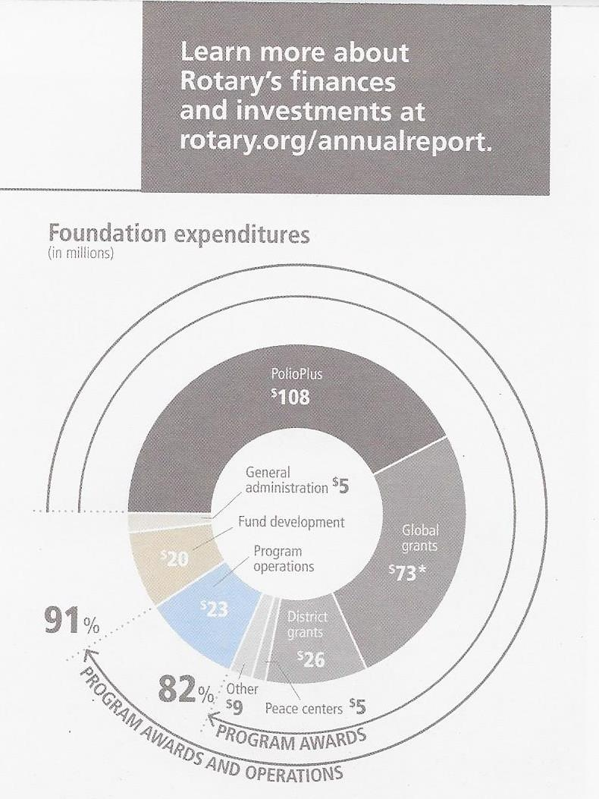
DOING GOOD IN THE WORLD
THE ROTARY FOUNDATION’S EXPENDITURES GO TO...
OUR LONG-TERM STRATEGY...
Ensure that we have sufficient funds to operate our Foundation
Maintain a fully funded operating reserve
Transfer surplus funds to the Endowment Fund
Notes:
The Foundation’s sound financial management and its commitment to accountability and transparency are recognized as exceptional, year after year, by independent evaluators of not-for-profits. Rotary’s website provides detailed information on the Foundation’s finances.
In fiscal year 2016-17, only 9 percent of Foundation expenditures went to administrative expenses and fundraising. The Foundation directed 91 percent of its spending to programs, far exceeding the benchmarks that independent charity-rating services view as a measure of high efficiency. I was listening to a news program about end of year donations and the speaker advised the audience to avoid certain charities where the dollars actually going to programs were less than 65%. 65% was the standard of Charity Watch.
The recent recession demonstrated to the philanthropic community that maintaining a strong financial base that includes operating reserves is necessary in order to weather increased volatility in financial markets.
Beginning 1 July 2015, five percent of contributions to the Annual Fund are earmarked for operating expenses or to build the operating reserve to three times annual operating expenses, when needed.
This change will have no impact on District Designated Funds, but will provide a more predictable level of financial support for programs and the operating expenses it takes to make them successful.
With a solid financial base and restored reserves, we’ll have an organization that is able to support the good work that Rotarians do in the world — even as the economic and financial environment remains unpredictable.

Slide 15
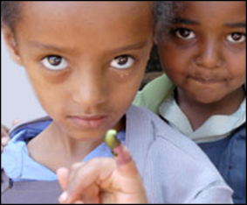
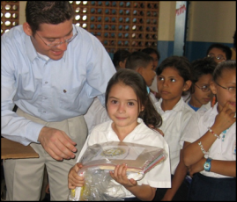
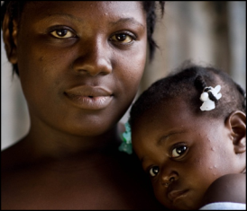
SUPPORTING THE ROTARY FOUNDATION
PolioPlus Fund
End Polio Now
Annual Fund
For Support Today
Endowment Fund
To Secure Tomorrow
Notes:
Rotarians support our Foundation through:
The PolioPlus Fund, dedicated to global polio eradication
The Annual Fund, primary source of funding for Foundation grants and activities
The Endowment Fund, which supports the Foundation in perpetuity

Slide 16
ANNUAL FUND
Primary funding source for Foundation grants and activities
Supports local and international grants through the SHARE system
Contributions are credited to donor’s club and applied to club’s goal
Notes:
Contributions to the Annual Fund support local and international grants and activities through the SHARE system.
Under the SHARE system, when you make a contribution to the annual fund, it is held for three years, then 50% of your contribution is returned to the District to the used for programs such as District Grants and Global Grants of the district, the other 50% is used by the Foundation in the World Fund for programs such as Global grants.
Contributions are credited to the individual donor and the donor’s club and counted toward the club’s and district’s Annual Fund goals.

Slide 17
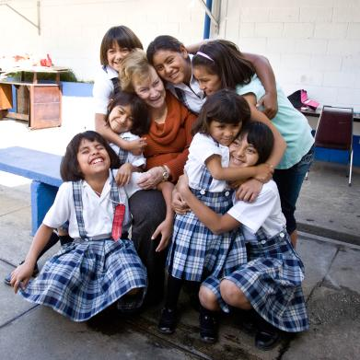
ENDOWMENT FUND
Contributions are professionally invested
Only the earnings are spent
Notes:
Gifts to the Endowment Fund are held in perpetuity as part of an endowment. They are professionally invested, with a portion of the earnings used each year for purposes specified by the Trustees and the donors.
The Endowment Fund offers donors a way to create their own lasting legacy through Rotary.

Slide 18
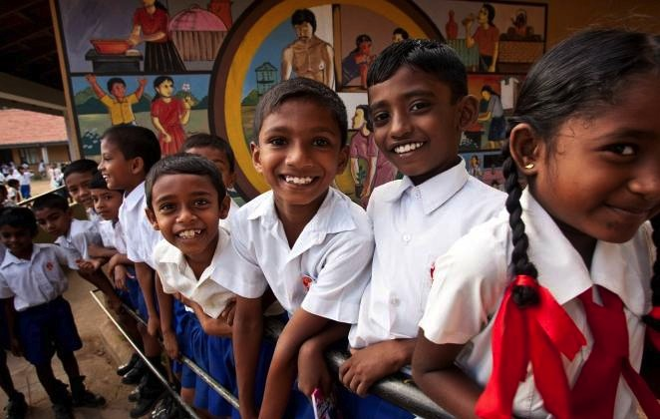
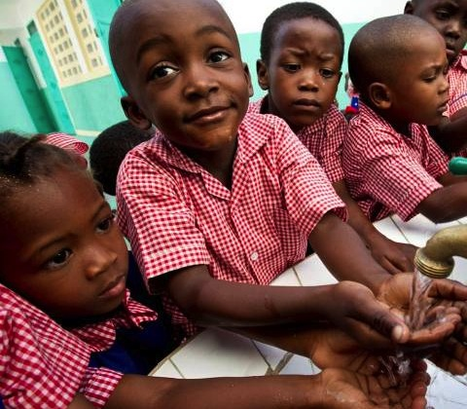
HOW WE FUND PROGRAMS – SHARE SYSTEM
50%
District Designated Fund (DDF)
50%
World Fund
Notes:
To review: when we contribution to Annual Fund – SHARE, fifty percent (50%) of our contributions come back to our district through District Designated Funds (DDF) in three years to spend on educational and humanitarian activities chosen by us such as District Grants that are used for projects in our local community and Global Grants.

Slide 19

SESSION 1
DESIGNING A PROJECT
Peggy Peter
Notes:
Now onto our grants training program.
As promised, PDG Peggy Peter will lead us off with a discussion of the designing of a District Grant Project.
Peggy it is all yours.

Slide 20
LEARNING OBJECTIVES
Identify best practices for designing a project
Develop a plan to implement your project
Notes:
We will discuss best practices for designing a project and how to develop a plan to implement your project.

Slide 21

SUCCESSFUL DISTRICT GRANT PROJECTS
Meet community needs
Have an implementation
plan
Maintain proper stewardship
of funds
Note: Funded district grants for 17-18
can be found on the District website.
Notes:
Speaking points:
Beneficiaries are more likely to support and participate in a project that addresses the needs of a community and has a sustainable outcome – one that will continue after the funds have been spent.
Rotarians should partner with the community and organizations with technical expertise; however, projects must be managed by Rotarians.
Working together means more than financial participation; it also means using each partner’s expertise to implement the project or activity.
The implementation plan should include an achievable project timeline and should be shared with partners and beneficiaries.
By establishing a financial management plan before applying for grants, clubs ensure that they will have processes in place to manage funds before any money is received.

Slide 22
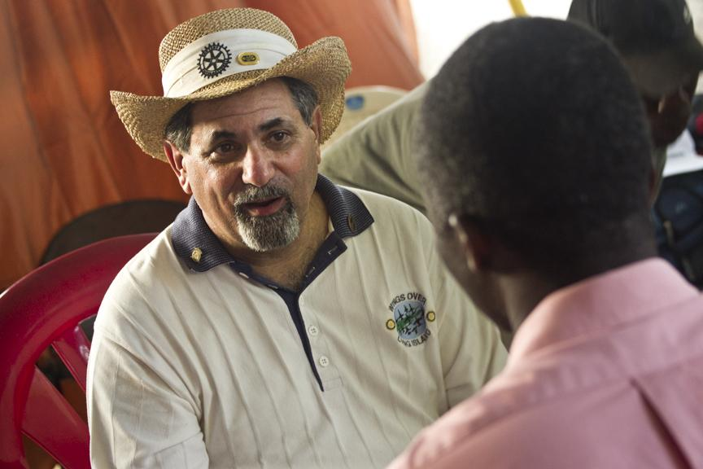
NEEDS ASSESSMENT
Base projects on
communities’
needs
Determine
availability of
club and partner
resources
Talk to the community
Notes:
Speaking points:
Asking members of the community what they need and what strengths they bring to the project results in greater support and involvement, which leads to a more sustainable, lasting impact.
Once the needs are identified, your club should consider which can be addressed with the resources, skills, and availability of your club and its potential partners, including other Rotary clubs, districts, The Rotary Foundation, and non-Rotary organizations.
Continue involving the community during the selection of the project and its planning and implementation.
The Rotary publications Communities in Action and Community Assessment Tools offer information and resources for conducting a community needs assessment.
Discussion questions:
Has anyone been involved in conducting a community needs assessment? What was your experience?
What successes or challenges can you share?

Slide 23
PROJECT PLANNING
Form a three-person grant committee
Assign roles
Make an implementation plan
Establish a budget
Have a contingency plan
Have a document retention plan
Inform your club of project application
Notes:
Speaking points:
Rotarians must manage all projects that receive funding from The Rotary Foundation.
Both the host sponsor and international sponsor must have committees of three Rotarians to manage the project.
Roles and responsibilities should be assigned to everyone on the committees.
Create a plan for managing funds and implementing the project.
Develop a budget that includes details and a timeline for the purchase and distribution of goods, training, and any other activities.
Consider your liability for the project, ensure that your club is protected, and have a contingency plan in case something goes wrong.
Set up a process for retaining documents related to the grant (see club MOU section 6) before funds are received.
Discussion questions:
Who would you include on the three-person project committee?
What systems do you use to store grant records?
Does everyone on the committee have access to the records?

Slide 24

CREATING A BUDGET
Realistic and Comprehensive
Reasonable prices with competitive bidding
Clubs keep records
of submitted bids
Disclose conflicts of
interest
Notes:
Speaking points:
A budget should be realistic and comprehensive to ensure adequate funding.
When choosing a supplier, Rotarians should use a competitive bidding process to ensure that they get the highest quality goods at the best prices.
Clubs should keep records of any submitted bids.
Clubs must disclose any potential or real conflicts of interest related to the budget.
Discussion question:
Has anyone been involved in a competitive bidding process?

Slide 25
JUDGING CRITERIA
Project is meaningful to the community and benefits many
Rotarian involvement (family of Rotary and Community/ies)
Public Relations Plan for the project
Application preparedness
Level of club giving to TRF over the previous 3 years (2014-2017)
Additional points may be given for uniqueness or innovative approach

Slide 26
Session Poll
Notes:
Thank you Peggy. Lets look at the polling questions. Please respond the questions when I prompt you to do so.
Question 1
Judging criteria includes all of the following EXCEPT:
Project benefits the community
Amount of Rotarian involvement
A plan for public relations
A well prepared application
X Level of club giving to TRF over the previous year Previous 3 years.
Question 2
District grants can be used for all of the following except?
Scholarships
X Polio Vaccines
RYLA
Youth Exchange

Slide 27

SESSION 2
APPLYING FOR AND IMPLEMENTING A GRANT
Bettye Dunham
Notes:
In Session 2, PDG Bettye Dunham will be leading a discussion of Applying for and implementing a grant, Bettye?
Welcome everyone. This is Bettye Dunham, District Grants Chair. In this session you may hear key points repeated as we go through the application. Please understand this is done to highlight areas that might have been confusing or not understood in past grant cycles. Some of you will be familiar with grant processes and this will all seem redundant and duplicative. However please be aware that some of you are new to grant writing and need the additional clarification. Also, every grant process is different in design, so this training is to help you know the focus of the District and TRF.

Slide 28
LEARNING OBJECTIVES
Write a successful grant application
Understand grant financing
Notes:
We have two main objectives:
writing a successful grant: It is our hope that by having a good understanding, through this session, of what is needed for a successful grant; the information we are looking for in the application and the assurances we are looking for in how the grant is to be implemented, that we can have a smooth process and limit the number of calls needing to be made for clarification and the best decisions can be made on how these grants are funded for the greatest impact to our district.
2) Understanding grant financing: This has been an area in past grant cycles that has been confusing so we want to spend time on this.

Slide 29
APPLYING FOR DISTRICT GRANTS
Send paper application to Bettye Dunham by May lst
Applications become part of the spending plan submitted to RI from our District
Grants are approved by RI as a package
Clubs must plan for District Grants
Common reporting date
Notes:
The deadline date is firm. Please don’t ask for extensions because in being ‘fair to all concerned’ we must have a definite cut off.
The Grants committee will review the grants when they are submitted and we will make the initial decisions on awards. However the full grant package or spending plan then goes to RI and they must give approval for the spending plan before we are authorized to release funds. That is the reason why we cannot give a definite date for when the club will receive the funds because we must wait for this approval.
You will notice that planning is talked about throughout this session. We stress the importance of planning. It is important to know specifically not only how Rotary’s funds are used in the project but the overall scope and specifics of the project. Projects will not be rated highly if it is a project where we give you a check, you give a check to the partners and Rotary is not intricately involved.

Slide 30
APPLICATION & FORMS
Application for grants funded during the 2018-19 Rotary year must be received by May 1, 2018 and must be in Word document format.
Applications reviewed by the District Grants Committee and the staff of The Rotary Foundation.
If approved, the clubs will receive a check for the amount of the grant (around August 1st).
Notes:
-Did I mention the deadline date: May lst.
-Please submit emailed documents in Word format.
-Again, we will not have a ‘definite’ date for release of the funds. Please do not commit in a partnership project to have the funds available before around the first of August as we cannot commit to this

Slide 31
APPLICATION
Items that must accompany the application:
Signed copy of the Club Memorandum of Understanding (MOU)
Completed & signed copy of Grants Management Compliance Questionnaire
Completed Transferring Custody of a Bank Account Form
Forms available at www.rotary6580.org under Foundation and then District Grants 17-18.
Notes:
These three documents on found on the website. These are required by TRF and MUST accompany the application by the deadline date.
-the MOU lines out the qualifications and the responsibility of the club leadership to assure proper grant management. These points will be highlighted throughout this training but your signature here documents your understanding of this.
-Compliance Questionnaire: The main point of this document is the detail of the financial management plan and the documentation retention needed. Judy will talk about this in more detail in Session 3.
-Transferring custody of a bank account. This form is usually one that creates many questions. The rationale for this form is because in the past club members that were responsible for the finances have left and there has been no trail or accountability for the funds that have been disbursed. This not only puts that club in jeopardy related to grants but the whole district as you will see through upcoming slides. This form is designed to help you assure there is a process in place if this happens.

Slide 32
APPLICATION: DISTRICT GRANT RULES
District grants: dollar-for-dollar matching grant on the following basis:
Not less than $250 and no more than $3,000
Funds used for local community service and international projects
Projects completed within the Rotary year granted
Notes:
Note:
DOLLAR FOR DOLLAR: This means if we grant you $500 you must match it with $500. The ‘matching’ funds can come from funds the clubs have raised through events, from other community funds given for the project, but these must come through the Rotary Club to be counted towards the match.
Your application can not be for less than $250 or for more than $3000.
These funds can be used for BOTH district projects AND international projects. You might however want to consider based on the size of your project and the funds needed whether to apply for a global or district grant if it is an international project.
The project must be able to be completed within the year granted. Again, for international projects this might mean you need to consider global rather than district since this is not a restriction on global grants.

Slide 33
APPLICATION: DISTRICT GRANT RULES
Submit a Final Report within 30 days of the completion of the project
Deadline: March 31, 2019
If the project is not completed by March 31st submit an interim report by March 31st on the District Grant Report covering the following:
-all activity to date
-detailing any delays
-assurance of the completion of the project before August 31st
Notes:
This slide covers reporting which is mentioned throughout. As soon as your project is complete send a report (with pictures). On March 31st we must have heard from all projects. If your project for some reason cannot be completed by March 31st then you need to submit an interim report detailing all activities, reason for delays, and assurance of completion by August 31st. These dates are critical because they impact the ability for our district to get grants in the following year.

Slide 34
APPLICATION: DISTRICT GRANT RULES
The use of District Grant funds must:
  Promote participation of Rotarians in the implementation of the project
  Not involve the establishment of a permanent foundation, trust, or permanent interest-bearing account
  Not directly benefit a Rotarian; an employee of a club district or other Rotary entity, or others connect to Rotary through any family connection
  Not to be used to reimburse clubs/districts for projects already undertaken and in progress, or completed
Notes:
This slide speaks to the terms and conditions of the grants regarding what is not allowed. Also note that ‘participation of Rotarians’ is a theme throughout and it is important to make sure this is covered in your grant. Simply ‘writing a check’ to another partner will not get high points. There must be involvement of Rotarians either in fundraising to secure the match, or actually carrying out or implementing the project OR both.
Regarding what cannot be covered Please note B. C., and D.
Cannot be used to start to contribute to a foundation or trust
Cannot benefit a Rotarian, an employee of a club or family members of Rotarians. This will be discussed again later as well.
Cannot go towards projects already completed or in progress. MUST be a NEW project. It can be ‘similar’ in nature to another project but not the same; i.e. if your club regularly does I Like Me books funds could not go for this, however if your club wanted to do dictionaries for children this would be different.

Slide 35
APPLICATION: ELIGIBILITY CHECKLIST
Have your President & President-elect signed and included a Memorandum of Understanding (MOU) ? ___No ___ Yes
Have you included the Grants Management Compliance questionnaire? ___No ___ Yes
Have you completed the Transferring Custody of a Bank Account Form AND the copy of the Grants Bank Statement showing the club’s portion of the funds on deposit? (Not required for grant awards of $1000 or less.) ___No ___ Yes
Did two members of your club participate in the webinar on grants management seminar this year? Names: ________________________, _________________________ ___No ___ Yes
Notes:
We added this to the application this year at the suggestion of a PDG after he talked with people in other districts. As we go through these next slides it lays out the basic eligibility for applying and what MUST be in place for your project to be considered.
The first 3 are the three forms that must accompany the application
#4 is attendance at this webinar. The reason for two is because, again, we often lose members or they are not available for assistance with the grant and then the club struggles and we struggle in getting everything in place.

Slide 36
APPLICATION: ELIGIBILITY CHECKLIST
Have you recorded an Annual Fund giving goal for your club on Rotary Club Central on the RI website? www.rotary.org ___No ___ Yes
Have you notified the Governor-elect of the name of your Club Foundation Chair? ___No ___ Yes
Have you paid all your District & RI dues that are currently due and payable? ___No ___ Yes
Have you received any Global or Community Grants for which you have not filed final reports? ___Yes ___No
a. If yes, is your club current with all interim reporting requirements? ___No ___ Yes
Is the project new to your club? ___No ___ Yes
Notes:
#5 & 6: The reason for these requirements is because the funds that make the grants possible come from the donations by members to the Foundation 3 years ago therefore the support of the Foundation is a consideration.
#7: If you do not know the answer to this please check with the District Treasurer: Jeffrey Berger.
#8: If you have an outstanding report from the 16-17 grants this could impact your ability to apply for these grants.
#9: Discussed earlier

Slide 37
APPLICATION: ELIGIBILITY CHECKLIST
Will your club be matching the amount requested? ___No ___ Yes
Is the project free of any conflict of interest or the appearance of such? (See page 2 Rules and Regulations.) ___No ___ Yes
Would your club still complete the grant if they do not get the full amount? ___No ___ Yes
And finally, have you signed this application? ___No ___ Yes
Are you current with your federal and state tax filing?_ __No __ Yes
If any of your responses are NOT in the RIGHT HAND COLUMN, please stop and contact the District Grants Committee.
Notes:
#10: Discussed
#11: Conflict of Interest will be further discussed later in this session
#12: If we are unable to give the full amount requested could you still do parts of the project? Think carefully here. We know you do not want to say you can do with less because you feel that will influence what you get. However it could also influence that you don’t get any funding if you say no. We try to take the money available and spread it to the best impact of the District but there are many great projects that come in and we will likely not have enough funding to do all of them so decisions must be made.
#14: Check with your club treasure to determine this. If not then you need to get in touch with Jeffrey right away.

Slide 38
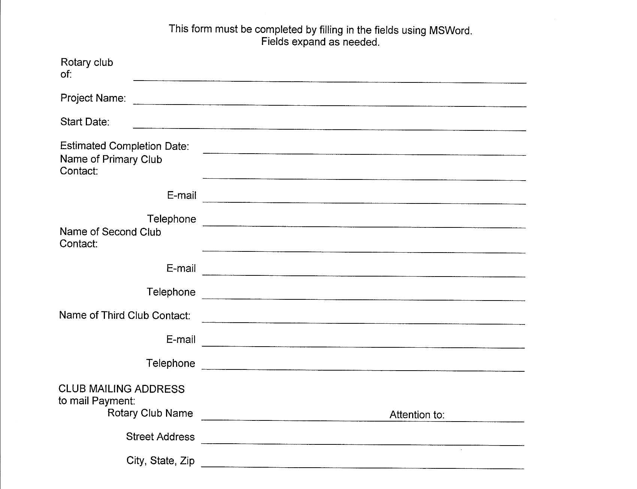
APPLICATION
Notes:
Need at least three people in your club that are thoroughly knowledgeable about the grant and how it will be implemented. Note: at the bottom it ask to whom you want the grant check mailed. Club treasurer

Slide 39
APPLICATION
Briefly describe the project, its location, and its goals and activities and how it will be sustained.
Describe how the project will benefit the community and/or improve the lives of the less fortunate, who will benefit by the completion of the project, and how many people in the community will benefit.
Describe the nonfinancial participation by Rotarians in the project (i.e., How many Rotarians will be involved and how they will be involved).
How will the general public know this is a Rotary-sponsored project; i.e. how will it be promoted and publicized? Please provide details, e.g., publicity in a newspaper or display of the Rotary wheel.
Notes:
This is the meat of the application:
Please be as detailed as possible on this. If your project is part of a larger project please outline the full project and what part your piece plays in this. Example: Madison’s project was to provide an infusion chair for chemo patients however the larger project was the renovation of the hospital for the cancer wing.
How will this project improve lives: who will benefit (again, be detailed about the parameters; does it only apply to a certain age, a certain income level, etc.) Also please try to give an estimate on the number of people that will be impacted; i.e. in the project in Brown County with Helping Hand, how many families are estimated to use these services each month/year? Sometimes it may be more difficult such as Greenwood where they are working on a trail for the park but here you could include things such as the population of the community that will access the park.
Non-financial participation by Rotarians: Again, we do not simply want to be writing a check for a project. The more ‘hands on’ a project can be the better and higher points.
Publicity: As Rotarians we constantly say we don’t let people know well enough how much we help our communities. This is important because the more we let the community know the more that will bring people to Rotary to join and then the more we can give back to others.

Slide 40
APPLICATION
Cooperating Organizations – If the project involves a cooperating organization, please provide the name of the organization below and attach a letter of participation from that organization that specifically states its responsibilities and how Rotarians will interact with the organization in the project. By signing this application, the Rotarian sponsors endorse the organization as reputable, responsible, registered with the project community, and acting within the laws of the United States.
Name(s) of Cooperating Organization(s) and Contact Person
Notes:
#5: We think partnering with others in the community toward a project is a great idea and if you are going to do this we need a letter from the other entity(ies) outlining their role in the project and how Rotary will coordinate/cooperate with them. A KEY here is that your members are taking the responsibility that this/these organizations are reputable and responsible.

Slide 41
APPLICATION
6. Identify the primary area of focus aligned with RI:
Peace and Conflict Resolution ___
Water and Sanitation ___
Basic Education and Literacy ___
Disease Prevention and Treatment ___
Maternal and Child Health ___
Economic and Community Development ___
Other (explain)_____________________
Project Duration: Projected Project start date: ___________
Projected end date: ___________
Notes:
Areas of Focus: All projects will not necessarily fit into these categories. This is something however that TRF wants to see so there is an ‘other’ category at the bottom. An example this last cycle would have been the 100 trees planted by Vincennes. This could be marked as other: Environmental.

Slide 42
APPLICATION
8. If additional funds are available, would your proposed
project benefit from additional funds? ___No ___ Yes
Would your club be able to match additional funds? ____No ___ Yes
Please indicate the amount of additional funds your project could utilize and match (up to $2000). ___________
Note: Criteria for allocation of additional funds would be based on the same ‘grant evaluation criteria’ identified for the initial funds.
Notes:
It is possible that this year we may have additional funds to allocate to clubs, after the selection of the grants are made. The criteria to allocate additional funds will be same as for the allocation of the initial funds.

Slide 43
APPLICATION
9. Enter Budget Information: Income Sources
Sources of Income | Amount
Amount of District Grant Funds Requested: (Funds must be matched by the club)
Other Funding Sources (please specify):
Total Budgeted Income:
Notes:
BUDGET information: This refers to the discussion earlier on One-to-one match. If you are asking for $500 then your club needs to put up $500. Other funds can be part of the project and it is good to include these here but you still need to indicate how the match will be raised for your amount: ie An example here was Brown county in a prior year: they asked for $5000 in grant request and then indicated in this section that their Rotary Club voted to give $5000 to the project thus making it $10,000. In addition this would be matched by the Brown County Community Foundation for another $5000 from a Lily Grant. Some clubs indicate they will be fundraising for the money and put in some descriptors as to how this is planned.
If you are using other funds from your community for part of your match then this must come through your club; i.e. If in the example above you intended for funds from the Community Foundation to be part of your match to the district grant funds then these funds would need to be awarded to your club and come through your club bank account.

Slide 44
APPLICATION
PROJECT EXPENSES: REQUIRED (please attach an additional sheet if you need more space):
Expense Items (please be specific) | Cost
(NOTE: Best practices is for vendors to be paid directly by the club.)
Total Budgeted Expenses:
Notes:
Expenses: This is where you detail what the money will be spent on. Again, it cannot just be that you are giving a check for the project. You need to lay out where the requested and matched funds will go. What we mean by ‘best practices’ is that even though you may be combining your funds with others for a project it is ‘preferred’ for Rotary’s money to be shown in the form of check payments directly to the vendors: Ex: back to Brown county’s project with Helping Hands…the best practice would be for Rotary to pay directly for the lumber and materials needed to renovate the building rather than giving a check to Helping Hands to do this.

Slide 45
APPLICATION
As President and President-elect of the Rotary Club named above, we hereby affirm that the club’s board has voted to undertake this project as an activity of the club and that the club’s officers and directors have read, understand and agree to abide by the Club Memorandum of Understanding. In consideration of receipt of these grant monies, we agree to implement the project as described in this application and to complete this project in a timely manner and to submit a final report within 30 days of completion. Failure to complete the project or to file timely final report will disqualify this club from future district or global grants. We also affirm that all information in this District Grant Application is true and accurate, to the best of our knowledge.
Notes:
#10: the main focus of this slide is to drive home that the project must be implemented as described in the application. If there are deviations to this then the club needs to get in touch with the grant committee for approval AND the grant committee then must get in touch with TRF to get their approval for the change. If you do not and the money is not spent as described the committee will ask for the funds back. We are charged with following through on what TRF has approved.
AGAIN: if reporting is not done as indicated the club can be disqualified from any future grants.

Slide 46
APPLICATION
*Signatures are not required if submitted via e-mail with both parties listed in the address line.
Send completed application and other required forms to: Bettye Dunham: bdunham@rauchinc.org
Club President |  |  | Club President-Elect
Name |  |  | Name
Signature or e-mail address* |  |  | Signature or e-mail address*
Date |  |  | Date
Notes:
Signatures….signatures…signatures….TWO…no need to say more.

Slide 47
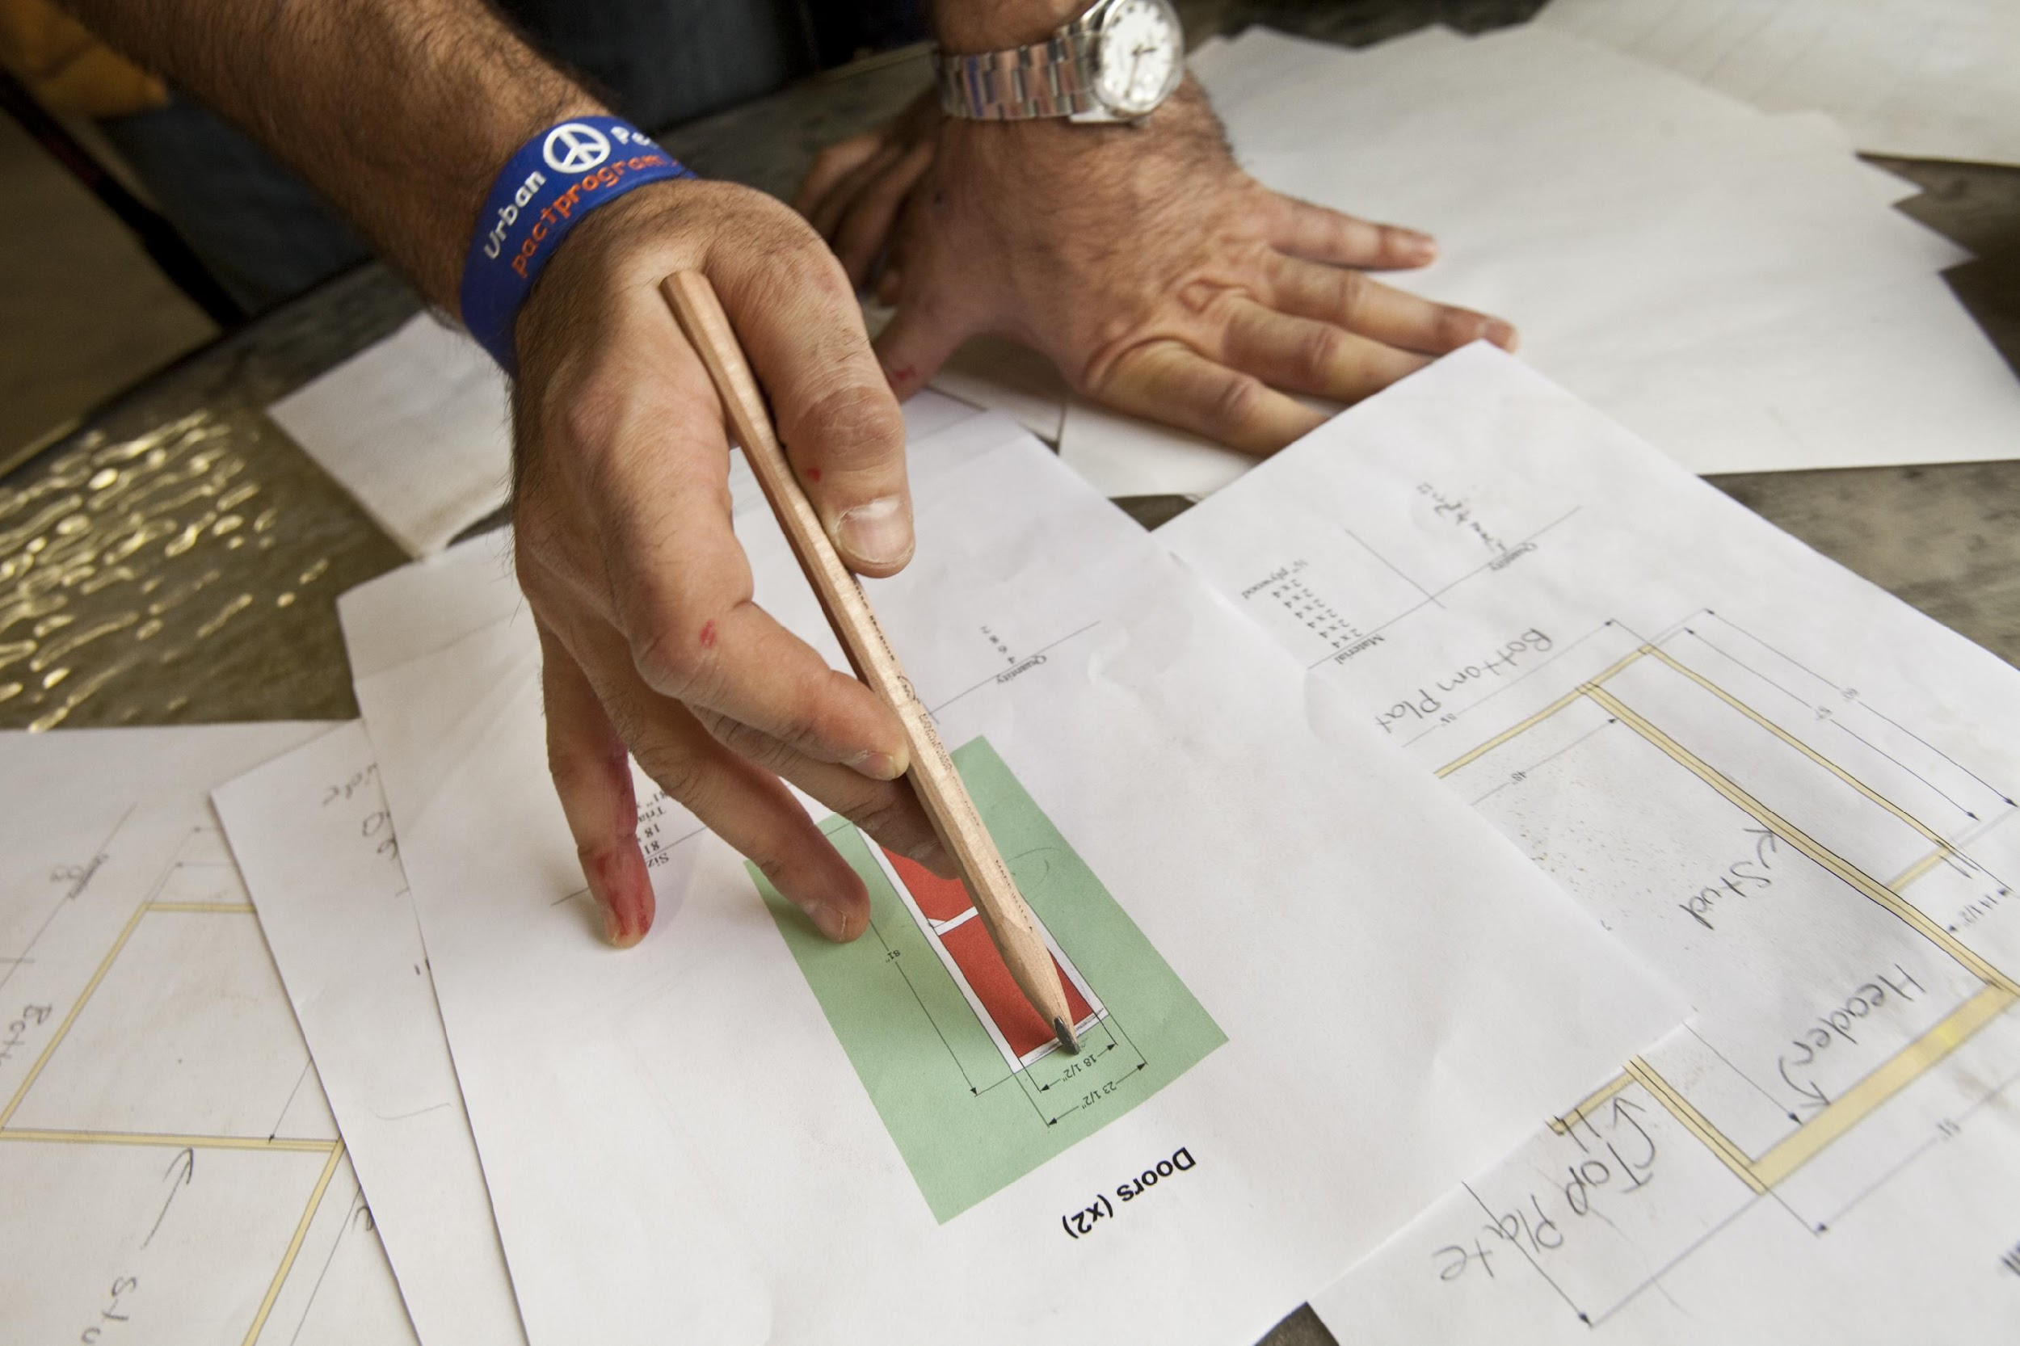
CONFLICT OF INTEREST
Exists when a Rotarian
benefits financially or
personally from a grant
Benefit can be direct to a Rotarian or indirect to an associate of the Rotarian
Notes:
This is pretty clear. Cannot benefit a Rotarian or a family member of a Rotarian. ONE clarification here: For example: If you were purchasing books and a Rotarian had a book store. If you get three prices on the books and the Rotarian quote comes in as the best quality and/or the lowest, then the Rotarian can be selected. However if not then you could not buy from the Rotarian. In these cases the KEY will be to have the documentation of all the bids and be able to show the justification for purchasing from the Rotarian. Otherwise it could not be proved that it wasn’t’ done to benefit the Rotarian.

Slide 48
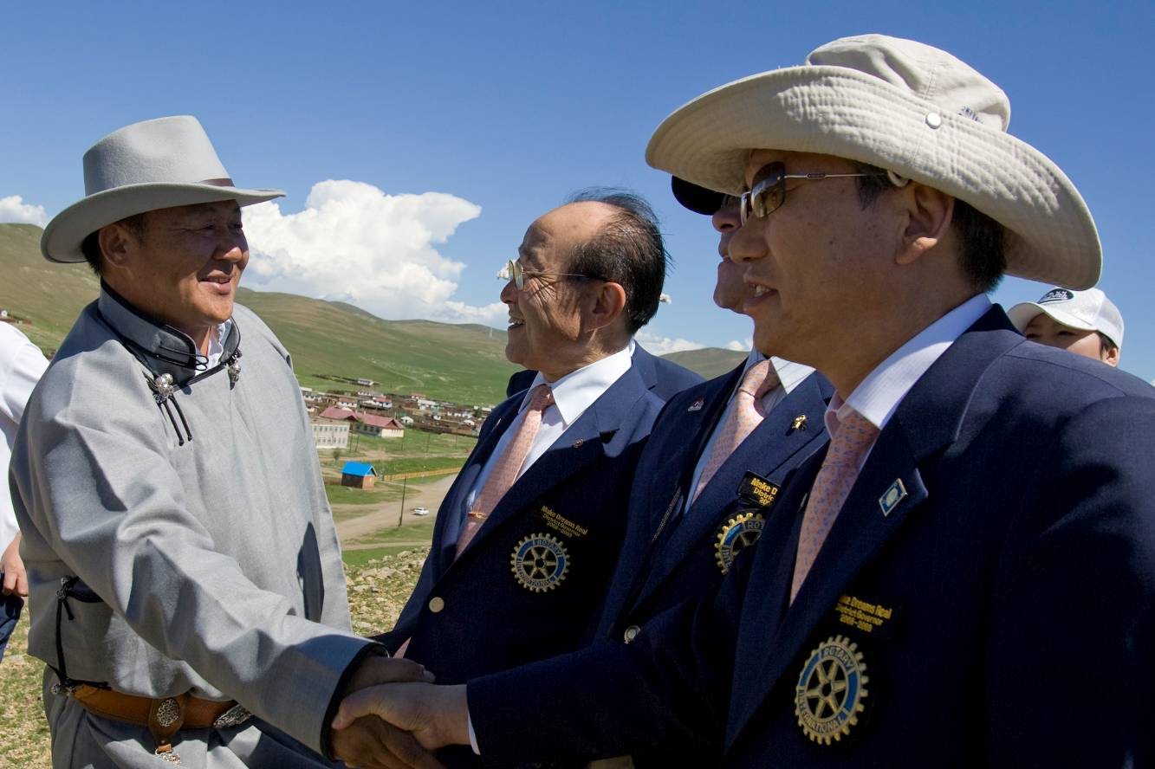
IMPLEMENTATION
Communication
Financial management plan
Record keeping
Notes:
Make sure to communicate to your club
Make sure to have a financial management plan
Make sure to keep good records!

Slide 49
Session Poll
Notes:
Thank you Bettye.
OK we are now ready for our next set of polling questions.
Question 3
The following must be included with the application except:
-Grant application
-MOU
-Grants Management Compliance Questionnaire
X Listing of previous grant history
-Transferring Custody of a Bank Account Form
Question 4
All of the following are true about grants except:
-Must be at least $250 but no more than $3,000
X Grant Funds are matched at 2:1 (Matched at 1:1)
-Grants cannot be granted for projects already undertaken by the club
-Grants are due by May lst
-Clubs cannot change the use of the grant funds without approval from the District

Slide 50
SESSION 3
OVERSIGHT AND REPORTING
Judy Bush
Notes:
We are now ready for our final session of the evening. In this session our DGE, Judy Bush will be discussing the important process of oversight and reporting.

Slide 51
LEARNING OBJECTIVES
Identify best practices for managing funds and record keeping
Identify which documents need to be retained
Understand reporting requirements
Notes:
Greetings, We are getting close to the end of the session so I will be brief. I am thrilled that virtually all of our District clubs are participating in this webinar and will be qualified to apply for a district grant. The Foundation is the way that we do good in the world for nearly 100 years which is wonderful when we think of all the good that has been done through the work of The Foundation.
We will be hoping to learn best practices for managing funds and record keeping; this, of course, is a review for most of us.
We hope to learn which documents need to be retained and to understand reporting requirements.

Slide 52
STEWARDSHIP
Stewardship is the responsible management and oversight of grant funds, including:
  Report any irregularities
  Rotarian supervision
  Financial records review
  Oversee funds
  Submit reports on time
Notes:
Speaking points:
Clubs must follow standard business practices for managing these funds.
It’s important to review financial records to confirm proper use of funds. Good stewardship is achieved by putting systems in place that create clubwide awareness of the use of funds. Widespread knowledge helps prevent mismanagement.
Any irregularities or misuse of grant funds should be reported immediately.
Submit timely, complete, and accurate reports to demonstrate good stewardship of funds to Rotary and all grant partners.
A club’s level of oversight, transparency, and accountability in managing Rotary grant funds affects donors’ confidence in giving to The Rotary Foundation and working with that club on future projects.

Slide 53
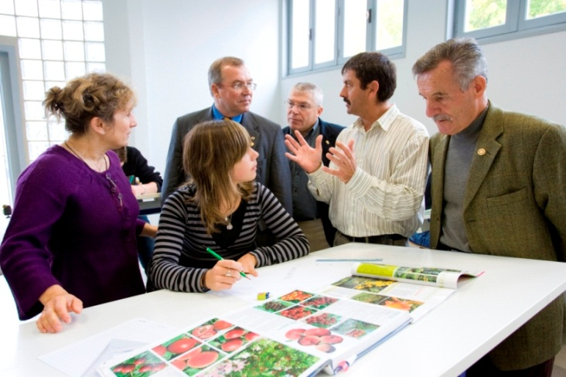
FINANCIAL MANAGEMENT PLAN
Distributing funds
Use checks or bank cards
to track funds
Detailed ledger
Pay vendors directly
Be aware of any local
laws (i.e. zoning, etc.)
Notes:
Speaking points:
Your club should have a club-controlled bank account. This will assist you with keeping accurate financial records.
Once your club receives grant funds, it is important to have a plan for distributing and tracking funds.
Expenditures should be made using a traceable method such as a check or a bank card.
Keep track of transaction details.
Be aware of local laws such as local zoning
Knowing your local laws is very important when doing a project. Rotary of course does not advocate breaking any laws when implementing a District Grant.
*If you are trying to put in a pocket park in a downtown area and it is zoned for something else then this could not only delay your well intentioned project it could even stop it.
*Remember District Grants can also be used to support a project/community in another country. Their laws are very different from what we are used to. You have to know the local laws when putting together a project
We have had situations like this come up before. It is something people take for granted not realizing the significance of this issue

Slide 54

DOCUMENT RETENTION
Retain for a minimum of
five years
Make copies
Notes:
Speaking points:
All documents should be accessible to everyone in the club. For example:
Keep documents in a binder or a file system, or
Scan documents and save them electronically to a shared network
Documents must be retained for a minimum of five years -- or longer if local law requires it.
With Rotary clubs changing leadership every year, document retention may be problematic. Make sure that there is a method of document retention.

Slide 55

REPORTING REQUIREMENTS
Reporting:
Verifies grants were managed properly
Provides valuable data for your club, partners, and Rotary
Notes:
Speaking points:
Reporting is a requirement, and it is a key component of proper stewardship and grant management.
If a club has already completed an evaluation of the project and maintained records in accordance with the club memorandum of understanding, completing Rotary’s reporting requirements is simple.
Reporting verifies that grants were managed properly and implemented in accordance with Rotary grant policies. Also, the grant needs to be managed in accord with the plans submitted in the application. If it is not, clubs may be disqualified from applying for another grant and will be expected to return the grant funds. If project plans have to change from what was submitted, contact District Grants Chair Bettye Dunham.
It also provides an opportunity for communication between partners, building the trust necessary to continue the partnership in support of future projects.
Reporting allows project partners and the Foundation to celebrate successes and learn from challenges.
It encourages future giving, because donors are confident that their funds have been used as intended.
It allows Rotary to demonstrate to current and future donors its effectiveness and the impact of its grants.

Slide 56
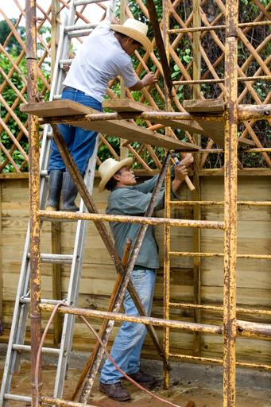
DISTRICT GRANT REPORTS
Submit final or interim reports by March 31
Copy all receipts
Pictures of the project
Email to Bettye Dunham bdunham@rauchinc.org
Notes:
Again, thank you for attending and be sure to contact one of us with any questions. You will receive an email tomorrow with a survey. Please reply to the survey to help us improve the process.
If your club is awarded a district grant for 2018-19, you will be required to submit the final report by March 31, 2019. If you project is not completed, you should submit an interim report by March 31. Submit a copy of all receipts and pictures of the project to District Grants Chair Bettye Dunham at bdunham@rauchinc.org

Slide 57
Session Poll
Notes:
Thanks Judy. Now for the last set of polling questions.
Question 5
All of the following are true about reporting except:
-Final report is due on March 31st
-Documents should be retrained for 5 years
-Copy of all receipts and checks issued should be submitted at the time of the final report
X If the grant project is not completed by March 31st then no paperwork is due until August 31st
-If the grant project isn’t completed as described, funds must be returned to the District Foundation team.

Slide 58
KEY WEBSITES
http://www.rotary6580.org
  Contains grant application and other forms, webinar PowerPoint, and other district grant documents
http://www.rotary.org/en/learning-reference/document-center
  Contains information on grant administration and a variety of forms on several topics
https://www.rotary.org/myrotary/en/search/all/communities%2Bin%2Baction
  Communities in Action newsletter. It is a good place to see what others are doing and contains a community assessment form
https://www.rotary.org/myrotary/en/search/all/community%2Bassessment%2Btool
            The community assessment tool will help you work with you community to determine what is really needed and wanted.
Notes:
The first web site is our district site and it contains the forms you will need, the application, MOU and other forms and a copy of this PowerPoint.
The second is a link to the RI learning and reference center. It contains a lot of information related to grants in general and training materials.
The third link is from the RI website to the communities in action newsletter which Peggy mentioned. It is a great place to see what clubs are doing and is a great source of ideas for projects.
The last is a link to the RI community assessment tool which Peggy also mentioned. It will help you determine the needs of your community to ensure that your project is a success..

Slide 59
KEY CONTACTS
Bettye Dunham—District Grants Chair: 812-981-4420 bdunham@rauchinc.org
Peggy Peter—Annual Fund Chair: 502-552-0342 prespeggy@aol.com
Laura Carie—District Foundation Chair: 812-881-9200 lcarie@sbcglobal.net
Sue Wright—District Governor Elect: 502-345-3851 cornelia.wright@att.net
Judy Bush—District Governor: 812-545-3100 jatully@sbcglobal.net
Notes:
On this slide here is the contact information for the…..
I have shown the contact information for foundation team and the current and incoming governor. Any of these people would be happy to assist you in any way we can with regards to questions on grants or the Foundation in general.

Slide 60
Thank you!
Notes:
The is it. You are almost qualified so your club can get a District Grant. The final thing you must do is to complete the evaluation of the webinar for us. Your feedback is important so do not forget to go to the District Website and download the forms and send it to Bettye Dunham.
Thanks for your participation and good luck planning your local projects.

