Slide 1

Rotary Club of Carmel
Community Service Impact
Spring 2024

Slide 2
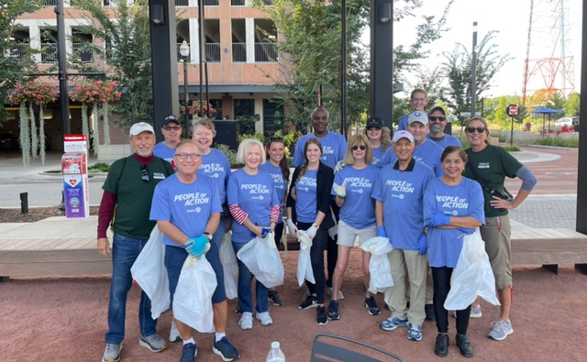
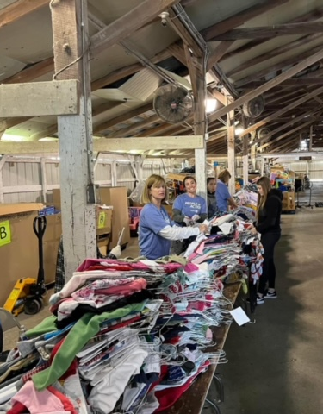
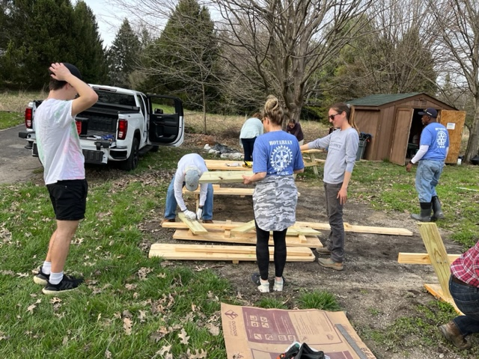
Rotary International Mission:
We provide service to others, promote integrity, and advance world understanding, goodwill, and peace through our fellowship of business, professional, and community leaders.
Promoting Rotary Mission in our Local Community
Serving our Community through Volunteerism
Long Standing Partnerships with Local Service Organizations
Focused Impact through Community Grants – Fall and Spring

Slide 3
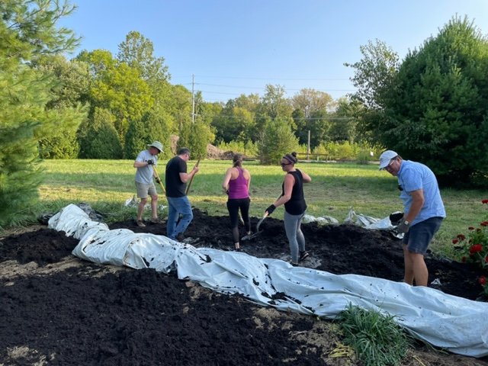
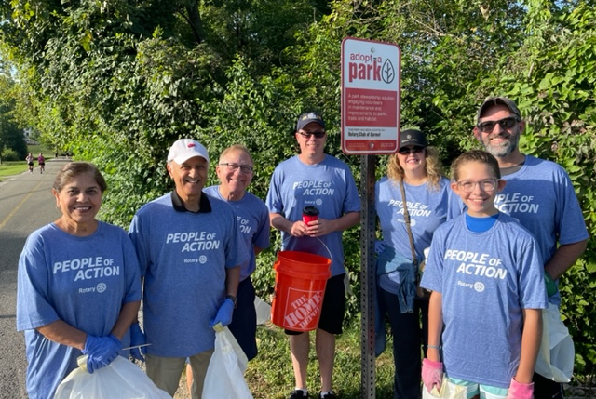
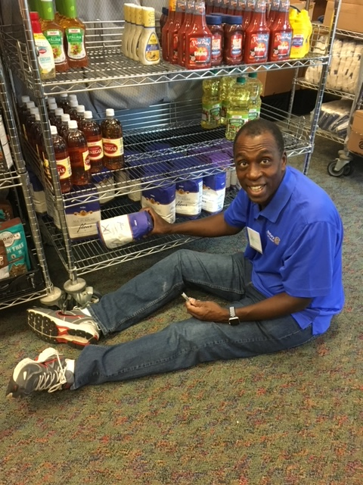
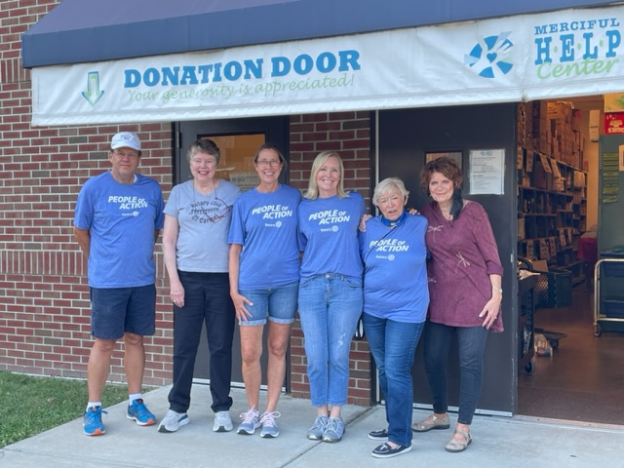
Serving Our Community through Volunteerism
Merciful Help Center
Crooked Creek Food Pantry
Good Samaritan Network
Meals on Wheels
Carmel Clay Parks
Fields’ Market Garden
The STEM Connection

Slide 4
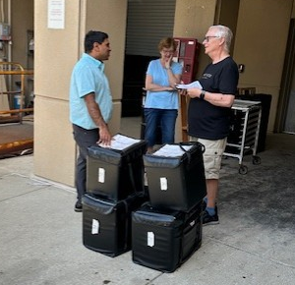
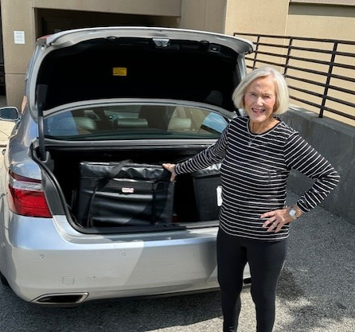
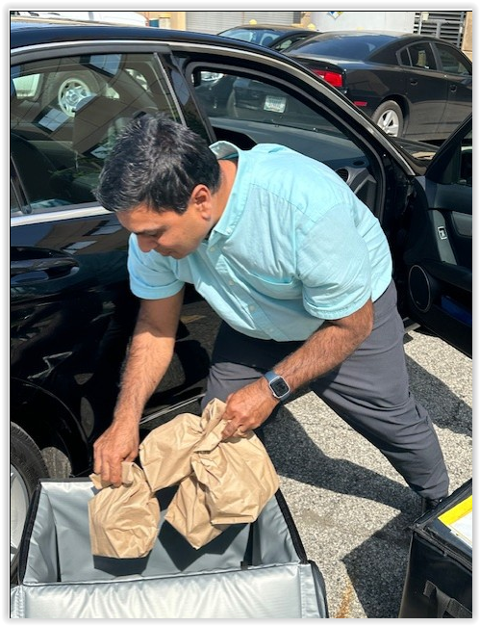
Meals on Wheels
Rotary Year 2023-2024
  ~48 hours/year
  24 Food deliveries planned
    Team of 8 Carmel Rotarians
    Monthly 2 Rotarians covering 2 routes on the 3rd Monday of the month. Each team member delivers 3 times per year.
Rotary Year 2022-2023
  ~48 hours/year
  24 Food deliveries planned

Slide 5


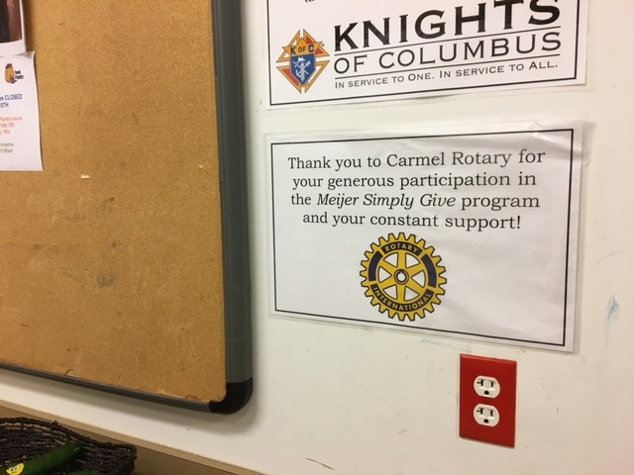

Long Standing Partnerships with
Local Service Organizations
Carmel/Clay Schools
  Circle of Kindness
  3rd grade Dictionary Program
  Science Fair Judging
Merciful Help Center – Meijer Simply Gives
Carmel Fire Department – Holiday Assistance Program
  17 families, 79 individuals

Slide 6

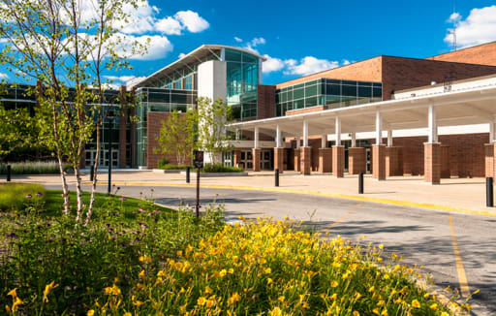
Carmel/Clay Schools
Circle of Kindness
Rotary Year 2023-2024
  Provided $11,530 in emergency rent assistance for eight single moms (health, breadwinner abandonment)
Rotary Year 2022-2023
  Provided $10,765 in emergency assistance for rent or utilities helping nine single parent families

Slide 7

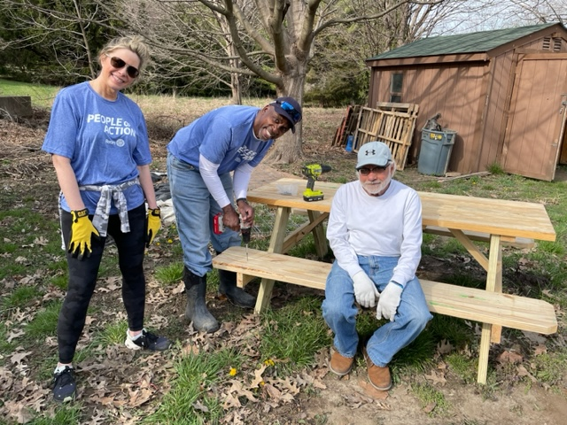
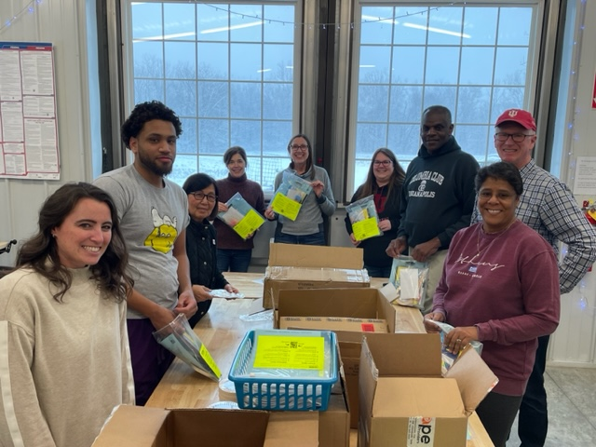
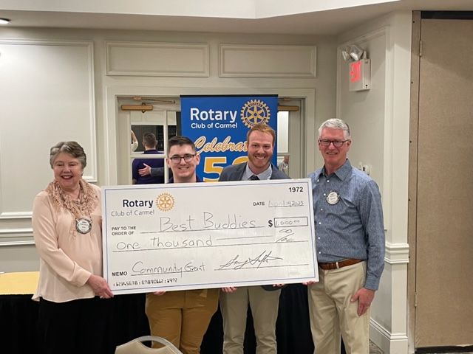
Focused Impact through Community Grants
2023-2024 Grants:
Carmel Education Foundation
Fields’ Market Garden
Crooked Creek Food Pantry
Ivy Tech Foundation
Assistance League of Indianapolis
Children’s Theraplay Fund
The STEM Connection
Trinity Free Clinic
Merciful Help Center
Humane Society
Indy Book Project
Notes:
Previous Grant Recipients:
Janus Development Services
Indiana Health Fund
Carmel Community Players
Best Buddies of Indiana
Damar Services
Prime Life Enrichment

Slide 8
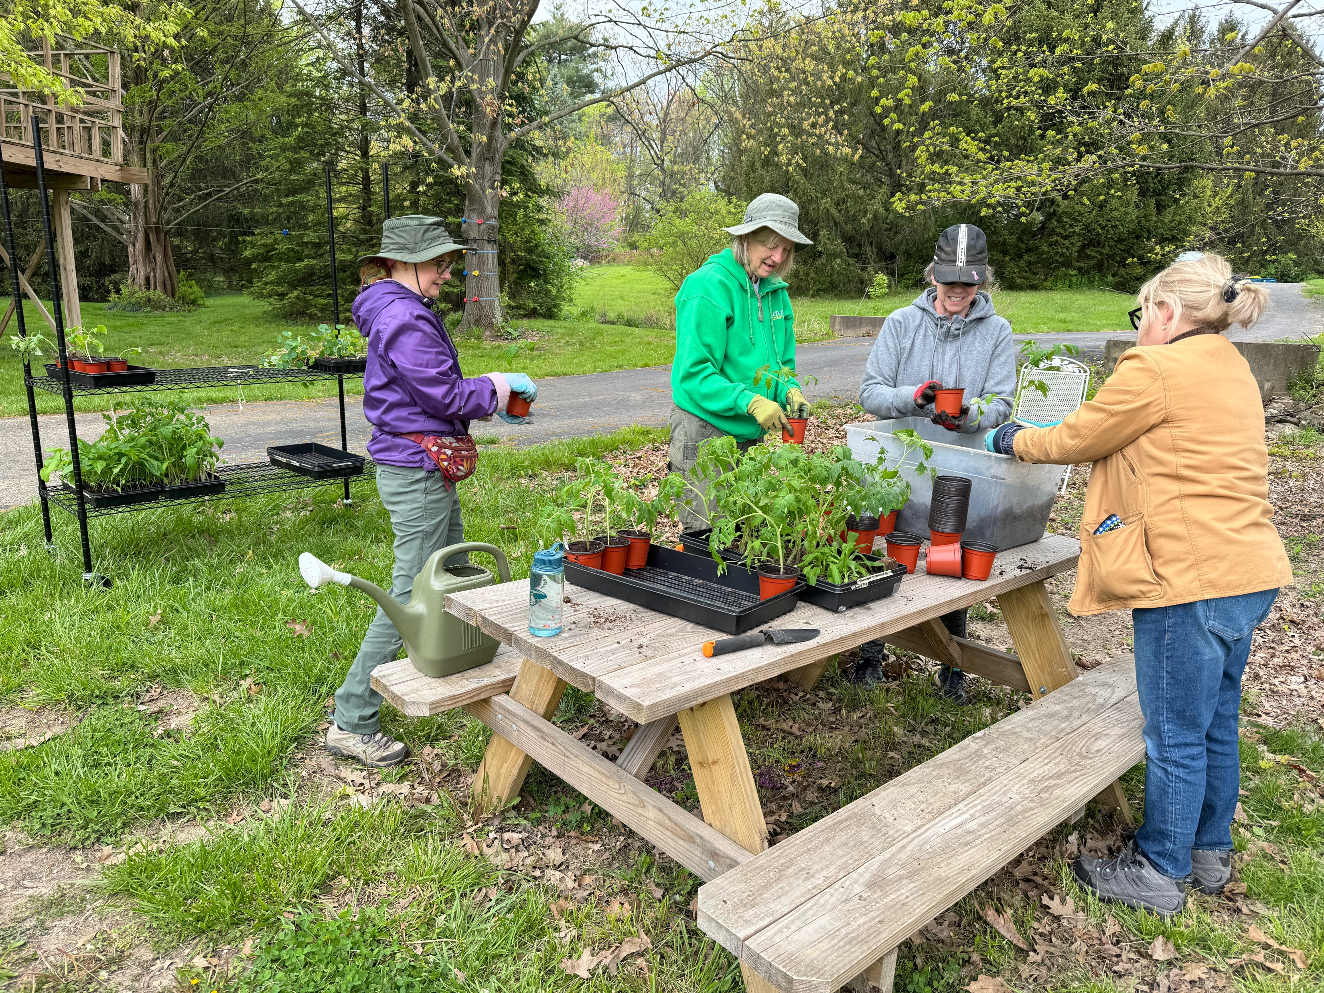
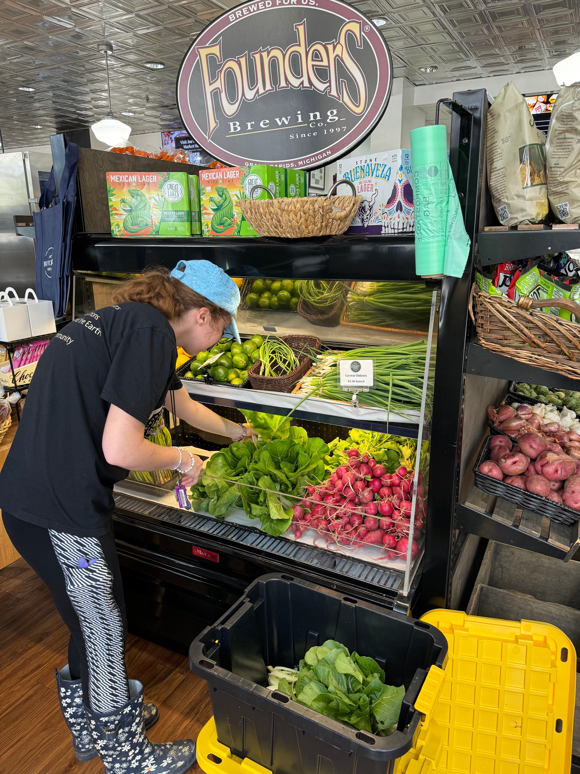

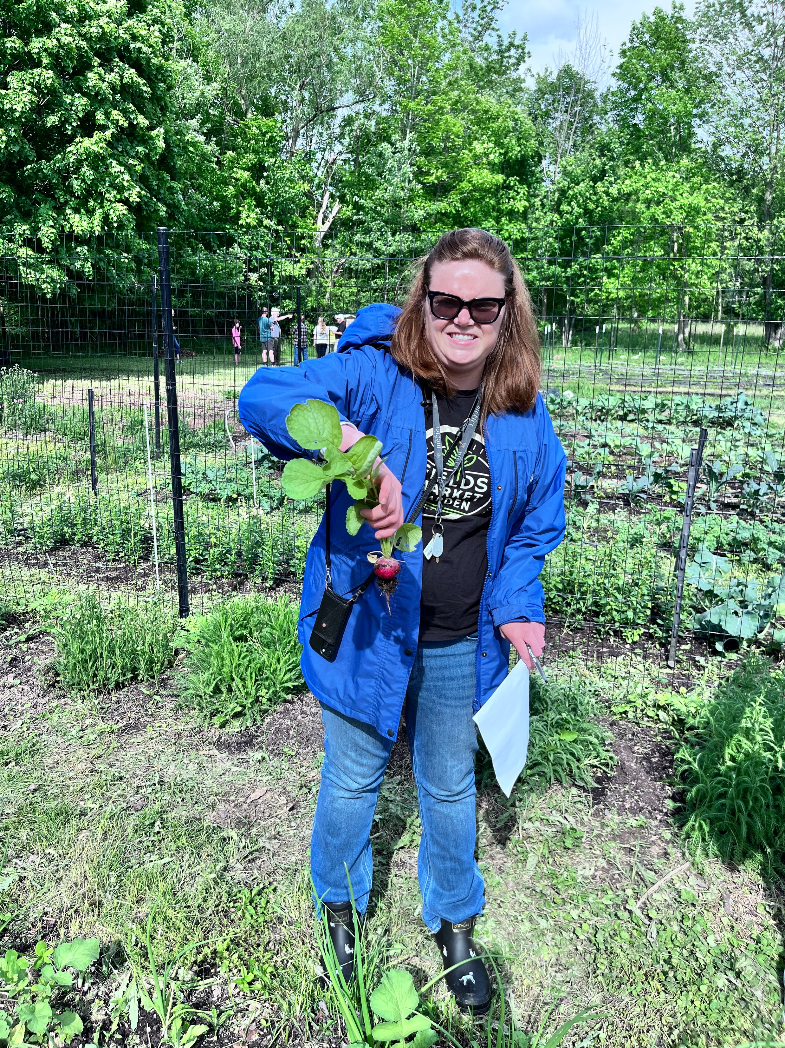
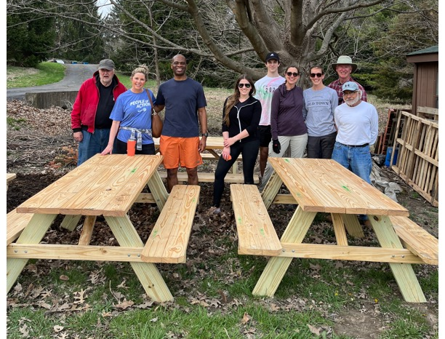
Fields’ Market Garden
Volunteer Opportunities
Employment opportunities for our neighbors at North End
Educational Workshops
Community Events
Flower Bouquet Subscriptions
Fresh Produce
Future Greenhouse

Slide 9
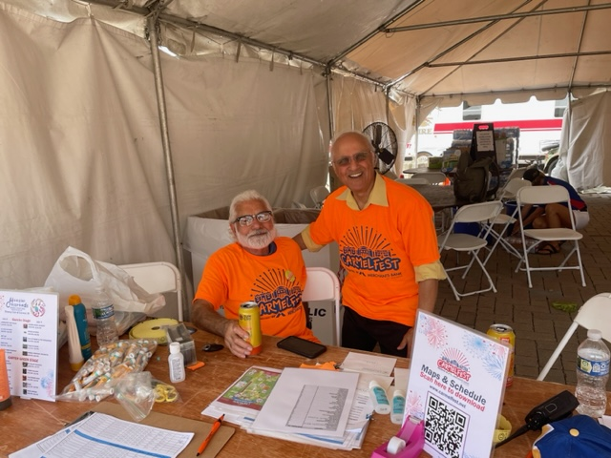
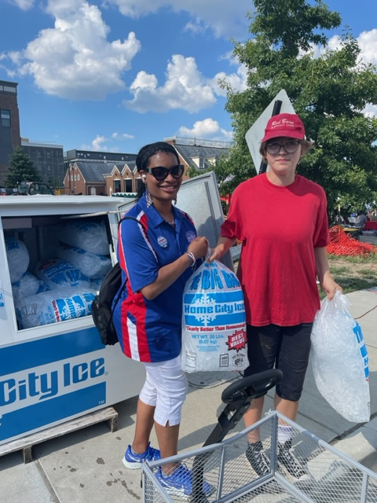
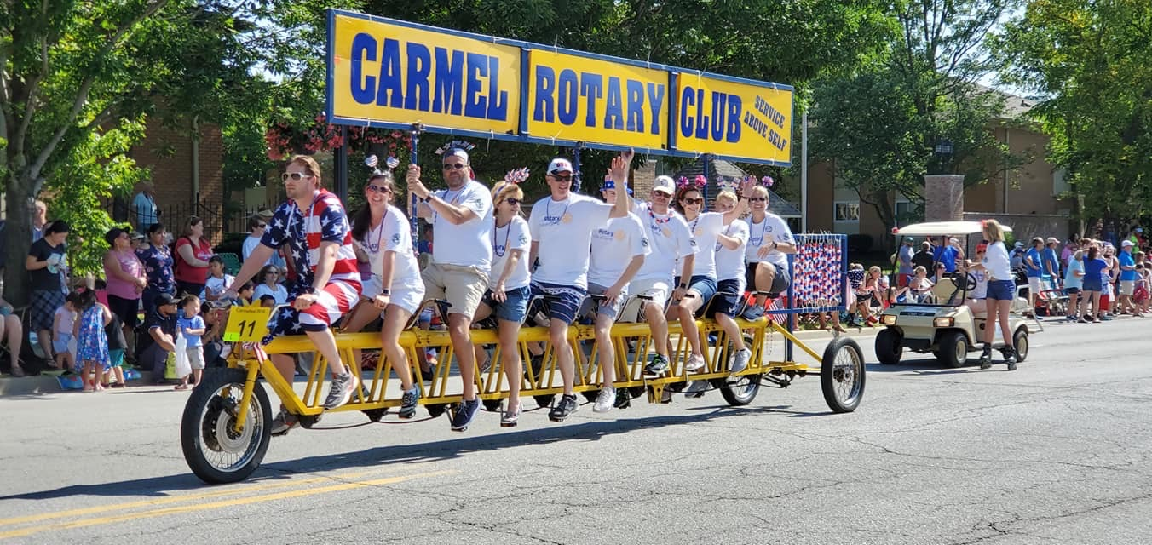
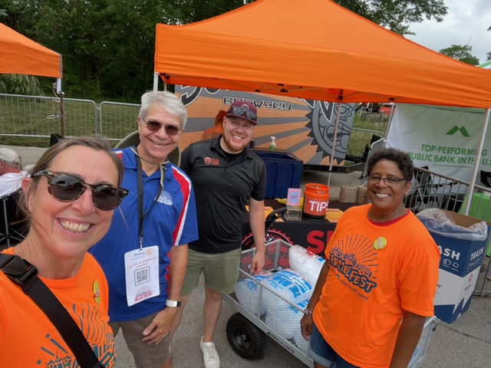
FUNdraising through Carmelfest Service
Visible and Engaged Service and Impact in our Community
It takes ‘ALL OF US’

