Slide 1
Rotary Foundation District 6540 District Grants 2023-24
Presenter
Sharon A. Kish
Valparaiso Rotary Club
District 6540 Grants Co-Chair
skish33@gmail.com
219-508-1516

Slide 2
The slides of this Presentation
are available
at
www.rotary6540.org
in the Downloads Section
A recording of this presentation will
Be uploaded to YouTube
Under Rotary District 6540

Slide 3
Rotary Foundation Grants
Rotary Foundation Makes Two Types of Grants
Global Grants are for Large International Projects that involve the cooperation of Two or More Clubs and Districts from around the World (Minimum Budget is $30,000) – RI staff supervise grant
District Grants are intended to support the projects and efforts of local Rotary clubs in smaller sized projects (Max Grant in D6540 is $3,000) – District 6540 Rotarians supervise projects

Slide 4
Where Do the $$ Come From?
It is a partial return of Contributions to the Rotary Foundation Annual Fund-Share from 3 Years Ago
50% comes back to District 6540 & 50% goes into the RI World Fund and is for global grants
Of the returned funds, 50% is eligible to fund District Grants
The other 50% is available to support Global Grant projects of our clubs and Polio Plus
In an Average Year, we will have about $68,000 available for District Grant supported activities

Slide 5
What Are District Grants
Rotary Foundation (NOT District) Funds. These $$$ are not from dues, but from donations to the Annual Fund-Share.
Each District sets its own rules for participation
Projects are smaller and completed in a shorter timeframe (3-6 months)
Projects (hopefully) will involve the active participation of the local Rotary Club
Can be done in conjunction with another organization or club

Slide 6
What Do District Grants Support
In addition to Club Projects, Grant Funds Support:
Interact, Rotaract, Earlyact
Rotary Youth Exchange
Summer Scholars – Scholarship Program
Rotaract Clubs can now apply for a District Grant in partnership with a Club

Slide 7
District Grant Cycle
Application Window – January 1 thru March 31
Application Review – As they are submitted, no decisions on funding until April
Preliminary Approval – May
Final Approval from RI – June
Project Execution – July through May
Final Report – When completed, no later than June 24
Payment to Club – Upon Approval of Final Report

Slide 8
Application Process
Project must fall under one of the Foundation’s 7 Areas of Focus
Water/Sanitation/Hygiene; Maternal & Child Health; Education & Literacy; Peace Building & Conflict Prevention; Disease Prevention; Community & Economic Development; Environment
The Grants Committee reviews, asks questions, or requests revisions & gives preliminary OK
We often have more requests than $ available – we will reduce request to match what we have
Clubs that Give More Generously to the Foundation have Better Chance of Full Funding

Slide 9
Examples: Eligible Activities
Conducting educational seminars
Repair of existing buildings
New construction in parks or public areas
Purchase of equipment for organizations
Food backpack programs
Scholarships (no payments to individuals)
Town Welcome Signs
International projects

Slide 10
Examples: Ineligible Activities
Purchase of Land or buildings
Fundraising activities
Expenses related to Rotary activities-conferences, anniversary celebrations, etc.
Unrestricted cash donations to an agency
Activities for an expense already paid
Cost of Rotary Signage over $500.00
Construction where money can be made (i.e., a business like a concession stand)
Rotary cannot own any equipment purchased

Slide 11
Guidelines and Resources
There are two important resources on the district website: www.rotary6540.org
Guidelines: Some do’s and don’ts
Terms and Conditions for Rotary Foundation District Grants
Please review before your start writing your 2023-24 grant!

Slide 12
Ineligible Clubs
Clubs not current with RI or District dues are ineligible
Because these funds come directly from the Rotary Foundation, Foundation giving plays a Role in decision-making
Any Club with three year average giving of less than $50 per capita will not be eligible to receive district grants – club presidents receive a copy of average giving each year
Any club formed in the last five years will be exempt from the average giving requirement and will be eligible to apply for a district grant

Slide 13
Coordinate with Other Clubs
Project too big for your club? Ask for Help
Multiple clubs can submit grants for the same project
Takes extra planning & coordination
Financing gets more complicated
Please talk to the Grant Committee first if you plan to submit a joint grant.
Successful Projects in past years:
Habitat for Humanity Playground—4 Clubs
Playground Equipment—2 clubs
Zambia Water Truck – 4 Clubs

Slide 14
Plan Your Project
Get two club members committed to project
Plan the scope of activities
Find ways to get Rotarians actively involved
Get cost and time estimates
Coordinate with any municipal or other entities
Make a plan for Publicity
Have Contingency Plans if we can’t fund your entire request

Slide 15
Online E-Application
Your Club Name (drop down box)
Club Mailing Address
Primary and Secondary Contacts Information
1a. Project Title
1b. Project Description
1c. Project Beneficiary
1d. Community Needs
1e. Area of Focus
1f. Estimated Project Start and Completion
Dates

Slide 16
Application
2. Participating Organizations
3. Project Budget & Financing (use template)
4. Purchase of Equipment, Materials, Supplies
5. Conflict of Interest Statement
6. Publicity
7. Reports
8. Sponsorship and Authorization
9. Completion Checklist

Slide 17
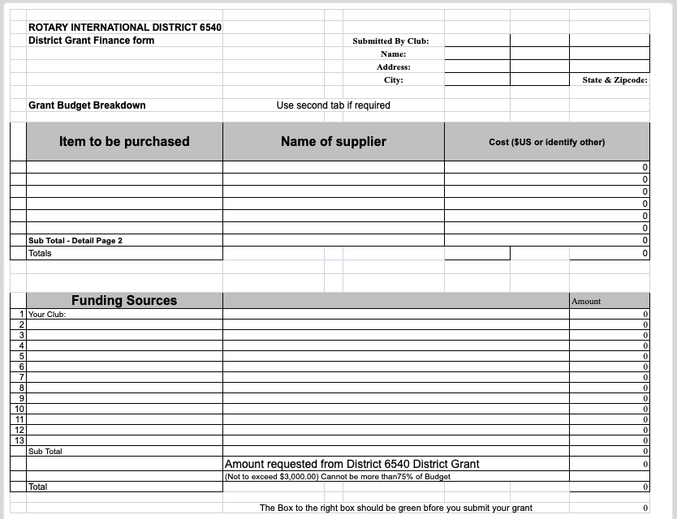
Financial Template

Slide 18
Conduct Your Project
Don’t Start before getting final approval
Don’t start before July 1
Don’t spend any money before July 1
Save your receipts!!! Invoices are not receipts. Must show payment has been made, with copies of checks or credit card receipts.
Try to run as many expenses through the club rather than individual members
Do Fundraising if grant is less than expected
If project goes over budget, can we get more Grant money? NO!

Slide 19
What if Things Change
We want all projects completed by June 24th
Municipal Timeframes get Changed
Key individual on project leaves
COVID Issues still affecting supply chains
Fundraising Falls Short
CONTACT US EARLY IF THERE’S A PROBLEM
We will work to try and accommodate changes
May need to substitute another project
May have to cancel grant

Slide 20
Prepare Your Final Report
DESCRIBE WHAT WAS DONE
Show what was spent
Email copies of your receipts
When Treasurer writes a check use memo area
Make sure your numbers match
Sign the report
Review and Submit the Final Report to skish33@gmail.com

Slide 22
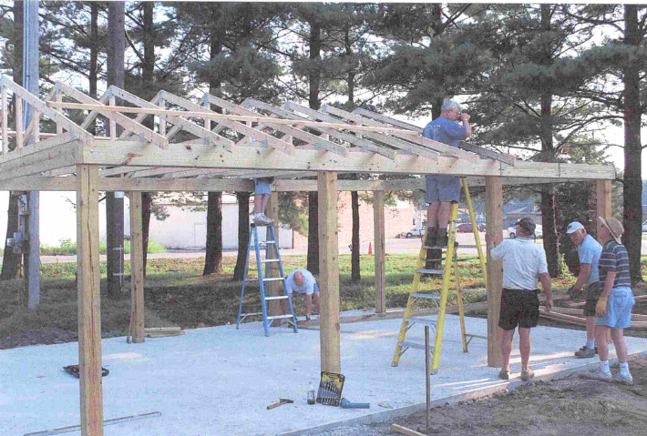
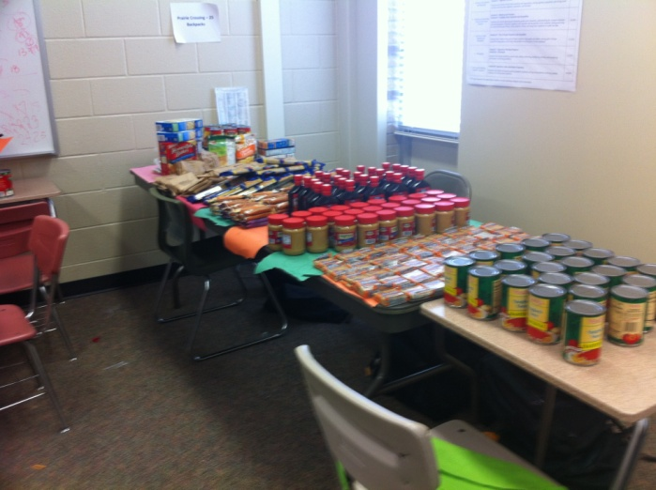
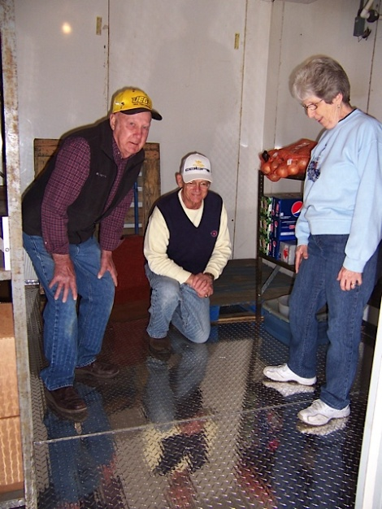
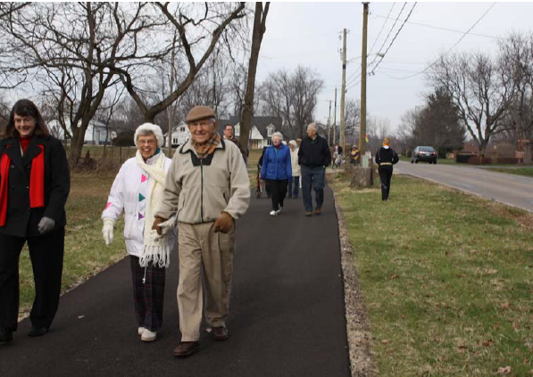
Email 2-3Pictures with Report

Slide 23
Getting Your Grant Funds
We operate District Grants as a reimbursement
Be timely in preparing your final report
Funds will be direct-deposited to Club’s checking account in 2023-24
Rotary allows only one District Grant year to be open at a time – meaning we can’t get funds for the 2023-24 grant year if 2022-23 projects are still open. Your problems become all our problems.

Slide 24
Common Mistakes
Income and Expenses don’t match
Buying Equipment, but no Rotary participation
Incomplete set of receipts
District Grant funds can only supply 75% of
Project Cost
Starting too early – Wait until after July 1
Providing way too much detail about project, both in the application and final report
Make Grant Request for Round Amounts, i.e. $950.00 not $947.65. Final Reports should be exact.
No handwritten applications or reports please

Slide 25
QUESTIONS ???
Sharon Kish
District Grants Chair
skish33@gmail.com
219-508-1516

Slide 26
The slides of this Presentation will be
available at
www.rotary6540.org
in the Downloads Section
A recording of this presentation will
Be uploaded to YouTube
Under Rotary District 6540
Thank you for Participating!!!

