Slide 1

Summer study abroad in spain
Cindy Torres

Slide 2
My First Day
Consisted of being awake for over 24 hours
I had my first Spanish meal and tapas
I went for breakfast with my friend Claudia, and was shocked that it costed me six euros for a meal and coffee.
I got an introduction to the Spanish lifestyle of what hanging out meant for young adults

Slide 3

Culture Shocks
The sun did not set until 10-10:30 pm
Siesta Hours
Mealtimes
Minimal stoplights, lots of roundabouts
The food
No ID was asked for when purchasing alcohol
The public transportation system
Life is made to be out of the house
Lukewarm coffee
Tattoos
PDA

Slide 4

Favorite Things
Meeting new people from all over the United States
Walking to school as well as the long breaks given at school
Public transportation
Cathedrals
The night life
People playing instruments on trains, busses, and in the streets
The architecture
Being able to walk everywhere

Slide 5
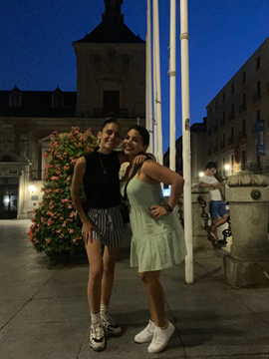
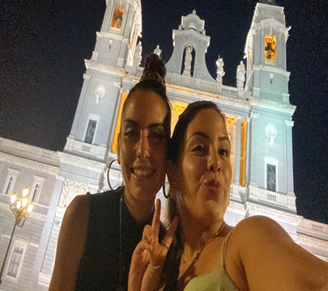


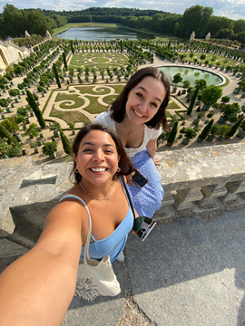
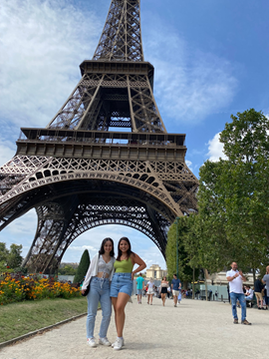
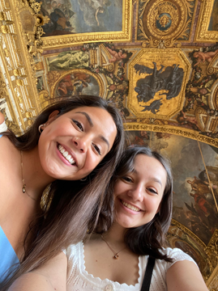
Most memorable moments
Seeing my two foreign exchange friends after four years
Being able to travel around Spain and Paris
Having a conversation with a teenager from Ukraine

Slide 6
Highlights of the Rotary Meeting
The President and Vice President of the Rotary club were a lawyer and businessman
They were the nicest people I have met!
I got to try truffles for the first time
We talked for over two hours about the culture of Spain and the United States
I learned valuable life lessons
I got to ride in a Porsche
Advice given:
Never be an extremist, always be in the middle to be able to see perspectives from both sides
Living to work is not good but not working to live is bad. Try to find a happy middle ground
Always respect everyone no matter your differences
Rule of 10-10-10 (How will my decision affect me in 10 minutes, 10 months, and 10 years.) Is the action worth it?

Slide 7
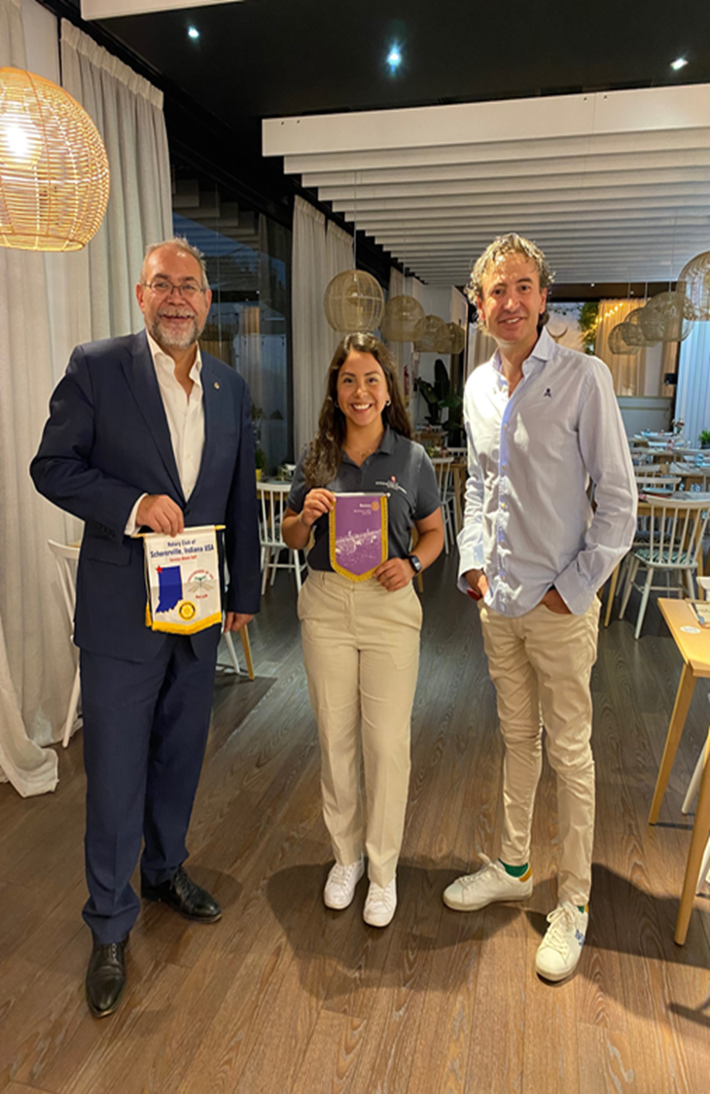

Slide 8
Life at La Universidad de Alcala de Henares
Communications Class
Hallway
Study Spaces Outside Dorms
Friends and I with our student advisor
Wall of windows in classroom
Upstairs Hallway
Window overlooking garden
Life:
There were study spaces outside
Minimal air conditioning
Classrooms had many windows
My teacher for communications is a Spanish professor at UIC.
Courses were challenging but rewarding
We walked to school and to different cafes on our breaks
School was Monday-Thursday leaving a lot of room to travel!
Classes I took:
Spanish Phonetics
Communication through Mass Media

Slide 9

Places I traveled while abroad
Alcala de Henares
Madrid
Barcelona
Toledo
Barcelona
Cordoba
Granada
Sevilla
Paris

Slide 10
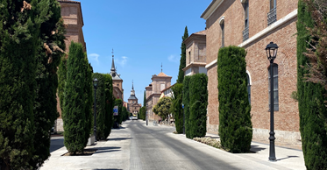
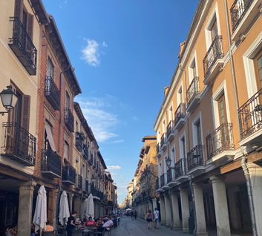
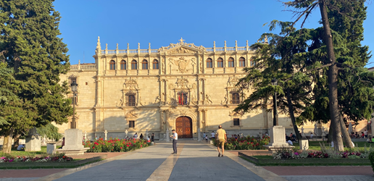
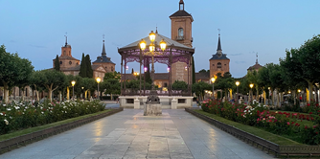
Alcala de Henares

Slide 11
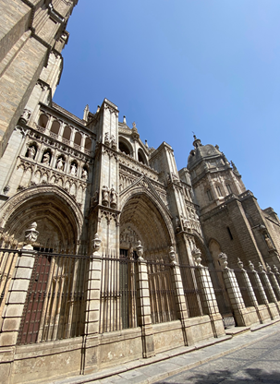
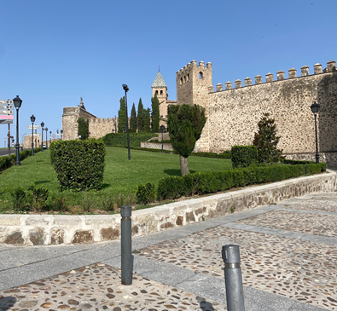
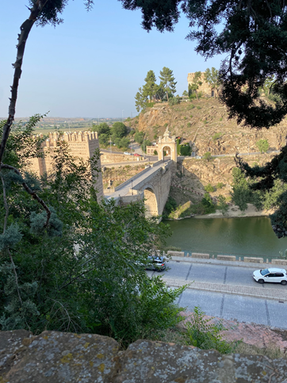
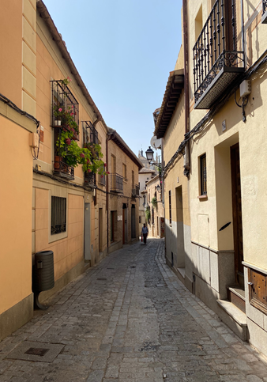
Toledo

Slide 12
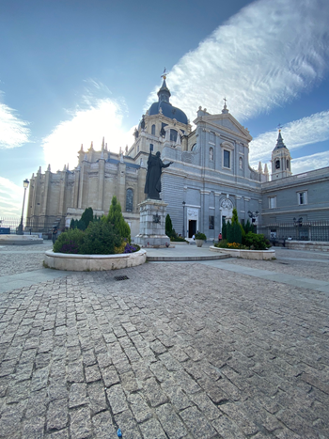
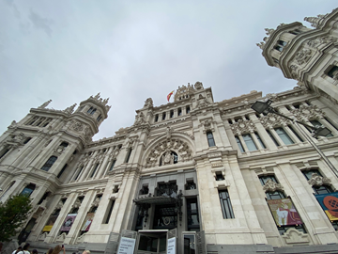
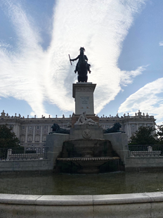
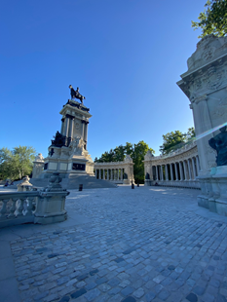
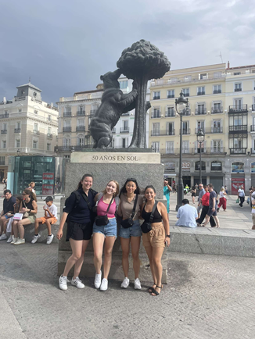
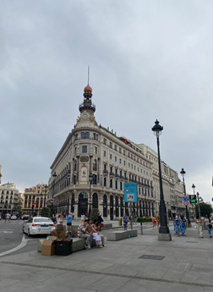
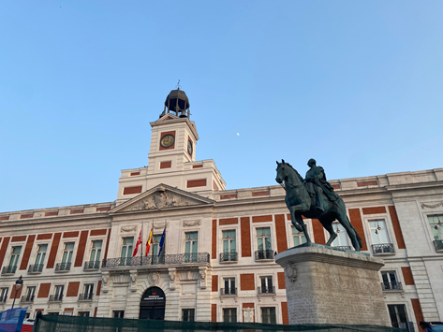
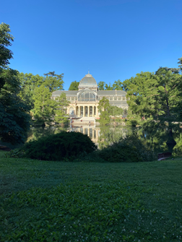
MADRID

Slide 13
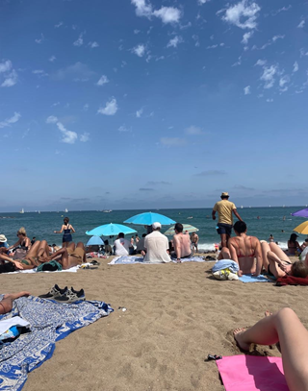
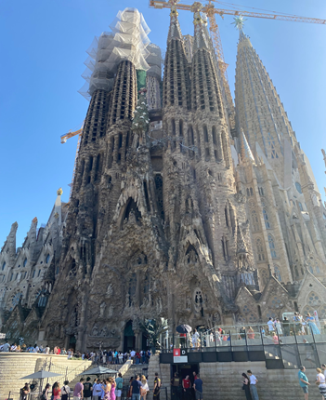
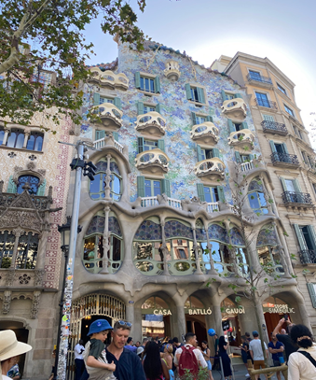
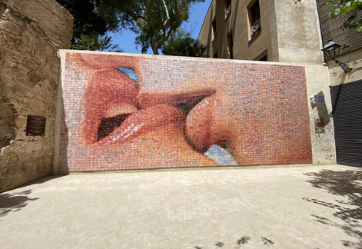
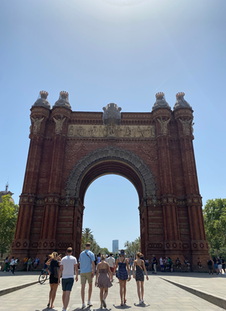
BARCELONA

Slide 14
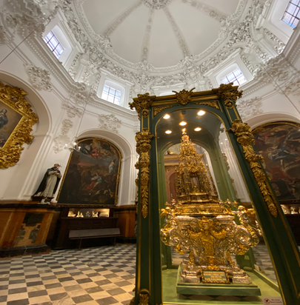
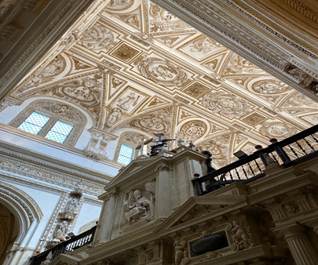
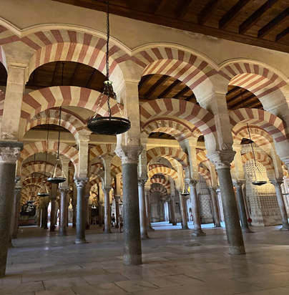
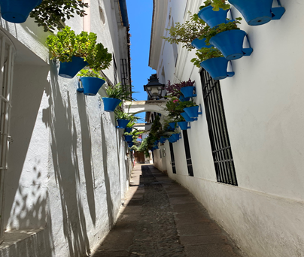
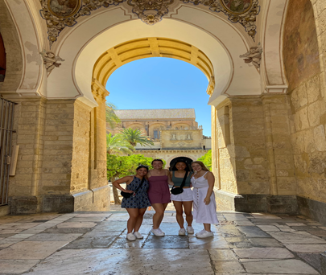
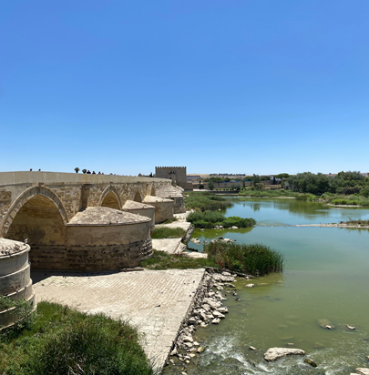
CORDOBA

Slide 15
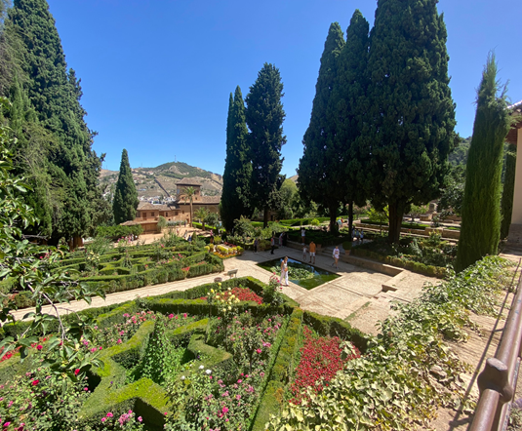
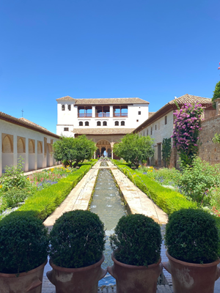
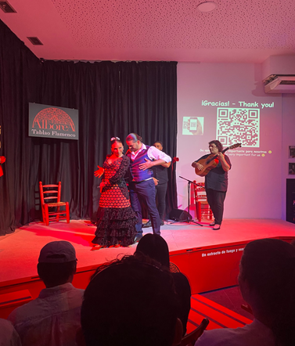
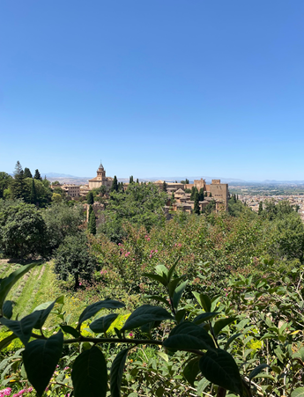
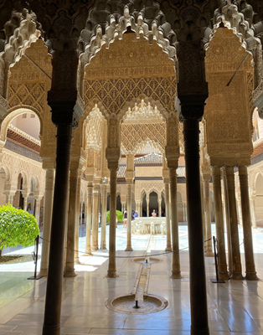
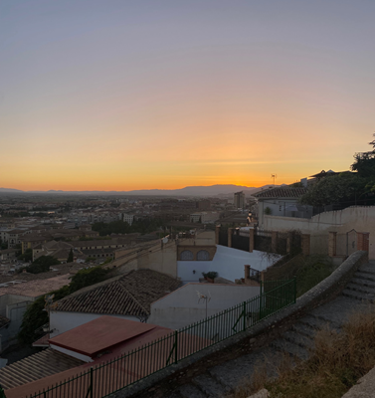
GRANADA

Slide 16
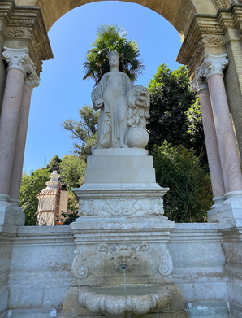
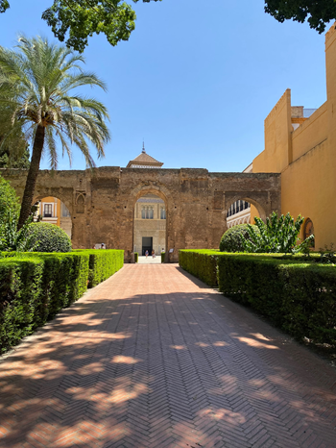
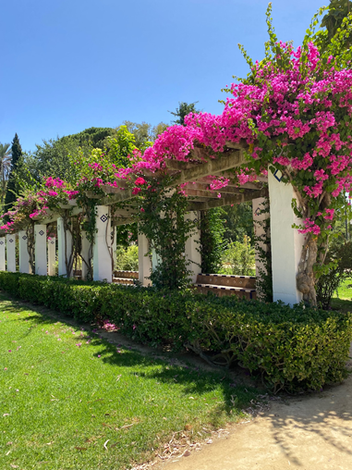
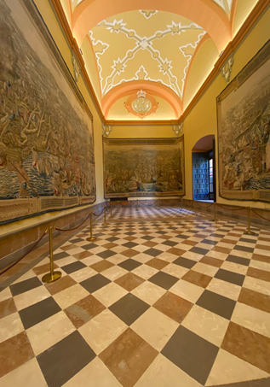
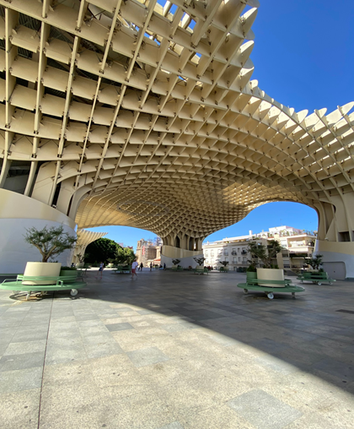
SEVILLA

Slide 17
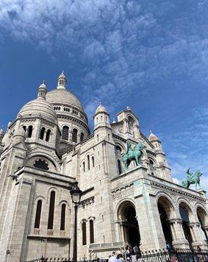
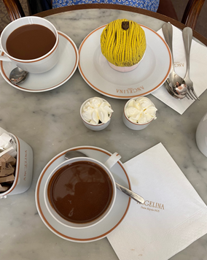
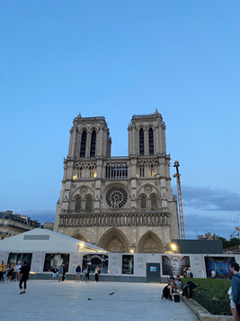
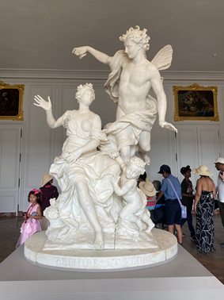
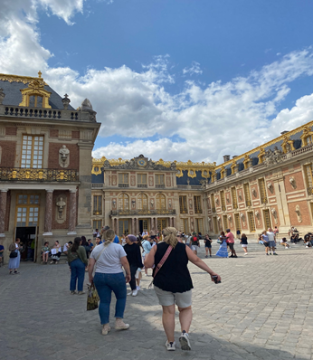
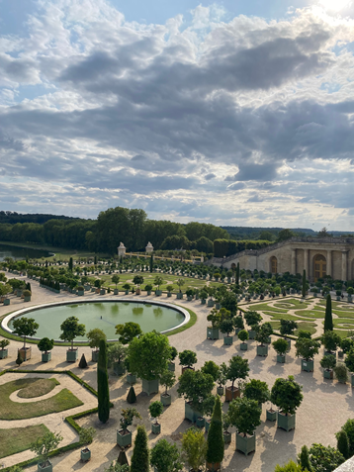



PARIS

Slide 18

Thank you!
Cindy Torres

