Slide 1
Stephanie Veit
President
Rotary Year 2023-2024
April 20, 2024

Slide 2
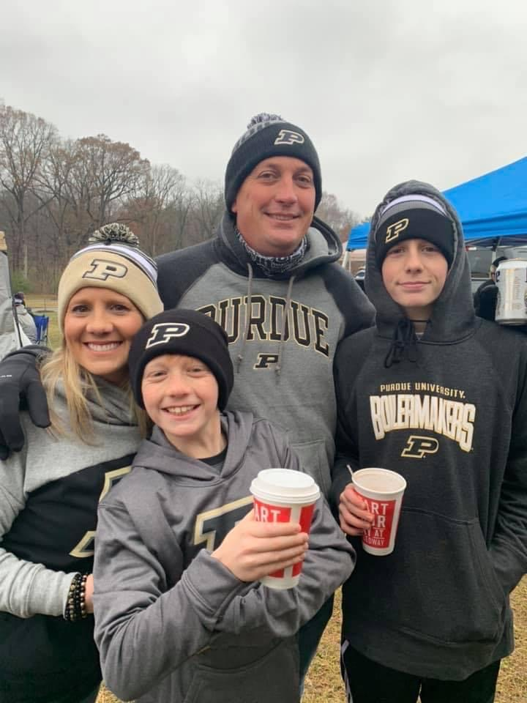
Who I am…..
God, Family, Purdue……..not always in that order
Mom of two boys, wife to Derek of 24 years
Love running, boating, hiking, being outdoors, and attending any Purdue sporting event
Giving back – Women’s Fund, Questa Foundation, Allen County Park Board, SACS School Board

Slide 3
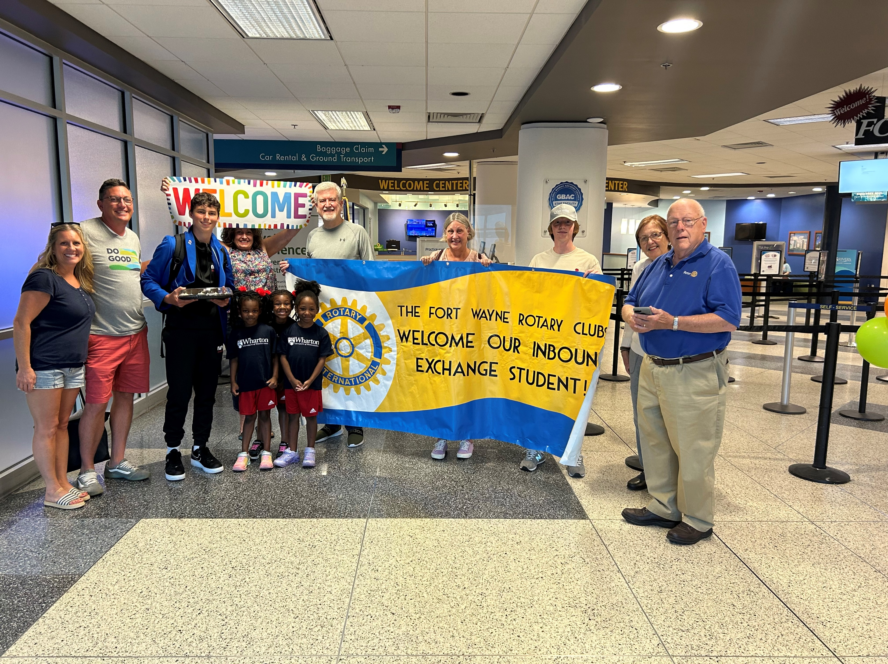
Why Now…….
Max’s Arrival in Fort Wayne on July 29, 2023

Slide 4
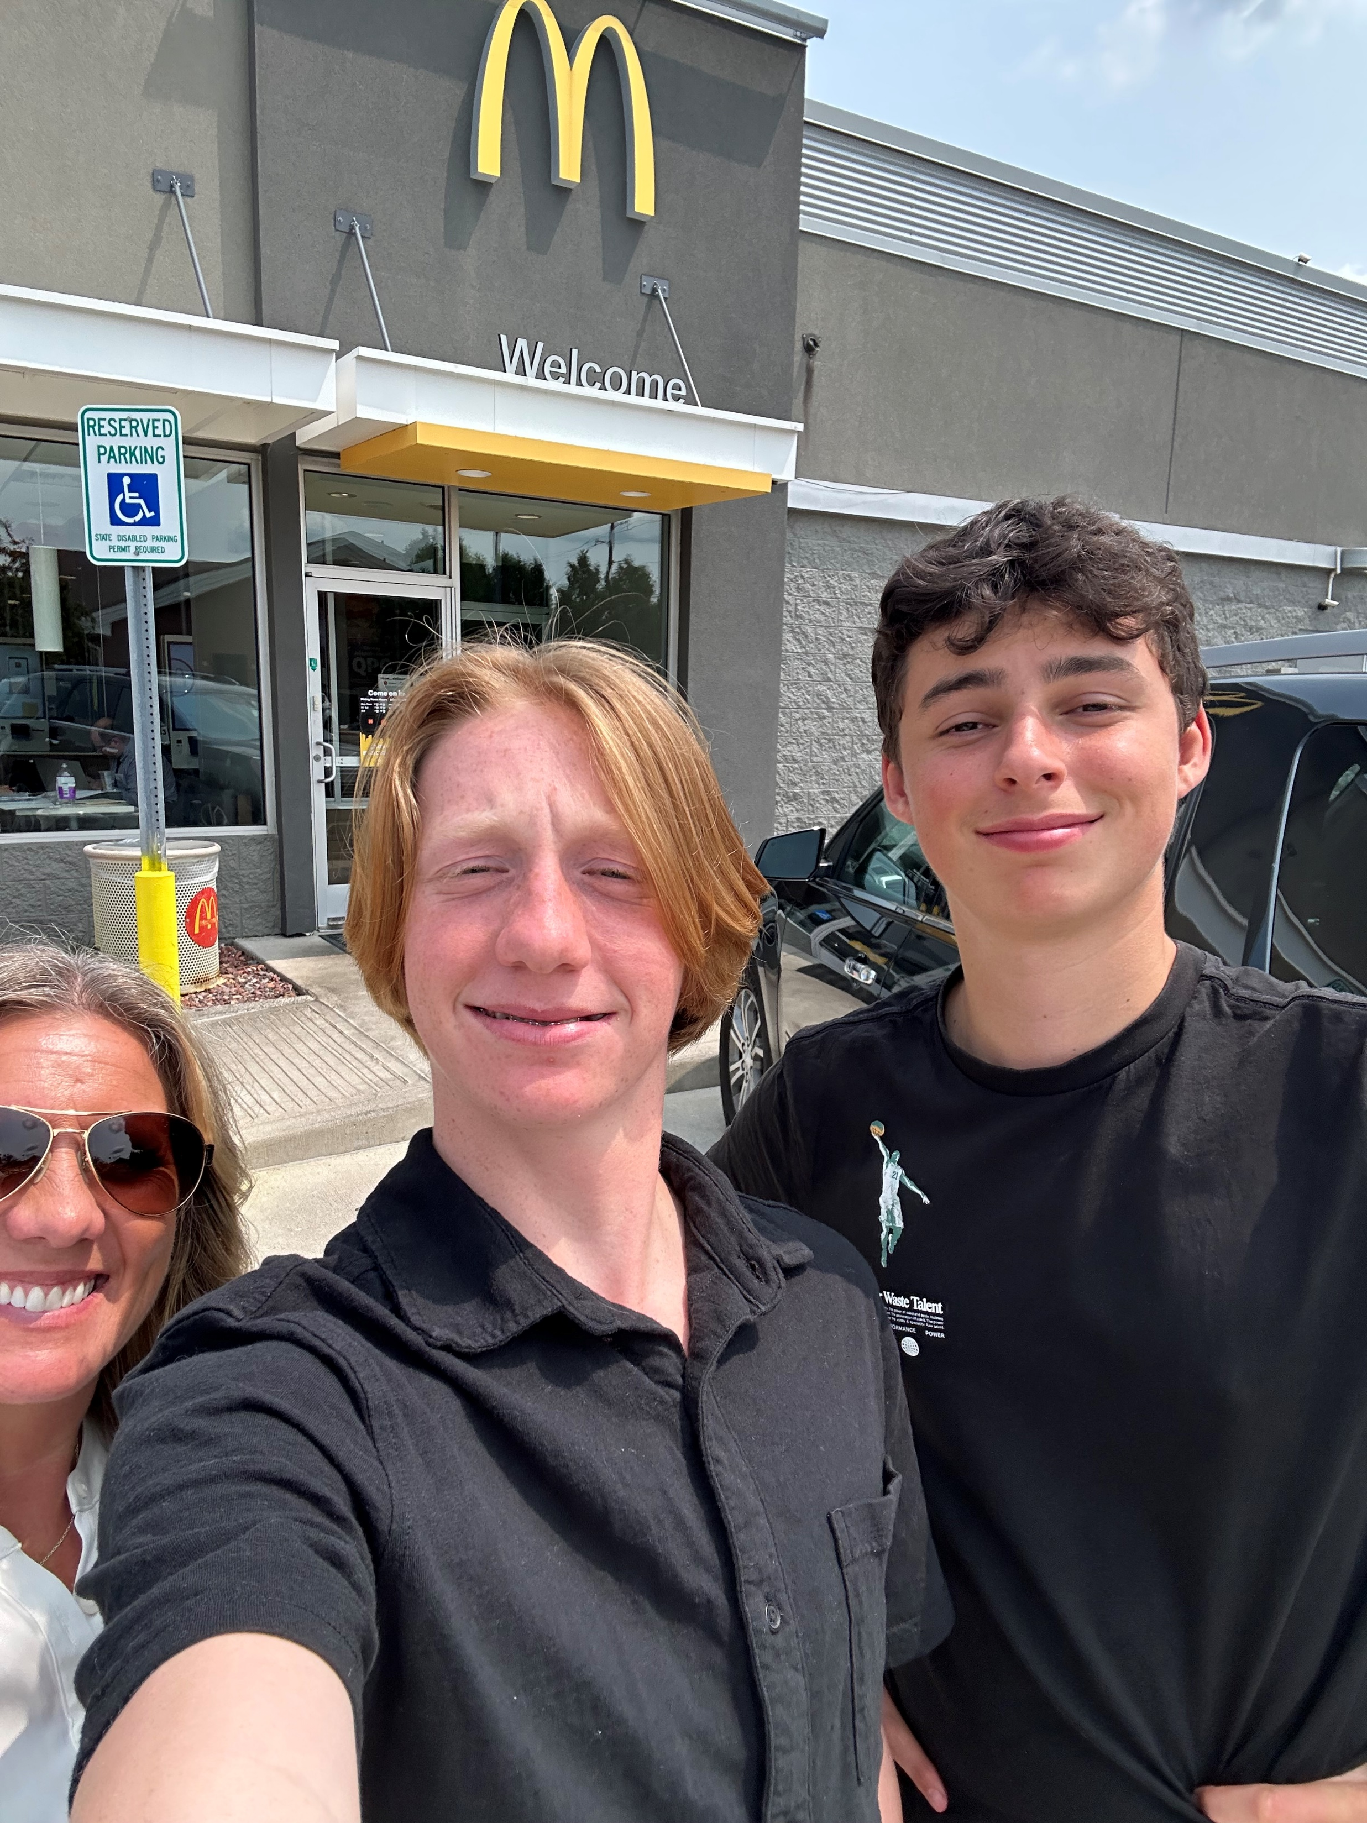
Lots of Firsts…… First lunch, meal in the US First Trip to McDonald’s

Slide 5
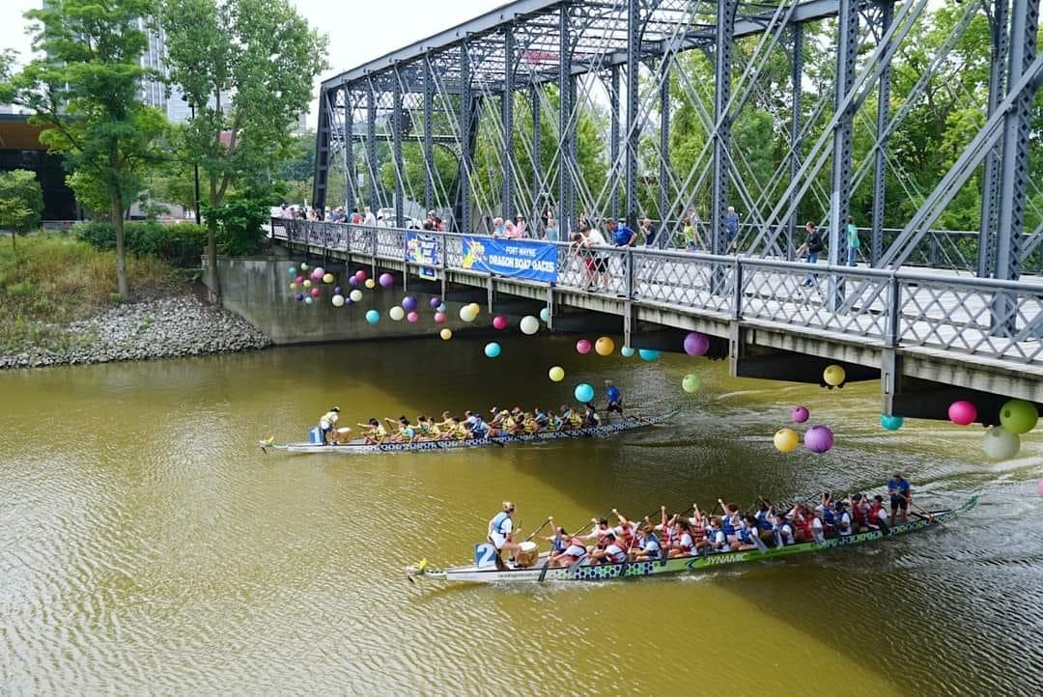
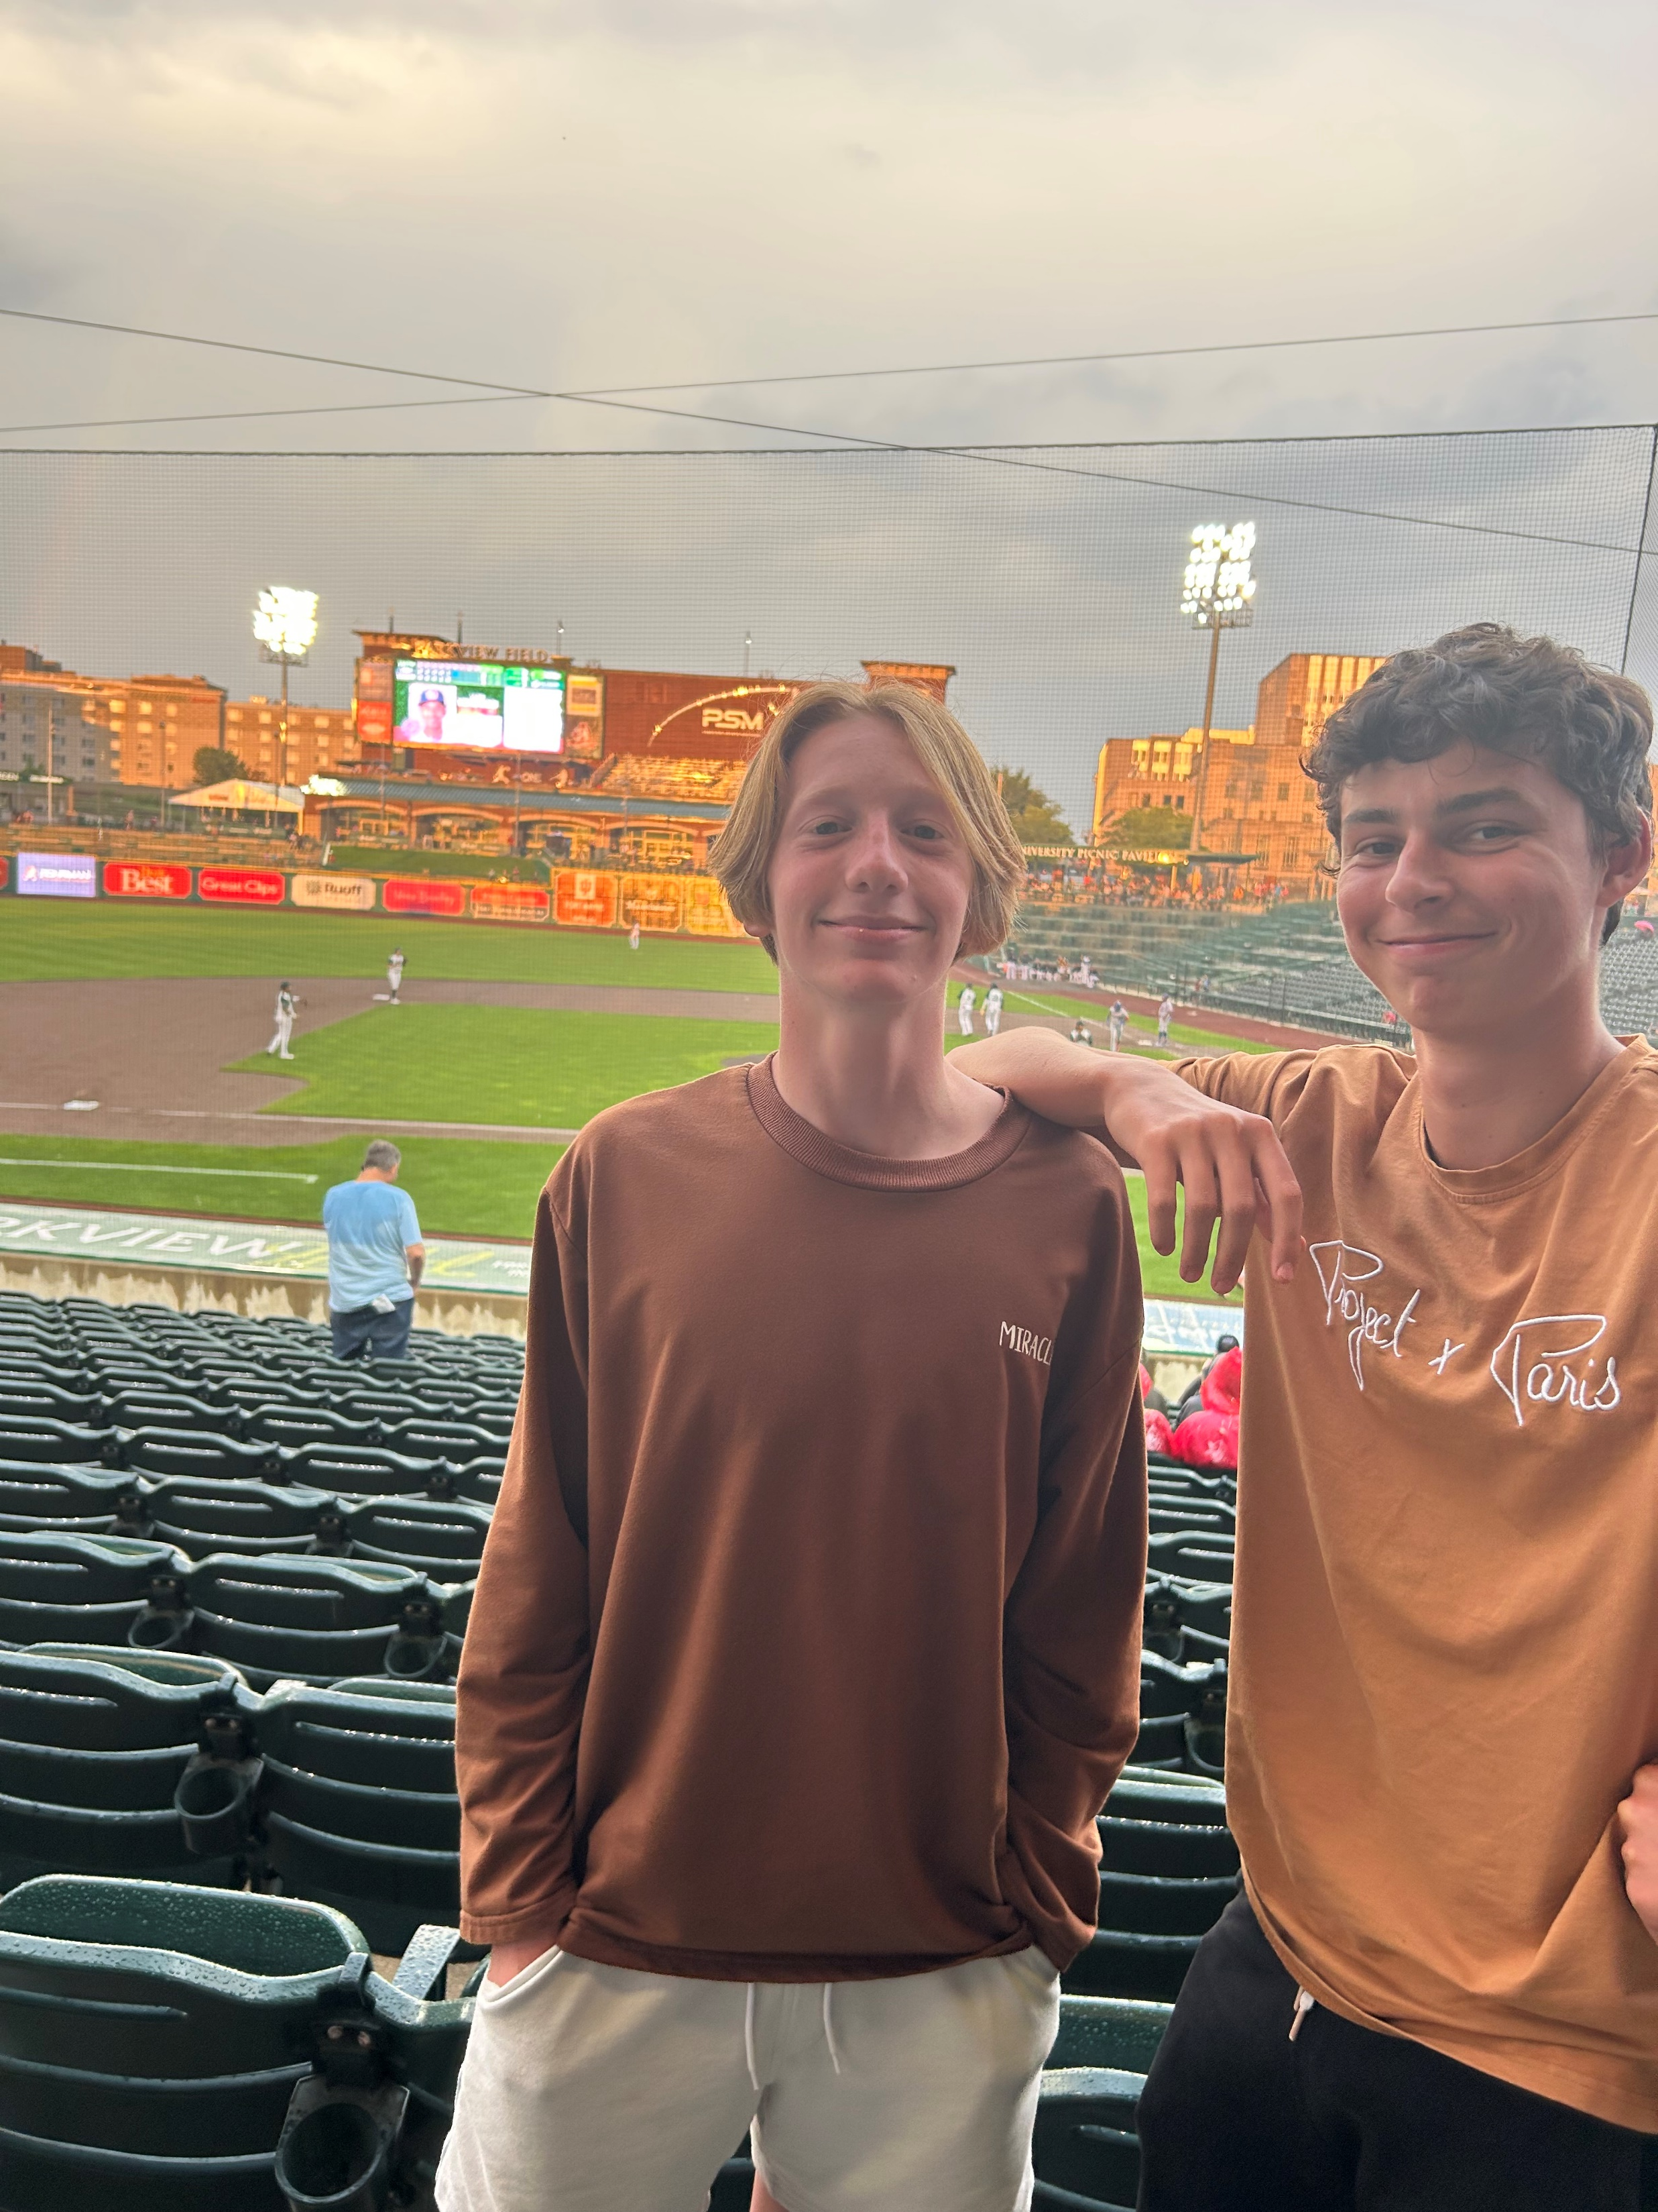
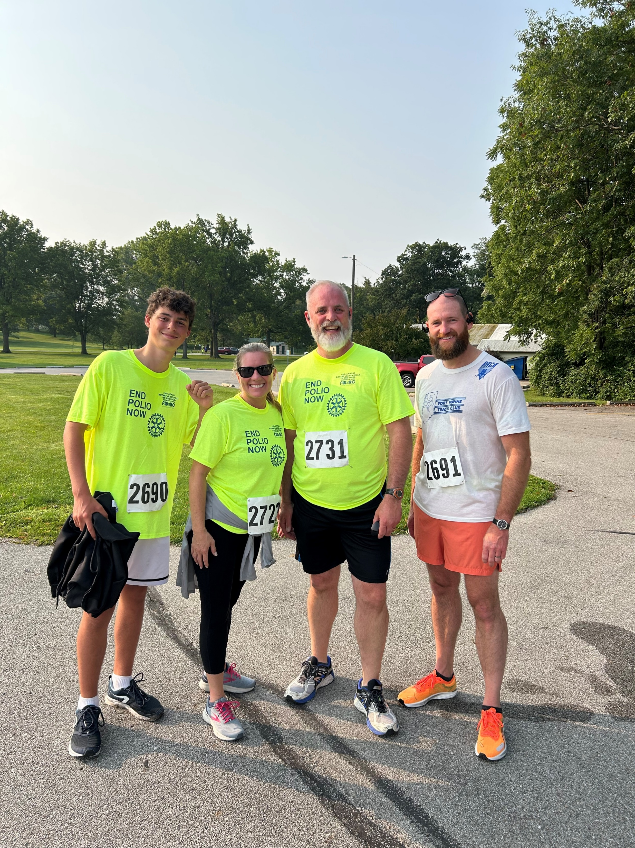
Rotary Events : Polio Plus Run/Walk Homestead HS Interact Students participating in the dragon boat races TinCaps Game

Slide 6
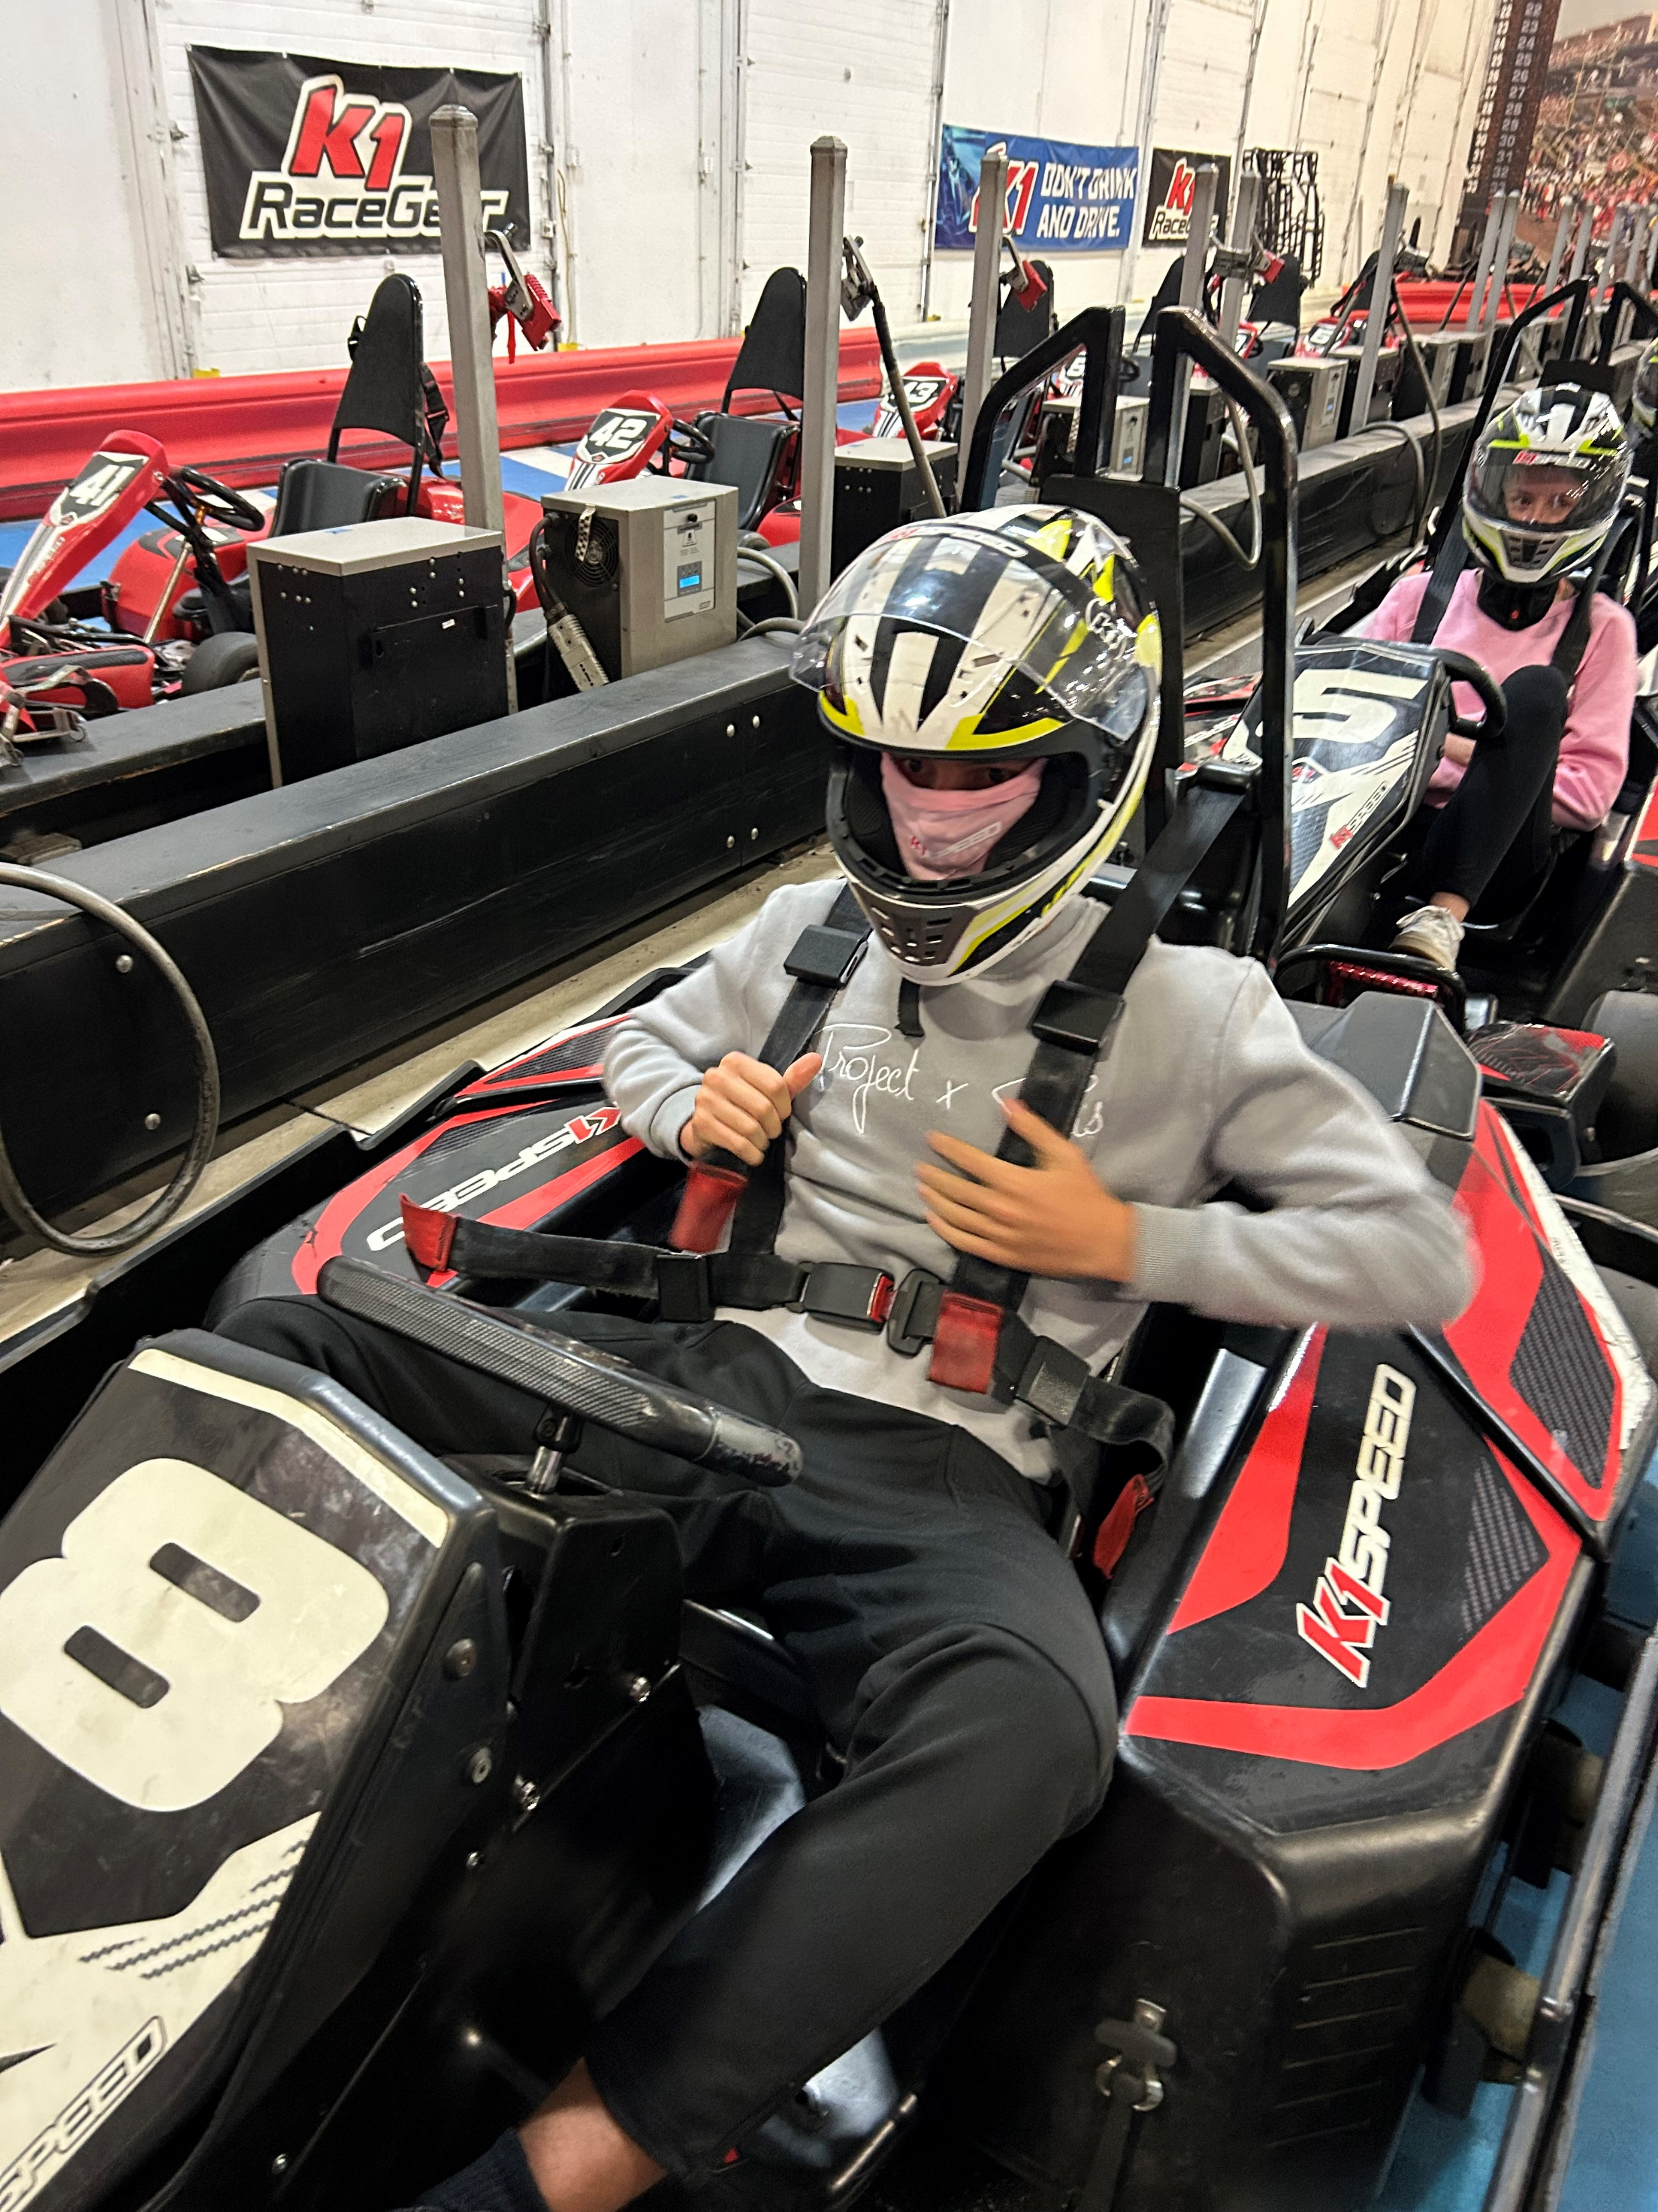
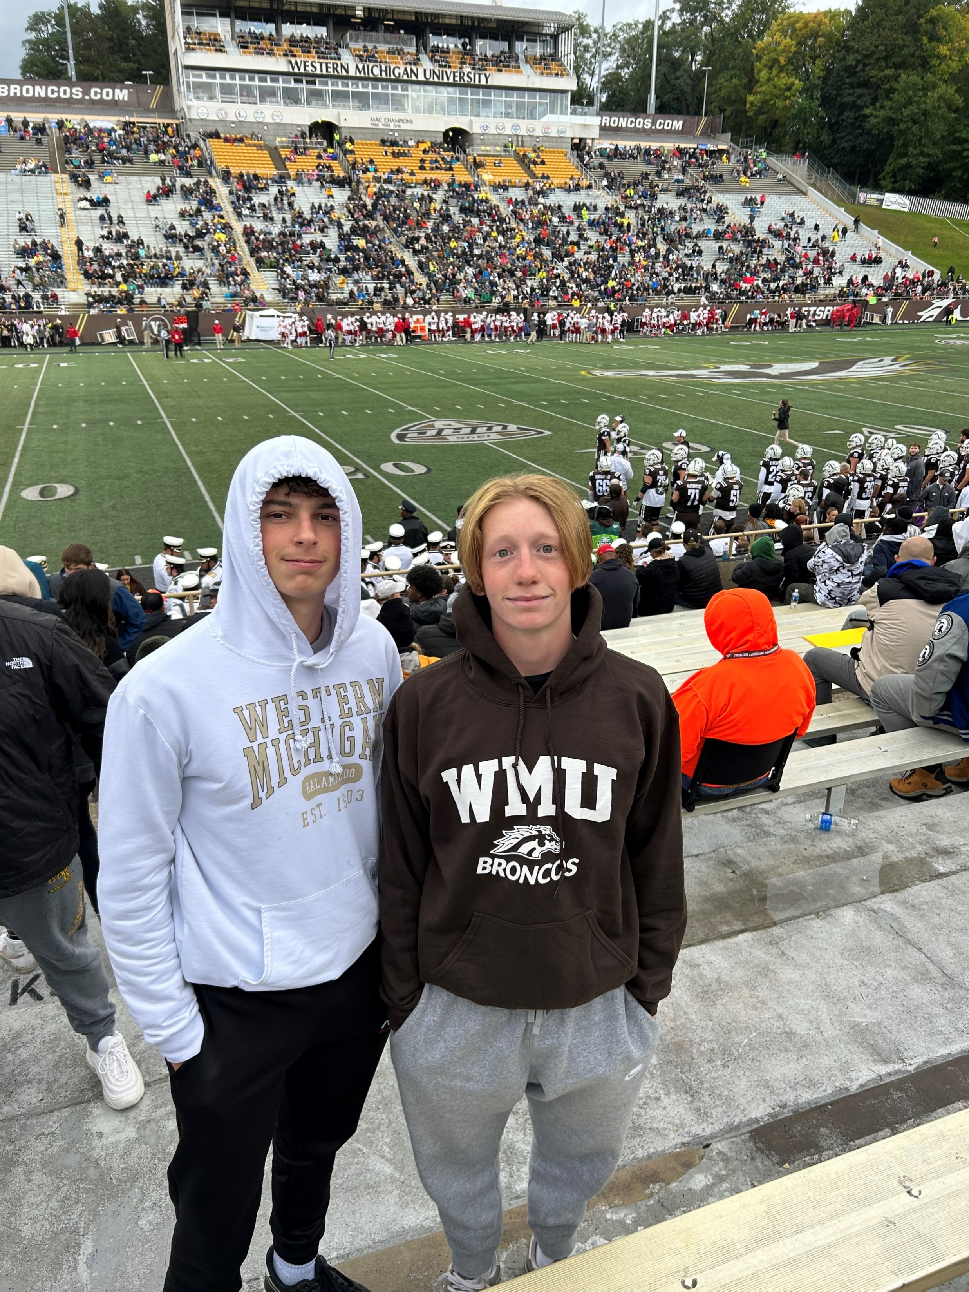
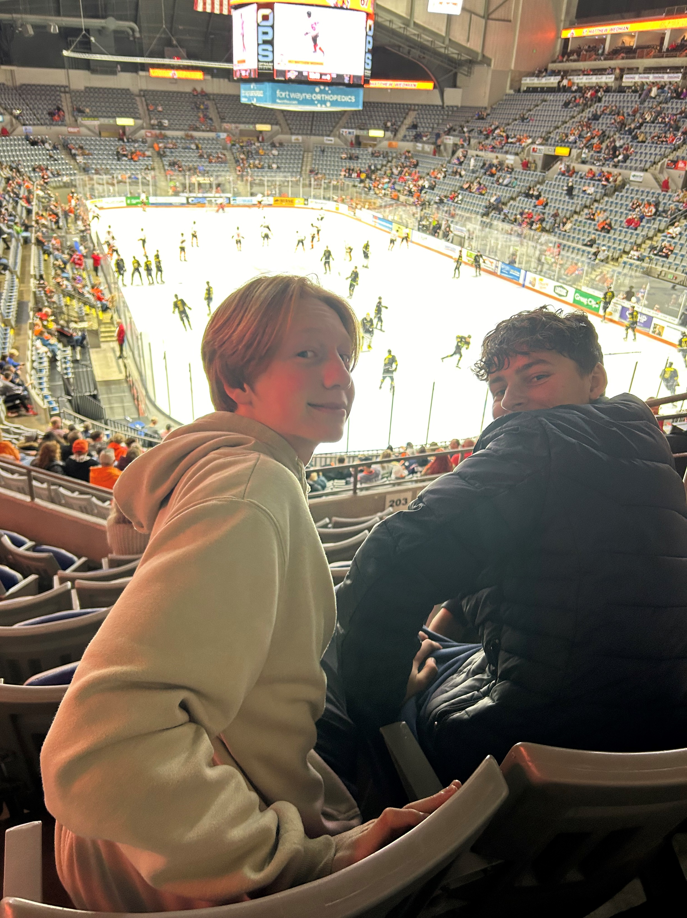
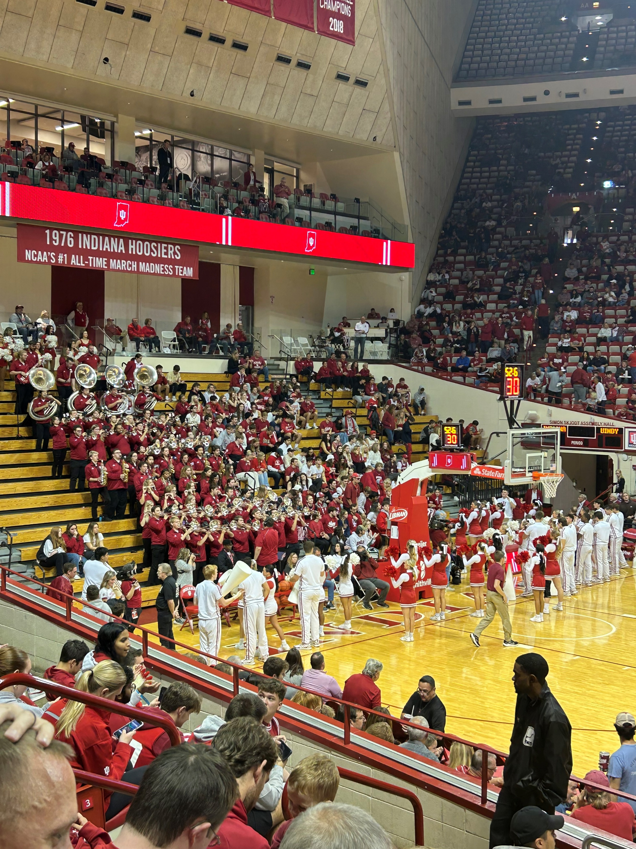
Sporting Events: Western Michigan Football Game, nd both IU and Purdue Basketball Games

Slide 7
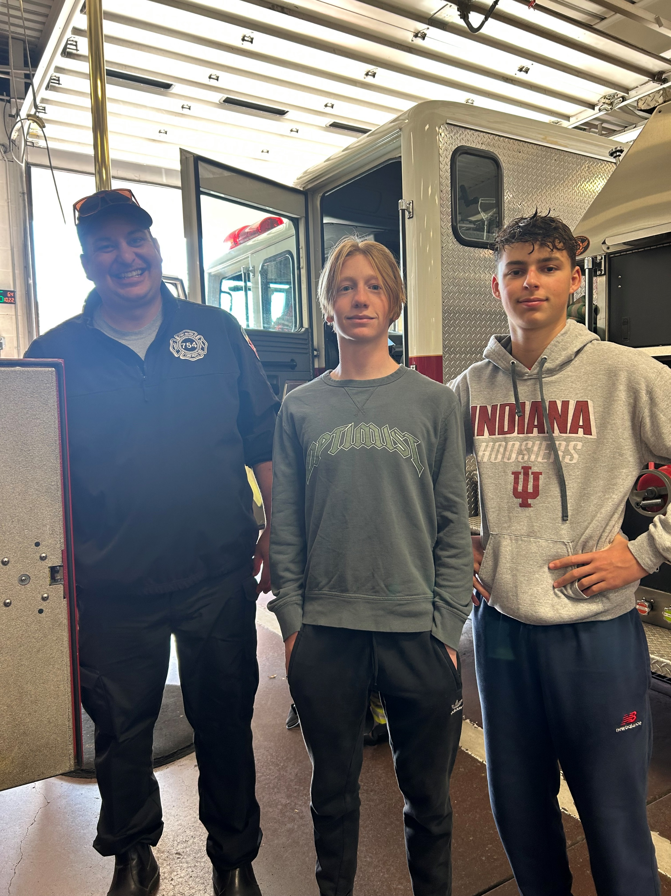
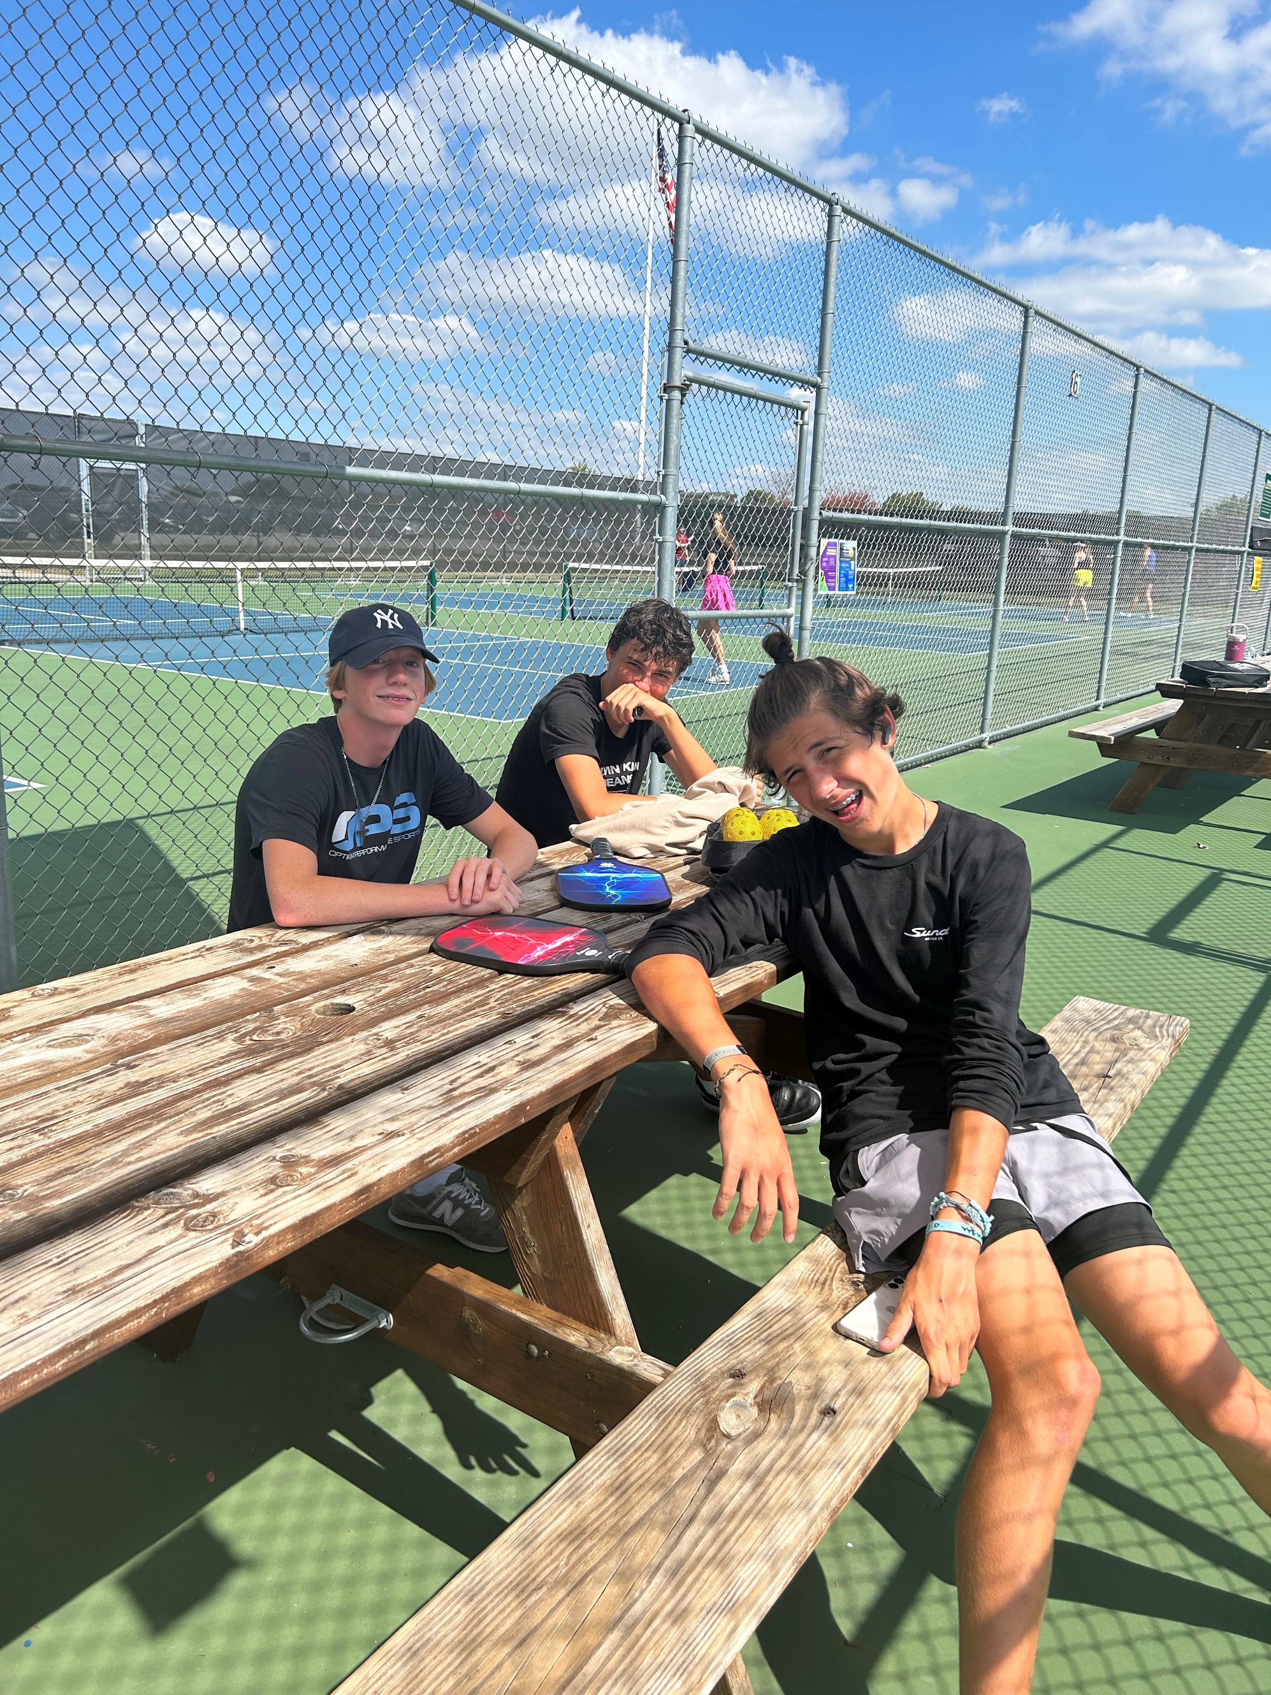
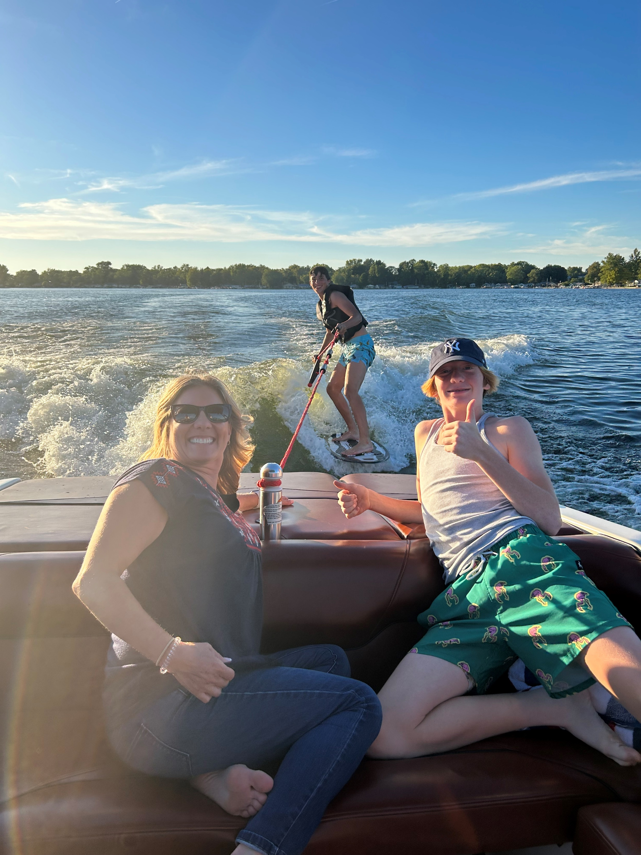
Everyday things….Birthday, swimming, lake, football games, pickleball, and Tour of FW Fire Department Station One

Slide 8
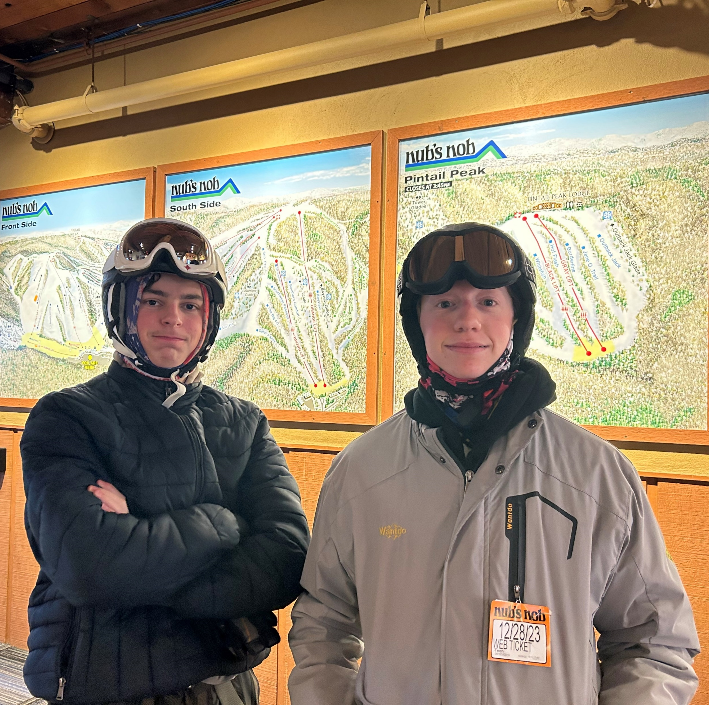
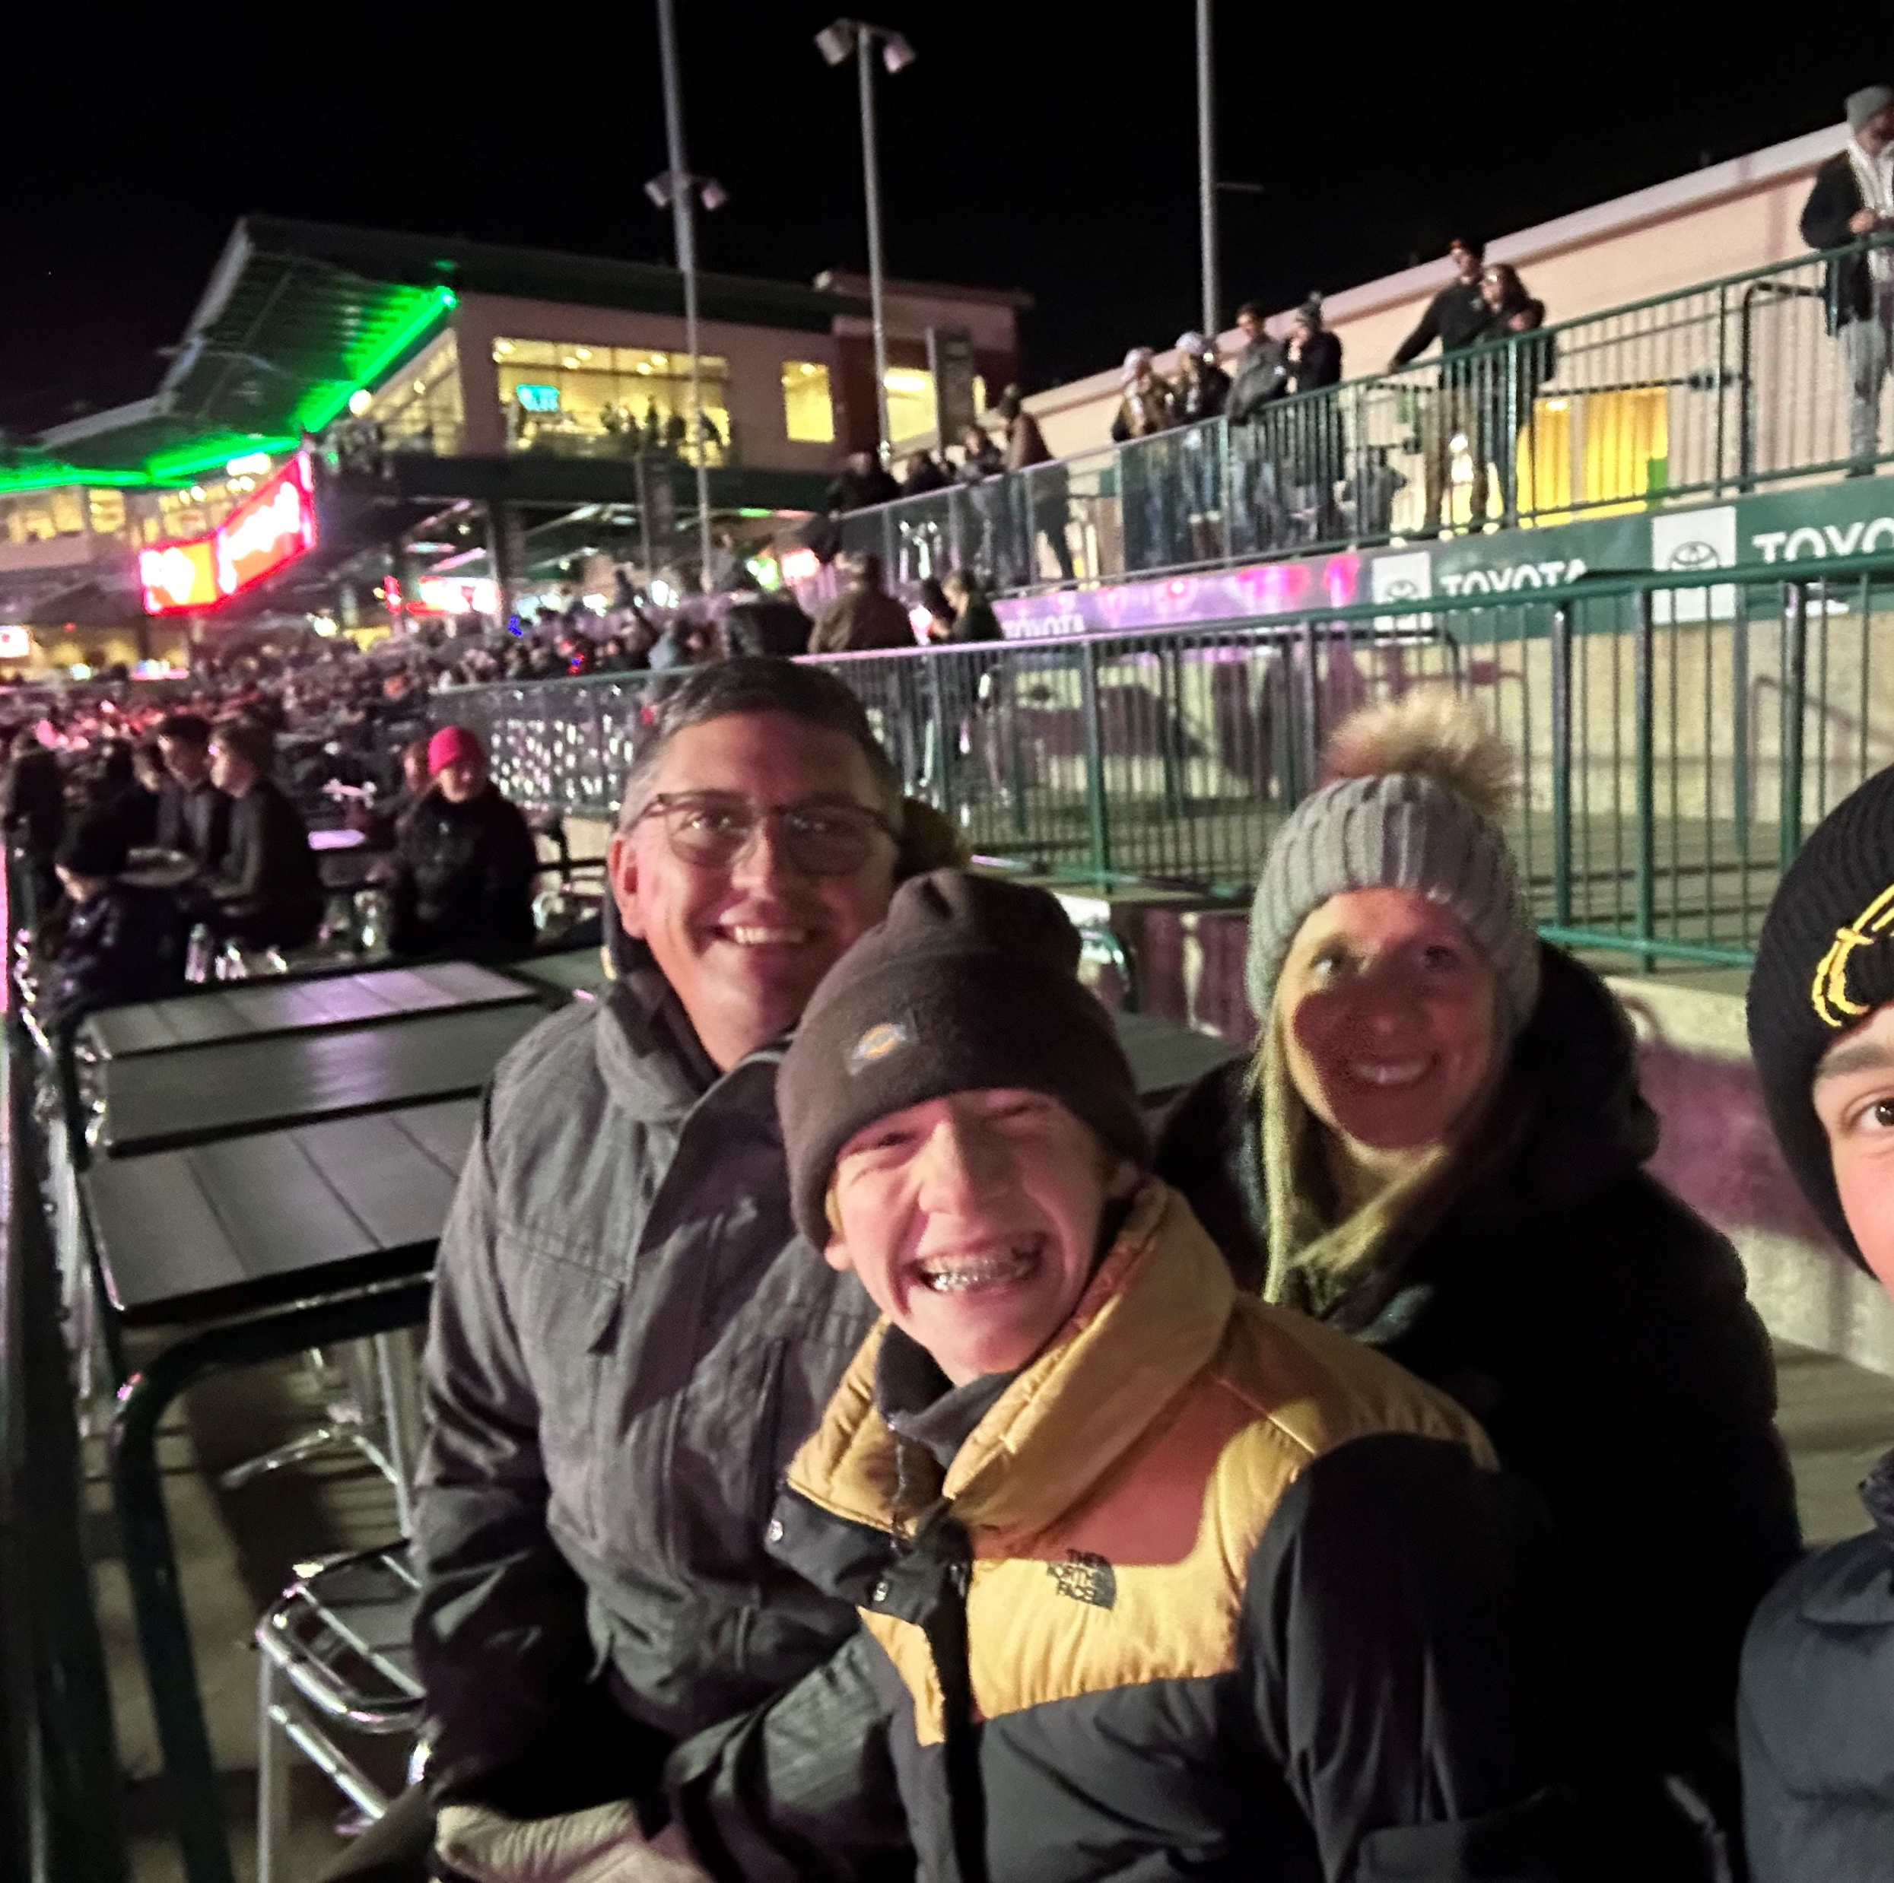
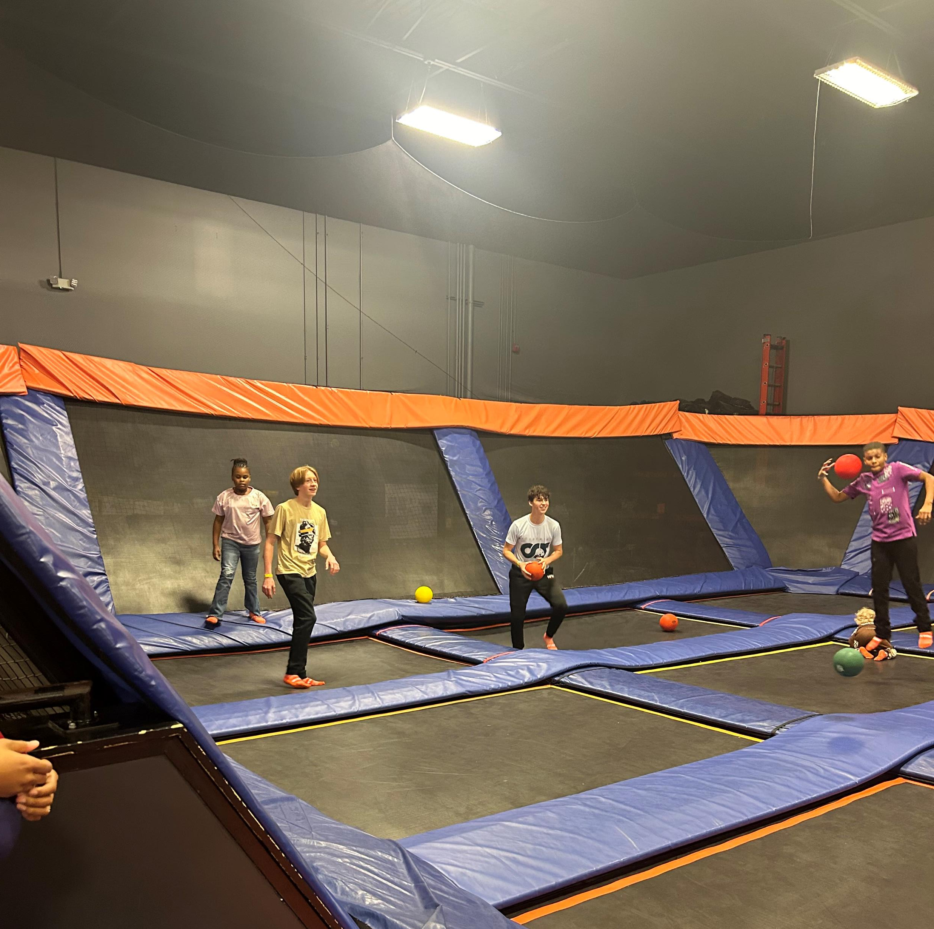
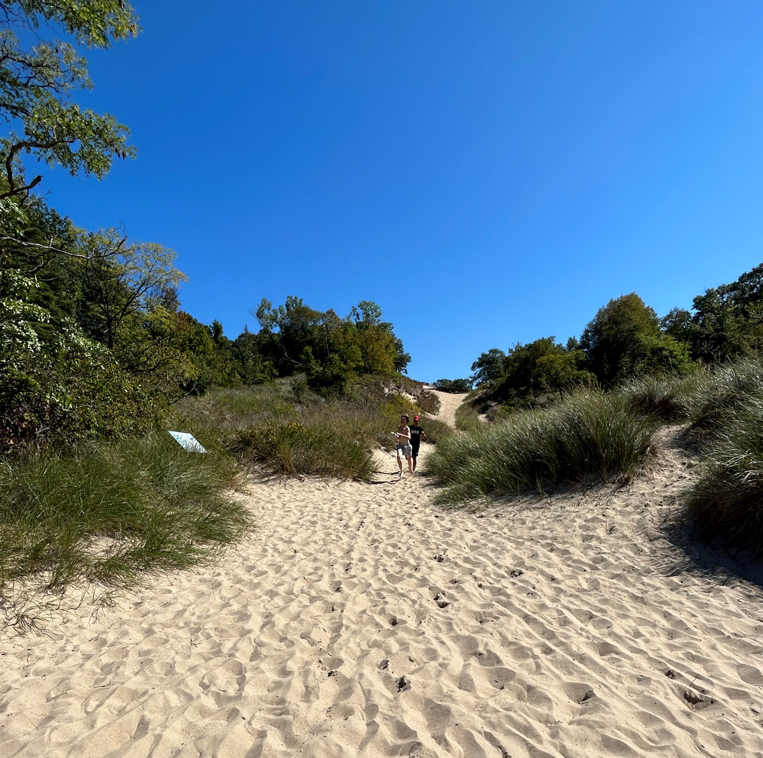
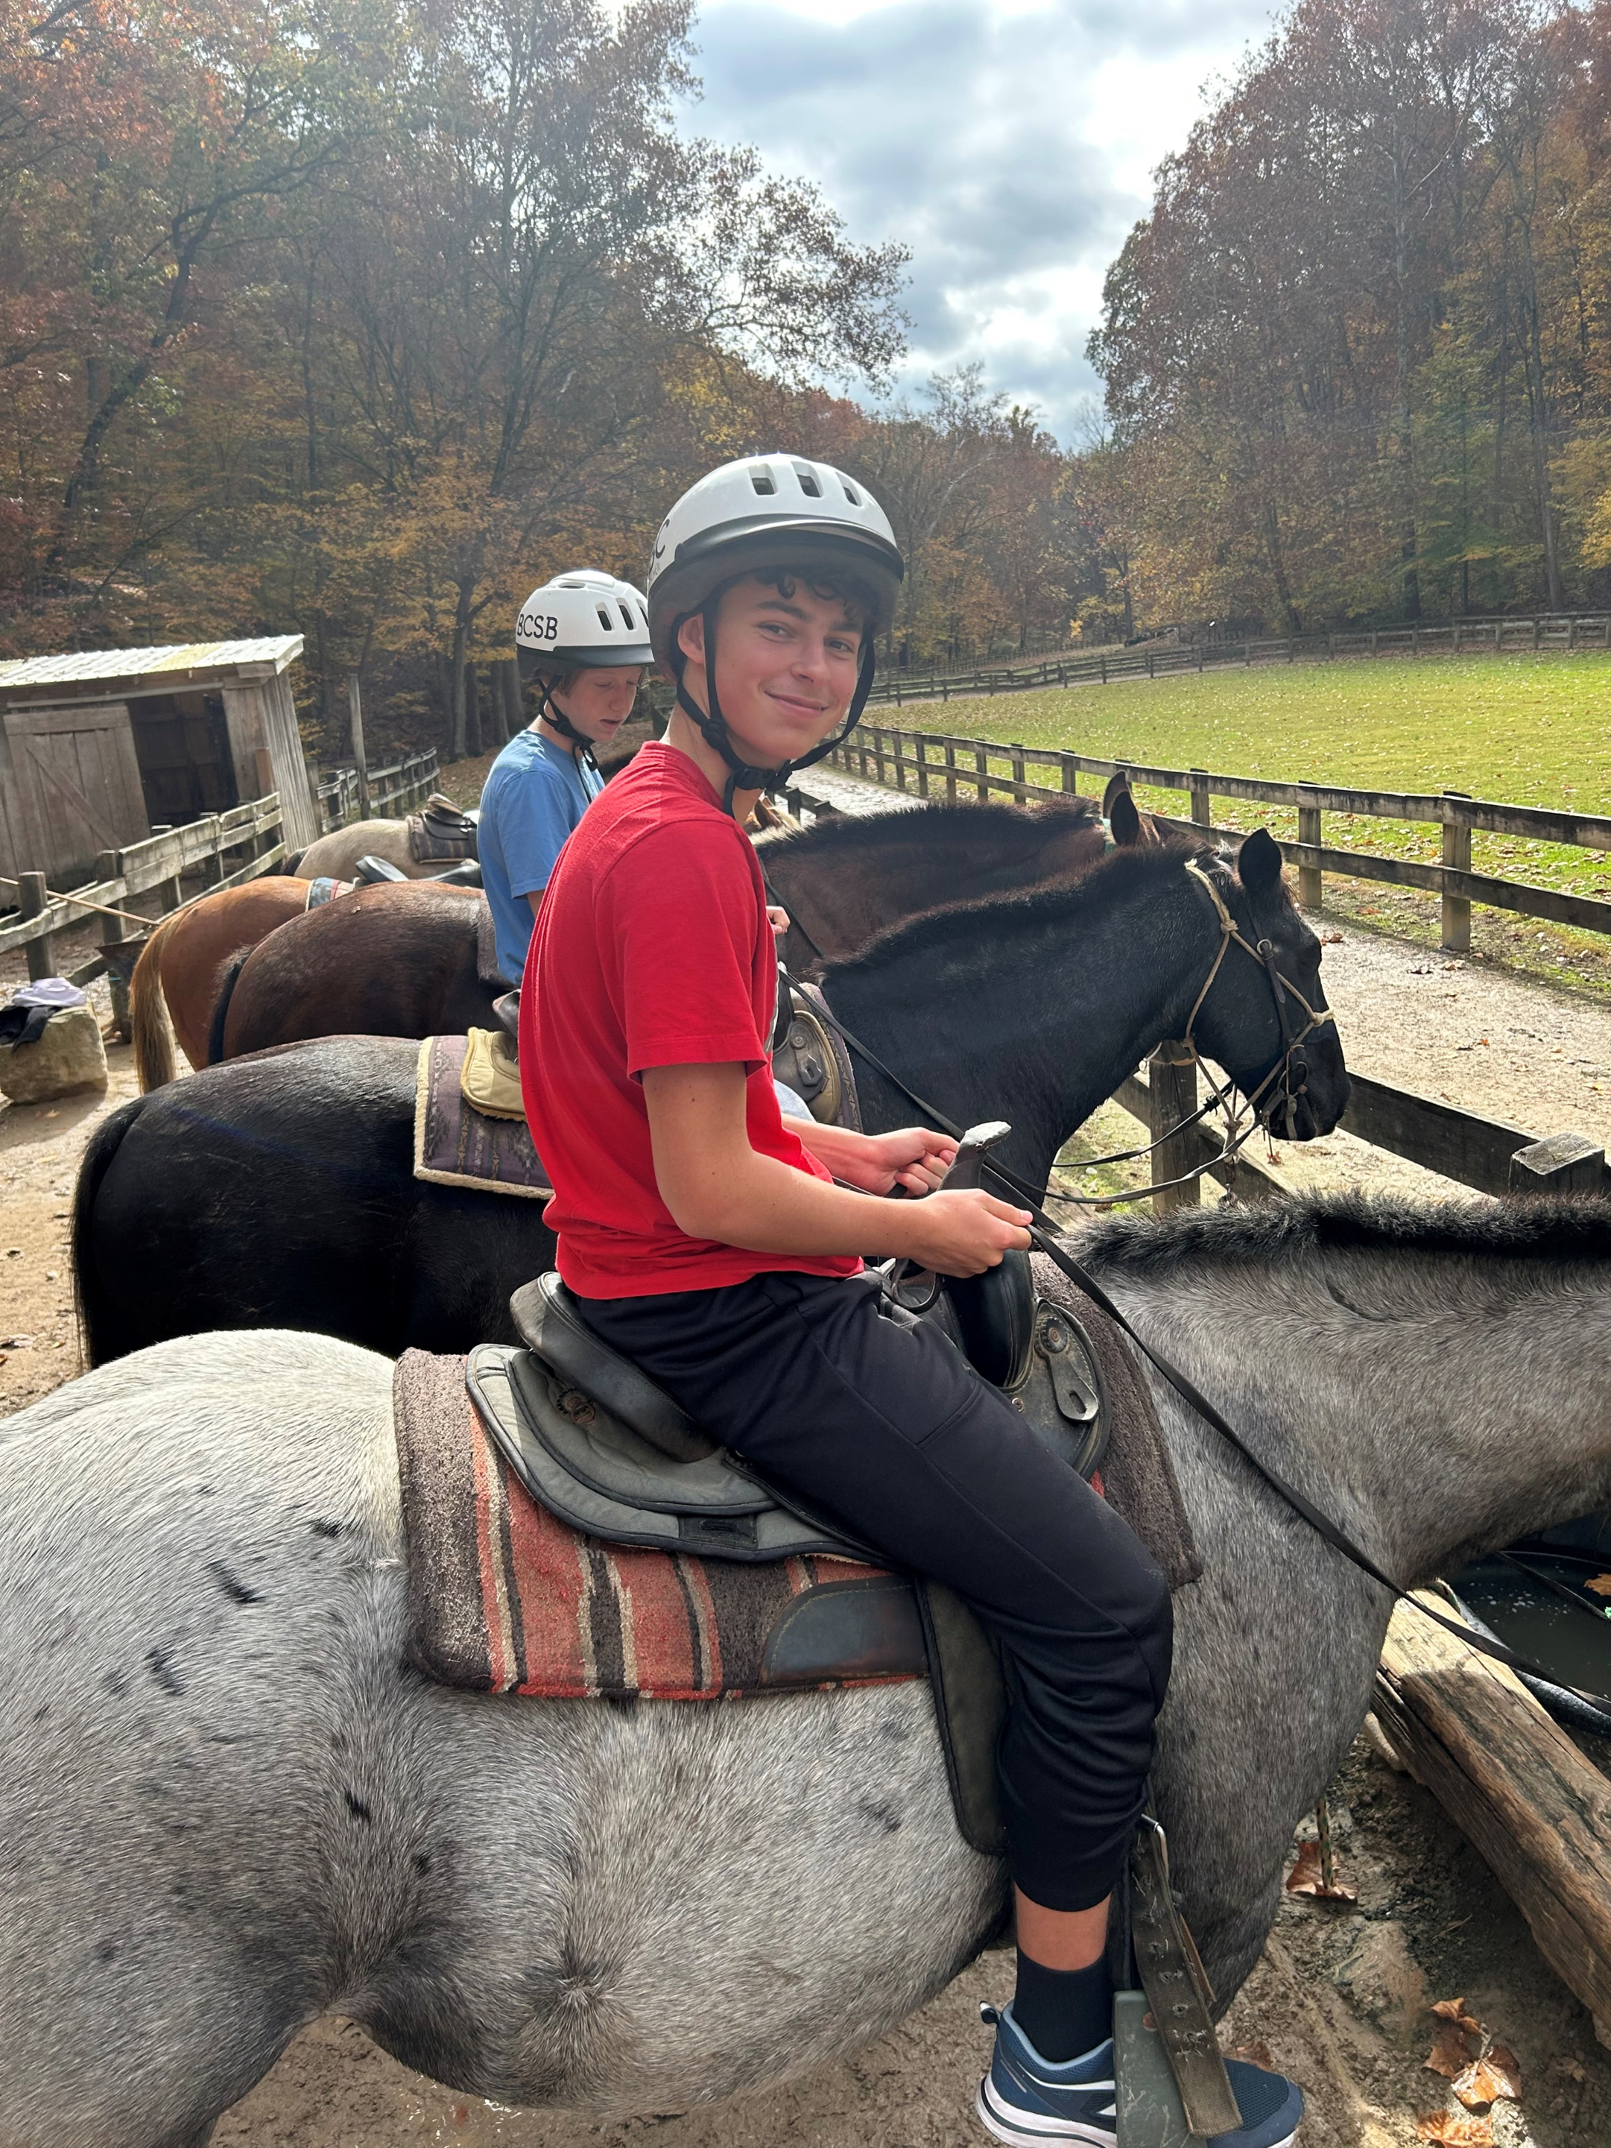
Trips: Indiana Dunes National Park, Brown County State Park, Skiing at Nubs Nobs, Ski zone, Night of lights, and go carting

Slide 9
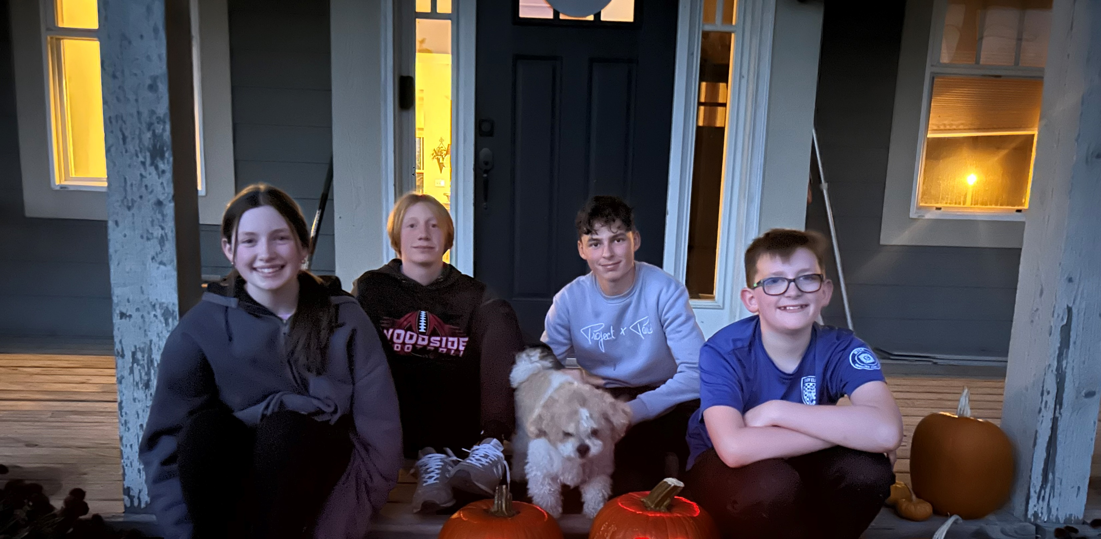
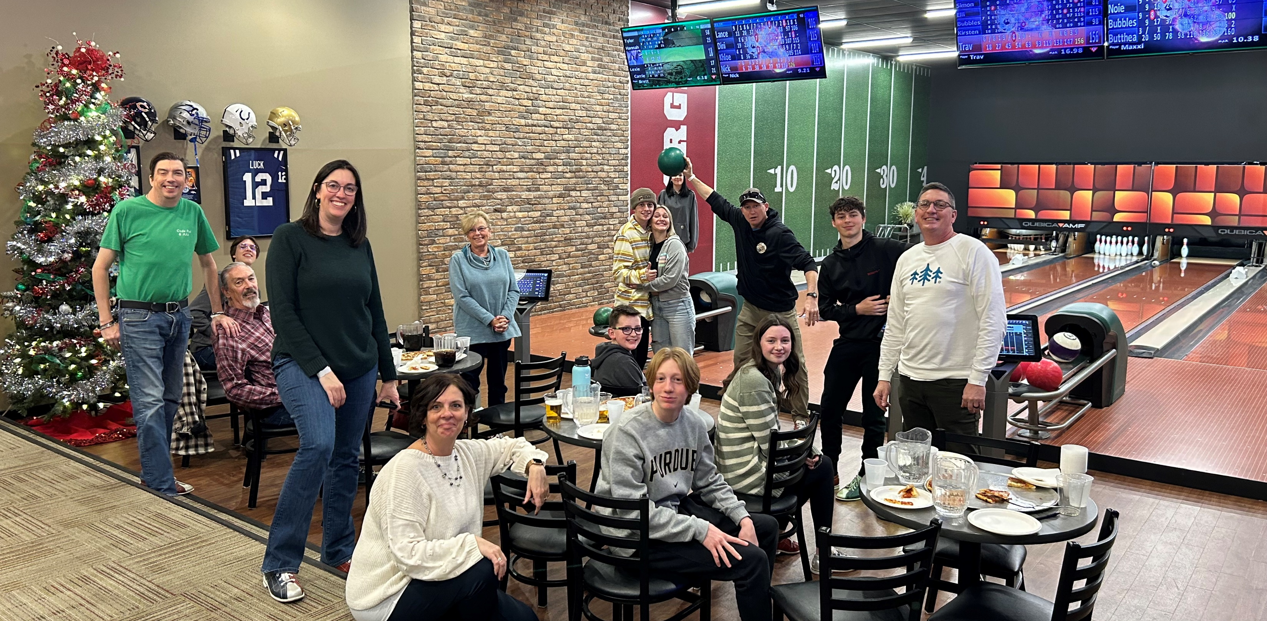
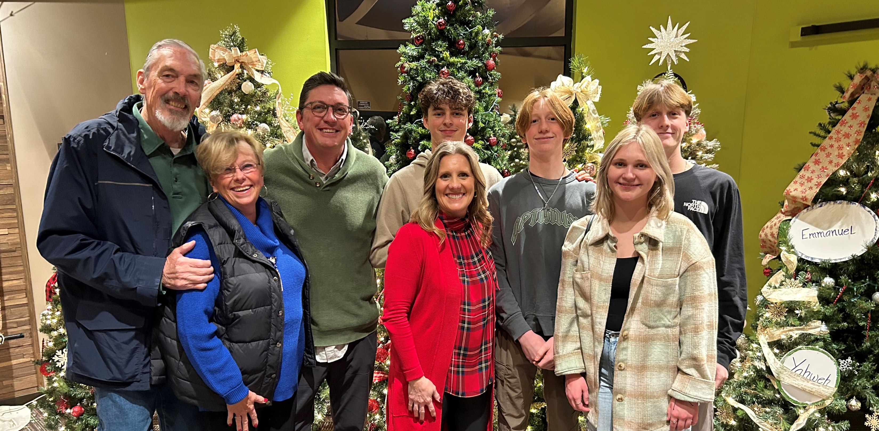
American Holidays: Halloween, Thanksgiving, and Christmas

