Slide 1


BRINGING OUR ACTION PLAN TO LIFE
LESSONS FROM THE 2023 NORTH AMERICA GROWING CLUB STUDY.
Doug Logan, Zone 28 Rotary Coordinator
Herb Klotz, Zone 32 Rotary Coordinator

Slide 2
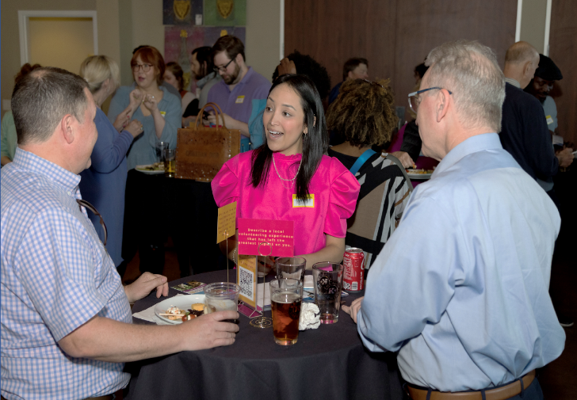
ATTRIBUTES OF GROWING CLUBS (2022 Study)
Active, intentional member engagement
Dynamic, meaningful service
Effective governance (intentional leadership)
Strong public image (well known in community)
Diversity (representative of community)

Slide 3

SURVEY (2023)
ROTARY CLUBS IN USA, CANADA & CARIBBEAN
(Zones 25B-34)
~350 clubs that showed consistent growth between 2018-2023
Top 4% to 5% of ~8,200 clubs
121 responded (35%)

Slide 4
SURVEY CRITERIA
10+ Net Members in 5 years
Growth in at least 3 of last 5 years
Club Sizes Surveyed
35% < 20 members
50% 21 – 59 members
11% 60 – 100 members
4% 101+ members

Slide 5

Survey Overview
Included 10 action statements linked to Action Plan priorities.
Plus, two open-ended questions focused on top reasons for growth in their club.
Example: Increase Our Impact
We set club goals (membership, foundation, service, etc.), track our progress and adjust our actions according to how well we’re doing.
(Check One: Never(1), Rarely(2), Sometimes(3), Often(4), Always(5))

Slide 6
AVERAGE RESULTS BY ACTION PLAN PRIORITY
Increase our Impact 3.8
Expand our Reach 4.2
Enhance Participant Engagement 4.3
Increase our Ability to Adapt 4.2
Never (1), Rarely (2), Sometimes (3), Often (4), Always (5)

Slide 7

ACTION PLAN PRIORITY 1:
INCREASE OUR IMPACT

Slide 8

HOW WILL WE INCREASE OUR IMPACT?
Set realistic goals and track progress.
Strengthen club leadership & governance, especially succession planning.
Focus on our community (local and/or international).
Assess community needs and build meaningful partnerships.

Slide 9

ACTION PLAN PRIORITY 2:
EXPAND OUR REACH

Slide 10
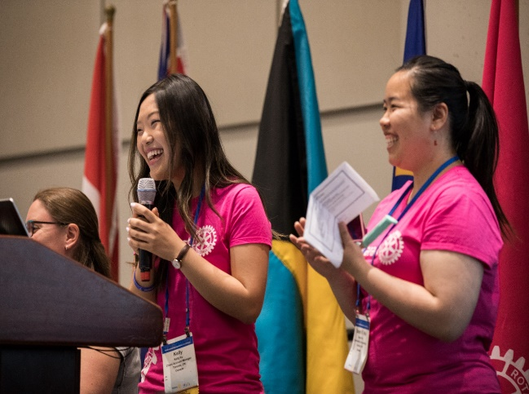


EXPAND OUR REACH
Average attraction
Growing clubs
25%/year
12%/year
All N.Am. clubs
~15%/year
Average attrition

Slide 11
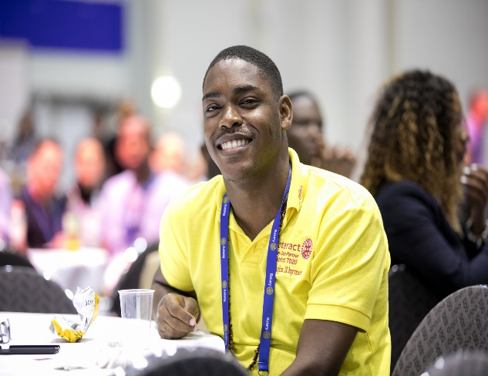
HOW WILL WE EXPAND OUR REACH?
Use multiple forms of media to tell our story.
Engage the whole club in attracting new members.
Invite others to our meetings and service projects.
Ensure membership reflects our community.

Slide 12

ACTION PLAN PRIORITY 3:
ENHANCE PARTICIPANT
ENGAGEMENT

Slide 13
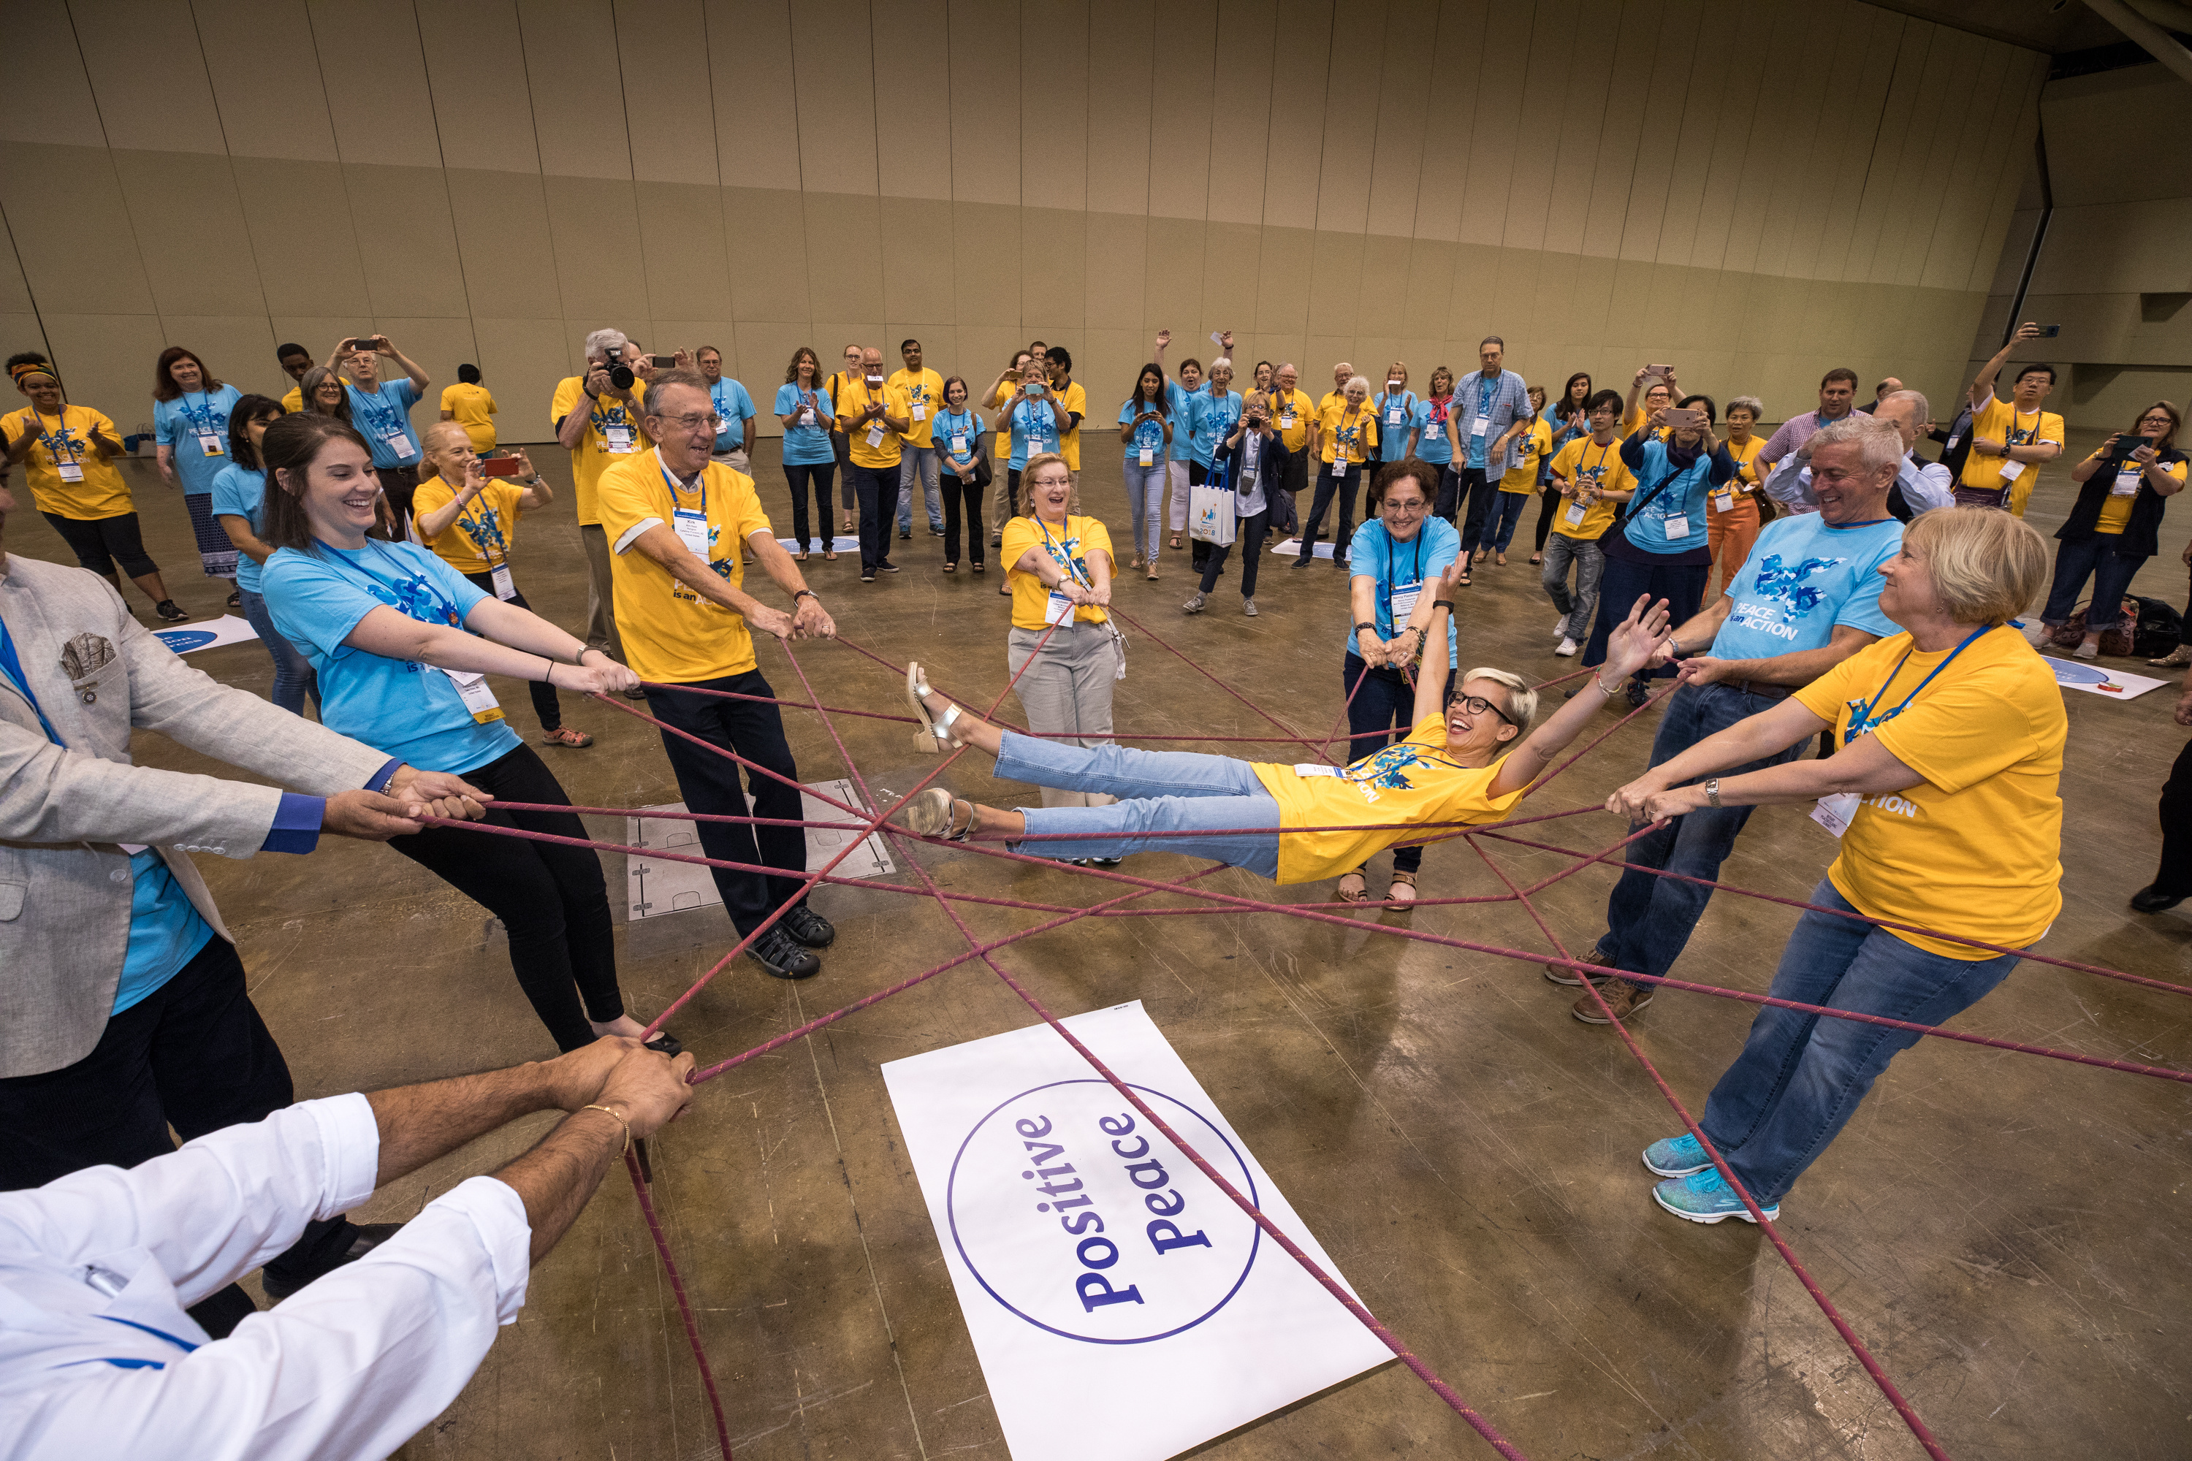
HOW WILL WE ENHANCE PARTICIPANT ENGAGEMENT?
Ensure a welcoming and ‘fun’ club culture.
Find new ways for people to be involved.
Respond to members’ interests and priorities.
Make member ‘care’ a top priority.
Consider the cost of participation.

Slide 14

ACTION PLAN PRIORITY 4:
INCREASE OUR ABILITY
TO ADAPT

Slide 15
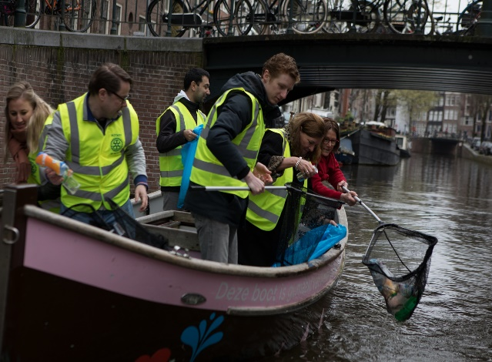
HOW WILL WE INCREASE OUR ABILITY TO ADAPT?
Ensure our club reflects our community.
Use our new members’ innovative ideas.
Try new approaches to meetings, service projects, fun events, etc.
Start a satellite or Impact, Rotaract, Passport club!

Slide 16

Growing clubs’ attraction rates are 10% higher than their attrition rates because they focus on creating an irresistible experience.
Retention is an outcome, not a target.

Slide 17
THANK YOU!

