Slide 1
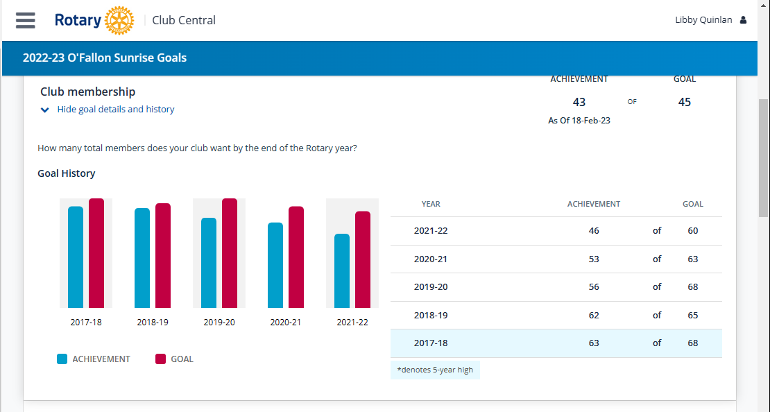

Slide 3
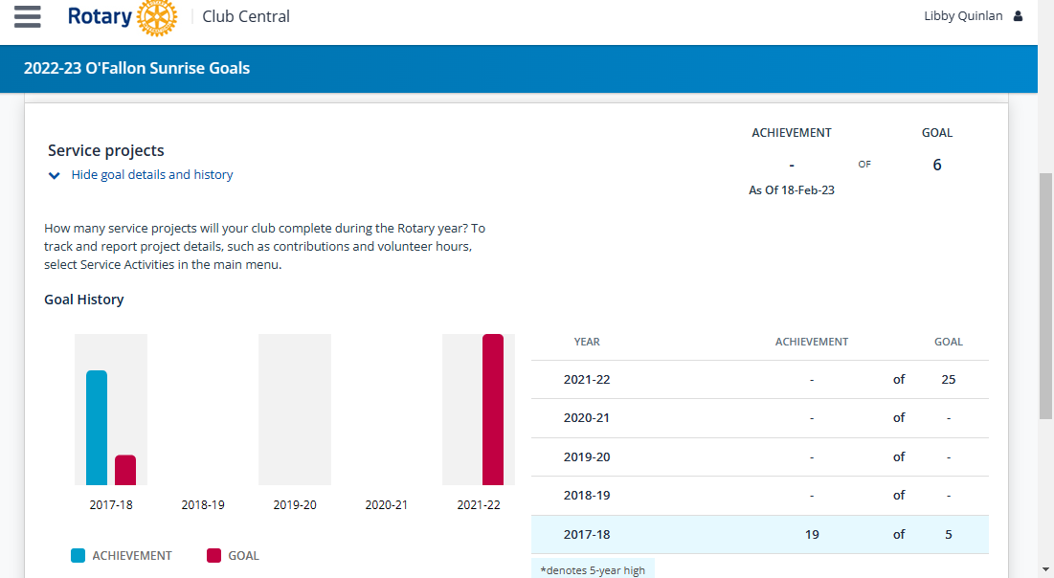

Slide 4
Volunteer Hours
Vine Street Market – 2-hours x 5 people per week (10 hours)
Food Pantry – 4-hours x 5 people one event (20 hours)
Rotary Garden – 2-hours x 5 people per week (10 hours)
Flags – 3-hours x 5 teams per holiday (18 hours)
Annual Grants

Slide 5
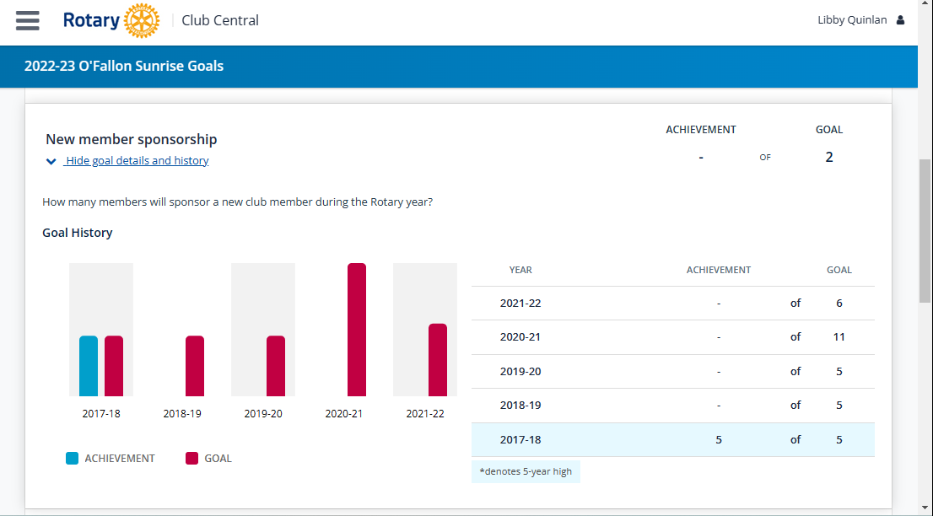

Slide 6
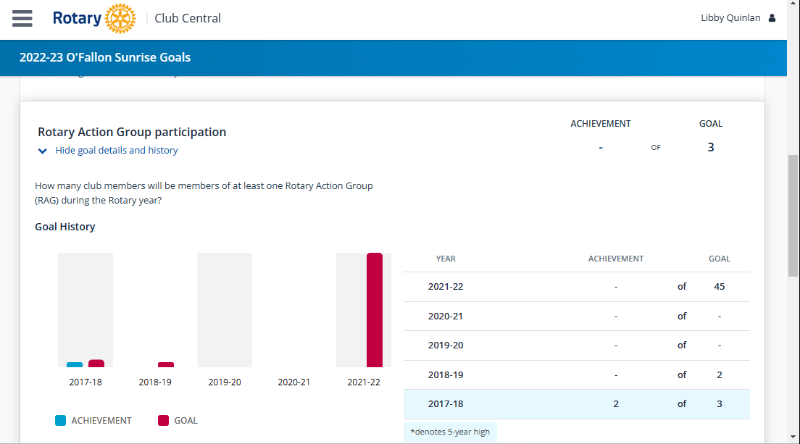

Slide 7
Rotary Action Group …at a glance
Introduction
Rotary Action Groups are international, RI-recognized groups whose members have expertise and
experience in a particular area of specialization. They use their knowledge, passion, and global
network to help clubs and districts plan and implement impactful service projects. By bringing
expertise, partners, funding resources and best practices to projects, they help clubs scale up smaller
projects to larger, higher impact, more sustainable international initiatives.
Every year Action Groups submit a report of activities and finances to Rotary International. These
annual reports summarize the groups’ membership statistics and highlight their humanitarian service activities. The following report provides an overview of the work Action Groups are doing to advance the Object of Rotary worldwide.
Additional information about Action Groups can be found online, www.rotary.org/actiongroups.

Slide 9
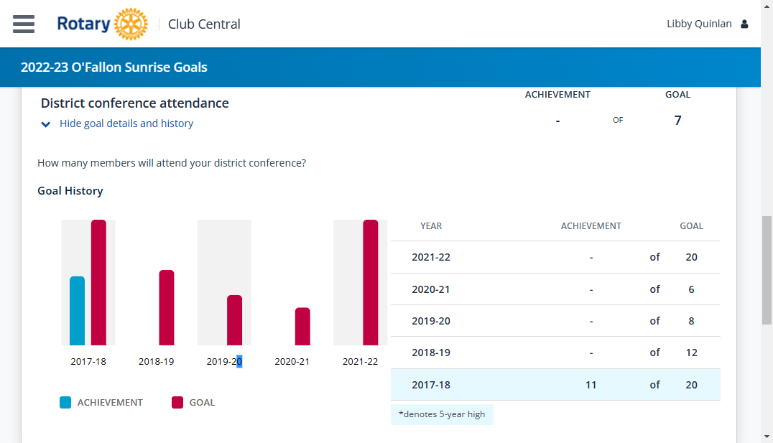

Slide 10
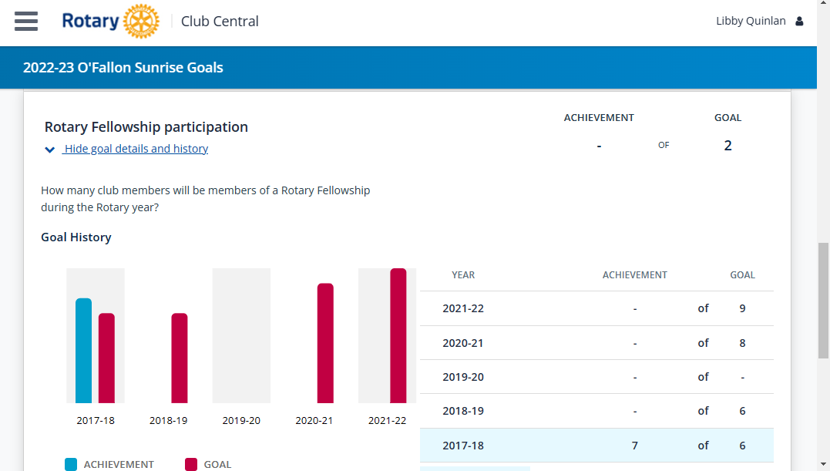

Slide 11
Have you ever wanted to help the club from the comfort of your own chair? Are you interested in a particular subject? One of RI Goals is membership participation in a Rotary Fellowship. Meet like minded people and help our club succeed.
Visit the group's website or email it to learn more.
4x4 vehicles Amateur Radio Antique Automobiles Argentine Culture Badminton Beard and Moustache Bee Beer Bird Watching Bowling Camping Caravanning Chess Coffee Lovers Comedy Composting Computer Users Corporate Social Responsibility Cricket Cruising | Cultural Heritage Curling Cycling Doll Lovers Draughts (Checkers) E-Clubs Editors and Publishers Educators Empowering Women Entrepreneurs Esperanto Ethics European Philosophy Fine Arts Fishing Flying Genealogists Gin Global Development Golf Gourmet Cooking | Graphic Designers Healthcare Professionals Hiking Home exchange Horseback Riding Hunting Internet Italian Culture Jazz Kannada Literature Kites Latin Culture Lawyers Leadership Magicians Marathon Running Metalhead Military Veterans Motorcycling Music Old and Rare Books | Past District Governors Performing Arts Photographers Pickleball Public Health Public Speakers Railroads Recreational Vehicles Rotary Means Business Scuba Shooting Sport Singles Skiing Social Networks Strategic Planning Whisk(e)y Wildlife Conservation Wine Yachting Yoga Young Rotarians

Slide 12
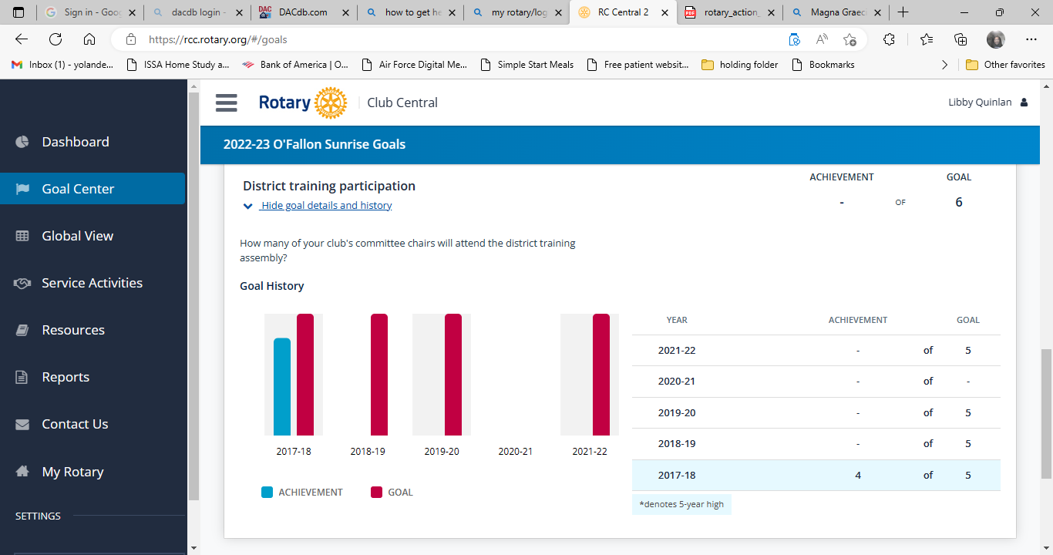

Slide 14
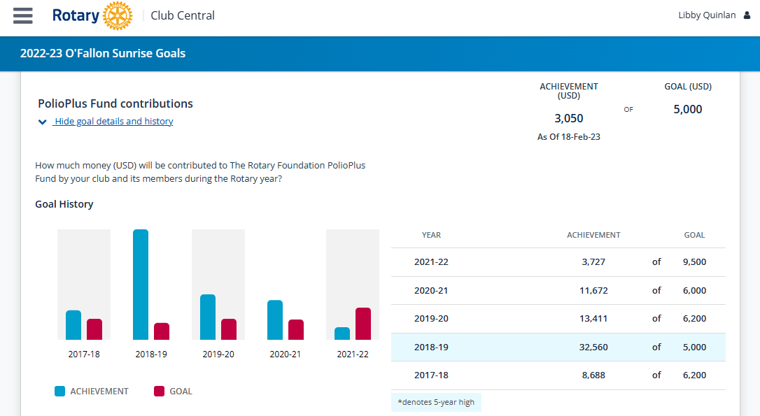

Slide 15
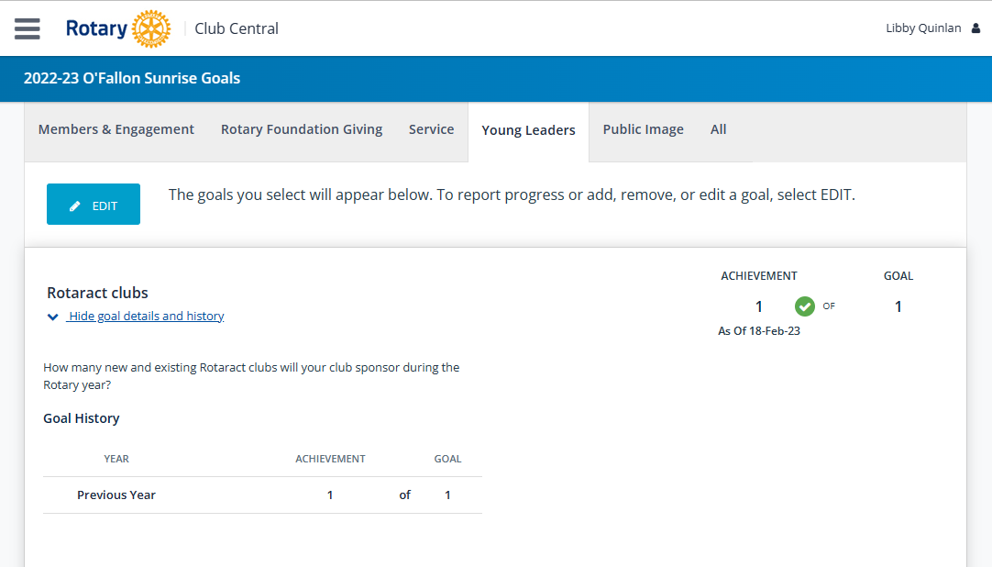

Slide 16
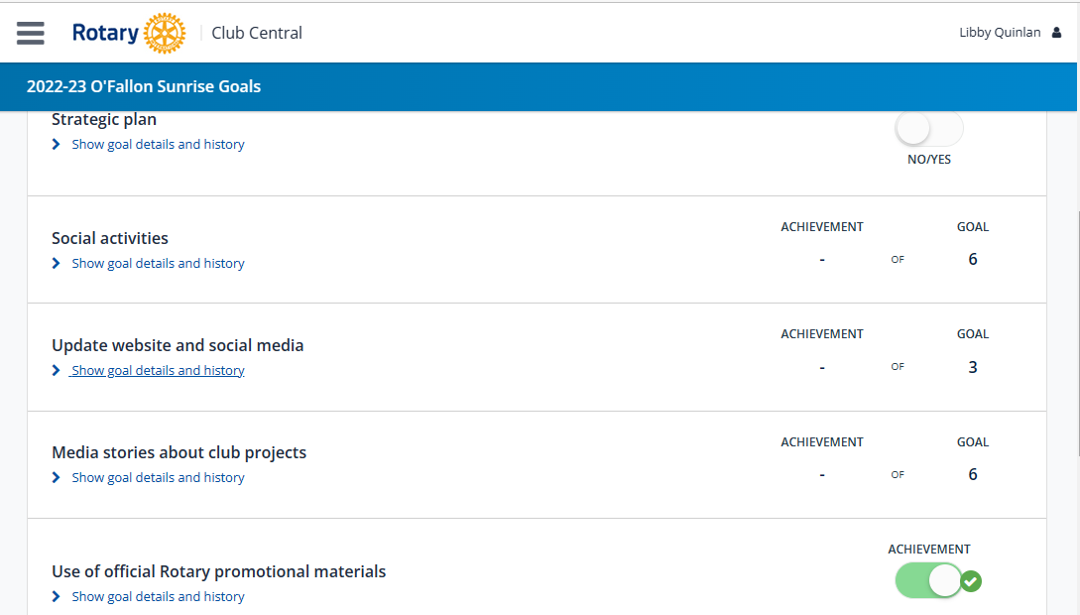
We do need to host a visioning.
Sunrise at Sunset is a perfect example.
Thank Steve Stater by assisting and providing content.
Help Steve by providing content.
The RI President’s banner is up at every meeting.

