Slide 1
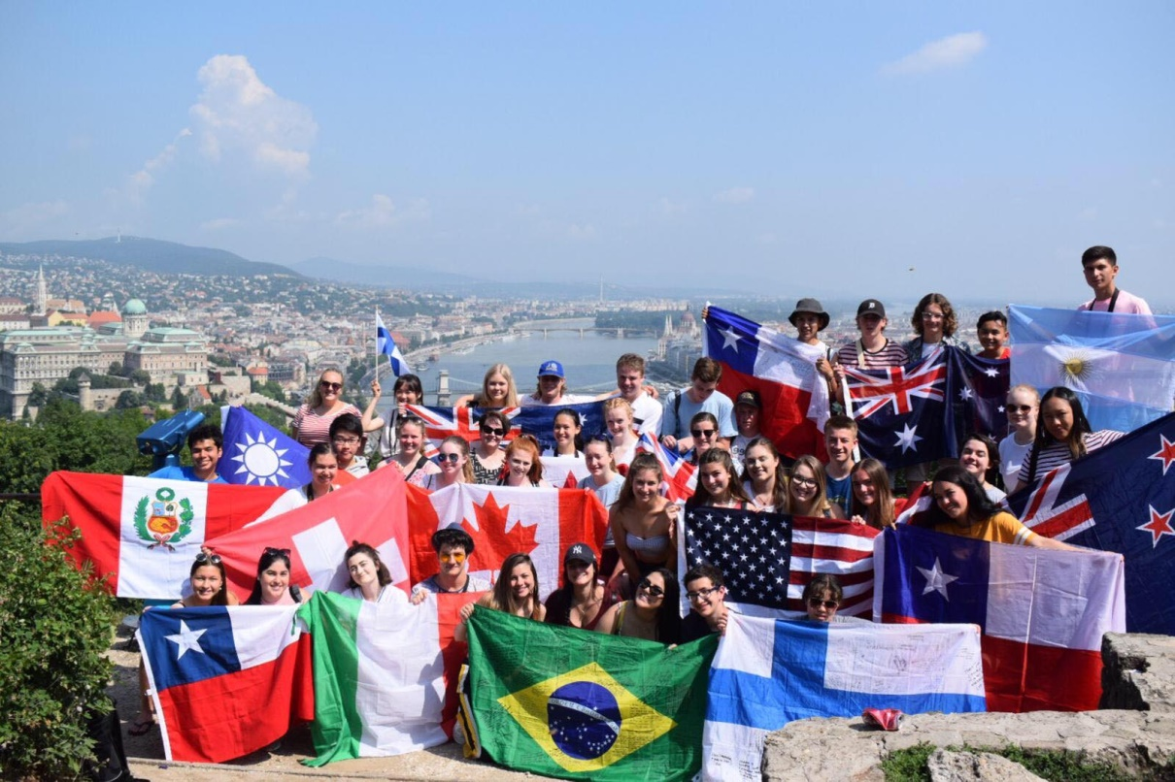
The future of Rotary begins with Youth!

Slide 2
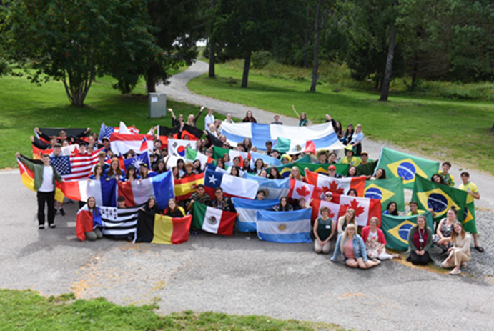
Why Rotary Youth Exchange? Peace, Leadership, and Global Competence
4th Object of Rotary… promote international understanding, goodwill, and peace...
Rotary Youth Exchange promotes peace through cultural understanding and develops leadership in youth.
The US Dept. of State: build programs that imbue students with global competence.
Pre-Covid: ~10,000 Total Student Exchanges
Notes:
“imbue” – tough word…inspire?
Object of Rotary
The Object of Rotary is to encourage and foster the ideal of service as a basis of worthy enterprise and, in particular, to encourage and foster:
FIRST: The development of acquaintance as an opportunity for service;
SECOND: High ethical standards in business and professions; the recognition of the worthiness of all useful occupations; and the dignifying of each Rotarian’s occupation as an opportunity to serve society;
THIRD: The application of the ideal of service in each Rotarian’s personal, business, and community life;
FOURTH: The advancement of international understanding, goodwill, and peace through a world fellowship of business and professional persons united in the ideal of service.

Slide 3
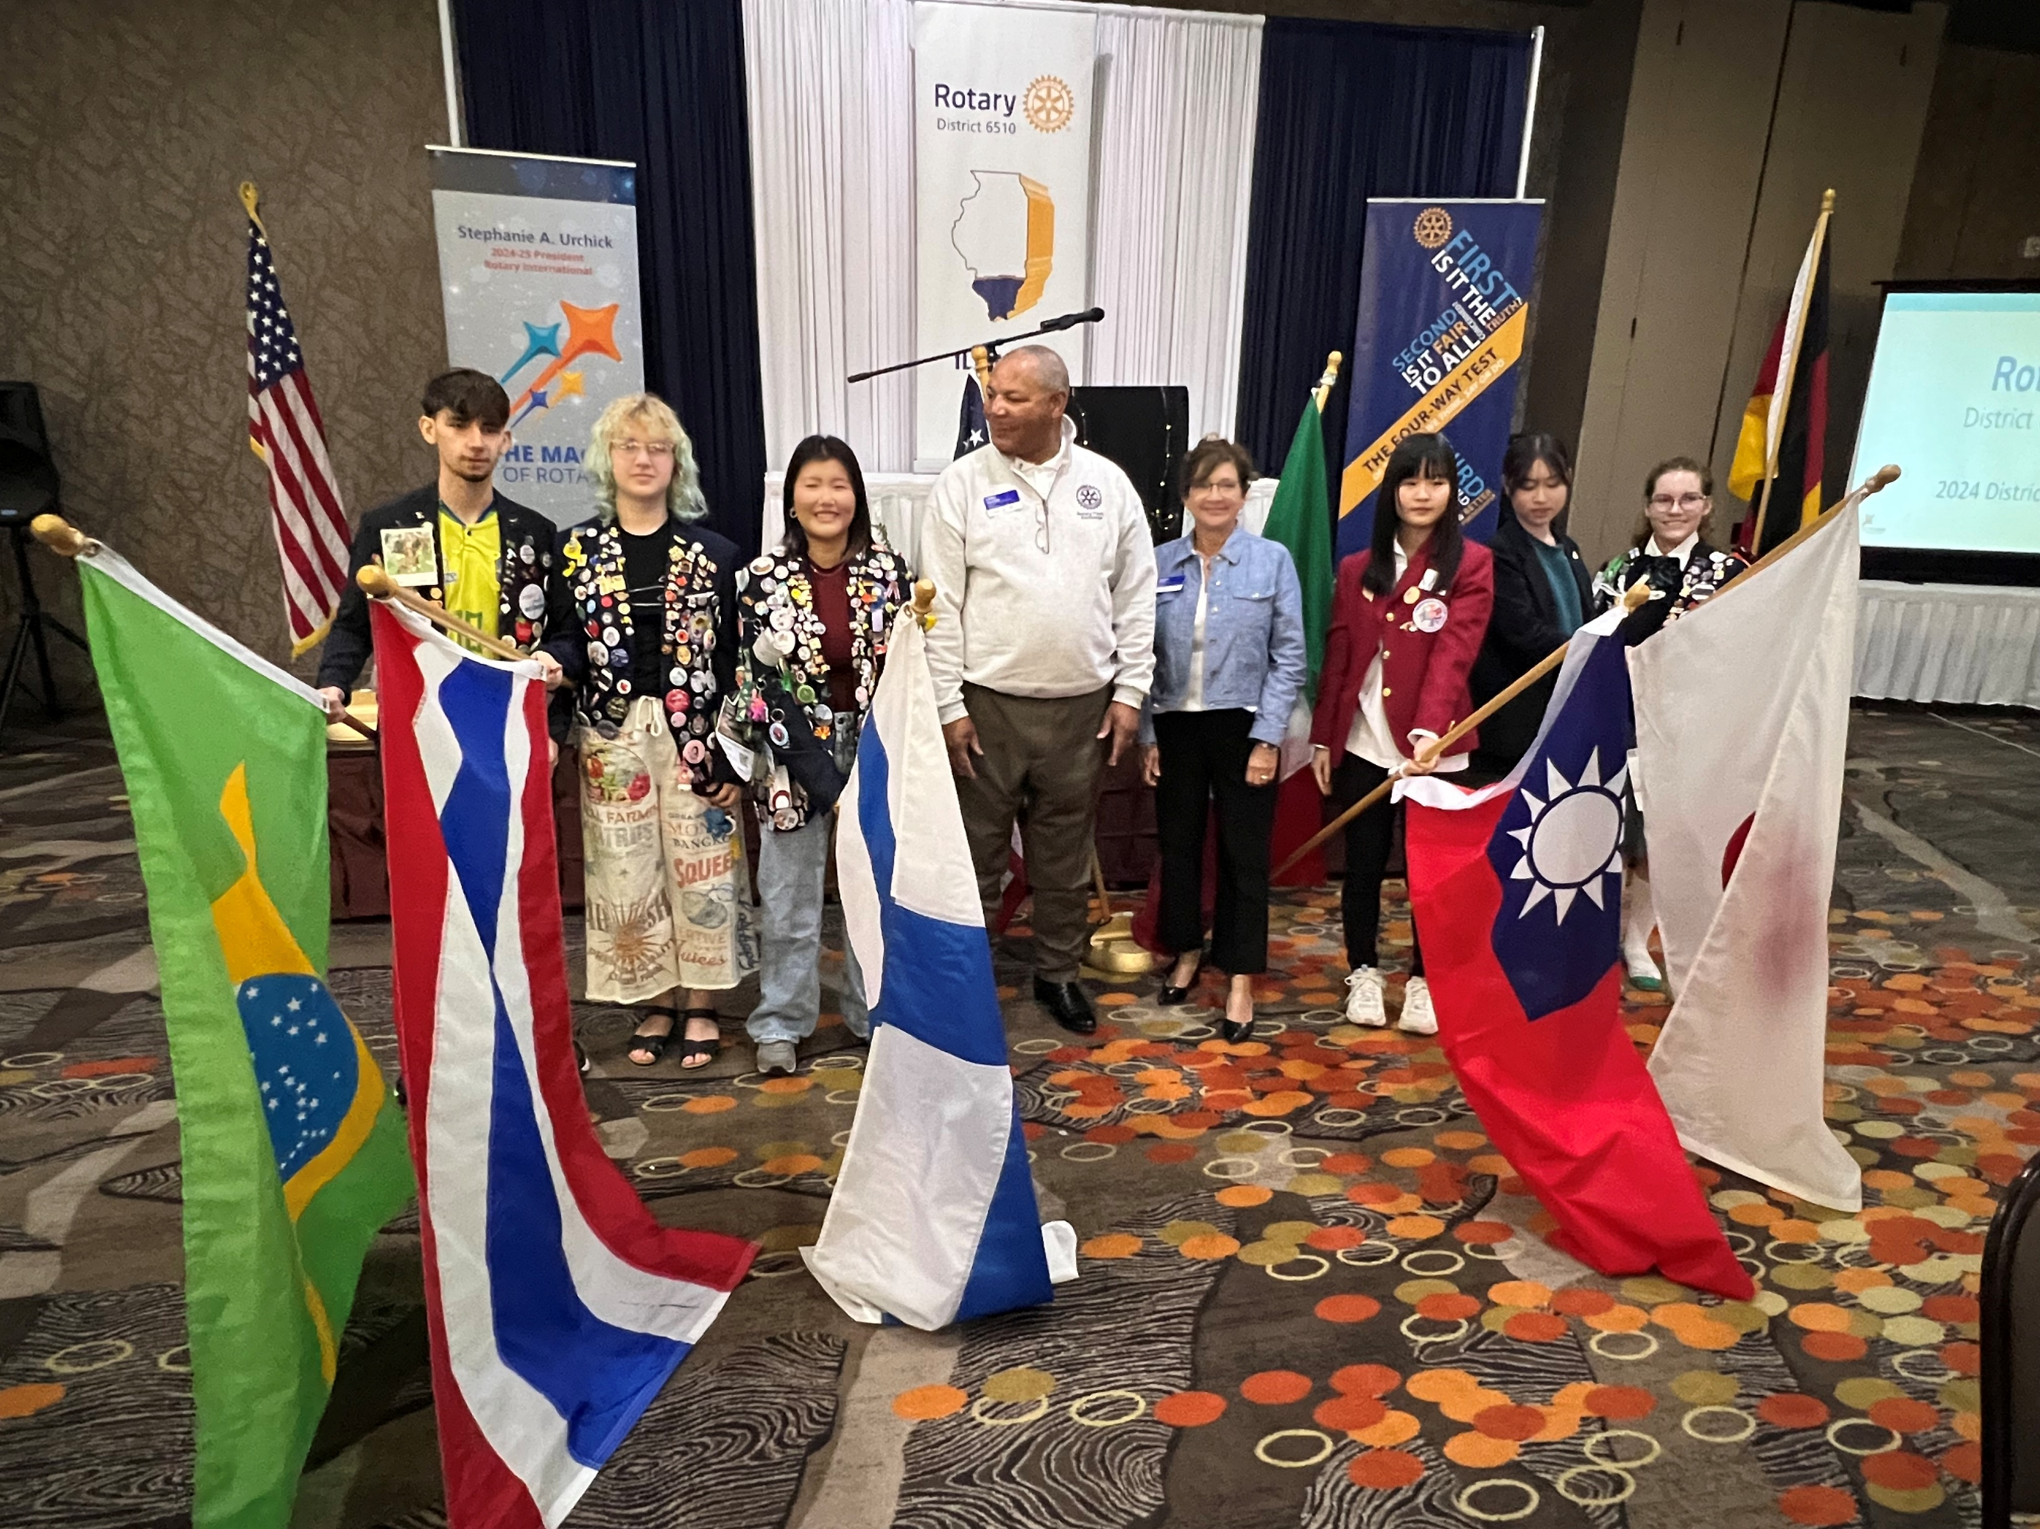
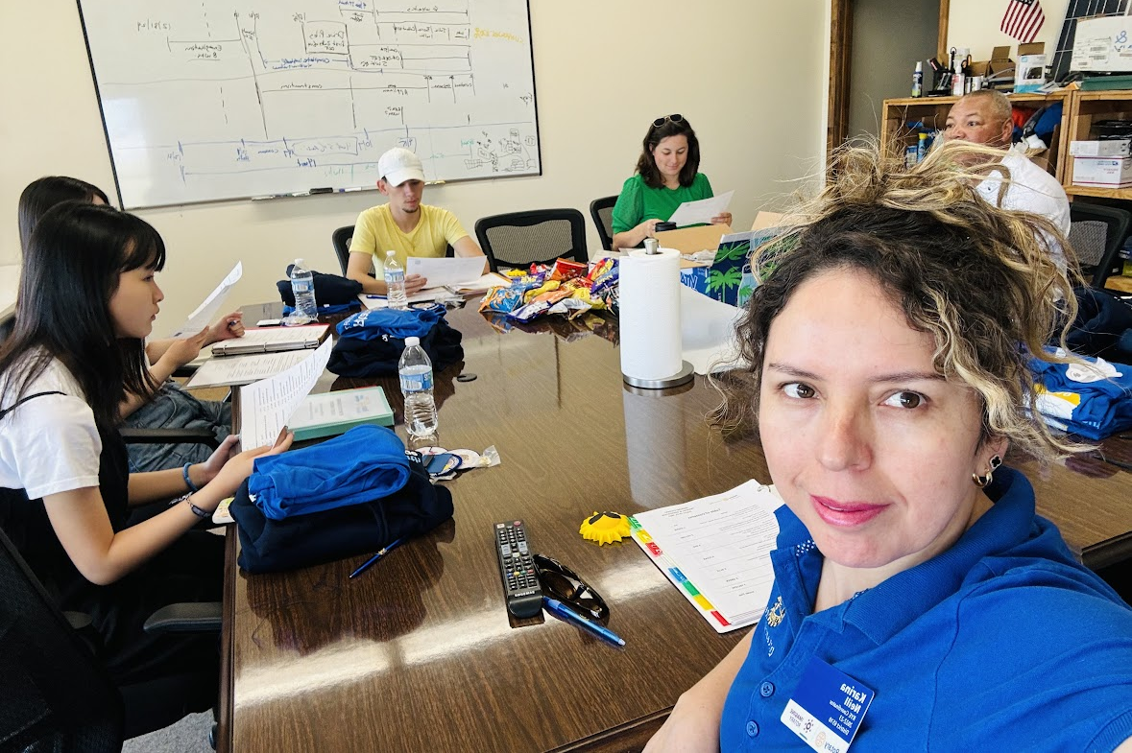
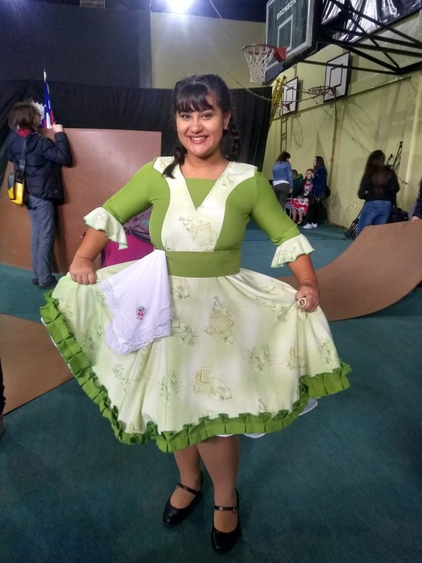
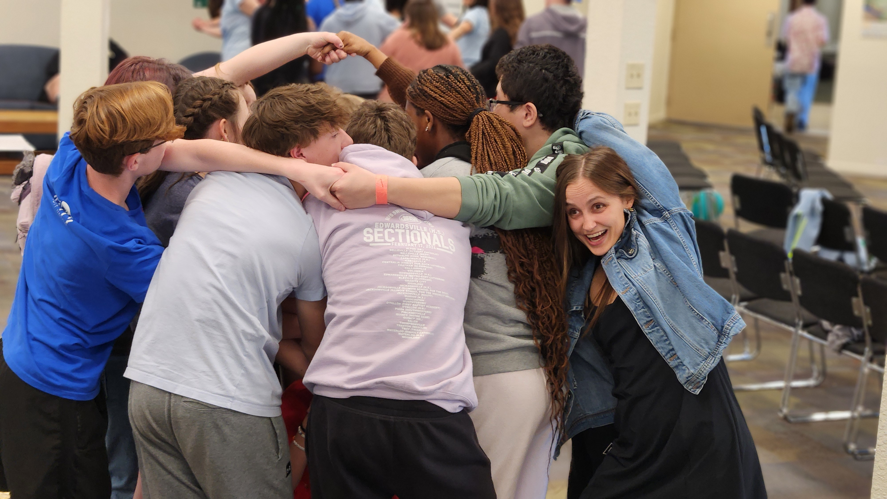
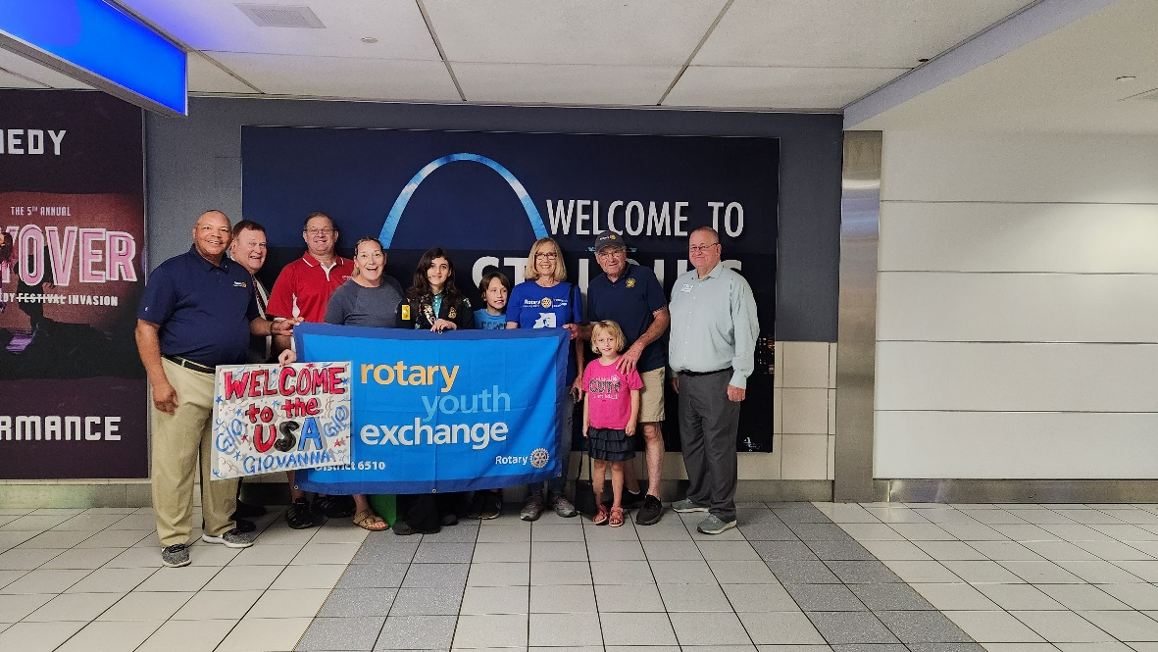
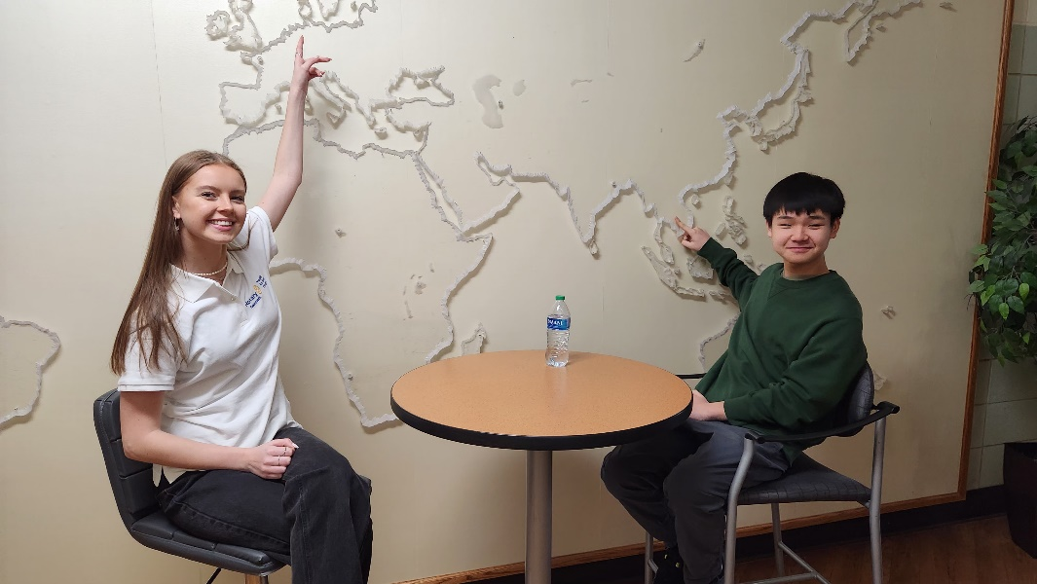
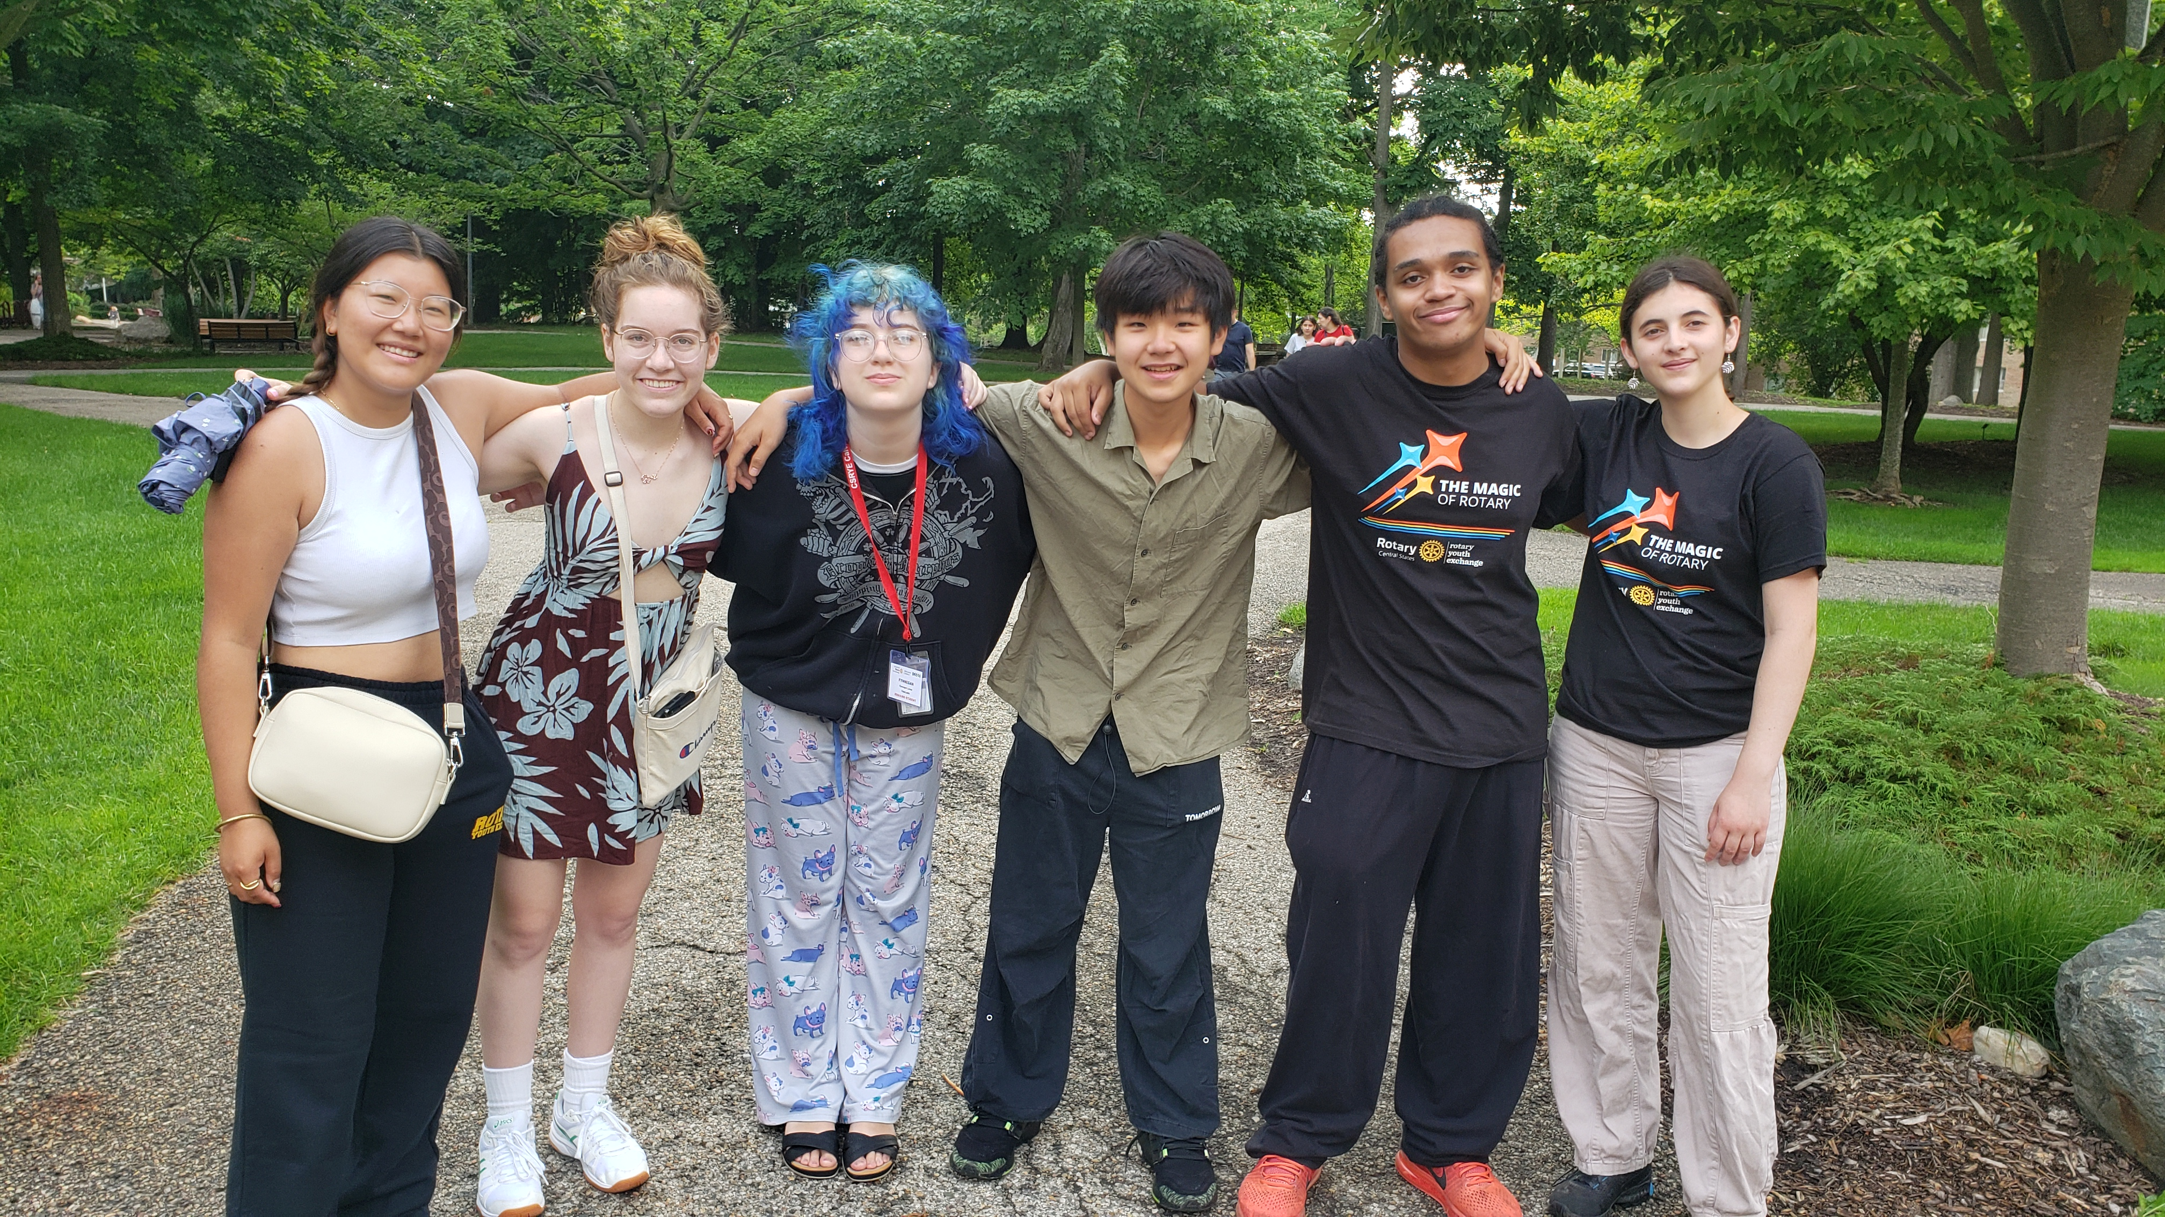

Slide 4
Club Sponsorship For Inbound Student
What Does It Cost?
Annual budget estimate to sponsor Inbound students: ~$2,825
$1,625 which covers – various planned activities:
Inbound Orientation
CSRYE Administrative Costs
CSRYE Summer Conference in Grand Rapids, Michigan
D6510 Administrative Costs
Activities including District Conference, St Louis, Springfield, Chicago, Winter Weekend, LOLPETS, End of Exchange Picnic, Shawnee Forest – Zip Lining, and Rotary Youth Leadership Award (RYLA)
$1,200 Student Allowance ($100 monthly)
$0.00 Optional Expenses Cell phone, some school expenses, gifts, miscellaneous

Slide 5
Club Sponsorship For Inbound Student
What's Required?
Find 2-3 host families for the student in the same school district
Appoint a Youth Exchange Officer (YEO) and a
Youth Exchange Counselor (YEC)
Per the Rotary International (RI) Code of Policies
YEO and YEC cannot be the same person
Both must complete the required training
Background checks are required

Slide 6
Club Sponsorship For Inbound Student
What is required?
Responsibilities of the Club YEO (Officer)
Administrative & program management
Arrange for schooling and introduce the student to the principal
Oversee student emergency fund and other important papers
Ensure that the student receives a monthly allowance
Introduce and integrate into your Rotary Club
Arrange to celebrate the student’s birthday, Christmas, and other holidays.

Slide 7
Club Sponsorship For Inbound Student
What is required?
Responsibilities of the Club YEC (Counselor)
Advocate for the student with difficulties at home or school
Works with the Club YEO
Meet with the student once or twice a month
Represent students’ points of view in case of conflict
Help student deal with any problems, fears, and worries, and self-discipline if he/she goes off track
Main Liaison with the high school

Slide 8
Club Sponsorship For Outbound Student
Club costs to sponsor an outbound student: $0
Parents pay a $10,000 flat fee per outbound student
Flat fee covers most US costs, but not additional host-country costs
Gives parents predictable $$ when they need to make decisions
Sponsor club must appoint a Youth Exchange Counselor (YEC) per the RI Code of Policies
Low demand position, but must complete RI required training
Assist the District team in the interview and selection process
Involve the sponsored outbound student in club meetings/activities
Notes:
How much will my exchange cost?
Rotary will provide the host families for your exchange and enroll you at a school for no charge. Rotary will provide you with your Rotary Youth Exchange blazer and a small monthly allowance.
The main costs you incur for an exchange are the return airfare and insurance along with the “exchange tour”. Depending on your host country, the “exchange tour” could be for 10 – 20 or more days. For European countries this is usually a “Euro Tour” while for other countries it might be a “cross country tour”. The Euro/Country tour is one of the highlights of the exchange as it brings many of the exchange students that are in that country together for the trip and it is where life-long friendships are made while at the same time seeing some amazing sights.
In addition to this your other costs will be for day to day living in your host country. Rotary is a non-profit service organization which facilitates travel and insurance and does not take a profit on these costs. The funding of day-to-day living costs will be directly between parent and student. We provide latest estimates of costs based on information provided by returned exchange students.
So what's the bottom line - how much does it cost?
Assuming you do not currently pay school fees in New Zealand, the extra cost above being at home is probably about $10,000
Approximate costs are:
Pre departure Costs: Selection Weekend (Live in) $350Administration Fee $100Marae & Orientation Weekend (live In) $350Rotary Exchange Blazer FreeAuckland Day FreePre Departure Briefing Free Medical & Dental Certificates $200 Exchange Base Costs: Comprehensive Insurance, Visa, Chaperones**, airfares $8,000 - $10,000 Euro Tour (or similar) $3,500 - $4,500
* For some countries the student must visit the countries embassy in Wellington. * * A Rotarian couple will accompany students (usually to the airport for their final flight).
The cost is not paid in one sum and is spread over a year or so.
Insurance and airfare costs are payable at the end of November/early December prior to departure.
While the Euro/country tour is not compulsory, it is a real highlight of the exchange. The timing for payment will be set by the host country but is usually around April.
Language school costs where applicable will be payable in January.
The balance of the costs, not included above, will be for day to day living and will be spread over the exchange year and the extent of these costs will depend on the activities that you choose to engage in, but might be around $500 per month.
Your host Rotary club and host families will provide accommodation and meals together with schooling enrolment.
Your host Rotary club will pay a small monthly allowance that will help with some of the daily out of pocket expenses.
A $500 (Approx.) emergency fund will be required on arrival in the host country, but if unused during the year, this will be refunded at the end of the exchange.

Slide 9
Student Eligibility
Good academic standing: top 50% of class or 2.75 GPA.
Age between 15 – 18 ½ before departure
Leadership qualities; adaptability and flexibility; positive character.
Medical Exam
Student and parent interviews
Sponsored by a local Rotary Club
Family affiliation with Rotary is not required

Slide 10
Planning for 2025-2026 Students
For the 2025-2026 school year…
Clubs and High Schools need to signal hosting intentions
COVID-19: All exchange students must be vaccinated

Slide 11
Planning for 2025-2026 Students
In District 6510… Clubs and High Schools need to signal hosting intentions In the 6 Rotary years from 2014/15 through 2019/20: - 16 clubs hosted 48 foreign students from 25 countries - 18 clubs sponsored 38 American students to 21 countries 2022-24 Rotary Year: - 7 clubs hosted 7 foreign students from Brazil, Denmark, South Korea, and Thailand - 8 clubs sent 8 students to Chile, Finland, Japan, Sweden, Taiwan, and Thailand
2025-2026 Rotary Year
- 4 clubs hosting 4 foreign students from Belgium, Brazil, Germany, and Thailand - 3 clubs sponsoring 3 American students two to India and one to Thailand
Will you host or sponsor students in your community?

Slide 12
What Do We Need From You?
Support For Rotary Youth Exchange has many forms…
Sponsor outbounds – our children need to know about the world they live in so they can function in the global economy
Host inbounds – Create a lasting impression about the USA
Recommend qualified host families for inbounds
Who do you know in your church or other community organizations?
Advocate – Spread the word in your local high school(s)
Volunteer to participate in youth exchange activities
Remember our website
www.studyabroadscholarships.org

Slide 13
No Amount of Money…
No Amount of Effort…
No Amount of Time…
… is ever wasted when spent on the youth of our country!!
They will never forget the positive experience you provided.

Slide 14
Questions?
Libby Quinlan, DGN
D6510 Youth Exchange Chair
district6510rye@gmail.com
www.studyabroadscholarships.org

