Slide 1

The Paul Harris Ladder
A Tour of the Paul Harris Pins

Slide 2
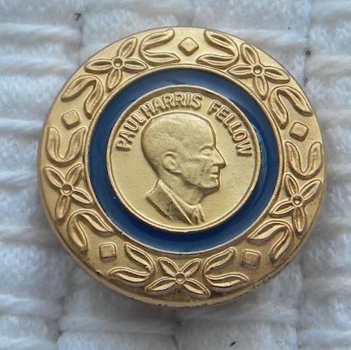
Your First Paul Harris Fellow Pin

Slide 3
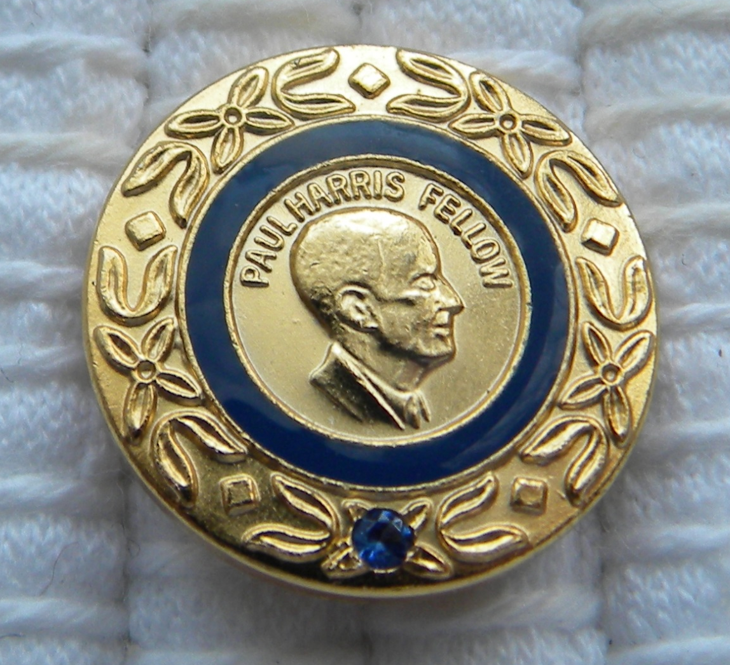
PHF + 1 (But it’s really your 2nd)

Slide 4
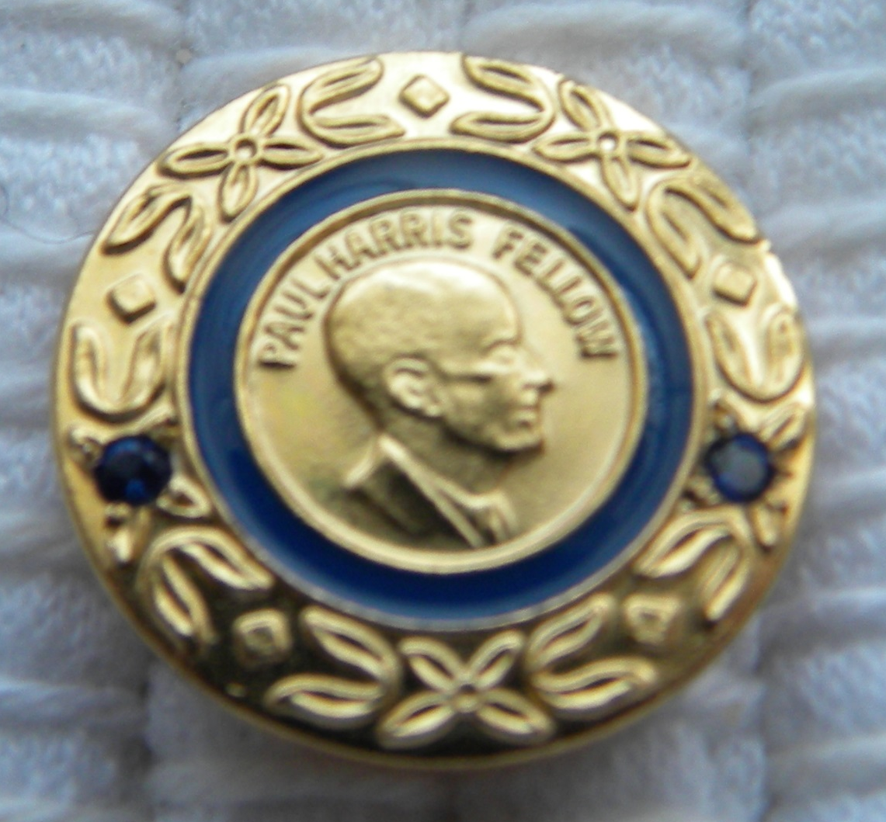
PHF + 2

Slide 5
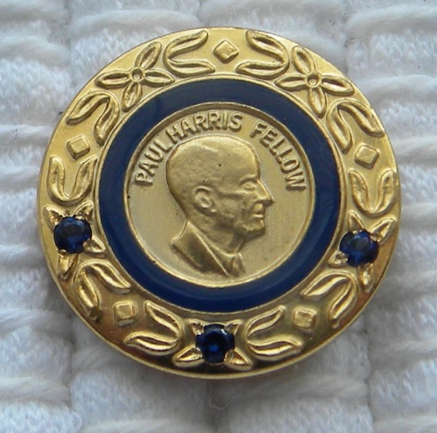
PHF + 3

Slide 6
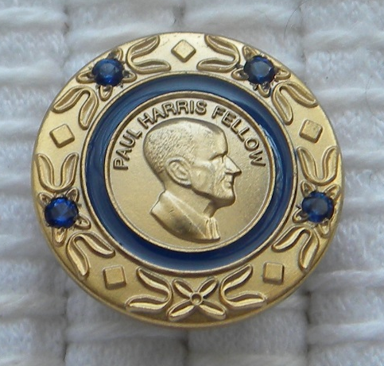
PHF + 4

Slide 7
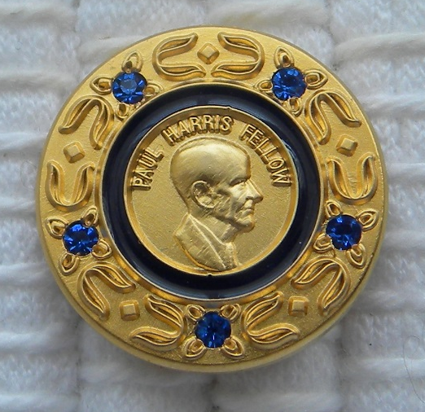
PHF + 5

Slide 8
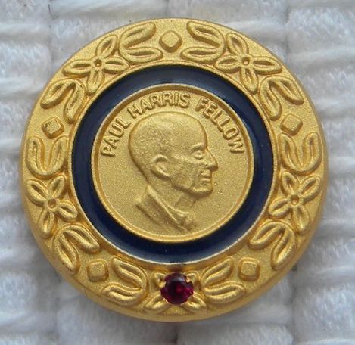
PHF + 6

Slide 9
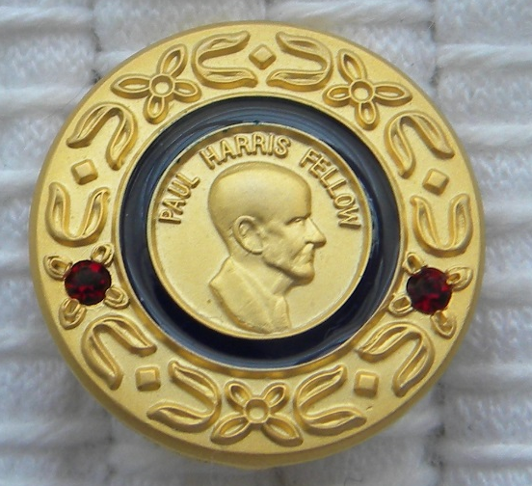
PHF + 7

Slide 10
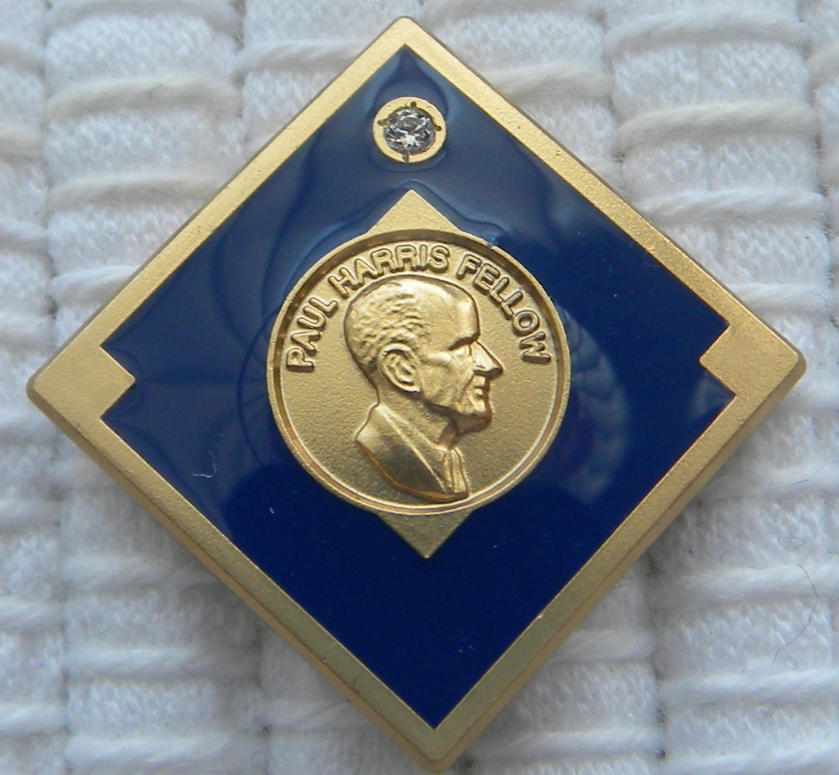
How far can we go?
Major Donor

Slide 11
Notice: This pin has 3 more corners

Slide 12

Paul Harris Fellow … Paul Harris Society

Slide 13
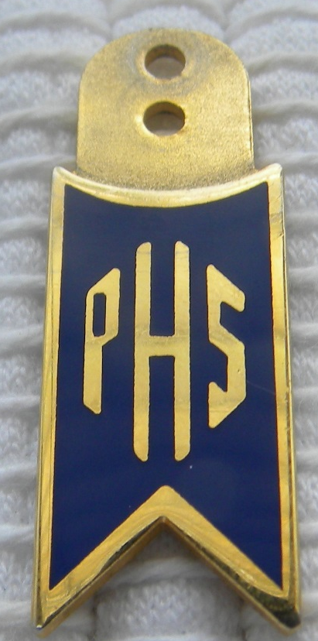
So, the perfect Paul Harris Ladder
Start with your first Paul Harris Fellow, and then
Tell us you want to join the Paul Harris Society

Slide 14
There are 2 Paul Harris Societies
District 6510 PHS (and our Founders’ Banner)
Rotary PHS
Compare them

