Slide 1
District Training Assembly
Membership
Mary Harvey, DGN-D, District Membership & Retention Chair
mharvey@mlh-law.net

Slide 2
Three BIG Questions
What is your plan for membership and engagement in your club for this coming Rotary year?
What do you want to accomplish around membership and engagement?
Who will be your “Membership Champion?”

Slide 3
Question 3
WHO is your Membership Champion?
WHAT is the role of a Membership Champion?
The advocate for and promote membership and engagement from within the club
They are instrumental in implementation of any membership strategic plan or model.
They are key communicators; they promote new ideas and motivate others.

Slide 4
Strengthening Your Membership
Creating your membership plan
My Rotary
mharvey@mlh-law.net

Slide 5
Creating a My Rotary account at Rotary International website
Go to www.rotary.org, go to "For Members" and click on My Rotary or click on My Rotary where ever you see it.
Click on Sign In/Register.
If you are a first time user, click on Create account.
Fill in the Account registration information and click on Continue. A club number is requested . Our District is 6510.
You will be informed that an e-mail has been sent to you.
Check your email for the address you provided in step 5. You will receive a message which will ask you to click on the blue link to finalize the process.
Fill in all the mandatory information and click on Create account.
When the screen refreshes you will be given information describing what you can do with the MyRotary account. After reading, click on Continue.
If you are not a first time user, after step 2, just enter your email address and password and click on Sign In.

Slide 6
myrotary.org

Slide 7
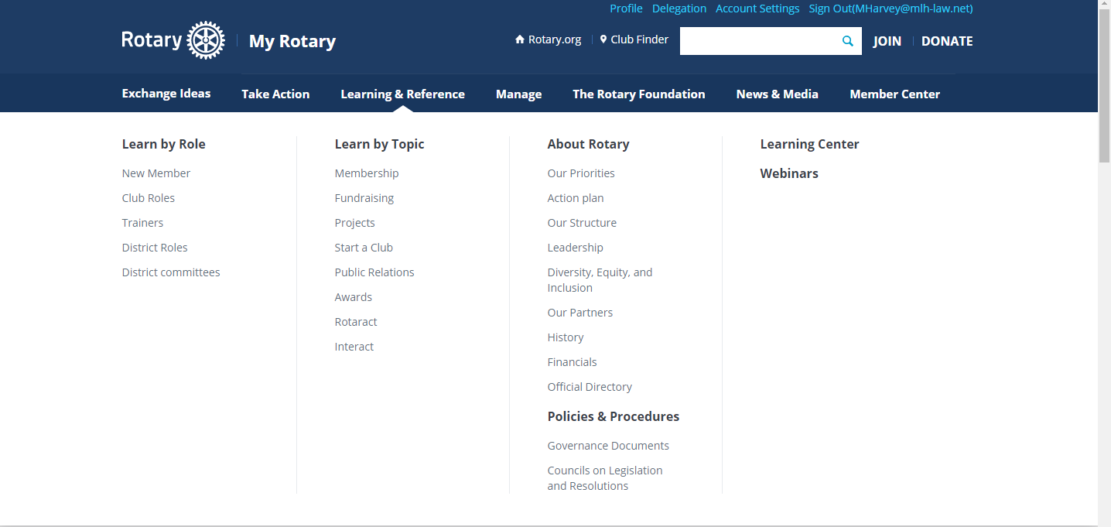

Slide 8
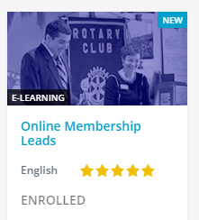
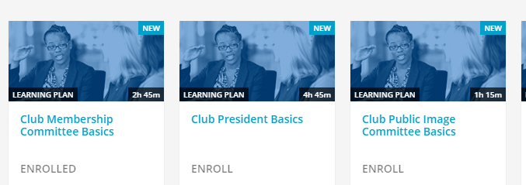
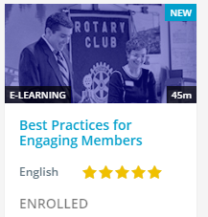
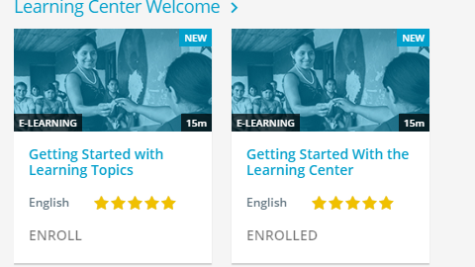

Slide 9
Questions
1. Do we have in place a committee AND a process for managing our club leads?
2. Who owns responsibility to follow up leads, within what timeline and what reporting/record keeping is utilized?
3. Do we have a process in place to verify that we are following up on leads and whether the lead became a member?

Slide 10
Your Membership Plan

Slide 11
Questions
1. How can we encourage our entire club to engage in the planning process?
2. Who are our club leaders who can initiate and support our planning process?
3. How can the District Membership Team help with challenges?

Slide 12
Club Development
Assess the health of your club
Know your statistics
Draw out what you want to achieve that will Grow Rotary in your club
Rotary Club Central
Be A Vibrant Club

Slide 13
Rotary Club Central

Slide 14
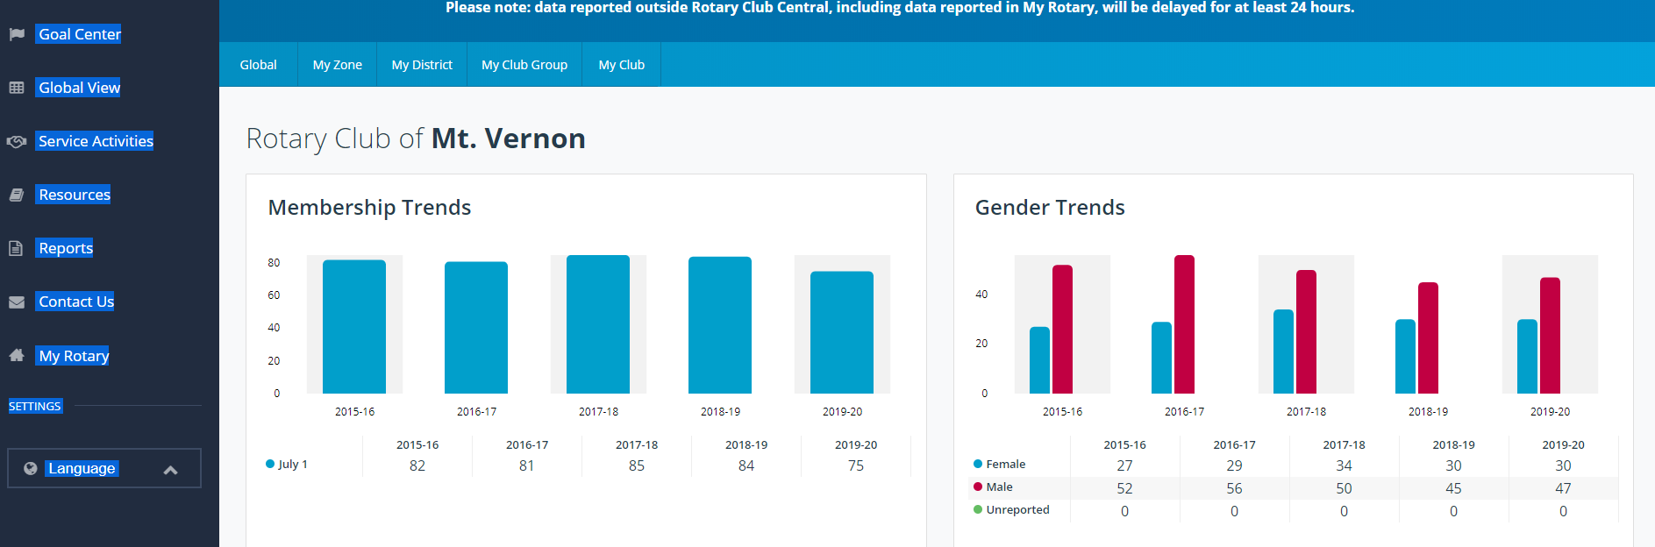
Dashboard

Slide 15
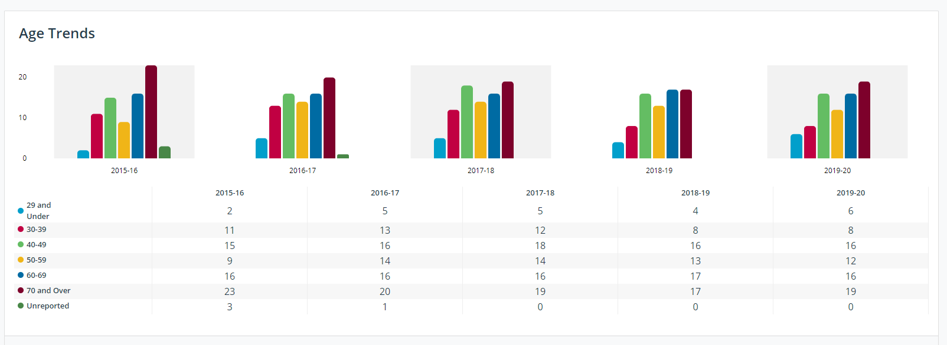
Dashboard

Slide 16
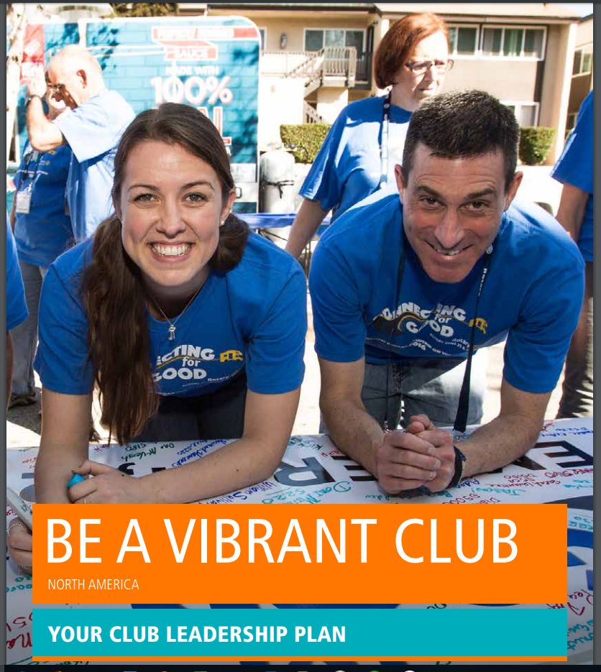

Slide 18
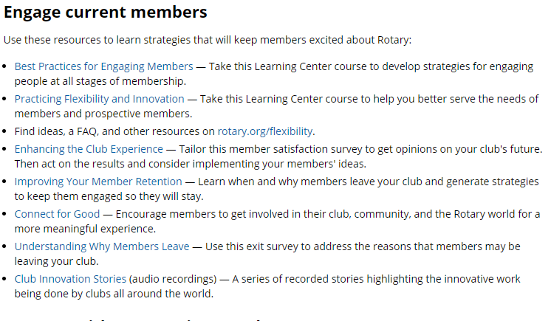
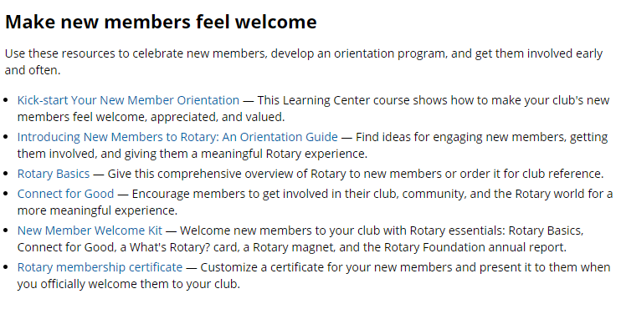
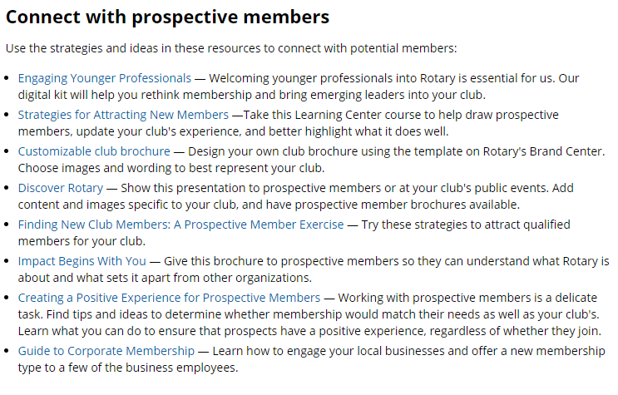
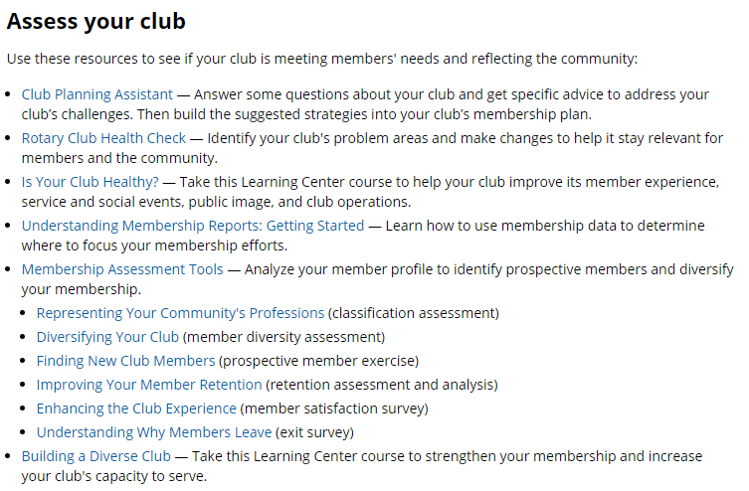

Slide 20
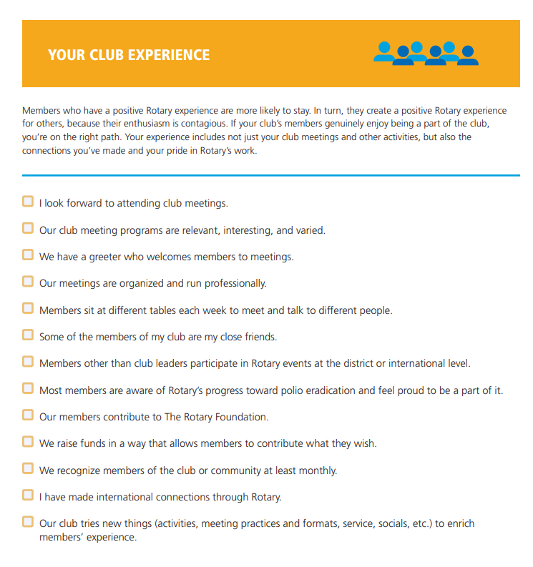
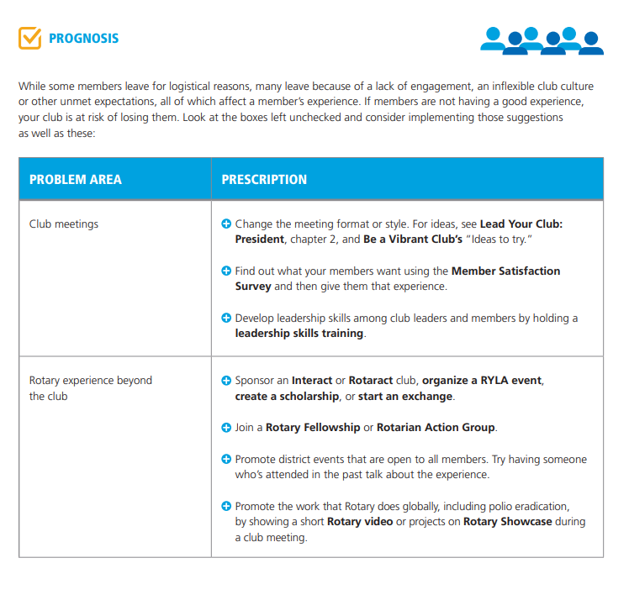

Slide 22
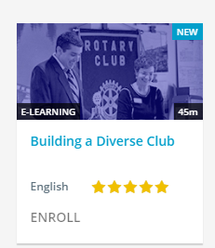

Slide 23
“an invitation to endless opportunities”
“We need to stop thinking of new members as people we can mark down as statistics and then forget about.”
Rather than setting a specific target for increasing the number of members, President-Elect Knaack is asking clubs to think about how to grow in a sustainable way.
Focus on keeping current members engaged and adding new members who are the right fit for the club.

