Slide 1
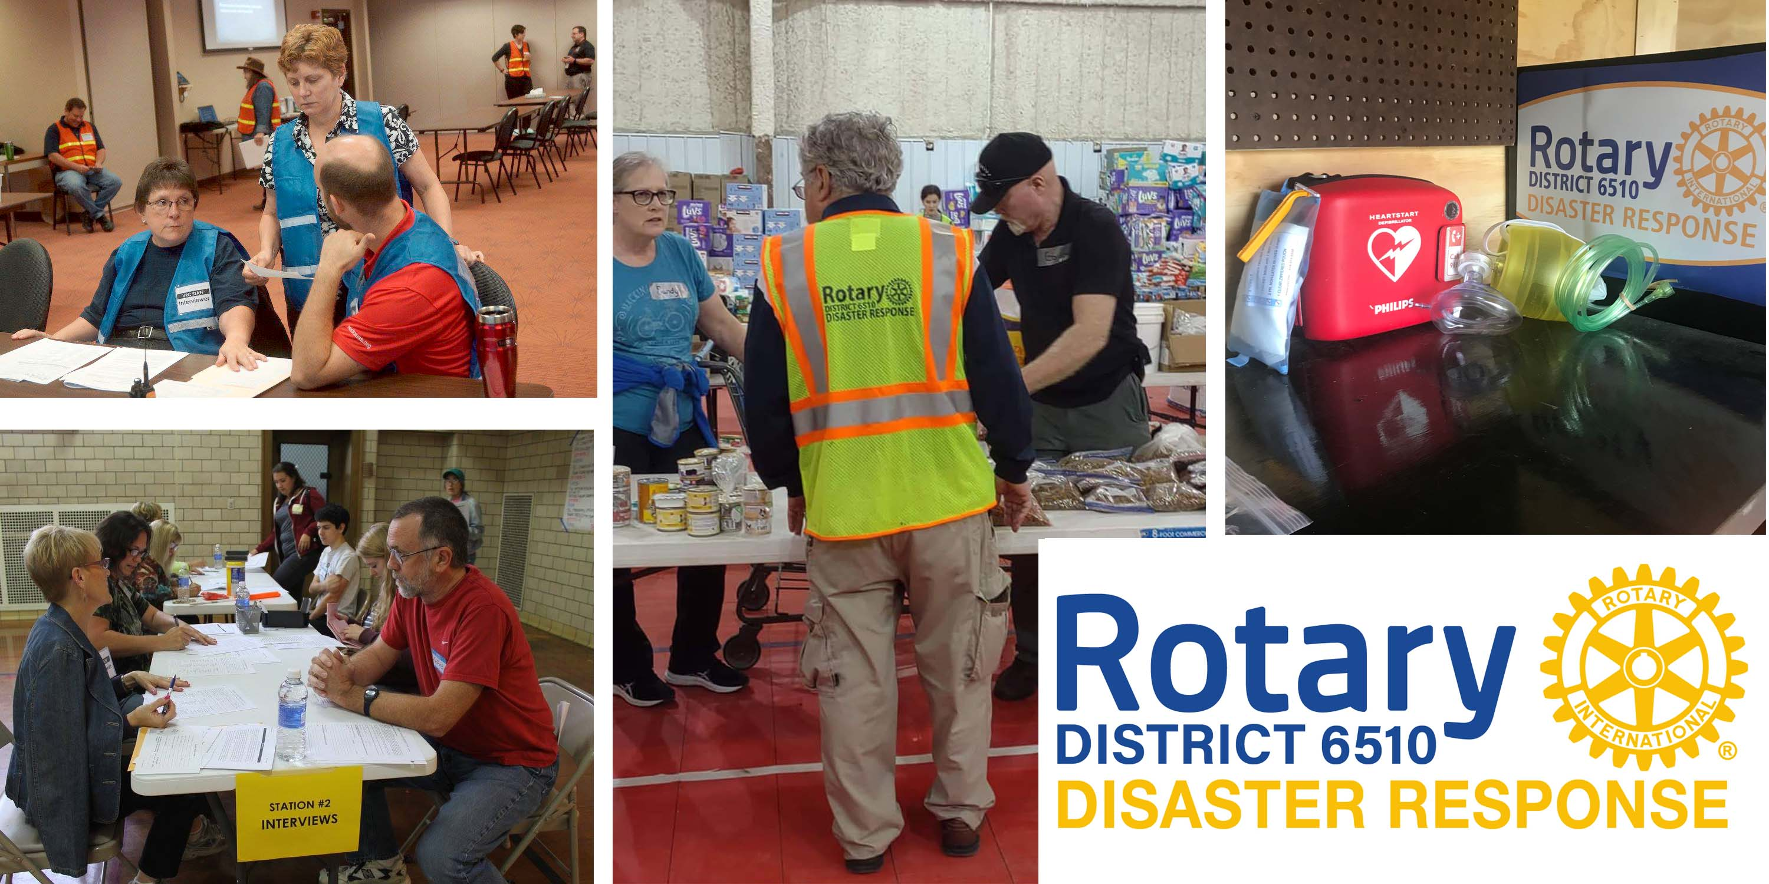
The Volunteer
VRC
Reception Center
Managing Volunteers
in Disaster

Slide 2
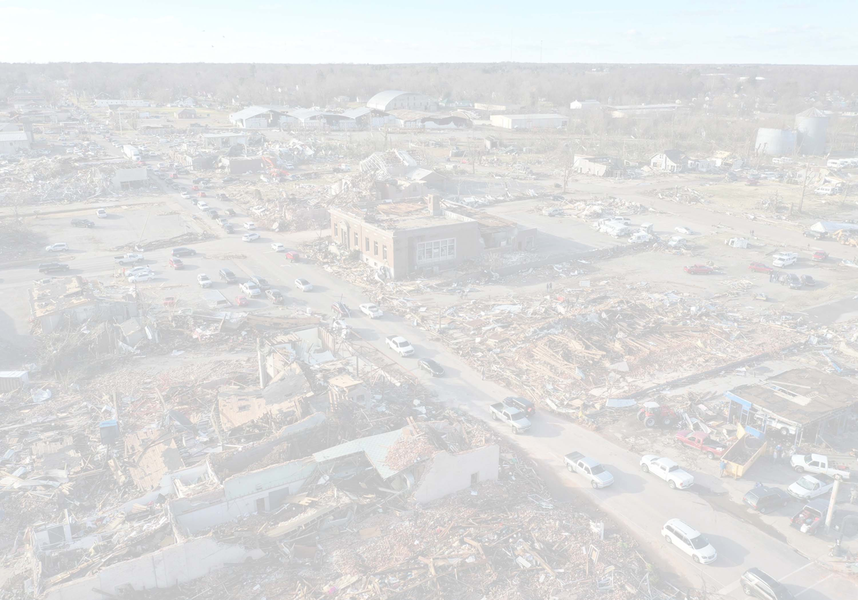
DEFINITION
DISASTER: When the resources available are exceeded; or an event located in time and space in which a community undergoes severe danger and incurs losses so that the social structure is disrupted and the fulfillment of all or some of its essential functions are prevented. A disaster situation is comprised of multiple incident sites.

Slide 3
WHAT IS A VRC?
  VRC stands for Volunteer Reception Center. VRC a a concept, not a location. It is used to manage and organize the unaffiliated volunteers during a disaster.
These volunteers are processed at the VRC to determine their skill-set and then tasked with assignments where their skills can be utilized for the disaster relief effort.

Slide 4
Why a
Volunteer Reception Center?
Disasters result in chaos and confusion
People want to help, but don’t know where or how.
People acting “on their own” may find
Anxious volunteers may overwhelm traditional
Potential volunteers may get in the way of
themselves in dangerous situations.
response organizations.
trained responders.

Slide 5
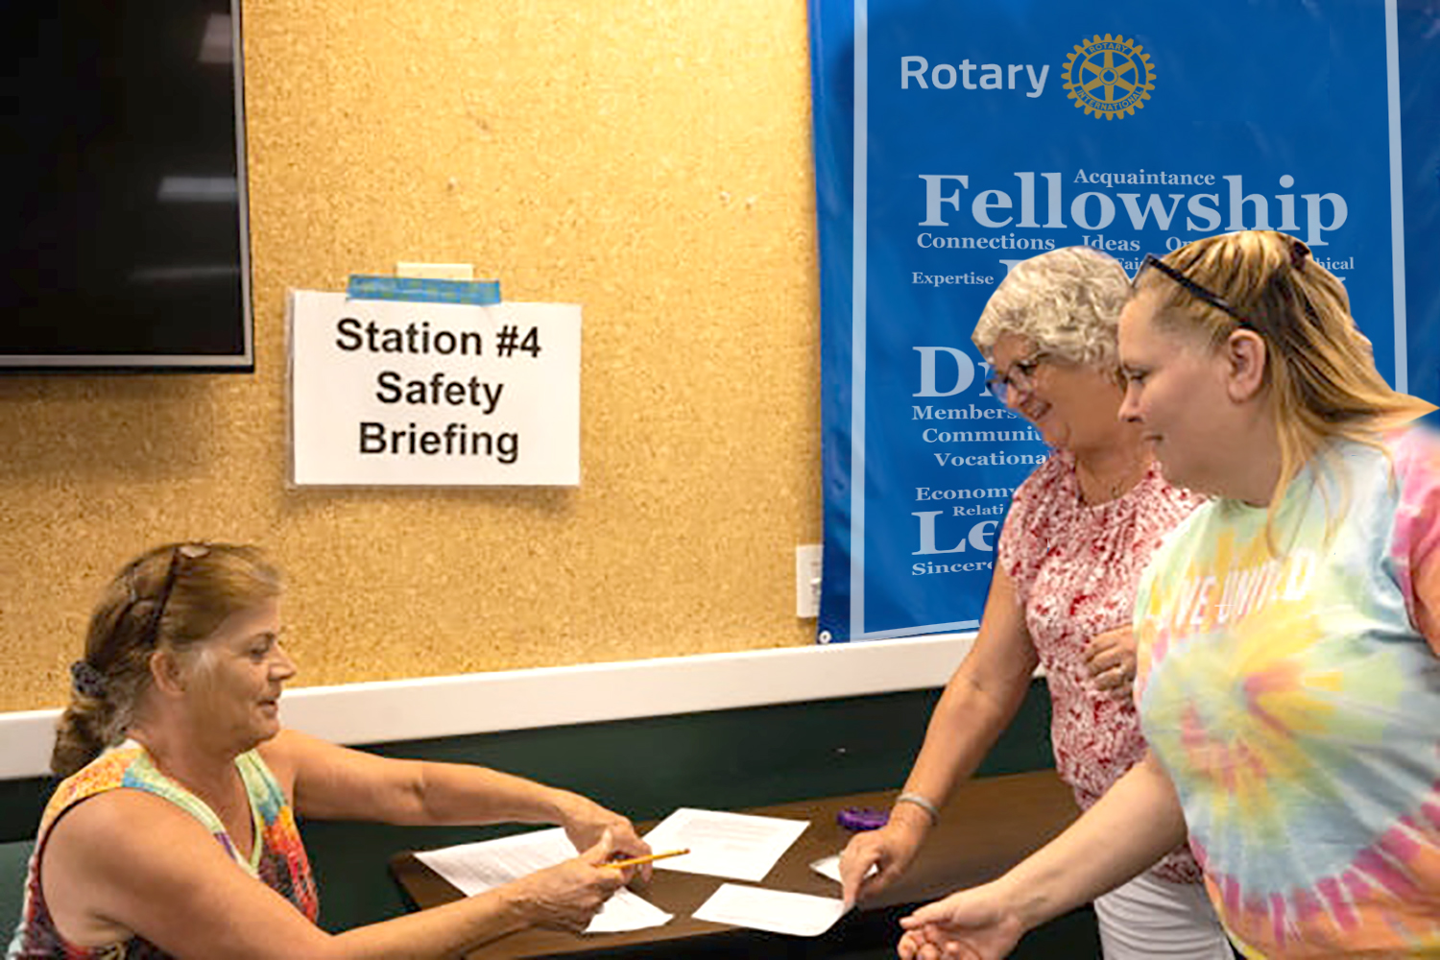
Purpose
of the VRC
  Provide face-to-face
Process and refer volunteers appropriately. Provide identification to volunteers. Provide registration and orientation.
Data coordination and record keeping related to the contribution of volunteers.
  interviews with
  volunteers.

Slide 6
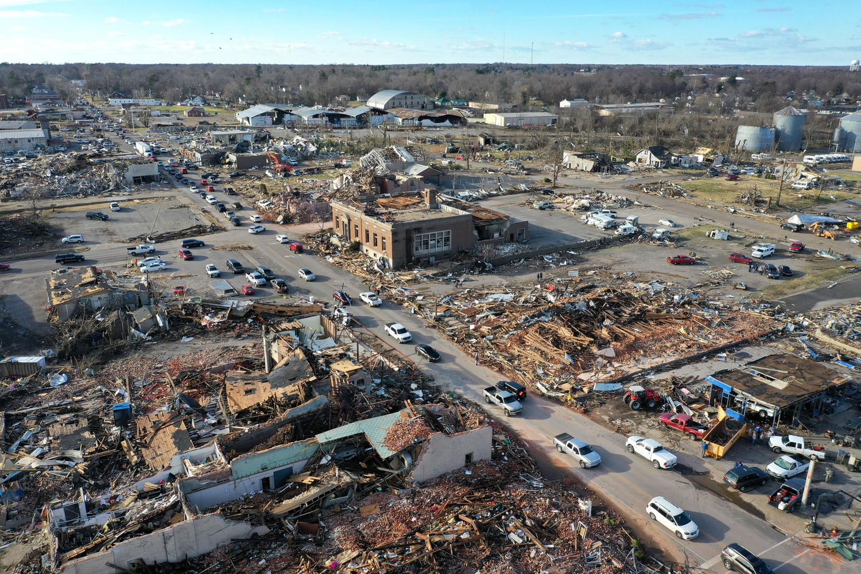
Activation of VRC
  A Disaster Strikes!!
County Emergency
Manager determines if
there is a need for a VRC
following a disaster.
Upon activation of VRC, the “Go-Team” is contacted, briefed and deployed to VRC.
The County PIO informs the public on VRC activation, location, contact information and hours of operation.

Slide 7
ACTIVATION OF VRC (cont.)
  Community organizations that are active in disasters will send their volunteer requests to the VRC.
These requests can be entered on-line, by phone or fax.
VRC remains active as long as the disaster recovery effort requires volunteers.

Slide 8
“Go-Teams”
“Go-Team” – A team of volunteers of county staff that have been formally trained for operating the Volunteer Reception Center.
“Go-Kits” – A container that contains all necessary materials required to operate the VRC, with or without power.
“Go-Teams” must complete VRC training exercise to understand VRC operations and staff station positions.

Slide 9
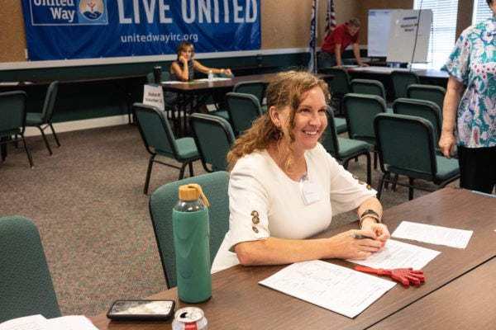
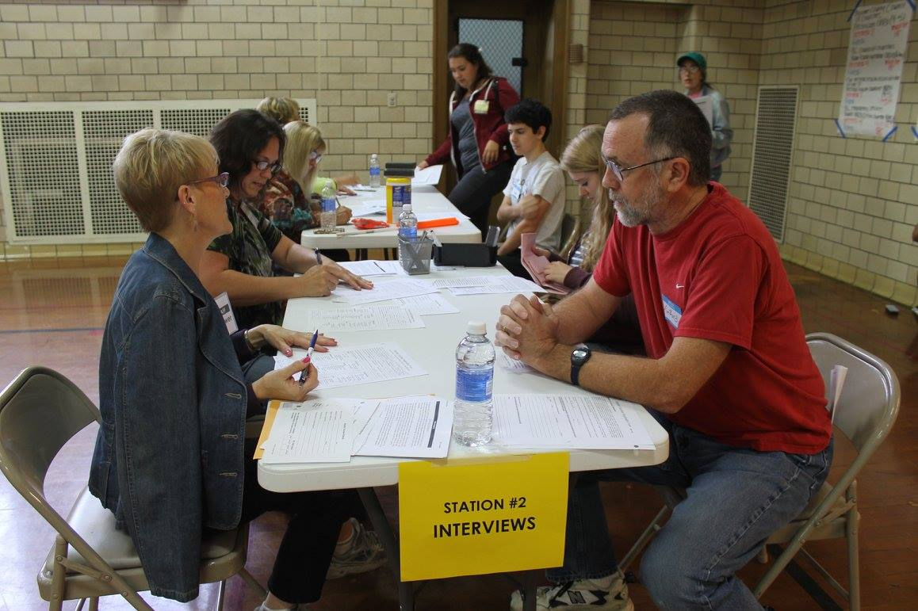
FIVE STATIONS of VRC
  Registration Area
Volunteers will complete a
Registration Application form and proceed as directed to an Interviewer at Station 2.
  Interview Area
Interviewer will take your Registration Application, get to know your skills and give you a Referral to an agency needing your help. Runner takes Registration Application to data entry.
  (Station 1):
  (Station 2):

Slide 10
FIVE STATIONS of VRC (cont.)
Agency Coordination Area (Station 3):
Coordinator will record and initial your Referral Form so that you will have access to the disaster site. Runner takes Referral Form to data entry.
Identification Card (Station 4):
You will receive an ID bracelet that will allow you to enter disaster restricted areas during the day(s) written on your I.D.
Safety Briefing Area (Station 5):
You will be given special instructions on safety, security and directions to Referral Site.

Slide 11
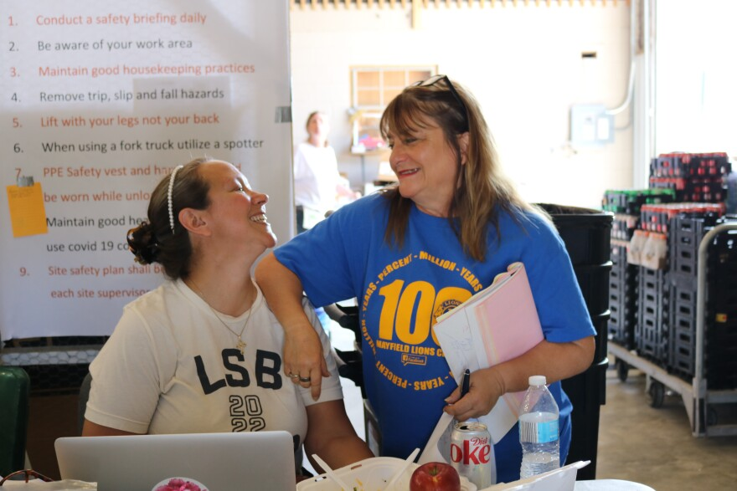
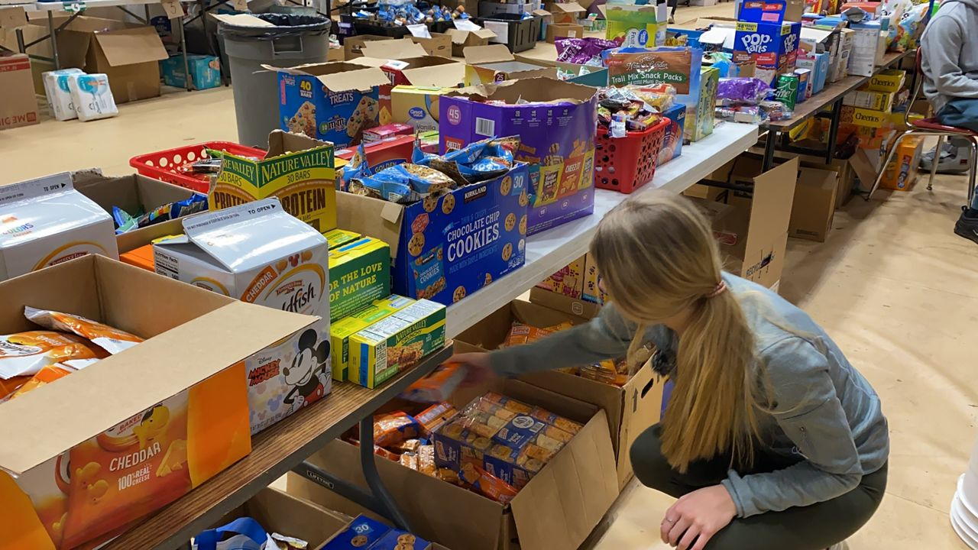
VRC Job Listings
Phone Bank Staff
Runners
Safety Trainer
Shift Manager
VRC Director
Data Entry
Greeters
Host/Hostess
Identification Coordinator
Interviewer
Master Data Coordinator
Notifications/Scheduling
Team Member

Slide 12
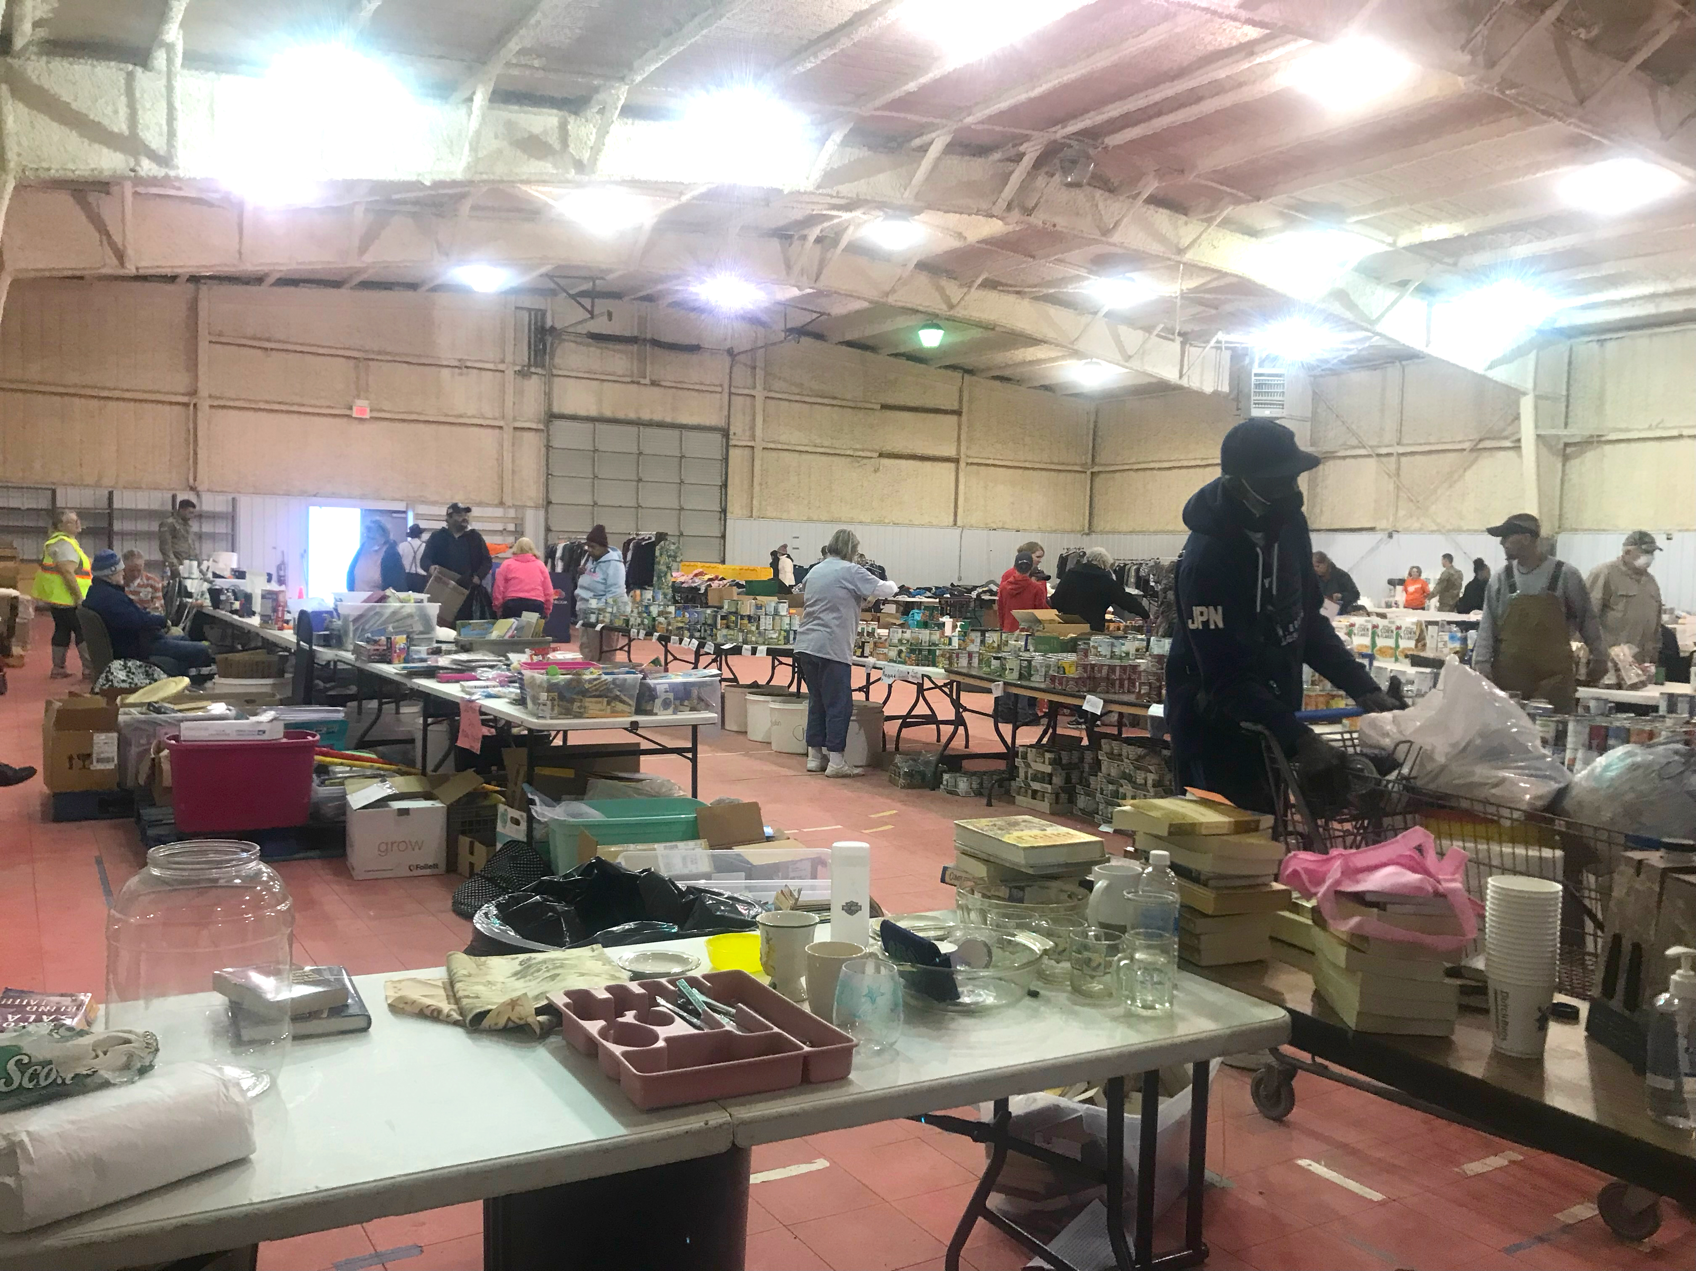
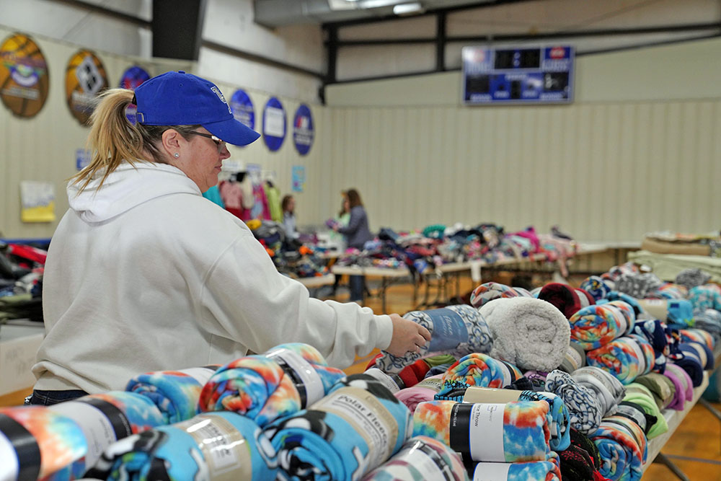

Slide 13
