Slide 1
LET’S MAKE ROTARY
Simply Irresistible!
DG Club Visit Presentation
2024-2025

Slide 3
The Magic of Rotary is ours to grow & share
Let’s Revolutionize Rotary to be Simply Irresistible!

Slide 4
Becoming Irresistible
The Magic of Rotary happens at Club level where people are serving their communities
Transform our culture to be Simply Irresistible
Be Member and Club-centric
Expand our commitment to DEIB
Live the Four-Way Test

Slide 5
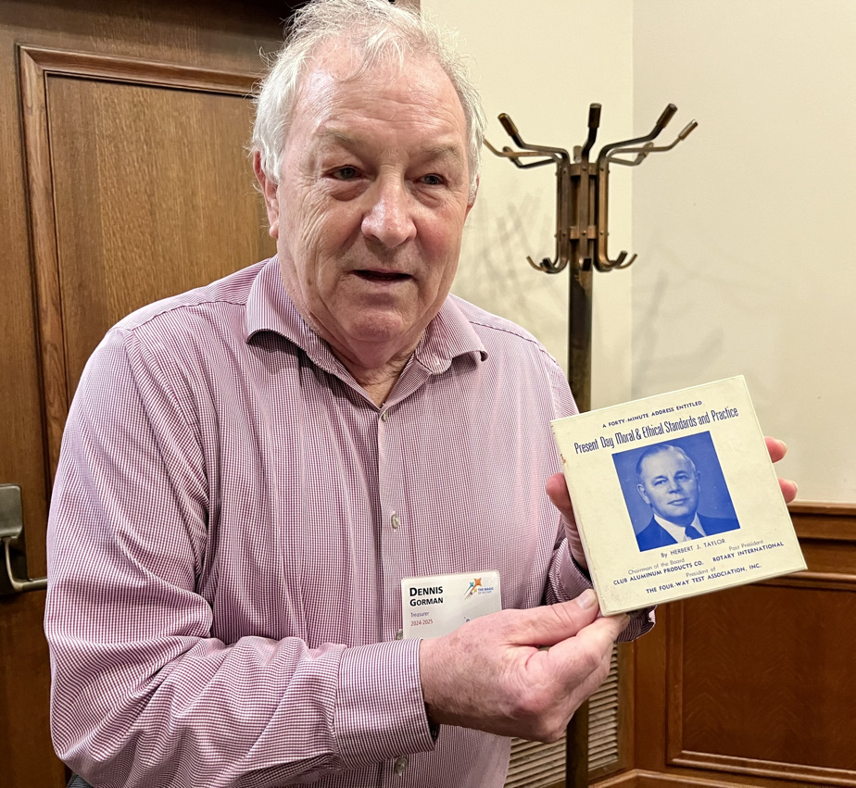

Slide 6
Becoming Irresistible
Great clubs stay great by finding room for continuous improvement
Foster a spirit of innovation
Have to constantly work to introduce Rotary into the community in different ways

Slide 7
Becoming Irresistible
Focus on modern day concerns
Offer meaningful hands-on service projects
Let the core values of Rotary shine through! Don’t worry about traditions that feel outdated
Engage Action Plan to grow membership & thrive
The District Team is here to help!

Slide 8
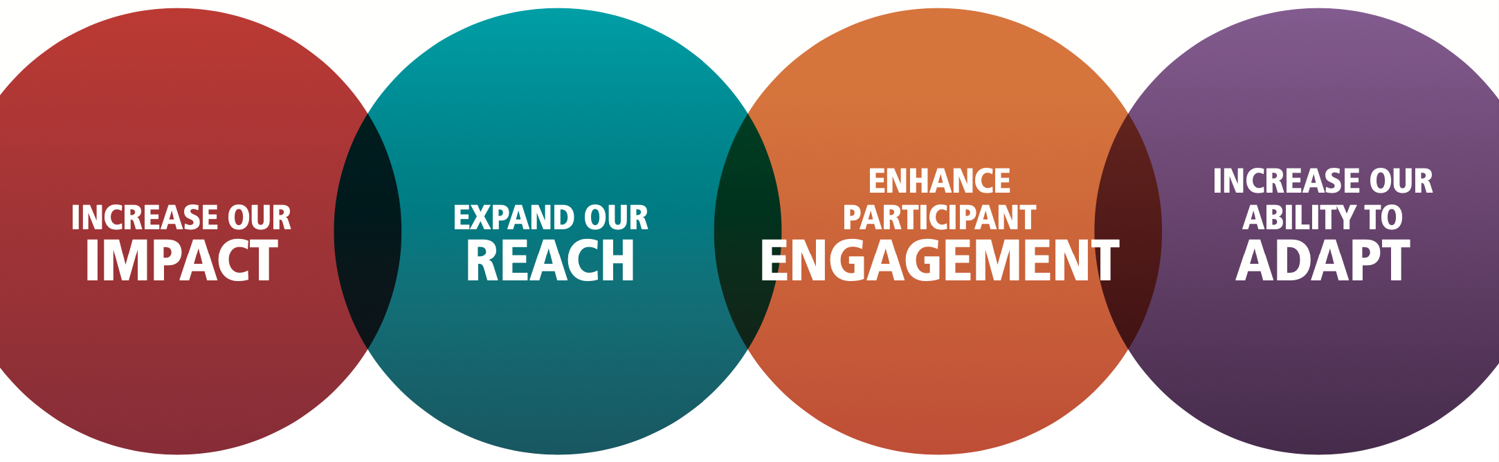

Slide 9
District 6450 Goals 2024-2025
Embrace Action Plan at the Club level to grow Rotary & increase our impact.

Slide 14
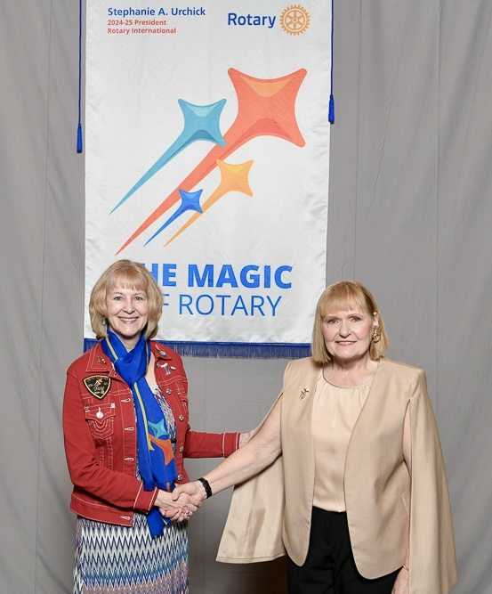
IRRESISTIBLE DISTRICT

Slide 15
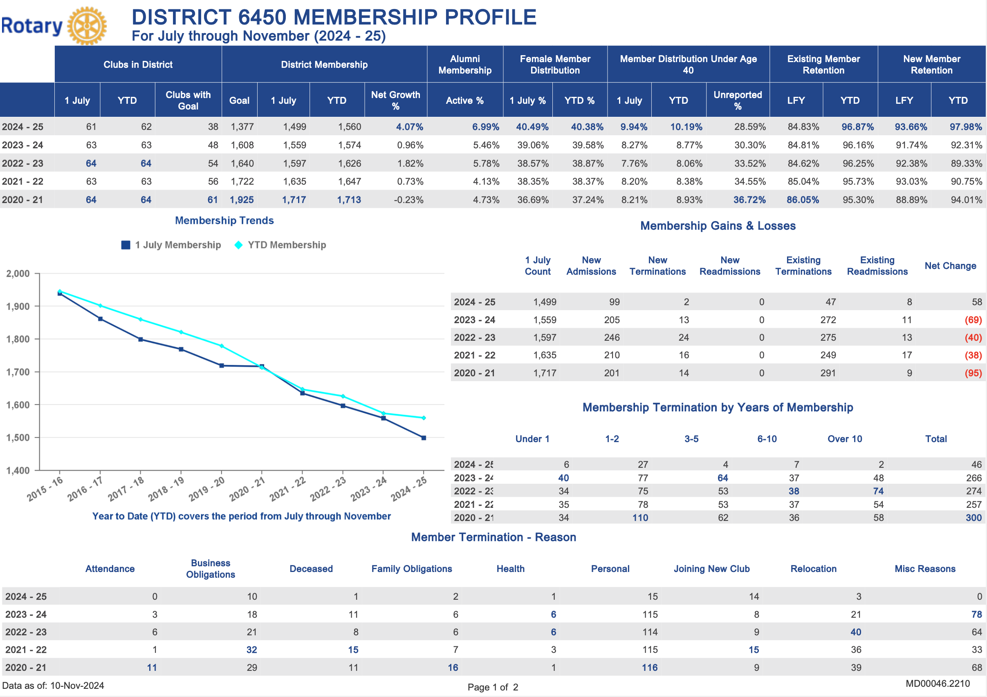

Slide 16
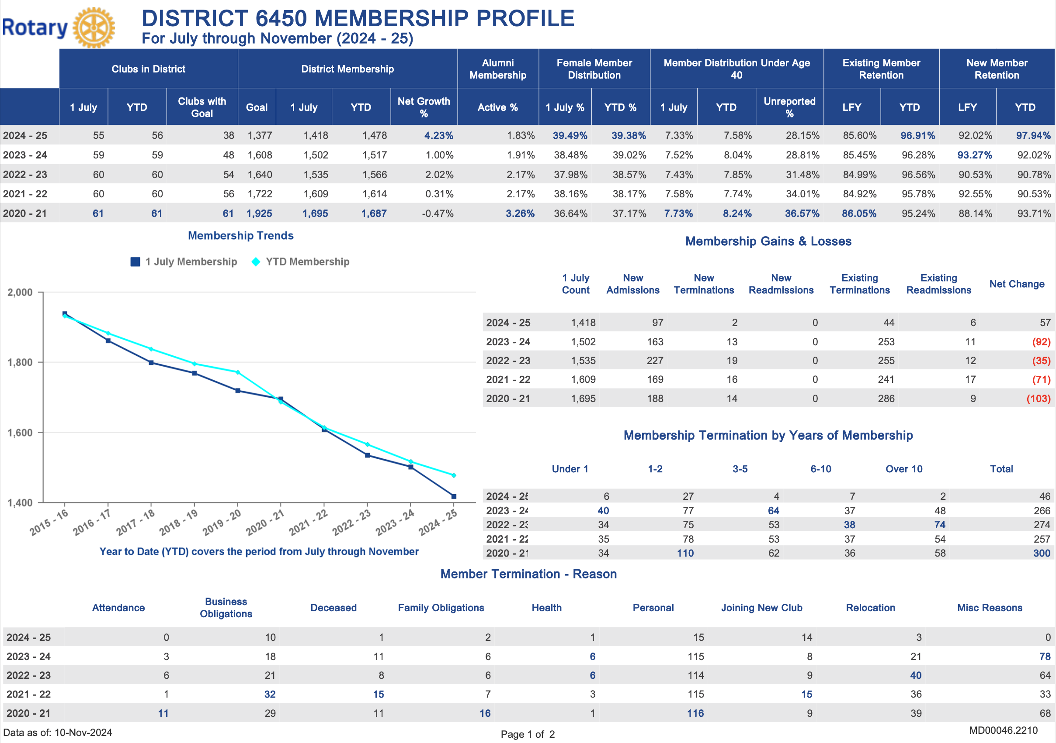

Slide 17
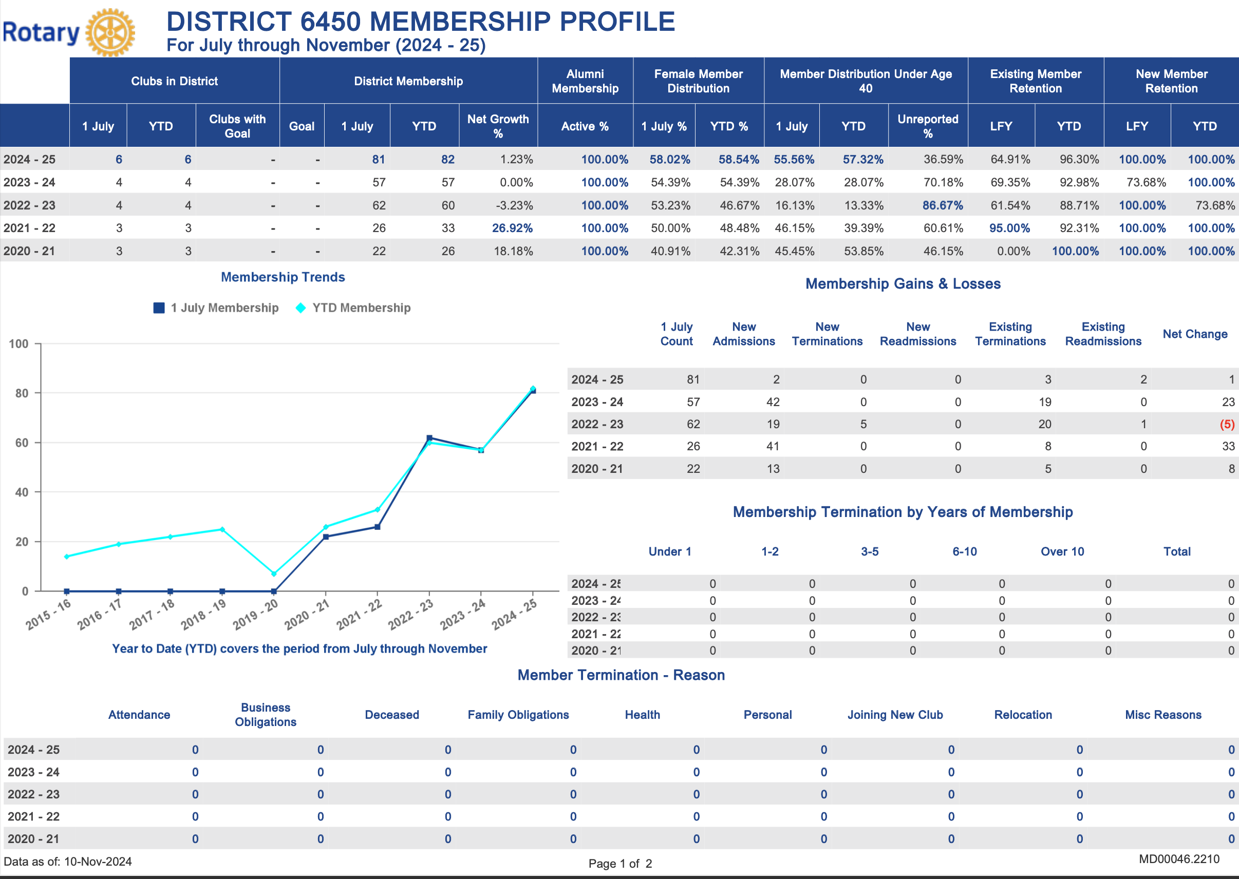

Slide 18
District 6450 Goals 2024-2025
Make our Club Experience Simply Irresistible.

Slide 19
District 6450 Goals 2024-2025
Everyone Belongs. Ensure all members feel welcomed, valued and safe at Rotary and feel they belong.

Slide 25
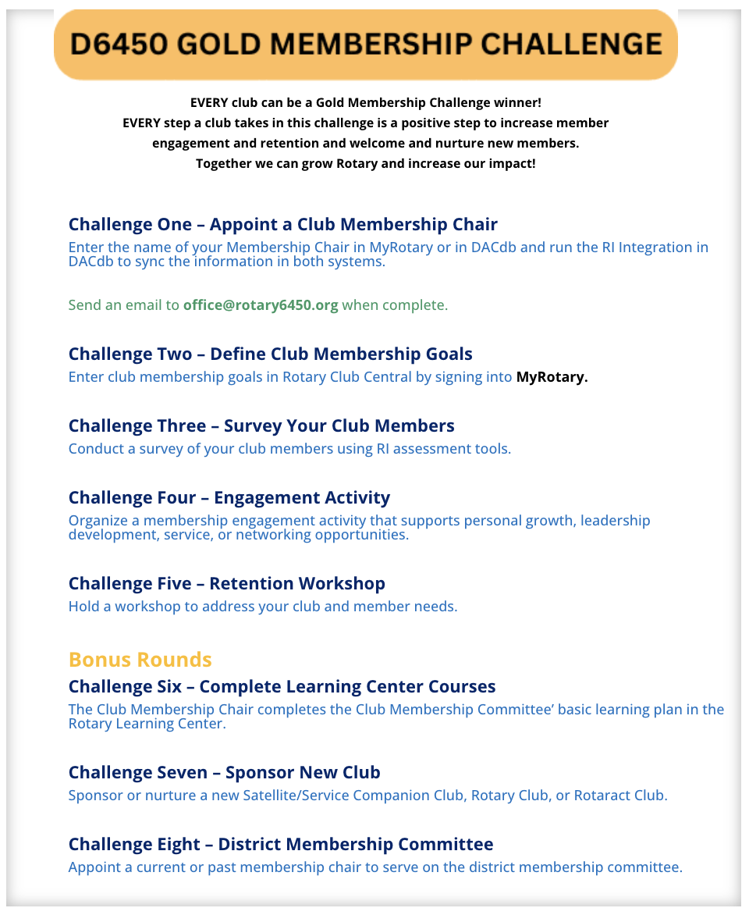

Slide 26
Be intentional about inviting new & diverse members
MAKE THE ASK!

Slide 27
District 6450 Goals 2024-2025
Engage our global humanitarian network to Do Good in the World together.

Slide 29
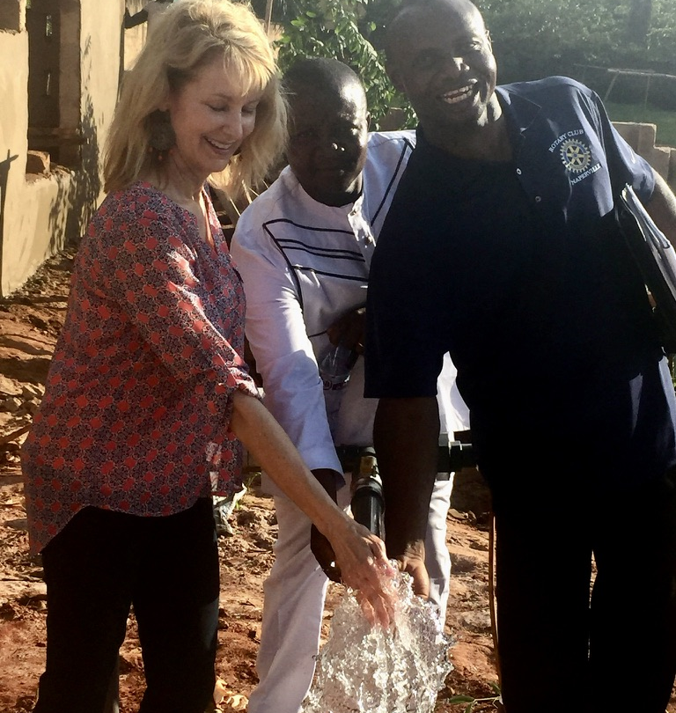
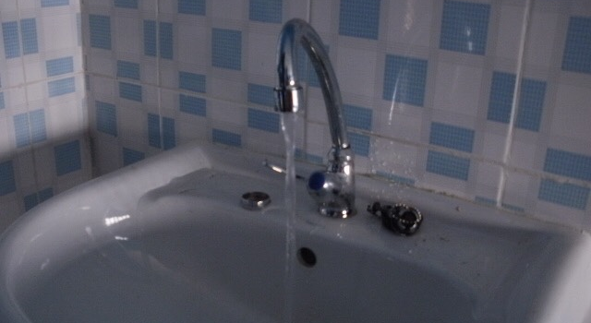
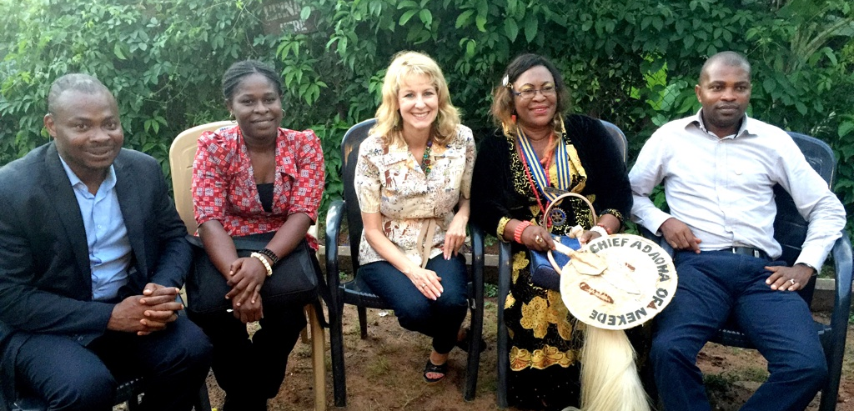

Slide 31
District 6450 Goals 2024-2025
Strengthen & grow our youth programs to focus on service, leadership development & peacebuilding.

Slide 33
District 6450 Goals 2024-2025
Grow the impact of our service.

Slide 34
District 6450 Goals 2024-2025
Tell our Story to share the value of Rotary.

Slide 35
District 6450 Goals 2024-2025
Use “Engage People” process for leading change to help Clubs increase impact & engagement.

Slide 37
RESOURCES FOR CLUBS
Simply Irresistible Coaches and Club Gold Membership Challenge to help grow, address challenges and start new clubs
District committees to support and grow Interact, Early Act, RYLA and Youth Exchange
Youth Mental Health First Aid initiative and Kindness Counts campaigns
Project funds for environmental service, youth mental health, homeless veterans support, cards for senior and disaster response
Several District-wide Days of Service, starting August 10
Fall Grants Extravaganza, October 26, to introduce more clubs to opportunities and collaboration
DEI committee is looking for new members to help advance action plan
District Action Plan Champion

Slide 38
DISTRICT 6450 CALENDAR
DATE | IMPORTANT EVENTS
Anytime August | Food Insecurity District-wide Day of Service
September | Start Homeless Veterans Coat Drive
October 11-13 | RYLA
October 24 | World Polio Day
October 26 | Fall Assembly: Grants Extravaganza!
November 4-10 | World Interact Week
November 7-8 | Homeless Veterans Stand Down District-wide Day of Service
January 10 | Rotary Youth Exchange Country Reveal Party
February 1, 15 | Youth Mental Health First Aid Training
February 14 | Cards for Seniors District-wide Day of Service
March 6 | Rotary Foundation Celebration
April 26 | Irresistible 6450 District Conference, Day of Service, Annual Meeting
June 21-25 | RI Convention in Calgary

Slide 42
3-YEAR GOALS & PLANS
Three-Year Goals and Plans
Enhance Participant Engagement
Goal #1: Service Participation
Increase Our Impact
Goal #2: Annual Giving
Goal #3: PolioPlus
Goal #4: Endowment / Major Gifts
Expand Our Reach
Goal #5: Club Membership
Increase Our Ability to Adapt
Goal #6: Create or update your club’s strategic plan

Slide 43
People of Action make magic happen!

Slide 44
LET’S MAKE ROTARY
Simply Irresistible!

Slide 45
BACK UP SLIDES

Slide 46
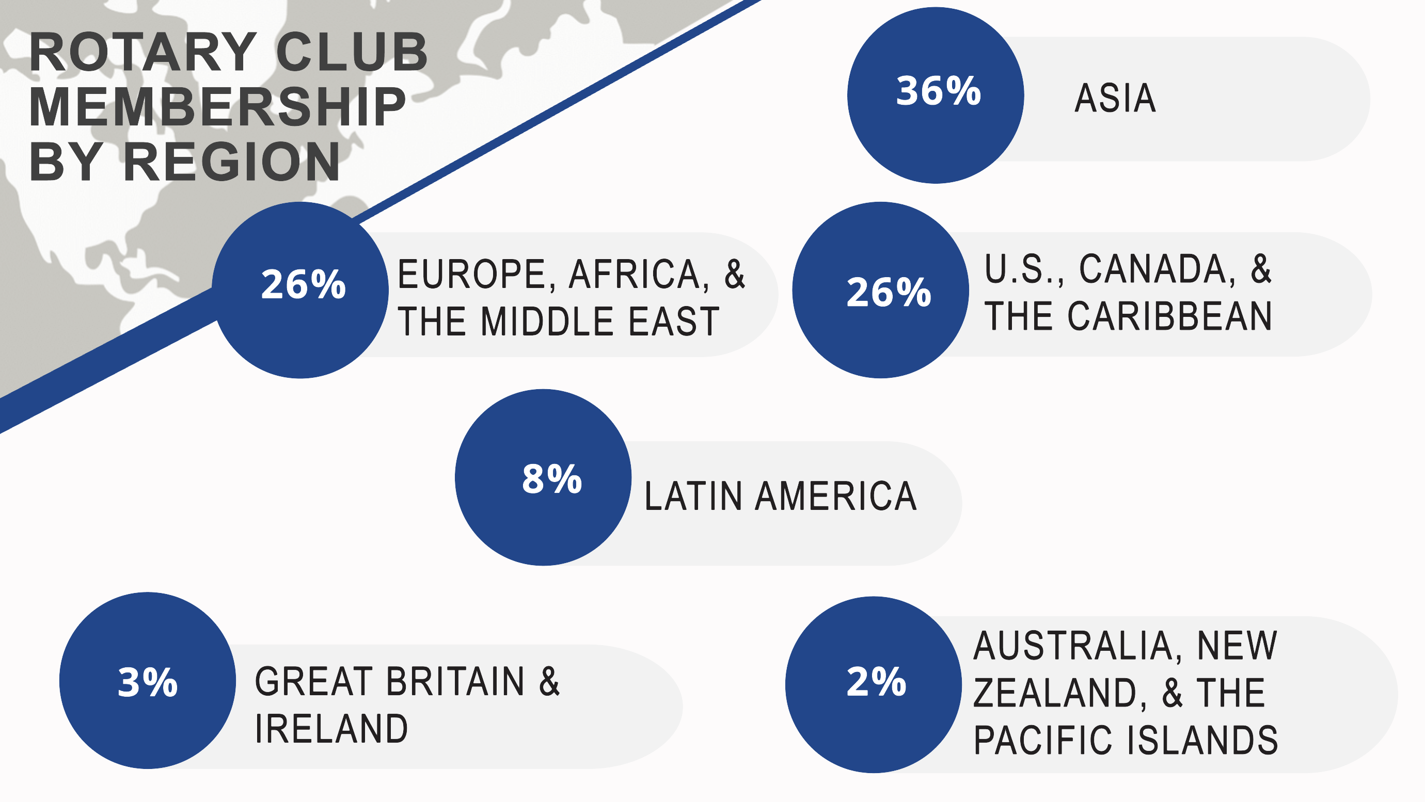

Slide 49
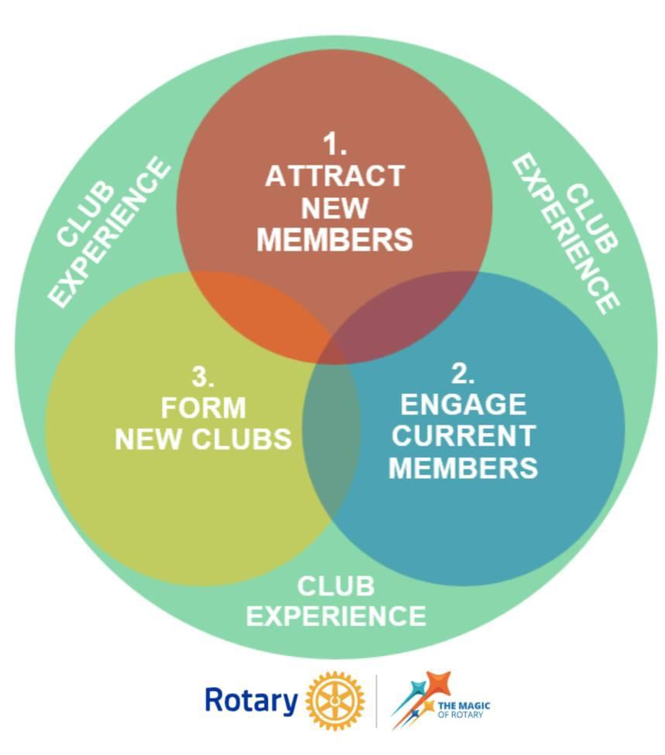

Slide 55
