Slide 1

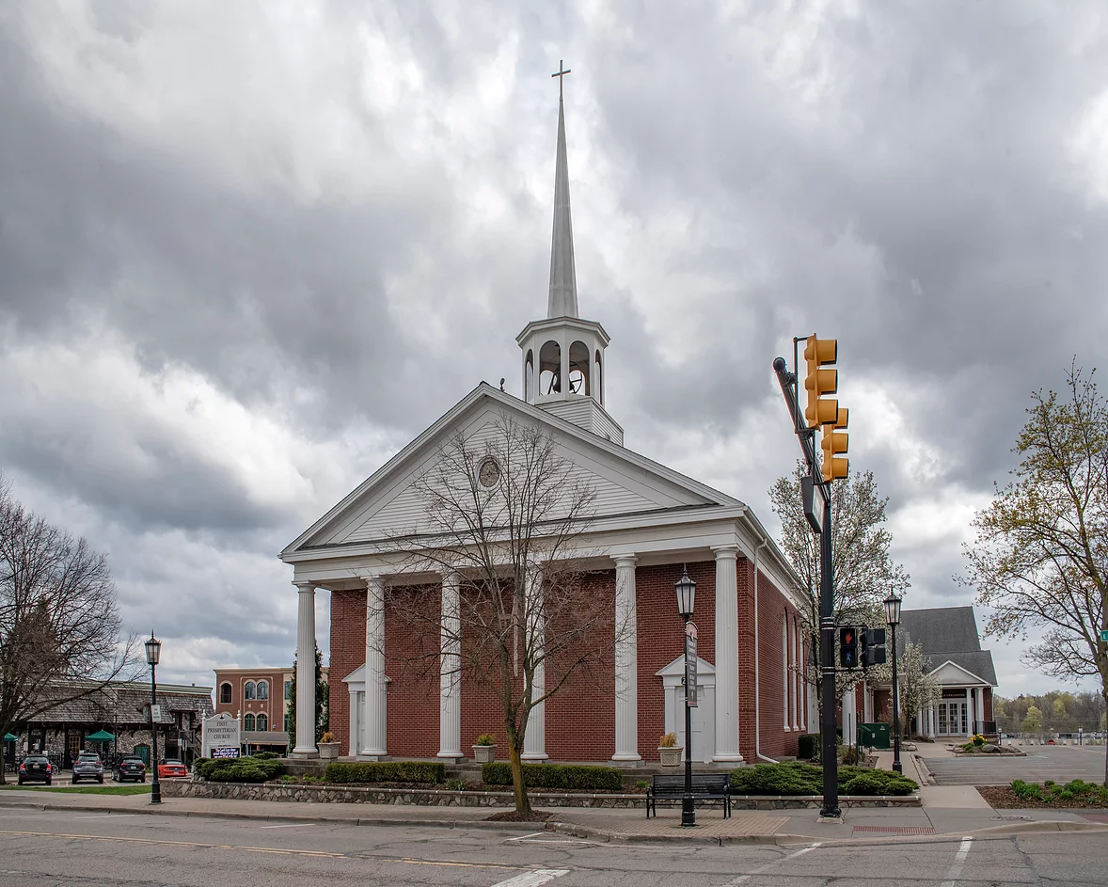
Welcome to the
Rotary Club of Northville
Club Meeting

Slide 2

Pledge of Allegiance

Slide 3
Meeting Agenda
Pledge of Allegiance
Invocation
Introduction of Guests and Induction of New Member, Greg Rivers
Lunch
President’s Remarks
Education: Calendar of Events
Raffle Drawings
Four-Way Test
Adjournment
Notes:
https://www.facebook.com/suegoldsen/videos/577936557284166
https://www.youtube.com/watch?v=gWA3MTHZ2pk

Slide 4
District 6400 Action PLan
Increase Our Impact
Expand Our Reach
Enhance Participant Engagement
Increase Our Ability to Adapt

Slide 5
Increase Our Impact
Host a creative Polio event to raise $1,500+ for World Polio Day, 10/24/24
Become a Benefactor or a Bequest Society member and support Rotary’s endowment goal of 2.25B by 2025
Join TRF Direct. It’s an easy way to contribute and Do Good in the World.

Slide 6
Increase Our Impact
Host a creative Polio event to raise $1,500+ for World Polio Day, 10/24/24
  Effortless generosity to grow our Polio fund.
  Last year, we gave $2,000. What can we give this year?
  Save the Date: Birthday Party! August 21, 2024
  Looking Forward: Bowlio for Polio!

Slide 7
Increase Our Impact
Become a Benefactor or a Bequest Society member and support Rotary’s endowment goal of 2.25B by 2025.
Increase Rotary Club of Northville Benefactor and/or Bequest Society by 25%
Direct learning events on this to come.
Join TRF Direct. It’s an easy way to contribute and Do Good in the World.
Increase Rotary Club of Northville TRF by 50%.
Direct learning events on this to come.

Slide 8
Expand Our Reach
Grow your district by identifying new clubs: Traditional, Cause-Based, Satellite, Interest-Based, etc.
  Reintroduce virtual meetings to expand our club reach and attract new members
  Invite our Rotary in Training Team to as many family events as possible

Slide 9
Expand Our Reach
Increase Public Awareness and understanding of Rotary and our impact locally and globally.
  Increase our social media presence.
  Commit to wear our gear, display our 4-way test prominently, be prepared to talk about Rotary succinctly to friends and family.
  Direct learning to come.

Slide 10
Expand Our Reach
What is your Rotary Moment? Share your story and help others understand our reach.
  Hire a CGT intern to record and compile the Northville Club’s Rotary moments.
  Hire a Social Impact Scholar.
  Hire an Honors Student to work with our organization closely.

Slide 11
Enhance Participant Engagement
Grow your Club! Provide meaningful responsibilities for new and existing members.
  Every member has a job, a path, and purpose!
Foster professional development and leadership skills via MyRotary courses.
  Every Rotary RoundUp will have an Education section.
  Hire an intern to develop Professional Mentor profiles based on “What’s my Job?”

Slide 12
Enhance Participant Engagement
Increase collaboration and connection, especially between Rotary and Rotaract Clubs.
Investigate developing/sponsoring a regional Rotaract Club with other area Rotary clubs: Livonia (2), Plymouth (2), Canton, Garden City, and Northville.
Make a strong regional alliance with colleges/universities: Schoolcraft, Madonna, Eastern, LTU, UM-Dearborn, etc.

Slide 13
Increase Our Ability to Adapt
Explore Rotary Action Groups and Rotary Fellowships.
Part of the Education Series.
Direct learning to come.
Attend inspirational and informative district learning sessions at your club on Membership, Foundation, and Public Image.
Invite District and external speakers on these topics.

Slide 14
Increase Our Ability to Adapt
Plant a Peace Pole in your community.
How many do we want?
Working directly with Living & Learning to make our own Peace Poles.
Attend the Calgary Convention in June 2025.
Have 20% member participation for the District 6400 conference in Windsor.
Commit to 3-5 members attend Calgary?

Slide 15
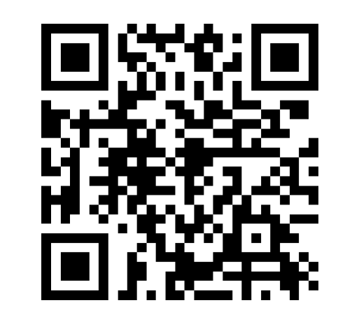
Calendar

Slide 16


Raffles

Slide 17
The Four-Way Test
Of the things we think, say, or do:
Is it the TRUTH?
Is it FAIR to all concerned?
Will it build GOODWILL and BETTER FRIENDSHIPS?
Will it be BENEFICIAL to all concerned?

