Slide 1

MSU Recycling Drop-off Center
Reopening
June 22, 2020

Slide 2
MSU Recycling Drop-off Center
Limited Operations
  Monday through Friday only
  9 am to 3 pm
    We will not be open on the weekends or after 3 pm on weekdays
    Materials will not be accepted after hours or on weekends

Slide 3
MSU Recycling Drop-off Center
Materials Accepted
  No changes to the following materials:
    Corrugated Cardboard
    Mixed Paper
    Boxboard
    Newspaper
    Glass Bottles & Jars
    Metal
    Books

Slide 4
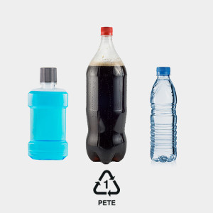
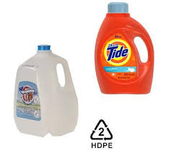
MSU Recycling Drop-off Center
Materials Accepted
  Plastics will be limited to two types of plastics:
    #1 PET Plastic Bottles
    #2 HDPE Plastic Bottles and Jugs
  Plastics no longer accepted include:
    #3 through #7
    Plastic bags/film (i.e. grocery bags)
      Please return plastic grocery bags to store where available
    Non-bottle #1 and #2 (i.e. flower pots and take out clam shell containers)

Slide 5
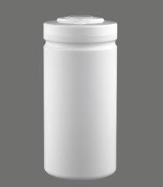

MSU Recycling Drop-off Center
How can I tell if my plastics bottles/jugs are recyclable?
  Is it labeled a #1 or #2 plastic?
  AND
  Is the base wider than the neck or opening?
If you can answer yes to both of these, then we will accept it.
Bottles/jugs are typically used for soda, juice, water, milk, shampoo or laundry detergent.
Neck
Items such as butter or cream cheese
containers and plastic flowerpots will not
be accepted.
Base

Slide 6
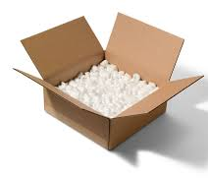
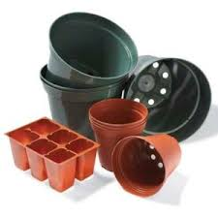
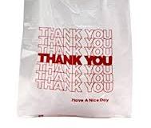
MSU Recycling Drop-off Center
Contamination
  It will be critically important that only the materials accepted are recycled at the Center
    Contaminants in the recyclables requires us to pull them out by hand which we cannot do right now due to safety concerns
  Common contaminants:
    Styrofoam and packaging peanuts in cardboard
    Plastic bags and nylon straps in cardboard
    Any materials contained in plastic bags
    Ceramic or Pyrex in glass bottles
    Kids toys, plastic pots in plastic

Slide 7
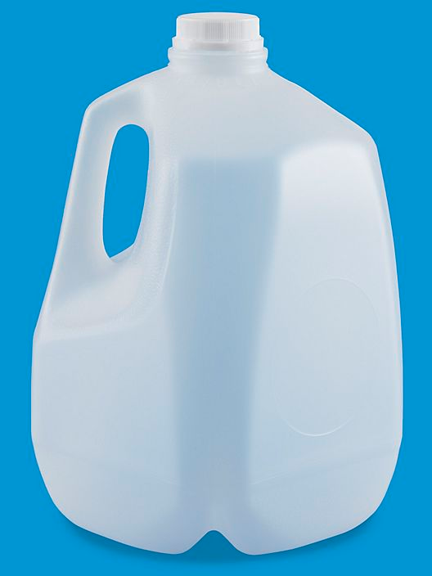
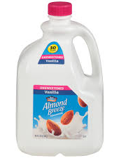
MSU Recycling Drop-off Center
How will plastics be collected?
  There will be two containers for plastics at the Drop-off Center
    1 for #2 HDPE “Natural” Bottles and Jugs (i.e. semi-transparent Milk Jugs)
    1 for combined #1 and #2 Bottles
  Natural HDPE is the original color of HDPE plastic before adding colorants
  The color of Natural HDPE is between clear and white
  Please Note some milk jugs are no longer made of “Natural” colored HDPE
    They are colored white (i.e. many almond or soy milks in plastic jugs)

Slide 8

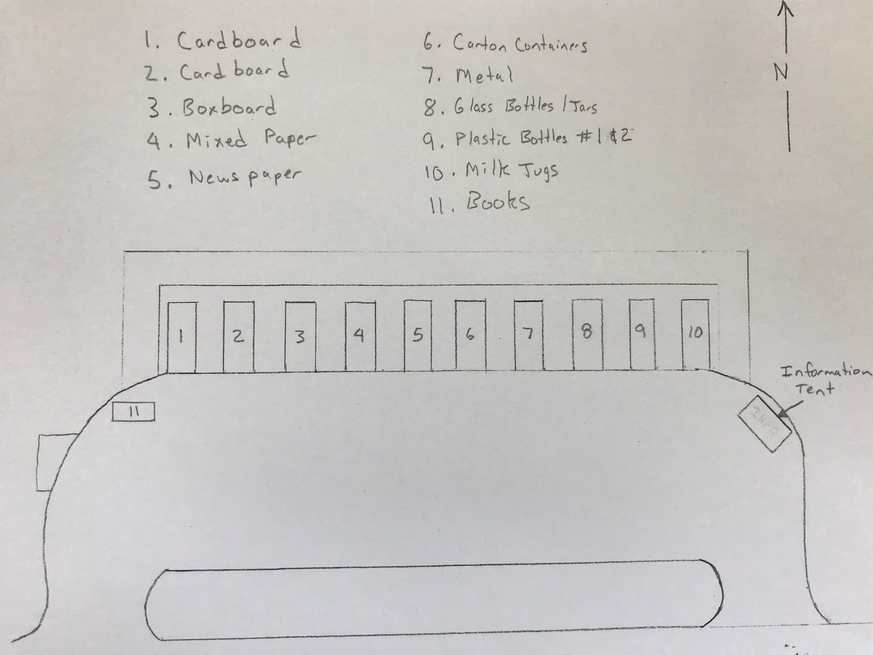
MSU Recycling Drop-off Center

Slide 9
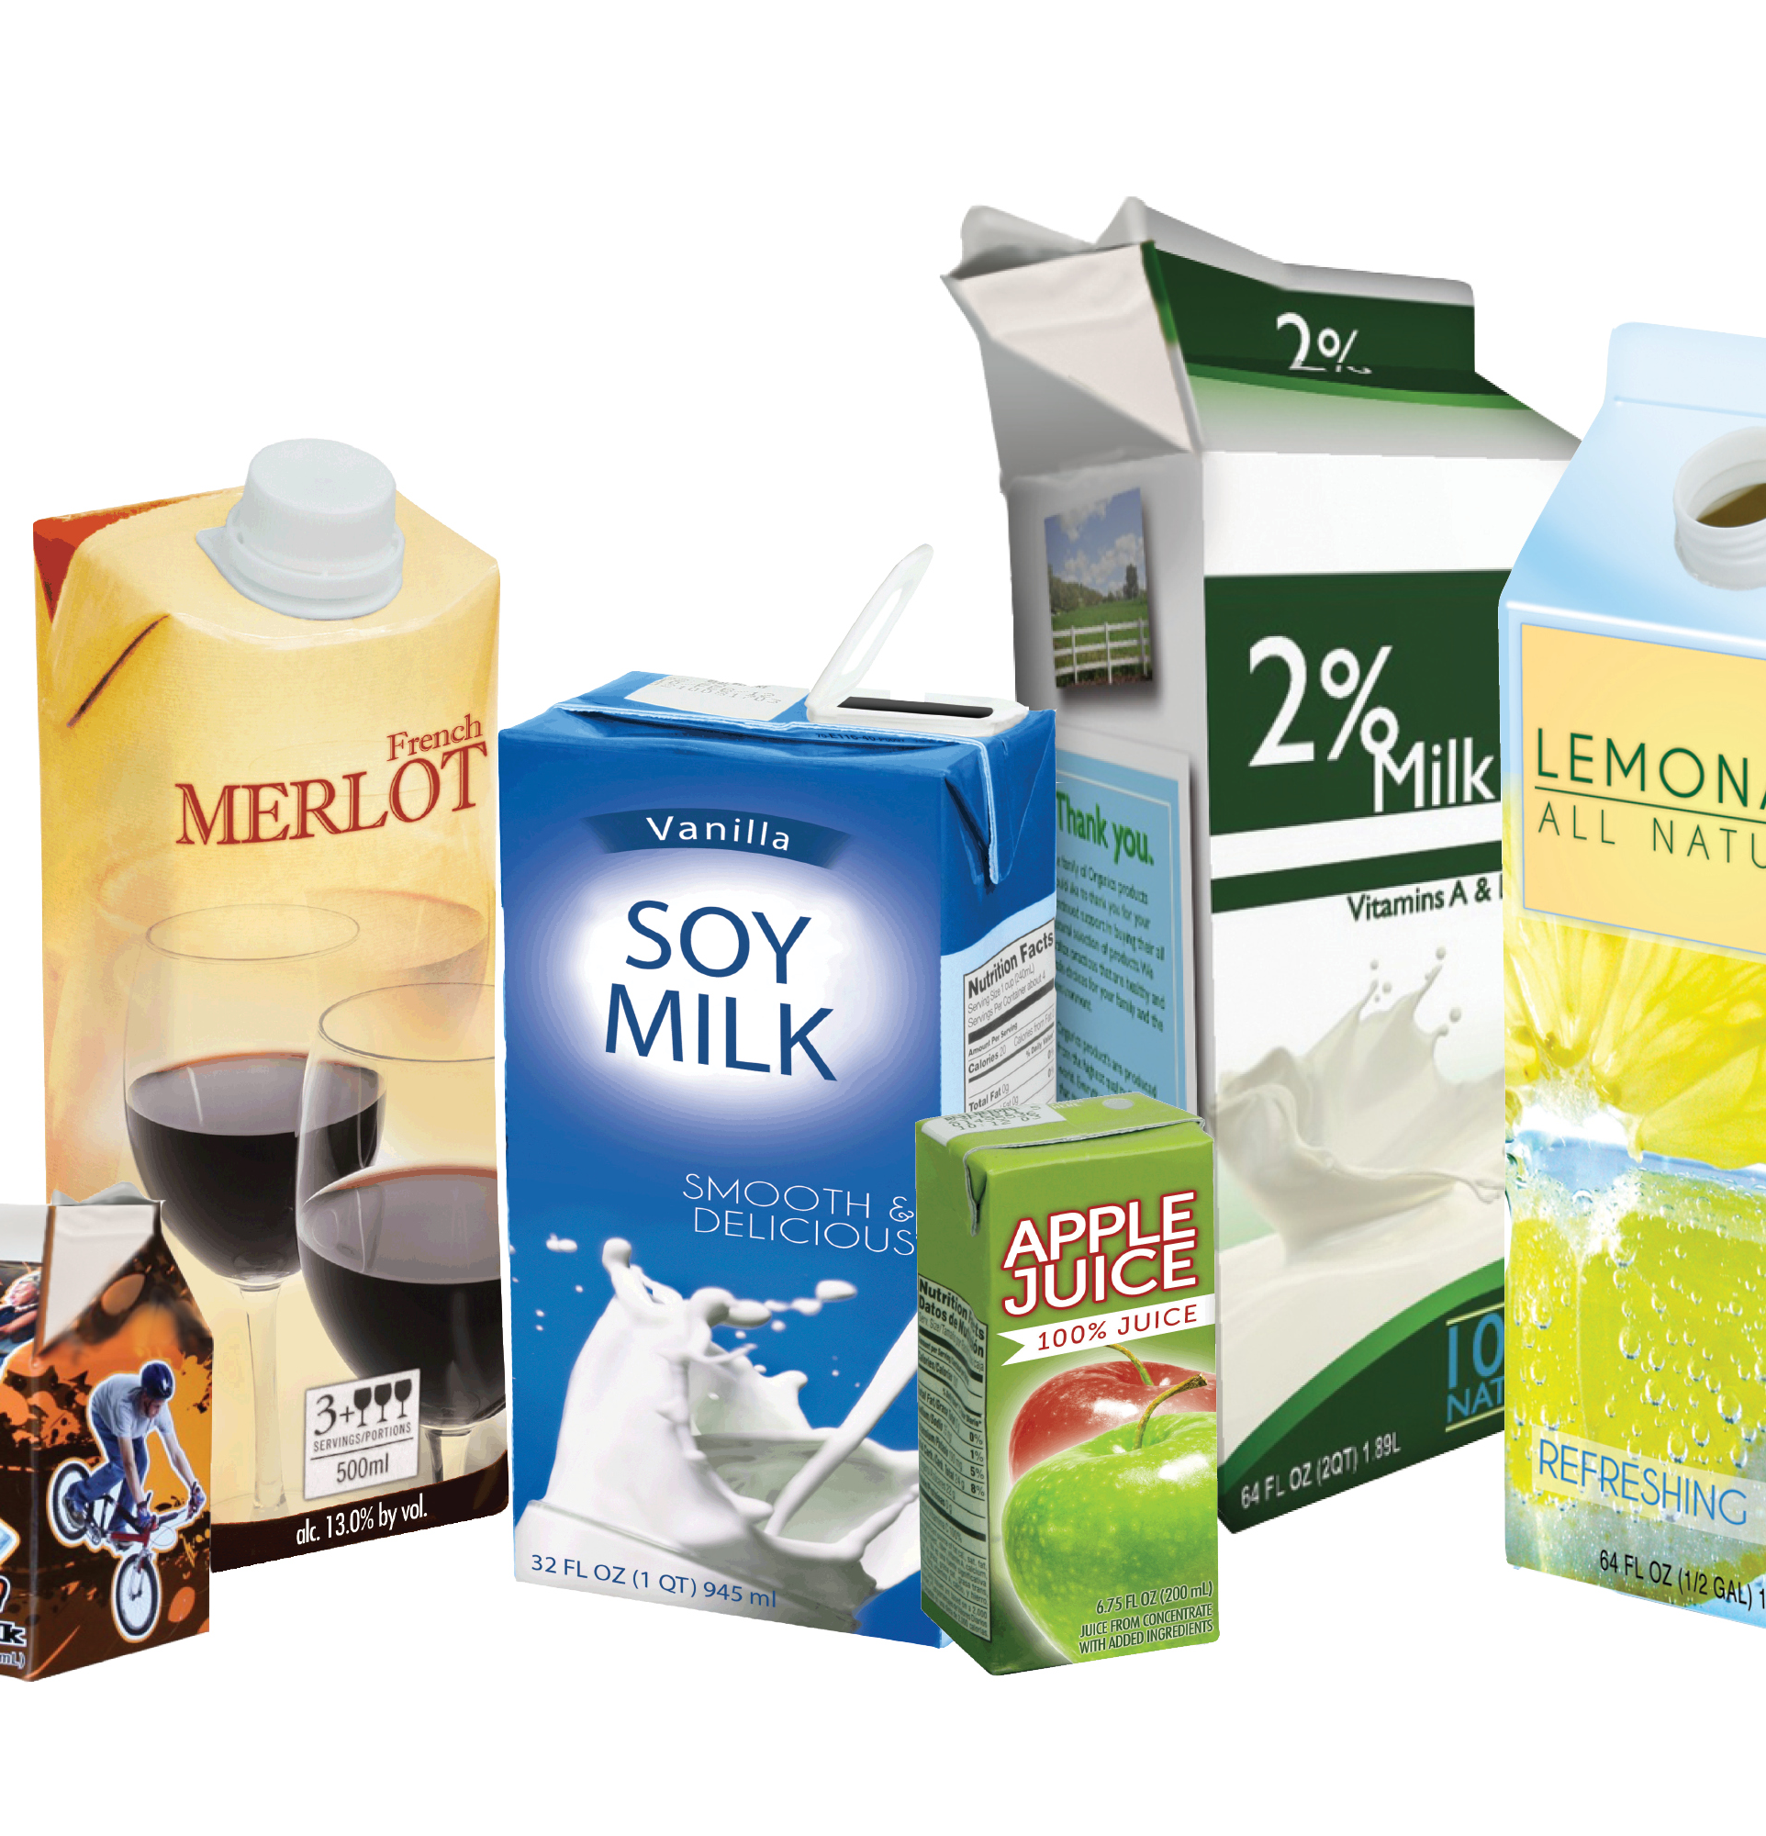
MSU Recycling Drop-off Center
NEW MATERIAL COLLECTED – Carton Containers
Carton containers are a type packaging commonly used to hold beverage and food products. They come in two general types
  Shelf stable cartons (aseptic) – can be placed on store shelves
    Commonly hold juice, soup, broth, and wine and milk stored at room temperature
  Refrigerated cartons (gable top) – are stored in the refrigerated section
    Commonly hold milk, juice, cream and egg substitutes
  Other cartons that can be accepted include ice cream and goldfish cartons
  Paper cups can be recycled with cartons as well
    No juice boxes, Styrofoam or cups coated with styrofoam

Slide 10
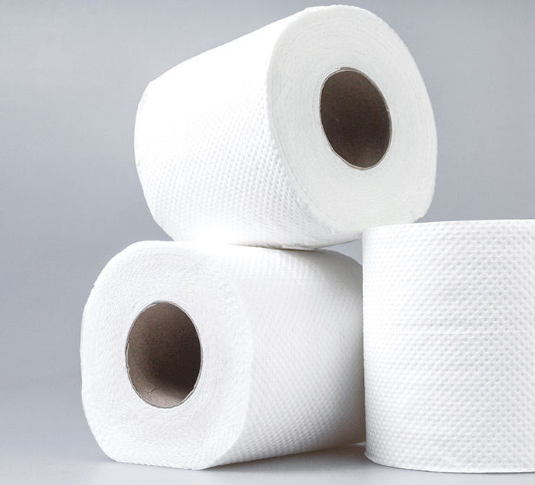
MSU Recycling Drop-off Center
Carton containers are sent to Great Lakes Tissue in Cheboygan, Michigan
Made into 100% tissue and towel products

Slide 11

MSU Recycling Drop-off Center
Tips to help you recycle at the site
  Pre-sort your materials as best you can before arriving
    Separate materials so it is quick and easy to deposit them in the appropriate bins
  Respect fellow recyclers and maintain at least 6’ of social distance
  Only recycle the items that are accepted
    “Wishful recycling” contaminates accepted materials, increases costs, requires additional sorting and decreases the value of recycled materials
  Never leave material on the ground
  Remove packaging from cardboard boxes and flatten them
  Bring your recyclables in reusable or recyclable containers such as totes or cardboard boxes. We cannot recycle plastic bags.

Slide 12
MSU Recycling Drop-off Center
We look forward to restoring the majority of the recycling opportunities we have provided in the past while only limiting the types of plastics we accept in order to keep our work force safe.
We are excited to introduce carton container recycling and providing a valuable recycled material for a Michigan business to produce much needed products!
Thank you for supporting our mission to Turn Waste into Resources and for your patience while the Center has been closed!

