Slide 1
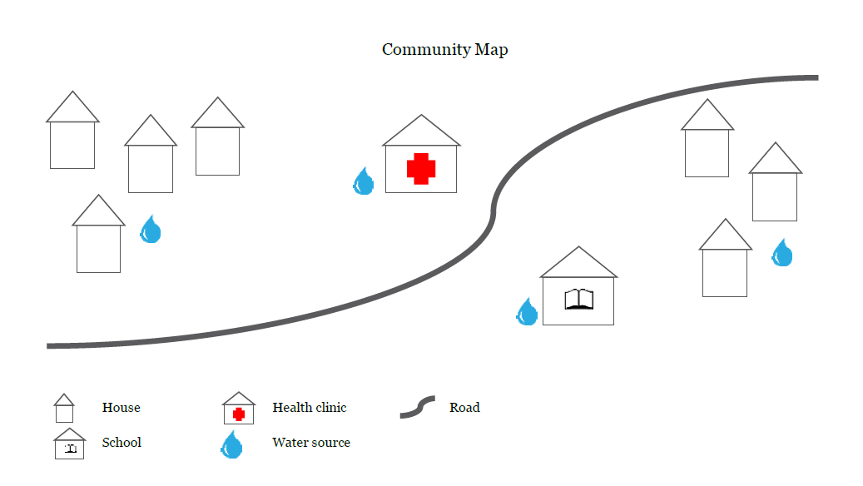
COMMUNITY MAPPING
Individuals or groups draw a map of their community
Maps mark points of importance
Facilitator leads discussion about maps
Notes:
CECELIA
Community mapping is used to reveal different perspectives about a community. It requires few resources and little time and can be adapted for participants of virtually any age or educational background. In this facilitated activity, individuals or groups draw a map of their community, marking certain points of importance and noting how often they visit these places. A facilitator leads a discussion about the maps, while another facilitator records the discussion.

Slide 2
COMMUNITY MAPPING
Tips
Keep groups small
Help groups draw map based on their own definition of the community
Discuss maps with large group
Ask for volunteers to analyze maps further
Notes:
CECELIA
Keep groups small — perhaps no more than 20 participants, divided into groups of four to six.
Help each group draw a map based on their own definition of the community. The wealth of information resulting from the maps will come from their variety and differences.
In the large group, discuss all the maps. Some questions you might ask are:
What are the differences between the maps?
Why might the differences be important?
What are the similarities between the maps?
What important aspects of the community are implied by the similarities?
What places were suggested to be added to the community? How would these places improve the community?
Do the maps indicate any specific activities or projects that might improve the community?
Ask participants to volunteer to join a committee to further analyze the maps and identify next steps.

Slide 3
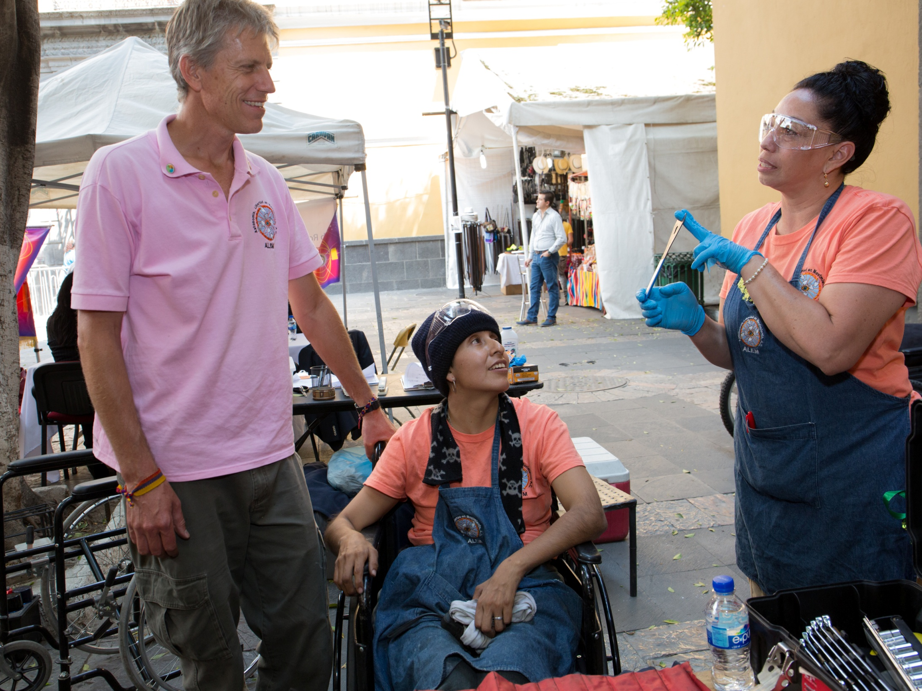

You’ve conducted your assessment… Now what?
Notes:
ABBY

Slide 4
PROJECT SELECTION
Falls within global grant guidelines
Is sustainable
Aligns with goals of area(s) of focus
Is technically feasible
Is one that you and your partner club are qualified to address
Does not duplicate existing efforts
Notes:
ABBY
Once you’ve completed the community assessment and analyzed the results, you can determine which needs you are able to address through a global grant.
Once you’ve identified a possible project, make sure that:
It falls within Rotary’s global grant guidelines
Is sustainable
It aligns with specific goal(s) of the area(s) of focus
It’s technically feasible
You and your partner club are qualified to address this need through your collective expertise and resources
The issues aren’t already being addressed by another organization

Slide 5
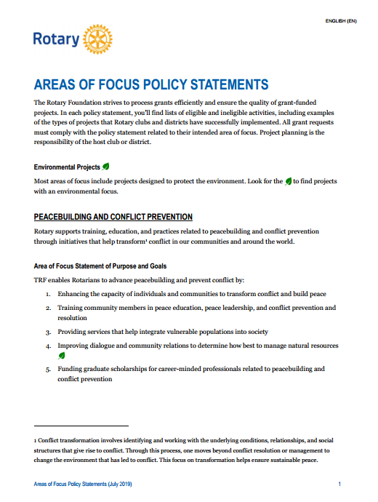

AREA OF FOCUS GOALS
Goals provide specific guidance within each area
Notes:
CECELIA
As mentioned a moment ago, global grant projects must align with a specific goal in an area of focus. These goals provide specific guidance about what types of projects are eligible in each area of focus. You can find the goals in the Areas of Focus Policy Statements on My Rotary.

Slide 6
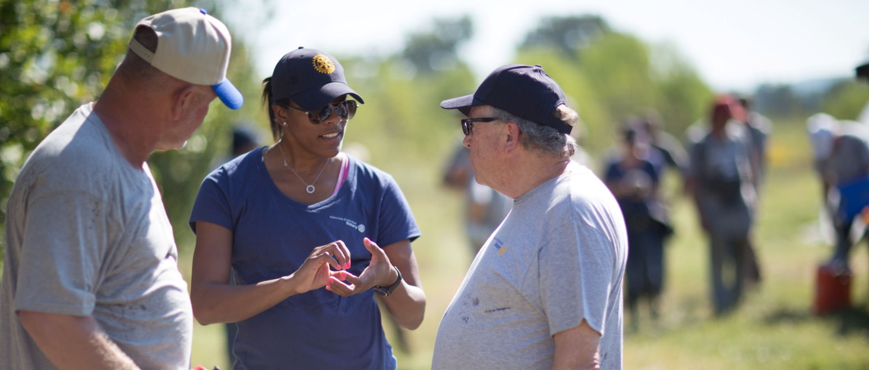
PROJECT PLAN
Collaboration is essential!
Sponsoring clubs work together to develop project plan
Involve community members
Notes:
ABBY
Collaboration is essential to developing your project plan. The sponsoring clubs should work together and agree on how to manage each part of the project and how to follow Rotary’s global grant guidelines.
Involve community members in the planning process. They can create the project plan with you or review it and provide feedback. The most successful plans allow Rotarians and community members to take action together. That collaboration — and the active involvement of Rotarians — should be clearly visible to anyone who sees your project plan.

Slide 7
PROJECT PLAN
Community impact
Measurable goals and outcomes
Actions for each step of project
Assignment of responsibilities
Monitoring
Possible alternative approaches
Notes:
ABBY
A successful project plan should include the following:
The impact you wish to have on the community
Measurable goals and outcomes of the project
Actions needed to implement each step of the project
Assignment of responsibilities so that all work is covered
Ongoing monitoring and data collection in the benefiting community
Possible alternative approaches if activities do not yield the desired impact

Slide 8

What do we see when a proper community assessment is not conducted?
Notes:
ABBY

Slide 9

COMMUNITY ASSESSMENTS: COMMON ISSUES
Identifying a need and developing a project before conducting a thorough assessment
“Shopping” around a solution
or intervention
Disconnect between the assessment results and the project design
Notes:
ABBY
Surveying schools to ask whether they have a specific technology, water filters or desks is not a community assessment. It is well known throughout development circles that people nearly always accept what is offered to them regardless of whether it meets a need or is likely to be used. It is for this reason that we cannot accept this approach as fulfilling the requirement for a community assessment. The fact that someone simply accepted the offer of materials raises doubts as to whether these materials will ever be effectively used.
Meeting with the local school superintendent to ask whether Rotary can provide specific materials to his/her schools also is not a community assessment. Meeting with the superintendent, a representative group of teachers and a representative group of parents to discuss what they need or hope for their children and then developing a project in response is a community assessment.

Slide 10
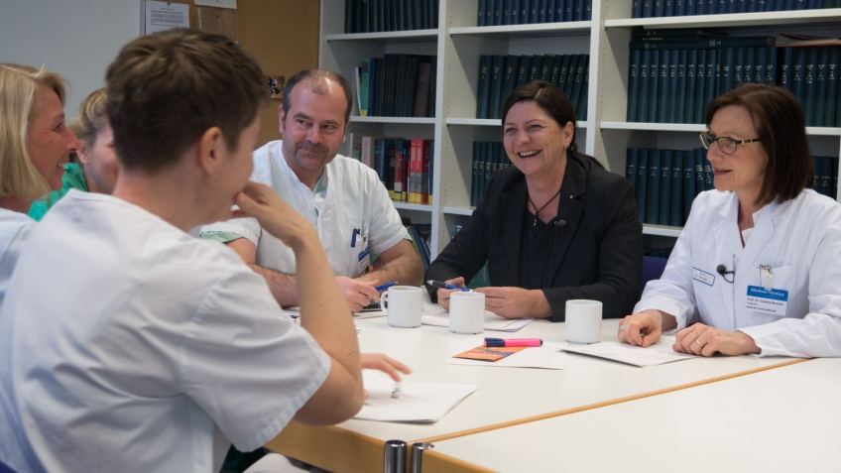
INADEQUATE TRAINING
Issues
Tack on training
Training on equipment use only
Training is too short
Knowledge transfer instead of true training
Solutions
Ensure that training is integrally related to grant activities
Any equipment-use training should be paired with behavior modification training and/or capacity-building
Ensure that training is high-quality and in-depth. Include follow-up training.
Ensure training involves more than just sharing information
Notes:
CECELIA
Tack on training - Rotarians add training in order to make grant eligible. This is often unrelated to grant project goals and intended outcomes and is a result of focus on equipment vs. skills
Training on maintenance and use of computers, instead of equipment at tool to increase skills.
Training lacks quality and is only held for a couple of hours. Follow-up training is not required but is highly recommended as it gives participants a chance to share successes and failures and make adjustments. (Talk about teachers and how they will try something once and if it doesn’t work, revert to old ways.)
Many trainings we see are just sharing knowledge. This is how to wash hands vs. this is how to teach to wash hands.

Slide 11
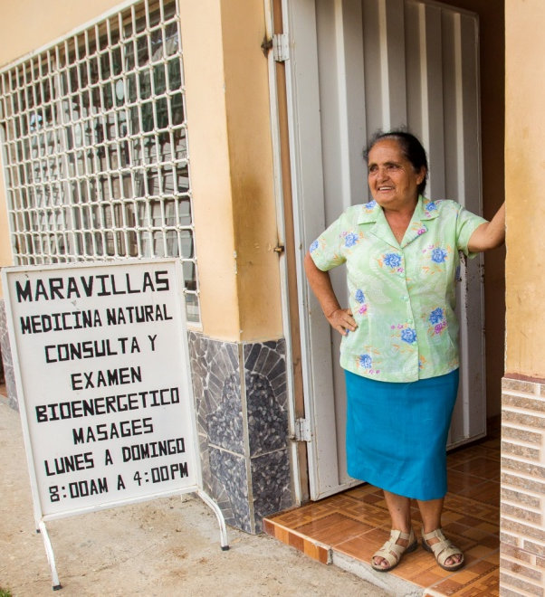
LOCAL OWNERSHIP
Issues
Local community is not involved
Sponsors and cooperating organization develop solutions and implement them
Lack of trust
Lack of innovation
Solutions
Ensure that community is involved and takes ownership
Have community lead the solution process
Take time to build trust between community and Rotarians
Re-think best practices and innovate to address community needs
Notes:
CECELIA
Lack of community ownership and Involvement, which can happen even if an excellent community assessment was carried out. Occurs when the Rotarians and NGOs become the experts who then develop the solutions and then implement them. Having the community lead the solution process and owning the solutions and the implementation with support only where needed becomes key. It also makes change management easier (mindset, culture, etc.). The challenge we face is that many of us as Rotarians equate poverty and entrenched hardships to inability to think out solutions, and we treat communities like children rather than leaders in their own development.
In community assessment, one thing that is often forgotten by us as Rotarians is that trust has to be established first, especially in dealing with rural communities, or any other community with entrenched challenges (for example the slums). Building trust in such conditions takes time - we must be ready for the long haul. Also applies to large institutions like hospitals and schools where we deal with organizational administrations.
Lack of Innovation. It sounds contradictory, but best practices are often the enemy of innovation. Each community is unique in many ways, and each project needs to be thought through from first principles to see which "best practices" can, maybe suitably modified, work; and where new innovations need to be developed. Best practices are born by innovation, but we often use them to block it.

Slide 12
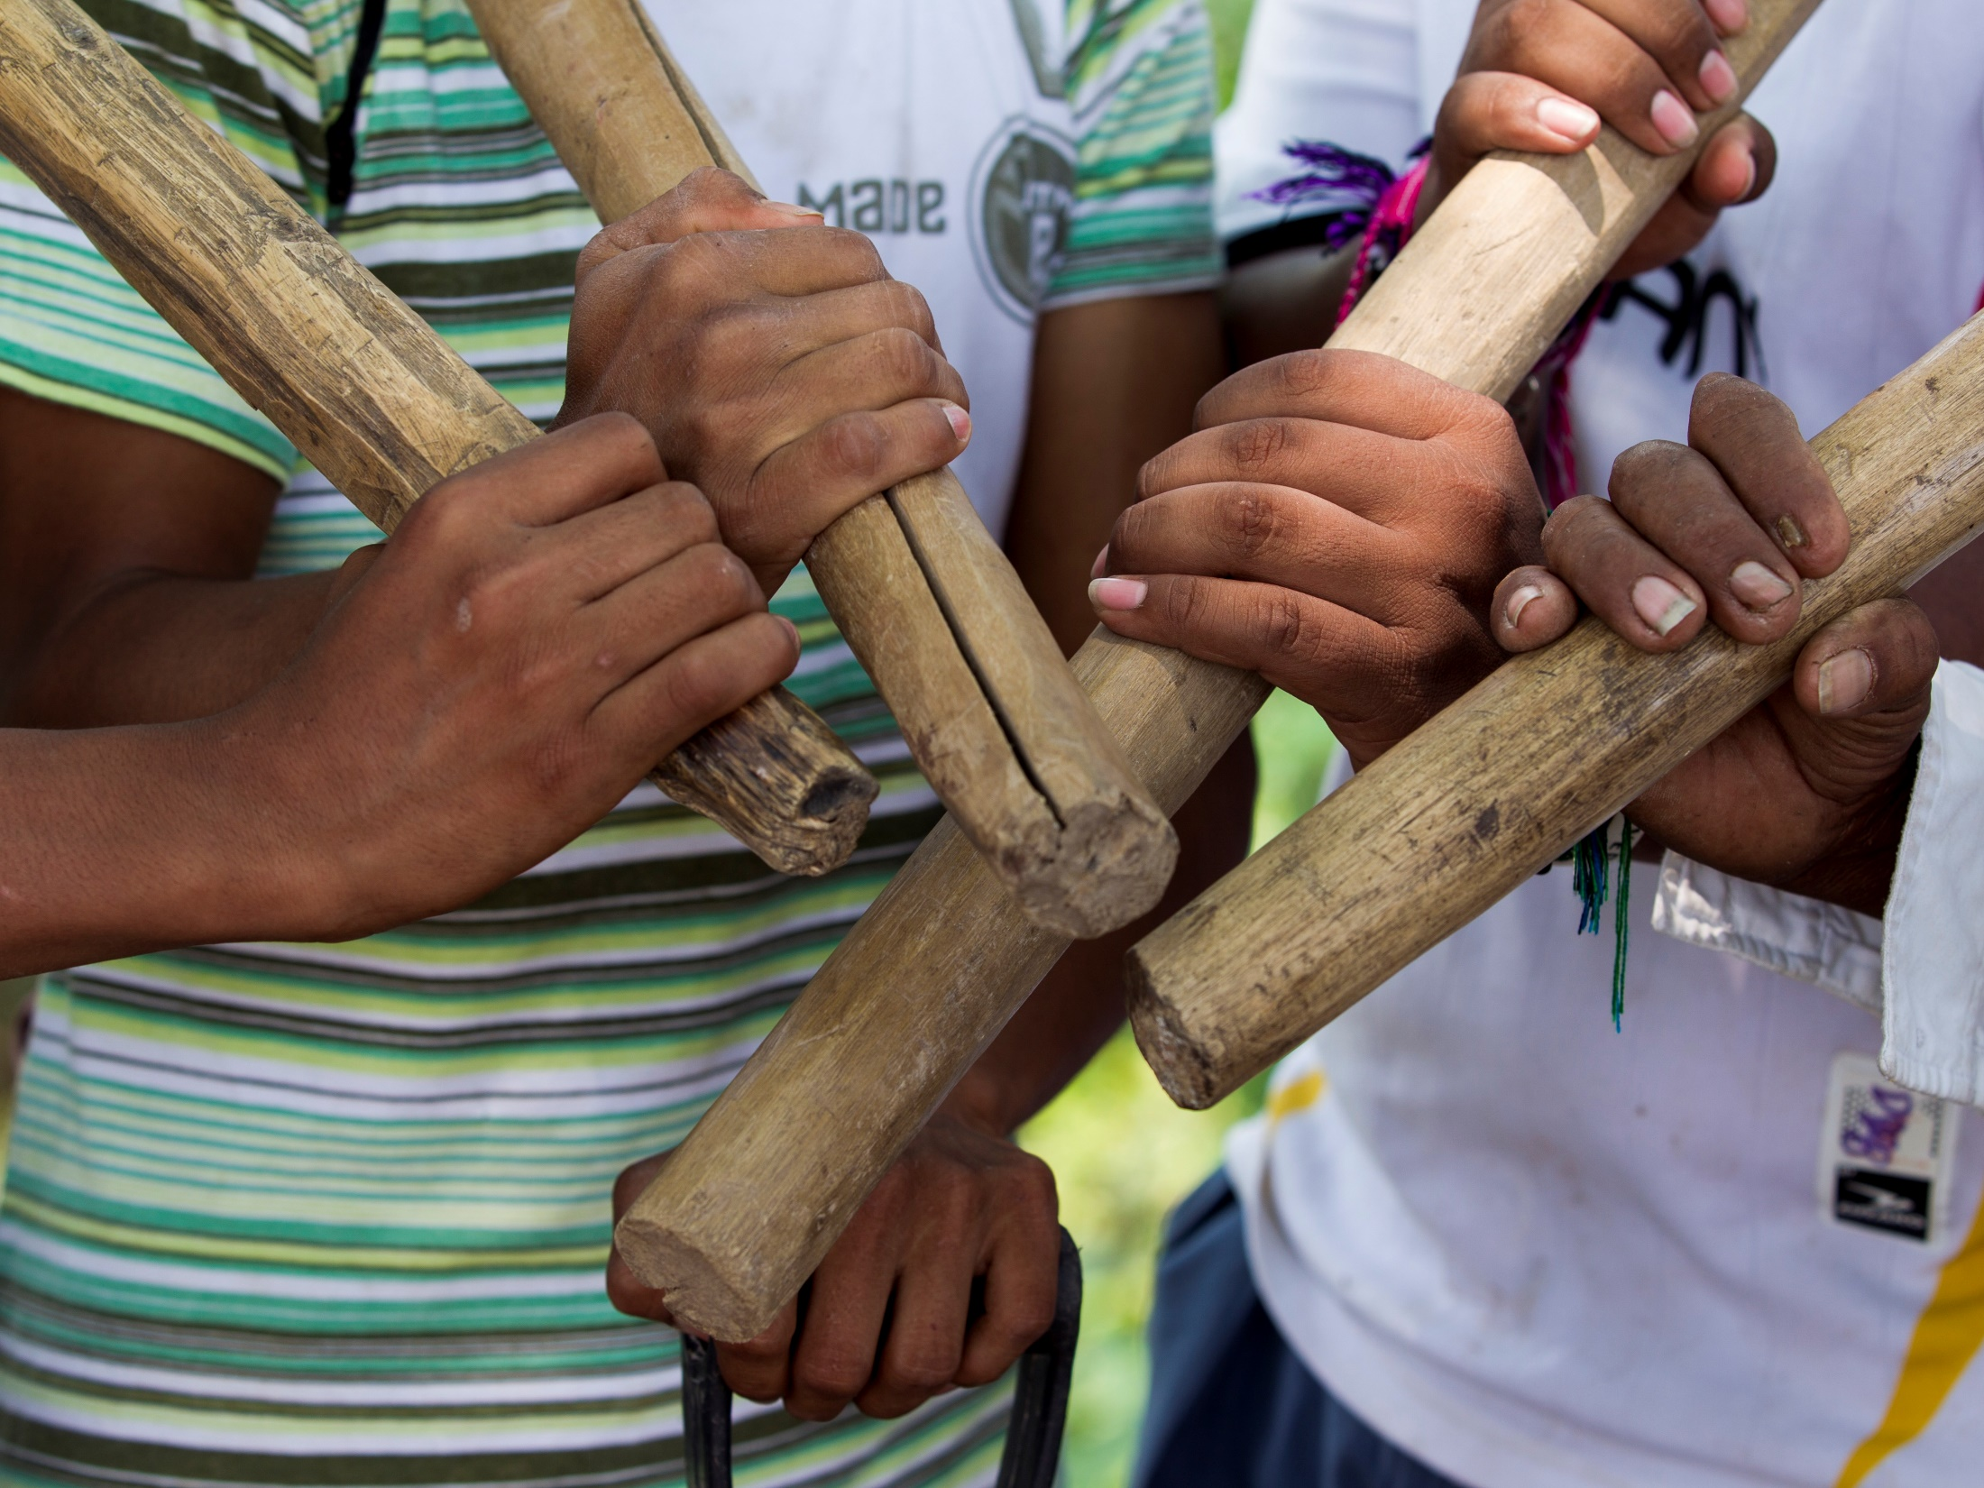
Questions?

