Slide 1



Williamston Sunrise Rotary
2016-17
A Year to Remember
Home of the Duck Race

Slide 2
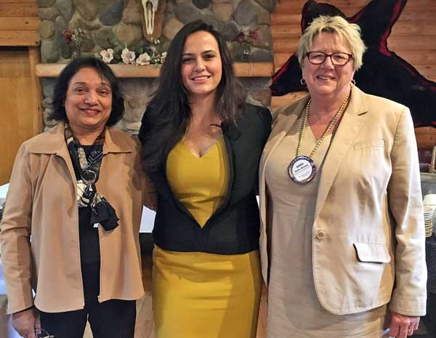
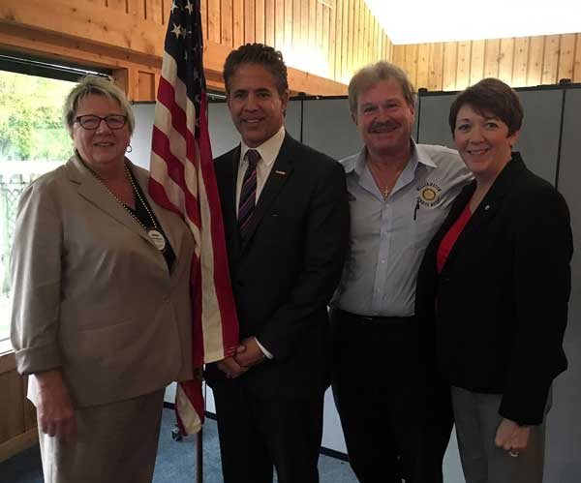
Meet the Candidates
Oct. 11 & 18, 2016
Democratic Candidate Suzanna Shkreli
Republican US Rep. Mike Bishop

Slide 3
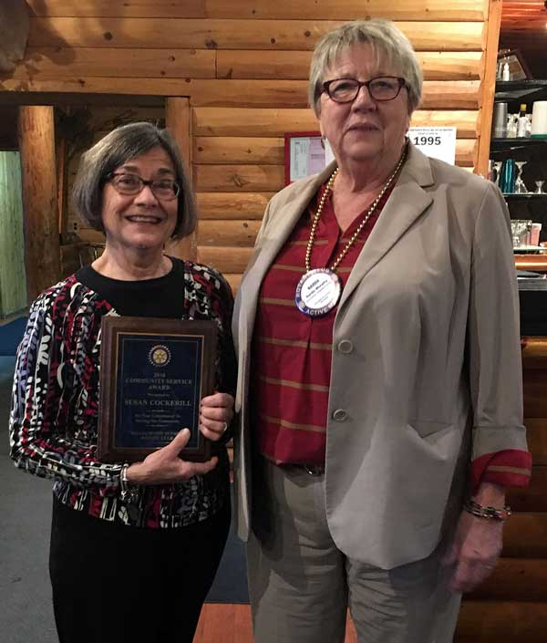
Community Service Award
Nov. 8, 2016
Susan Cockrill was chosen by Rotarians for the 2016 Community Service Award

Slide 4
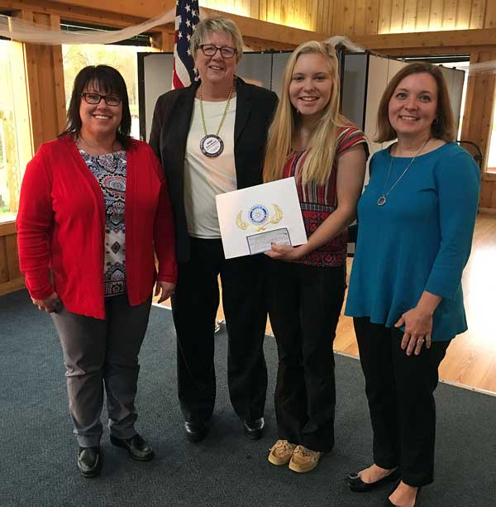
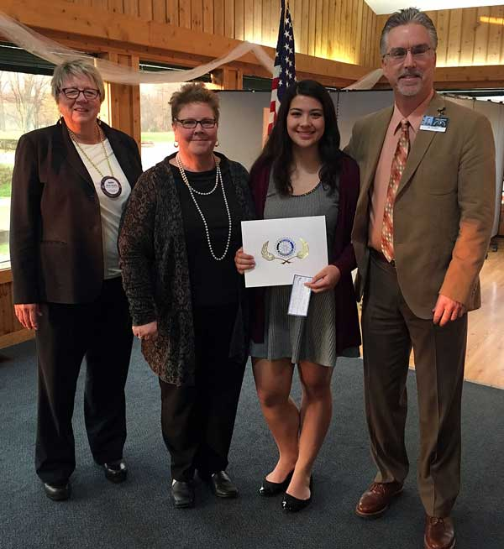
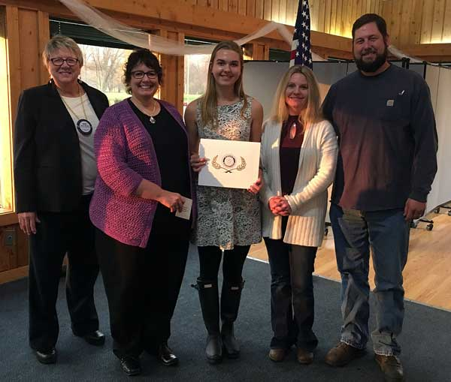
Students of the Quarter
Nov. 15. 2016
Emily Wisuri –
Webberville
CamilleFlores –
Williamston
Addison Dunham –
Dansville

Slide 5
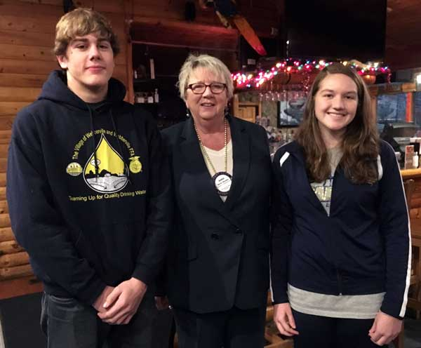
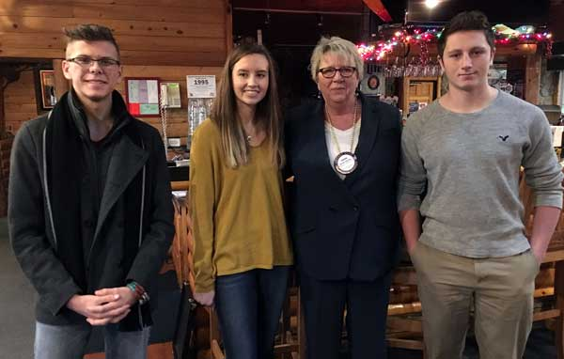
RYLA Presentations
Dec. 6, 2016
Ethan Stiffler & Hannah Fairfield
From Webberville
Nicholas Ressagre from Dansville and
Lillie Wilson-Daeschein & Jacob Milam from Williamston

Slide 6

Christmas Families
We obtained names and info on 3 area families that needed gifts for their children
From the list, Rotarians bought & wrapped gifts for them
They were taken to a Rotarian’s office for distribution for Christmas

Slide 7
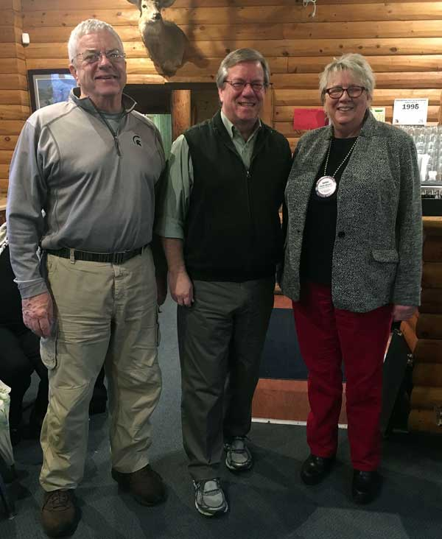
Guest Speaker – City Manager
Jan. 17, 2017
Alan Dolley –
City Manager

Slide 8
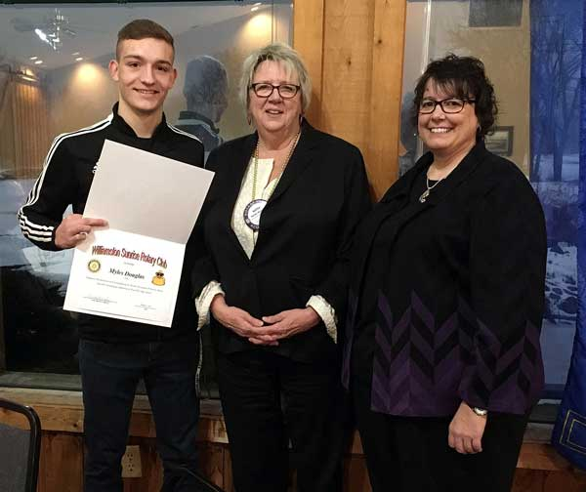
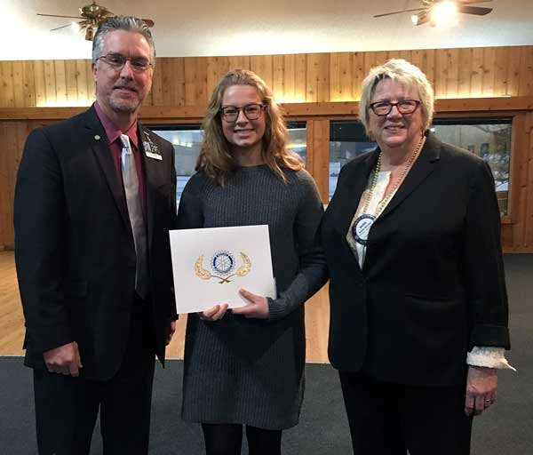
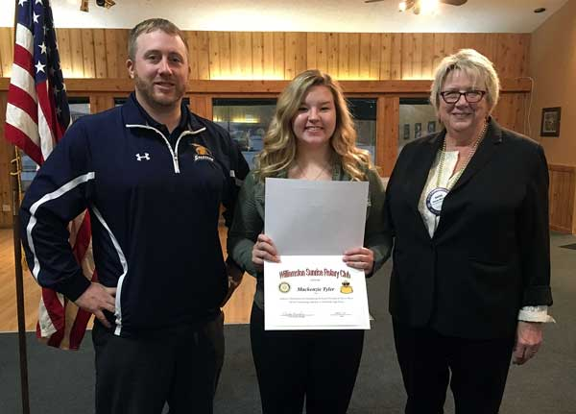
Students of the Quarter
Feb. 7. 2017
Myles Douglas - Dansville
  Emma Drake - Williamston
  Mackenzie Tyler - Webberville

Slide 9
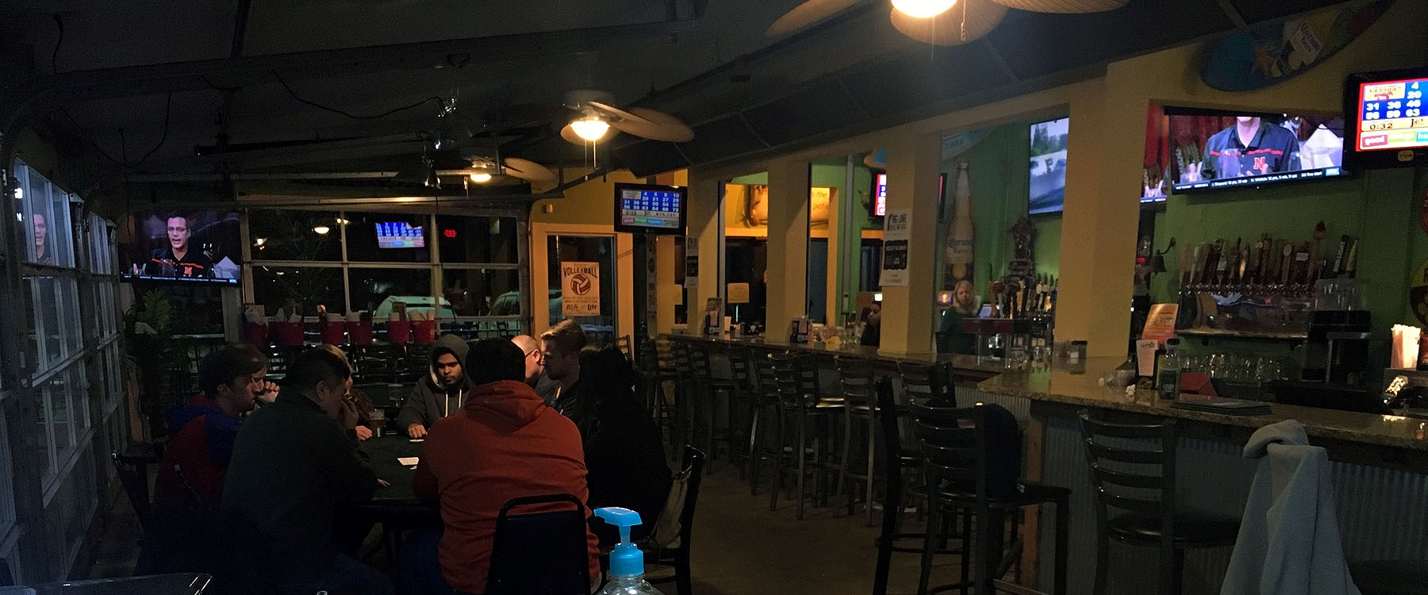
Charity Poker
Feb 27-March 1, 2017
We do Charity Poker 3-4 times per year for fund raising.
Also May 1-3, 2017
Nov. & Dec. dates cancelled

Slide 10
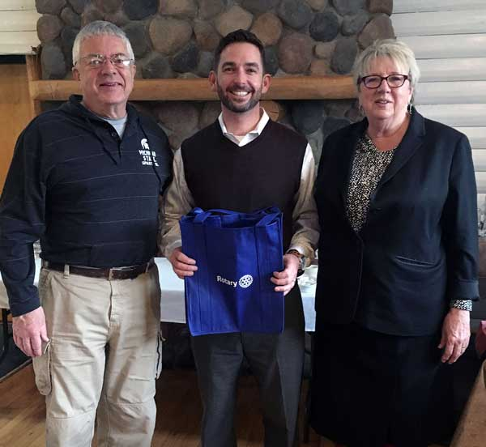
Many Hands Presentation
Our Rotarian Jeff Gorsline told us about Many Hands Weekend Survival Kits
March 4, 2017

Slide 11
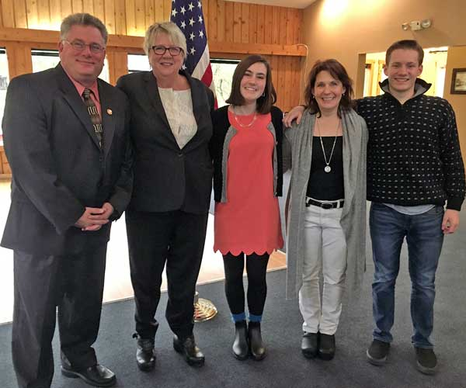
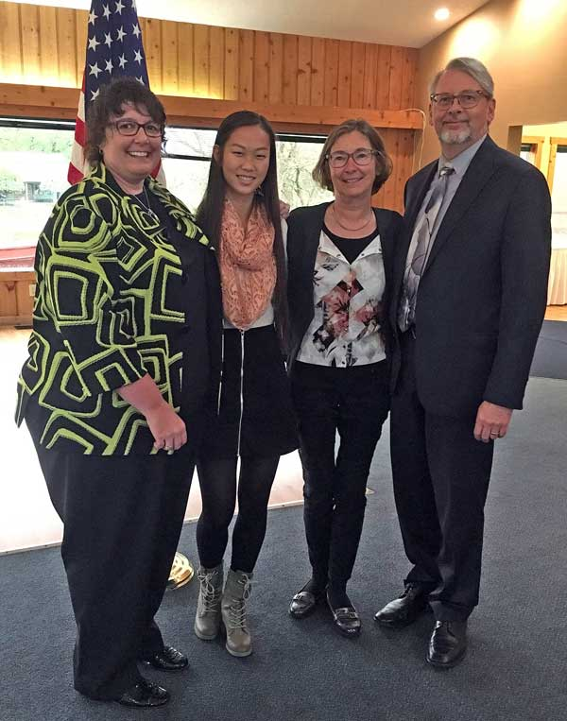
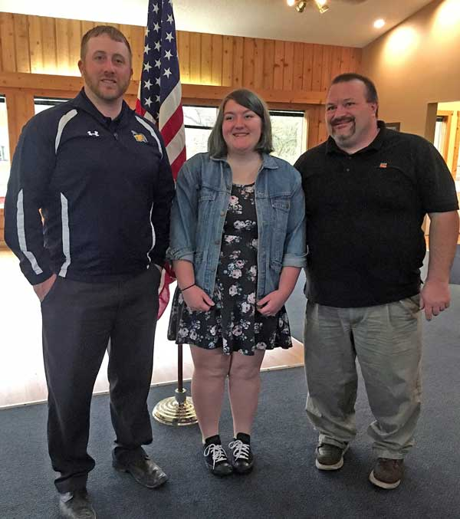
Students of the Quarter
May 2, 2017
Shea Monette - Williamston
Rebecca Teed - Webberville
Jianwei Kapp - Dansville

Slide 12
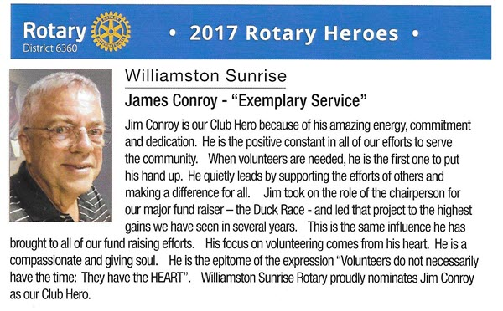

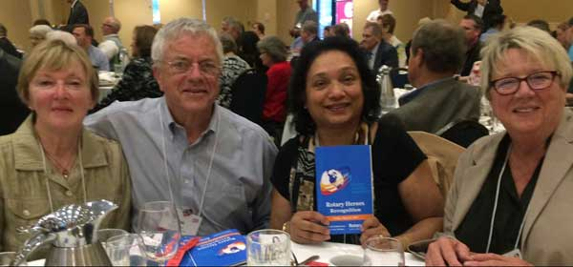
Rotary Heroes Recognition
May 13, 2017
Jim Conroy was presented as our Rotary Hero at the District Conference

Slide 13
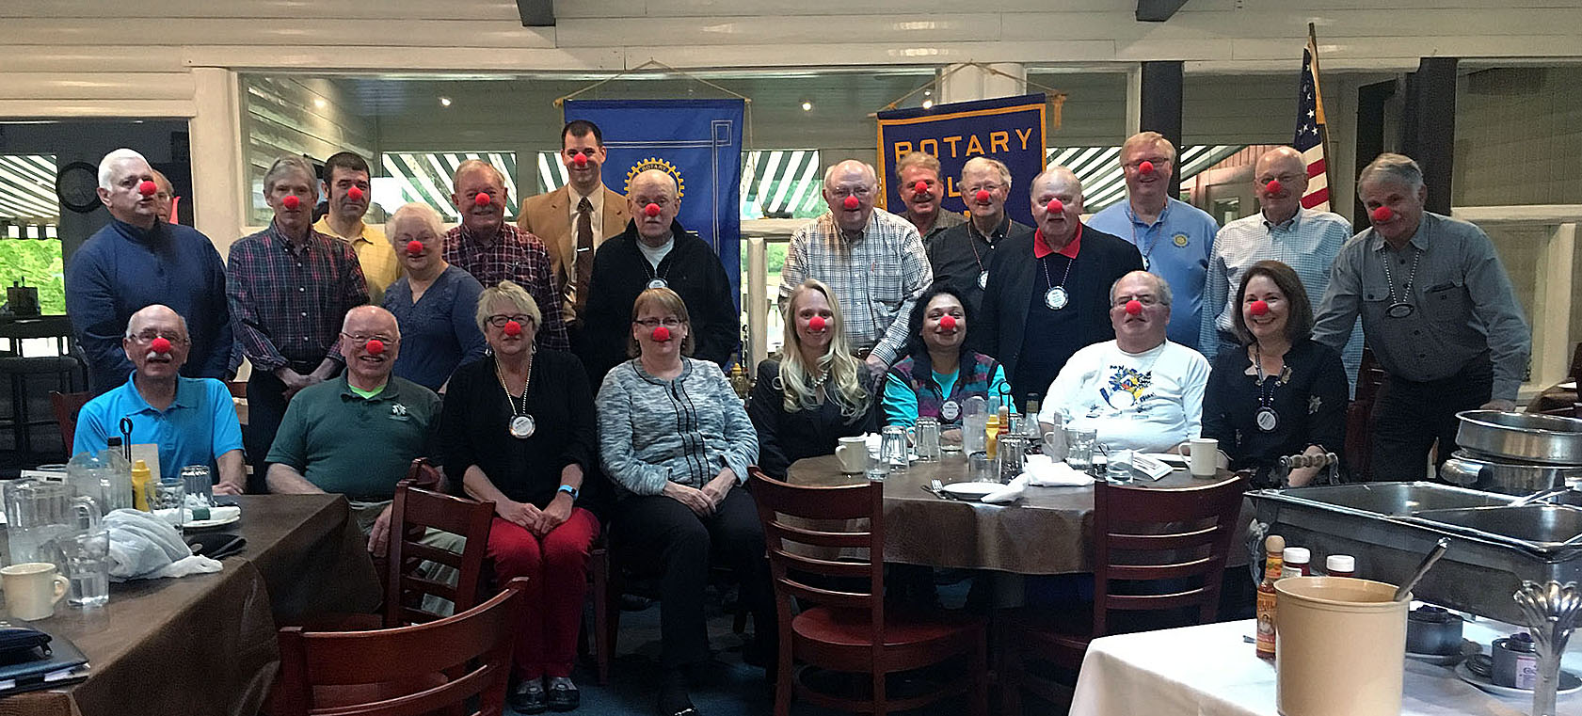
Red Nose Day at Rotary
May 23, 2017
We donned our Red Noses to help end Child Poverty

Slide 14
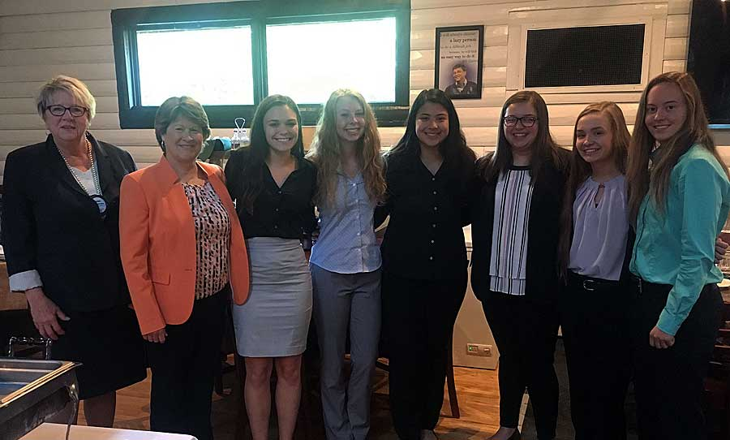
BPA Students
June 6 ,2017
Williamston HD Business Professional Association Students told us about their club

Slide 15
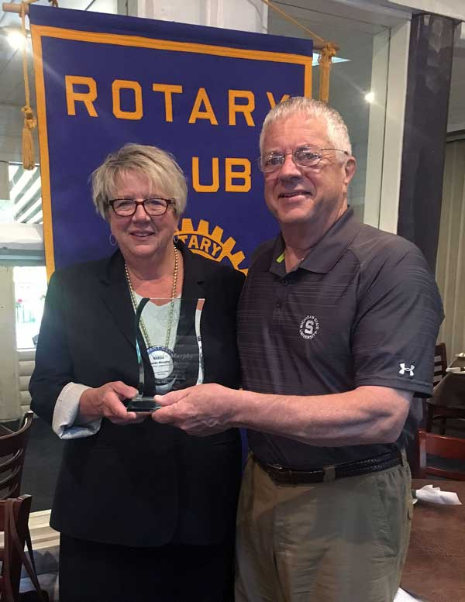
Rotarian of the Year
President Narda Murphy was named our “Rotarian of the Year for 2016-17”
June 6, 2017

Slide 16
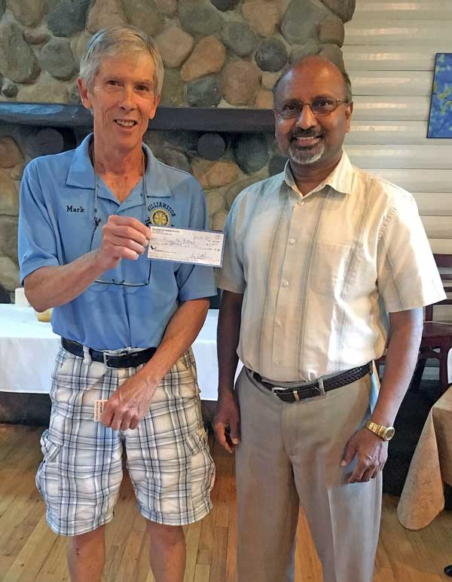
Check for International Project
Mark Steinberg presented a check to Uma of the East Lansing Rotary Club for the Rising Star Project – to aid leprosy victims in India.
June 20, 2017

Slide 17
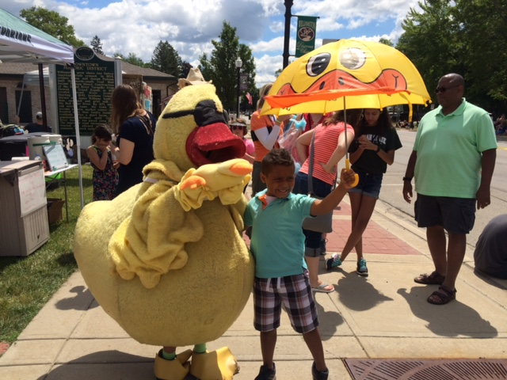
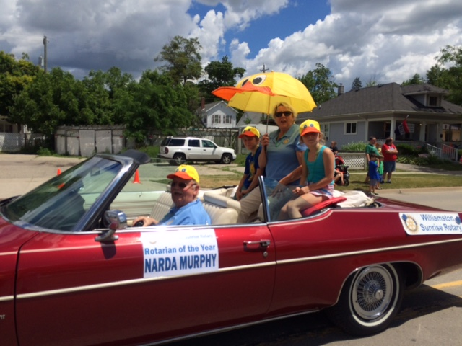
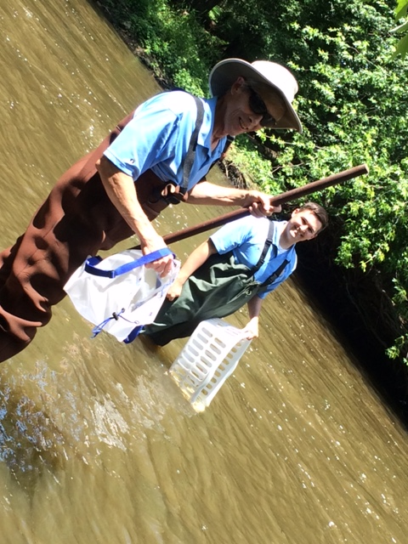
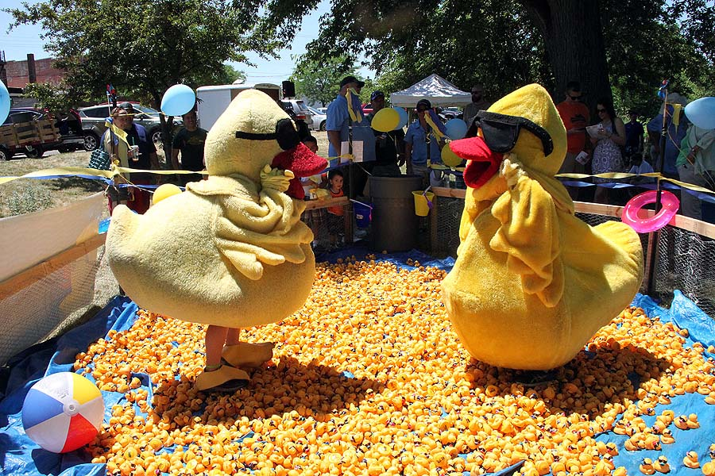
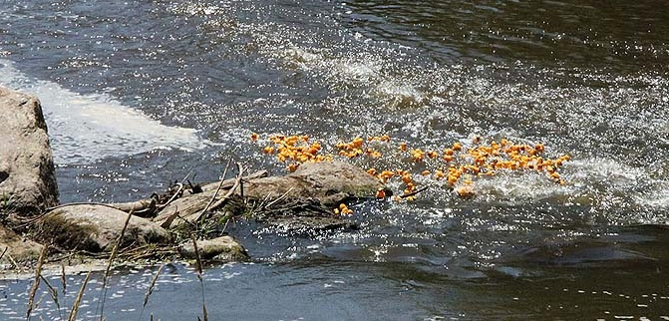
2017 Duck Race
June 24, 2017

Slide 18
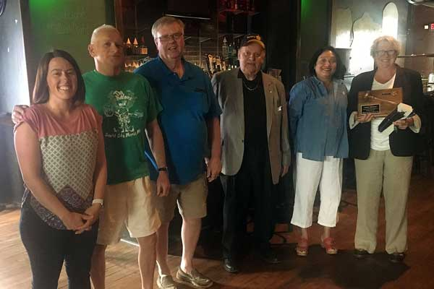
Officer Exchange Night
June 27, 2017
Narda passed the gavel to Raj.
She asked all past Presidents to join them.

Slide 19
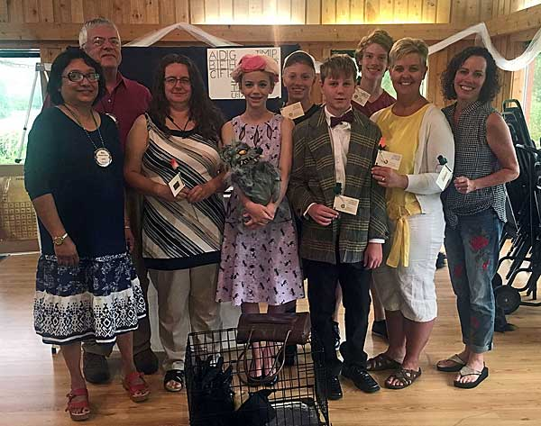
Destination Imagination Skit
July 11 ,2017
The Middle School Destination Imagination Team presented their skit that got them to Nationals in Atlanta.

Slide 20
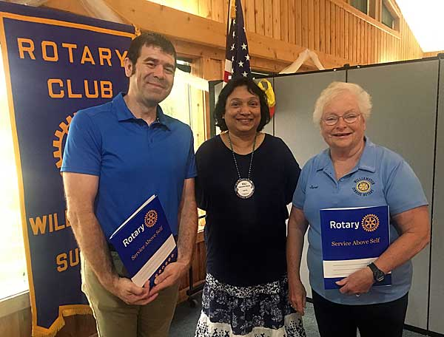
New Members Inducted
July 11, 2017
New members Brian Tort and Janet Eyster were inducted into the club.

Slide 21
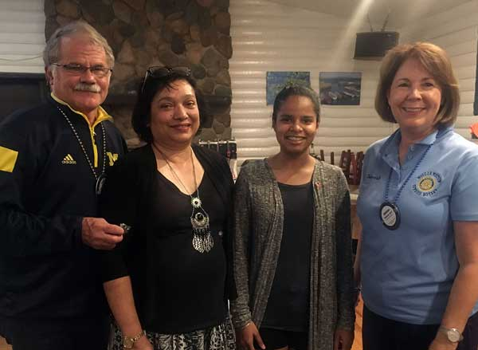
Rotary Exchange Student Welcomed
August 22, 2017
Rotary Exchange Student Aanchal from India was introduced to the club. Deborah & Earl Wolf are her host family.

Slide 22
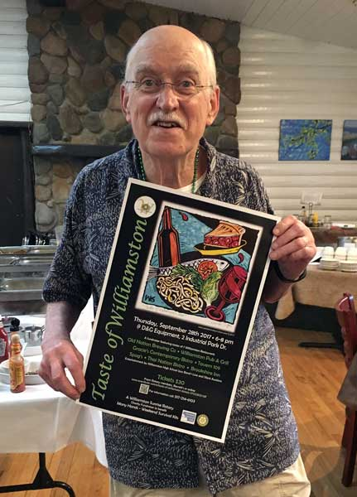
Taste of Williamston Prep
August 22, 2017
Jack Helder shows off the Taste of Williamston Poster

Slide 23

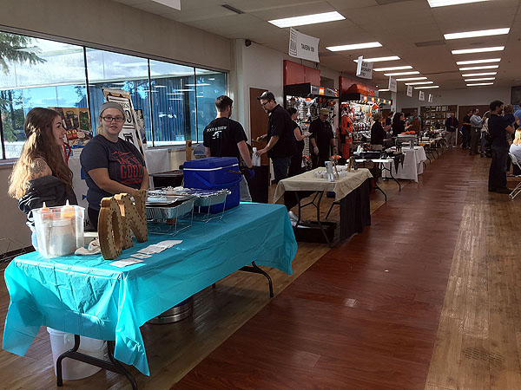
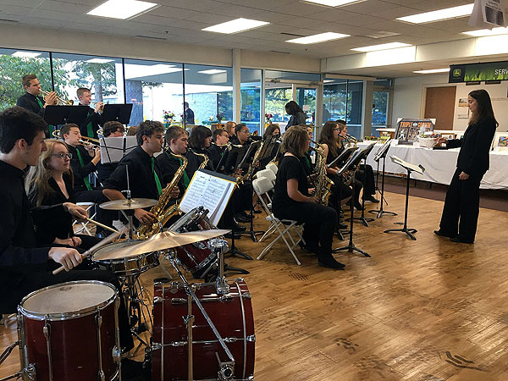
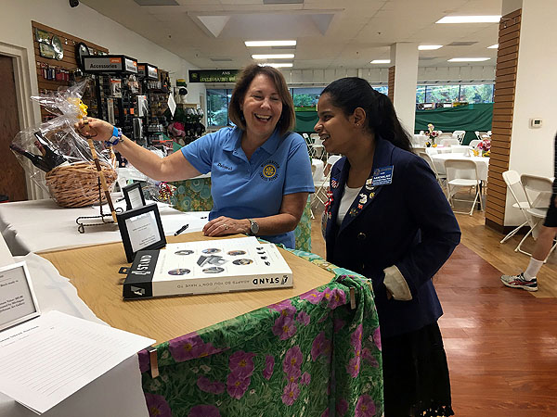
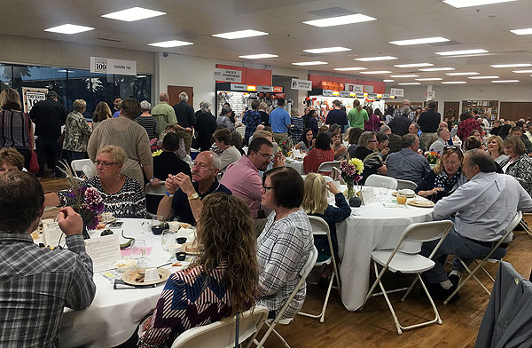
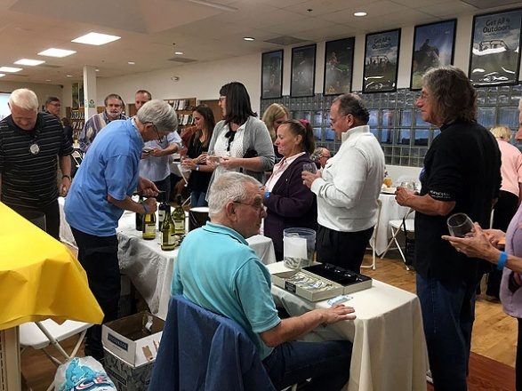
Taste of Williamston
Sept. 28, 2017

Slide 24
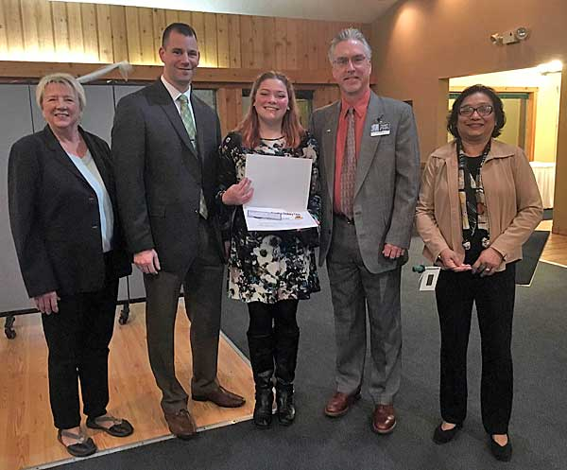
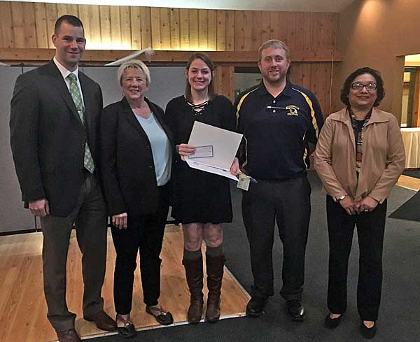
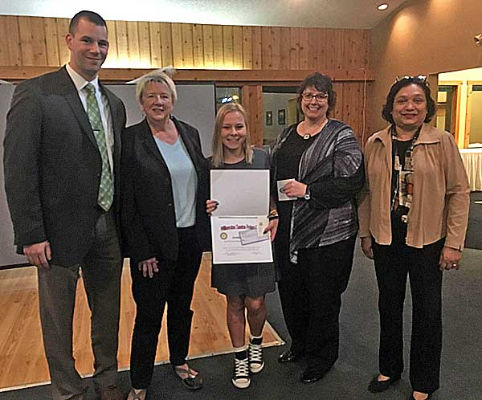
First ‘Narda Murphy Student Excellence Award’ Presentations
The Student of the Quarter presentations were renamed to “The Narda Murphy Student Excellence Awards”
Lia Bommarito -Williamston
Kelsey Mayville -Webberville
Jordan Simon
- Dansville
October 24, 2017

Slide 25
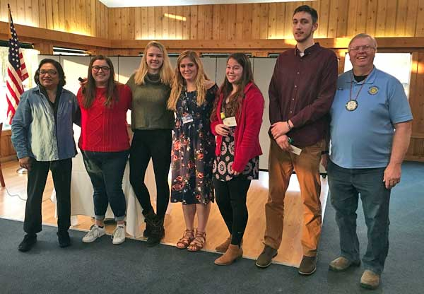
RYLA Students
November 14, 2017
President Raj Wiener, Tasha Hagelberg & Erin Bowling (Williamston), Carson Nolan & Taylor Detting (Williamston), Caleb Hodgson (Dansville) & Merlin Hopkins

