Slide 1
WILLIAMSTON SUNRISE ROTARY 2023 ANNUAL REPORT

Slide 2
CURRENT FINANCES
Notice Current funds for distribution
Current grant requests
Notes:
Steve Finance Report
Chris – Grants requested
Kiosk Design = $2000. coupled with Sandelin of $2000.

Slide 3
STRATEGIC PLANNING
Meeting at the township pavilion –
What to keep, what to leave
Meeting in person
Shared muffins
Developing a Think Tank to work through ideas that surfaced
Documenting how we do all our activities
Moving to the church meeting place
Moving to 3 member meetings a month
Dedicating one additional meeting / month to committee work
Creating a Rotary Calendar
ByLaws review (ongoing, close to member review)
Notes:
Sort if Ongoing
√General results of the discussion:
Satisfaction of what we’re doing – YYY (Ys indicate a group agreement)
Set Priorities
Duck Race with improvements - YY
In river
Make more money
Raffle - YY
ToW - Y
No Poker – Y
More community activities
In Park
Music Concerts
More branding/Marketing of who we are
Service
Potential members
What can we do?
International Project
Membership impact
Service vs. fundraisers
How does Satellite Club fit in?
Combine Satellite Club with our evening meeting
Invited to join us on July 26th at 6:00 pm
Membership opportunities
No Membership Chair now
It’s everybody’s problem
Timing of meetings
Young family members can’t make a morning meeting
Lunch meeting?
A lot of money and work done!
Supporting kids
Review how we want our money used
Raise about $1000/member annually
How decide what to do with this info?
Take to board, include Narda & Sharon
read more

Slide 4
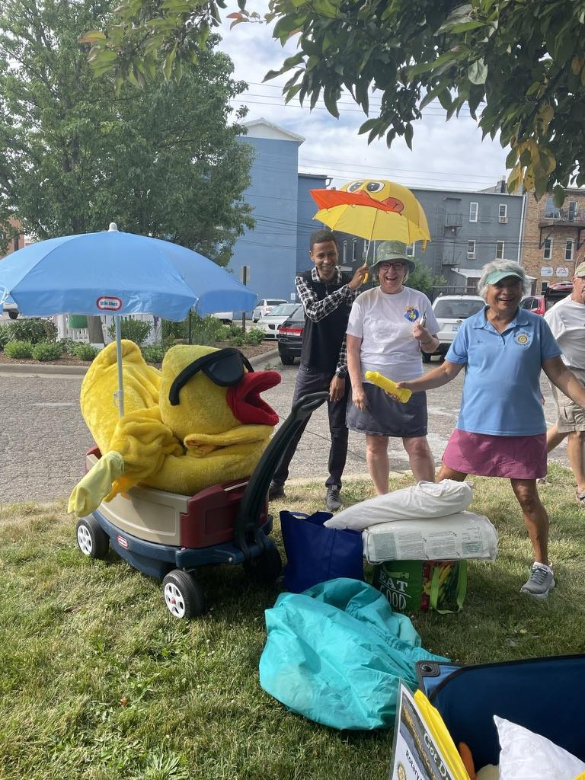
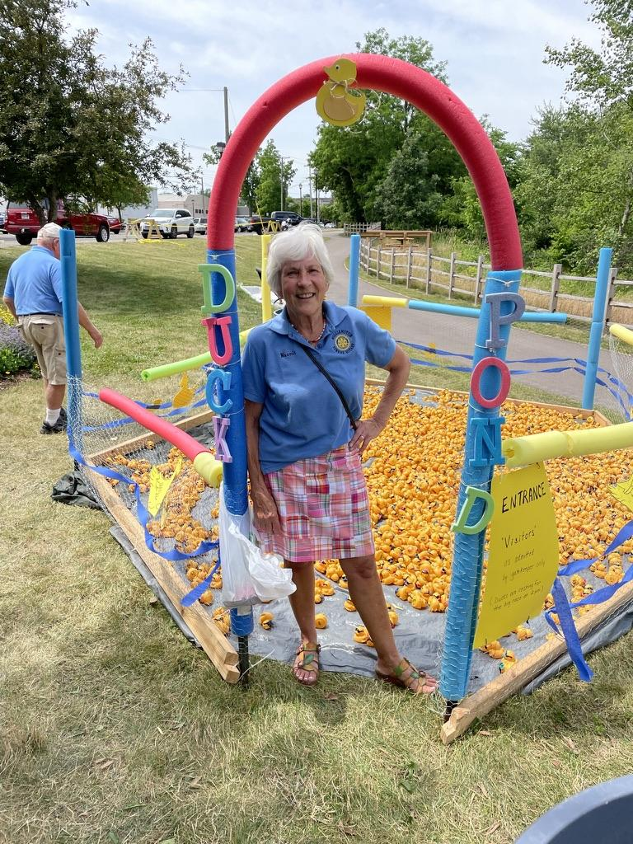
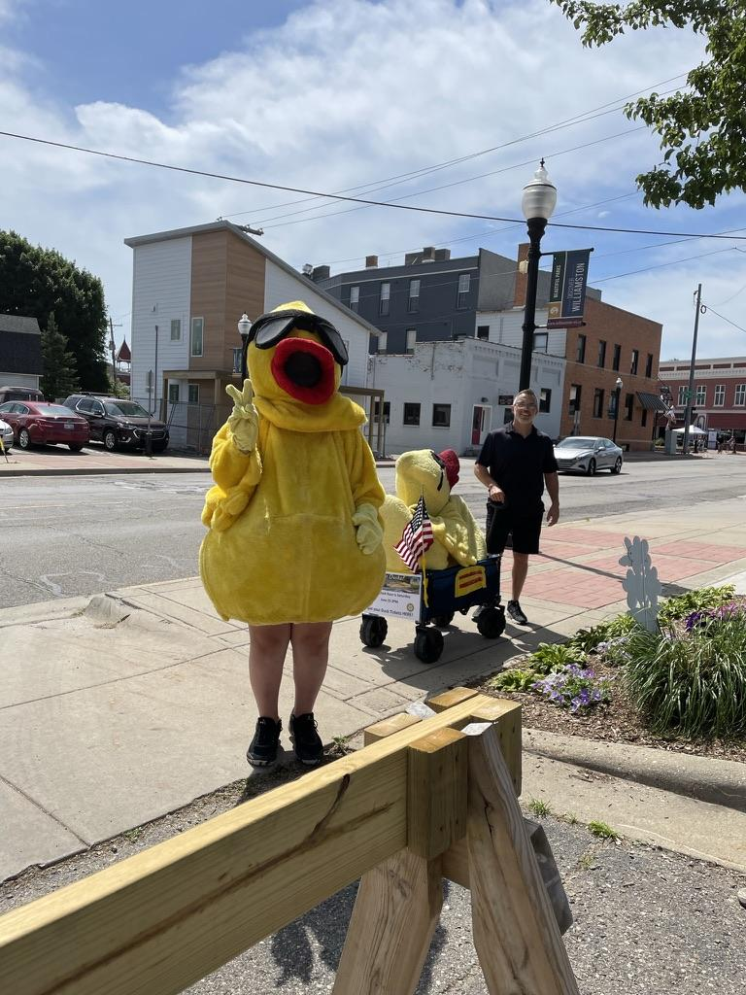
REVIEW OF OUR YEAR
Duck Race
Notes:
Really in June but we just saw how much we succeeded in raising monies!
Satellite gave much support!
Running Race in Conjunction with the Harvest Festival at the township

Slide 5
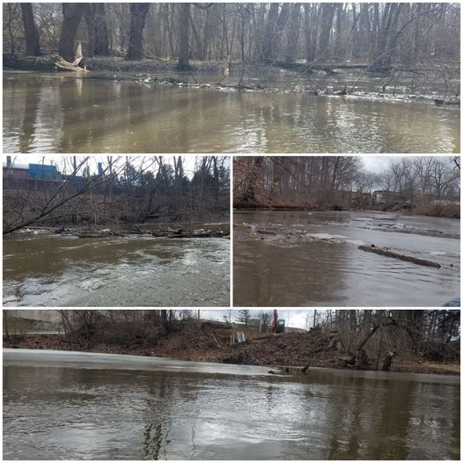
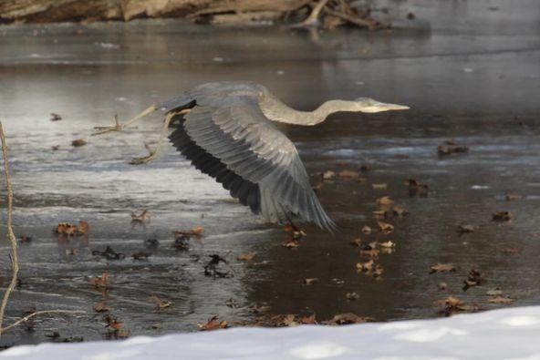
RED CEDAR RIVER PATHWAY
Notes:
Mike Stout to come on March 21
John Bollman representing from Satellite
Sharon LaPointe is our representative
Sept. 30 culminating event

Slide 6
GETTING TO KNOW THE SATELLITE CLUB
Notes:
Can speak to our growing alignment.
In one year the Satellite club now has 14 members and only 3 of these members were originally from the Sunrise group
People in our community are talking a lot about the service projects that they are doing and they are making an active difference in Williamston!

Slide 7
GRANTS AND OPERATING EXPENSES
We provide grants to: (and more) | We provide ongoing operating expenses to:
Williamston Community Schools | Jubilee Committee
Webberville Schools | Light Parade Committee
Dansville Schools | Scheffel Toys
Autism Awareness | Williamston Beautification
YMCA | Food Bank
Depot Museum | Weekend Survival Kits
Refugee Services | WUMC – Open Table

Slide 8
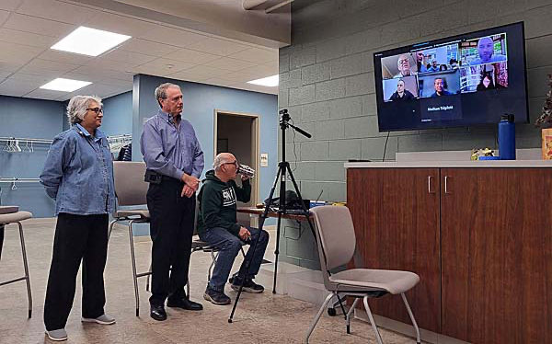
UKRAINE
Notes:
$5252. in 25 minutes!
The Sunrise Rotary Foundation of Williamston Michigan donated $3,000 to the cause and club members donated an additional $2,525 for a total of $5,525 (which included the $500 District drawing won by club member, Raj.) In addition, Dr. Sung Lee donated $500, and the Greater Lansing Jewish Federation pledged an additional $1000. East Lansing and Lansing Rotary Clubs have each contributed $3,000 and District 6360 has secured $9,000 for the transportation of a sea container of medical supplies.
The humanitarian effort from the region is supplying three needs.
Ambulances are needed in the interior towns that are being shelled. To date, the GLJF has funded, and Ody Norkin has delivered four ambulances- one to Odesa, two were diverted to the war front, and one most recently to Dnipro.
Medical supplies specific to wound care, burn care, and surgical repair. The city hospital supplies to treat civilians have been depleted as their resources have been sent to the war front, but Putin has been randomly shelling civilians as well. Supplies are from local donations and purchases from World Relief Service.
A sea container has been secured at the Detroit Ambassador Bridge to collect the supplies. Nathan Triplett secured Rotary Disaster funds for the transfer. It will be delivered via Suceava, Romania to Dnipro Rotary for distribution to local hospitals and doctors. Ody will meet the container upon its arrival, secure a flatbed truck in Bucharest, and hire a trustworthy Ukrainian driver to deliver it to Dnipro.
Williamston Rotarians will be helping sort items on the container to simplify its transit through customs. It currently has mixed contents. Bruce Wiggington is recruiting a crew for March 9 or 13 to help Ody and Raj with this.
Later we will pick up the remaining medical supplies in Chicago and transfer non-medical fire equipment to the Chicago containers headed to Ukraine.
Evacuation Vehicles. An evacuation vehicle was needed specifically to bring the elderly who can travel out of Ukraine. Ody delivered baby food from Sparrow Hospital to those who are too frail to be moved.
Williamston Rotary funds were used to refurbish the 4th ambulance in Bucharest and transfer it for use in Dnipro, towards the purchase of the evacuation vehicle that was delivered last week, and medical supplies that have not been donated. Local medical supplies were collected from Sparrow Hospital, and Raj and George Eyster arranged donations from the MSU School of Veterinary Medicine.

Slide 9
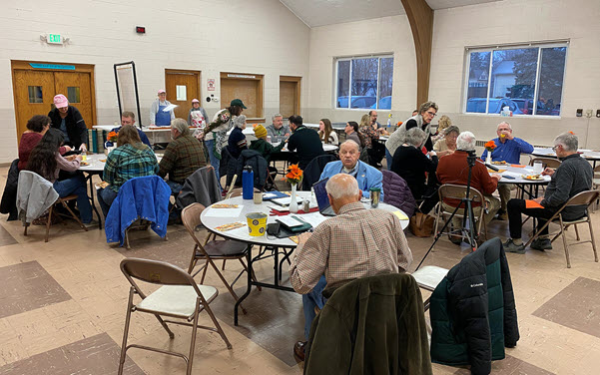
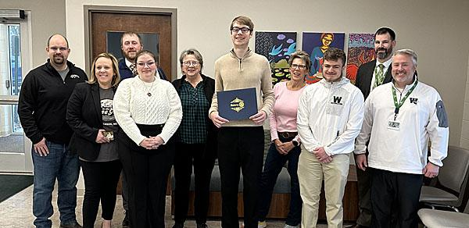
ALL THE THINGS WE DO…
Murphy Awards
Notes:
3 times per year

Slide 10
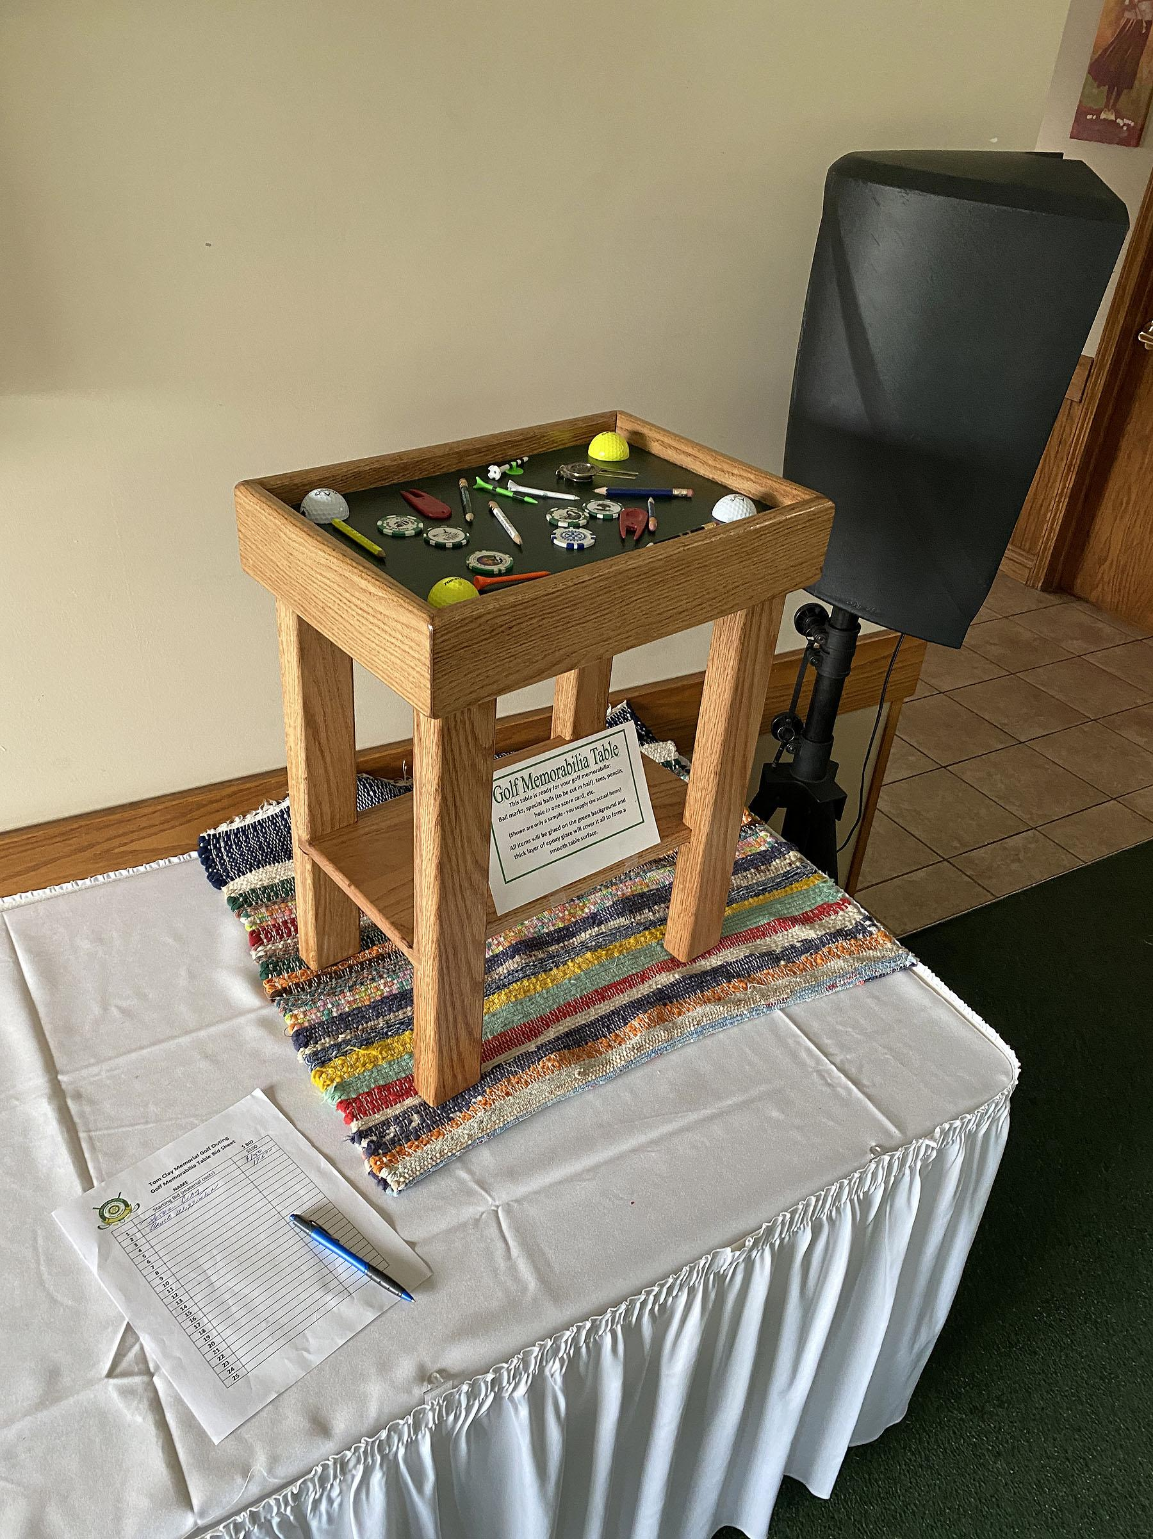
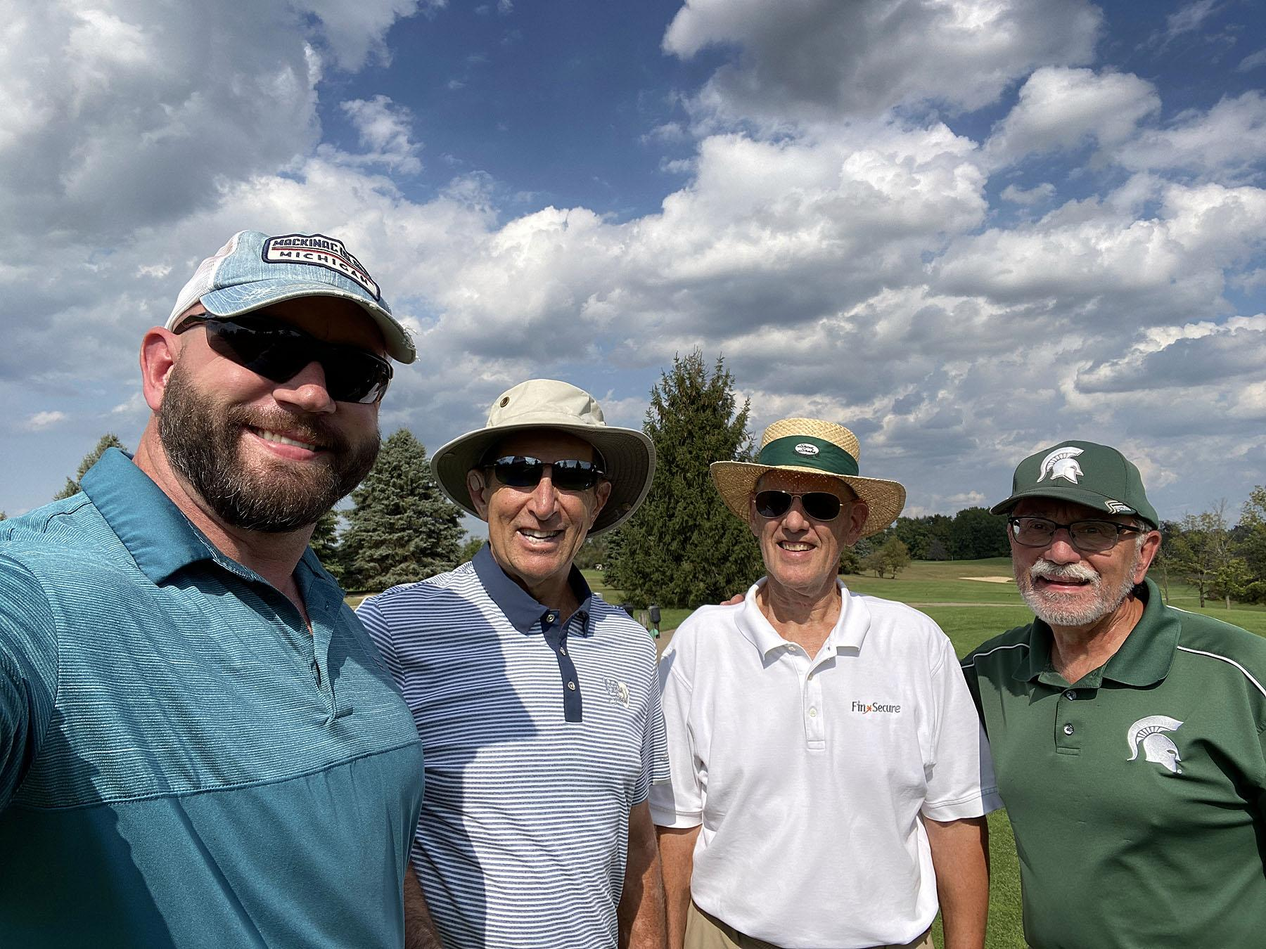
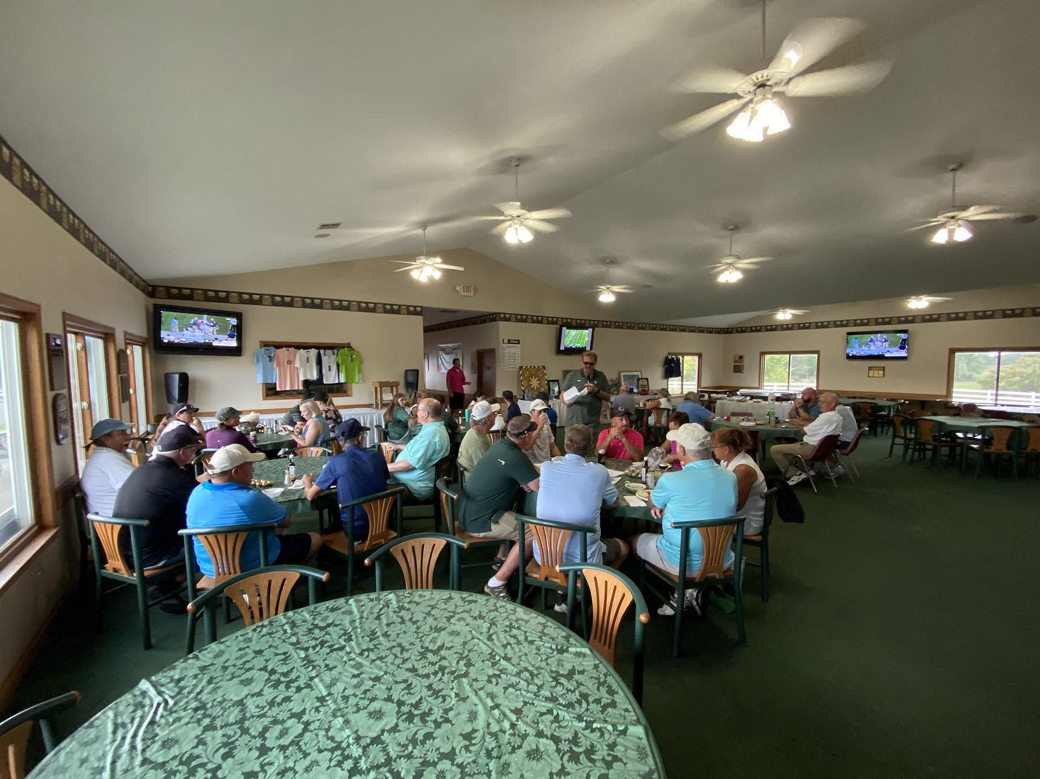
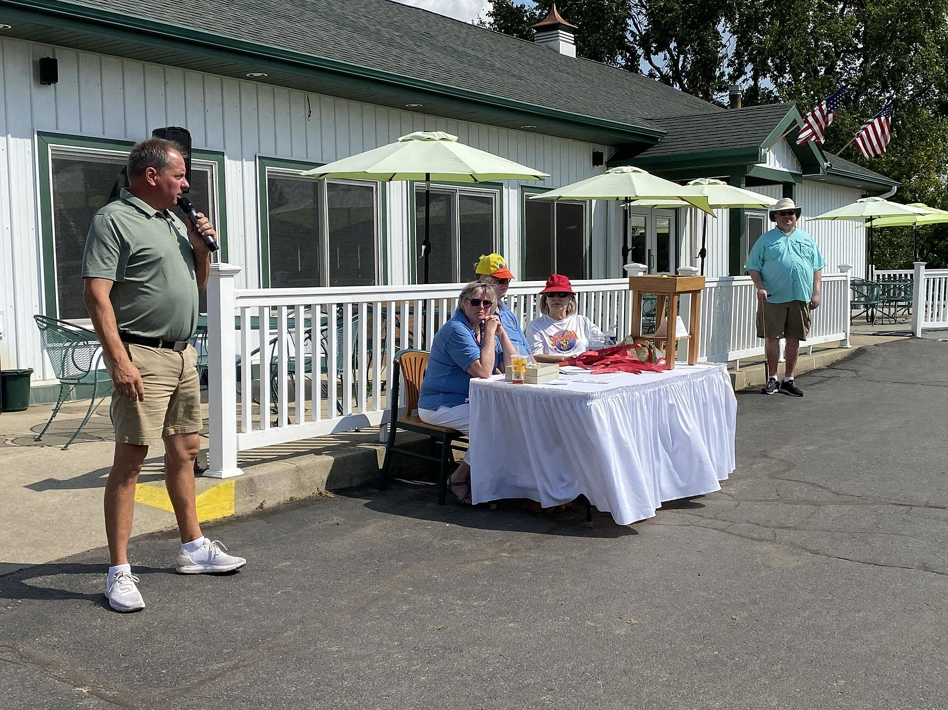
TOM CLAY GOLF OUTING
Notes:
Scholarship money for a deserving Senior

Slide 11
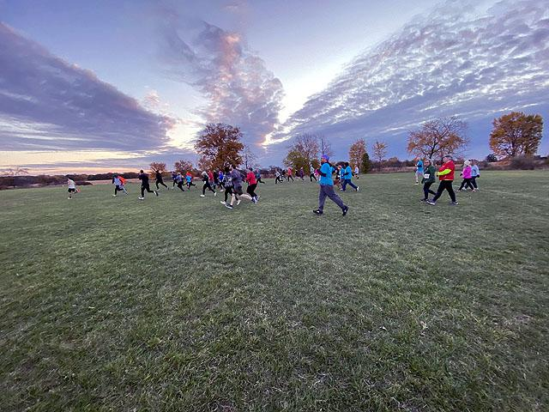
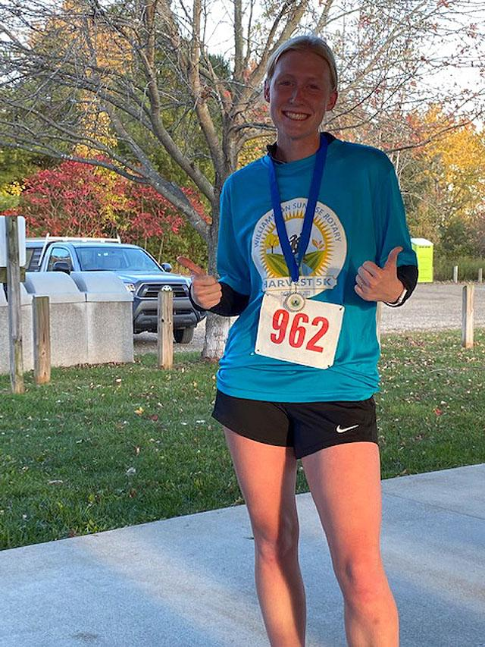
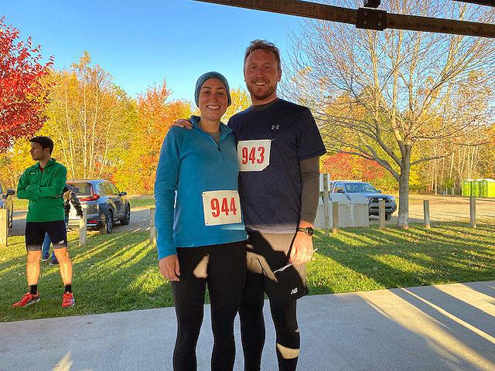
HARVEST 5K RUN
Notes:
Fun first time!
Needs some adjustments for the next time!
Raised approximately $600

Slide 12
PROVIDING ONGOING NOURISHMENT AND SUPPORT TO PEOPLE
Weekend Survival Kits
Open Table at WUMC
Blessing Box
Spark in the Dark
Haven House
Notes:
Haven House is on. Hold for now

Slide 13
WE SHOULD BE PROUD OF ALL WE ACCOMPLISH

