Slide 1
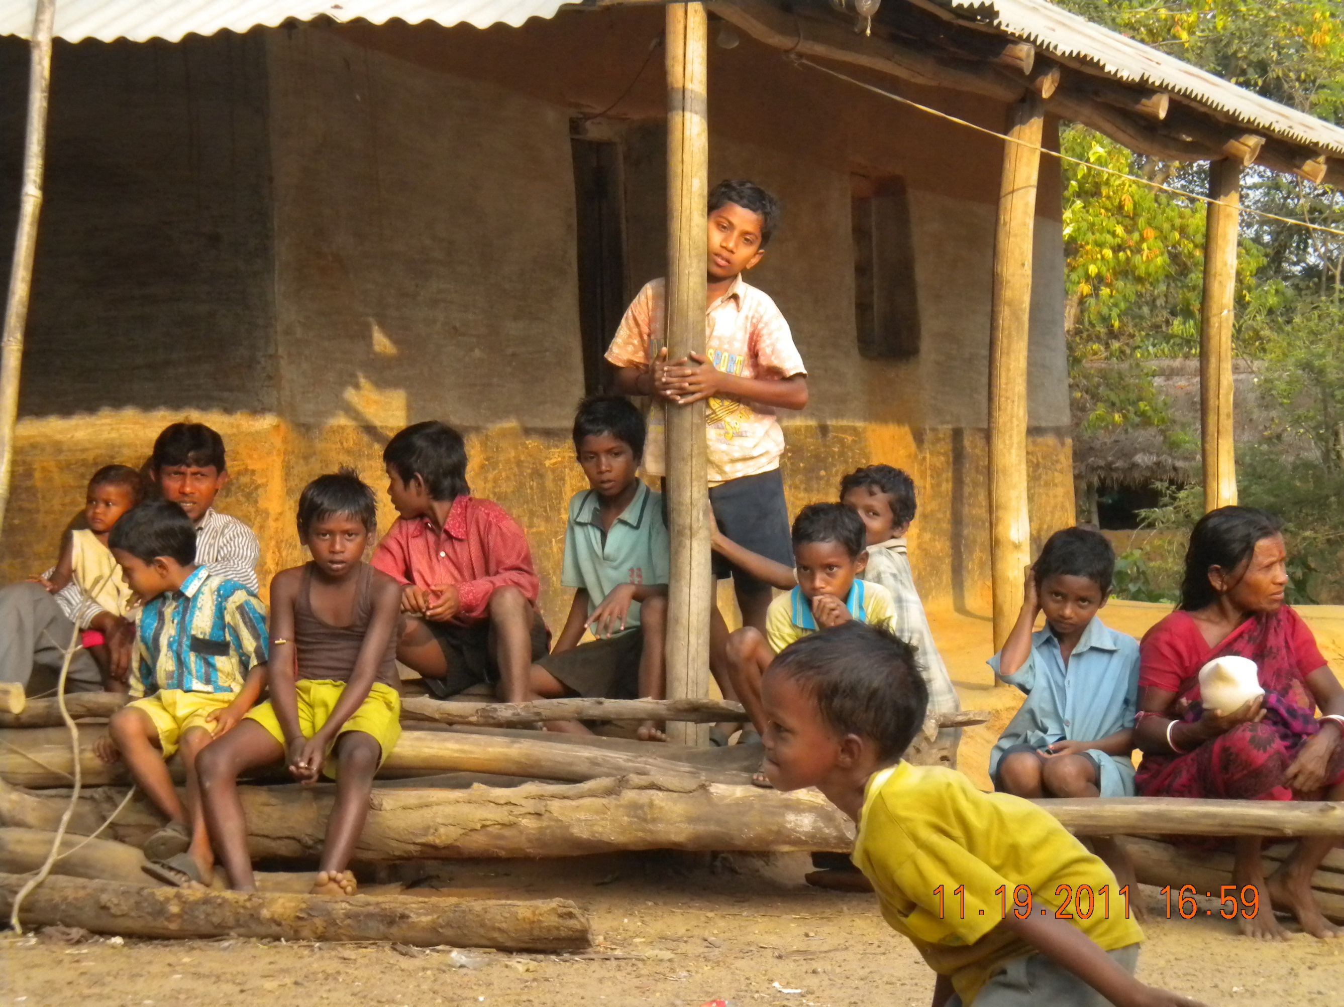
ROTARY INTERNATIONAL BLOOD BANK PROJECT
SARENGA, WEST BENGAL, INDIA IN BLOOD CRISIS

Slide 2
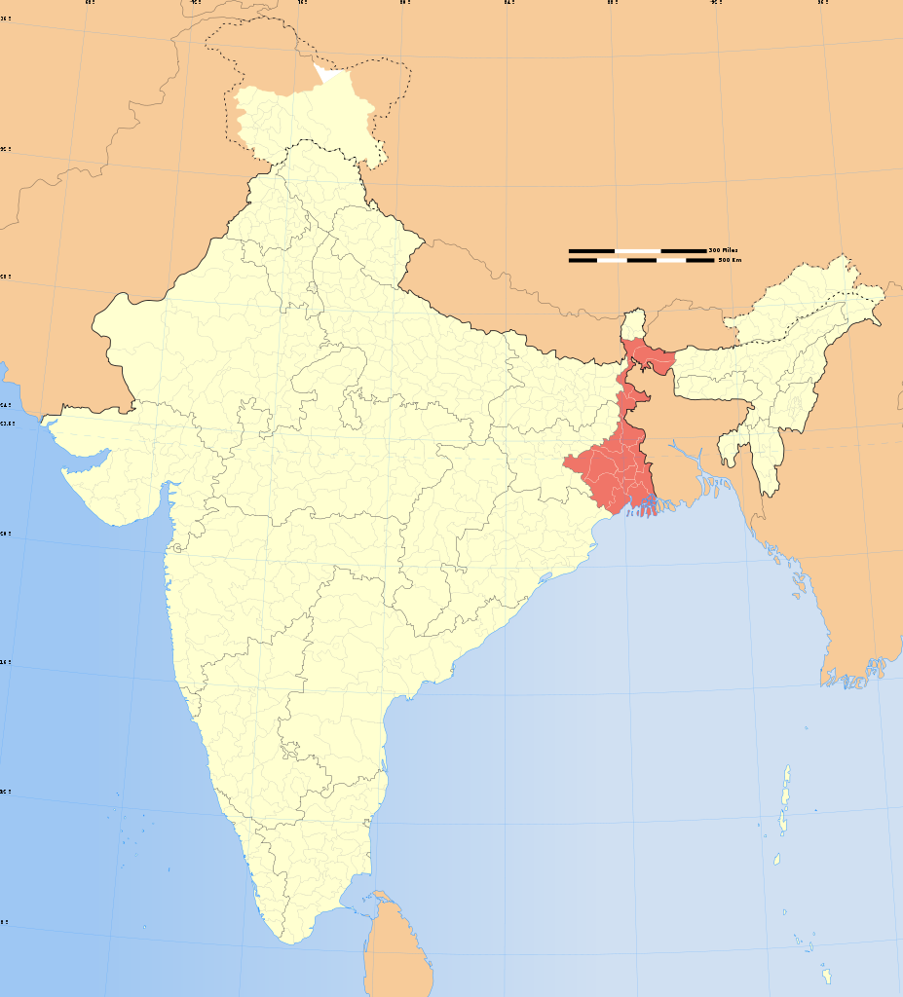
NEPAL
BANGLADESH
INDIA
WEST BENGAL

Slide 3
Rotary International Grant Request
Establishment of Medical Process for Blood collection, Testing, Blood Transfusion, and Blood storage
Khristiya Seva Niketan Hospital, Sarenga, West Bengal India
Serves ~720,000 people – mainly Tribal population who are underserved and in dire need of medical care, and life saving procedures.

Slide 4
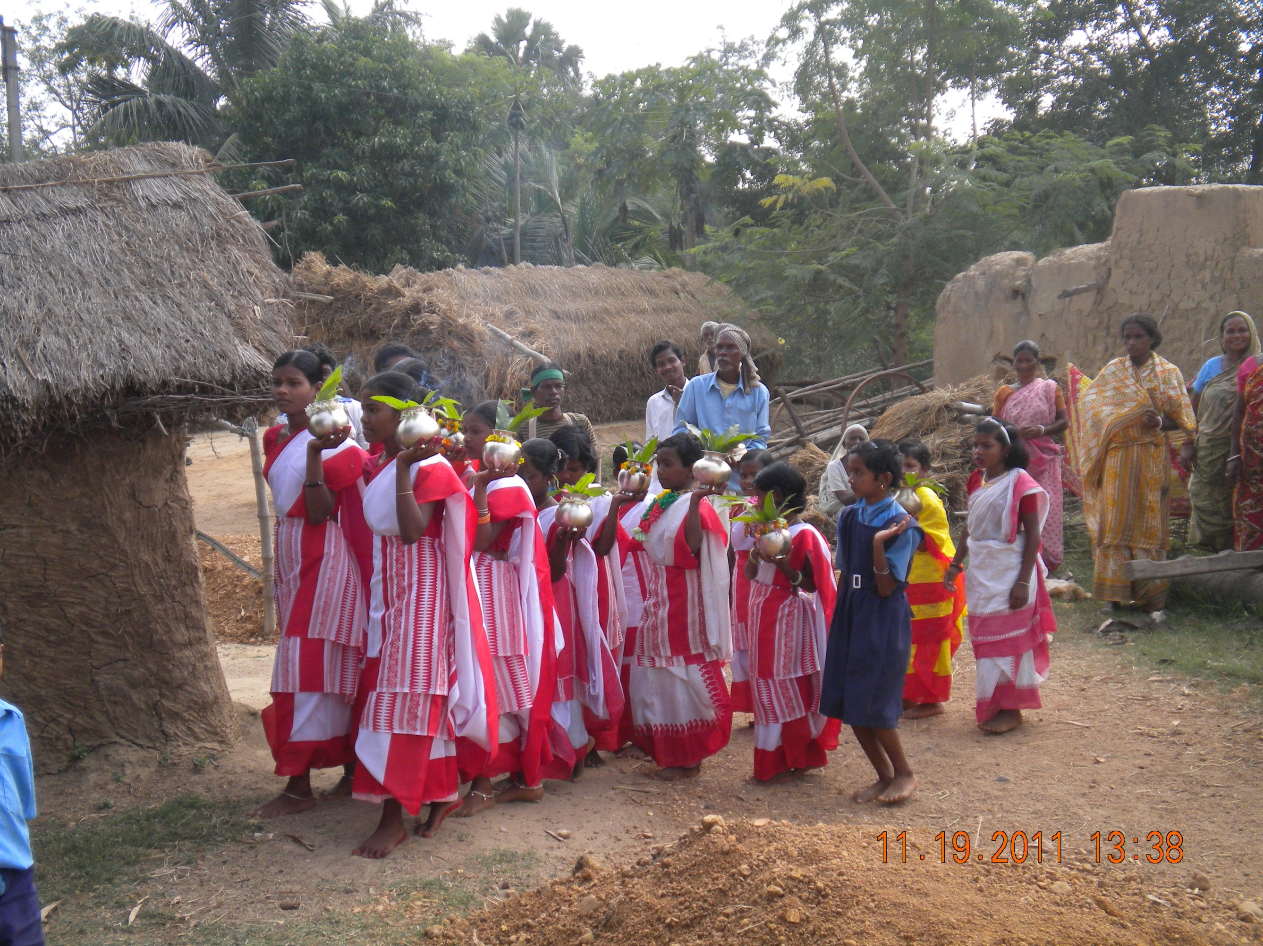

Slide 5
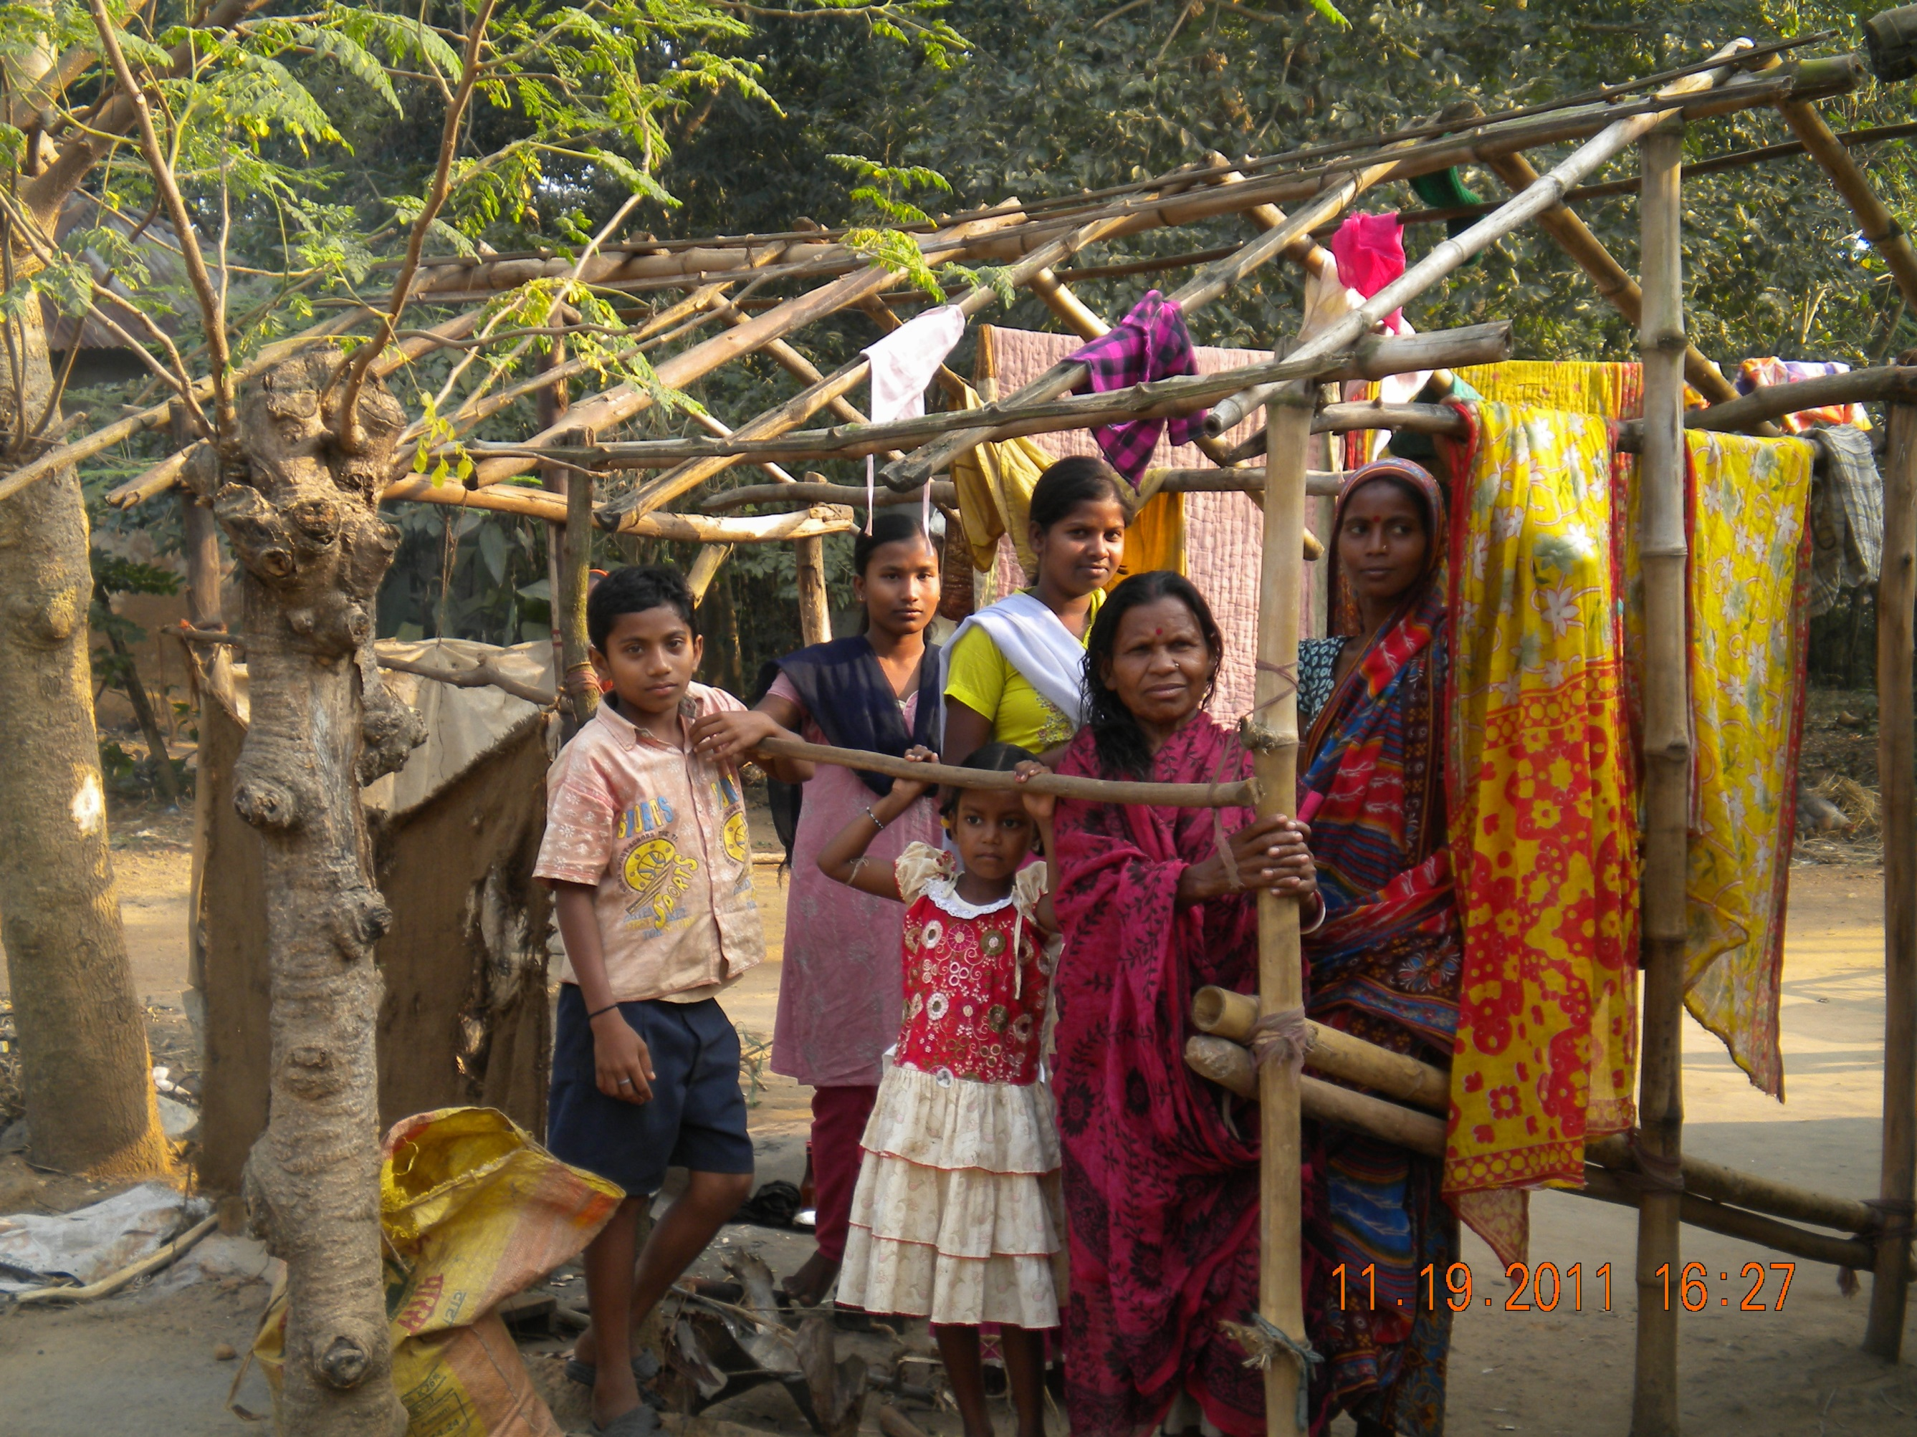

Slide 6
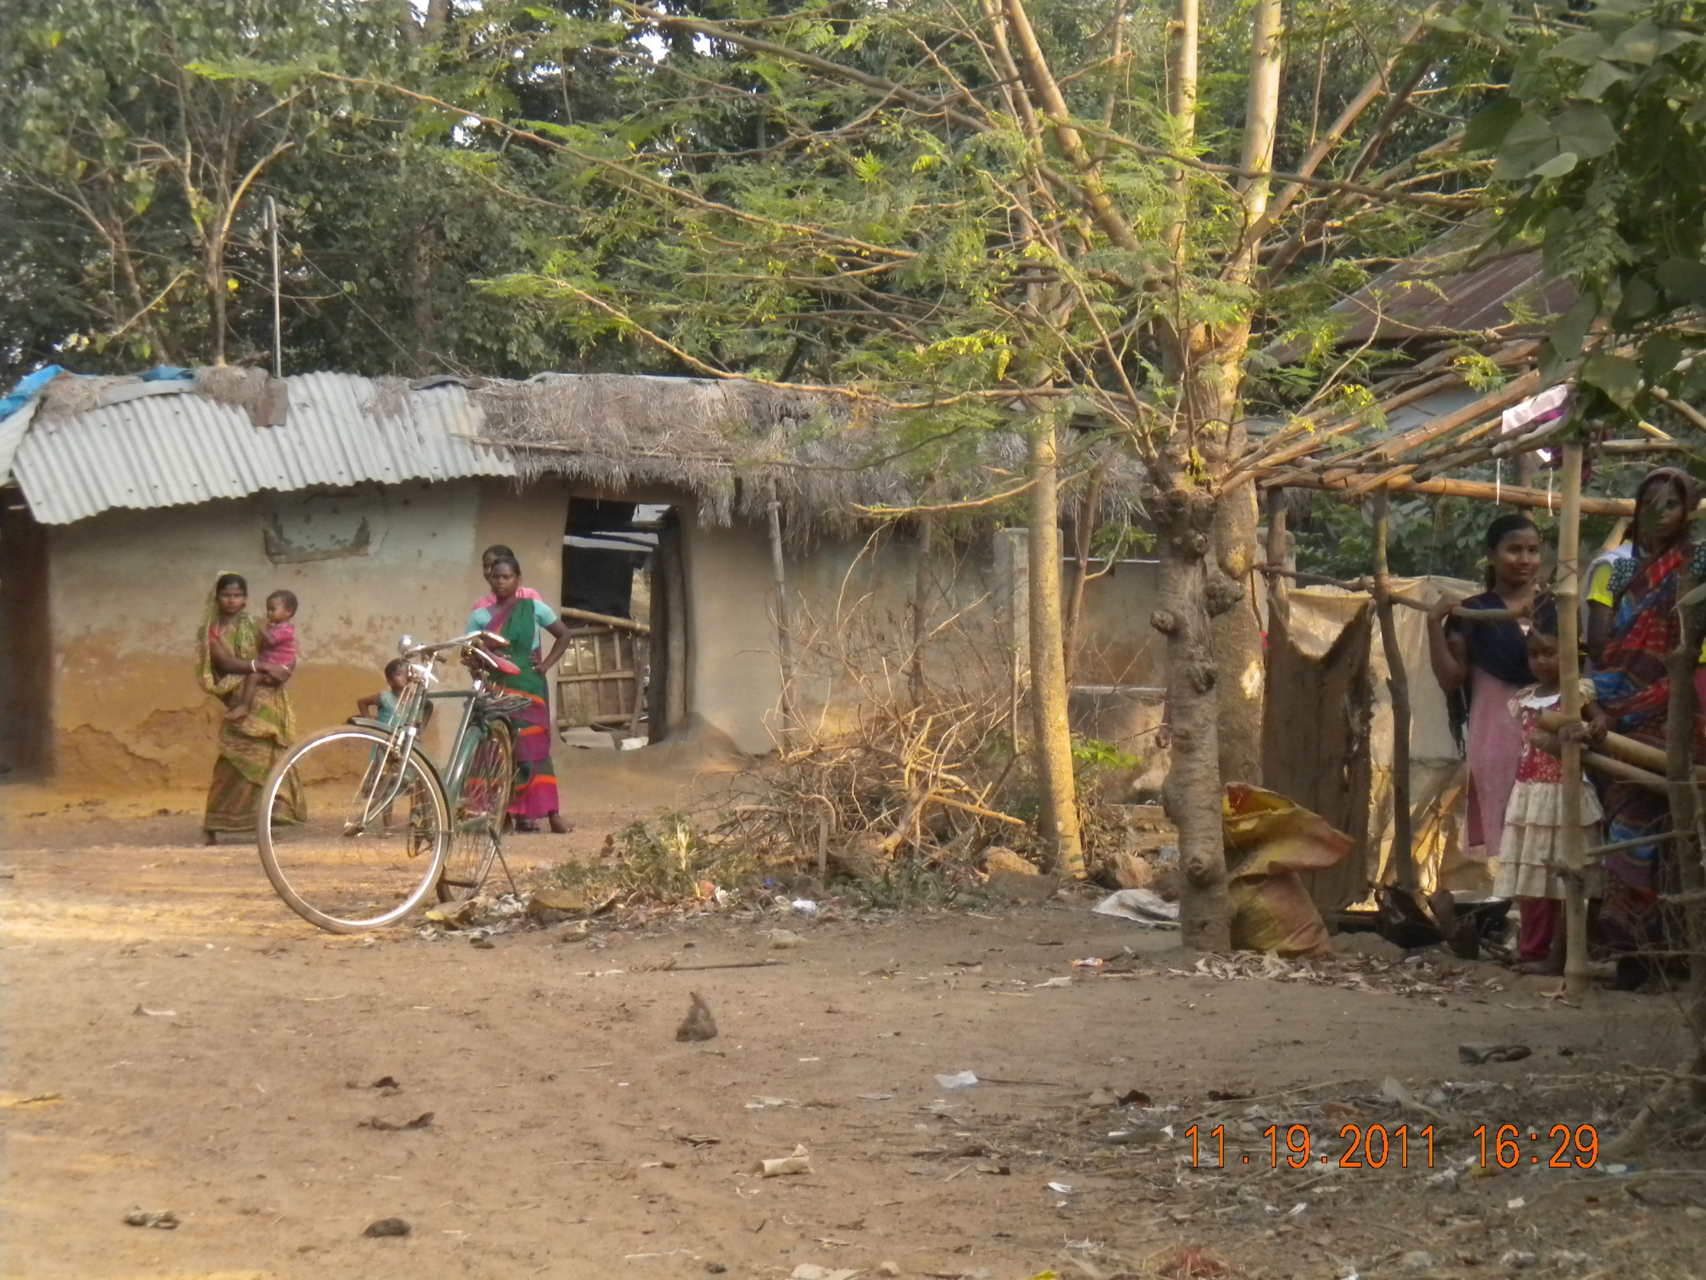

Slide 7
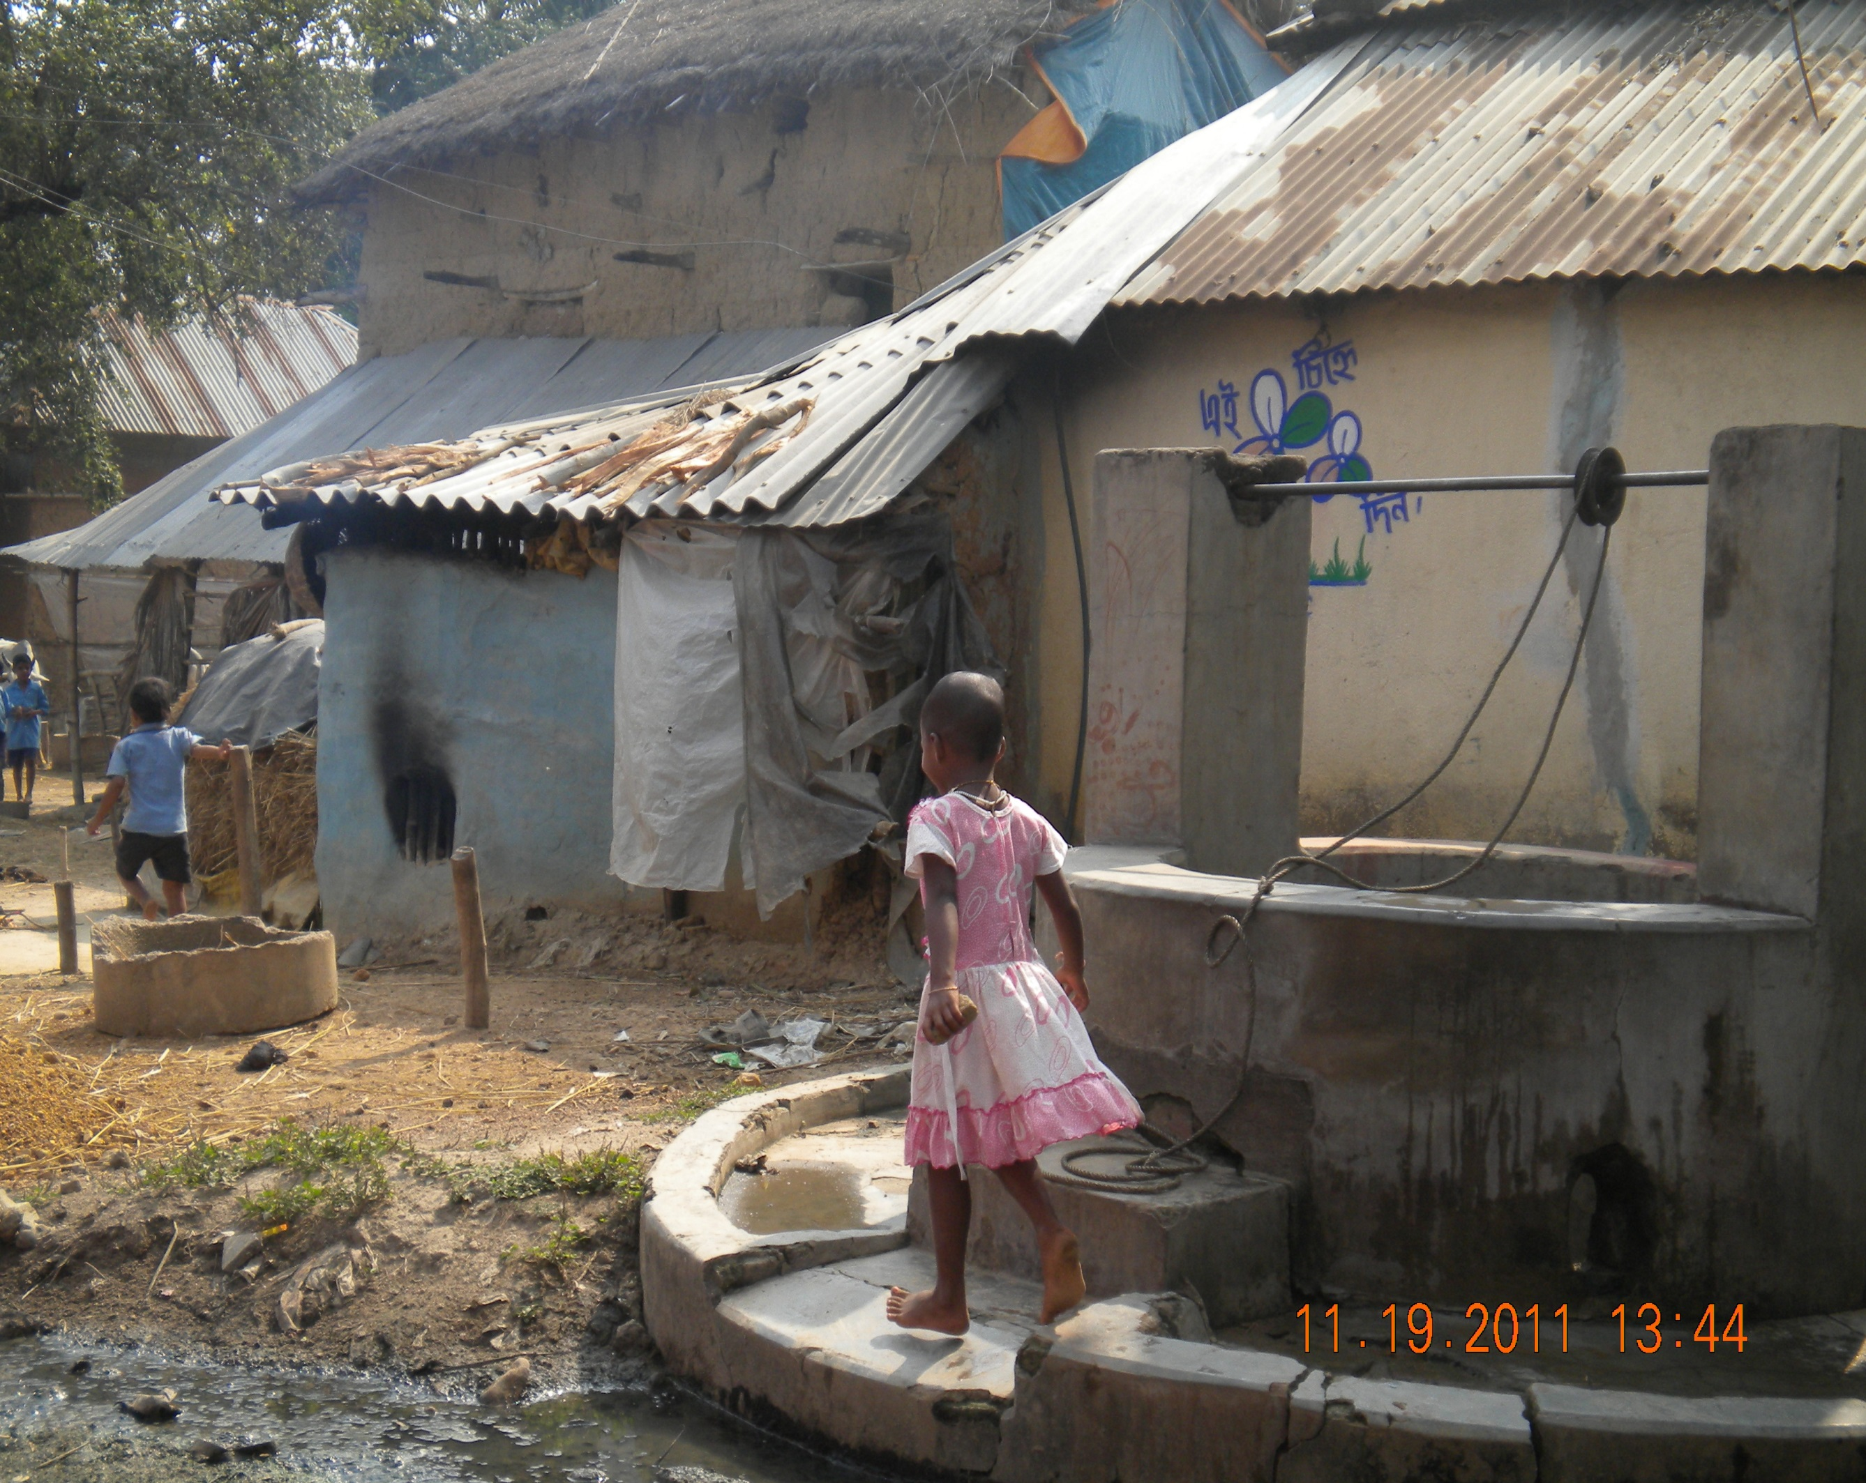

Slide 8
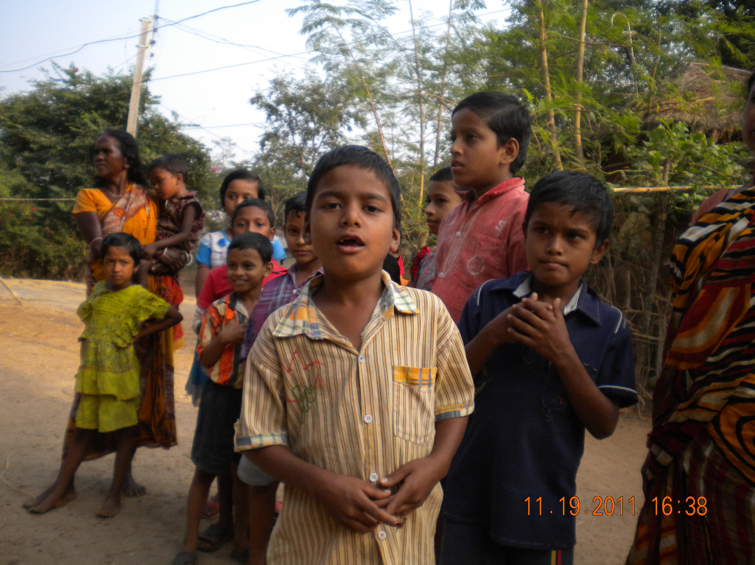

Slide 9
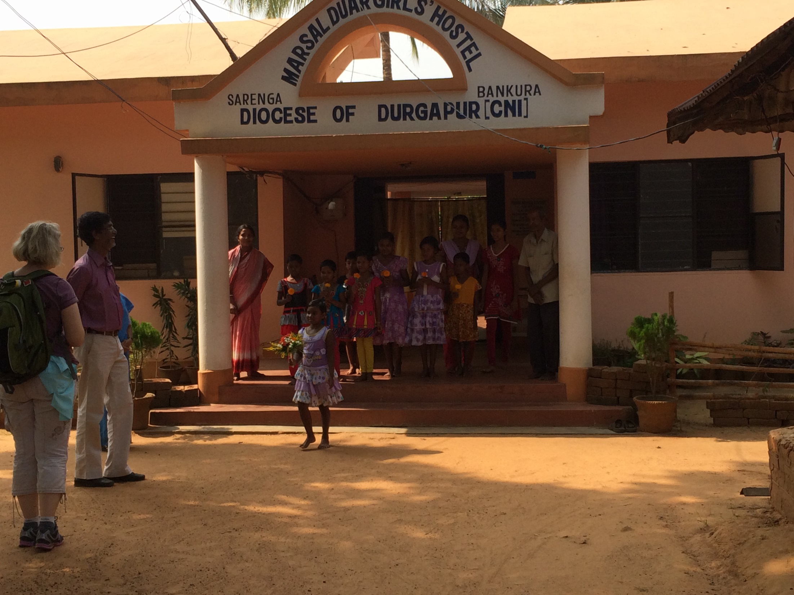

Slide 10
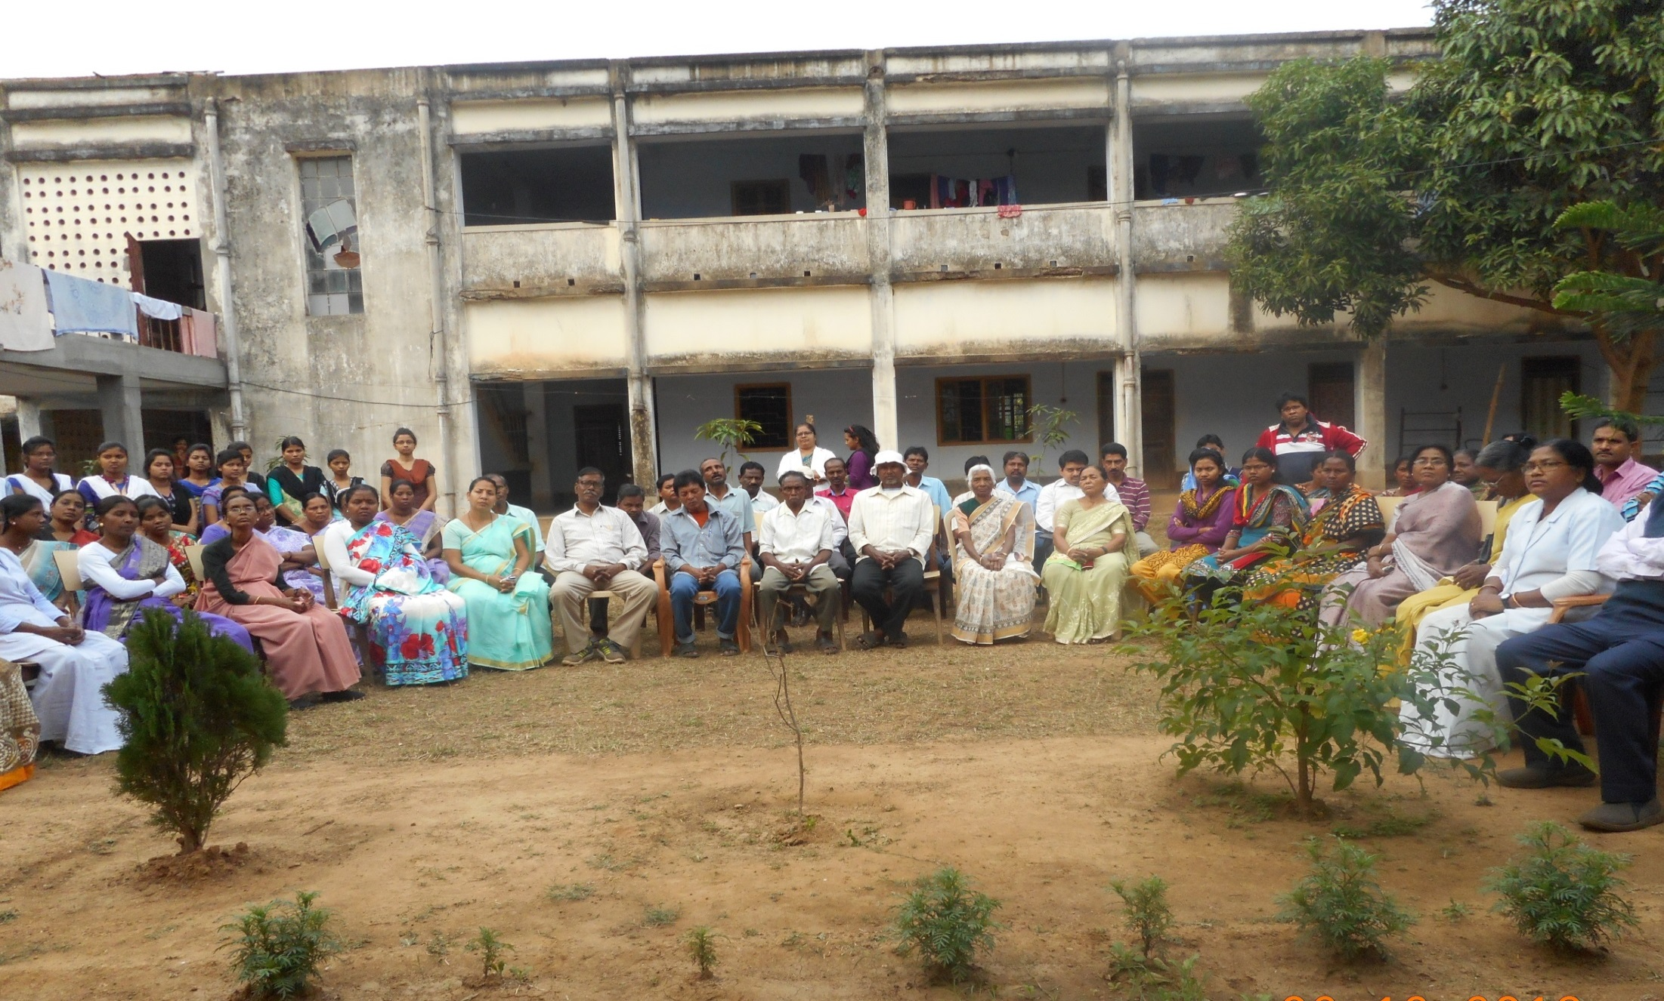
Medical Staff at Khristiya Seva Niketan

Slide 11
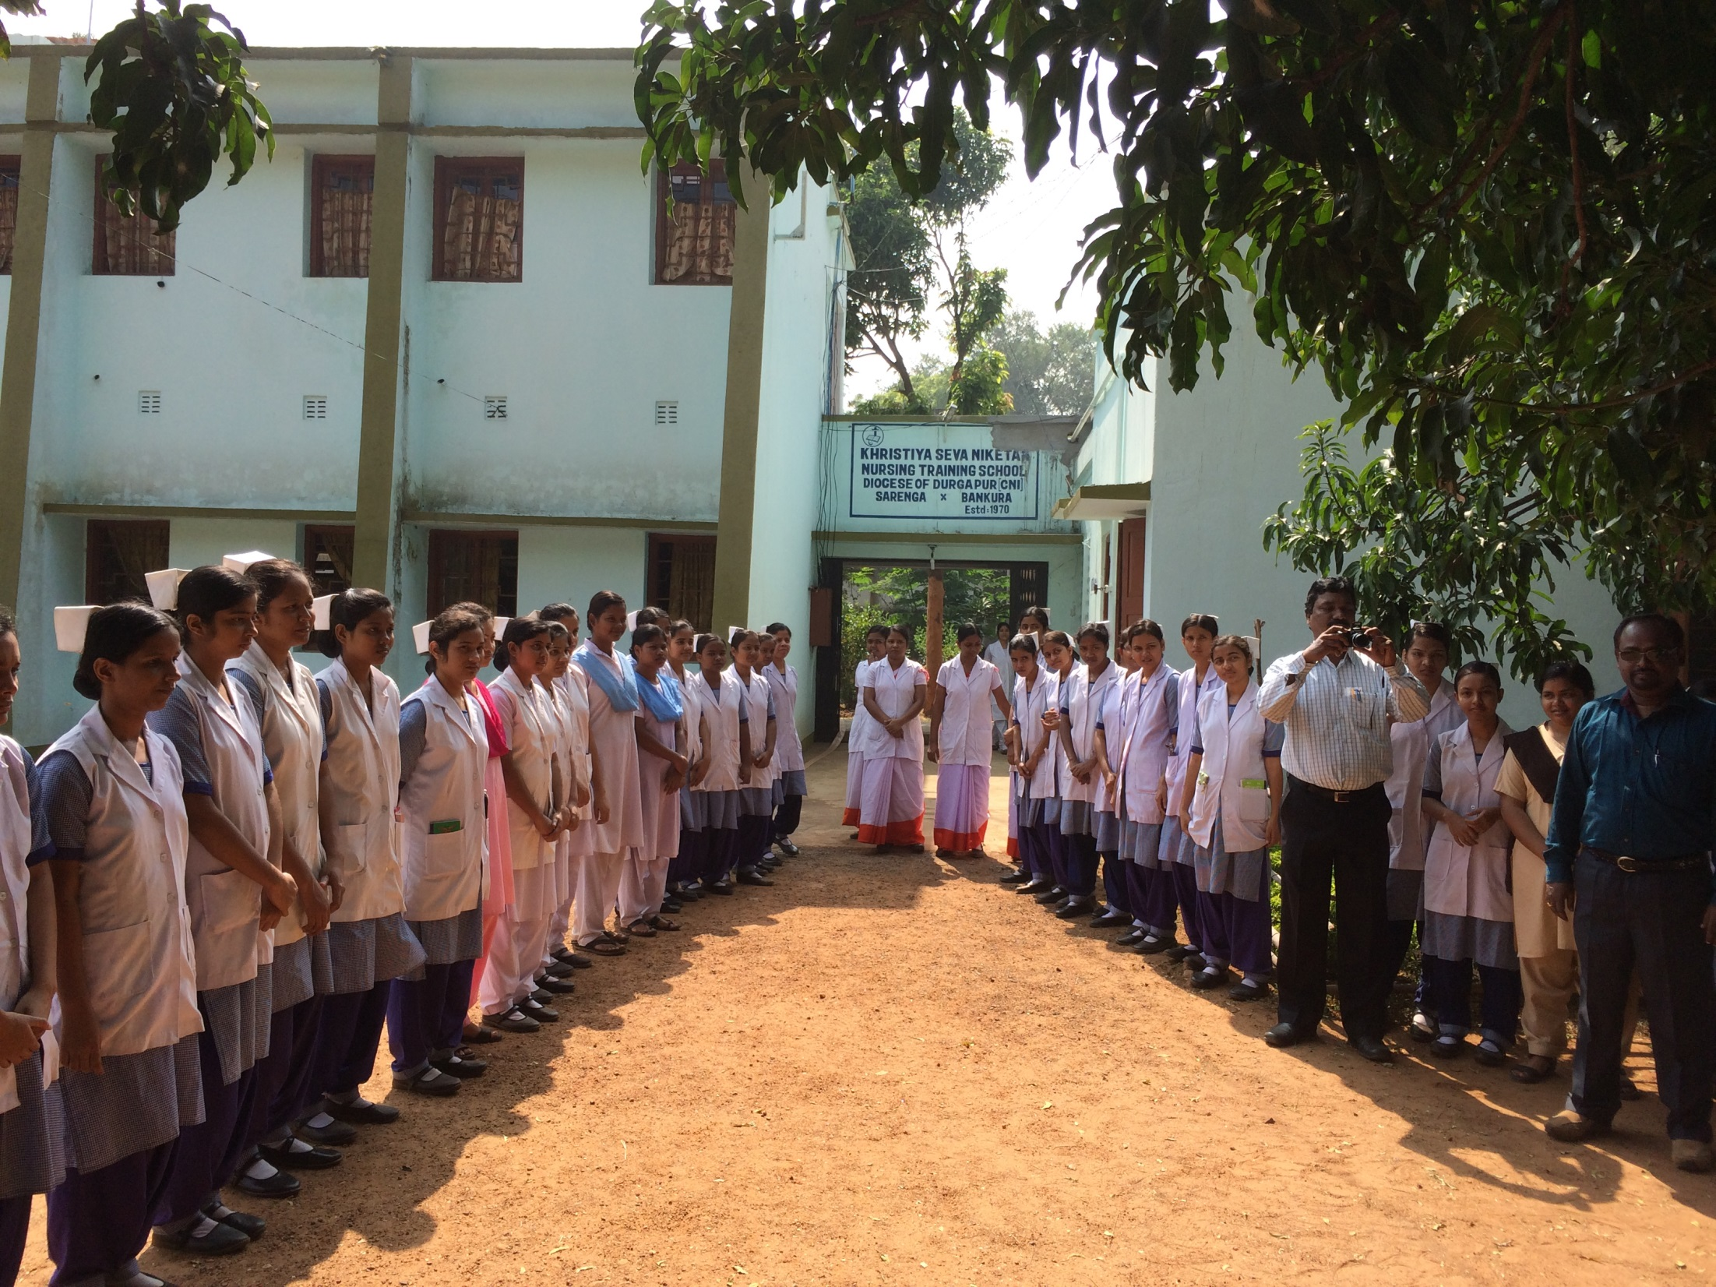
NURSING SCHOOL IN SARENGA

Slide 12
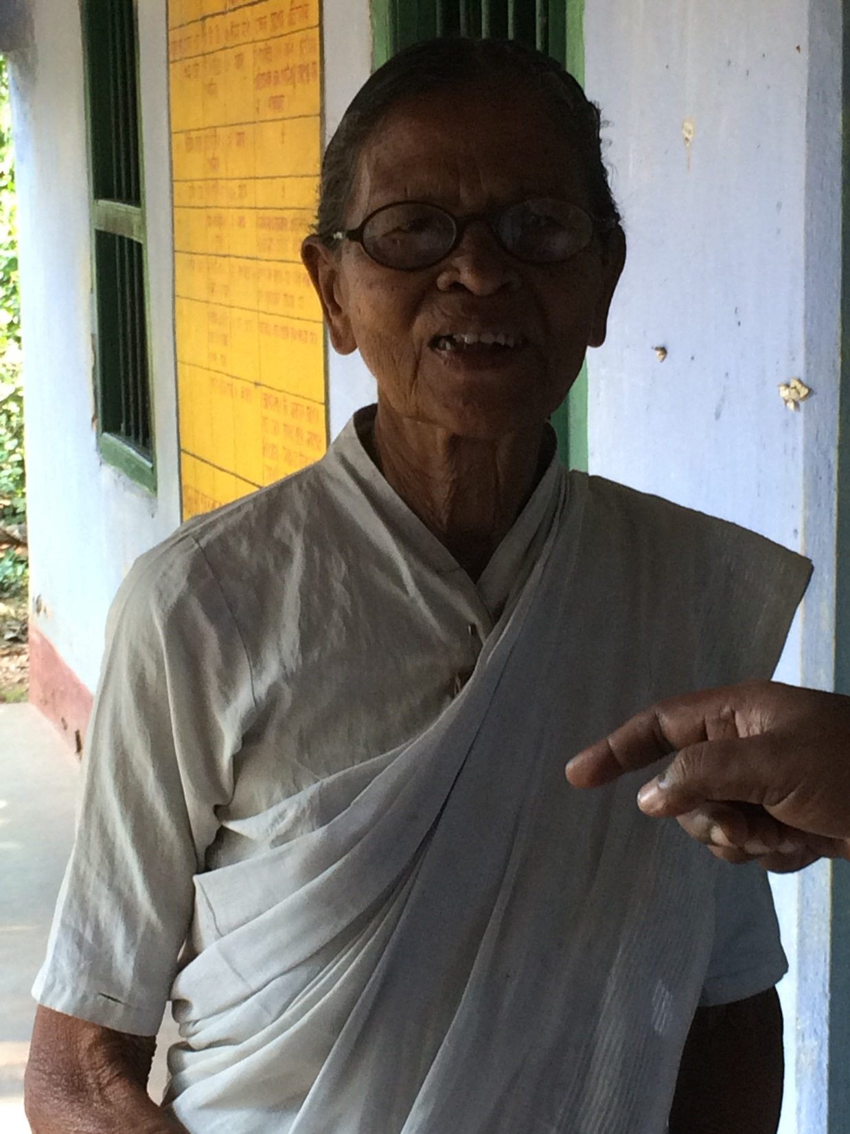
HEAD NURSE SARENGA HOSPITAL

Slide 13
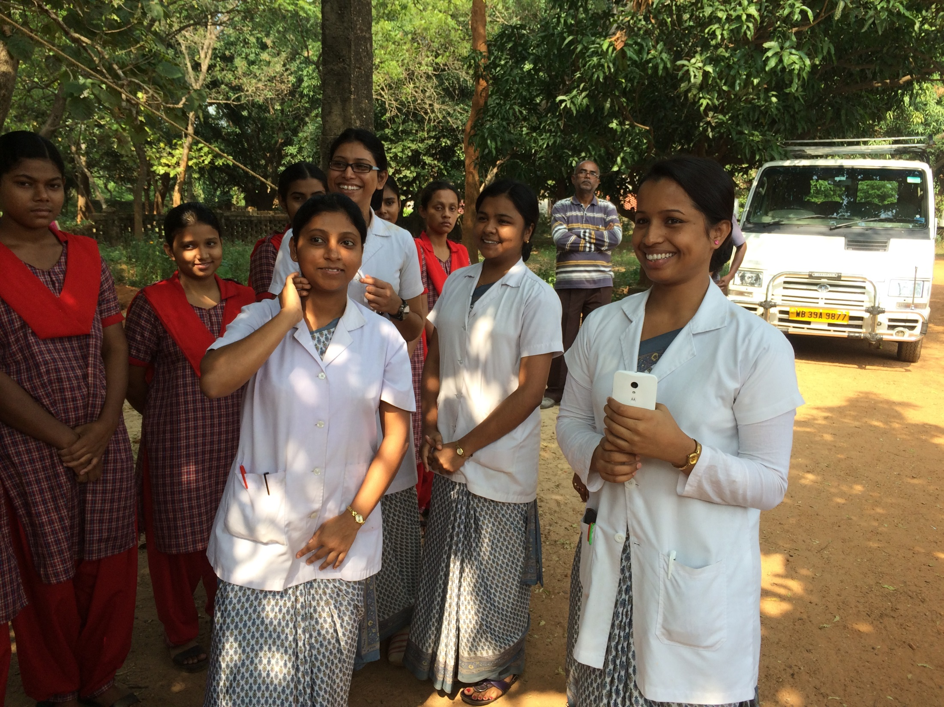
FIRST AND SECOND YEAR NURSING STUDENTS

Slide 14
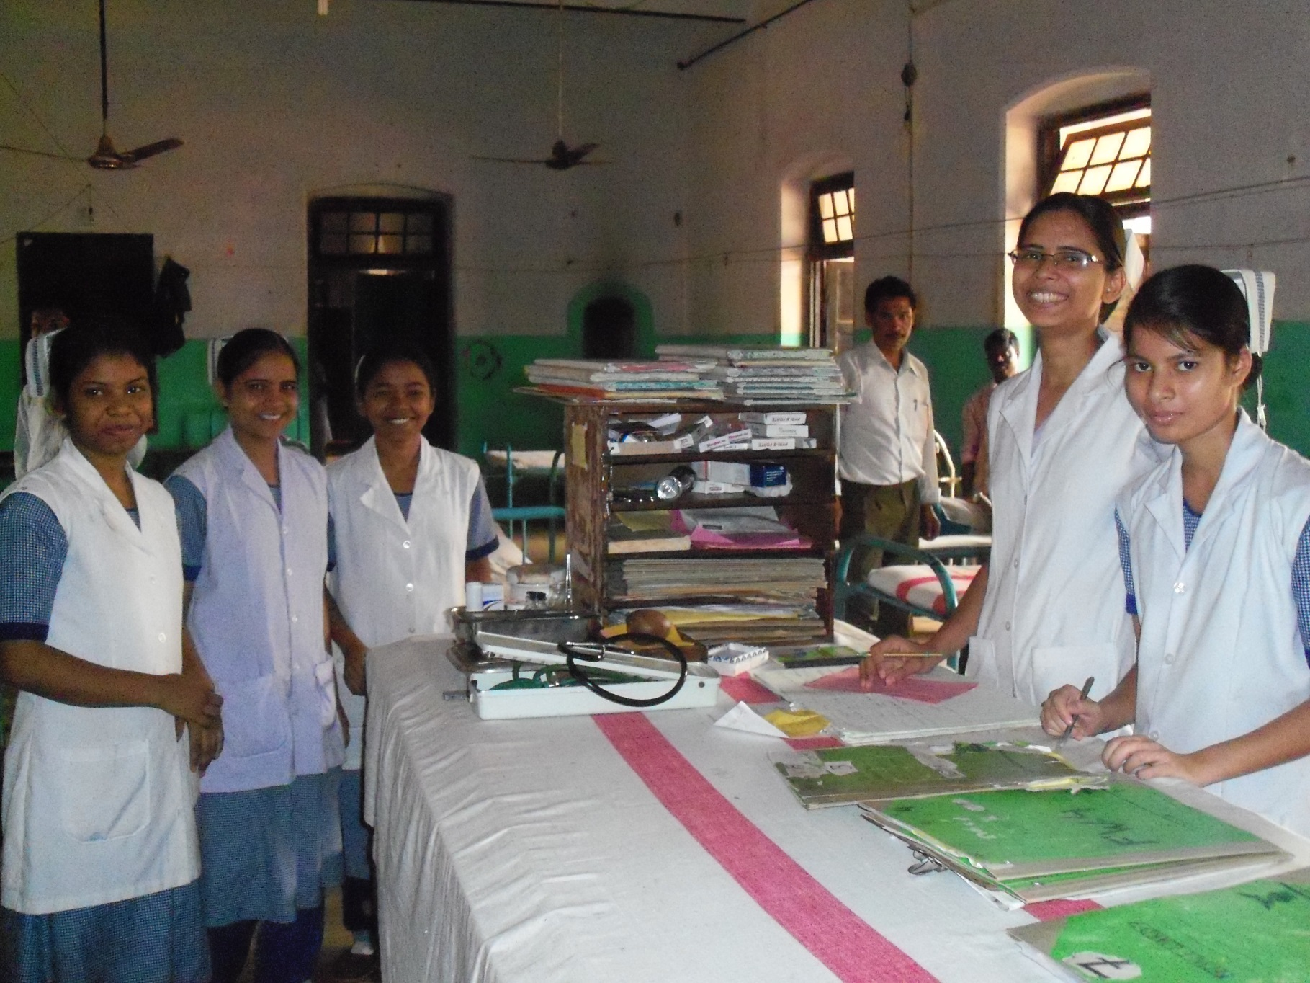
Nursing Station in Sarenga Hospital

Slide 15
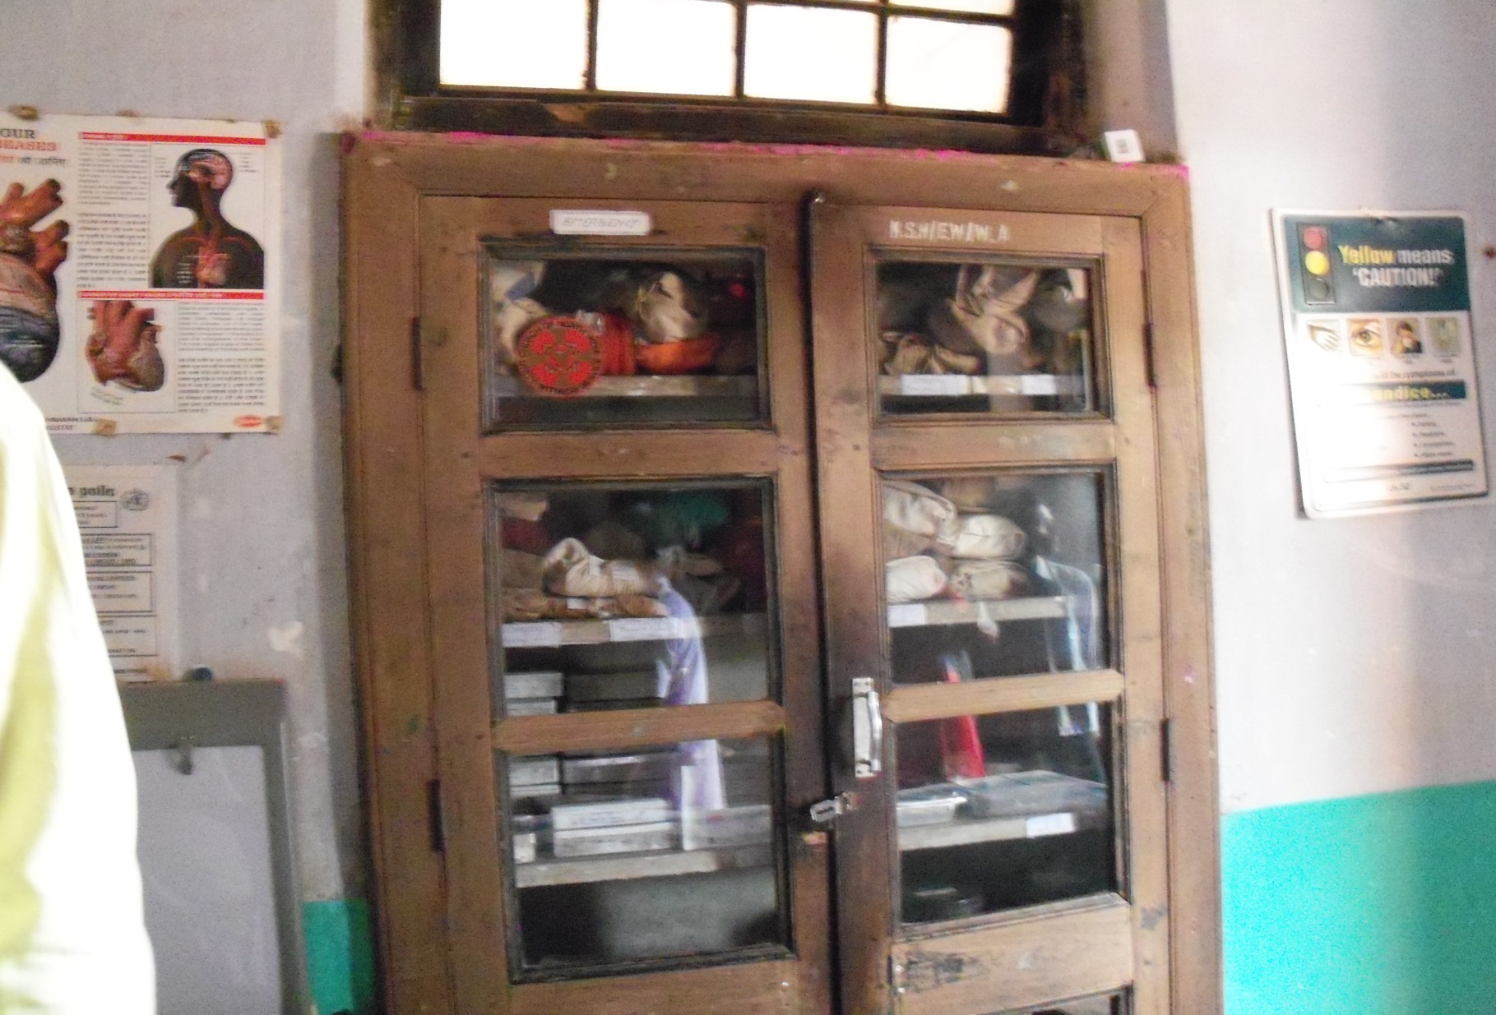
MEDICAL SUPPLY CABINET

Slide 16
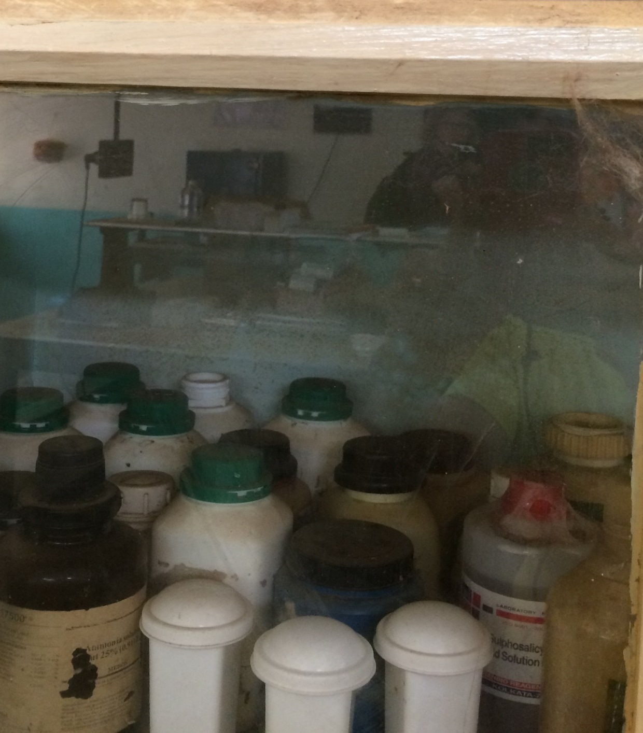
SARENGA HOSPITAL PHARMACY

Slide 17
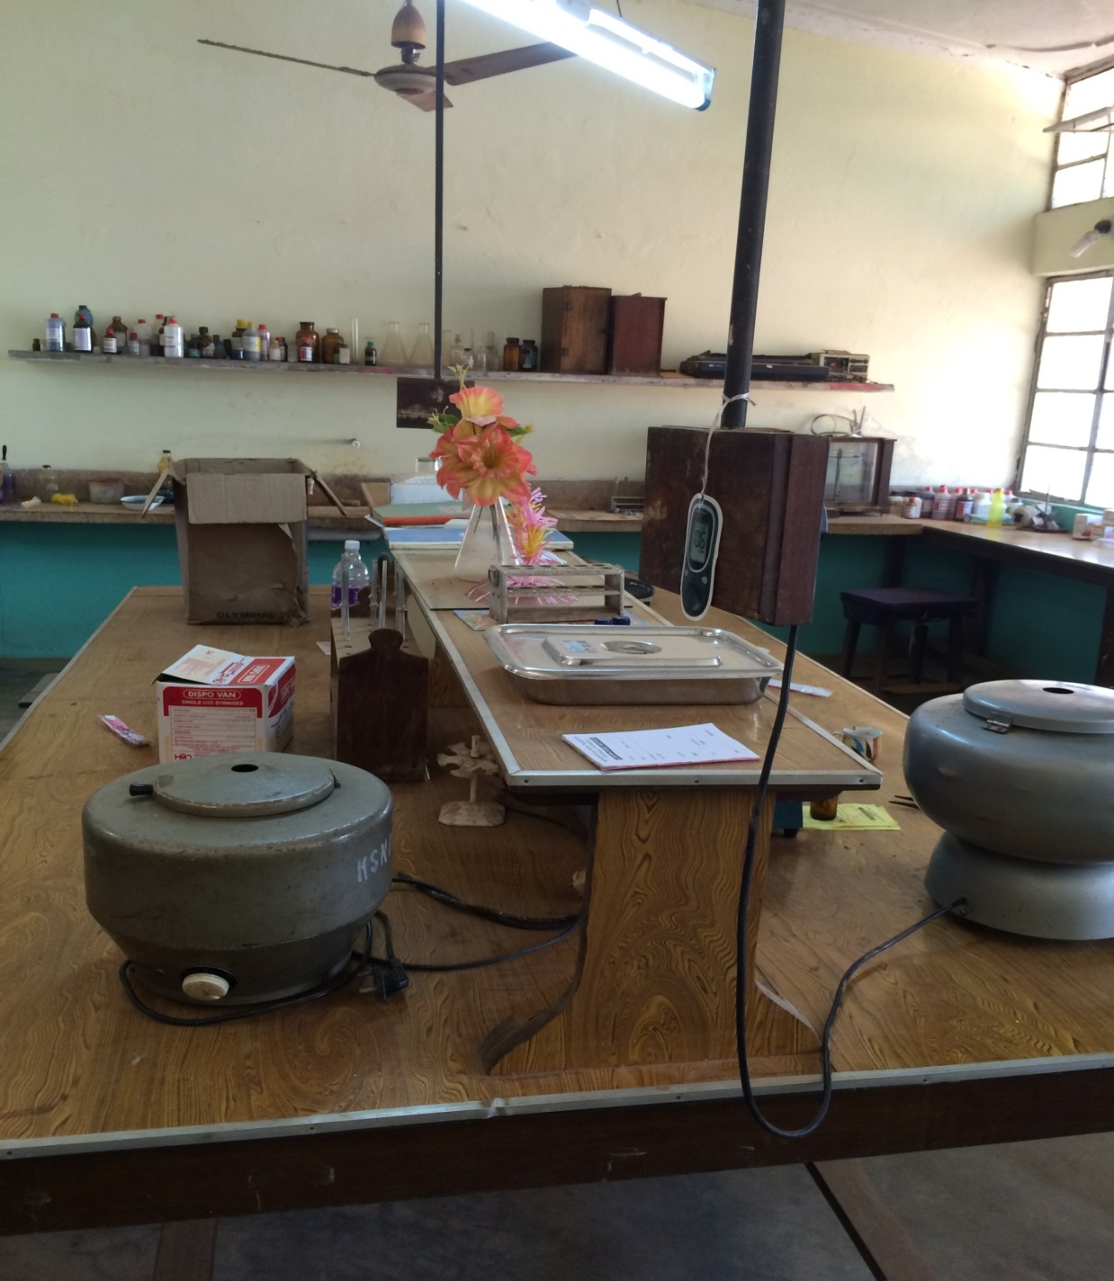
SARENGA HOSPITAL LAB

Slide 18
Population at Risk
Prevalence of anemia among pregnant women < 25 years of age- 91.46%
Prevalence of anemia age 15-19 years-
94.3%
Overall prevalence of anemia among school children – 80.2%

Slide 19
Hospital Procedure Data Oct ‘14-Sept ‘15
Total # outpatients 10,780
Total # inpatients 6,113
Total # deliveries 2,931
Total # C- Sections 246
Total # of Hysterectomies 54
Other major surgeries 347

Slide 20
SARENGA HOSPITAL WOMEN’S WARD

Slide 21
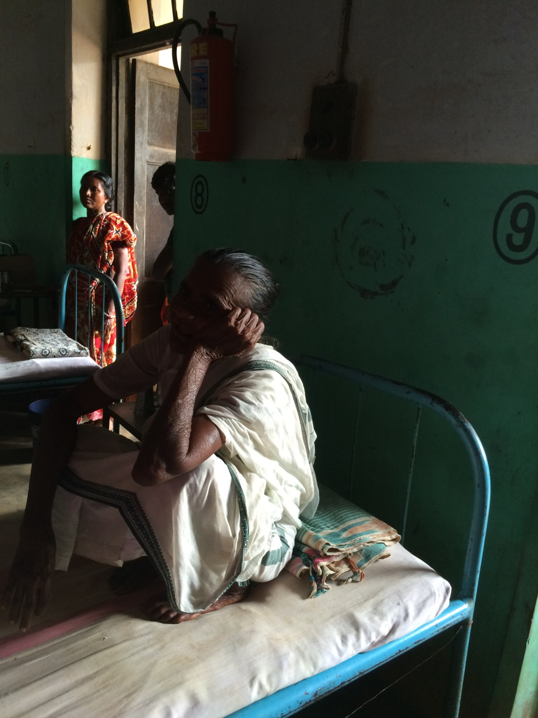

Slide 22
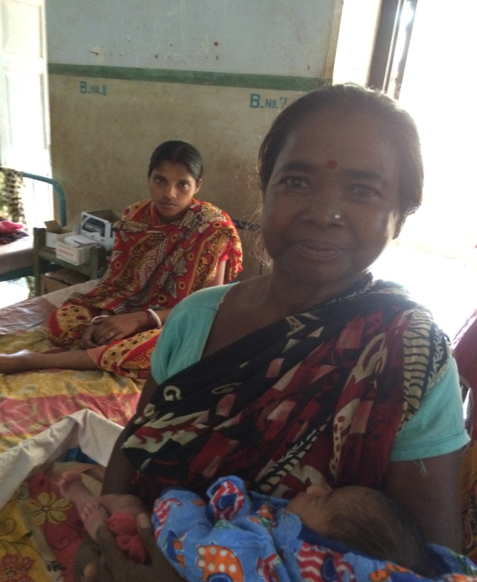
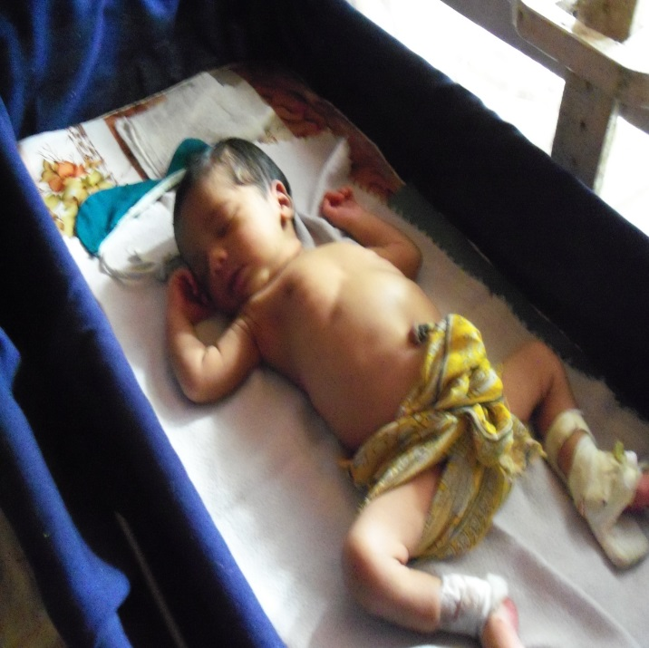
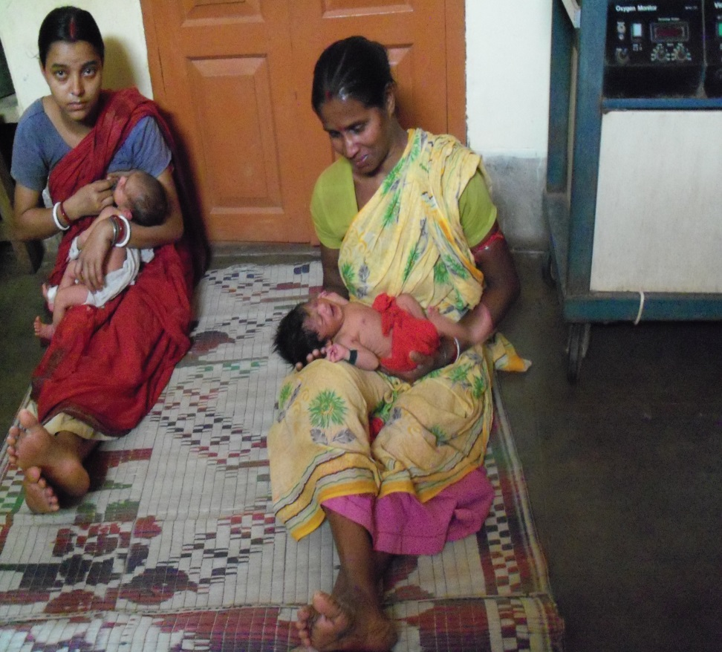
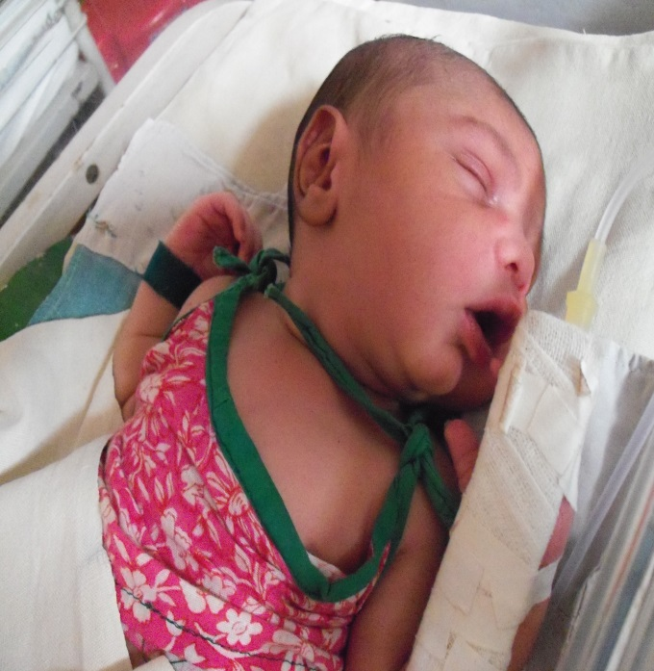
NATAL AND MATERNITY WARD

Slide 23
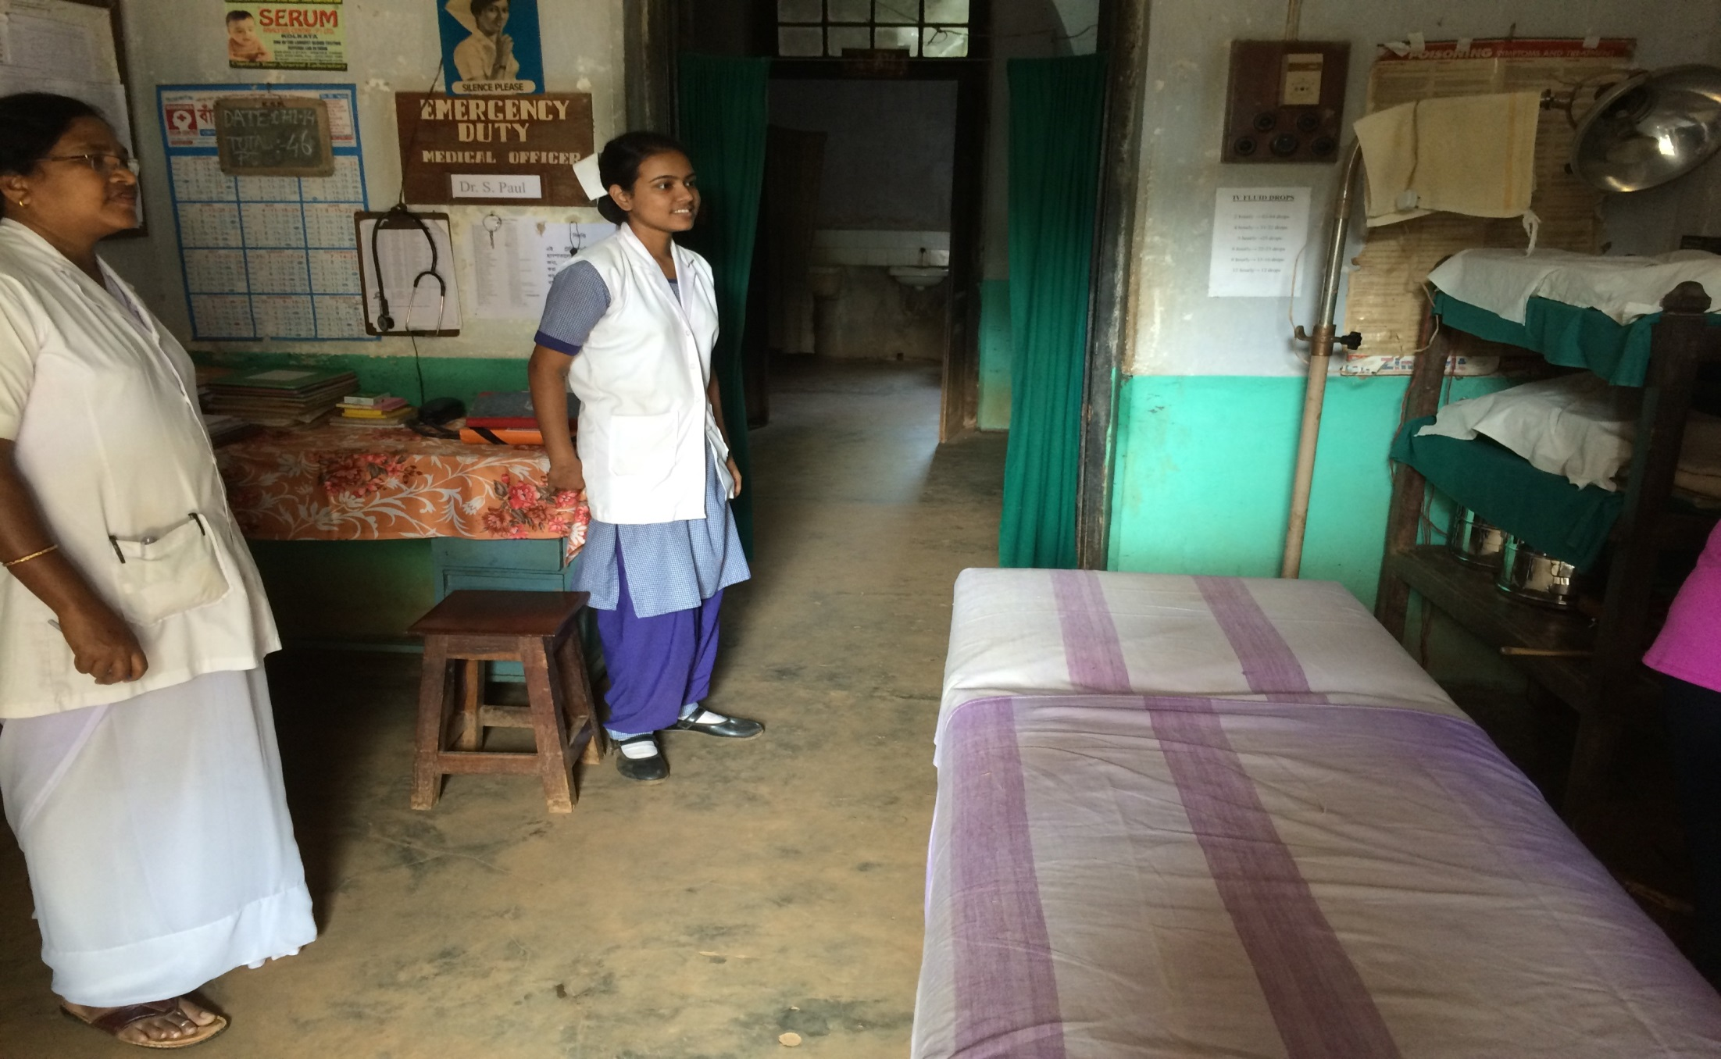
SARENGA SURGERY CENTER

Slide 24
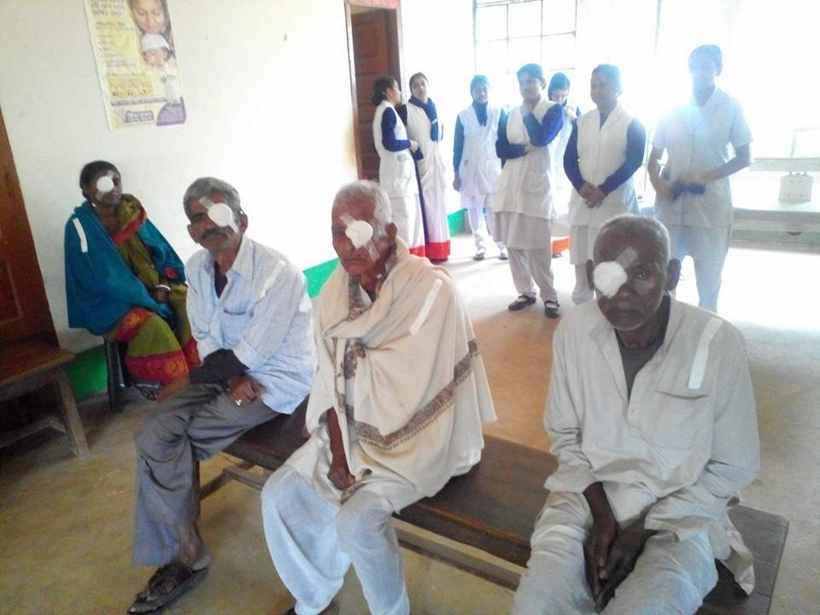
CATARACT CLINIC
1821 SURGERIES IN 2015

Slide 25
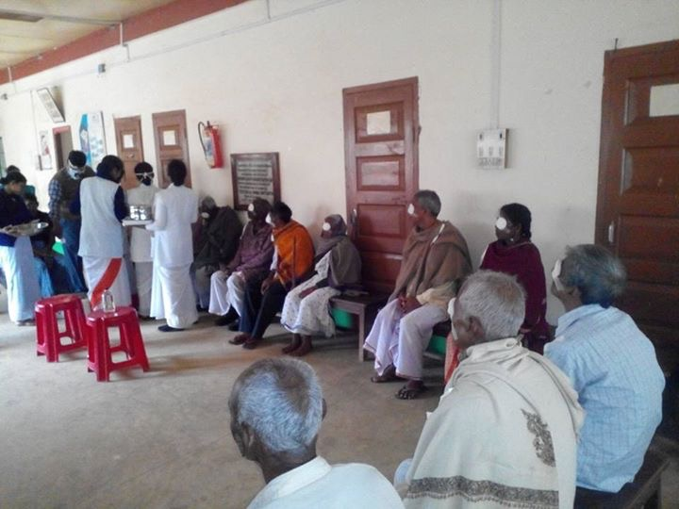

Slide 26
PERSON TO PERSON TRANSFUSION
OUTSIDE THE BOUNDS OF MEDICAL PRACTICE
BLOOD BORNE DISEASES
NON-ABO INCOMPATIBILITIES THAT CAN BE LETHAL TO THE RECIPIENT THAT CAN ONLY BE DETECTED IN A LAB
RISK OF TAKING TOO MUCH FROM DONOR AND SENDING HIM/HER INTO SHOCK OR DEATH

Slide 27
PROJECT GOAL
To make safe blood transfusion readily available for underprivileged communities
in proximity to Sarenga, West Bengal, India

Slide 28
AREA OF FOCUS
To address the needs of anemia burden in rural and tribal communities
To provide means for safe blood donation and prevention of spread of communicable diseases
Provision of adequate supply of blood needs of the community, in both emergency and elective conditions

Slide 29
To bring about a change in traditional beliefs and practices to help in the improvement of health status. To remove prejudices with regard to acceptance of blood and blood donation.
AREA OF EDUCATIONAL FOCUS

Slide 30
FUNDING PROPOSAL
Procurement and installation of equipment and instrumentation for an advanced blood bank $86,000
Electrical installation, temperature controlling system and emergency power system $9500
Salary for 1 Doctor, 2 technicians, 2 nurses
$10,500 first 6 months
Training of personnel (2 graduate lab techs/nurses) first 6 months $7700
Operational /materials cost for first six months $5600
Continuing Medical Education and community outreach/ awareness. $500
$119,800

Slide 31
Funding Received
Goal $30,000
Durgapur Rotary 10,000
Diocese of No India 8,000
St Martin of Tours 2,000
Portage Rotary 2,000
W Michigan Parishes 2,000
W Michigan Rotaries 3,000
Individual donations 3,000

Slide 32
WHO’S AT RISK?
GIVE THEM A LIFE SAVING CHANCE

