Slide 1

The state of rotary membership
As of 1 January 2020
Notes:
NOTES TO SPEAKER: Customize this presentation to meet your region’s needs. At minimum, you will need to customize slide 5: Where you see X’s, replace them with data from Rotary Club Central or delete them. Unhide the slide (use the Slide Show menu) so it’s visible during the presentation. Make comparisons between regional and global trends.
SPEAKER:
Our members are our greatest assets. And when Rotary’s membership is strong, our clubs are more vibrant, Rotary has greater visibility, and our members have more resources to help communities flourish.
If we want to continue to create lasting change in our communities, in our world, and in ourselves, we have to act on what we know. With that in mind, Rotary conducted several large-scale surveys this year that gave us a clearer understanding of why people join Rotary, why they leave, and the challenges clubs face as they try to make a difference in their communities.
I’m going to share that information with you today to reinforce the importance of growing Rotary.

Slide 2
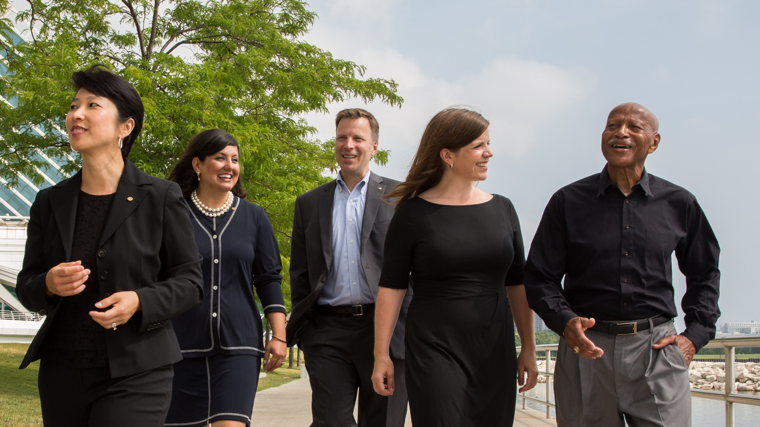
MEMBERSHIP OVERVIEW
District 6170 PETS 2020
Notes:
Over the past five years, we’ve remained at around 1.2 million members. Although we experienced a slight decrease last year, overall our membership is still strong.
To accomplish all the good in the world that we want to do, we need a commitment and a continued emphasis on growing Rotary and Rotaract from our club, district, and zone leaders. Keeping Rotary relevant and thriving into our second century, while continuing to enhance our members’ lives, requires a willingness to be innovative, seek out diversity, and adapt to changing needs.

Slide 3
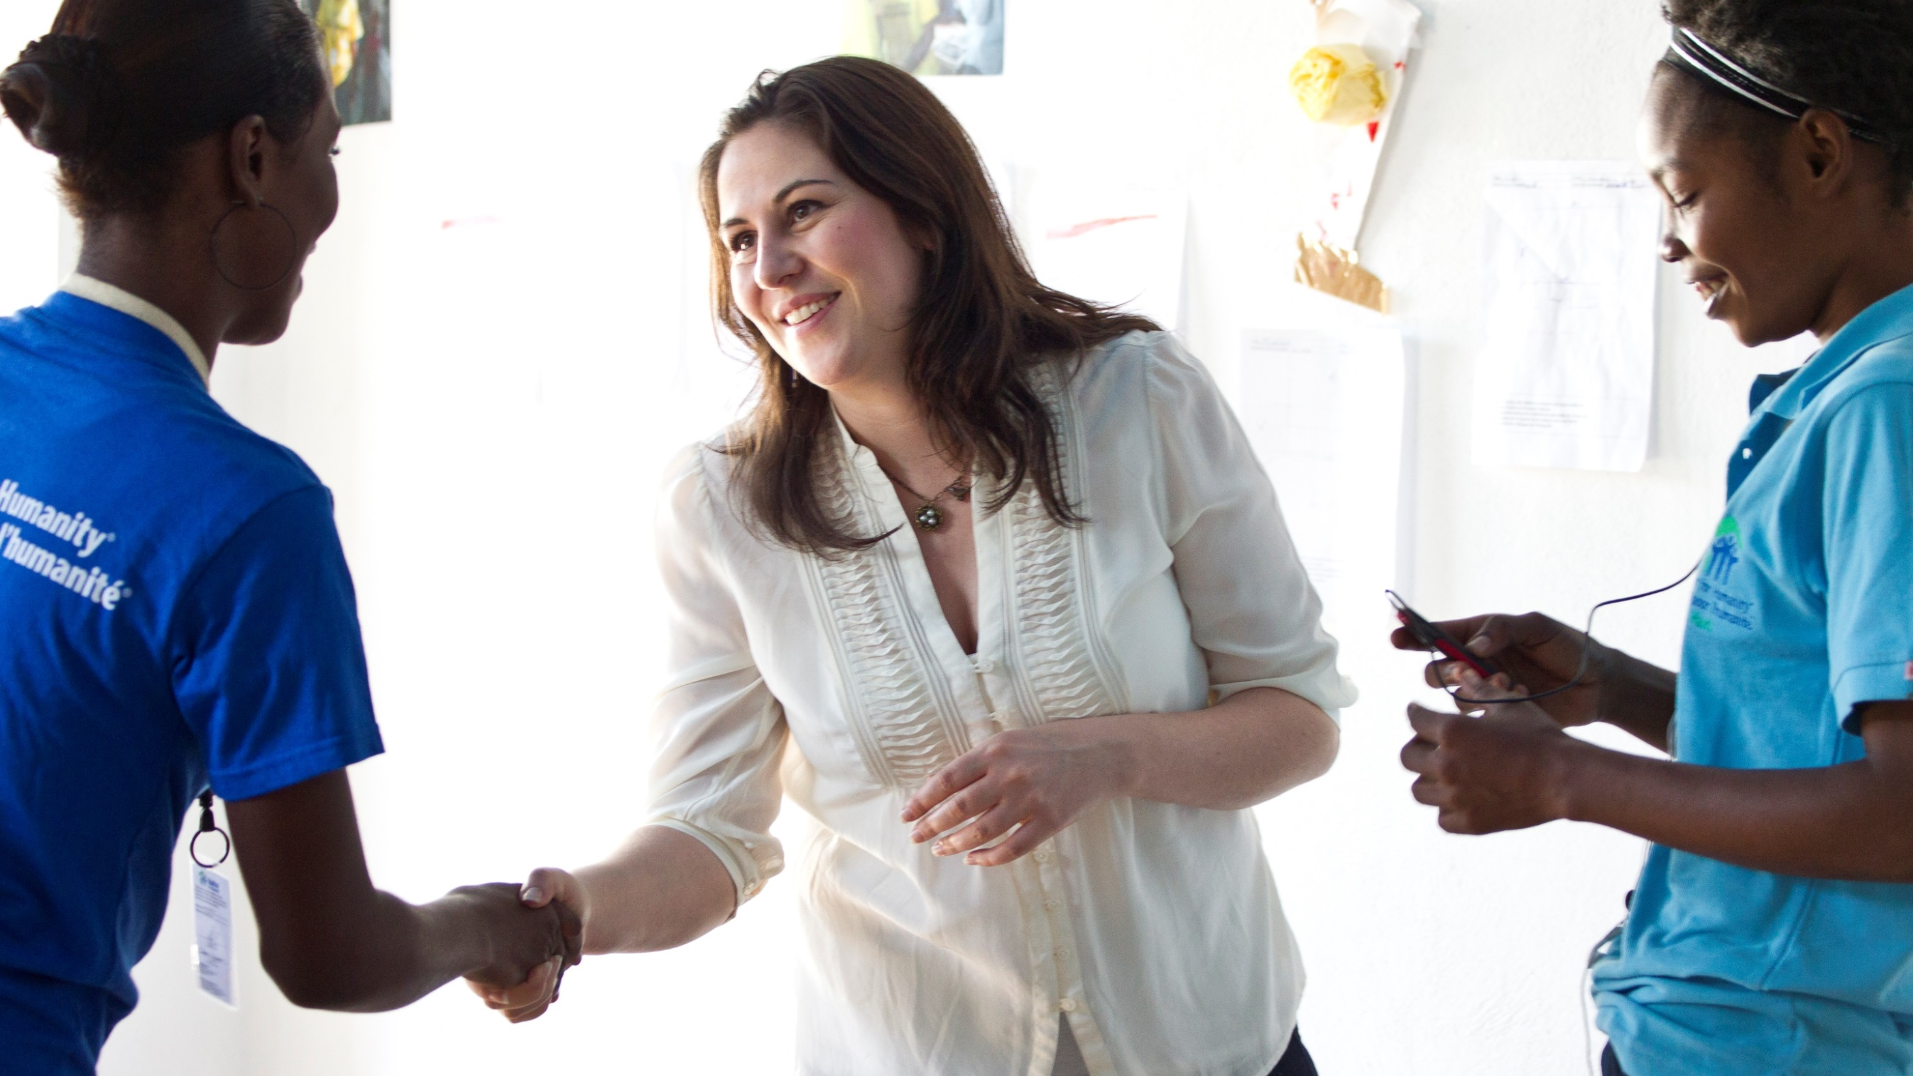
35,945 CLUBS
1,208,611 Rotarians
23% women
6% under 40 years old
+55 since 1 July
As of 1 January 2020
+19,145 since 1 July
Notes:
As you look at the information on this slide, think about your own club. Does your membership reflect the diversity in the community you serve? When our membership is diverse, it makes our clubs more vibrant and helps members understand and respond to the needs of our community.
Diversity is one of our core values. The RI Board of Directors passed a diversity, equity, and inclusion statement to help us become a more open and inclusive organization, “Rotary will cultivate a diverse, equitable, and inclusive culture in which people from underrepresented groups have greater opportunity to participate as members and leaders.”
As of 1 January, we had:
35,945 clubs, an increase of 55 since 1 July. Starting new clubs expands our reach and increases our capacity for service around the world. Alternative membership types and club experiences, including corporate memberships and flexible meeting times, can help clubs address the needs of current and potential members.
1,208,611 Rotarians, which is an increase of over 19,000 since 1 July 2019. When compare January of last year, with our current figure, our overall count is lower by around 4,000 members.
Information in Rotary Club Central suggests that most of our members are ages 50 to 69, though definite figures are hard to gauge because 37 percent of our members don’t indicate their age in their profiles.
Women make up 23 percent of our members, an increase of about 1 percent since 1 July 2018. However, women are still underrepresented in leadership positions at every level of Rotary. The Board of Directors set a goal for women to make up 30 percent of our members and leaders by June 2023.

Slide 4
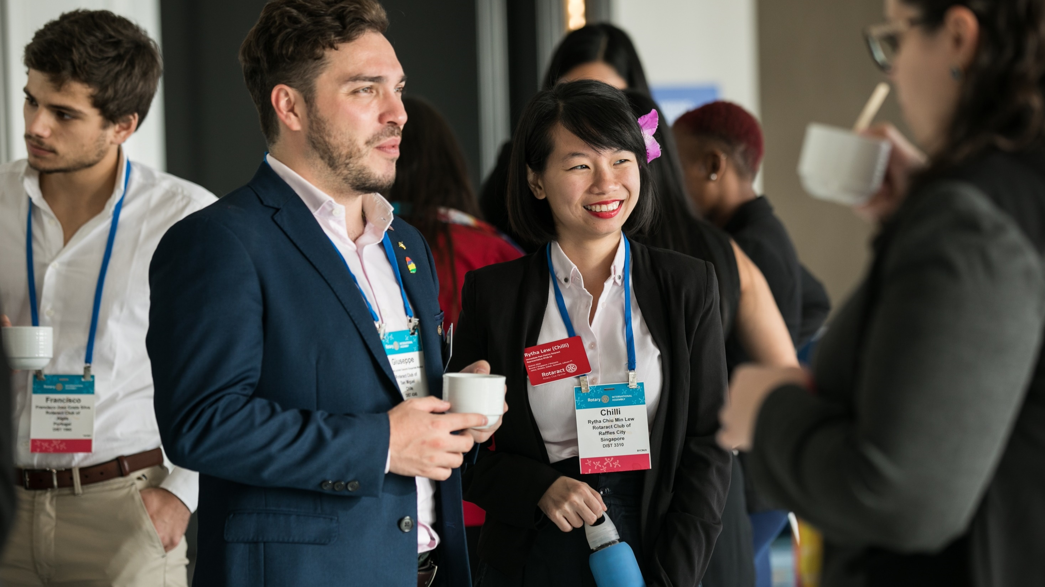

10,260 CLUBS
189,525 Rotaractors
50% women
ROTARY.ORG/ROTARACT
+16,710 since 1 July
+8 since 1 July
As of 1 January 2020
Notes:
Let’s talk about Rotaract. The 2019 Council on Legislation amended our constitutional documents to include Rotaract clubs as members in Rotary International. This action elevates Rotaract and positions Rotary for a future that’s innovative, inclusive, and better able to adapt to the world around us.
Overwhelmingly, we have heard that Rotaract was more than just a program and Rotaractors wanted more flexibility, more products and services, and more recognition from Rotary for the amazing work they’re doing in their clubs, districts, and multidistricts. membership experience.
Rotary International has set some long term goals for Rotaract, including:
To increase the number of Rotaractors reported to Rotary by 100 percent by 2022
To increase the number of reported Rotaractors who join Rotary clubs by 20 percent by 2022
To increase the number of reported Rotaractors to 1 million by 2029

Slide 5
District 6170:
1,493 MEMBERS
- 3 from 2016
36 CLUBS
+/- 0 from 2016
TREND, AS OF (INSERT DATE) | DISTRICT | WORLDWIDE
Men / Women | 64.7% / 35.3% | 77% / 23%
New Member Retention | 94.15% | 79%
Existing Member Retention | 90.57% | 77%
Members Under Age 50 | 9.65% | 16%
Members 50+ | 66.84% | 46%
Age Not Reported | 23.51% | 37%
Notes:
NOTE TO SPEAKER: Age and gender trends are found on the dashboard of Rotary Club Central. To populate this slide with district-specific data, leaders at the district-level and above can access the District Membership Profile for your district, under the Reports section of Rotary Club Central.
Where you see X’s on the slide and in the notes below, replace them with data from Rotary Club Central or delete them. Unhide the slide (use the Slide Show menu) so it’s visible during the presentation. Draw comparisons between regional and global trends, and add your own observations.
SPEAKER:
Here’s the district profile for D6170, as of 31 Mar 20.
GENERAL MEMBERSHIP TREND
Currently we have 36 clubs and 1493 members.
RETENTION
Our district’s retention profile for existing and new members is shown here:
91 percent of members who joined before 1 July of this year are still members.
94 percent of members who joined after 1 July of this year are still members.
[Add your observations:]
AGE AND GENDER PROFILE
Our district’s members are 65 percent men and 35 percent women, and this has changed [greatly/a little/somewhat] over three years. xx percent of members are under the age of 40, and xx percent have not reported their age to Rotary International.
[Add your observations:]

Slide 6



Membership gains
& losses 2018-2019
52% have been members for less than 3 years
158,000 members
164,500 MEMBERS
Notes:
One way we can grow and strengthen our membership is by delivering value to our members. It can be the difference between someone who stays in Rotary for just three years and someone who stays for a lifetime.
As you can see, Rotary doesn’t have a problem generating interest in membership. More than 158,000 people joined last year. But an almost equal number of people left. And half of those who leave were members for less than three years.
Before they join, 90% of prospective members have very positive impressions of Rotary. Yet after they join, only 44% percent still anticipate being lifelong members. And only half of our current members would recommend Rotary to their families, friends, and colleagues.
So what’s happening — or not happening — between when they join and when they leave?

Slide 7




WHY MEMBERS LEAVE
30%
Cost and/or time
23%
Club environment
19%
Unmet expectations
Notes:
According to the study, 30 percent of former members cited cost or time as the No. 1 reason they leave.
RI President Mark Daniel Maloney reminds us that: “The job of a Rotarian should never be seen as a time commitment too great for a busy professional to consider. Otherwise, we’re closing the door to the contributions of the people we need most in Rotary — the ones with the potential for decades of Rotary service and leadership. We need to meet people right where they are, at whatever stage of life they are in, and welcome them.”
Take the example of a young club president who set “Rotary Work Hours” for herself. She dedicates time on Tuesdays and Thursdays to Rotary work, giving her the ability to focus, brainstorm, and do long-term planning. It makes her more effective, provides the balance she needs in Rotary and her career, and ultimately makes her more passionate about her work as club president.
A growing number of departing members also cite the club environment and say their expectations weren’t met. Imagine being excited to be a Rotarian, only to discover that the experience you were promised isn’t available. We need to be honest with potential members about our club experience if we hope to change these numbers.
And we need to be flexible so we can accommodate the needs of our members and the community. Clubs have more freedom than ever to structure themselves in ways that work for every member. There is a club for everyone. And if there isn’t one in your community, we need to create one.

Slide 8
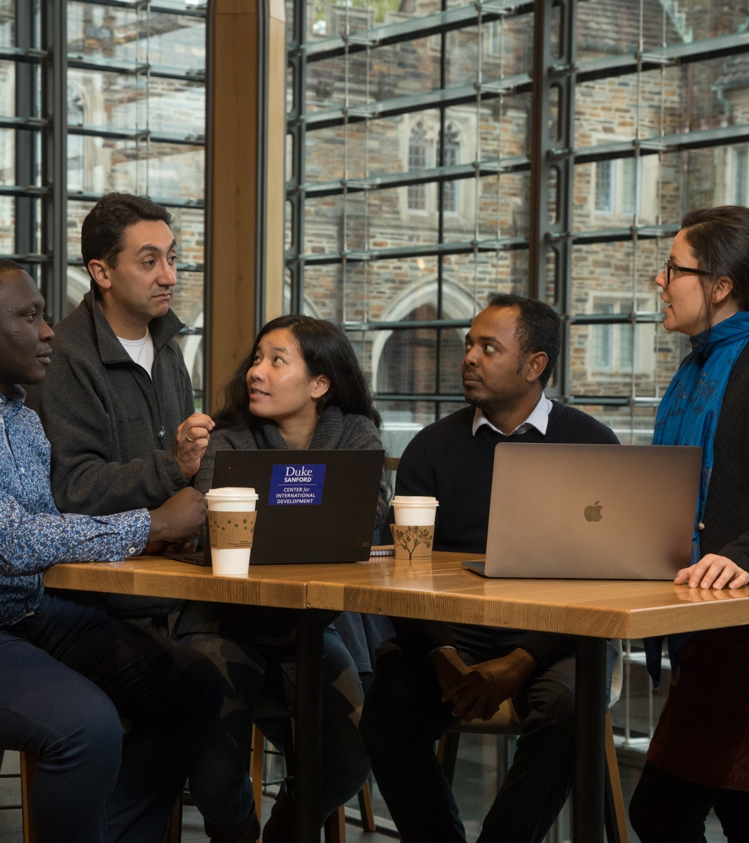
subhead
Diversity, equity & inclusion
Rotary will cultivate a diverse, equitable, and inclusive culture in which people from underrepresented groups have greater opportunities to participate as members and leaders.
Notes:
We’ve talked about Rotary’s commitment to diversity, but inclusion is equally important and even harder to measure. Inclusion refers to a cultural and environmental feeling of belonging. And we measure it by the extent to which members valued, respected, accepted and encouraged to fully participate in the club. However, diversity doesn’t necessarily imply inclusion. For example, while adding women to the board or promoting more people of color might enhance diversity, it doesn’t necessarily change the culture of the organization or ensure that these underrepresented groups will feel fully included and valued. Making diversity, equity, and inclusion a priority is everyone's responsibility, and here are some ideas to try:
Invite local diversity, equity, and inclusion experts to speak at your club’s next gathering.
Encourage and support people from underrepresented groups to take on leadership positions in your club and district.
Create a community advisory board and invite diverse members from the community and from your club to take part. You'll learn what's important to the community and discover ways to work together to take action.
Diversity and inclusion won’t happen on its own or in a vacuum. We need to invest in people in order to have them invest in Rotary.

Slide 9
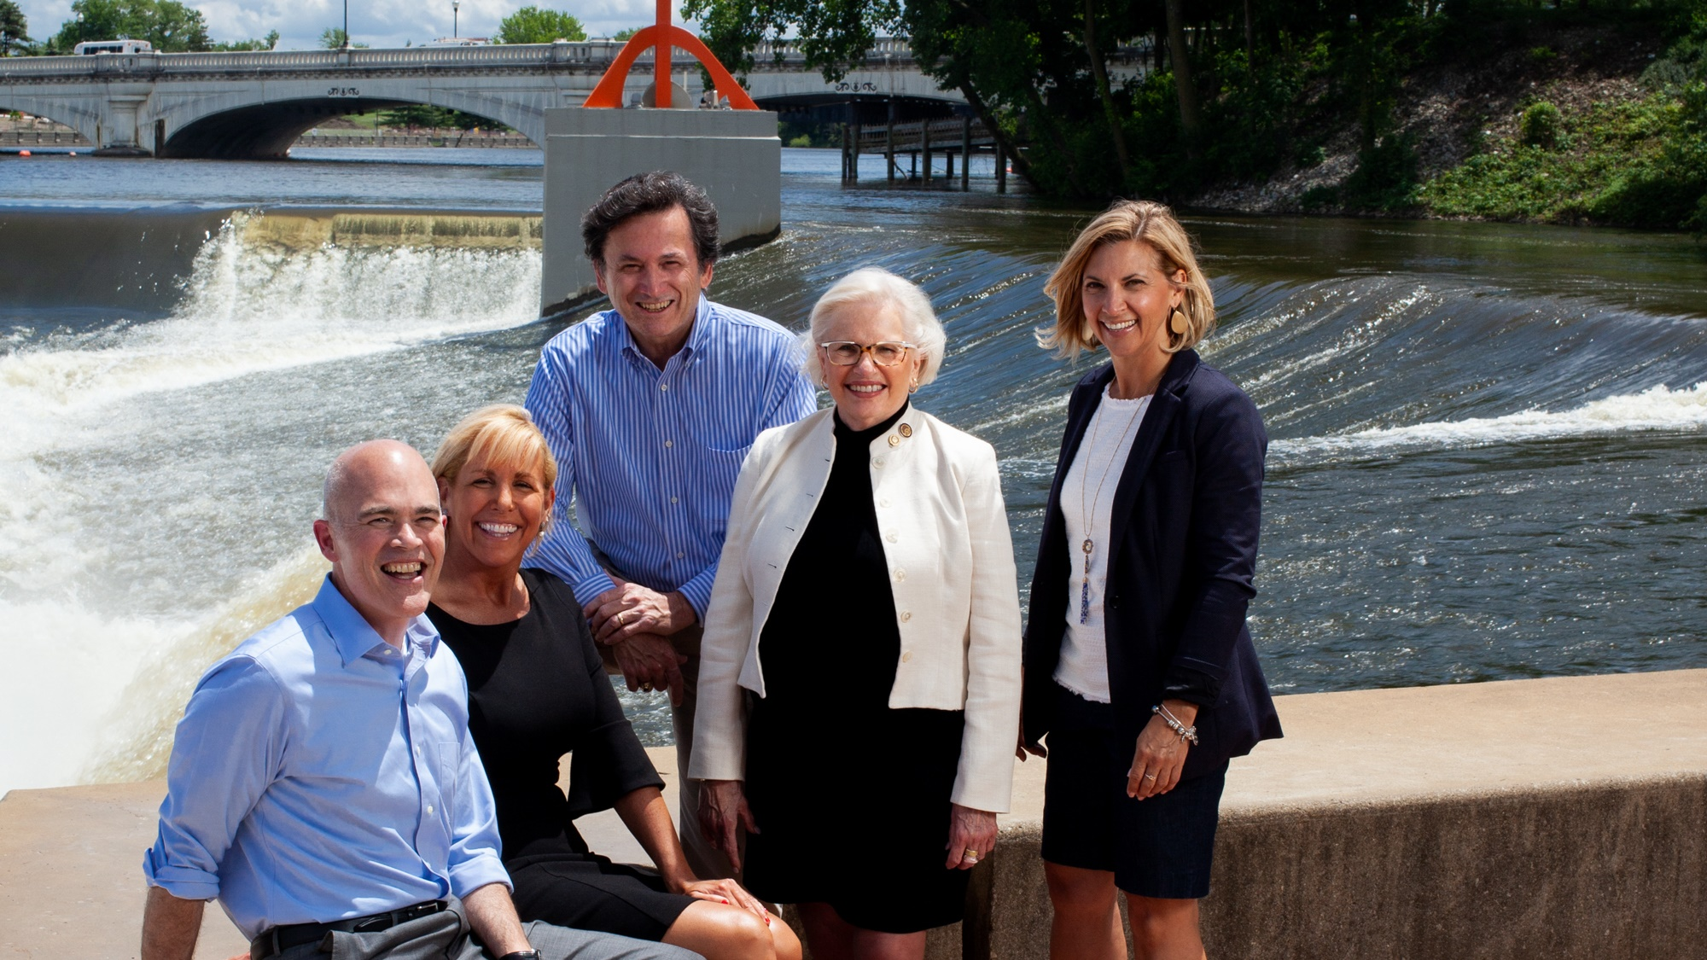
What members want
Local community service
Friendship & fellowship
Professional development opportunities
Notes:
So why Rotary? What do we offer that’s unique? Here’s what one current member said: “Rotary is a worldwide organization with the power to make meaningful change. It affords a platform for personal growth and development, quality friendships, leadership development, and the opportunity to give back to the society.”
What’s encouraging is that these responses reflect our vision statement. Members clearly understand the value of Rotary.
When we look at what potential and current members value most, some interesting trends appear. Both list “participating in service projects to positively impact my community” as the opportunity they value most. But potential members also want to make change globally and foster their careers through professional development and networking.
Current members, however, value community service, friendship and fellowship, and connecting with people outside work and their circle of friends. So even when both groups cite making a positive impact through service as their top reason for joining or staying, they each have different motivations. If those desires aren’t met, they may no longer have a reason to say yes to Rotary.

Slide 10
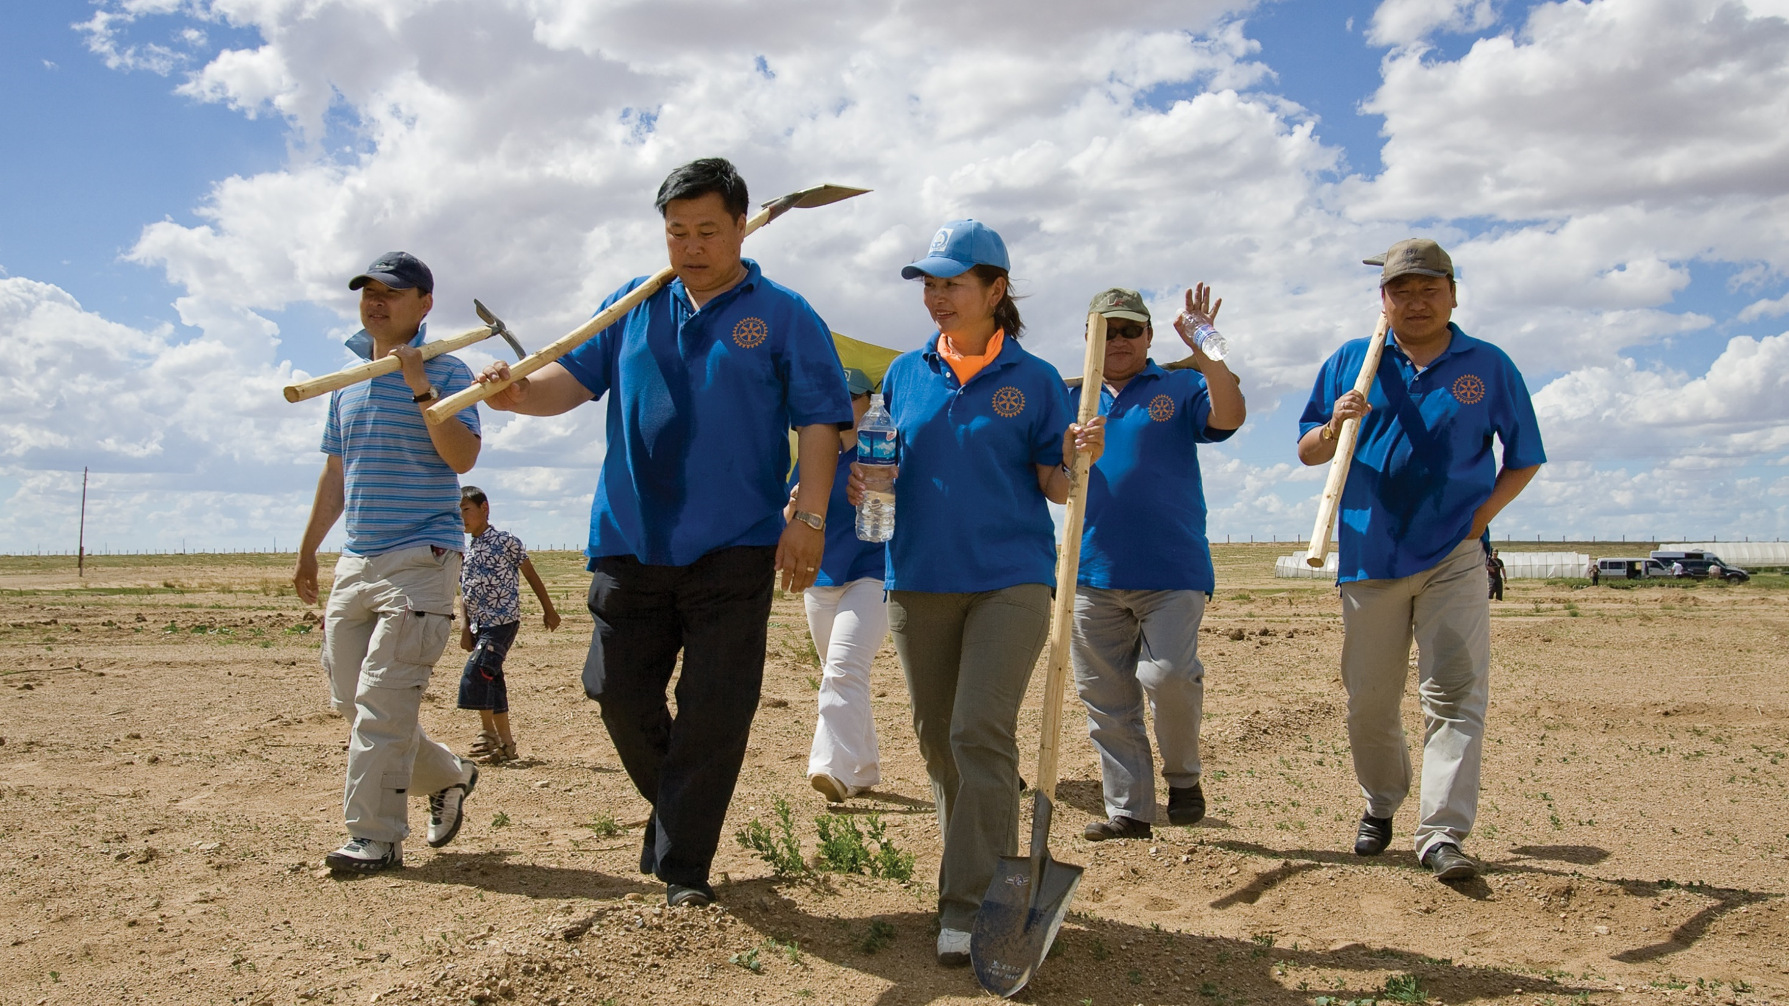
development
“When we say yes to Rotary, I don’t think many people understand the scope of what they’re saying yes to.
The great joy is finding that out.”
– A Rotarian
Notes:
Our research shows us that prospective members are looking for opportunities to grow personally and professionally. Rotary offers them that.
Consider the Rotarian who was terrified of public speaking and trembled her way through her first 5-minute speech. She was later asked to speak at an institute in front of 500 people, and now trains others in public speaking.
Think of the member who counts her experience in Rotary as why she attained a new job as a community engagement manager: “I wouldn’t have gotten it if I wasn’t a part of Rotary.”
You don’t have to offer a formal professional development strategy for members to achieve their goals. Every service project or event you hold is a chance for someone to lead and grow. Members can also take online courses through Rotary’s Learning Center, or Leverage our alliance with Toastmasters to provide your members with additional growth opportunities.
The next time someone asks you about Rotary, you can say: “You’ll achieve more than you ever thought possible. And you won’t do it alone.”

Slide 11

subhead
Is your club healthy?
Members who have a positive Rotary experience are more likely to stay.
In turn, they create a positive Rotary experience for others, because their enthusiasm is contagious.
ROTARY.ORG/MEMBERSHIP
Notes:
And all of these opportunities, from local community service to professional development are things that are offered in clubs around the world. No two clubs are exactly the same, and those unique club experiences are what differentiates Rotary from any other organization.
If someone walked into your club meeting — uninvited but curious to learn more — what would they find? Would they be warmly welcomed? Would your members appear engaged? Would they leave understanding who you are and how you’re helping your community? And would someone follow up with them to see what they thought about the experience?
One of the most important things we can do is assess our clubs regularly and make sure they’re welcoming to prospective members. If you find that your club needs to improve, Rotary offers resources to help. You can find them at rotary.org/membership. Remember this address — write it down, take a picture of it. And visit as often as you need to.

Slide 12
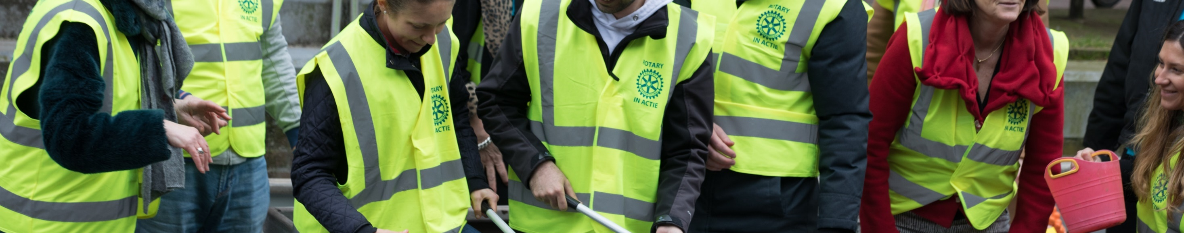


WHAT IS YOUR BIGGEST CHALLENGE?
43%
Attracting new members
26%
Accommodating the varied needs of members
Notes:
With more than 50 resources available to you at rotary.org/membership, finding the one that meets your needs can seem like a challenge. Earlier this year, we developed a new resource called the “Club Planning Assistant.” This interactive tool asks a series of simple questions and then recommends resources for addressing those specific challenges.
In fact, we were so excited about this that we invited every club president and membership chair in the world to take it and share with us their biggest membership challenges.
The majority listed “Attracting New members” as their biggest challenge. But many also said that Accommodating the needs of prospective and current members (busy schedules, family or financial obligations, etc.) was a challenge too. Addressing both of these challenges effectively requires us to think differently and adapt to change more quickly.

Slide 13

The prospective, referred, relocating or returning members who go to Rotary.org/join to connect with clubs like yours
+19,500 inquires per year
37% women
59% under 40 years old
50% have a personal connection to Rotary
71% are
never
contacted
by clubs
Notes:
Bringing in more members than we lose is not the answer. But there is one opportunity that all clubs and districts should pay closer attention to.
Membership candidates are prospective members who use Rotary’s come through rotary.org/join to express interest in joining a club. A notice of their interest is sent to a district, and district and club leaders can track those notices through the Manage Membership Leads page of My Rotary. Last year, 19,500 people contacted Rotary this way.
Unfortunately, clubs contacted less than a third of the prospective members assigned to them last year. In fact, in places that experienced the highest decline in membership, an equally high percentage of membership leads were never contacted.
In the US, for example, membership declined by around 5,711 members in 2018-19. In the same time period, the US received 7,282 membership leads. Imagine what our overall membership would look like if we followed up on every lead. Although not every one of these prospective members will be a viable prospect, each one provides an opportunity to identify the value they might bring to the Rotary.
Managing prospective members is an opportunity. When we don’t respond to inquiries, we miss more than just the chance to expand our clubs — we lose a chance to build goodwill in the community and a positive impression of Rotary.

Slide 14

subhead
Take your club in a
New direction
Is your club flexible and ready for the future?
New resources on satellite clubs, passport clubs, and Corporate Membership can help you create an experience that works for
every member.
ROTARY.ORG/FLEXIBILITY
Notes:
The second challenge club leaders mentioned is accommodating the varied needs of their members. If your current structure is working, there’s no need to change it. But clubs actually have more freedom than ever to create an experience that works for their current and prospective members.
Clubs around the world are taking advantage of this flexibility. Here are some ways clubs are meeting the diverse needs of their members and their communities:
Starting a satellite club to give qualified people who can’t attend club meetings a chance to join Rotary.
Changing how, when, and how often clubs meet. Some examples are meeting just twice a month, switching from a sit-down meal to a less formal — and likely less expensive — gathering, or replacing a regular meeting with a social event or service project.
Offering a new membership type. For example, offering a corporate membership to attract multiple members of the same company, or an associate membership for younger professionals who want an option that costs less or requires less time.
Meeting online to attract members who can’t attend in-person meetings.
Developing a cause-based club to attract and engage members who are passionate about a specific issue, like water or peace.
You can find more information at rotary.org/flexibility.

Slide 15




TAKE ACTION
LEARN
ASK
VISIT
ROTARY.ORG/MEMBERSHIP
Notes:
What can you do with all of this information, especially if some of it is new to you? I suggest three things:
Take time to understand membership data and trends in your region. We can offer you a global look at the state of membership, but Rotary Club Central makes it easy for you to see the trends closest to you.
Ask members what matters most to them. Find out what they value, what they might be missing, and what they need to stay a member for life. And make sure you deliver that.
Finally, visit rotary.org/membership for resources to support you. Whether you need access to club assessments, directions on how to manage your membership leads, or even guidelines for starting new clubs and membership types, there is likely a resource designed to help.

Slide 16
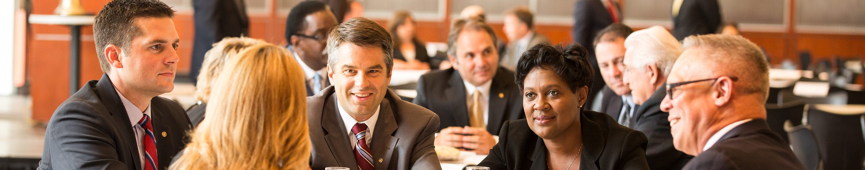
Strengthening Your Membership: Creating Your Membership Plan
Evaluating your club
Creating a Vision for your Club
Attracting New Members
Engaging Your Clubs Members
Mentoring New Clubs
Supporting Your Club: Rotary Resources and Tools

Slide 17
Strengthening Your Membership: Creating Your Membership Plan
Evaluating your club
  Club officers complete Rotary Club Health Check
  Get member feedback about the club
  Questions to consider

Slide 18
Questions??????
To consider
Is your club diverse?
Does the membership represent a good balance of professions?
Is the club sustainable?
Why do members stay in your club? Why do they leave?
Is your club innovative and flexible?
Is the community aware of your club?
How are you using digital communications to promote the club?
How does the club appear to a nonmember?
Notes:
Club flexibility is key for us now. We must adapt to the times and the circumstances we encounter.
Be innovative: change the meeting time and type, change the location, loosen attendance rules and promote engagement, reduce fees for younger members, allow different types of membership

Slide 19
Creating a Vision for your Club
What is your club good at?
What are your clubs areas of weakness?
What would you like your club to be like or known for?
What changes can you make now?
What are the short and long term goals of the club?
Who will make sure that you stay on track?
Notes:
Take the time to create a vision for the club
Club Visioning Team is available.
Involve the club members
The Strategic Planning Guide in your packet can help your club formulate its vision.

Slide 20

Attracting new members
Who are your prospects?
How do you approach a prospective member?
Communicate the benefits of joining Rotary
How can your club diversify its membership?
Notes:
Identify prospective members, consider Rotary alumni
Tell your Rotary story and keep the message simple
Invite them to participate in projects
10 ideas for attracting younger professionals

Slide 21
Engaging Your Club Members
Engage current members
Orient new members
Involve new members
Form and appoint a membership committee
Notes:
Feedback from members should be solicited regularly
Update the members regularly on progress toward goals
Don’t try to do it all
Encourage and enlist others to serve
Appreciate opinions
Communicate with the club
Get to know the members
Reach beyond the club for training opportunities
Utilize the club trainer and the membership committee

Slide 22
Mentoring New Clubs
Set goals with the new club
Provide structure
Establish regular communication
Notes:
Different types of clubs
Satellite
Passport
eClub
Corporate Club
Cause-based Club
Alumni-based Club
Rotoract Club
Every new club can use a good sponsor

Slide 23
Supporting Your Club:
Rotary Resources and Tools
Regional Leaders
  Rotary Coordinator
  Rotary Public Image Coordinator
  Regional Rotary Foundation Coordinator
District Membership Committee
Assistant Governor
Club and District Support Representatives
My Rotary

Slide 24
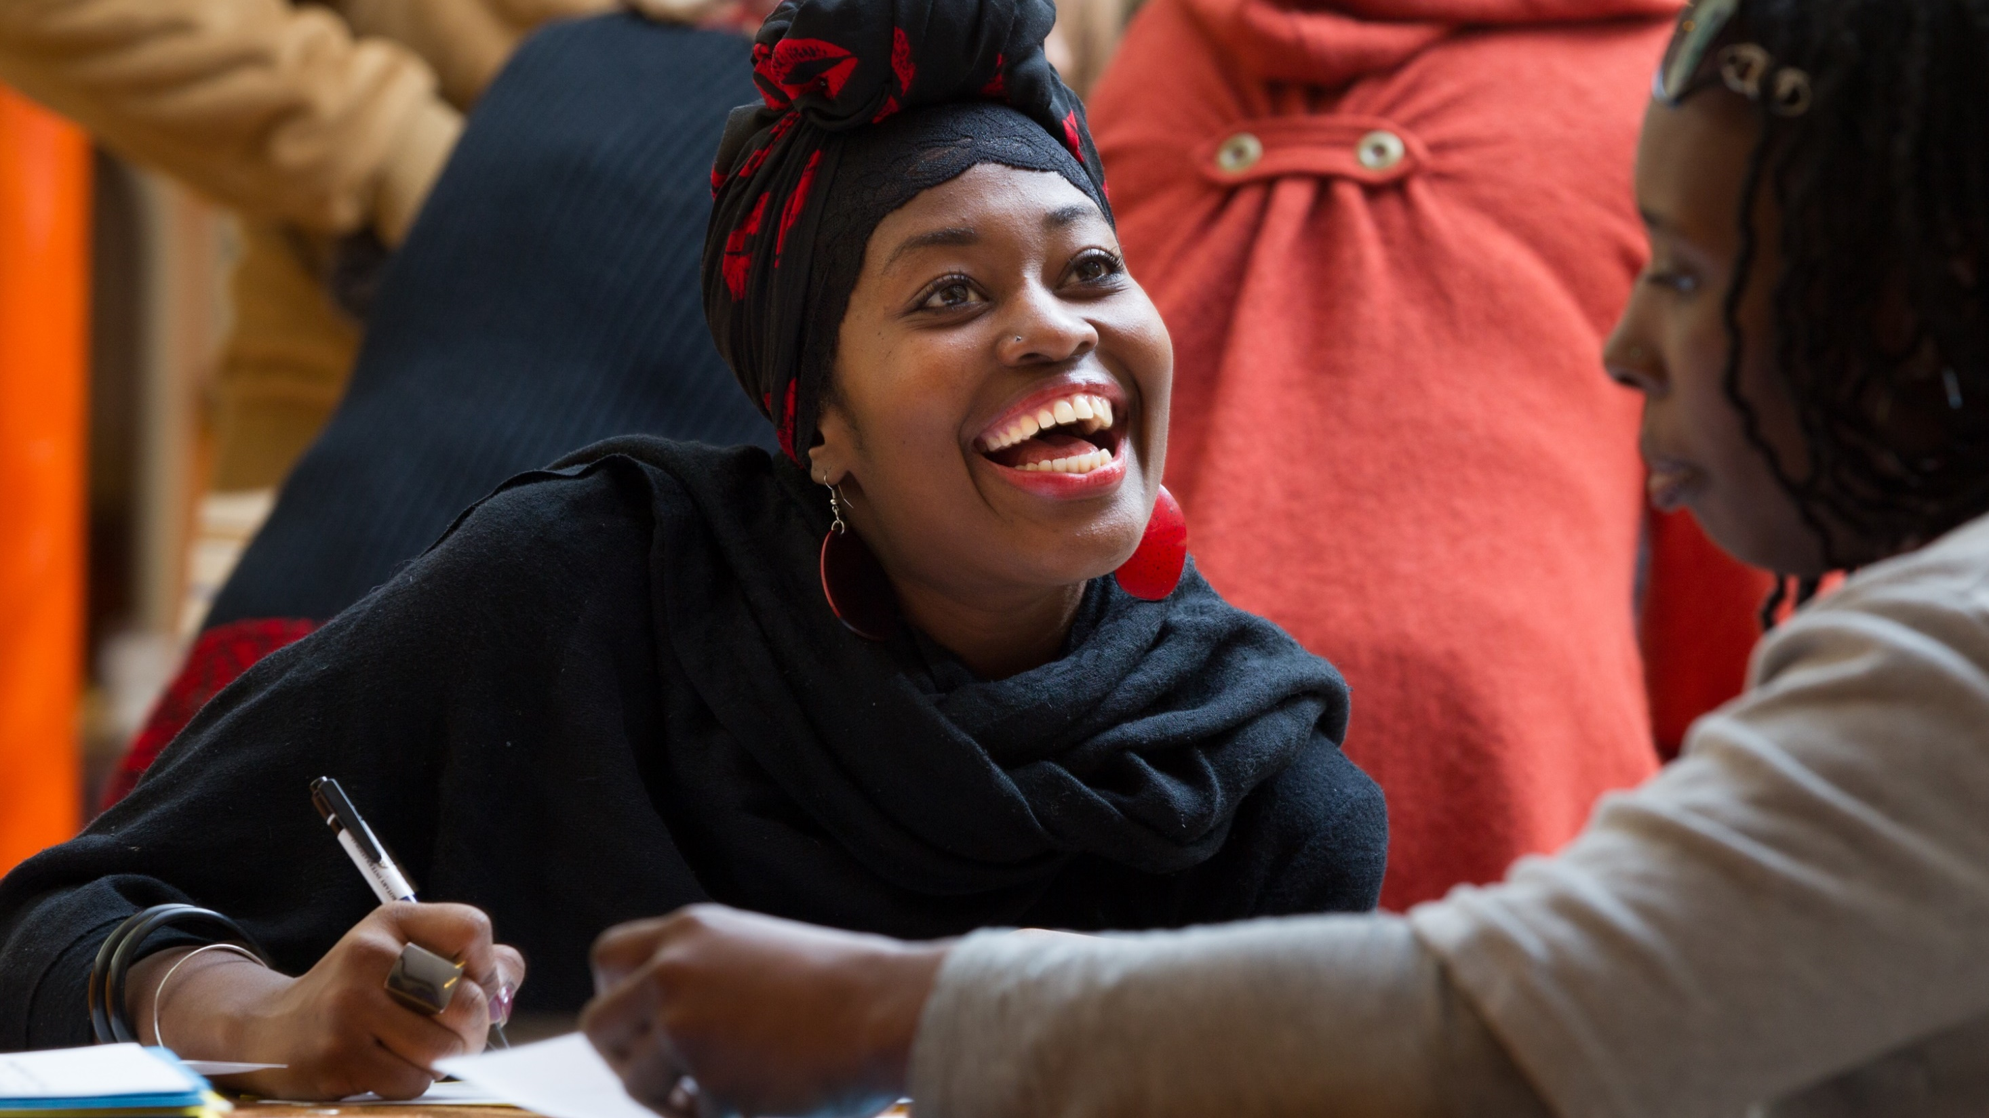
Notes:
When people join a Rotary club, their potential to make a difference in the world grows exponentially. That’s because they’re joining a network of over 1.2 million people who take action — volunteers from all over the world who share a goal of improving people’s lives.
But simply joining isn’t going to change lives or make those connections. That happens when members get involved and take every opportunity to get the most out of their Rotary membership. Whether they’re connecting with their club, community, or the larger Rotary world, let your members know they’re connecting for good.
Our members are our greatest assets: a diverse group of professionals who share the drive to serve their communities. And together, we see a world where people unite and take action to create lasting change — across the globe, in our communities, and in ourselves.
Thank you.
Are there any questions I can answer?
NOTE TO SPEAKER:
Write to membershipdevelopment@rotary.org with any questions.

