Slide 1
District 6150
CLUB OF
THE YEAR
2025
July 8, 2025

Slide 2
Rotary Ramblings
I have a neck, but no head. I have two arms, but no hands. What am I?

Slide 3
PLEDGE OF ALLEGIANCE

Slide 4
INSPIRATIONAL MOMENT
Brenda Fasulo

Slide 5
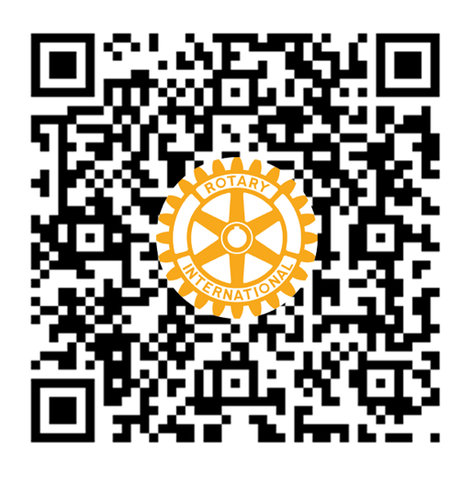
INTRODUCTION
OF GUESTS
JOIN US!
Kenna Harrelson
Interested in becoming a member?
Scan the QR code or visit www.JonesboroRotary.org to view our Membership Application

Slide 6
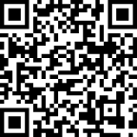
GOOD NEWS
John Deacon

Slide 7
July 25th

Slide 8
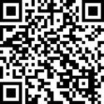
Period Poverty Project
Sonya Sanders -
The Period Poverty Project was created by Sonya Sanders who saw a need in the community, began asking for donations and doing her part to fill the need.

Slide 9
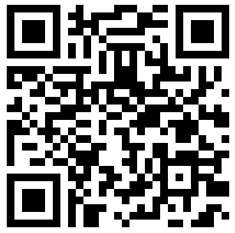
SIGN UP
POLIO PLUS SOCIETY
Pledge $100 or more each year to the PolioPlus program of the Rotary Foundation
Rotary has helped reduce polio cases by 99.9% since 1979
Polio remains endemic in only Afghanistan and Pakistan

Slide 10
Join the
$10-A-MONTH CLUB
Also known as the Annual Fund, ShareFund, or Every Rotary Every Year
Funding goes to support Rotary’s seven areas of focus:
promoting peace
fighting disease
providing clean water and hygiene
saving mothers and children
supporting education
growing economies
protecting the environment
Along with supporting international and district projects, a portion of these funds come back to us for our own club projects

Slide 11
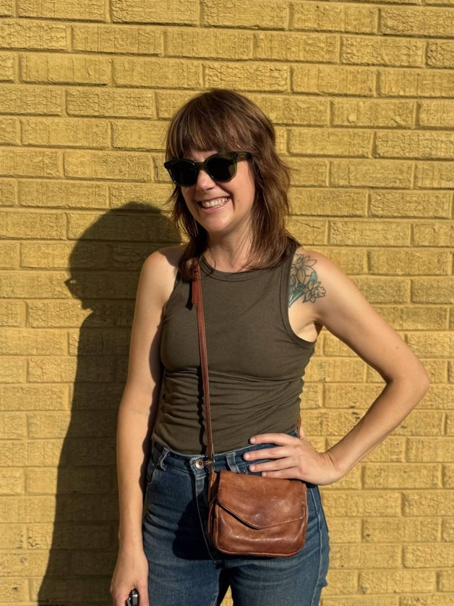
PROGRAM
Leah Schroeder
Open Studios – A Community Craft Studio and Market

Slide 12
Why Everyone
Needs Hobbies
(or *How Sewing Saved My Life)

Slide 13
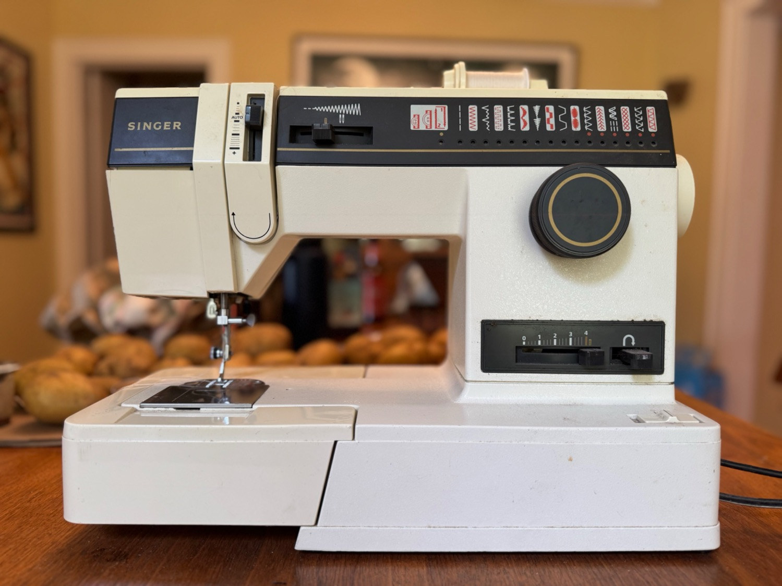

Slide 14
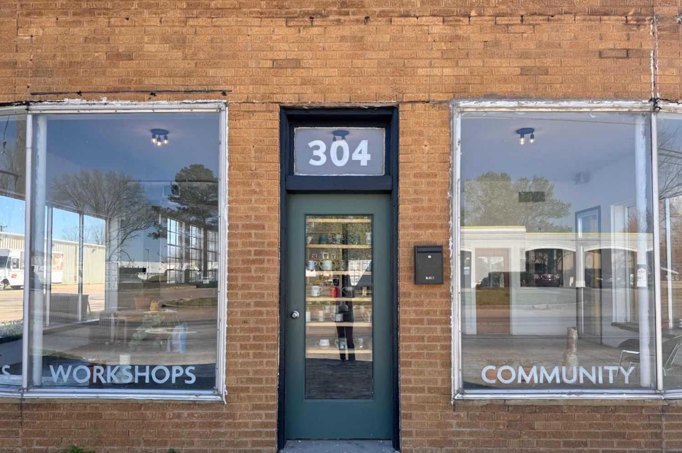

Slide 15
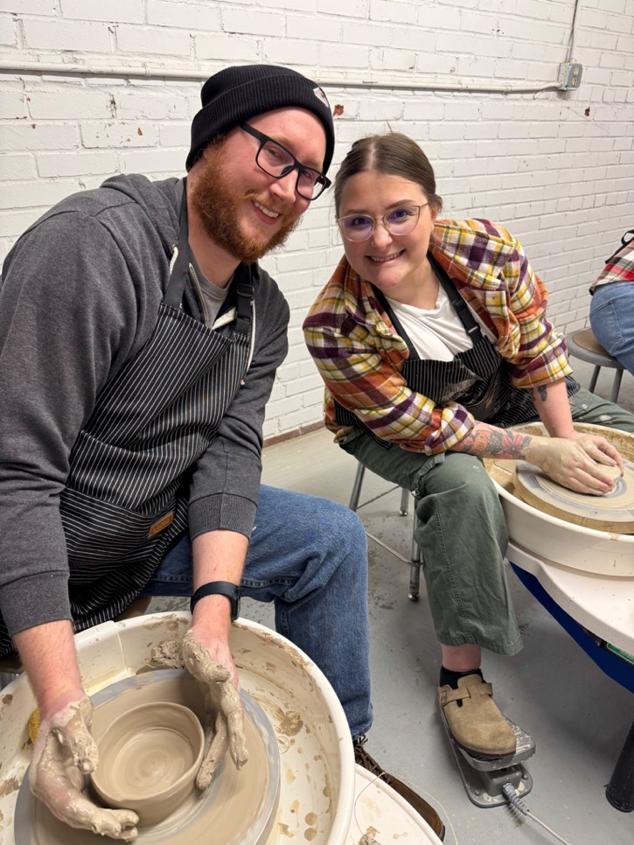
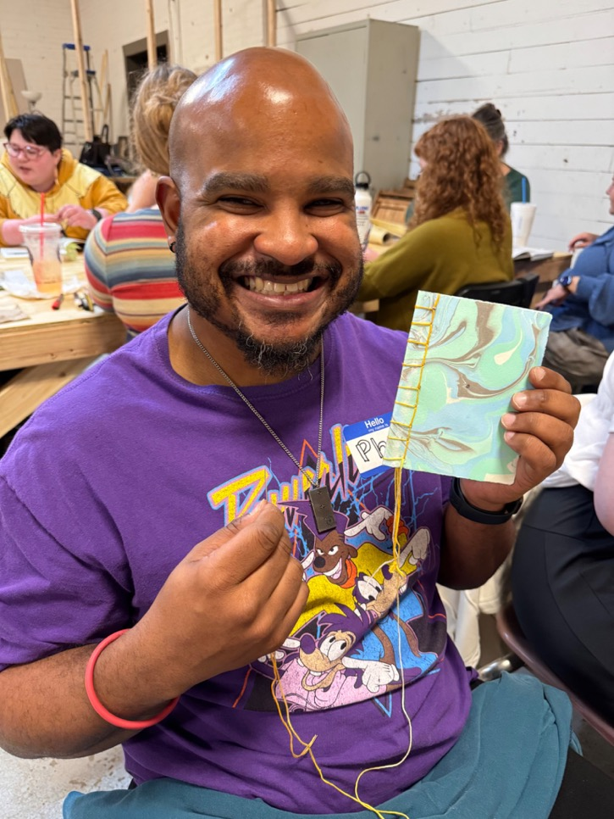

Slide 16
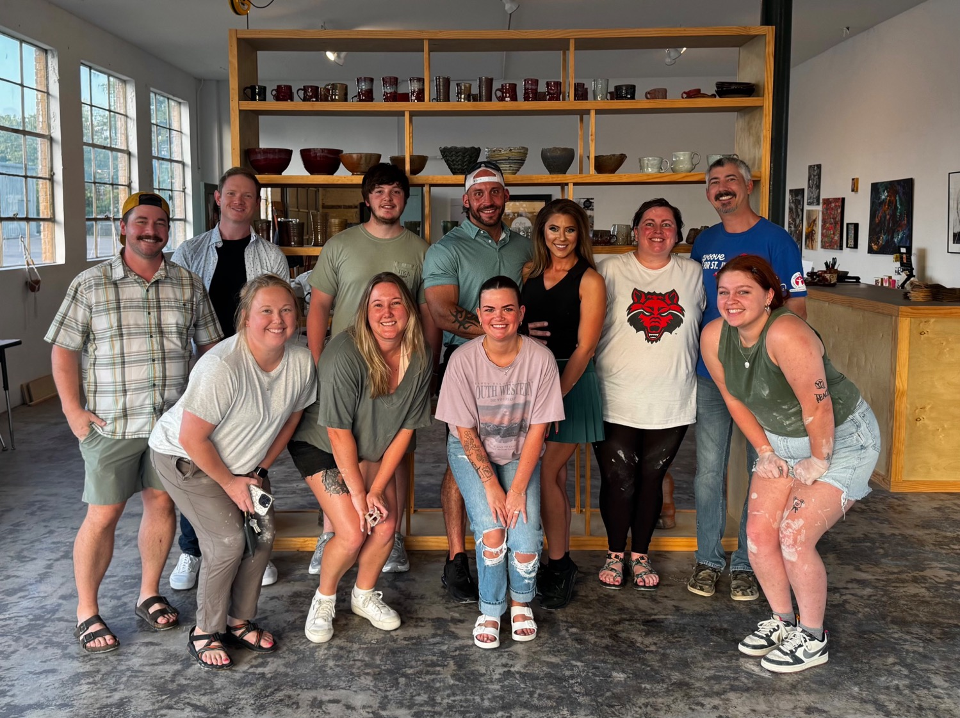

Slide 17
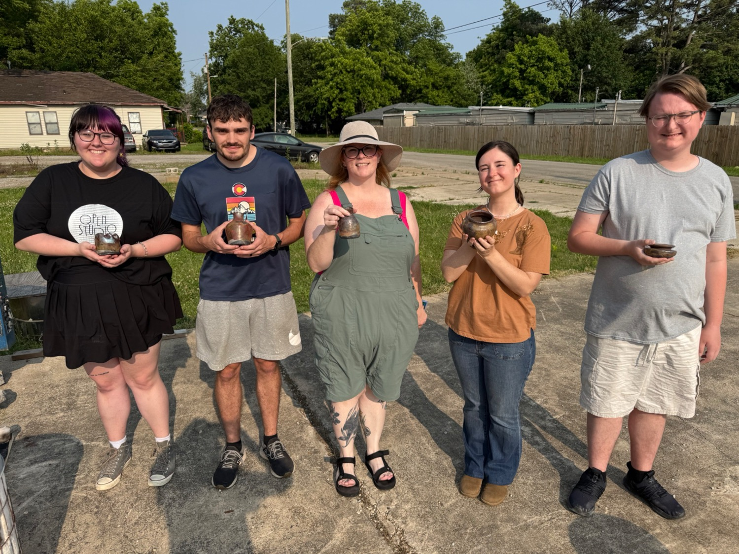

Slide 18
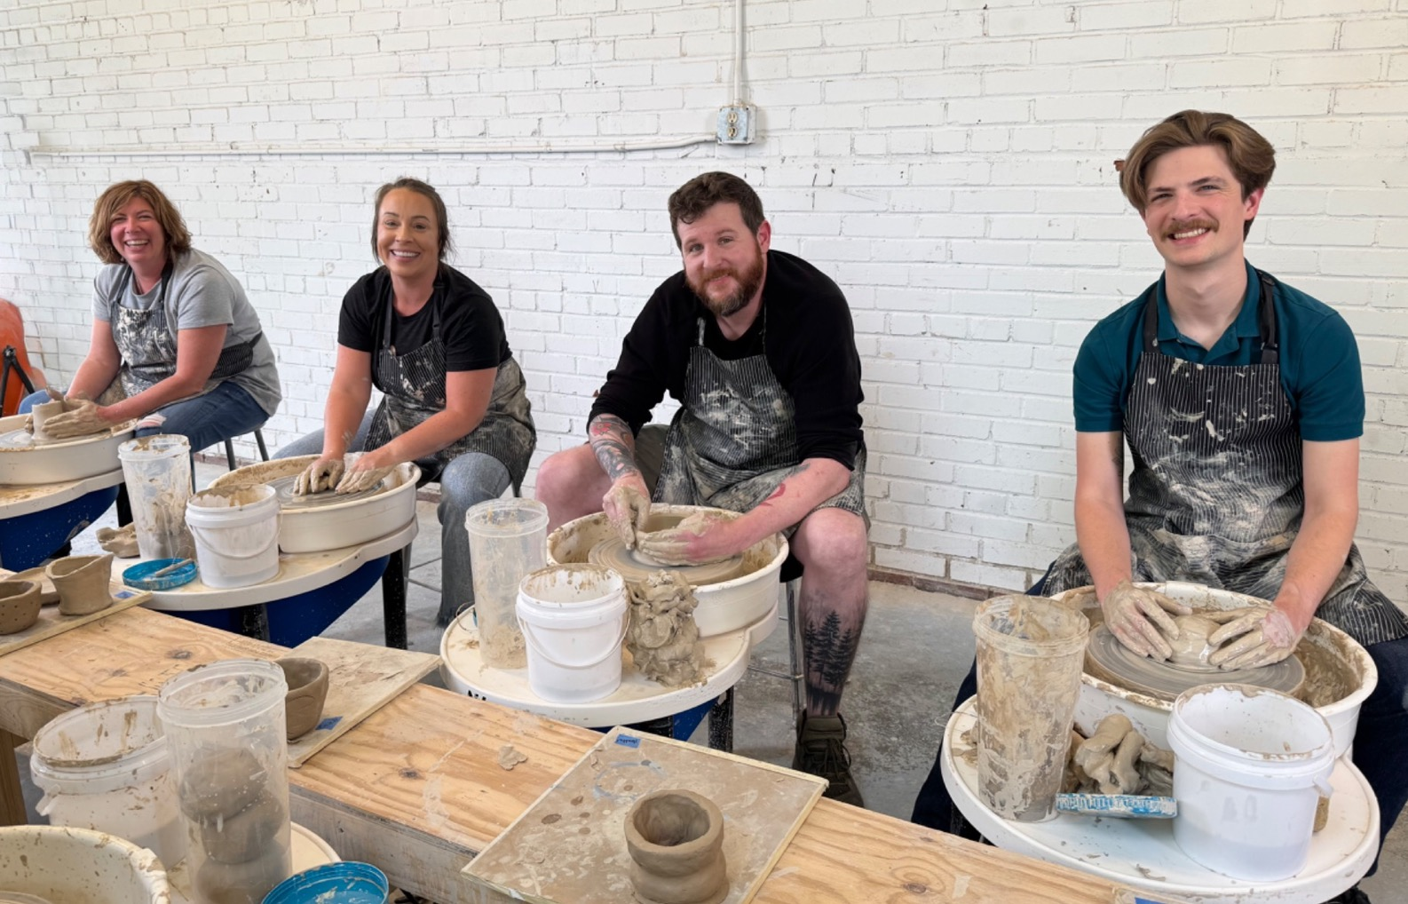

Slide 19
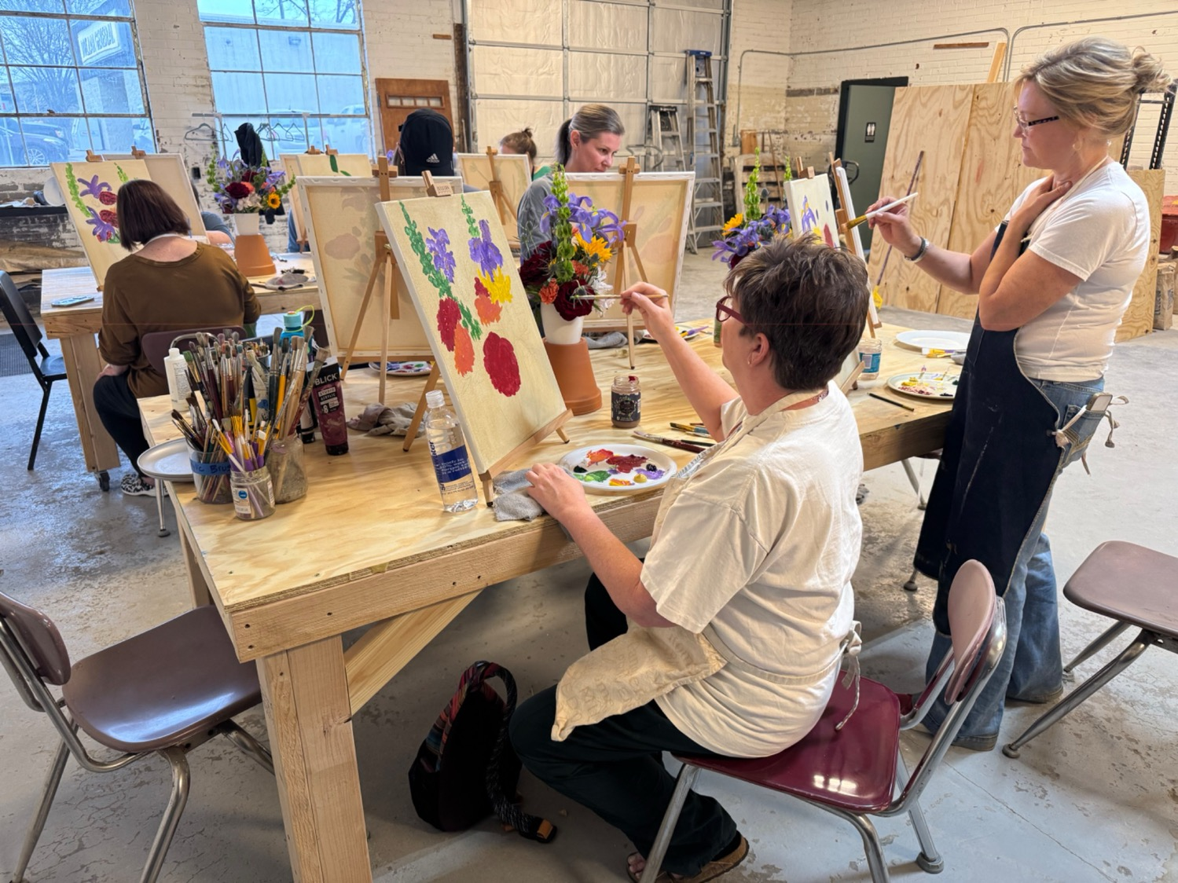

Slide 20
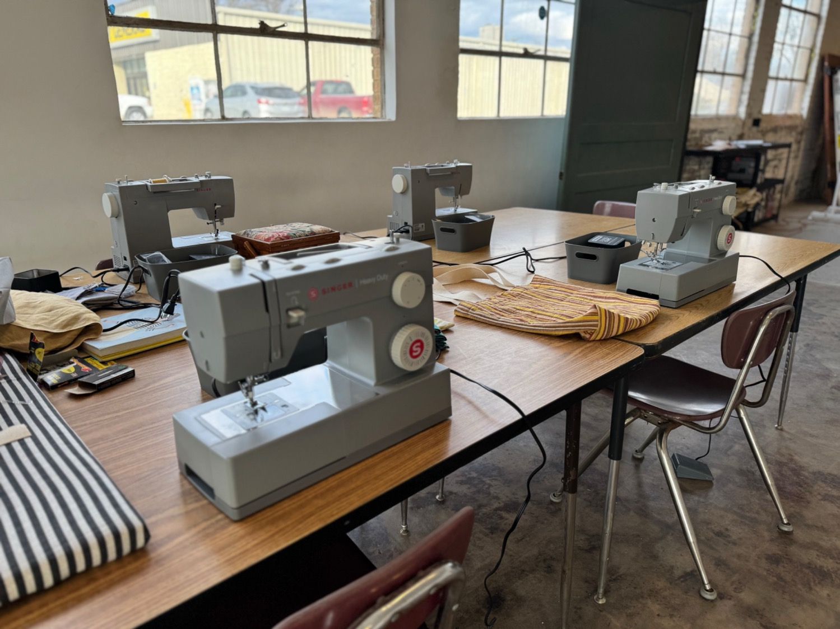
SEWING CLASSES + WORKSHOPS

Slide 21
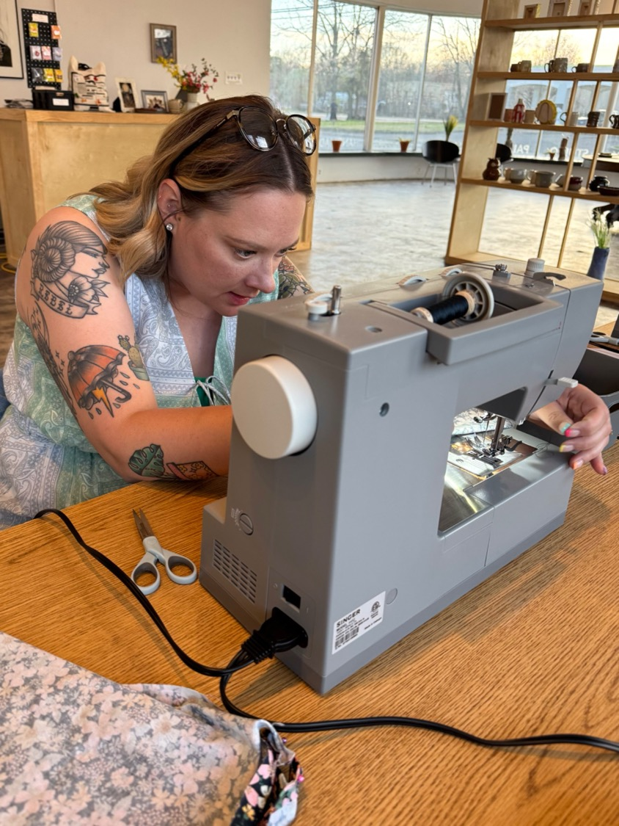
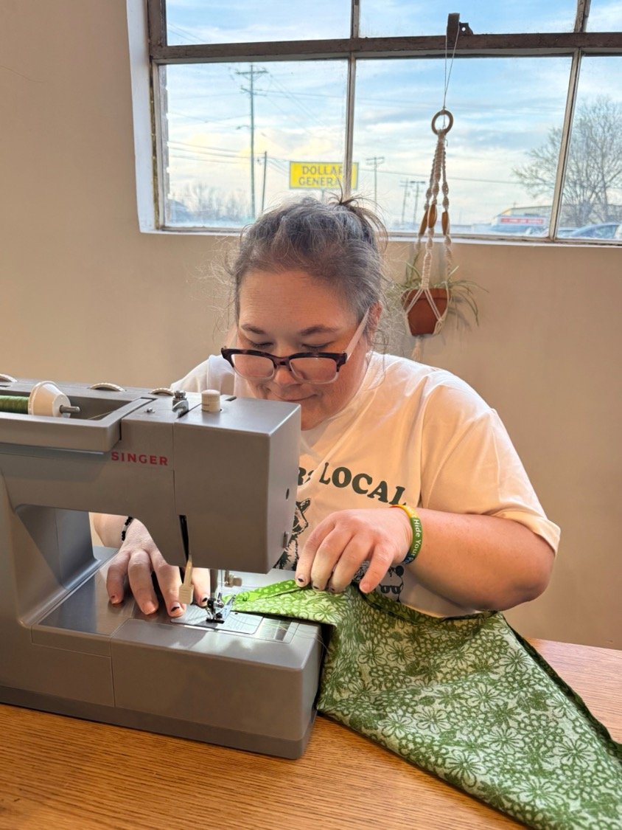

Slide 22
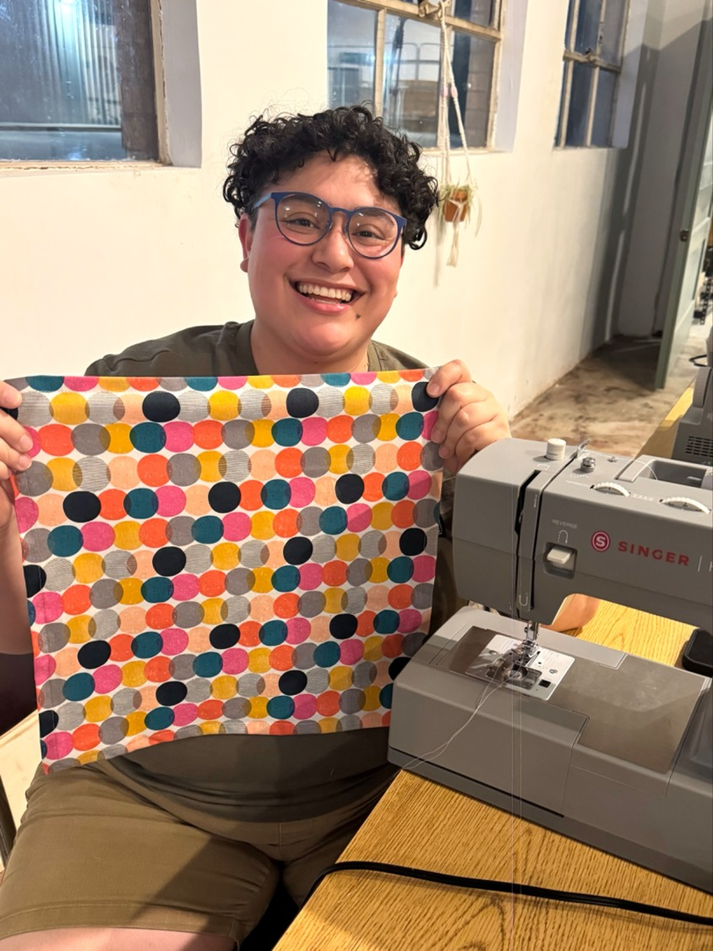

Slide 23
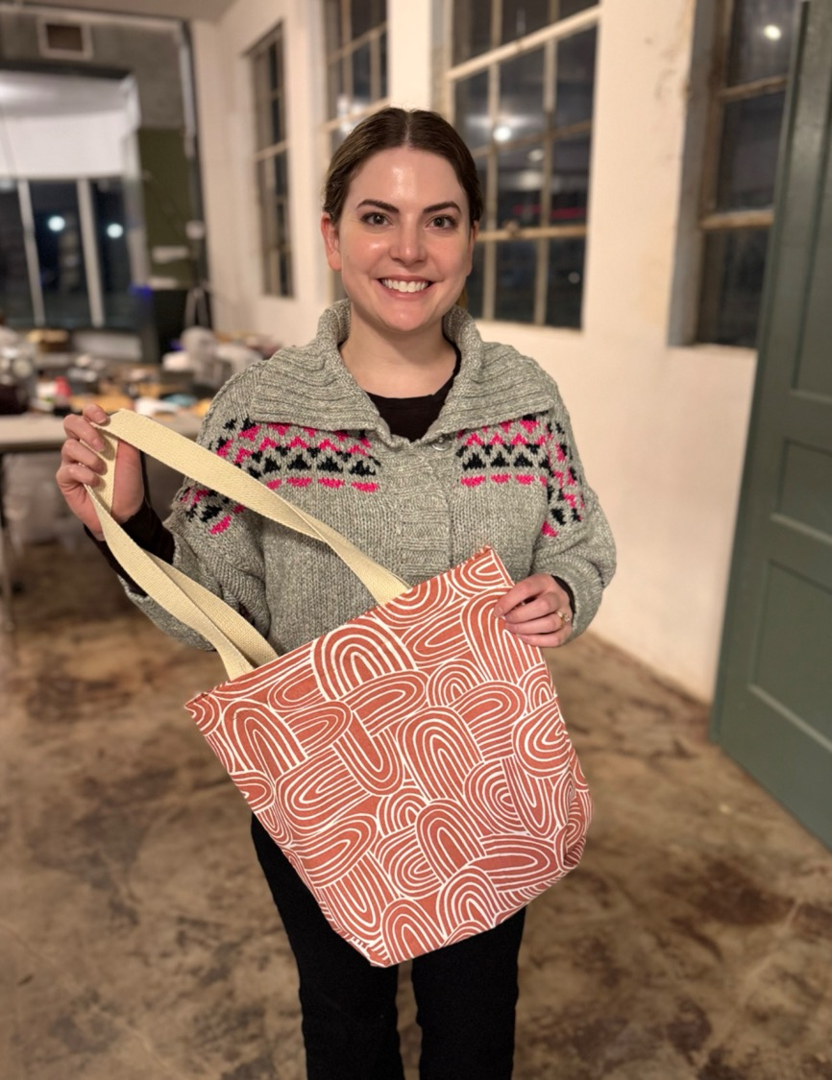
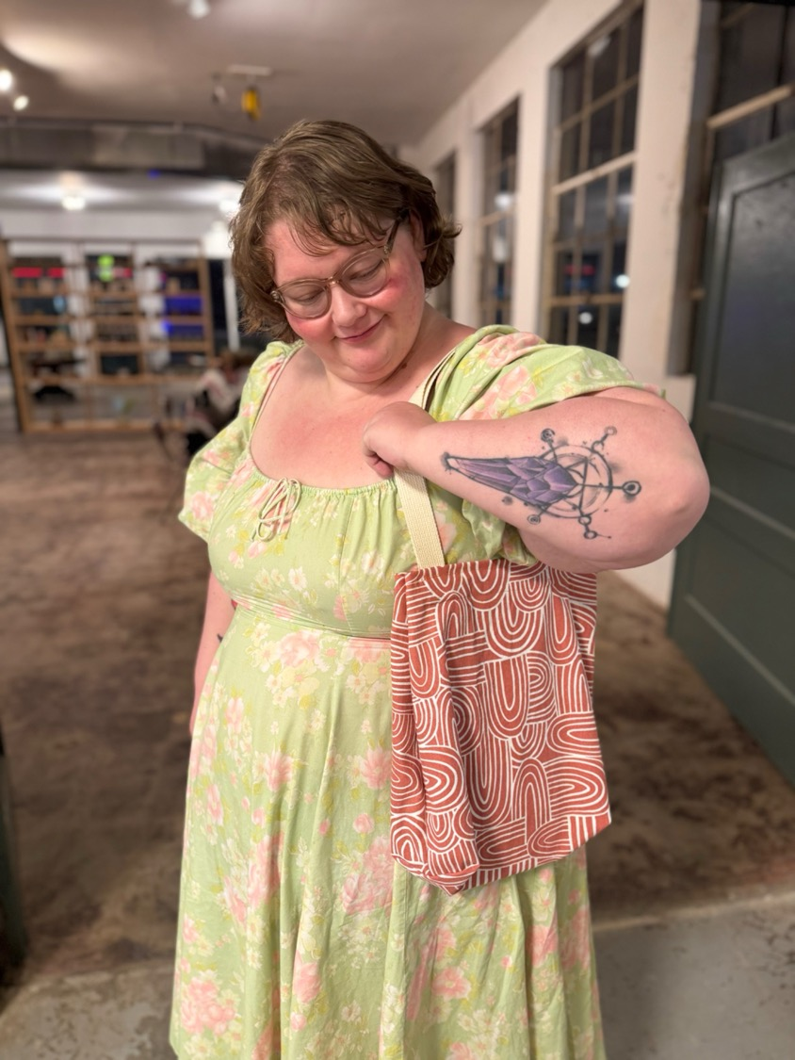

Slide 24
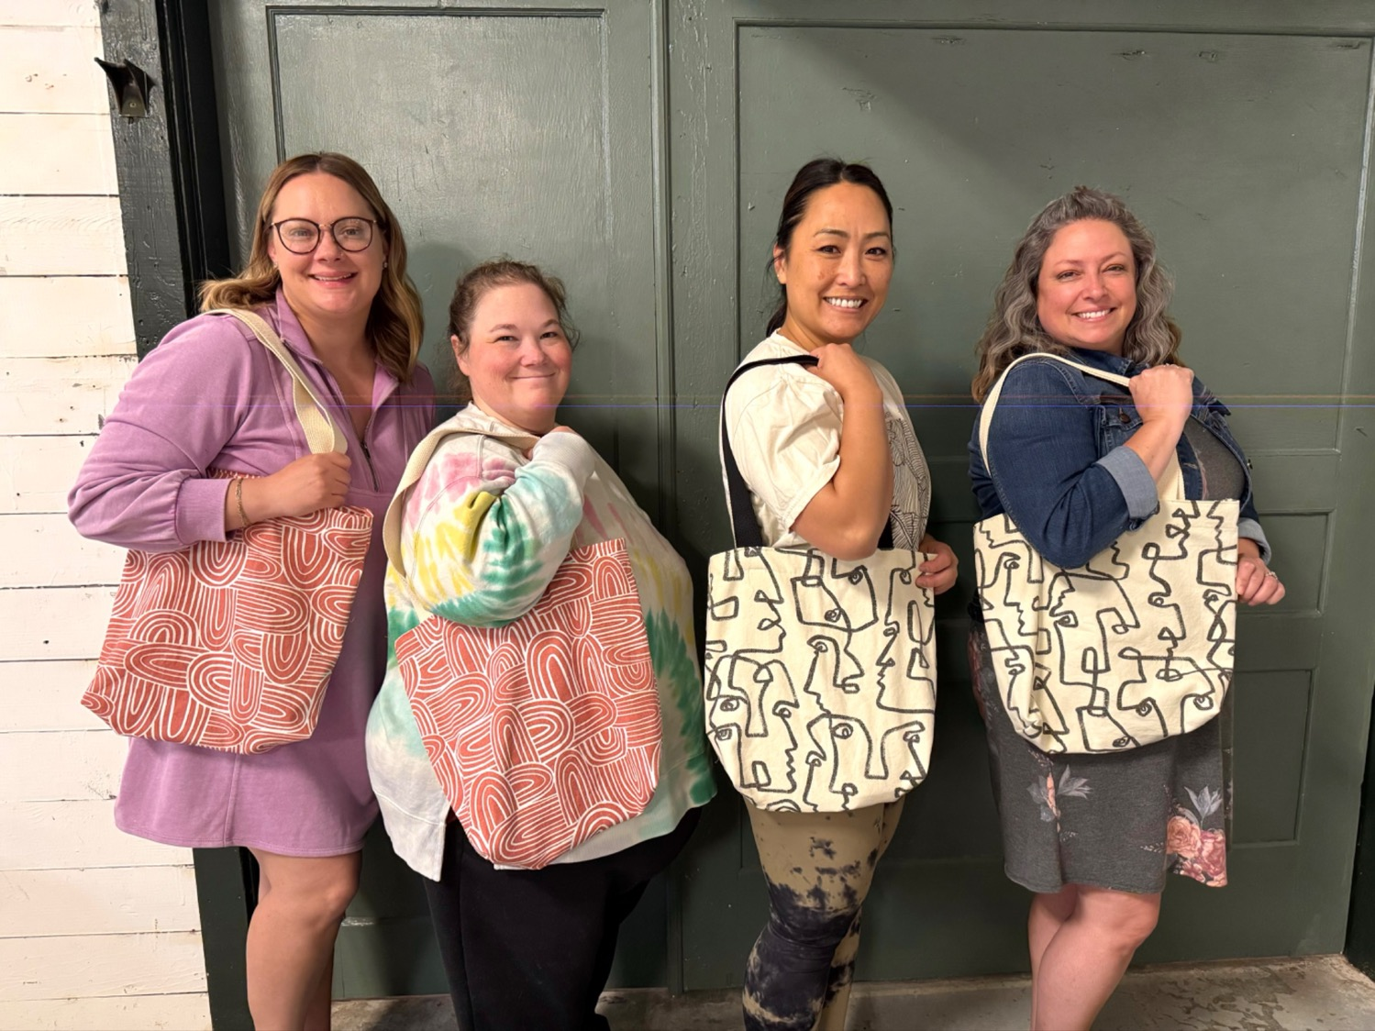

Slide 25
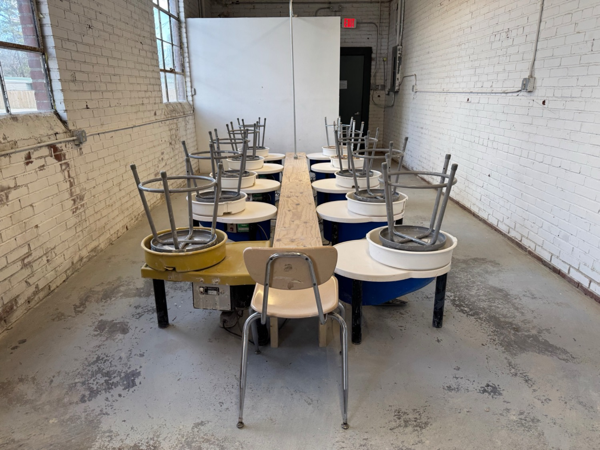
CERAMIC CLASSES + WORKSHOPS

Slide 26
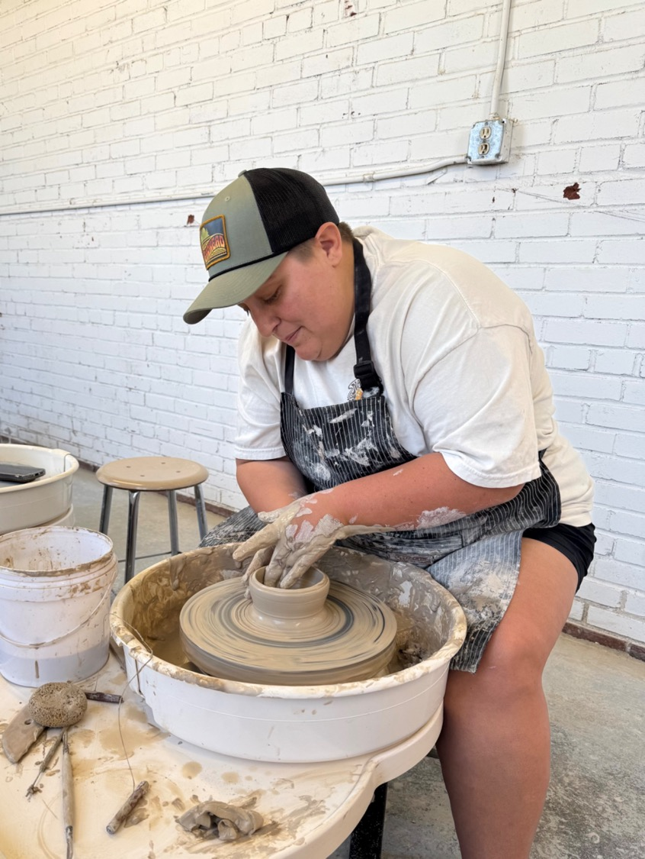

Slide 27
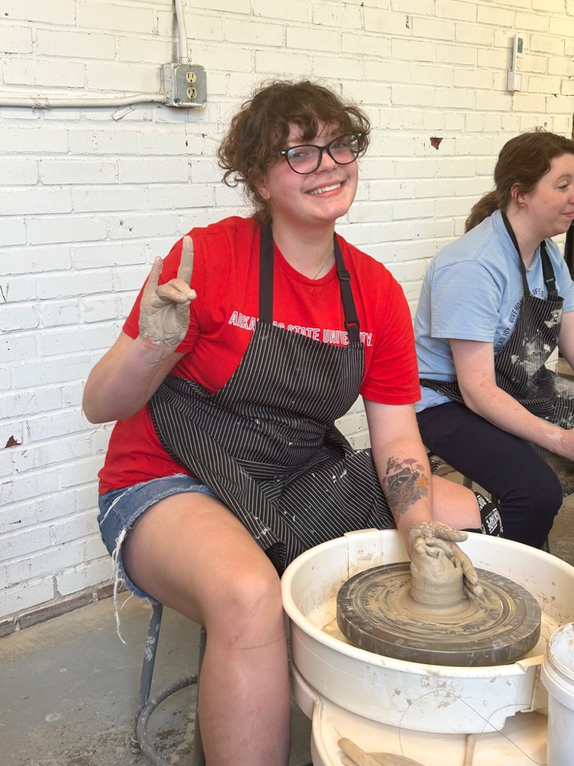
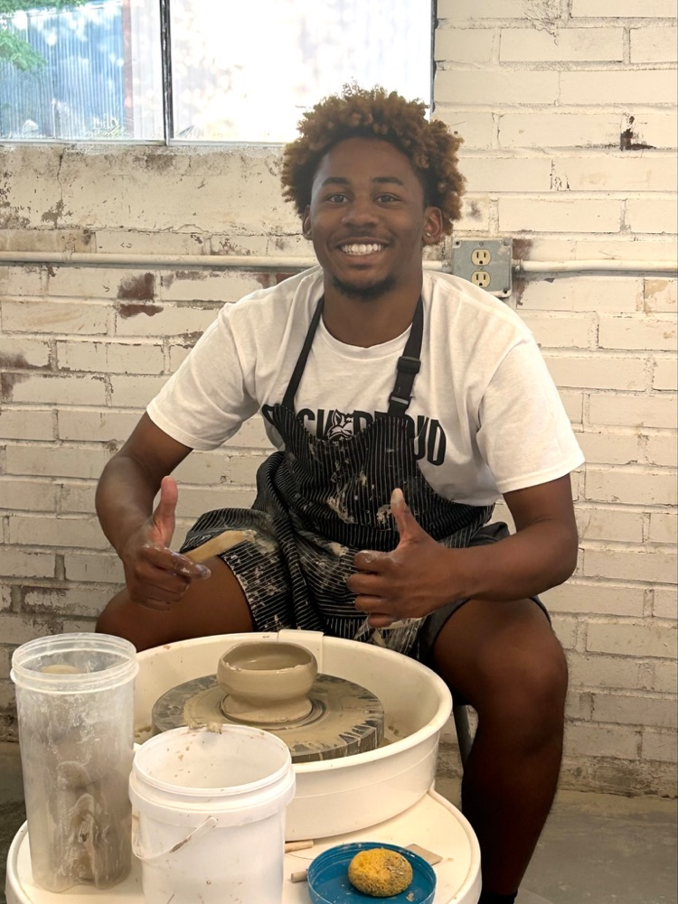

Slide 28
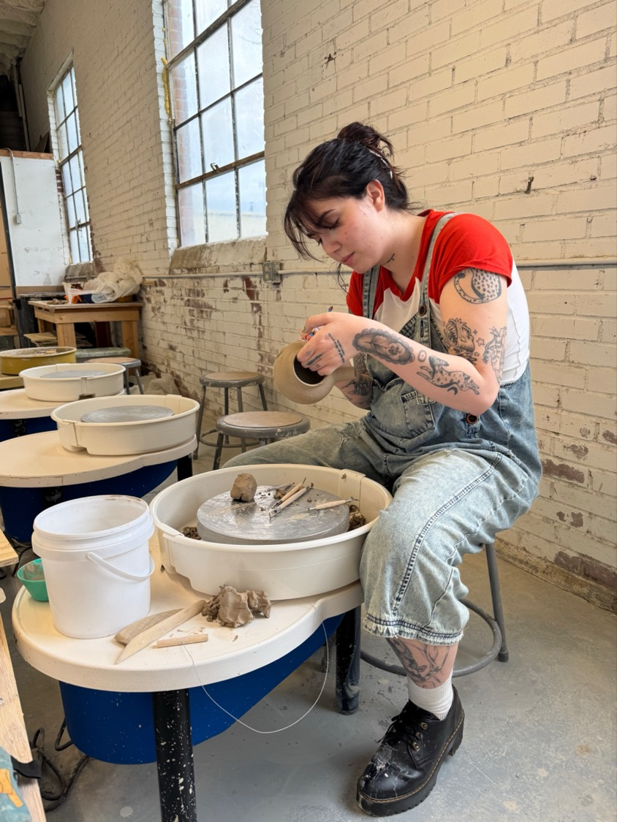

Slide 29
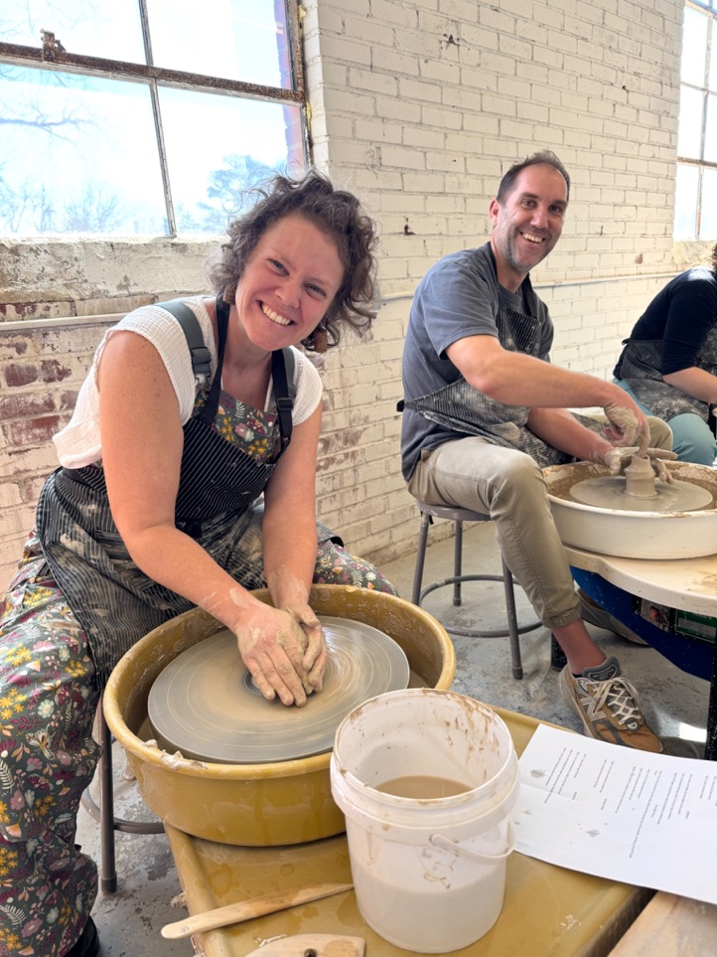
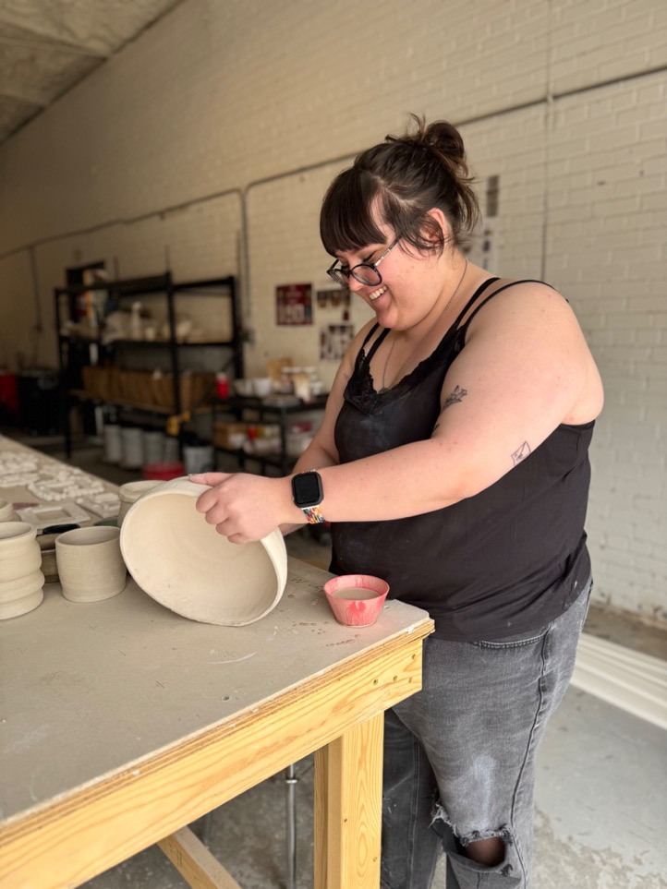

Slide 30
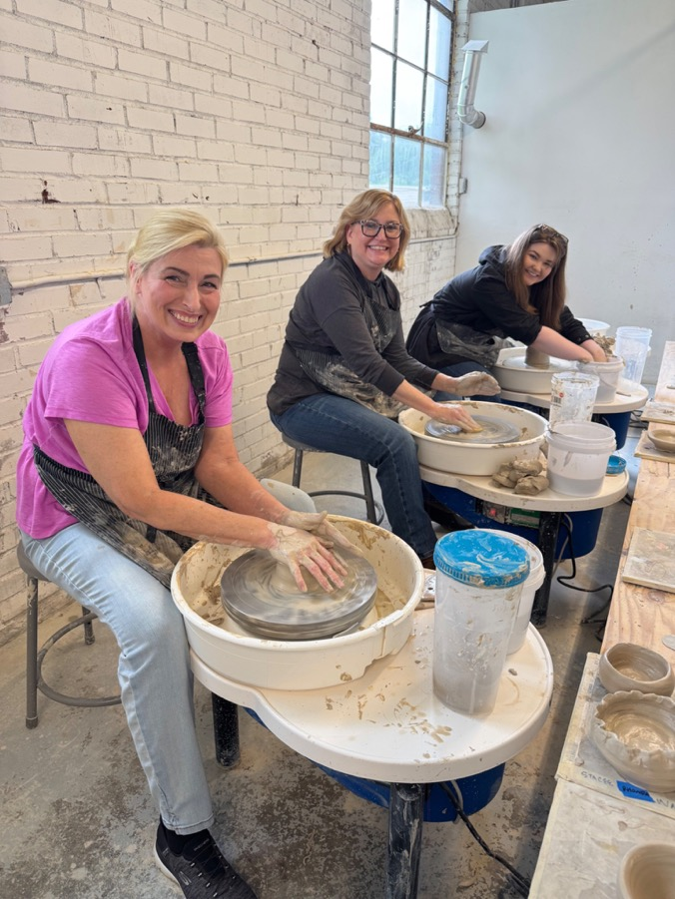
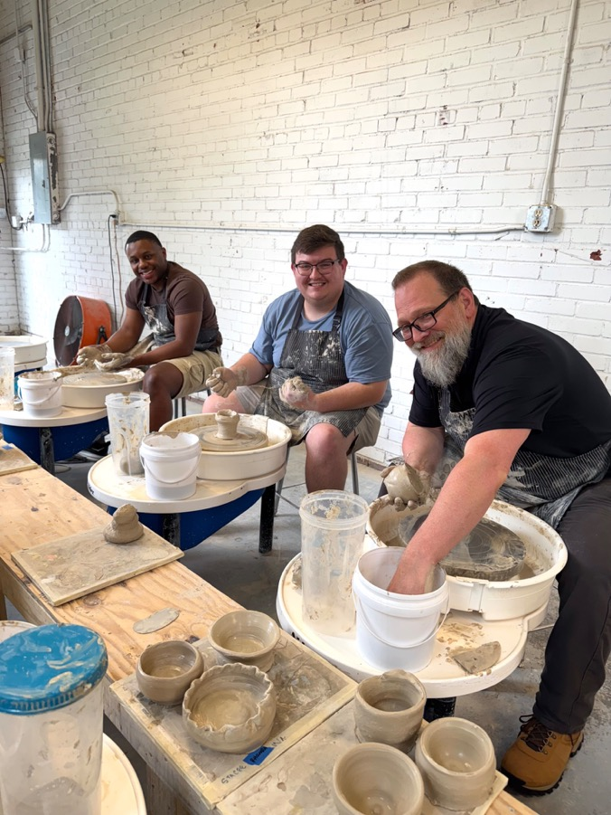

Slide 31
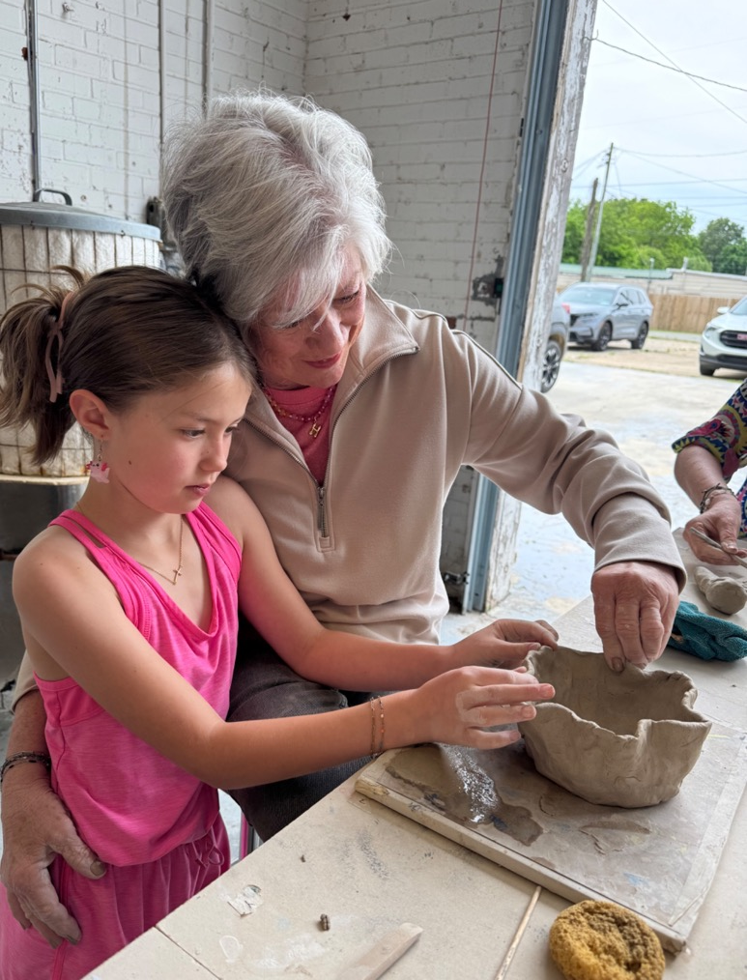
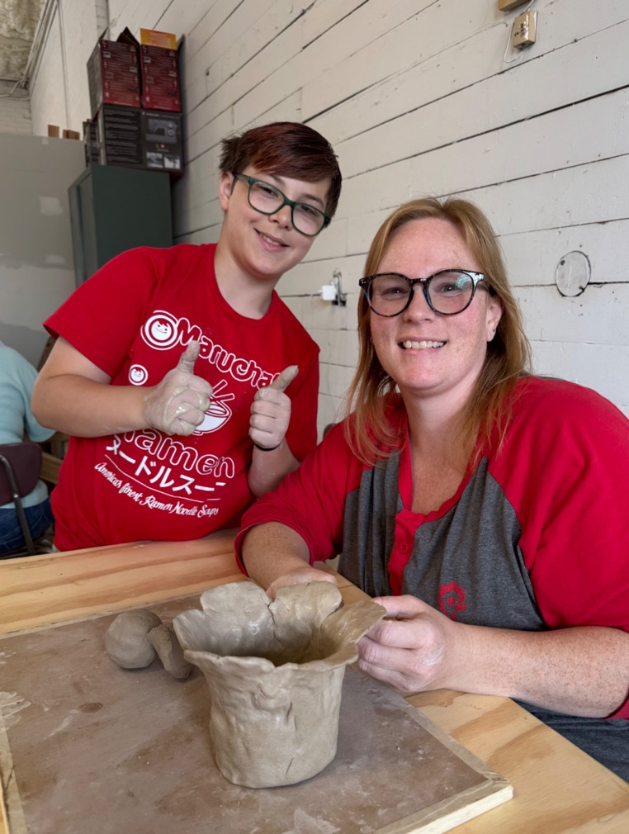

Slide 32
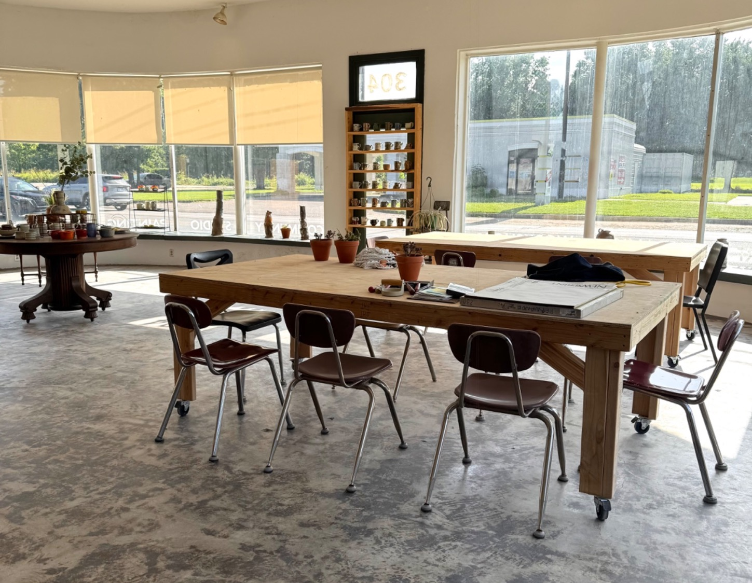
PAINTING CLASSES + WORKSHOPS

Slide 33
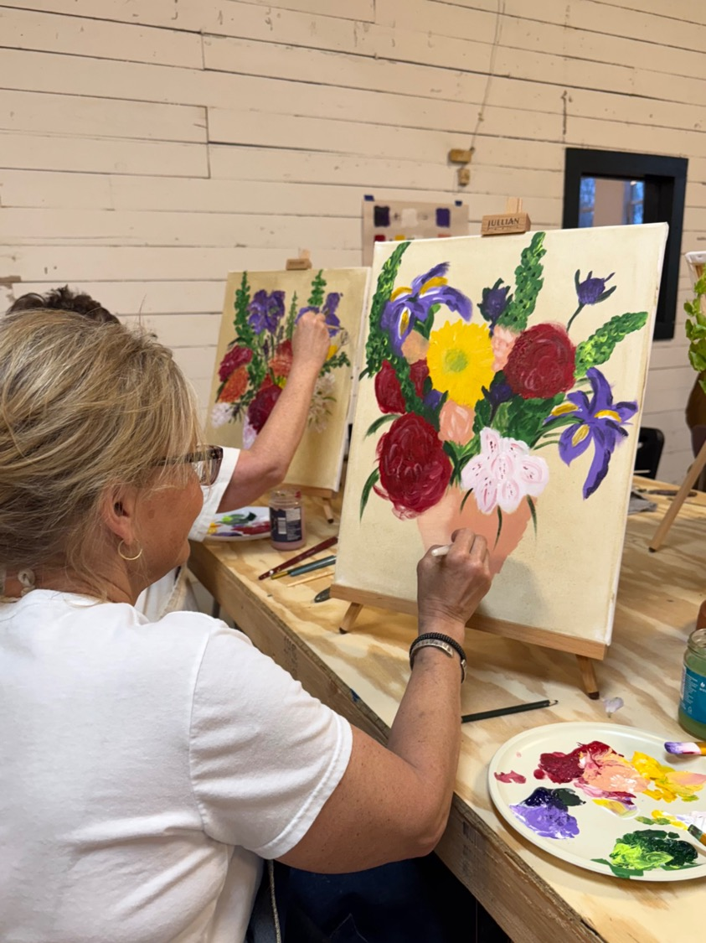
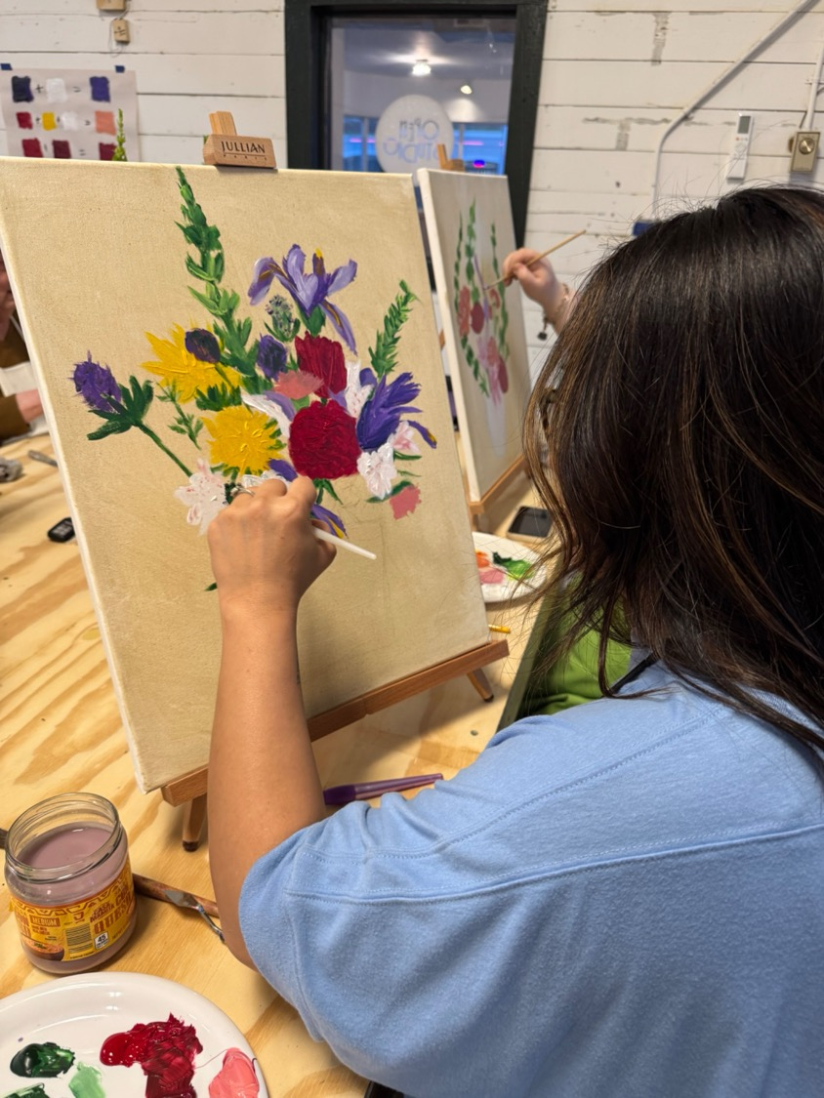

Slide 34
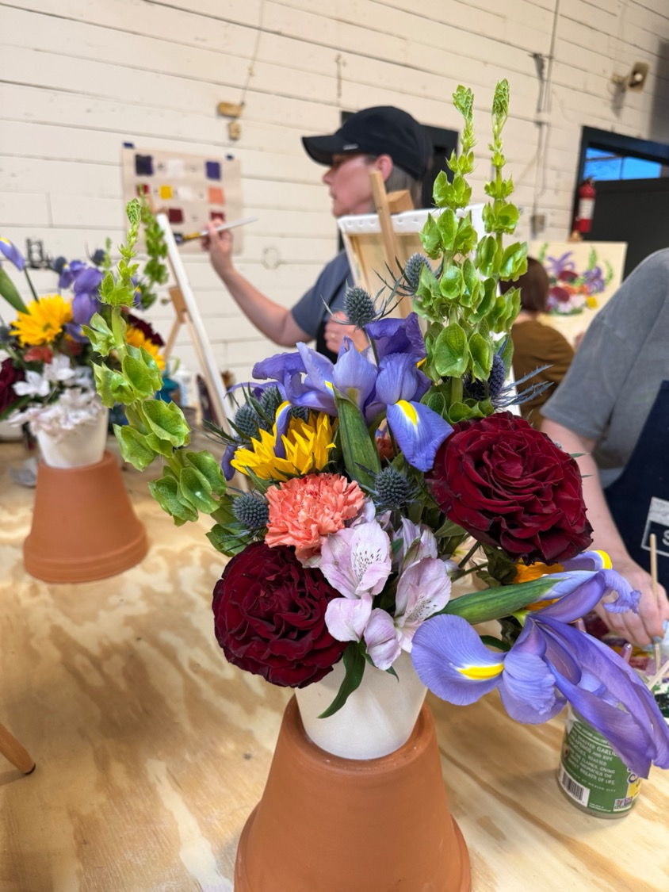

Slide 35
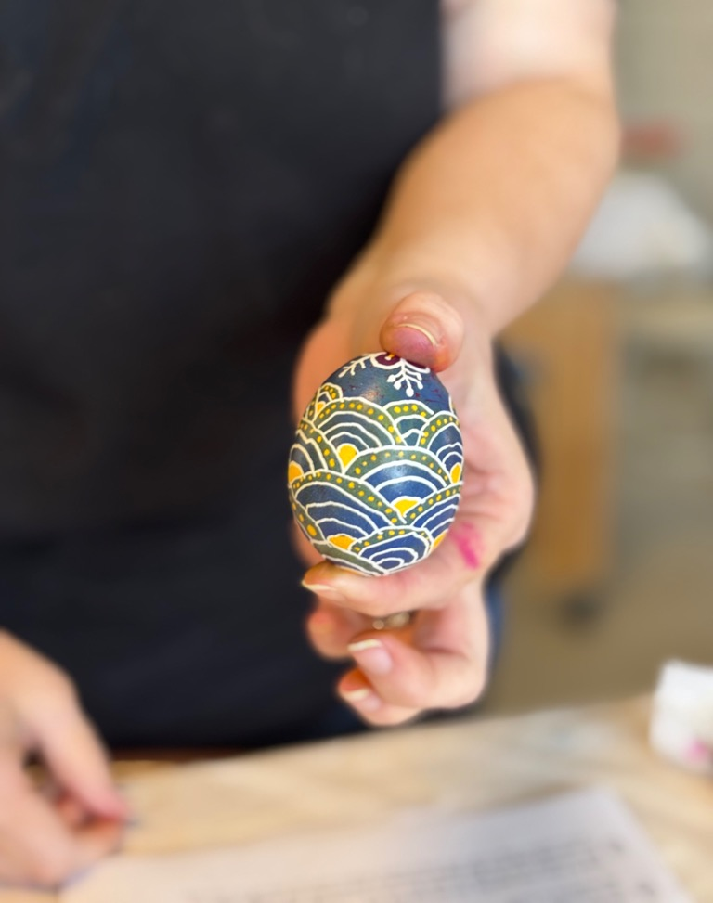
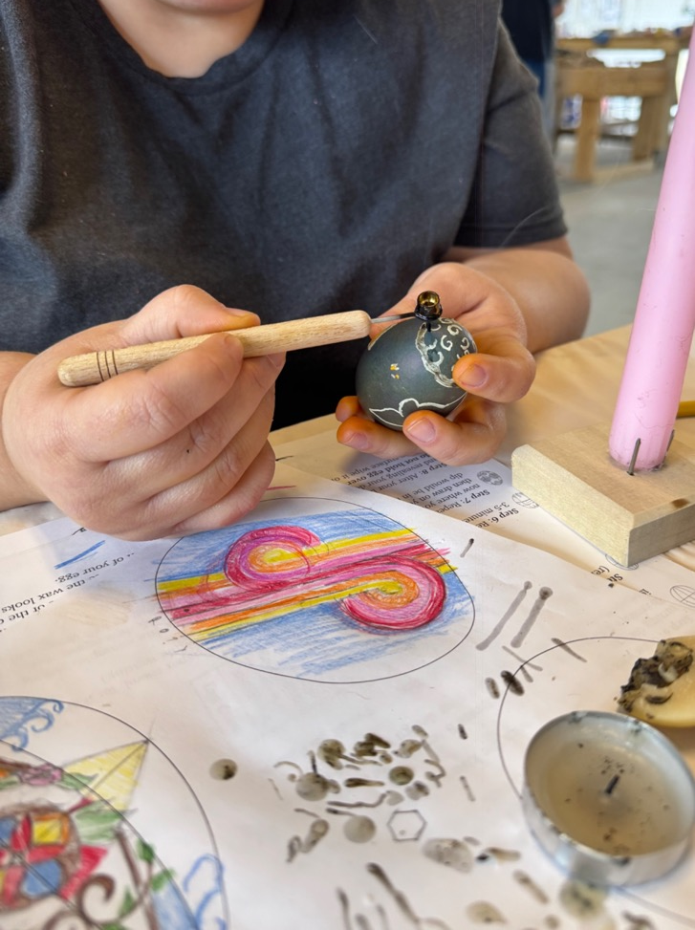

Slide 37
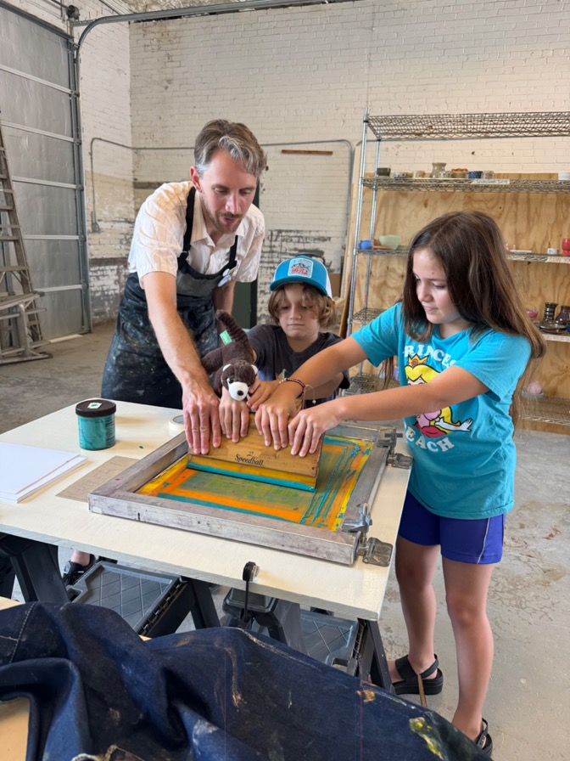
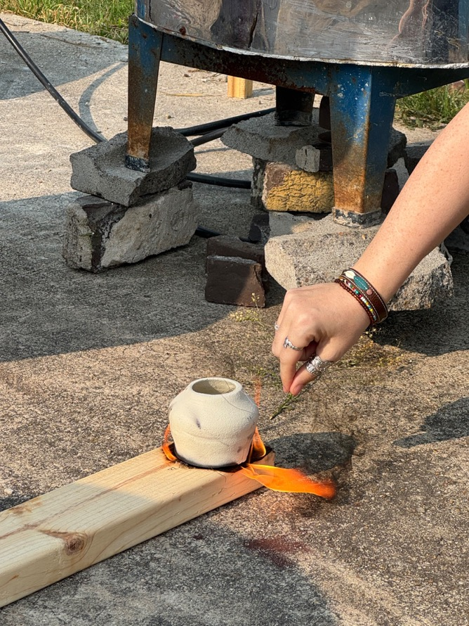
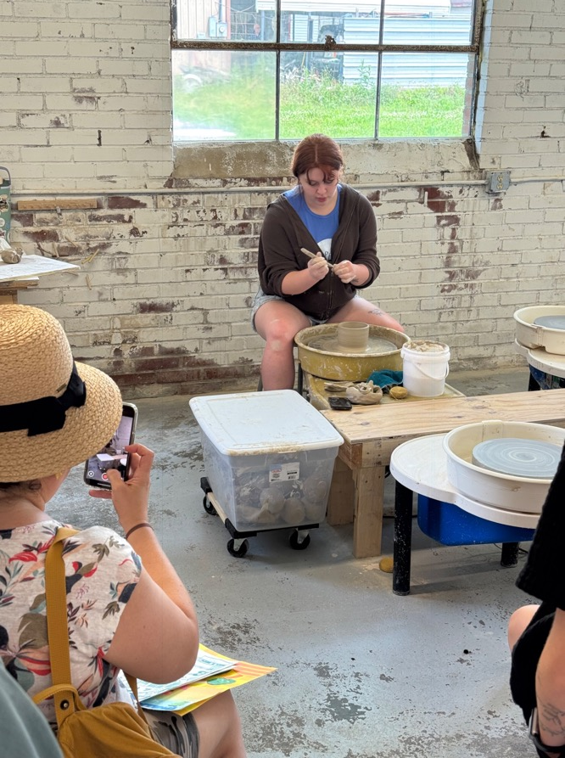

Slide 38
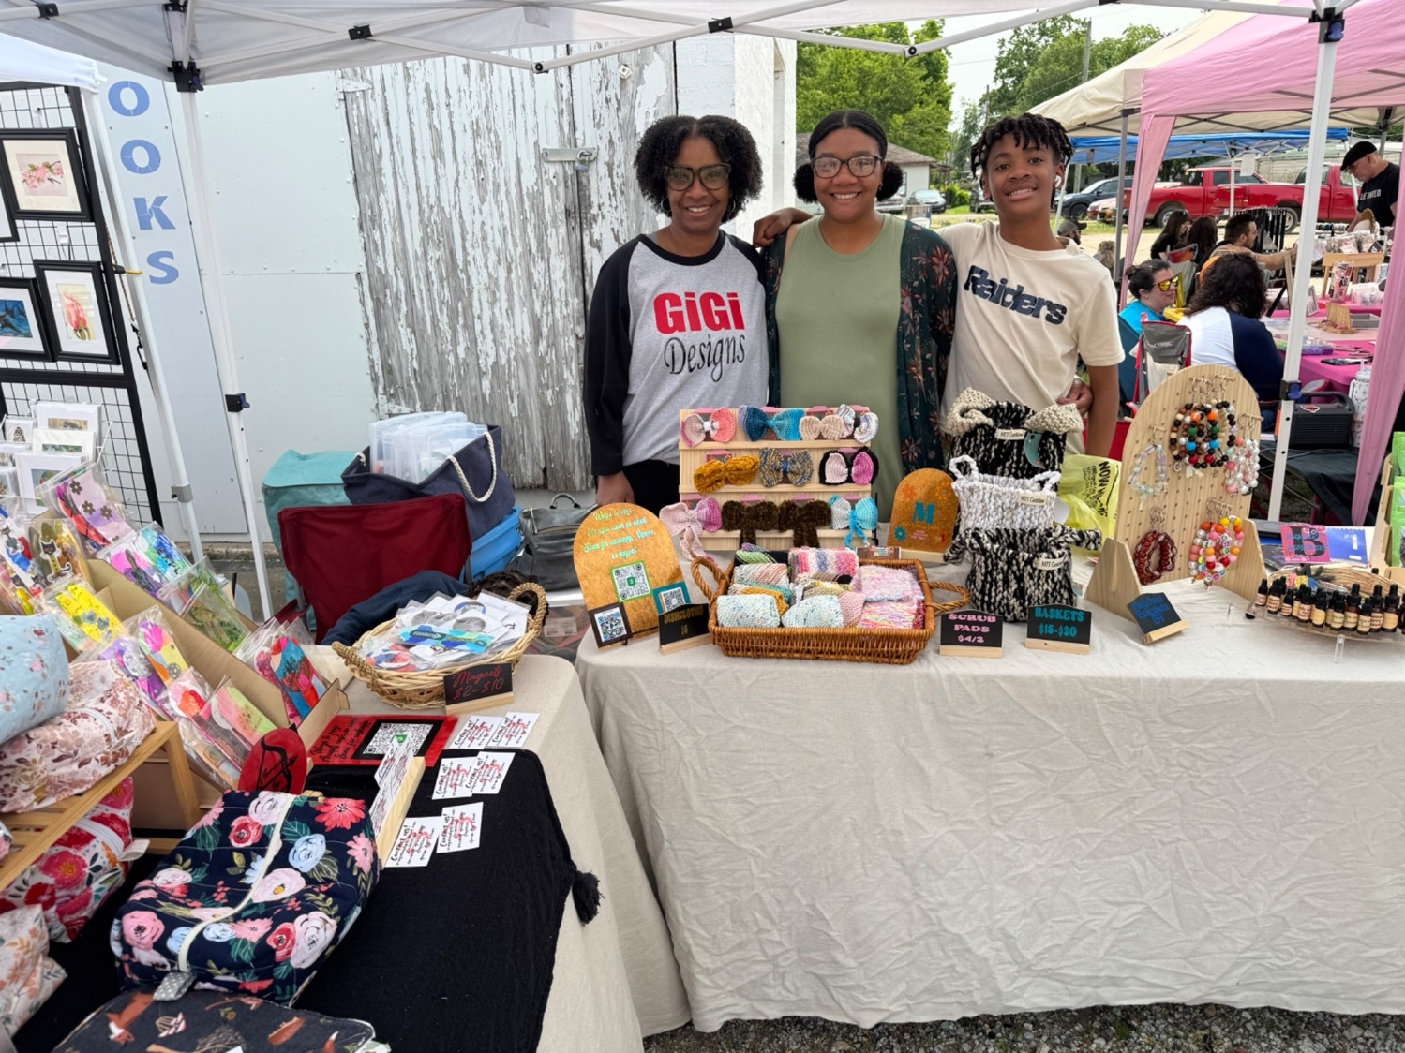

Slide 39
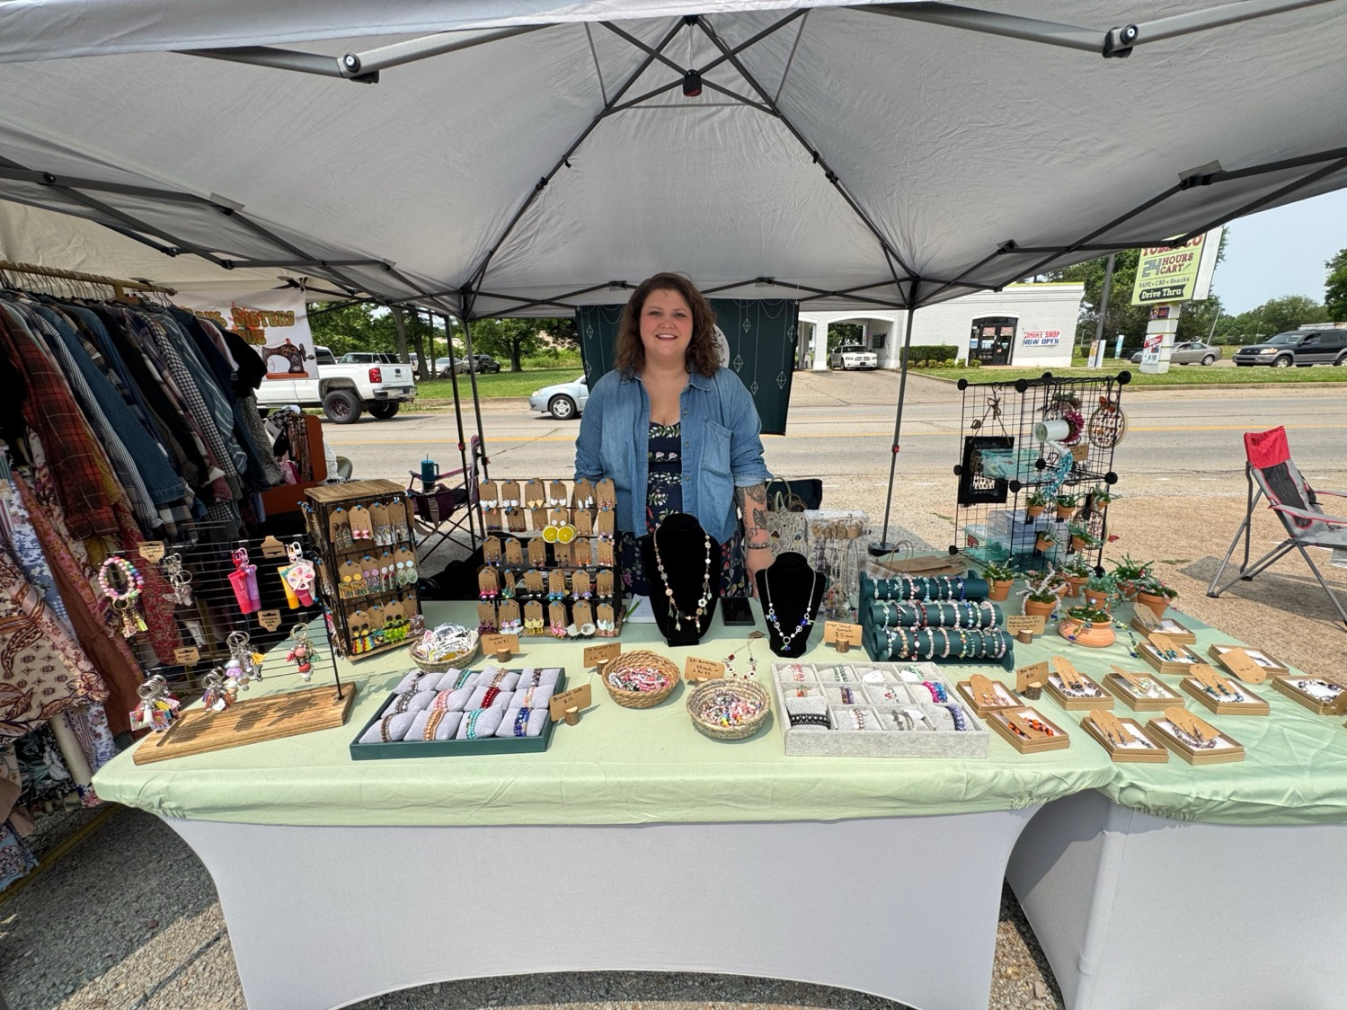

Slide 40
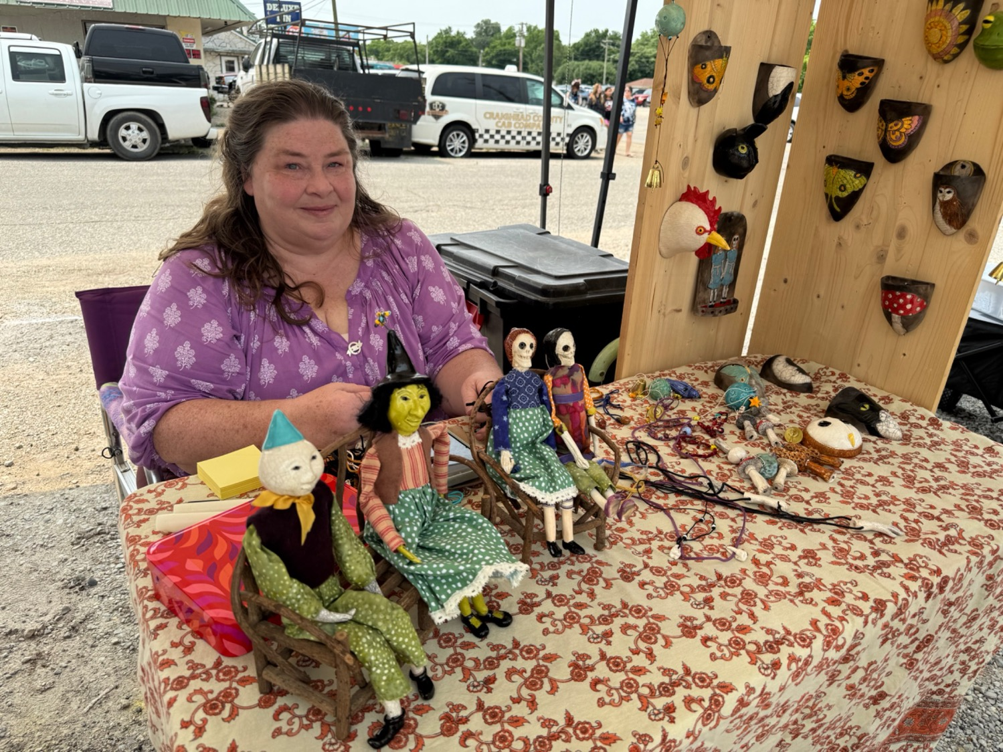

Slide 41
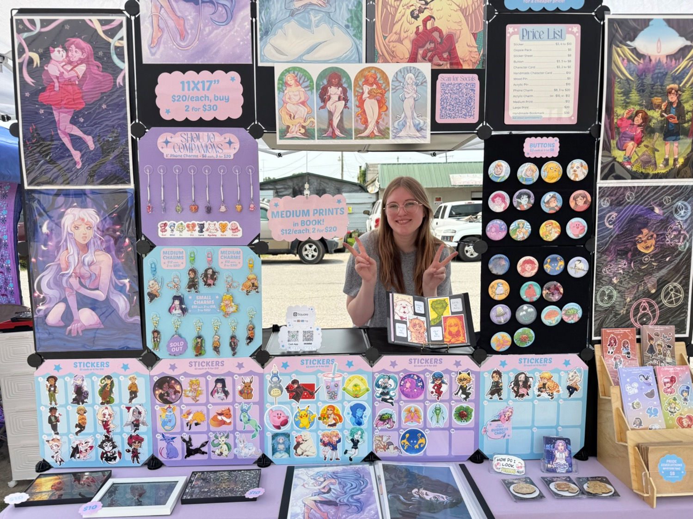

Slide 42
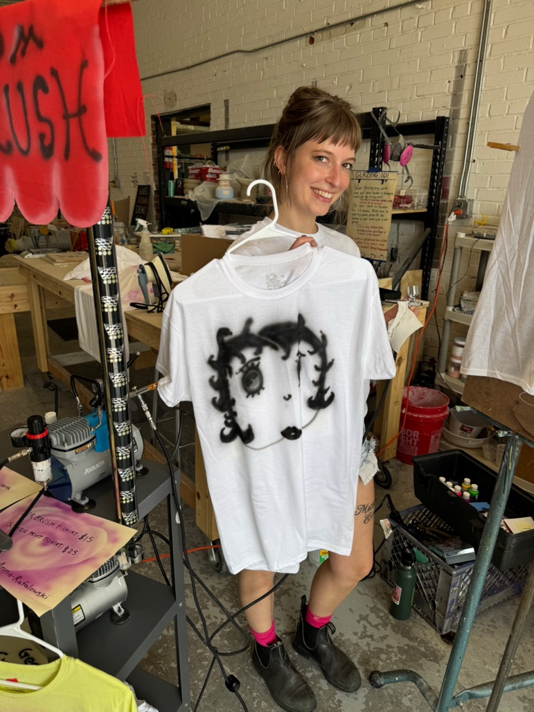
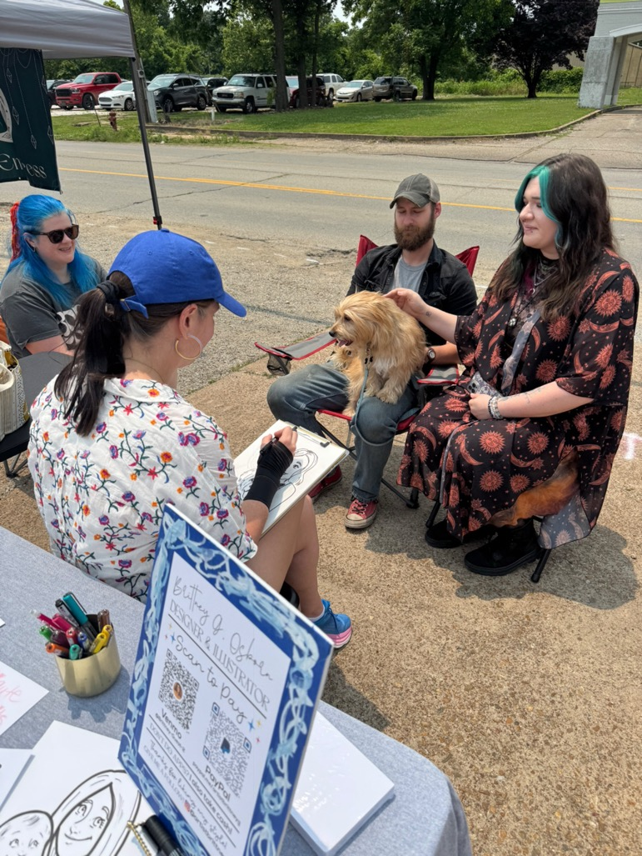

Slide 43
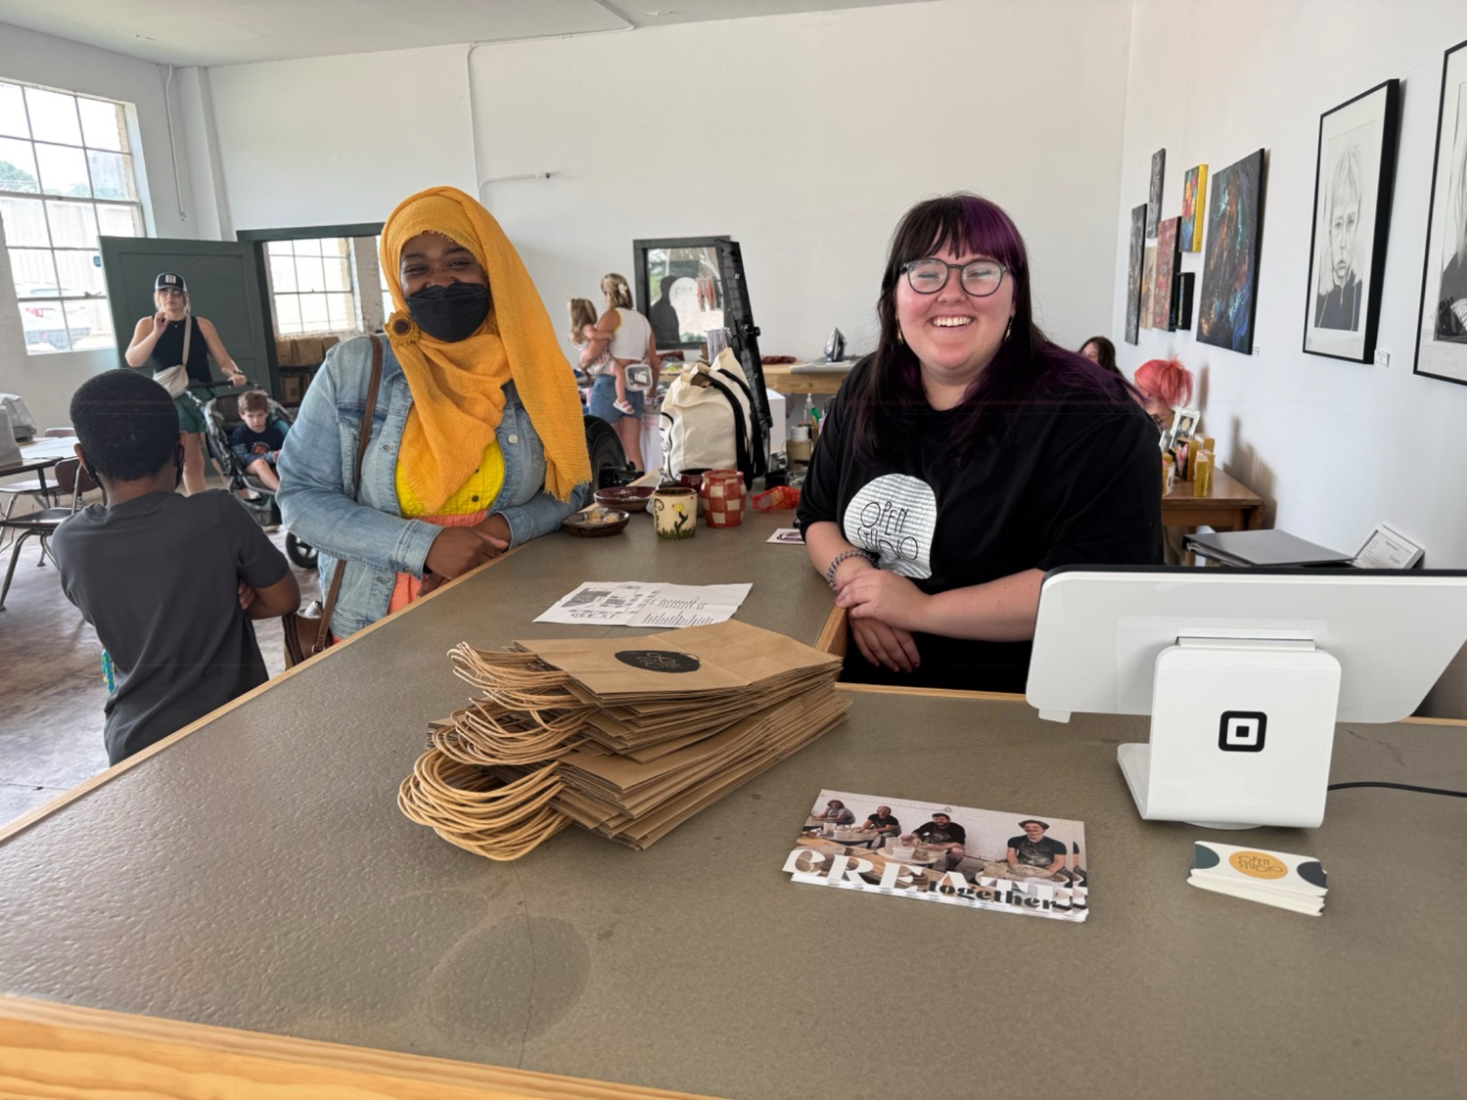

Slide 44
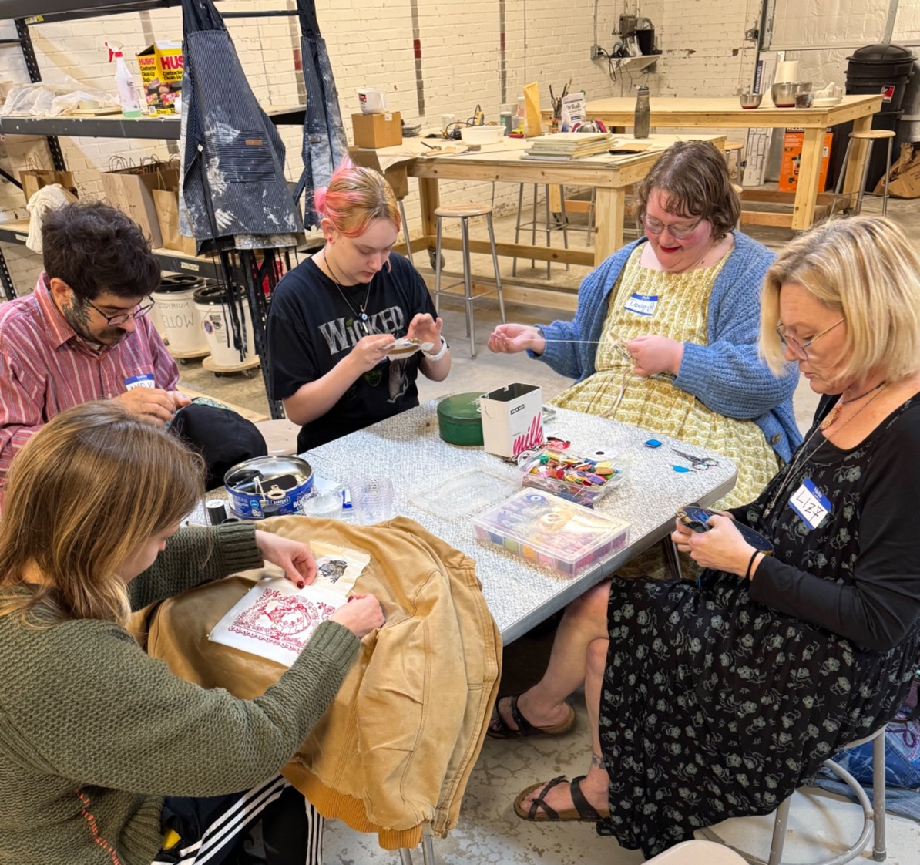

Slide 45
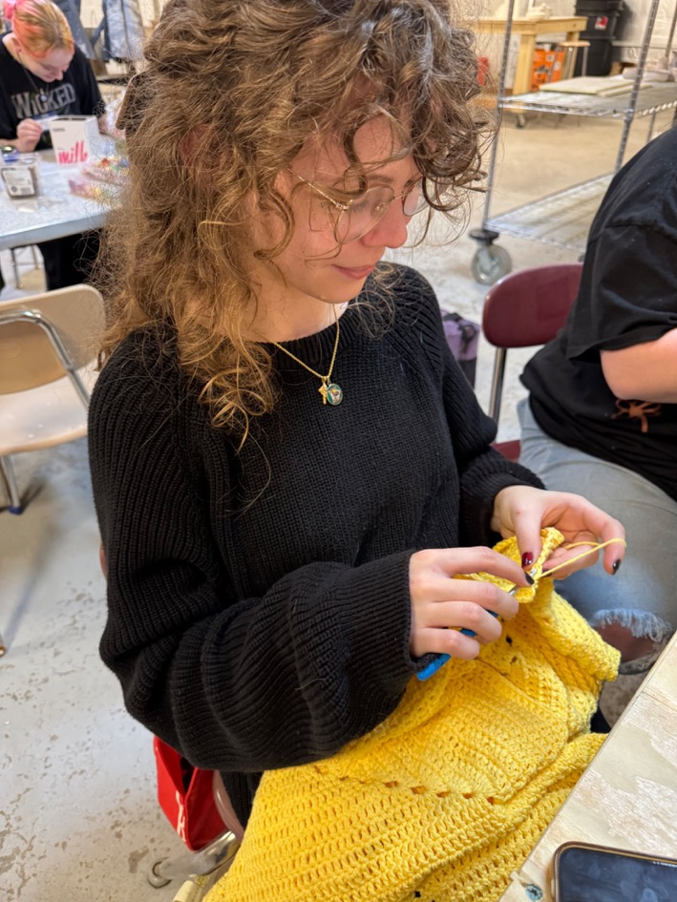
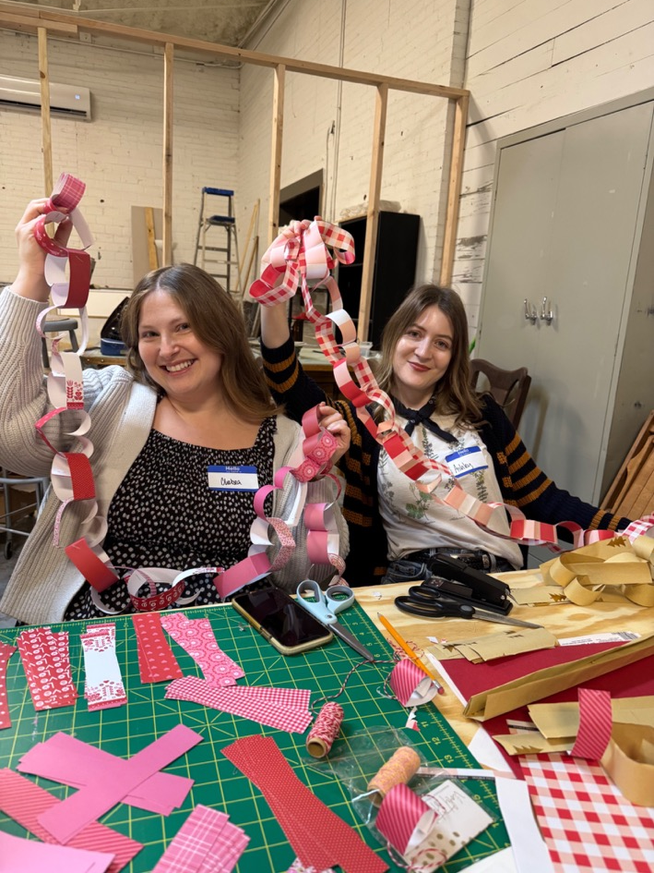

Slide 50
NEXT WEEK
Guinn Massey
AI: Ethics and the Truth Today
(Sherwood Rotary Club)

Slide 51
THE FOUR-WAY TEST
of the things we think, say or do
Is it the TRUTH?
Is it FAIR to all concerned?
Will it build GOODWILL & BETTER FRIENDSHIPS?
Will it be BENEFICIAL to all concerned?

