Slide 1
ROTARY FOUNDATION
BASICS
Notes:
Welcome Message:
Introductions: John Carter, Bob Warner, (if present, Gene Wing and Lance Bennings)
Thank you for attending this evening
This seminar will only give you an introduction to what The Rotary Foundation is all about
You may find more information about TRF on the Rotary website under My Rotary in The Learning Center (e.g. Online courses “Building a Global Grant,” “Rotary Foundation Basics,” and detailed information on the “Areas of Focus”)
To be “Club Certified” for applying for a District Grant: 2 members must attend a Foundation Seminar and 2 members must sign the Memorandum of Understanding (MOU)

Slide 2
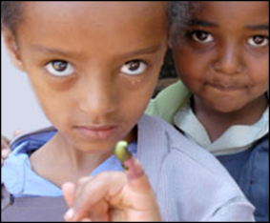
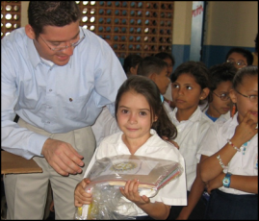
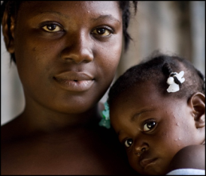
SUPPORTING THE ROTARY FOUNDATION
PolioPlus Fund
End Polio Now
Annual Fund
For Support Today
Endowment Fund
To Secure Tomorrow
Notes:
Rotarians support our Foundation through:
The PolioPlus Fund, dedicated to global polio eradication
The Annual Fund, primary source of funding for Foundation grants and activities
The Endowment Fund, which supports the Foundation in perpetuity

Slide 3
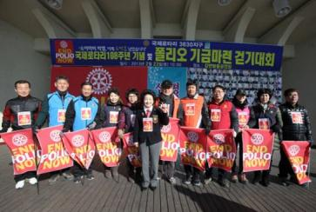

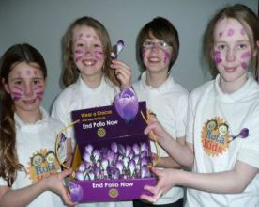
END POLIO NOW: MAKE HISTORY TODAY
Notes:
Rotary’s own financial support for PolioPlus will be magnified by an agreement with the Bill & Melinda Gates Foundation.
At the Rotary Convention in Atlanta, Bill Gates announced the extension of his Foundation’s 2 to 1 match for 3 more years, every $1 that Rotary commits in direct support of polio immunization (up to $50 million per year) will be matched by an additional $2 from the Gates Foundation. This means contributions to Rotary’s PolioPlus program will have three times the impact ($450 Million).

Slide 4
ANNUAL FUND
Primary funding source for Foundation grants and activities
Supports local and international grants through the SHARE system
Contributions are credited to donor’s club and applied to club’s goal
Notes:
Contributions to the Annual Fund support local and international grants and activities through the SHARE system.
Contributions are credited to the individual donor and the donor’s club and counted toward the club’s and district’s Annual Fund goals.

Slide 5
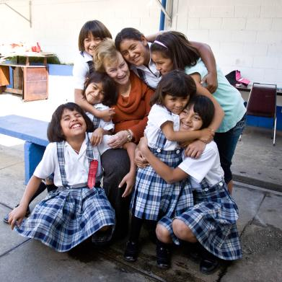
ENDOWMENT FUND
Contributions are professionally invested
Only the earnings are spent
Goal: $2.025 B by 2025 in commitments + assets
Notes:
Gifts to the Endowment Fund are held in perpetuity as part of an endowment. They are professionally invested, with a portion of the earnings used each year for purposes specified by the Trustees and the donors.
The Endowment Fund offers donors a way to create their own lasting legacy through Rotary.
The fund’s net assets plus expectancies are $ 1.173 B as of 6/30/17. (Commitments of $754.9 M plus net assets of $418 M.)

Slide 6

EVERY ROTARIAN, EVERY YEAR
  100% Member Participation
Notes:
The Every Rotarian, Every Year effort encourages Rotarians to participate in their Foundation by volunteering for service activities and contributing to the Annual Fund each year.
Contributions to the Annual Fund support the Foundation’s grants and programs through the SHARE system. Contributions are credited to the individual donor and the donor’s club, and they are counted toward the club’s and district’s Annual Fund goals.

Slide 7
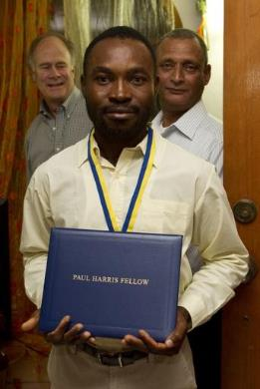

PAUL HARRIS FELLOW
A person who contributes $1,000 or in whose
name $1,000 is contributed
Notes:
By making a gift of $1,000, a donor becomes a Paul Harris Fellow or can have another person honored as a Paul Harris Fellow.
Recognition consists of a certificate and lapel pin. Optional Paul Harris Fellow medallions are available for purchase.
Lapel pins are given in recognition of multiple Paul Harris Fellows — those who make contributions of $2,000 to $9,999. Based on their Paul Harris Fellow level, recipients may receive pins with simulated sapphire (blue) or ruby (red) stones.

Slide 8
PAUL HARRIS SOCIETY
Bringing positive change to communities around the world
Notes:
Rotary has a more than 100-year record of serving communities here at home and around the world. Your continued support of The Rotary Foundation brings lasting and positive change to communities in need and inspires others to join our efforts to do good in the world.

Slide 9
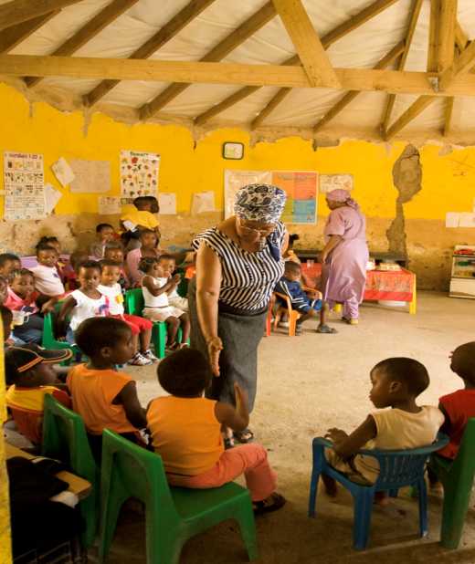
WHAT IS THE PAUL HARRIS SOCIETY?
Donors who elect to give US$1,000 every year
  Annual Fund
  PolioPlus Fund
  Approved Foundation grants
Notes:
Named after Rotary’s founder, the Paul Harris Society (PHS) recognizes Rotary members and friends of The Rotary Foundation who elect to give individual contributions of $1,000 or more each year to the Annual Fund, PolioPlus Fund, or approved Foundation global grants. This recognition was administered by districts until the Paul Harris Society became an official Rotary Foundation recognition program in July 2013. Its purpose is to identify, engage, and recognize members who have the ability and desire to make substantial annual gifts to help communities around the world.
The Paul Harris Society was created in 1999 by Past District Governor Wayne Cusick from District 5340. Cusick realized that giving US$1,000 annually to the Foundation was not possible for every Rotarian, but many could be encouraged to contribute at this level or above. He introduced the Paul Harris Society program to encourage and recognize these donors. The idea gained momentum and quickly spread to other districts throughout the world.

Slide 10
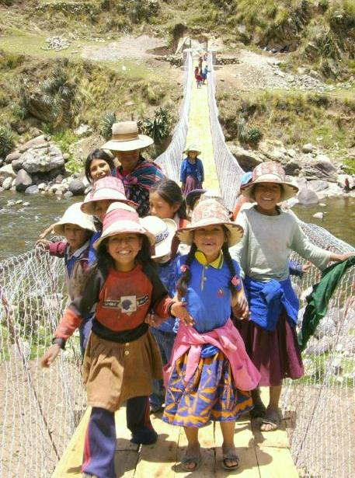
WHY JOIN THE PAUL HARRIS SOCIETY?
Doing so helps ensure the continued good work of Rotary members.
Notes:
The Rotary Foundation works to improve communities by putting grassroots expertise to work and forging lifelong partnerships in the process. Donations at the Paul Harris Society level are crucial in order for us to continue making a positive impact — from local projects to our continued efforts to rid the world of polio.
When you join the Paul Harris Society, you help support projects such as:
• Providing vocational training for teachers who are establishing an early childhood education center in South Africa
• Supplying water filters, toilet blocks, and hygiene training to prevent fluorosis in a community in India
• Funding a scholarship for a medical professional in Italy to research treatments that minimize mortality rates among premature babies
• Offering peace-building seminars to 200 teachers and 1,300 students in Uganda
• Distributing treated mosquito nets and offering medical services that help prevent malaria in Mali
And do not forget Rotary’s No. 1 priority: eliminating polio from the world. It takes .60 cents to vaccinate a child from polio. A PHS level contribution helps immunize over 1,600 children from polio.

Slide 11

IMPORTANT SOURCE OF FUNDING
7% of Rotarians give $1,000 or more to the Annual Fund
These donors represent about 45% of all Annual Fund giving
Notes:
Those who give at the Paul Harris Society level help provide the financial foundation for Rotary to fun projects where they are most needed.
Poll (audience shouts out answers call on participants):
How many Rotarians do you think give $1,000 or more to the Annual Fund in 2015-16?
Click one to reveal 7% of donors give $1,000 or more to the Annual Fund
What percentage of giving to the Annual Fund do you think these donors represent?
These donors represent about 45% of giving to the Annual Fund. 15% of all contributions come from PHS members. They have contributed over US$86 million since Rotary adopted the program.
These numbers show that donations at the PHS level provide vital momentum for the Foundation supported projects. It also shows that the PHS members are small, but a vibrant and growing community of donors.
(Optional: Share example of PHS impact in own district)

Slide 12
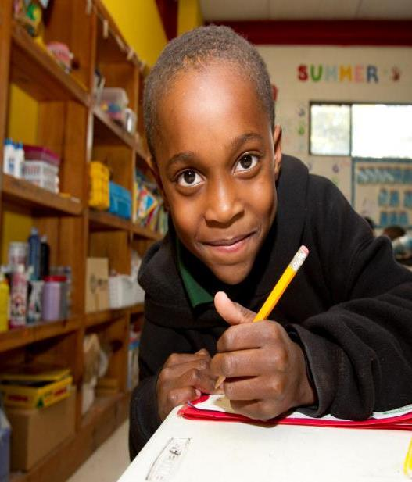
JOINING THE PAUL HARRIS SOCIETY
Become a member
  Join online.
  Complete the brochure
  Call the Rotary Support Center
Notes:
By joining the Paul Harris Society, you are electing to contribute at least $1,000 or more to the Annual Fund, PolioPlus, or an approved Foundation grant each year. You can join the Paul Harris Society without having any history of contributing US$1,000 or more to the approved funds and you do not need to make an immediate $1,000 contribution when you enroll.
You can fulfill your Paul Harris Society giving gradually over the Rotary year through any combination of giving to the Annual Fund, PolioPlus, or an approved Foundation grant. For example, making a monthly contribution of $85 through Rotary Direct to PolioPlus and the Annual Fund would amount to $1,000 in contributions in one year, and thus would honor your Paul Harris Society giving goal.
To join, you can:
Complete the online sign-up form found on the PHS page at rotary.org/paulharrissociety.
Contact Rotary’s Support Center at rotarysupportcenter@rotary.org or call 1-866-9ROTARY (976-8279).
Fill out the Paul Harris Society form and mail it to One Rotary Center or your international office.
Outside of North America, email or call the Rotary International office that serves your area, and ask to join.

Slide 13
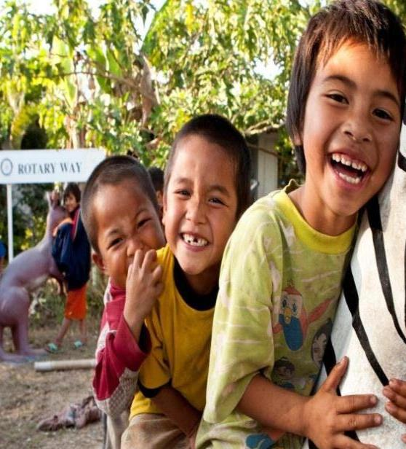
ROTARY DIRECT
Recurring giving
  Choose your designation
  Set amount & frequency
    Monthly
    Quarterly
    Annually
  Enroll online: www.rotary.org/give
Notes:
Rotary Direct, Rotary’s recurring giving program, provides a safe, secure, and easy way to join the Paul Harris Society. It allows the Foundation to process a recurring contribution by charging a credit or debit card at the amount and frequency that are most convenient for you.
And you can enroll online, using any of 14 currencies, while preserving local tax benefits in most cases. For example, a Canadian Rotarian can donate via Rotary.org in Canadian dollars and receive a tax receipt from the Canadian Associate Foundation.
With recurring contributions of $1,000 annually, $85 per month, or $250 per quarter, Rotarians and friends can honor their Paul Harris Society membership easily and regularly.
Optional: Rotary’s website accepts online contributions in the following currencies: Argentine pesos (ARS), Australian dollars (AUD), British pounds (GBP), Canadian dollars (CAD), Danish kronen (DKK), euros (EUR), Japanese yen (JPY), New Zealand dollars (NZD), Norwegian kronen (NOK), South African rand (ZAR), Swedish kronor (SEK), Swiss francs (CHF), Indian rupees (INR) and United States dollars (USD). In most cases recurring giving can be set up in these currencies as well, check with the Support Center or the International Office that serves your area.

Slide 14
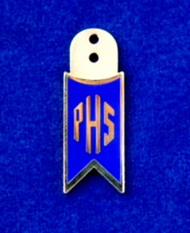
PAUL HARRIS SOCIETY MEMBER
Contributes $1,000 each year to the Annual Fund, PolioPlus, or approved grants
Notes:
Named after Rotary’s founder, the Paul Harris Society recognizes those who annually contribute $1,000 or more to the Annual Fund, PolioPlus, or an approved Foundation grant.
The Paul Harris Society was created in 1999 by Past District Governor Wayne Cusick from District 5340. Cusick realized that giving $1,000 annually to the Foundation was not possible for every Rotarian, but many could be encouraged to contribute at this level or above. This idea gained momentum and quickly spread to other districts throughout the world.
Although the Paul Harris Society was originally administered by districts, the Foundation’s Trustees adopted the Society as an official recognition program of The Rotary Foundation in 2013.

Slide 15
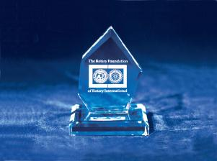

BEQUEST SOCIETY
Provision in estate plan totaling $10,000+
Examples: living will, life insurance policy
Notes:
Couples or individuals who have made commitments in their estate plans that total $10,000 or more are invited to join the Bequest Society.
Donors may elect to receive an engraved crystal recognition piece and a Diamond Circle pin commemorating the commitment at each recognition level:
$10,000 to $24,999.99 — Level 1
$25,000 to $49,999.99 — Level 2
$50,000 to $99,999.99 — Level 3
$100,000 to $249,999.99 — Level 4
$250,000 to $499,999.99 — Level 5
$500,000 to $999,999.99 — Level 6
$1,000,000 and above — Level 7
Rotarians can also complete the Bequest Society membership card at Rotary.org.

Slide 16

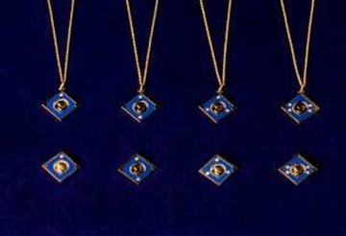
MAJOR DONOR
Personal outright or cumulative gifts of
$10,000+
Cash, life income agreements, bequests, real estate, or securities
Notes:
Donors can become Major Donors through outright or cumulative contributions of $10,000 or more to The Rotary Foundation.
They may elect to receive crystal recognition pieces and Major Donor lapel pins or pendants.
Major Donor recognition levels:
Level 1 $10,000 to $24,999.99
Level 2 $25,000 to $49,999.99
Level 3 $50,000 to $99,999.99
Level 4 $100,000 to $249,999.99

Slide 17
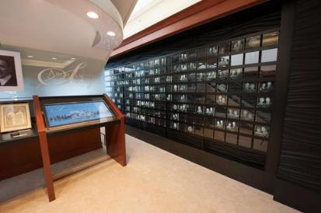
ARCH KLUMPH SOCIETY
Trustees Circle $250,000+
Chair’s Circle $500,000+
Foundation Circle $1 million+
Notes:
Donors who contribute $250,000 or more to the Foundation either as a one-time gift or over a number of years become members of the Arch Klumph Society.
Each receives a certificate, a crystal recognition piece, and a lapel pin or pendant. Their portraits are displayed in the interactive Arch Klumph Gallery. A traveling kiosk showing the gallery is displayed at each International Assembly and Rotary International Convention.
Arch Klumph Society recognition levels:
Trustees Circle $250,000 to $499,999.99
Chair’s Circle $500,000 to $999,999.99
Foundation Circle $1 million or more

Slide 18
TAKE ACTION
Give to The Rotary Foundation
Subscribe to Grants and Giving e-newsletter
Subscribe to Visions e-newsletter
Learn more at rotary.org
Notes:
Review Take Action items, add your own, and ask participants for any additional items.

Slide 19
Annual Fund
2018-19 ??????
2017-18 $ 130,618
2016-17 $ 164,081
2015-16 $ 180,949
2014-15 $ 160,707
2013-14 $ 166,226
2012-13 $ 138,377

Slide 20
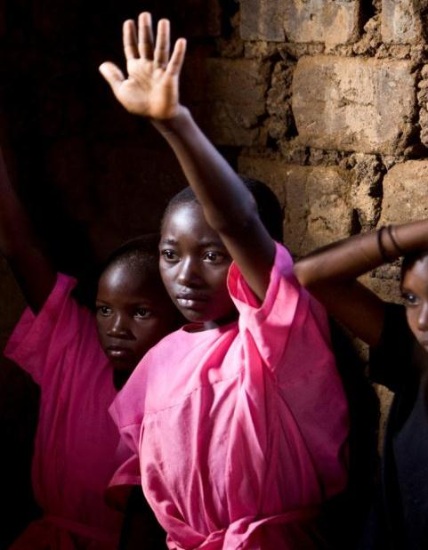
QUESTIONS?
Thank you for your time, commitment, and support.
Notes:
Thank you for trusting Rotary to use your contributions to make a lasting difference.

Slide 21
FEATURES OF A DISTRICT GRANT
DISTRICT GRANTS
A single block grant awarded annually for club and district projects
Local or international activities
Local decision making with broader guidelines
Smaller activities and projects
Notes:
District grants are single, annual block grants made to districts in amounts up to 50 percent of their District Designated Fund (DDF).
The district grant can fund multiple club and district projects, which may be local or international.
District grants allow local decision making, with minimal restrictions, for smaller-scale activities and projects.

Slide 22
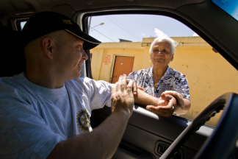
DISTRICT GRANT ACTIVITIES
DISTRICT GRANTS
Include active Rotarian participation
Adhere to stewardship guidelines
Demonstrate cultural sensitivity
Align with the Foundation’s mission
Notes:
Activities funded by district grants must:
Include active Rotarian participation
Adhere to stewardship guidelines
Demonstrate cultural sensitivity
Be consistent with the mission of The Rotary Foundation (but they need not be related to an area of focus)
ASK: What types of projects or activities do you think are possible when using The Rotary Foundation mission as a guide?

Slide 23
MISSION STATEMENT
The Mission of The Rotary Foundation of
Rotary International is to enable Rotarians
to advance world understanding, goodwill,
and peace through the improvement of
health, the support of education, and the
alleviation of poverty.
Notes:
The Rotary Foundation Mission Statement.

Slide 24
DISTRICT GRANT SCHOLARSHIPS
DISTRICT GRANTS
Scholarships: More flexible in terms of:
  Level of study (secondary, university, or graduate studies or certificate programs)
  Location (local or international)
  Length
  Field of study
  Cost
Managed by district
Notes:
You can also use district grants to support scholarships.
They have fewer restrictions on the study level (which can be secondary school, university, graduate, or certificate), location of study (local or international), duration of program, field of study, and cost.

Slide 25
DISTRICT GRANTSISTRICT GRANTS

Slide 26
DISTRICT GRANTS 2017-18
DISTRICT GRANTS
  Club must be certified
  Application submitted on DACdb
  Deadline for Applications 8/31/2018
  All previous District Grants must be closed for completed projects (all Final Reports submitted and approved)
Notes:
Deadline for this year’s District Grants

Slide 27

AEAS OF FOCUS
SIX AREAS OF FOCUS
Peace and conflict prevention/resolution
Disease prevention and treatment
Water and sanitation
Maternal and child health
Basic education and literacy
Economic and community development
Notes:
The six areas of focus reflect critical humanitarian issues and needs being addressed by Rotarians worldwide.
They align Rotary with other international development efforts and advance the Foundation’s mission. Each of the areas listed has specific goals that are outlined in the corresponding area of focus policy statement.
Peace and conflict prevention/resolution
Disease prevention and treatment
Water and sanitation
Maternal and child health
Basic education and literacy
Economic and community development

Slide 28
GLOBAL GRANTS
GLOBAL GRANTS
Align with an area of focus
Respond to a community need*
Include active community and Rotarian participation
Strengthen knowledge, skills, resources
Have long-term, sustainable benefits
Have measurable results
Have a budget of at least $30,000
Notes:
Global grants fund large-scale projects and activities that:
Align with an area of focus
Respond to a need the benefiting community has identified
Include the active participation of the benefiting community
Include the active participation of Rotarians
Strengthen local knowledge, skills, and resources
Are designed to enable the benefiting community to address its own needs after the Rotary club or district has concluded its work
Have measurable results
The minimum grant award is $15,000 (for a total budget of at least $30,000). The DDF allocation is matched 100 percent, and cash is matched at 50 percent from the World Fund. A global grant project is sponsored by a host club in the project country and a club outside the project country.

Slide 29
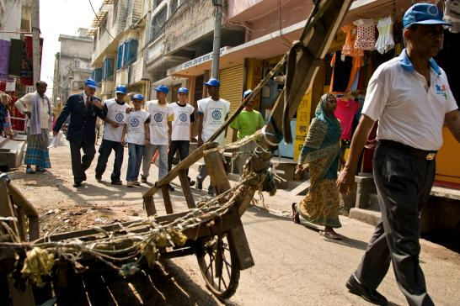
BUILDING SUSTAINABLE PROJECTS
GLOBAL GRANTS
Community participation
Materials and technology
Funding
Knowledge
Motivation
Evaluation
Notes:
Global grant funding is an investment in lasting change. Sustainable projects can take many forms, but all display the following elements:
Community participation: Sustainable projects are well planned, involve the collaboration of multiple project participants, and suit the needs and values of beneficiaries. A needs assessment must be included with the application.
Materials and technology: Sustainable projects employ durable materials that are accessible, ready to use, and environmentally sound.
Funding: Sustainable projects ensure that a reliable source of funding exists to continue project outcomes after the grant is complete.
Knowledge: Sustainable projects increase capacity by helping communities acquire new skills, knowledge, and behaviors.
Motivation: Sustainable projects provide tangible incentives for community ownership of project activities and outcomes.
Evaluation: Sustainable projects are designed to ensure clear and measurable outcomes.
Let’s look at the steps in planning a sustainable global grant project.

Slide 30

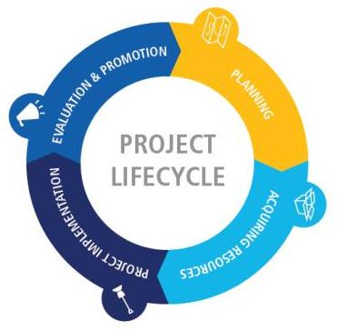
PROJECT PLANNING
GRANTS
Notes:
Planning and organizing are key to implementing a successful global grant project. In planning a small or large project, it’s beneficial to your club and the project community to organize using these proven steps.
A wonderful resource for planning your project is the five-part Lifecycle of a Service Project webinar series, which covers detailed strategies and best practices for developing successful, sustainable projects. In it, you can also hear from other Rotarians on what they’ve learned about planning successful projects.
You can view one or all of the webinars at www.rotary.org/webinars.

Slide 31
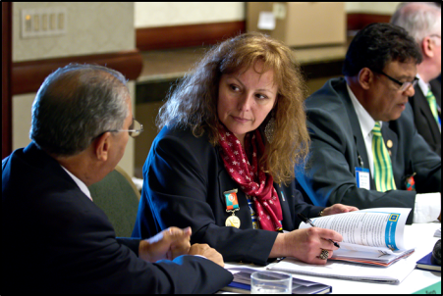
STEWARDSHIP
GRANTS
Stewardship is the responsible management and oversight of grant funds, which ensures that funds are used properly and benefit populations in need.
Notes:
Stewardship is the responsible management and oversight of grant funds from The Rotary Foundation. Proper stewardship is the responsibility of each Rotarian.
Implementing good stewardship practices ensures that grants are well managed and that grant funds are used according to Foundation guidelines and benefit populations in need.
Careful grant management also sustains donor confidence in the Foundation and can increase donations.

Slide 32
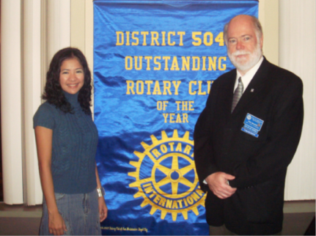
SCHOLARSHIPS
Scholarships can be funded by
  Global grants
  District grants
Notes:
Under the new grant model, Rotary continues promoting peace through education.
Clubs and districts have more flexibility in sponsoring international and local scholars through global grants and district grants.

Slide 33
GLOBAL GRANT SCHOLARSHIPS
GLOBAL GRANTS
Graduate level
Study periods of 1-4 years
Alignment with the areas of focus
  Previous work, volunteer, and study experience
  Academic program
  Future career plans (immediate and long-range)
Host and international sponsors
$30,000 minimum budget
Notes:
Global grants can fund scholarships for career-minded professionals for one to four years of graduate-level study in the areas of focus.
The scholars’ previous work, volunteer, and study experience must strongly relate to the selected area of focus; the scholars’ academic program must strongly relate to the selected area of focus; and the scholars’ future career plans, both immediately after the scholarship period and in the long term, must strongly relate to the selected area of focus.
A host sponsor and international sponsor work together to identify the scholar and submit the application.
The minimum budget for global grants is $30,000.
Global grant scholarship applications undergo an intense review process. Not all applications are approved because, often, applications do not align with an area of focus.

Slide 34
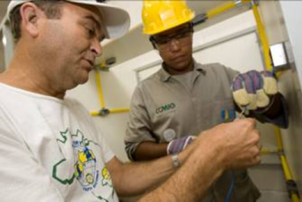
VOCATIONAL TRAINING TEAMS
VOCATIONAL TRAINING TEAMS
Traveling groups of professionals:
  Learn about their vocation
  Teach professionals
  about a particular field
  Strengthen knowledge and skills
Notes:
Vocational training teams are groups of professionals who travel, either to learn more about their vocation or to teach local professionals about a particular field. These teams can expand the knowledge and skills of individuals and communities.
The vocational training team concept was inspired by the successes of past grant programs, including Group Study Exchange and Volunteer Service Grants.
Rotary clubs and districts can support vocational training teams through district grants or global grants.

Slide 35
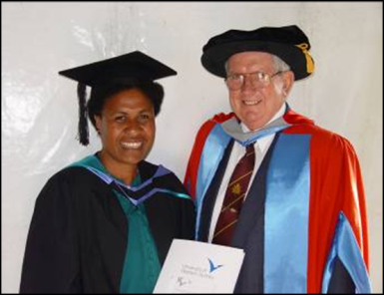
ROTARY PEACE CENTERS
Rotary Peace Centers offer master’s degrees or professional development certificates in fields related to peace studies and conflict resolution.
Notes:
The Rotary Peace Centers program is Rotary’s premier educational program and a top priority for achieving the Foundation’s mission of world understanding and peace.
Up to 100 Rotary Peace Fellows are selected annually for master’s degree programs in international relations, peace studies, conflict resolution, and related subjects, or for a three-month professional certificate program.

Slide 36
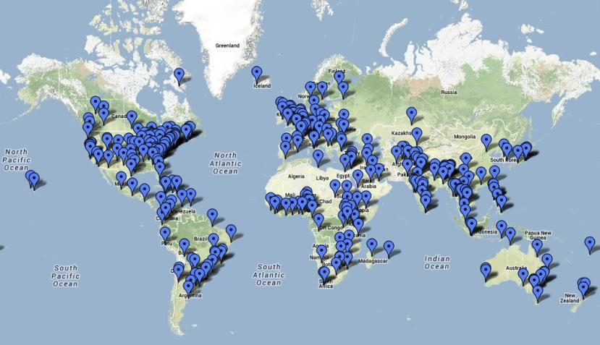
ALUMNI AROUND THE WORLD
ROTARY ALUMNI
Notes:
The Rotary Peace Centers program has over 1100 alumni in more than 100 countries around the world.
95 percent of these alumni work in areas related to peace and conflict resolution.
Peace center alumni have found work as a world bank analyst, a media monitoring analyst for NATO, and a civil affairs officer with the UN mission in Nepal.
Peace fellows are also scattered across the globe on every continent:
34 percent are in North America
22 percent are in Asia
20 percent are in Europe
9 percent are in South America
6 percent are in Africa
6 percent are in Australia and Oceania

Slide 37
ALUMNI
ROTARY ALUMNI
Interact
Rotaract
Rotary Youth Exchange
New Generations Service Exchange
Rotary Youth Leadership Awards (RYLA)
Rotary Peace Fellowships
Rotary Scholarships (global grants and district grants)
Vocational training teams (members and leaders)
Ambassadorial Scholarships
Grants for University Teachers
Group Study Exchange (members and leaders)
Rotary Volunteers
Notes:
Rotary alumni are individuals who have experienced Rotary through various programs, including these listed on the slide.

Slide 38
ROTARY ALUMNI
Encourage alumni to maintain a lifelong relationship with Rotary:
  Service project participation
  Rotary club membership
  Rotaract club membership
  Alumni association activities
  Contributions to the Foundation
Notes:
Clubs should build relationships with alumni to encourage them to maintain a lifelong connection with Rotary. They can do this by:
Inviting them to participate in a club or district service project
Inviting them to join their club or a Rotaract club
Asking them to participate in an alumni association
Inviting them to assist in participant selection and orientation
Encouraging them to contribute to the Foundation
ASK: How can Rotarians use alumni to tell Rotary’s story to the community?
ASK: What is the best way to stay in contact with your Rotary alumni?

Slide 39
Questions?
TRF Email: Contact.center@rotary.org
My Rotary / Club Central: www.rotary.org
District 6150: www.rotary6150.org
Diana Holmes
District Rotary Foundation Chair
dholmes@mcec.coop
Notes:
Ask for questions from participants. Review contact information.

