Slide 1
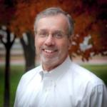
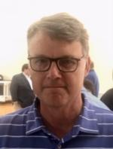
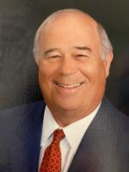
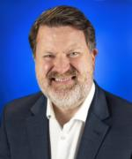
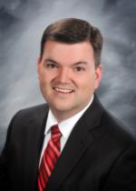
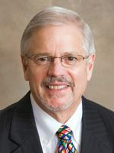
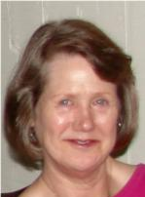
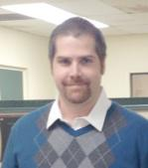
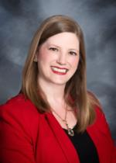
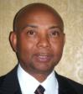
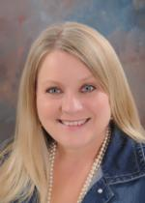
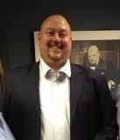
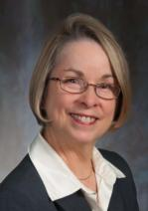
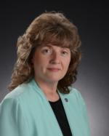
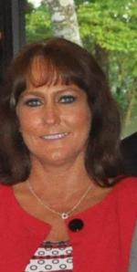
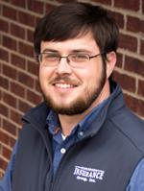
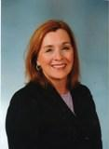
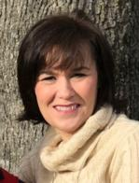
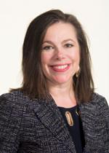
Rotary District 6150
James
Arbuckle
District Governor
2021-22 Organization chart
Brian
Rega
District Trainer
Mike
Marlar
DG Chief of Staff
District Governor Line
Membership
Committee
Public Image Committee
Foundation Committee
Youth Services
Assistant Governors
David Menz
District Governor Elect
Matt Buie
Membership Chair
Doug Shackelford
Public Image Chair
John Carter
Foundation Chair
Susan Chan
Youth Exchange
Adam Sartin
Area 1
Mark Brasfield
Area 2
Sydney Gilbert
District Gov. Nominee
Charles Harris
Visioning Chair
Newsletter
Paul Harris Society Chair
RYLA
Kelly Lewis
Area 3
Website & Social Media
Jennifer Dilaha
Polio Plus Chair
Interact Chair
Darin McCollum
Area 4
Ad Hoc Leadership
Diana Holmes
District Grants Chair
Rotaract Chair
Donna Cole
Area 5
Sydney Gilbert
District Admin
Annie Lankford
District Conference
Darlene Andrews
District Finance Chair
Rena Kelley
Area 9
Jai Lambert
Area 6
International Service Chair
Vacant
Area 10
Michelle Oglesby
Area 7
Will Branch
District Insurance Rep
Rotary Leadership Institute
Anne Fuller
District Treasurer
Erin Mathews
Area 11
Sonya Murphy
Area 8
Michelle Blasengame
Area 12

