Slide 1
2021-2022 VISIONING
District 6150 Team Training
February 27, 2021

Slide 2

2021-2022
Visioning chair
Charles harris
little rock metro

Slide 3
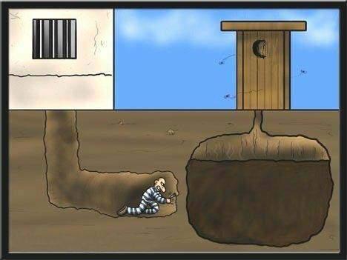
subhead
Good Planning Just Makes Sense!!!

Slide 4
  Club Leadership changes yearly; often reinventing the wheel each year
  Establishes a multi-year coordinated plan
  Provides for greater continuity, consistency and consensus
  Club Members know what the club is working towards
Why is a plan needed?

Slide 5
  It is a living management tool that…
  Defines a shared commitment
  Provides long-term direction (3-4 years)
  Creates framework to establish goals and objectives
  Optimizes use of resources
What is a club vision?

Slide 6
The visioning process
Survey sent to all club members
    How are you perceived in the community; what are your attributes; why did you retain members and grow; vocational service projects; community service projects; youth service projects; international projects; Rotary Foundation achievements; and pubic image/awareness
Results compiled and developed into Zoom polls
Club meeting to vote on polls
Results shared and presented in a visioning plan for the club
Club Champion: their role is to ensure that the vision created is in the forefront as club leadership discusses annual goals and projects throughout the next couple of years.

Slide 7
QUESTIONS

Slide 8
2021-2022 MEMBERSHIP
District 6150 Team Training
February 27, 2021

Slide 9
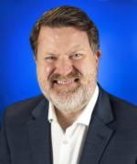
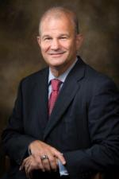
2021-2022
MEMBERSHIP TEAM
Matt Buie, Chair
little rock afterhours
Kenny gibbs
little rock
Charles harris
Little rock metro

Slide 10


Slide 11
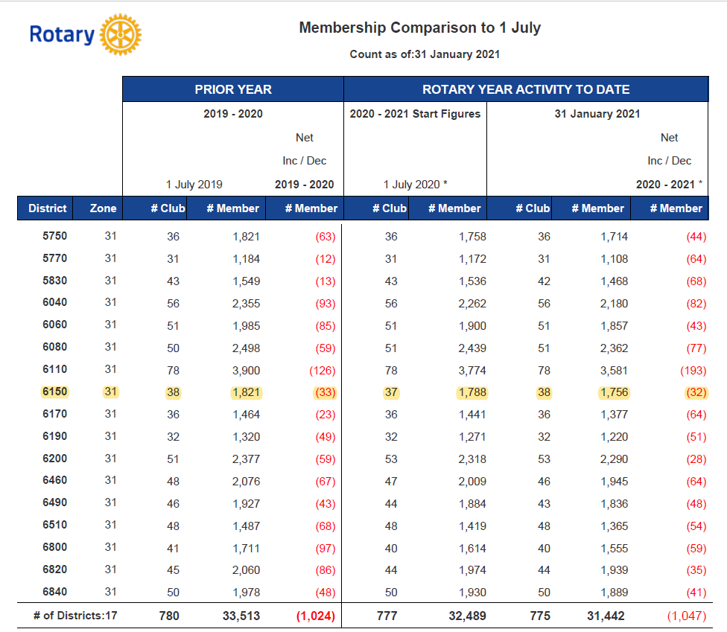
* A loss of 65 members in 18 months

Slide 12
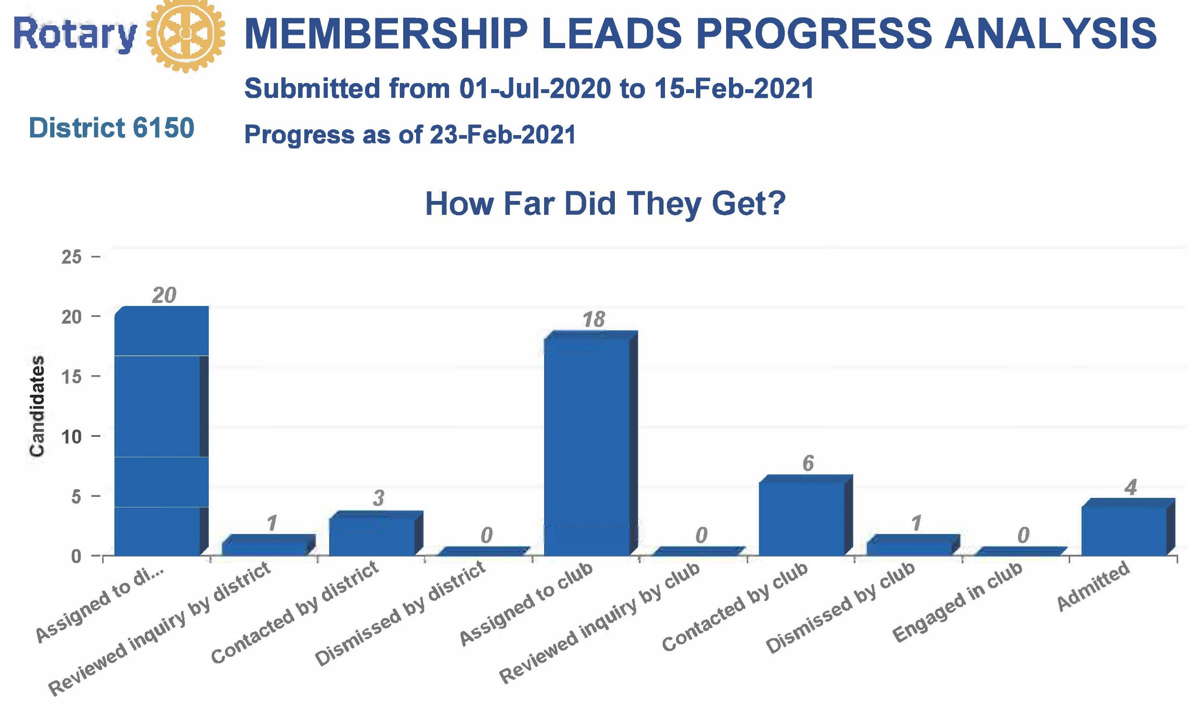
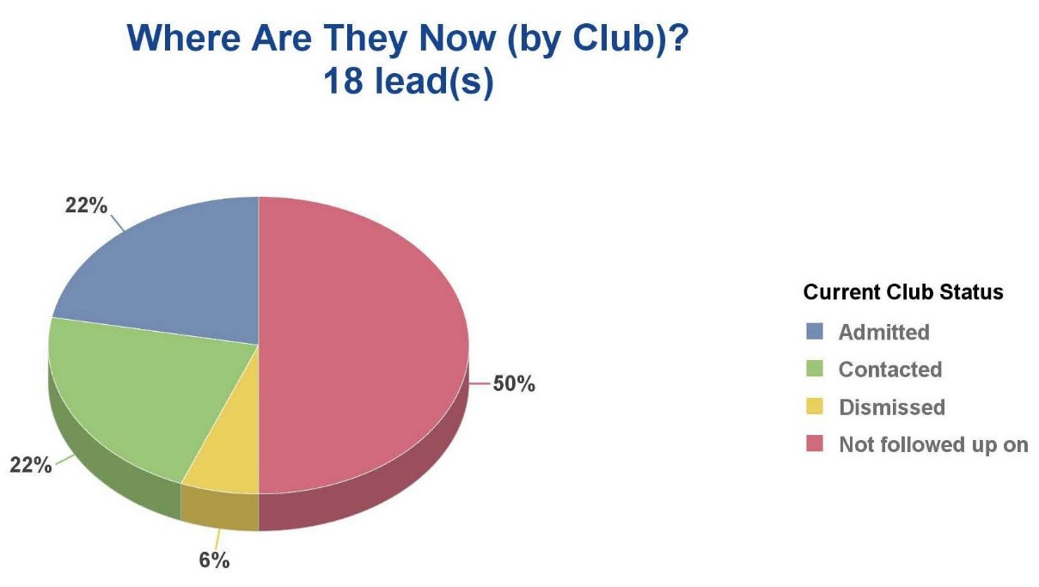

Slide 13
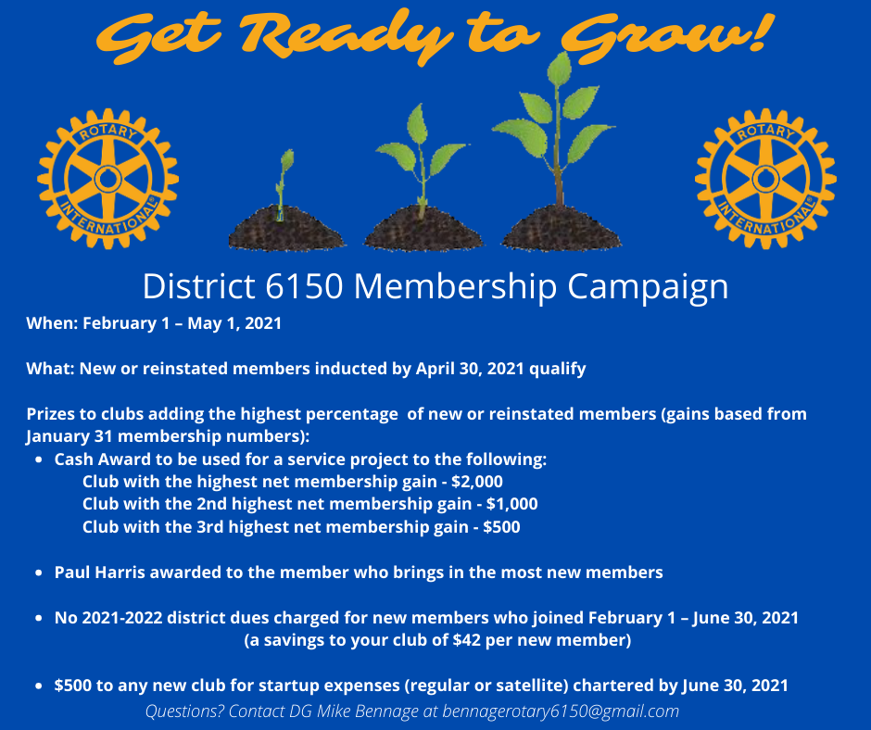

Slide 14
Both personally and professionally
Survey members – what are they looking for in their club experience and how do they want to grow and develop through Rotary
Encourage members to explore the Learning Center – curriculum to develop leadership and other skills
Find ways to keep members engaged; particularly those who are feeling disconnected while clubs are meeting virtually
Enhance participant engagement
Delivering Value

Slide 15
Membership resources
Publications
  Strengthening Your Membership
  Introducing New Members to Rotary
  Connect for Good
Learning Center: Online Courses
  Club Membership Committee Basics
  Best Practices for Engaging Members
  Kick-Start Your New Member Orientation
  Building A Diverse Club
  Practicing Flexibility and Innovation
D6200 Guide to Forming and Managing a Satellite Rotary Club
White paper: Engaging with Rotary Beyond the Club

Slide 16
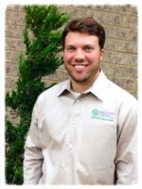
2021-2022
INNOVATIVE CLUB ADVOCATE
ADAM SARTIN
JONESBORO UNIVERSITY

Slide 17
#GROWROTARY
New and Innovative Club Ideas
  Satellite
  Cause Based
Re-engage former Rotarians
  Terminated members list in DACdb
Reduced dues – minimum in D6150 = $128 (RI=$86/6150=$42)
Variety of membership types/meeting times

Slide 18
QUESTIONS

