Slide 1
Science Vs.COVID-19
A battle without borders
Notes:
Biology lesson

Slide 2
Outline
Life of a PhD student
Biology 101
Using science to fight COVID-19

Slide 3
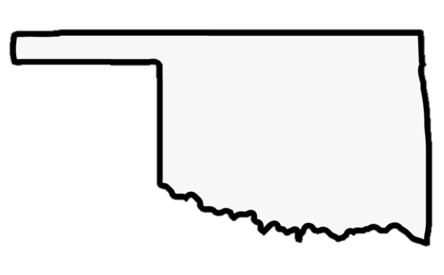
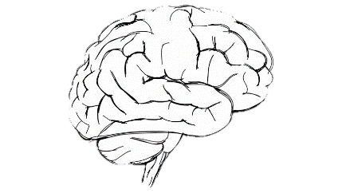
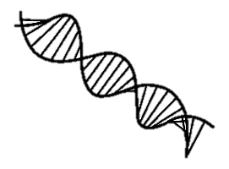
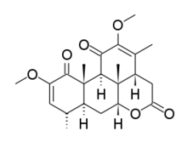
Muskogee
Oklahoma City
Norman
Notes:
Add circles at stuff to show where I grew up, college, and now grad school

Slide 4
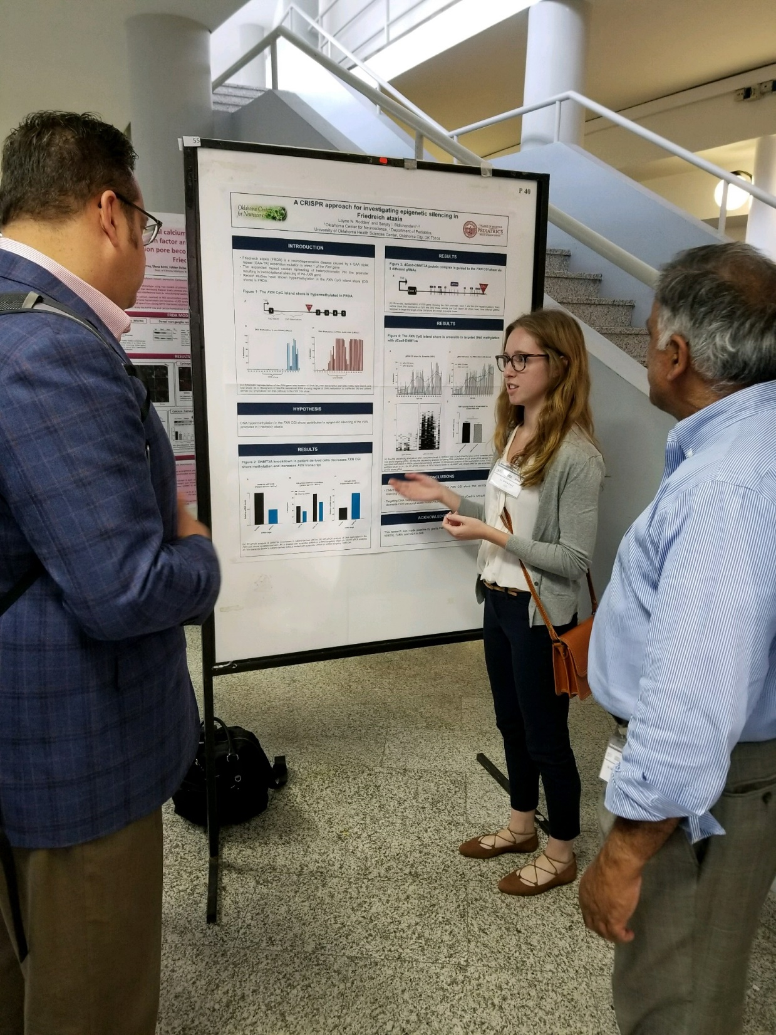
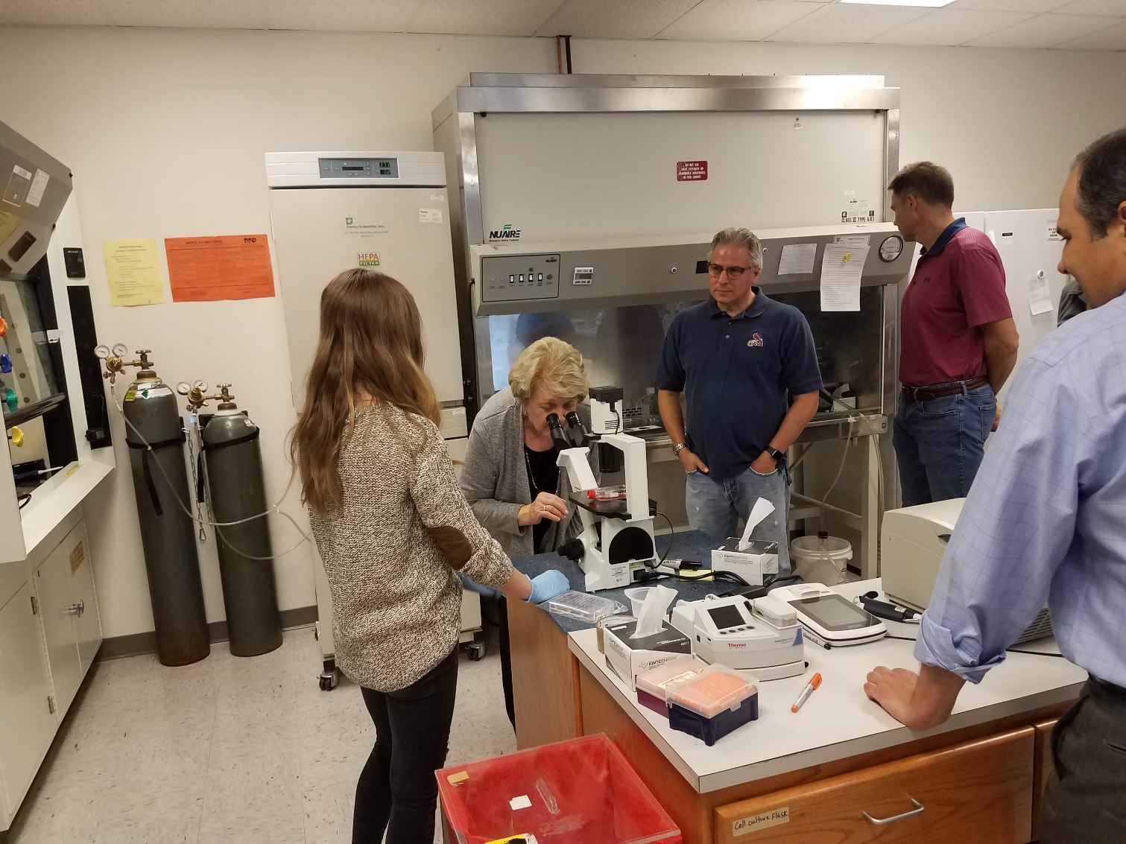
Graduate school
Notes:
What is grad school? Show pictures of lab and presenting data etc...maybe time line? Finishing up soon

Slide 5
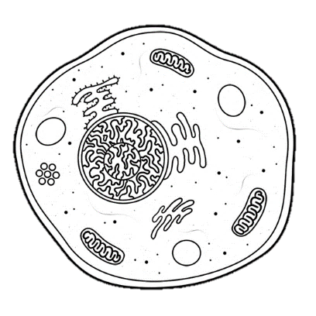
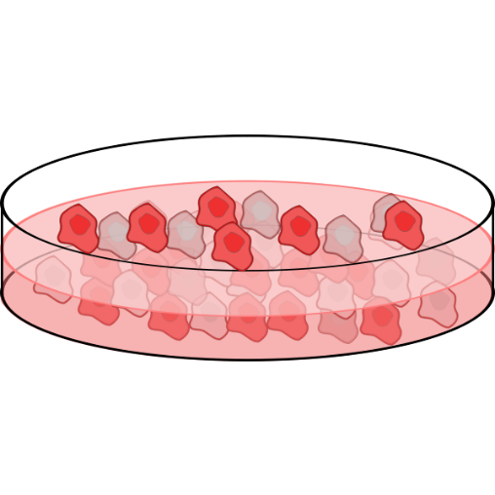
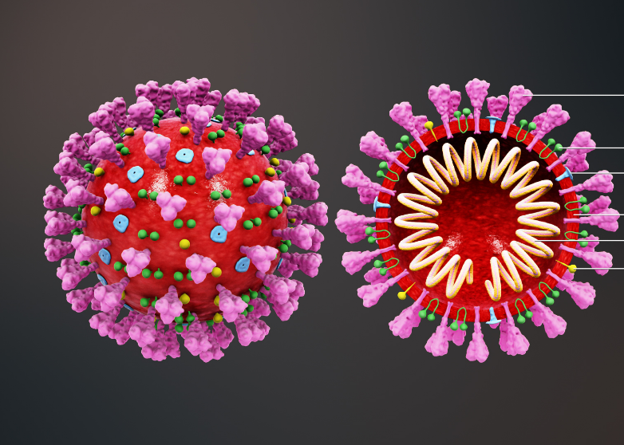
Biology 101
DNA
RNA
Protein
Notes:
What do we do in research labs? Use my project as an example, but also talk about other research being done at OUHSC...cancer, aging, virus research

Slide 6
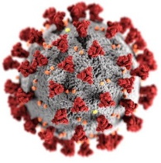
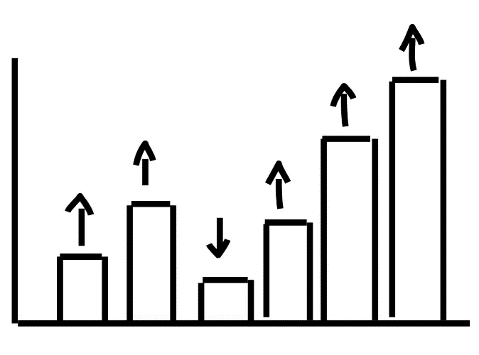
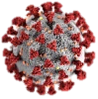
Strategy 1-new drug treatments
Novel Coronavirus
Notes:
What do we do in research labs? Use my project as an example, but also talk about other research being done at OUHSC...cancer, aging, virus research

Slide 7
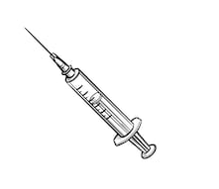
Strategy 2-vaccines
100 people
1000 people
30,000 people
07/27/2020
Notes:
What is a virus?

Slide 8
Strategy 3-public health measures
Notes:
Biology 101

Slide 9
Conclusions
Researchers around the world are continually looking for treatments
We are possibly really close to a vaccine
Together, we can make a huge impact

Slide 10
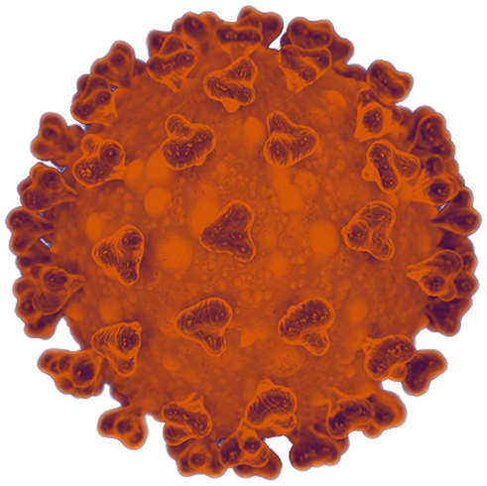
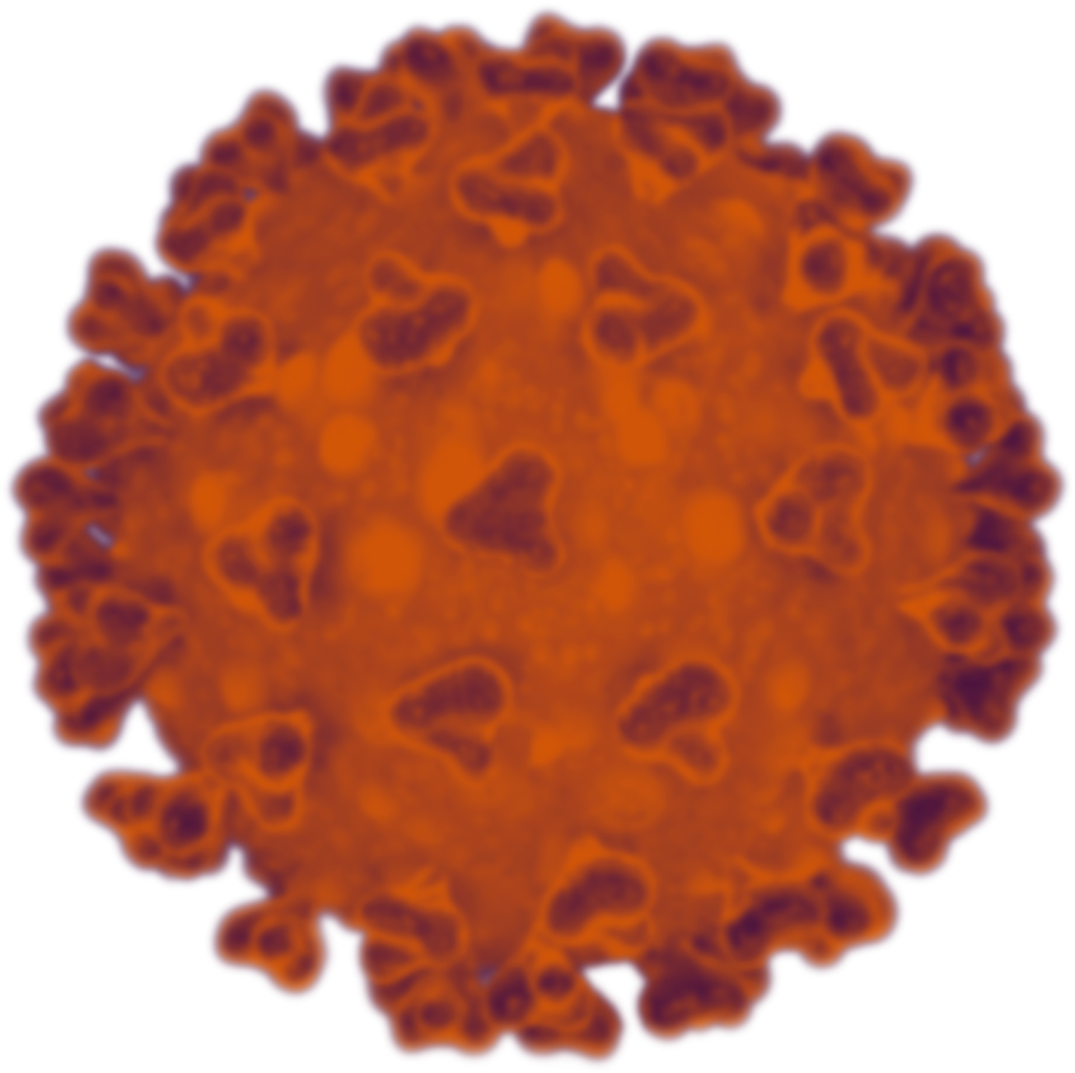
Thanks!
Notes:
end with something saying we are all in this together. We have the power to make things happen and make change happen.

