Slide 1
Club Assembly
Rotary Club of Broken Arrow
July 27, 2020

Slide 2
Business Meeting Topics
Cool Grilles Status
Rotary After Hours
MSNI – Arctic Cat Raffle Fundraiser
MSNI Workday – Saturday August 8, 9:00am
Ice Cream Pie Fundraiser

Slide 3
Rotary Geography trivia
Which Rotary Club is farther west:
Reno, Nevada
Los Angeles, CA?

Slide 4
Rotary Geography trivia
Which Rotary Club is farther west:
Reno, Nevada
Los Angeles, CA?

Slide 5
Rotary Geography trivia
Which Rotary Club is farther east:
Pensacola, FL
Detroit, MI?

Slide 6
Rotary Geography trivia
Which Rotary Club is farther east:
Pensacola, FL
Detroit, MI?

Slide 7
Rotary Geography trivia
Which Rotary Club is farther south:
Cairo, Illinois
Richmond, VA?

Slide 8
Rotary Geography trivia
Which Rotary Club is farther south:
Cairo, Illinois
Richmond, VA?

Slide 9
Rotary Geography trivia
What do these Rotary Clubs have in common:
Libreville, Gabon
Quito, Equador
Singapore
Kampala, Uganda

Slide 10
Rotary Geography trivia
They all lie approximately on the Equator
Kampala
Quito
Singapore
Libreville

Slide 11
What is Rotary?

Slide 12
Club Goals: 2020-21
Members & Engagement
Club Membership – 75 members at year end (currently 69)
New Member Sponsors – 5 members sponsor at least 1
Service Participation – 60 members participate in at least 1
District Conference (May 1 @ Stoney Creek) – 7 members attend
District Training Conf. (Aug 22 Online) – 5 members attend

Slide 13
MEMBERSHIP
IDEAS & INITIATIVES FOR RECRUITING AND RETENTION
GALEN ENGEL

Slide 14
Rotary foundation
WAYS TO CONTRIBUTE TO ROTARY’S MISSION…TODAY AND INTO THE FUTURE
STAN EVETTS

Slide 15
Club Goals: 2020-21
Rotary Foundation Giving
Annual Fund Contributions - $6,000
Every Member, Every Year
Polio Plus Fund Contributions - $1,000
Bequest Society Members – 1 member

Slide 16
COMMITTEES & ENGAGEMENT
RESTRUCTURING, LEADERSHIP, AND SERVICE OPPORTUNITIES
ROY WOOD

Slide 17
Club Goals: 2020-21
Service Projects
14 Projects

Slide 18
SERVICE, YOUTH & FUNDRAISING COMMITTEES
SERVICE COMMITTEES
Adopt-a-Mile (Trash Bash) – Jeanine Truman
Blood Donors – David Rampey, Lucy Laird
Joy in the Cause – ??????
Medical Supply Network, Inc. – Lisa Engel
Rooster Day Parade – Doris Watson
Rotary Up With Trees area – ??????
Salvation Army Ding-a-Lings – Scott Eudey
International Service Projects - ??????

Slide 19
SERVICE, YOUTH & FUNDRAISING COMMITTEES
YOUTH COMMITTEES
4-Way Test Speech Contest – Derek Blackburn
Adopt-a-School (Libr. Books) – Mike Scrimsher
BAHS Scholarships – Lloyd Dawes
BAPD Events – ??????
Be Wise, Immunize – Stan Evetts
Dictionary Project – Jeff Hewett
Interact/Rotaract – Steve Barnes
Josh the Otter – Brena Meadows
RYLA – Zarria Young
Shop with a Rotarian – Stan Evetts
Students of the Quarter – Steve Barnes
Rotary Youth Exchange - ??????

Slide 20
SERVICE, YOUTH & FUNDRAISING COMMITTEES
FUNDRAISING COMMITTEES & $$ GOALS
Cool Grilles Car Show ($20,000) – Lisa Engel
Pancake Breakfast ($1,500) – Don Henderson, Stu Conrad
Rooster Egg Hunt ($3,000) – Janie Green
Trivia Contest ($2,000) – Janie Green, Stan Evetts
Micro-Fundraisers ($2,500) – Galen Engel
Fundraising is Critical to Continue to Support Community Charities and Keep Our Club Running.

Slide 21
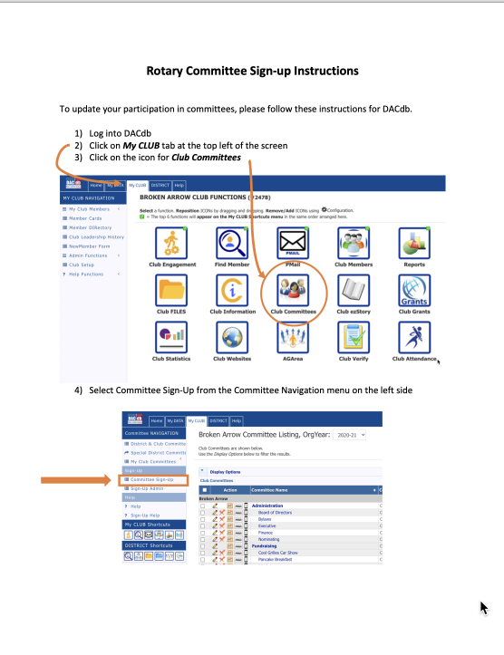
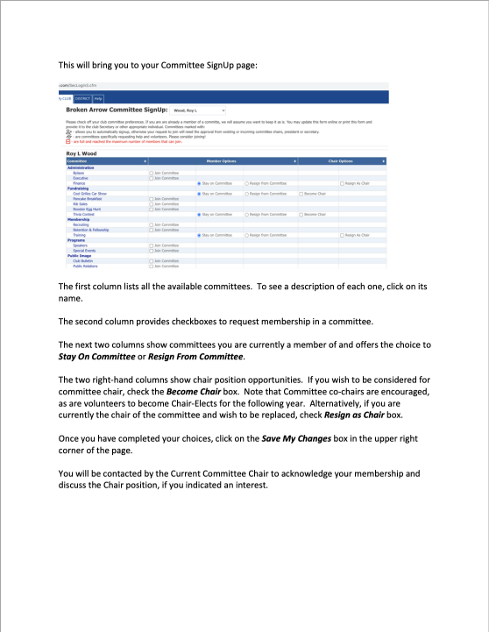
Dacdb Committee signup process
How-To Document will be sent to all members to review current committees and sign up for new ones.
Members are encouraged to step up to leadership role as Chair, Co-Chair, Chair Designee, or Task Leader. Buttons in DACdb.

Slide 22
Youth Leaders
PROVIDING OPPORTUNITIES FOR HIGH SCHOOL AND COLLEGE STUDENTS TO LEARN AND SERVE THROUGH INTERACT/ROTARACT AND ROTARY YOUTH LEADERSHIP AWARDS PROGRAMS (RYLA).
Zarria Young
Steve Barnes

Slide 23
Club Goals: 2020-21
Young Leaders
Interact Clubs – 1 club
RYLA Participation – 6 Jr. High Students

Slide 24
PUBLIC IMAGE
RAISING AWARENESS AND PROFILE OF ROTARY CLUB BROKEN ARROW IN OUR COMMUNITY.
DEBRA WIMPEE

Slide 25
Club Goals: 2020-21
Public Image
Maintain Online Presence
Update Website & Social Media – 4 times per month
Social Activities – 8
Strategic Plan – Review & Update

Slide 26
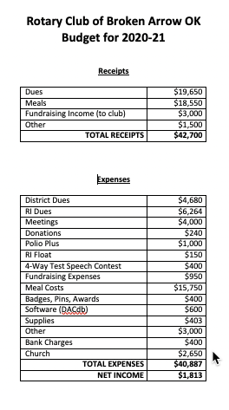
2020-21 Budget
Tight budget to meet club expenses.
Asking members to pay dues promptly.
Due to Covid, made regular member meals post-paid (with RSVP). Meals show up on next quarter’s invoice.
Budget will change with conditions.

