Slide 1
PODs Coordination
Larry Long
District Governor Nominee
larryou67@gmail.com 479-530-2065

Slide 2
PODs Historical Perspective
In 2003, then DG Tom Clark said "When we brainstormed my idea out in the San Diego District Governor's Training session, I felt it should benefit the Clubs, the Presidents and the Assistant Governors like peas in a pod!"
Thus, the origin of “POD”

Slide 3
What is a POD
Definition: a seed case, detachable compartment, an educational grouping, ...
POD: President’s Open Discussion
PODer: Member of a POD
PODee: A PODer at a POD gathering
PODing: act of participating in a POD (I’m going PODing, so don’t wait up)
PODist: one who promotes the notion of a POD (an forward-thinking AG is a PODist)
PODism: the resolute belief in the effectiveness of PODs
AGOD: An open discussion group made of AGs

Slide 4
PODs in District 6110 (an incomplete list)
Active PODs (Barney, Don, and Herb)
Tulsa Metro President’s POD
Tulsa Area AG POD, really an AGOD
In the past
The 4 clubs of then AG John Williams in NWA
The 5 clubs of then AG Roger Bates in North AR
And others?

Slide 5
Why Have PODs
To make the life of an AG less complicated and a lot more fun
Peer groups are amazingly effective because it is human nature to pursue an objective with more vigor when you participated in the evolution of that objective
To enable current club presidents to learn from each other so their respective clubs can be even better clubs at the end of their terms

Slide 6
What is a District 6110 POD A POD is a group of 3 to 15 club presidents who are in relatively close geographic proximity to one another who meet periodically to:
Pass notes on ideas and best practices
Collaborate on projects and activities
Help one another find solutions to problems and issues
Answer difficult questions
Share materials and resources
Provide feedback to club and district leadership
Facilitate coordination and cooperation among Clubs
Facilitate coordination and cooperation with the District
Share promotions of events and projects
Catch up on the latest Rotary gossip

Slide 7
To Be a Most Excellent POD (1/2)
AGs are key: coordinate with one another to put PODs together
Suggest topics
Attend when invited
Monitor and intervene as needed
Let geography rule
Have an POD coordinator (preferably within the peer group)
Focus on President Open Discussion (POD) groups
Send president-elect when president is unable to attend

Slide 8
To Be a Most Excellent POD (2/2)
Bring the president-elect along to any POD gathering
Invite specific district leadership on occasion (AGs, DGs, PDGs, etc.)
Remind district leaders that they are invited guest, not facilitators
Gather no more than 3 or 4 times per year.
Consider gathering electronically as an option, too: GoToMeeting, Google Chat/Video, conference call, etc.
Limit to 1 to 1.5 hours

Slide 9
The PODs Coordinator The PODer who enjoys PODing and is passionate about the importance of information exchange among PODees:
Sets dates, times, location
Sets agenda, always leaving at least 50% of session for open discussion
Communicates with PODers
Communicates with PODists, as needed
Runs sessions
Invites guests, as needed

Slide 10
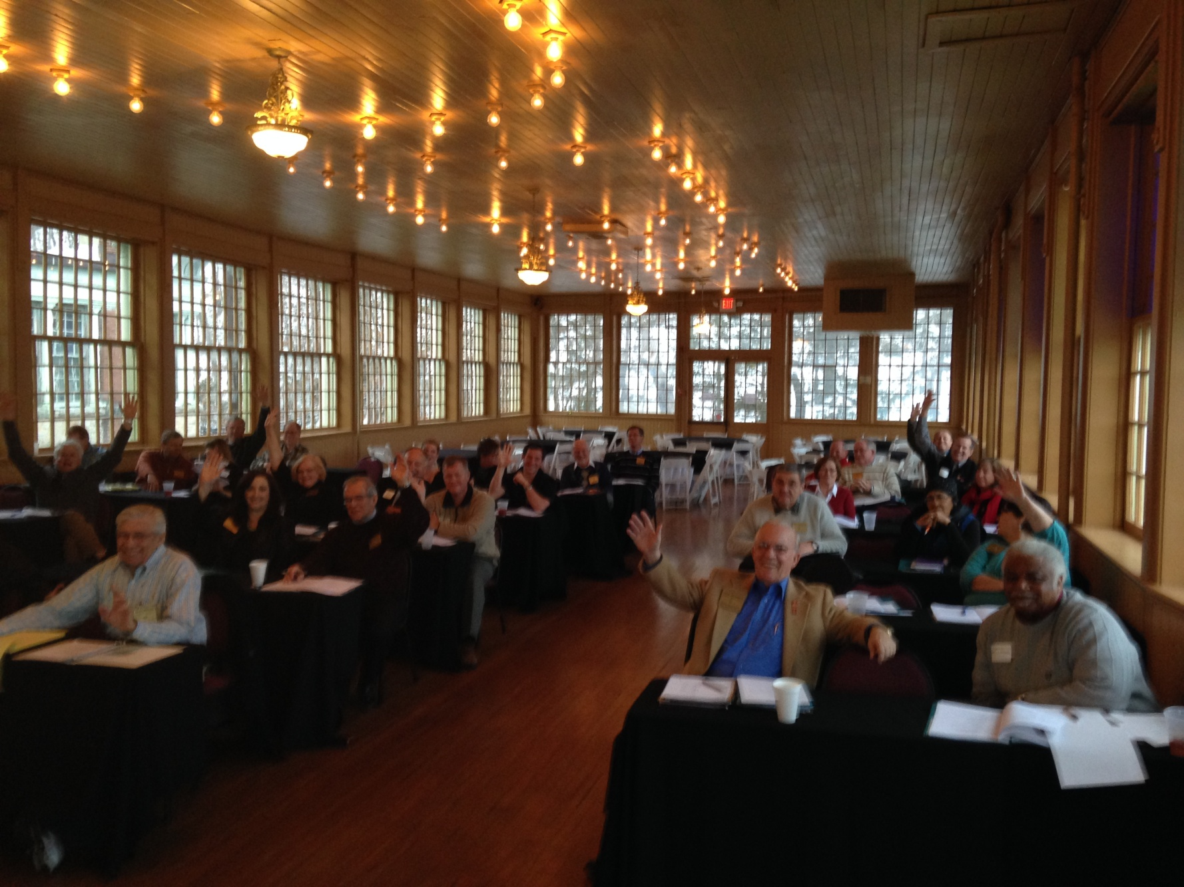
Exuberant PODists pledge to create most excellent PODs throughout D6110

