Slide 1
Club Planning Guide for Effective Clubs
Larry Long
District Governor Nominee
District Governor 2015-2016

Slide 2
50 or 415 Days Until You Take Over as Club President!
Congratulations!
Thank you, thank you
Good luck
Now, don’t screw it up

Slide 3
The President’s Call to Action
What will you do to better understand your responsibilities as a club president?
Who will you consult with when you have questions about your role?
What do you need to learn more about before your term begins?
How will you involve your members in the goal-setting process?
What will you delegate and to whom
What will you do to ensure your club’s goals are met?

Slide 4
Your Role is to Lead an Effective Rotary Club 1/2
Review your club’s current plan
The 2013-14 Planning Guide for Effective Rotary Clubs
The 2013-14 Strategic Plan
Talk to and listen to your current president and other seasoned officers
Make your club’s assistant governor your new best friend—as soon as possible
Appoint your committee chairs

Slide 5
Your Role is to Lead an Effective Rotary Club 2/2
Learn
MAPETS
Club Presidents Manual (download to smartphone, tablet, laptop)
2013 Manual of Procedures (download to smartphone, tablet, laptop)
Be a Vibrant Club (8 page booklet)
District Training Assembly
District Conference
D6110 Website
RI Website
DaCdb
Complete the Strategic Planning Worksheets (Ch 2, App 3)
Complete the Planning Guide for Effective Clubs (Ch 2, App 2)
Schedule Club Visioning for your club as soon as possible
Join a District 6110 POD (President’s Open Discussion)

Slide 6
What is a District 6110 POD A POD is a group of 3 to 15 club presidents who are in relatively close geographic proximity to one another who meet periodically to:
Pass notes on ideas and best practices
Collaborate on projects and activities
Help one another find solutions to problems and issues
Answer difficult questions
Share materials and resources
Provide feedback to club and district leadership
Facilitate coordination and cooperation among Clubs
Facilitate coordination and cooperation with the District
Share promotions of events and projects
Catch up on the latest Rotary gossip

Slide 7
Will you make it through Rotary year 2014-15?
Yes!
And so will the other 34,000+ presidents

Slide 8
Will you lead an effective Rotary club?
Well probably.
But that’s up to you, your initiative, imagination, perseverance, leadership, and willingness to plan NOW.

Slide 9
In planning to be a most excellent and effective club, for sure include ...
Increasing and sustaining membership
Implementing innovative community and/or international projects
Supporting the Rotary foundation
Developing future leaders

Slide 10
The Planning Guide for Effective Clubs Who? Where? Why? How? When?
Our Focus Today

Slide 11
The Planning Guide for Effective Rotary Clubs 1/5
Who?
President-elects
Invite input from your club’s assistant governor, the president, the president-nominee, club secretary, the Board, and wise members

Slide 12
The Planning Guide for Effective Rotary Clubs 2/5
Where?
Club President’s Manual; Ch 2, App 2
Rotary Club of Fayetteville website (http://www.fayettevillerotary.org/)
Fayetteville Rotary/Resources/Rotary Manuals
Club President’s Manual
Planning Guide for Effective Rotary Clubs (fill in the blank PDF)
2013 Manual of Procedures

Slide 13
The Planning Guide for Effective Rotary Clubs 3/5
Why?
To make your life easier
To assess the current state of the club
Establish goals for your year
So 2014-2015 District Governor Herb Orr will have a solid understanding of your club, now and in the future, for his official visit

Slide 14
The Planning Guide for Effective Rotary Clubs
How?
Download Planning Guide for Effective Rotary Clubs (PDF or doc)
Complete the PDF of docx form

Slide 15
The Planning Guide for Effective Rotary Clubs (5/5)
When?
Submit a hardcopy or a PDF or Word document to your assistant governor no later than July 1, 2014
Your club AG forwards to DG Herb

Slide 16
CONTENT: The Planning Guide for Effective Rotary Clubs
Setting your club’s annual goals, which support long-range goals in Strategy Plan
Assessing your club’s membership situation
Discussing and organizing service projects
Identifying ways to support The Rotary Foundation
Developing future leaders
Developing a public relations plan
Planning action steps to carry out your club’s administrative responsibilities

Slide 17
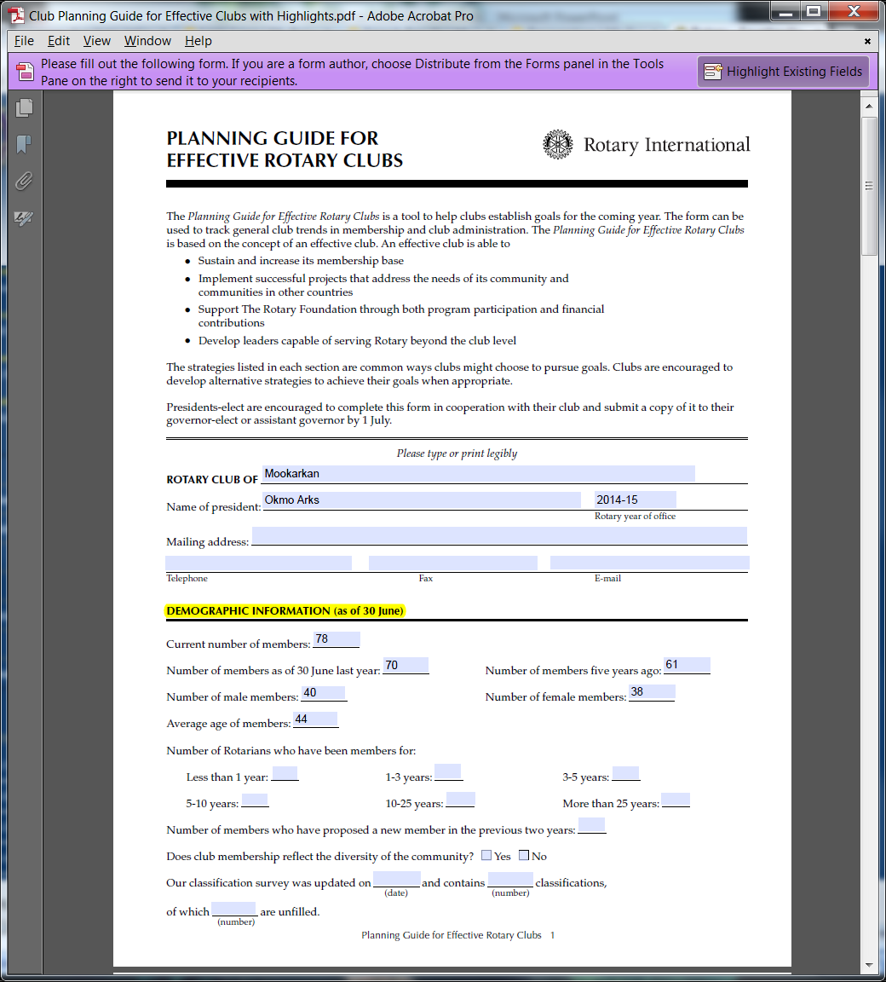

Slide 18
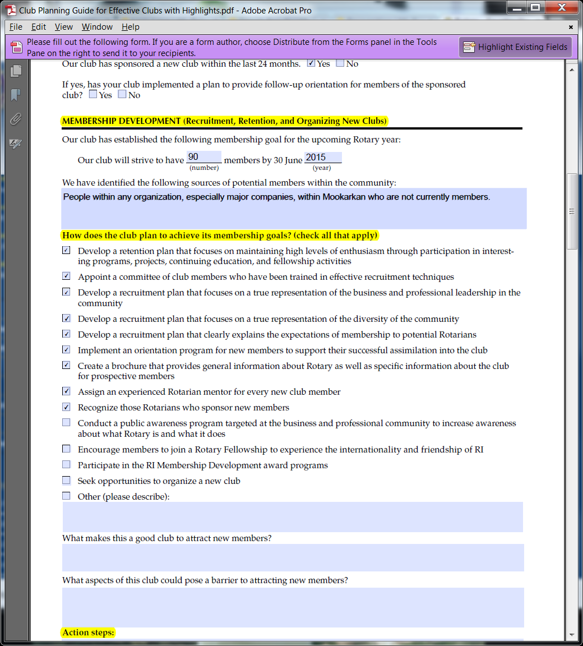

Slide 19
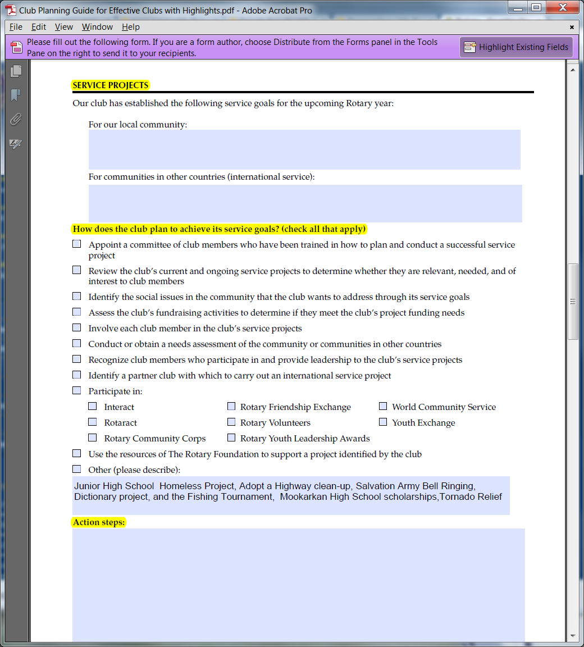

Slide 20
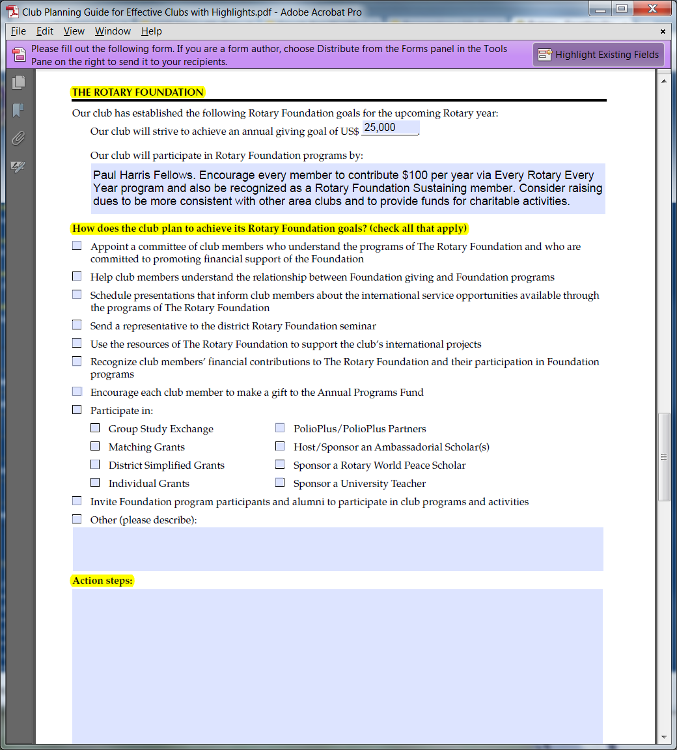

Slide 21
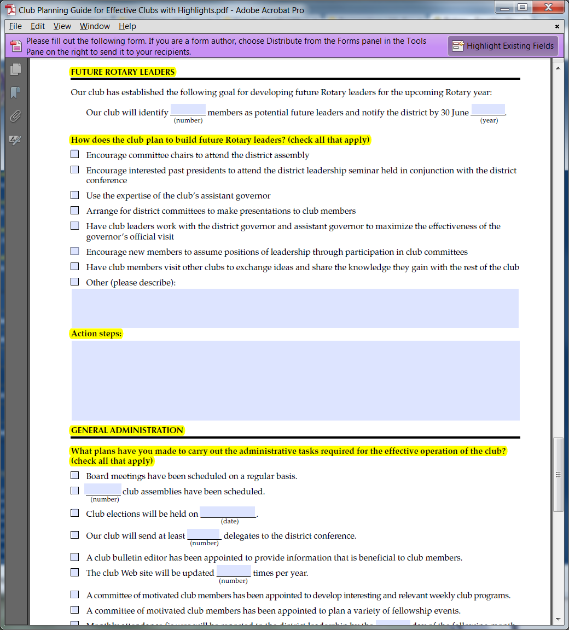

Slide 22
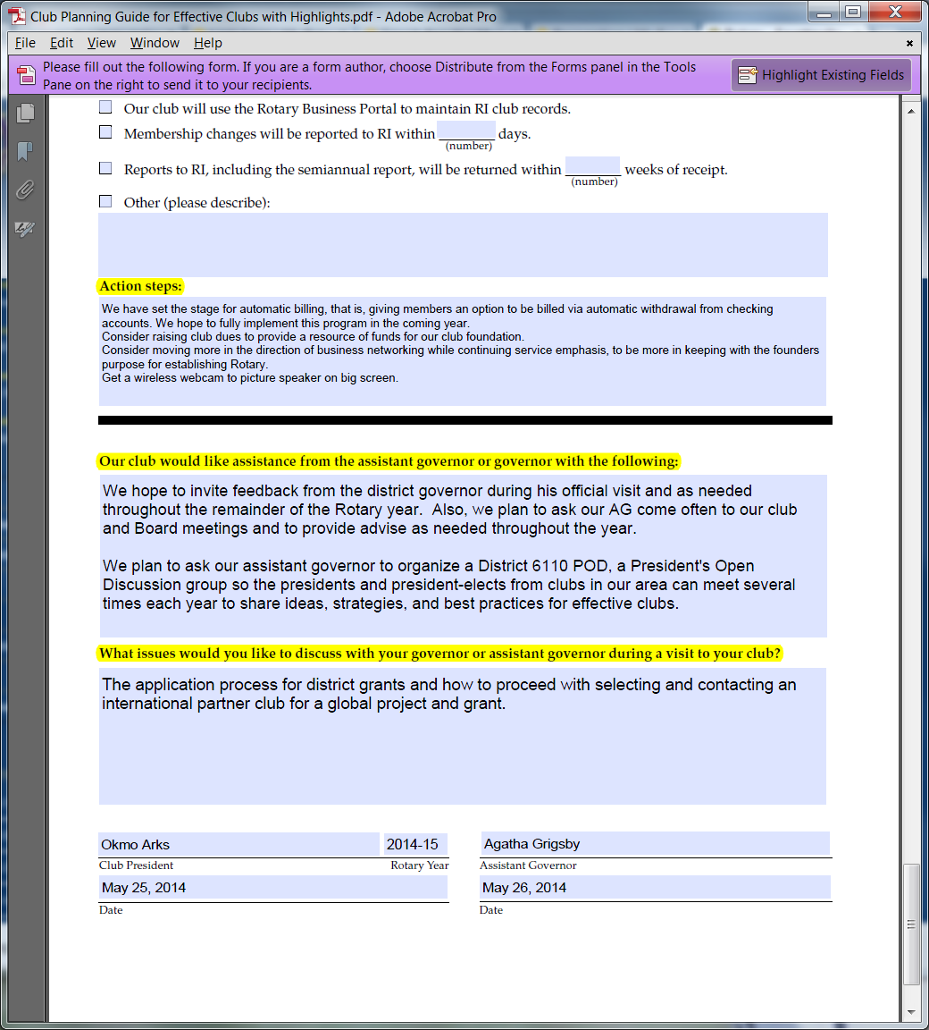

Slide 23
In planning to be a most excellent and effective club, what to plan to do to ...
Increase and sustain membership
Implement innovative community and/or international projects
Support the Rotary foundation
Develop future leaders

Slide 24
Club Planning Guide for Effective Clubs
Due July 1 to:
Your club’s assistant governor
District Governor Herb Orr, 2014-2015

