Slide 1
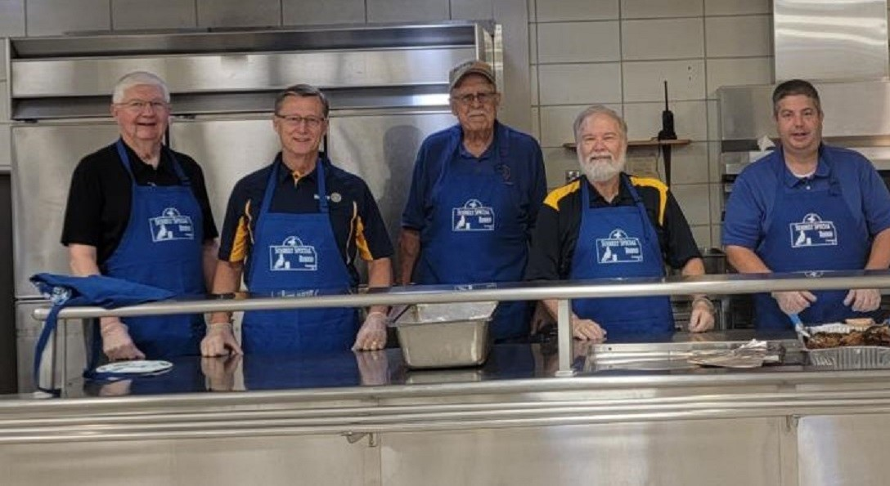
Celebrate Parsons
Service!

Slide 2
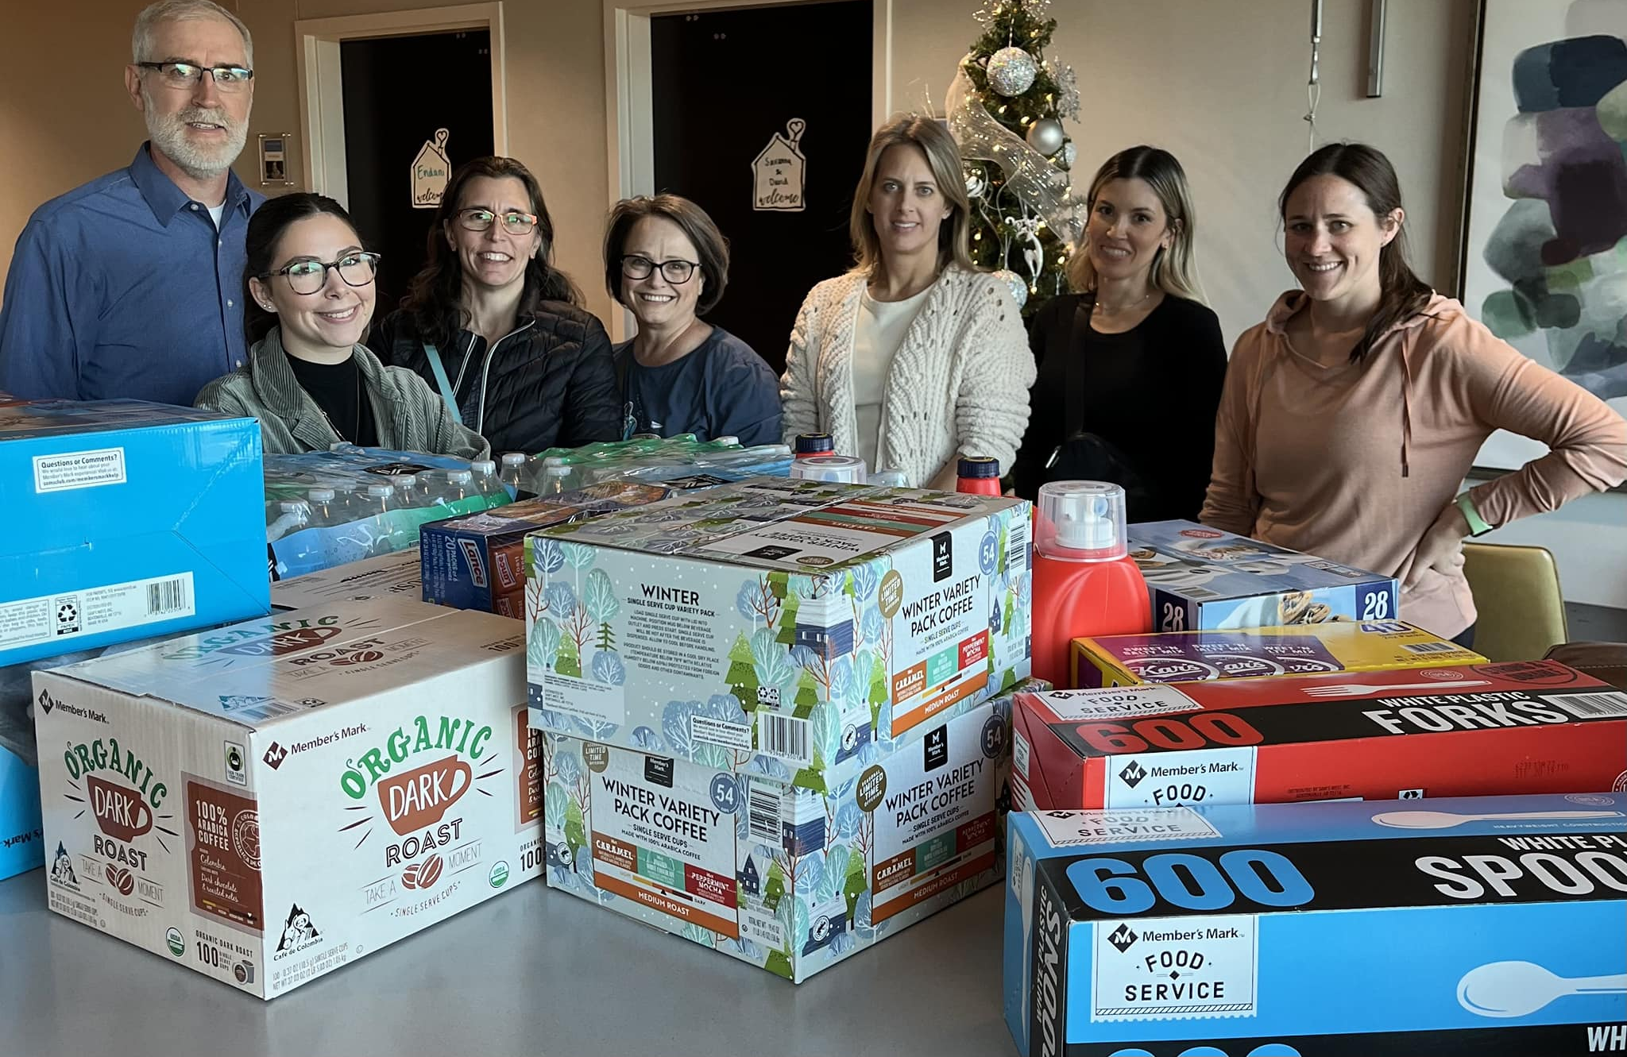
Celebrate
Ronald
McDonald
House
Supplies
in
Fayetteville!

Slide 3
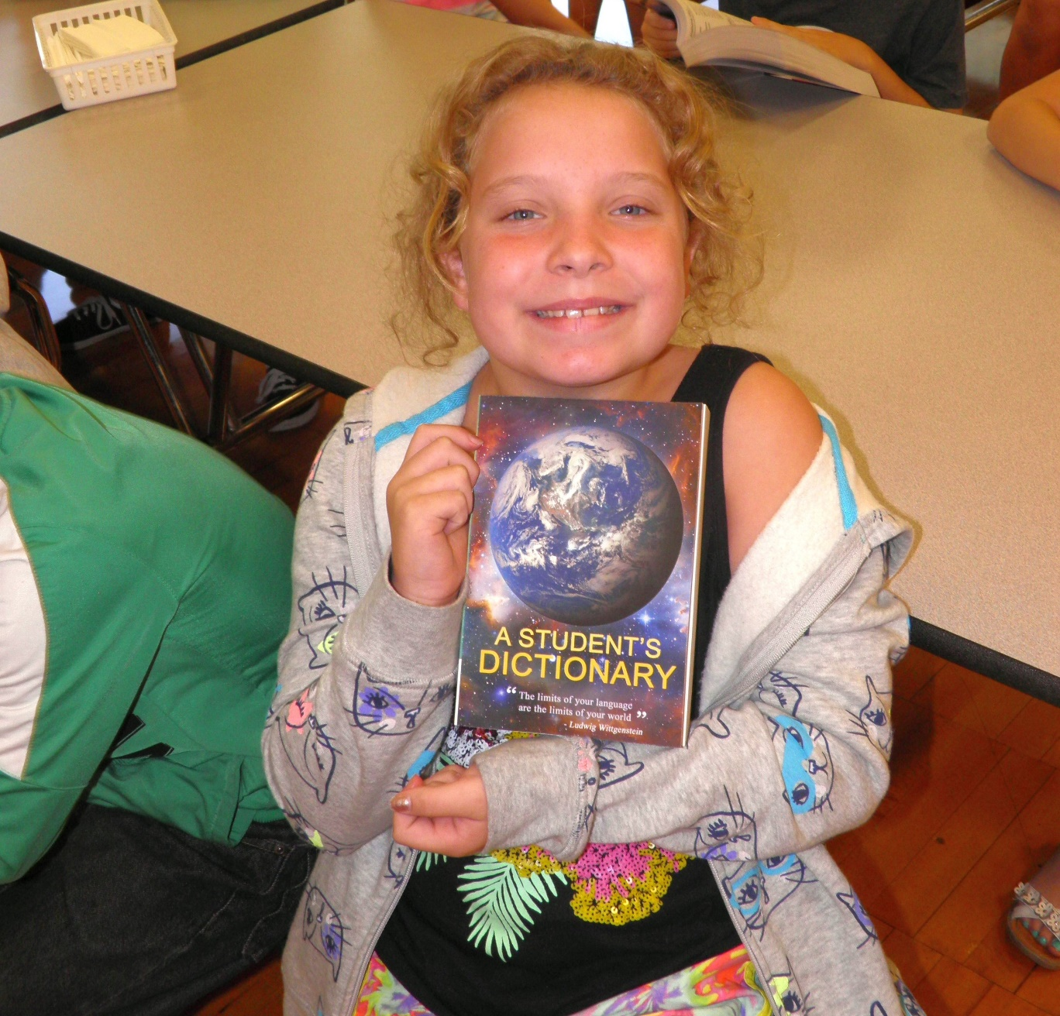
Celebrate Literacy!

Slide 4
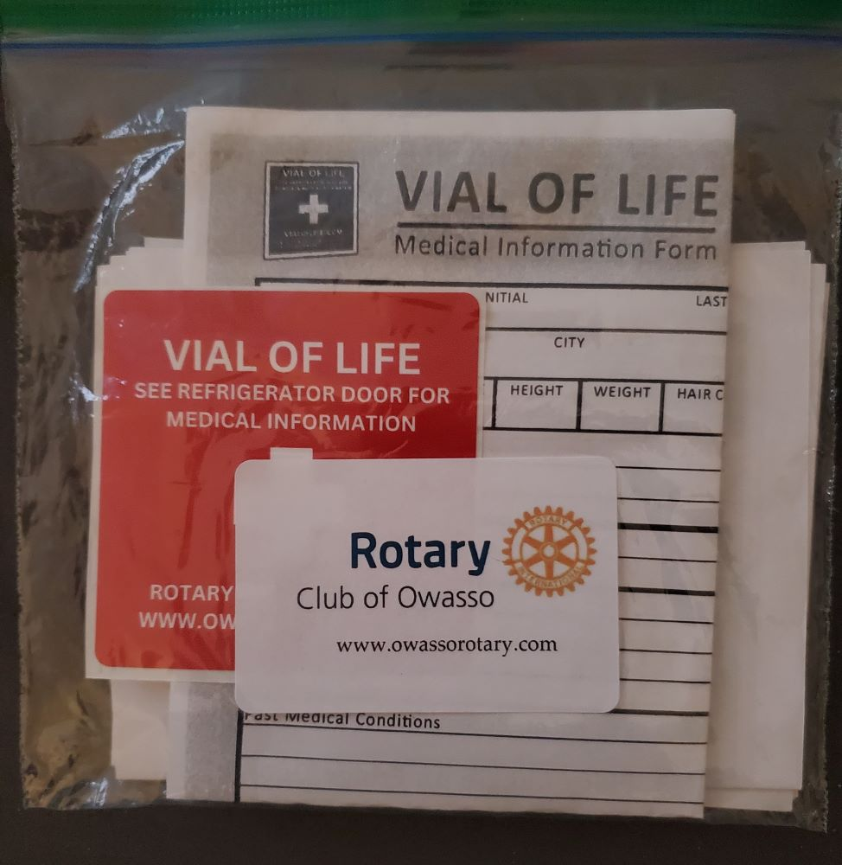
Celebrate Oswego Vials!

Slide 5
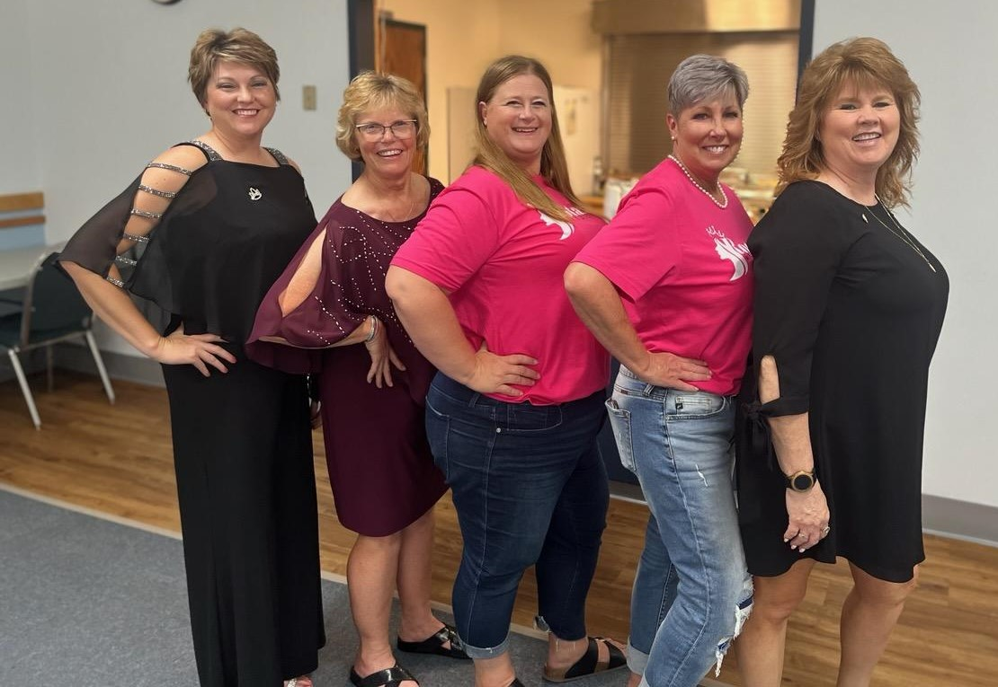
Celebrate Women in 6110!

Slide 6
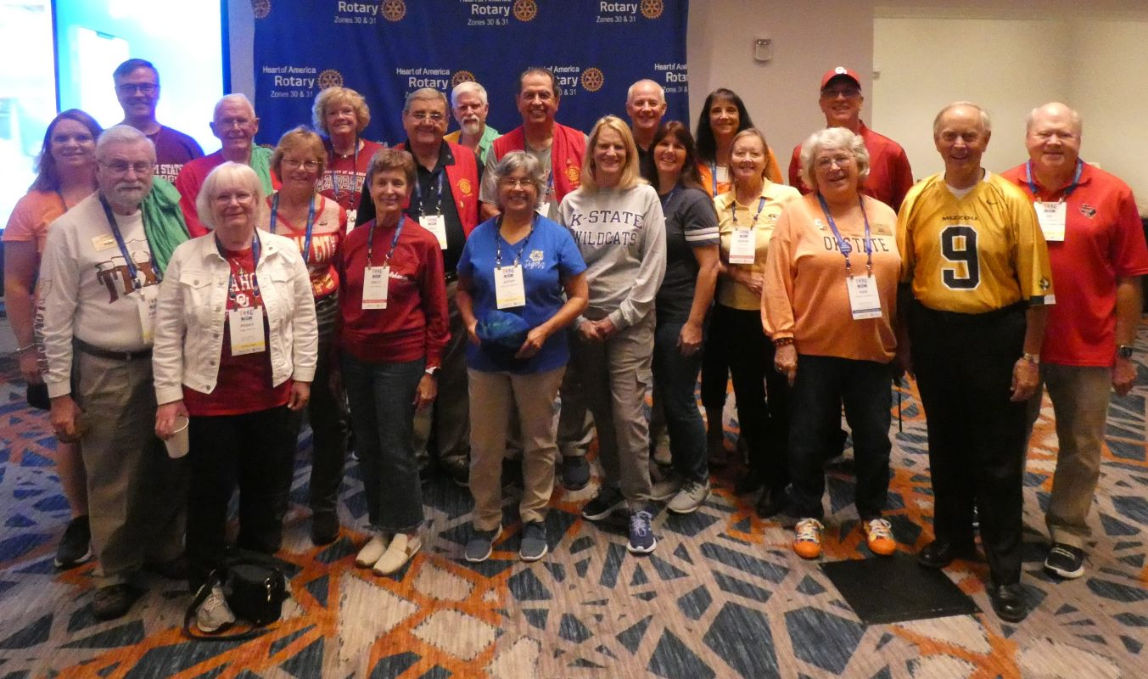
Celebrate 6110
at Memphis

Slide 7
Celebrate
Ending Polio!

Slide 8
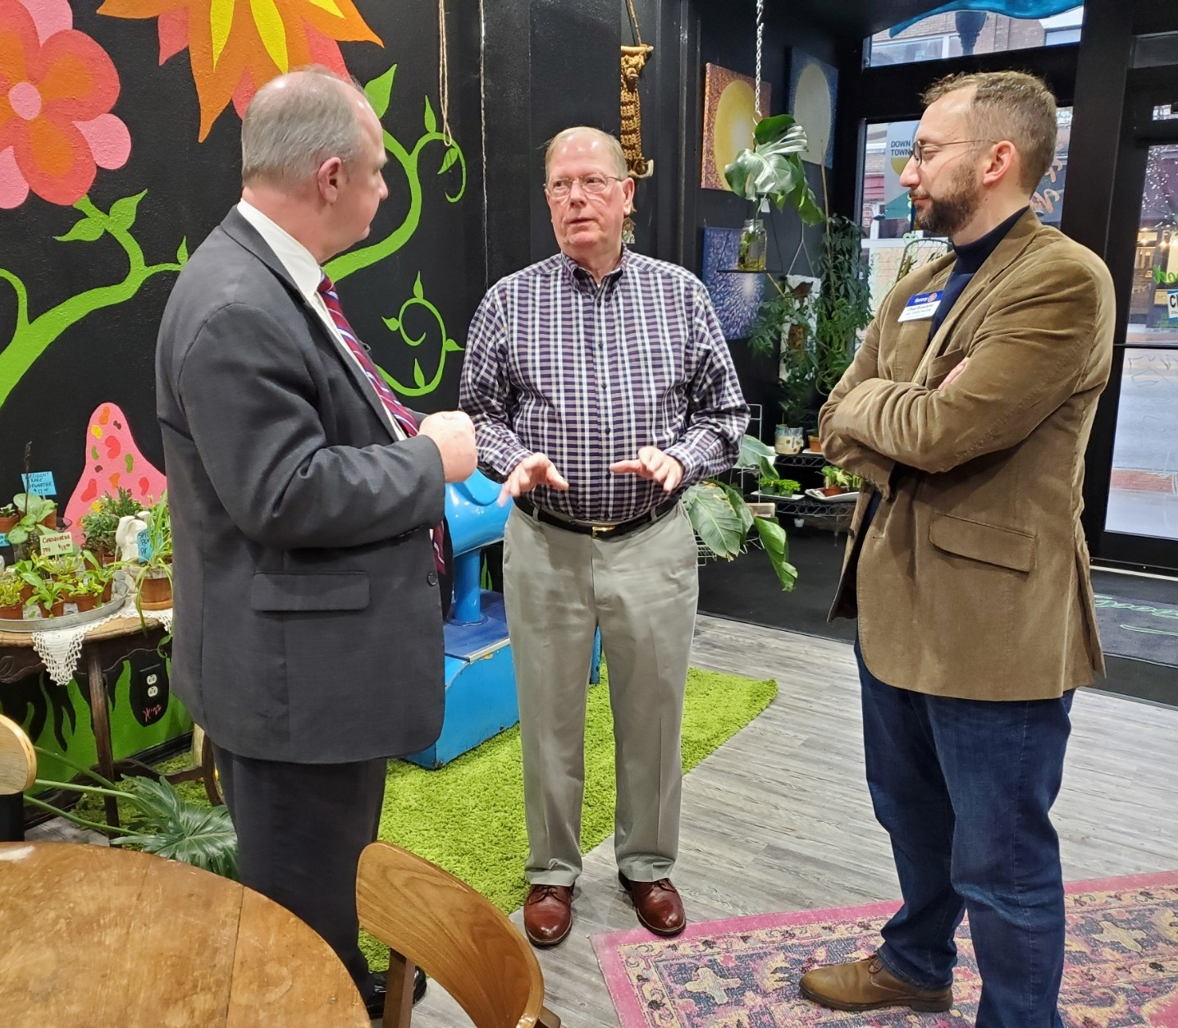
Celebrate Joplin ROtary!

Slide 9
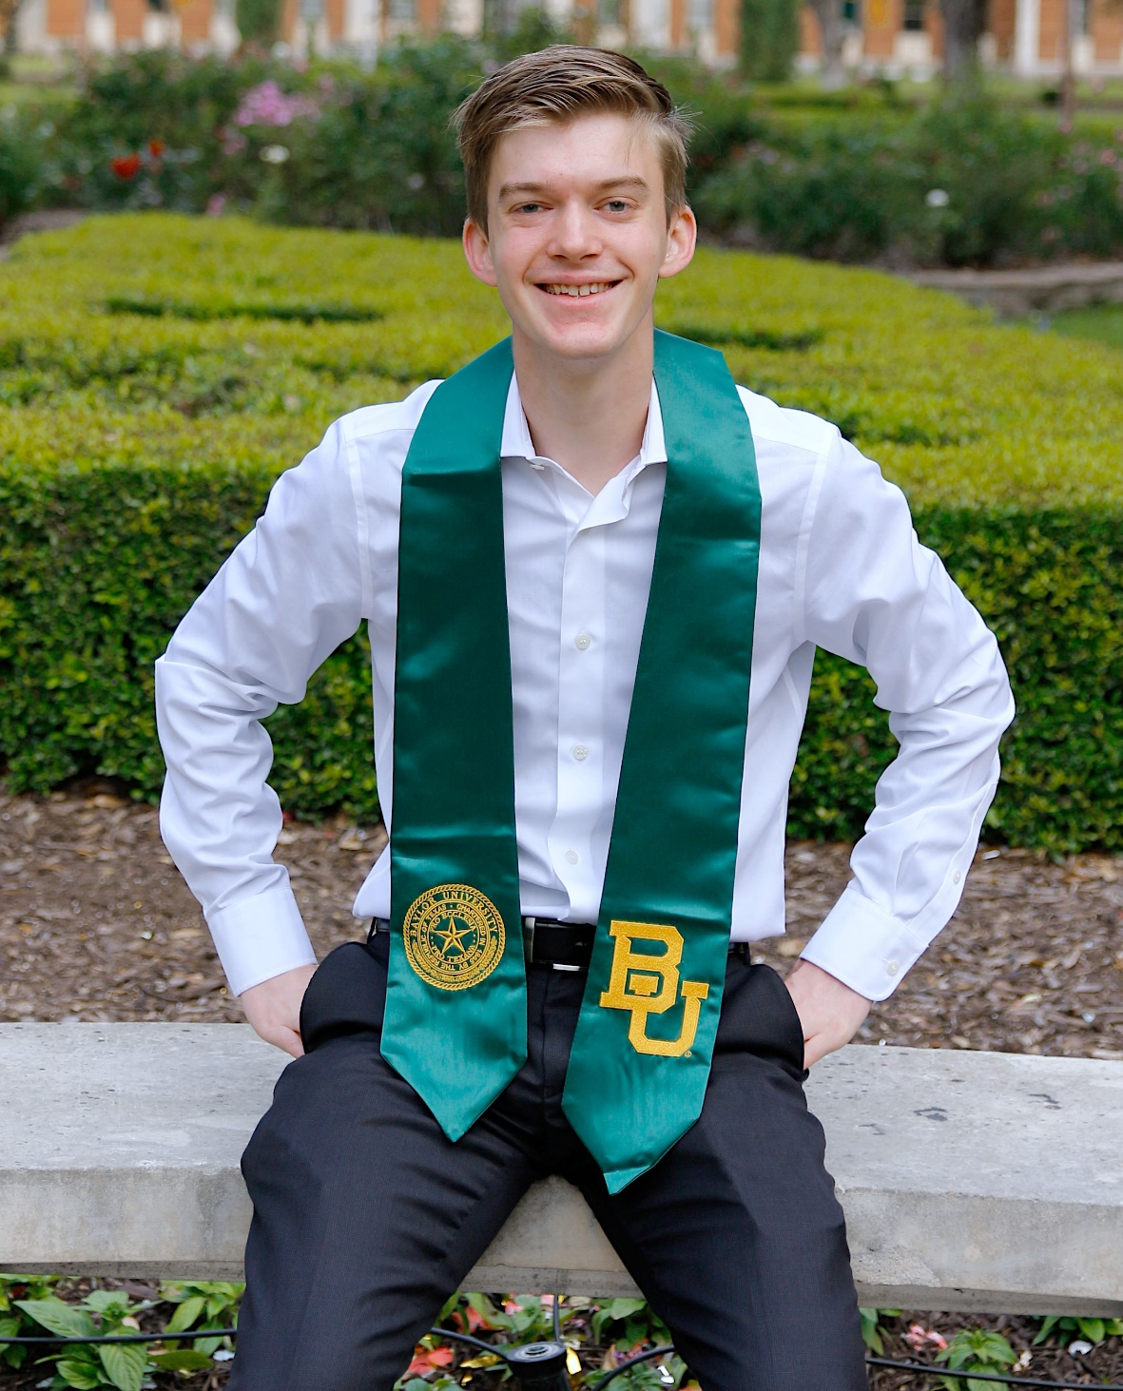
Celebrate Scholarship!

Slide 10
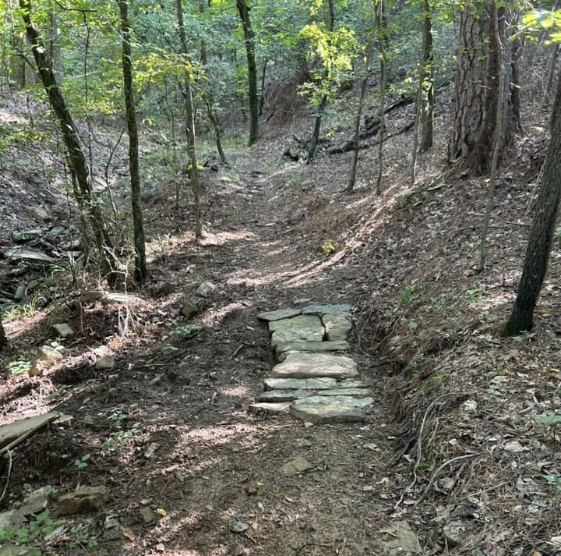
Celebrate
Poteau’s
ROC: Rotary
Outdoor
Complex!

Slide 11
Celebrate Friendship!

Slide 12
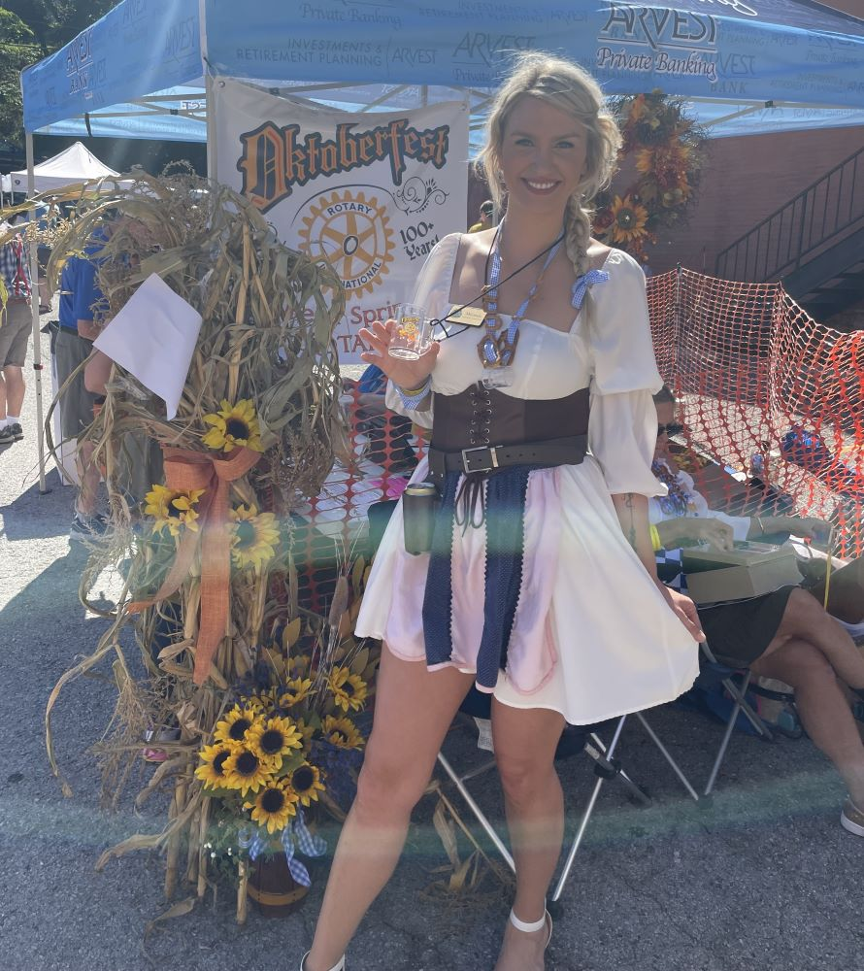
Celebrate Eureka
Springs
Service!

Slide 13
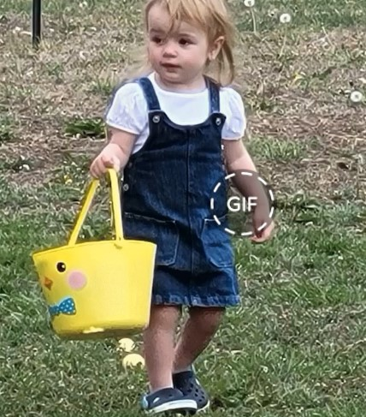
Celebrate
Independence
Easter Egg
Hunt!

Slide 14
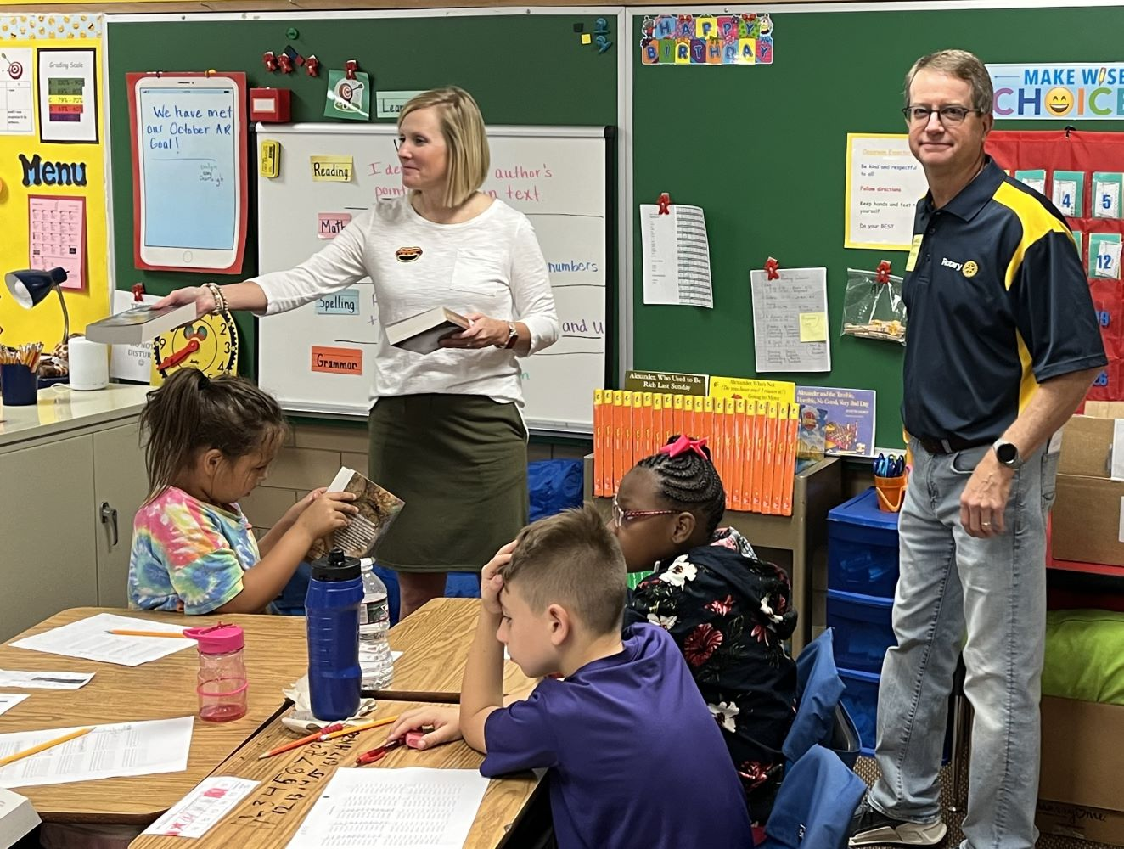
Celebrate Literacy!

Slide 15
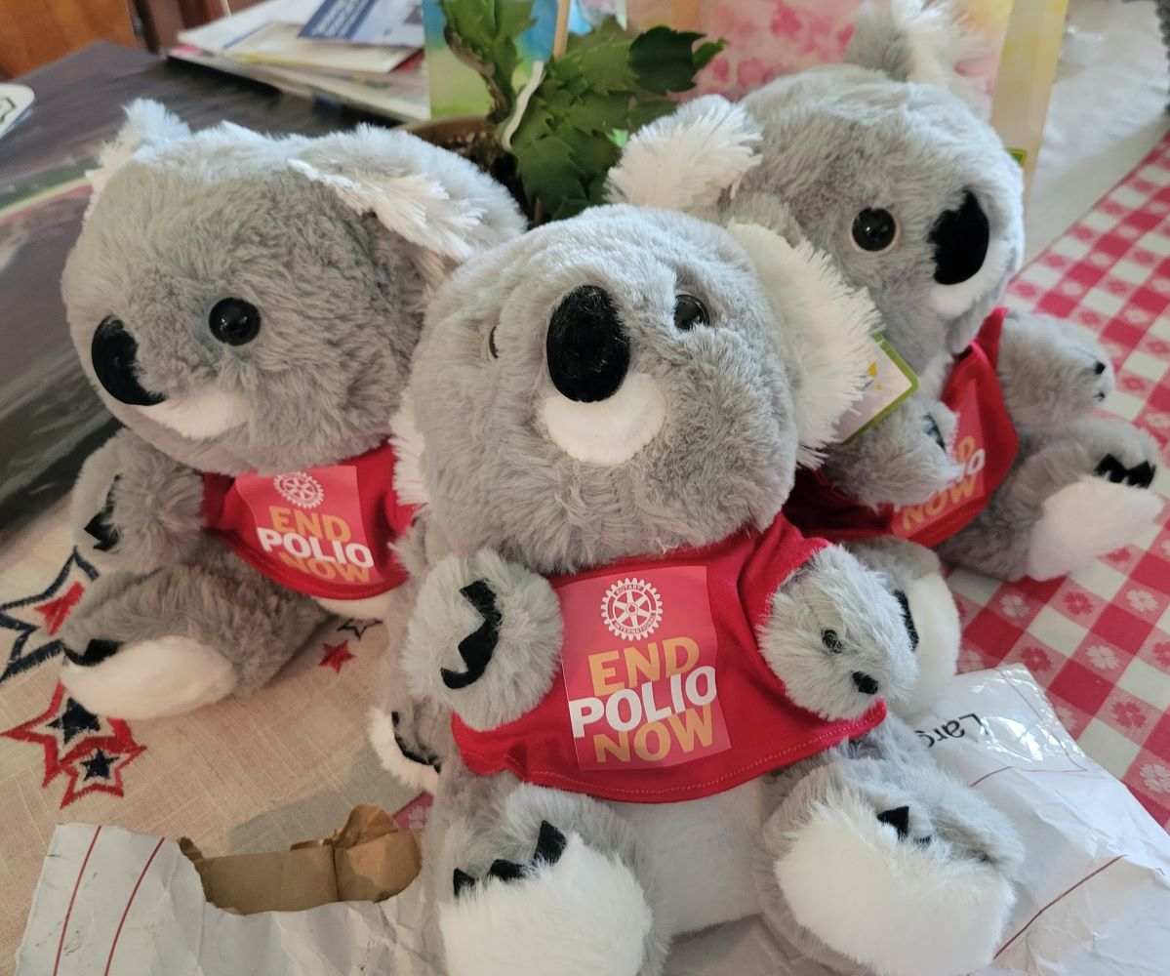
Celebrate
Koala
Polio
Bears!

Slide 16
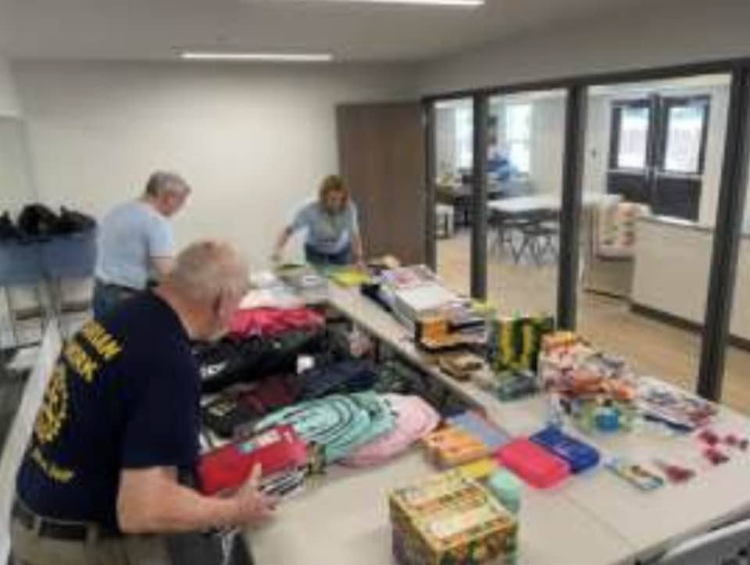
Celebrate
Tulsa
Sunrise!

Slide 17
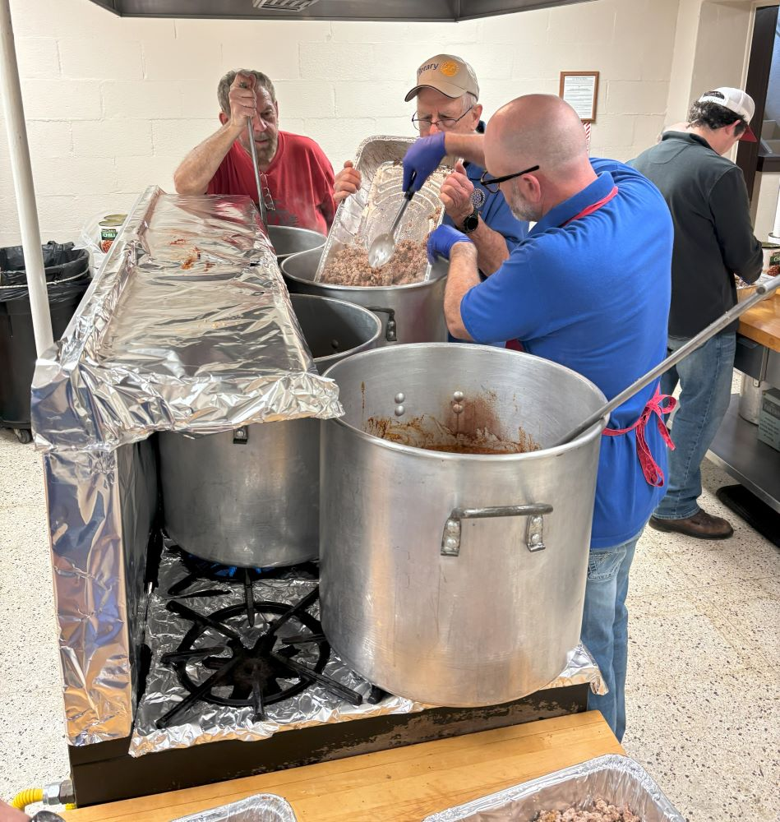
Celebrate Service!

Slide 18
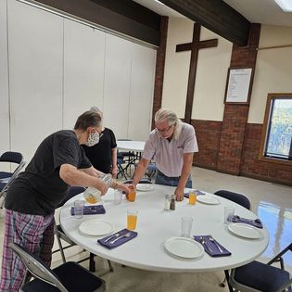
Celebrate 6110!

Slide 19
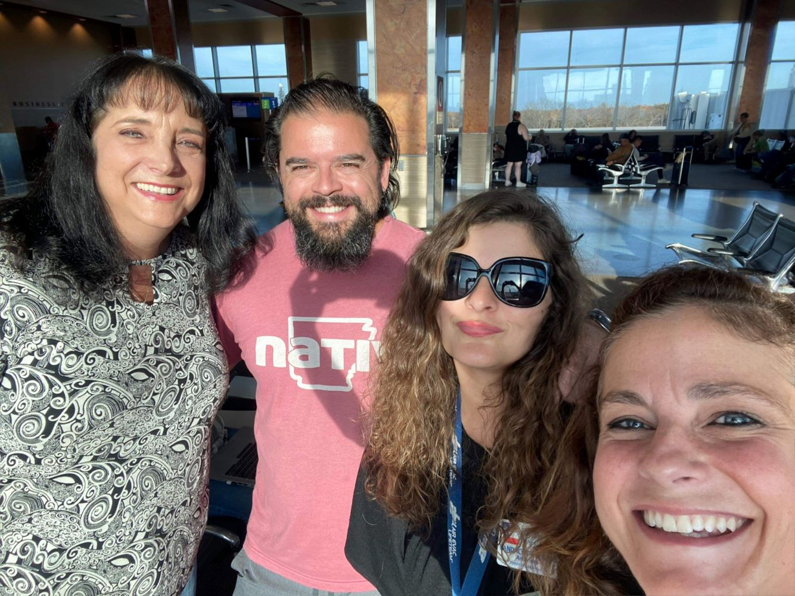
Celebrate Inaugural
D2D!

Slide 20
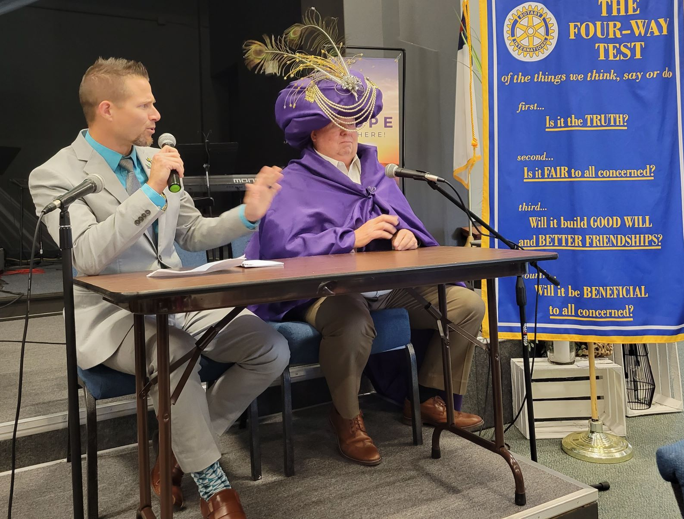
Celebrate Grove’s own Karnac

Slide 21
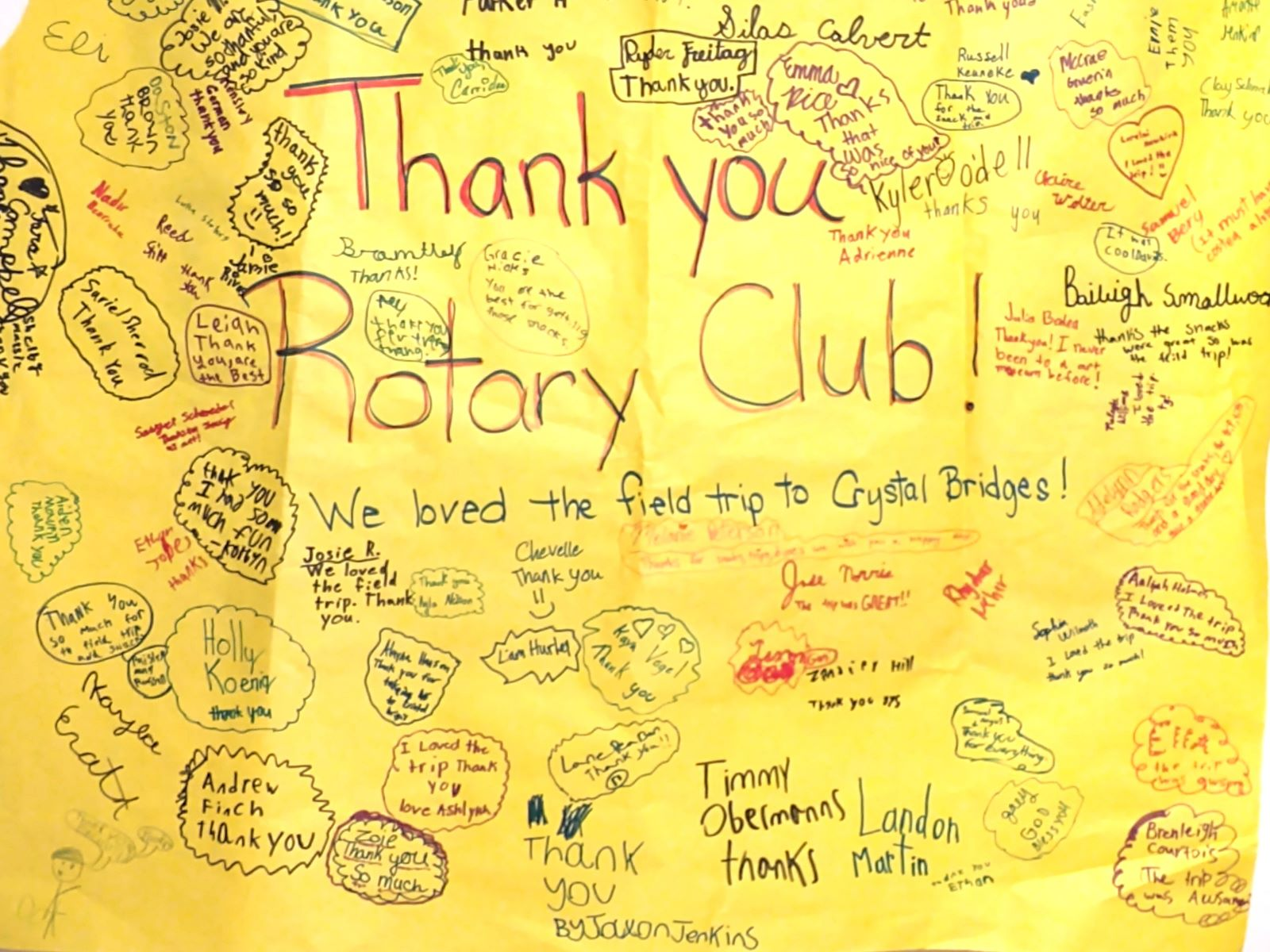
Celebrate
Mt Vernon Service!

Slide 22
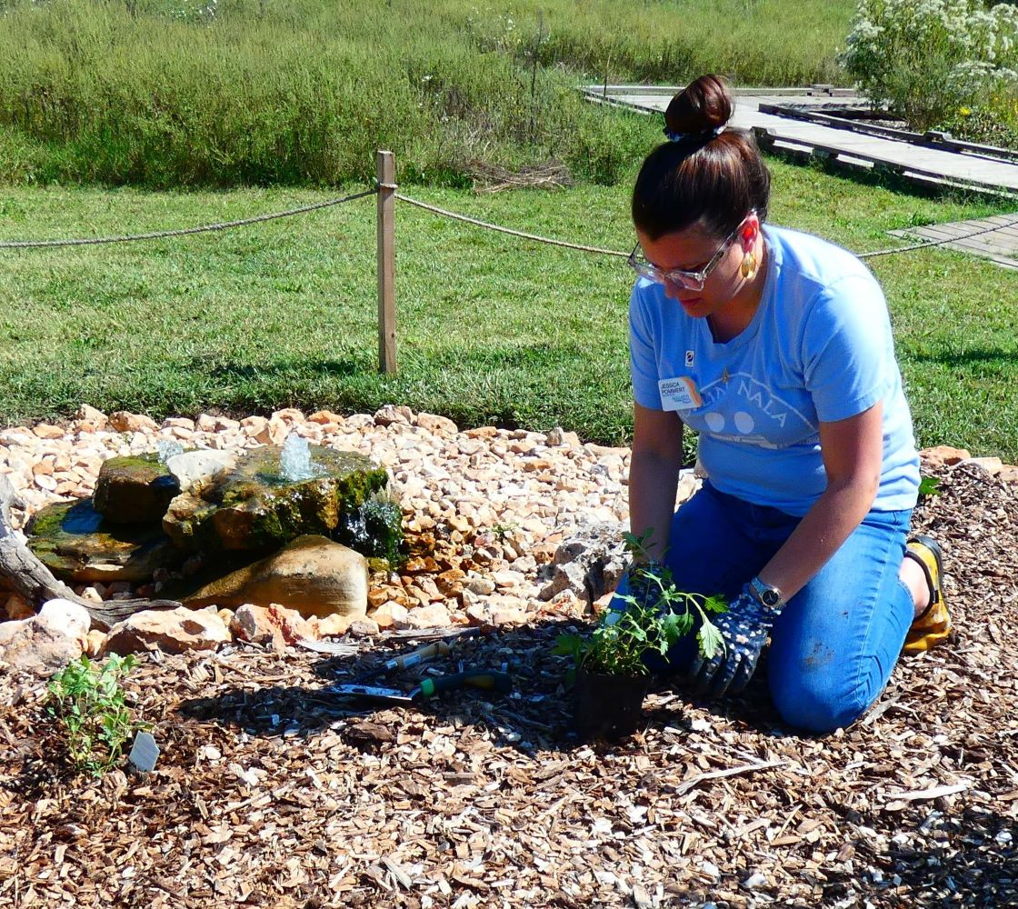
Celebrate
Joplin
Service!

Slide 23
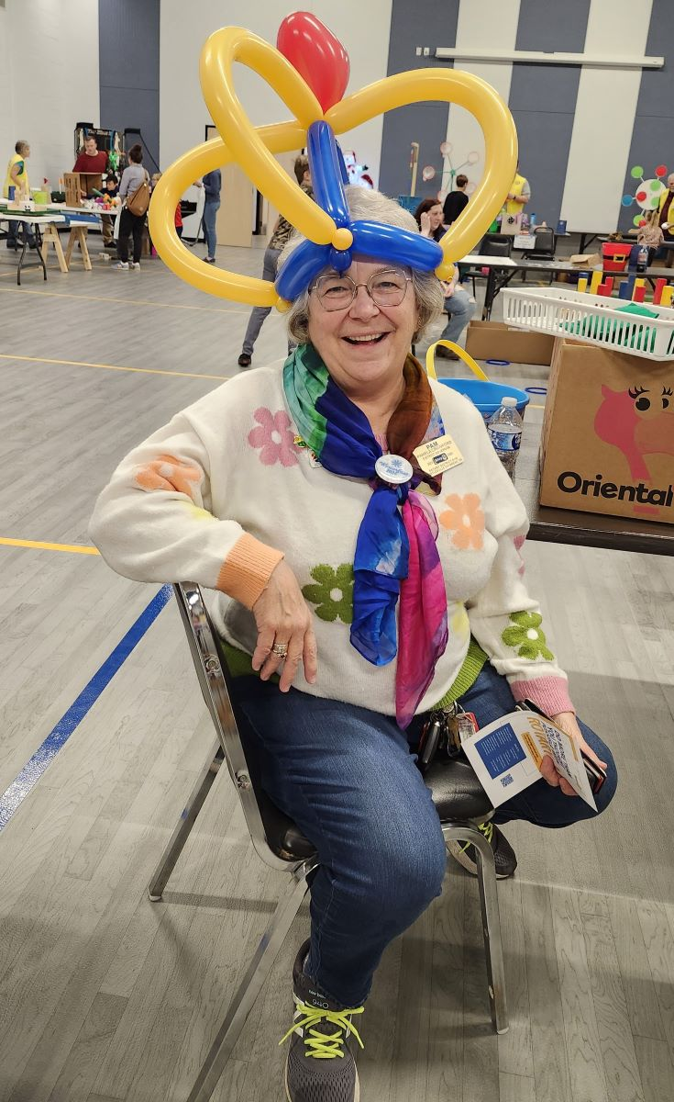
Celebrate District Governor Pam!

Slide 24
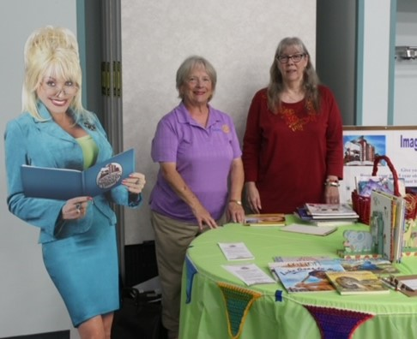
Celebrate Literacy!

Slide 25
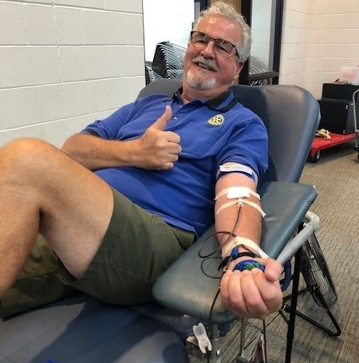
Celebrate Muskogee
Blood Drive!

Slide 26
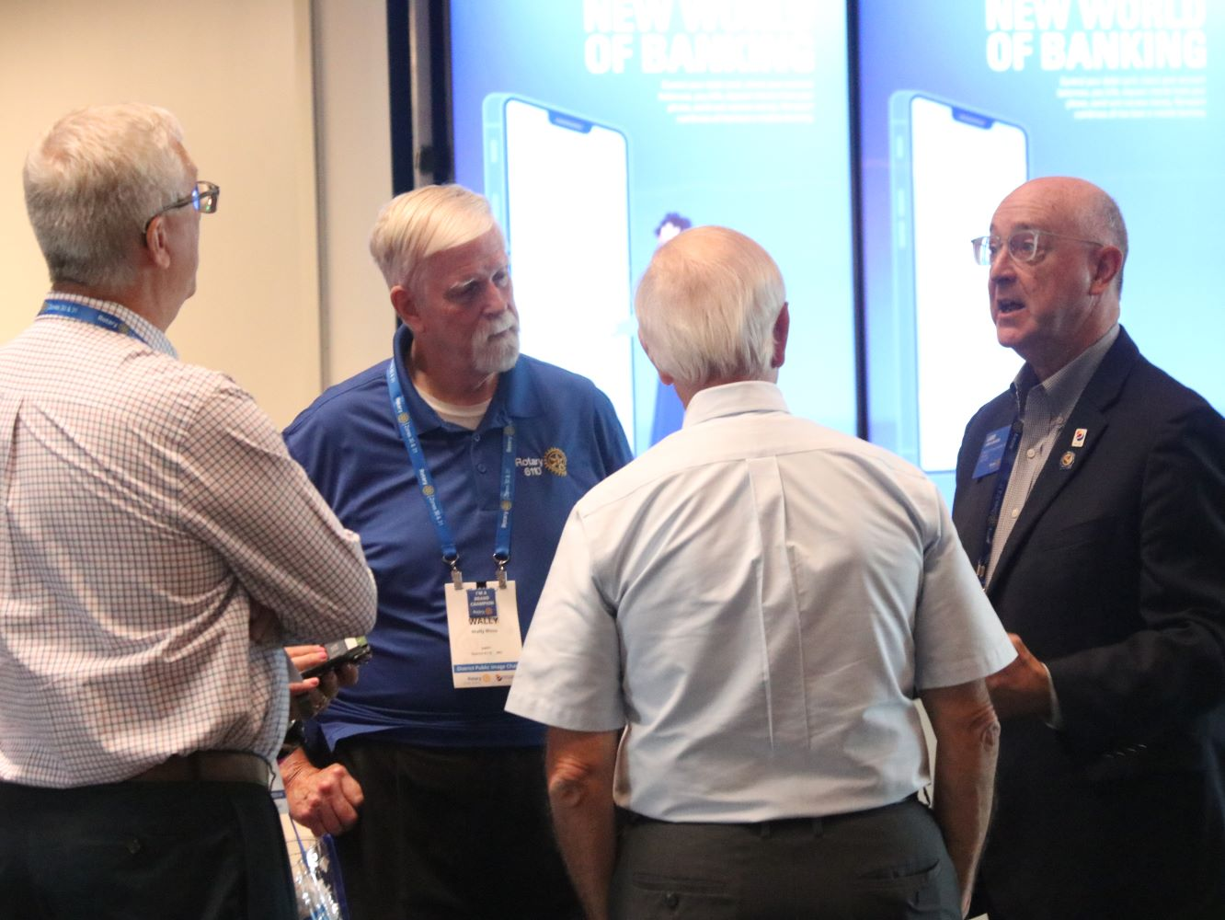
Celebrate
Plans
Afoot!

Slide 27
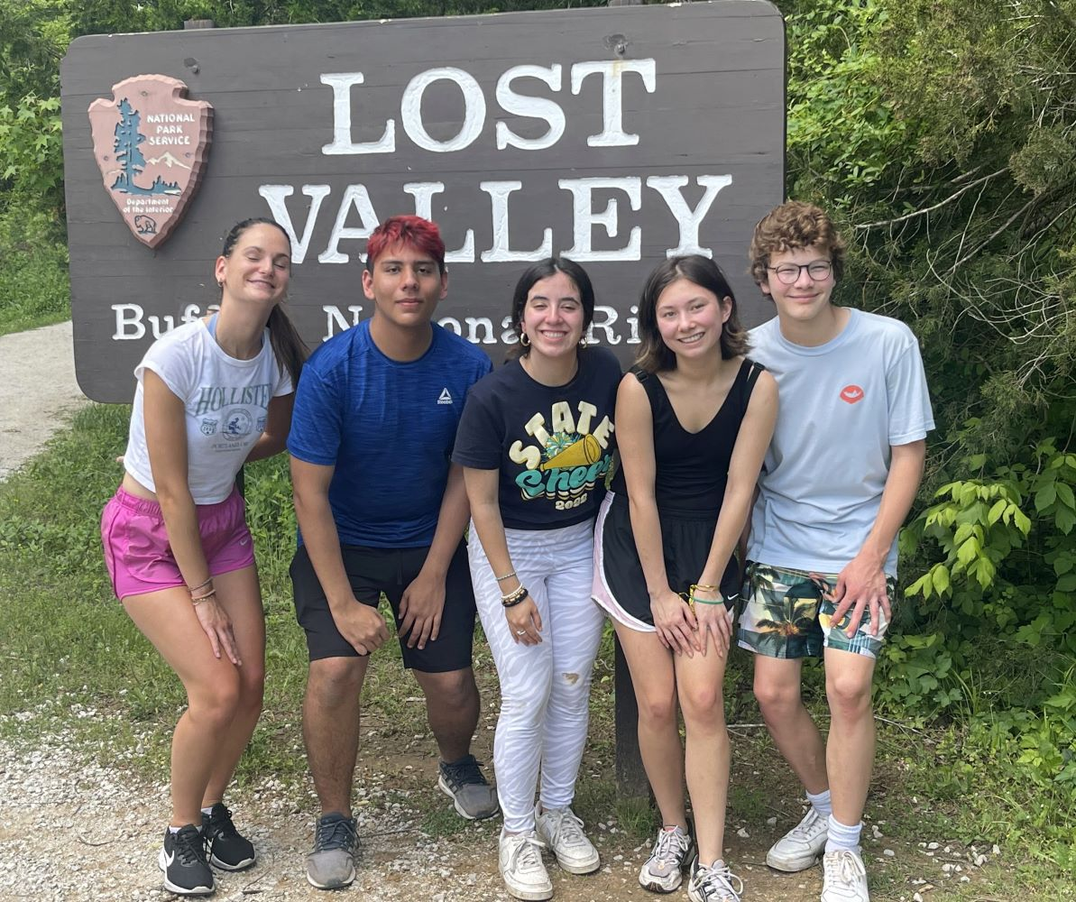
Celebrate
Youth
Exchange!

Slide 28
Celebrate
Car Seat Checks in Pittsburg!

Slide 29
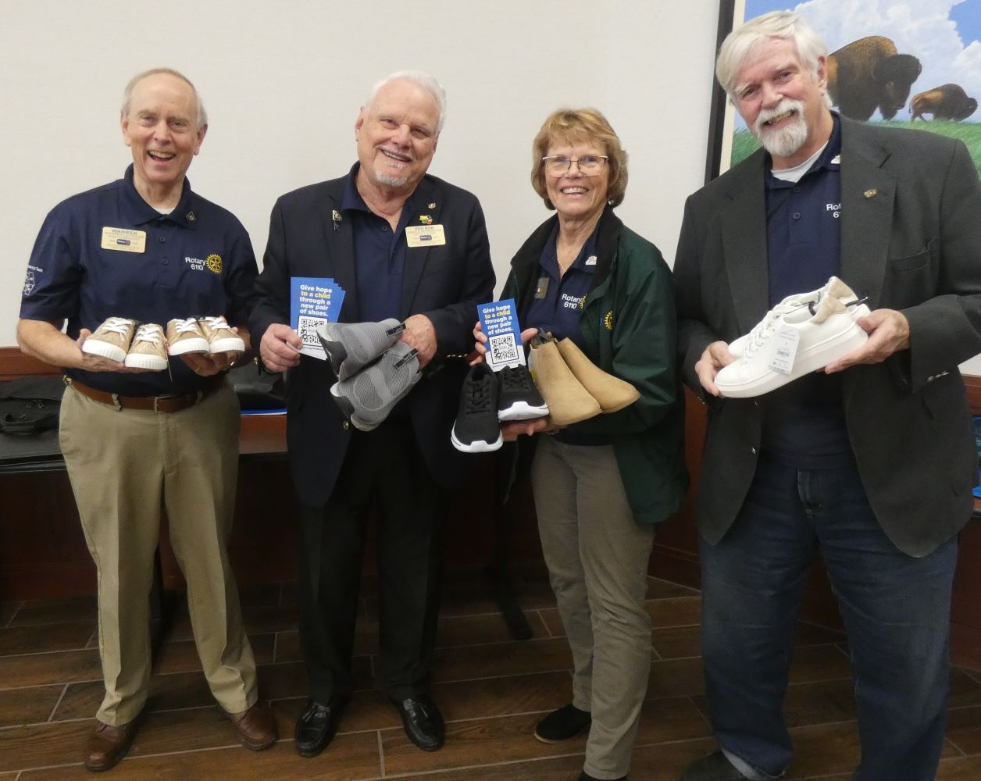
Celebrate
Shoe
Project!

Slide 30
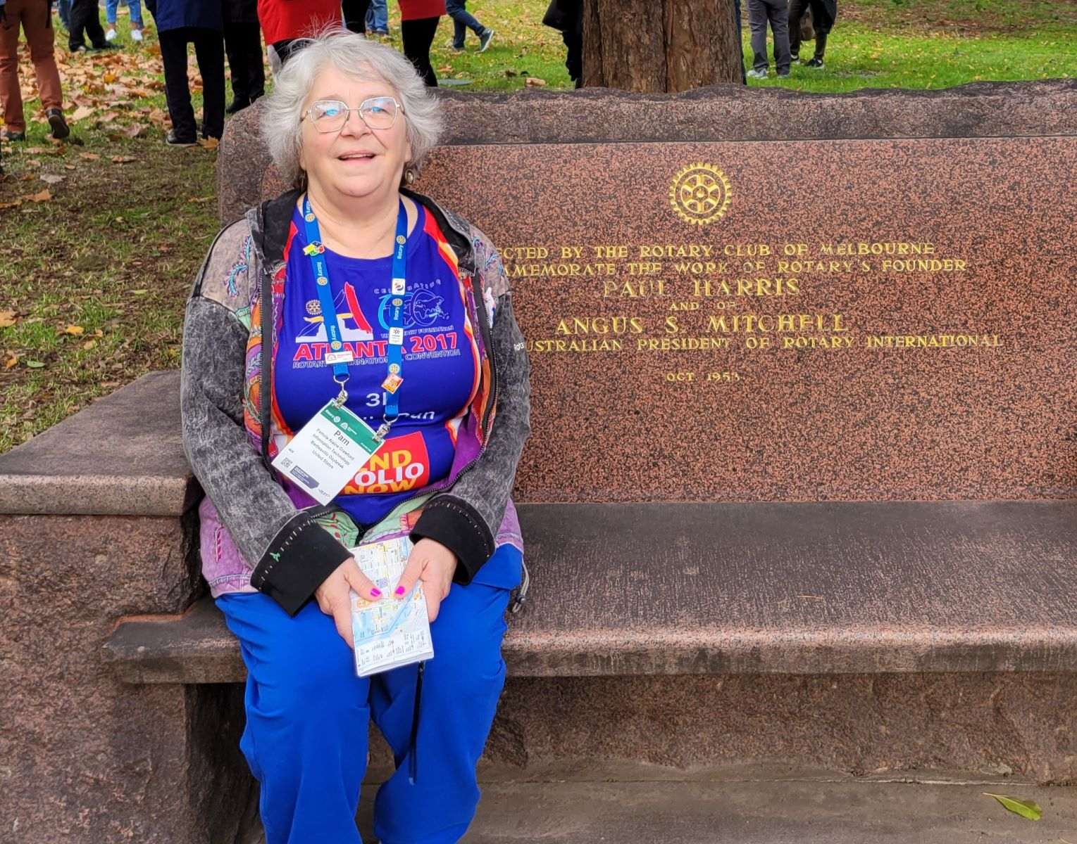
Celebrate
End of
Polio
Walk!

Slide 31
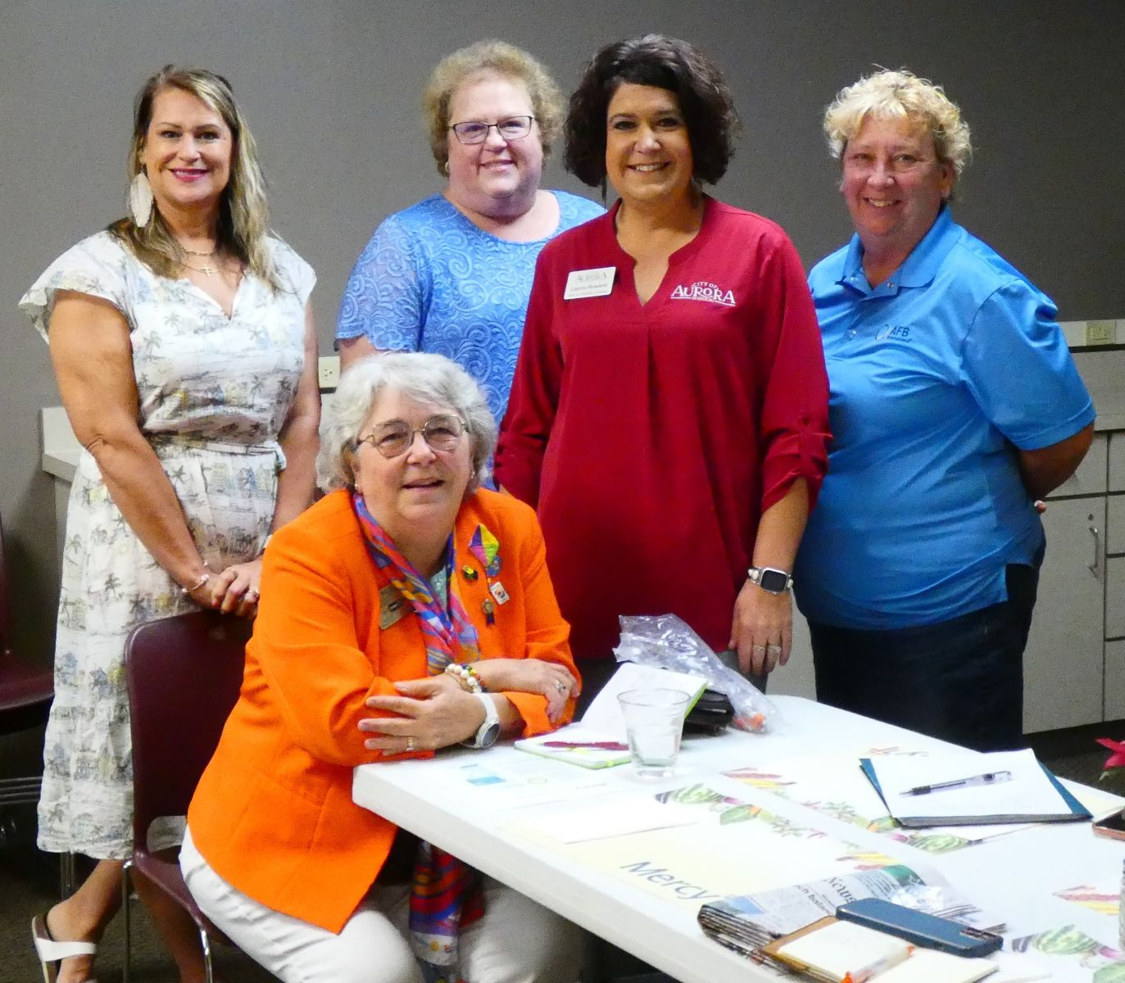
Celebrate
Aurora
Women
Leaders!

Slide 32
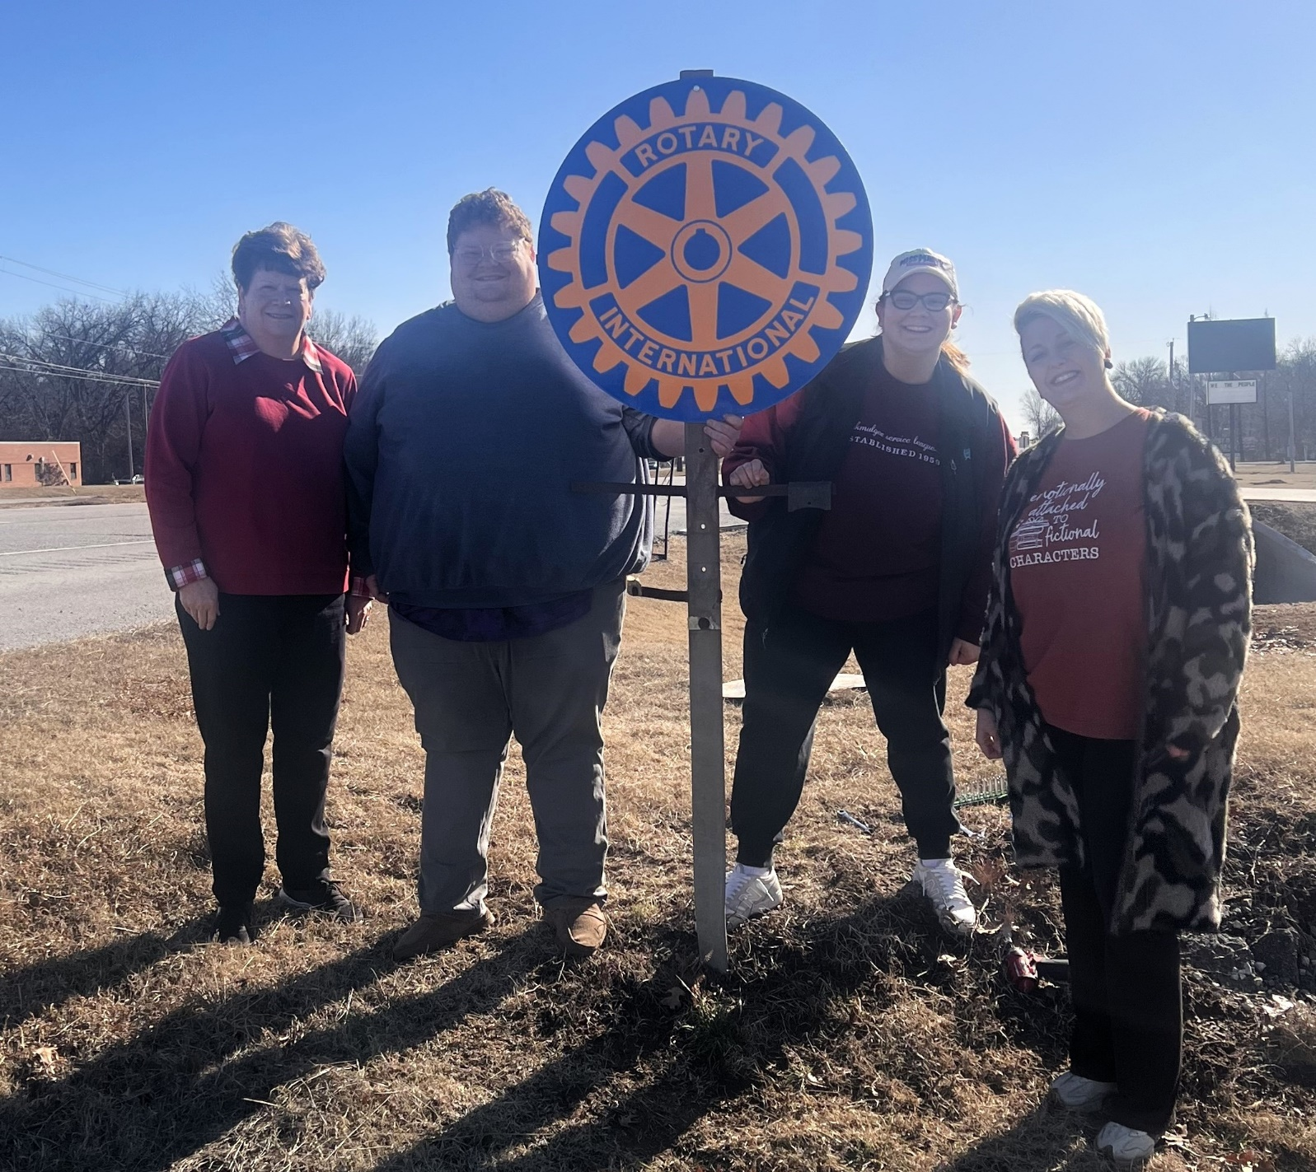
Celebrate
Okmulgee
New Sign!

Slide 33
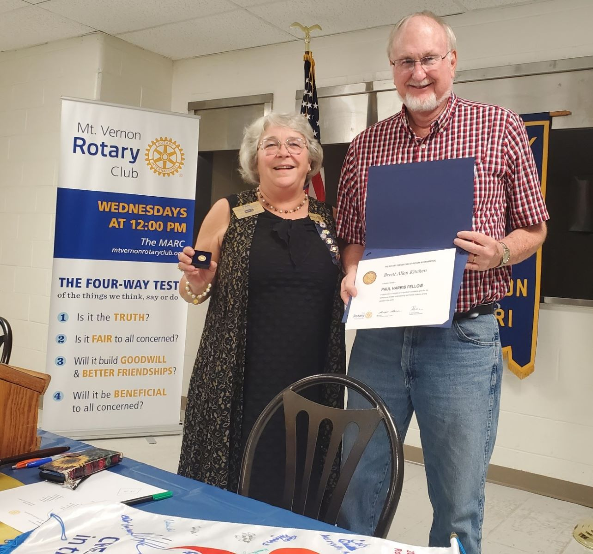
Celebrate
New Paul
Harris
Award!

Slide 34
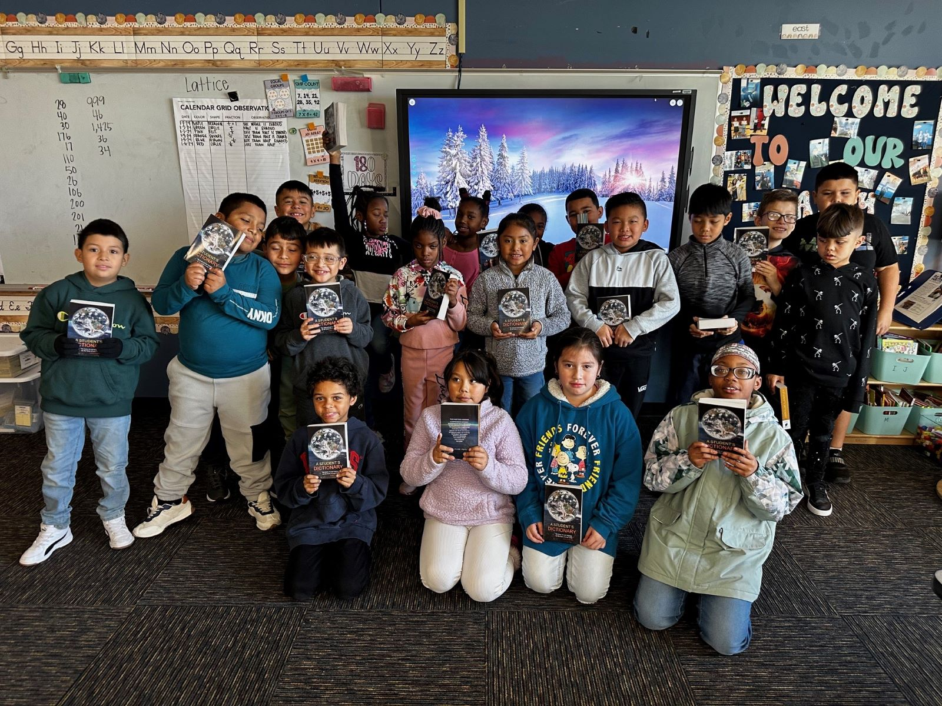
Celebrate Southeast Tulsa’s
Rosa Parks School
Literacy!

Slide 35
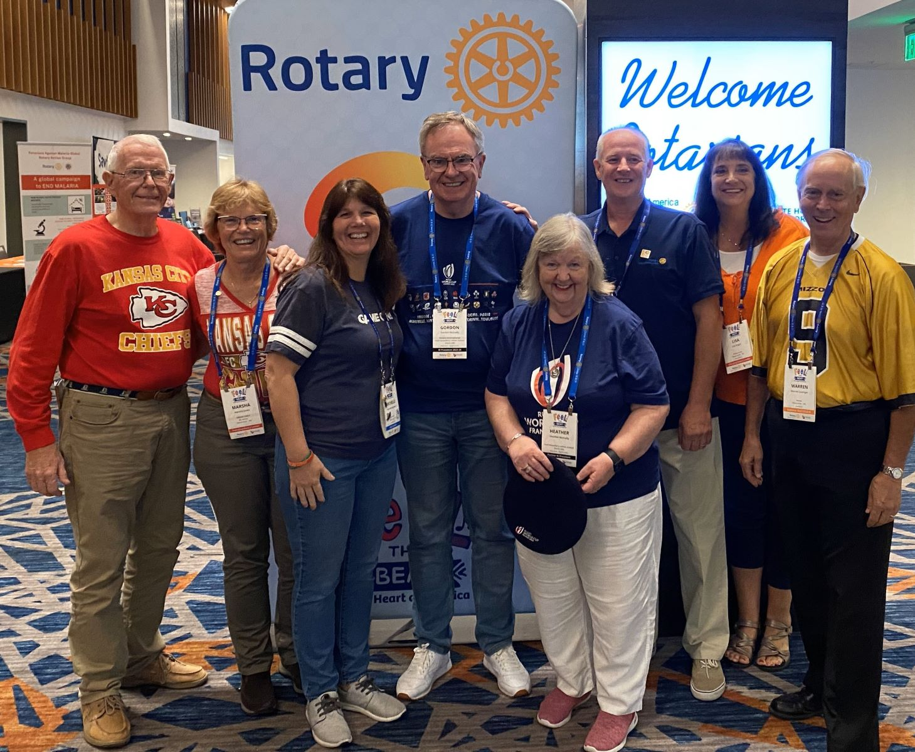
Celebrate Rotary International President!

Slide 36
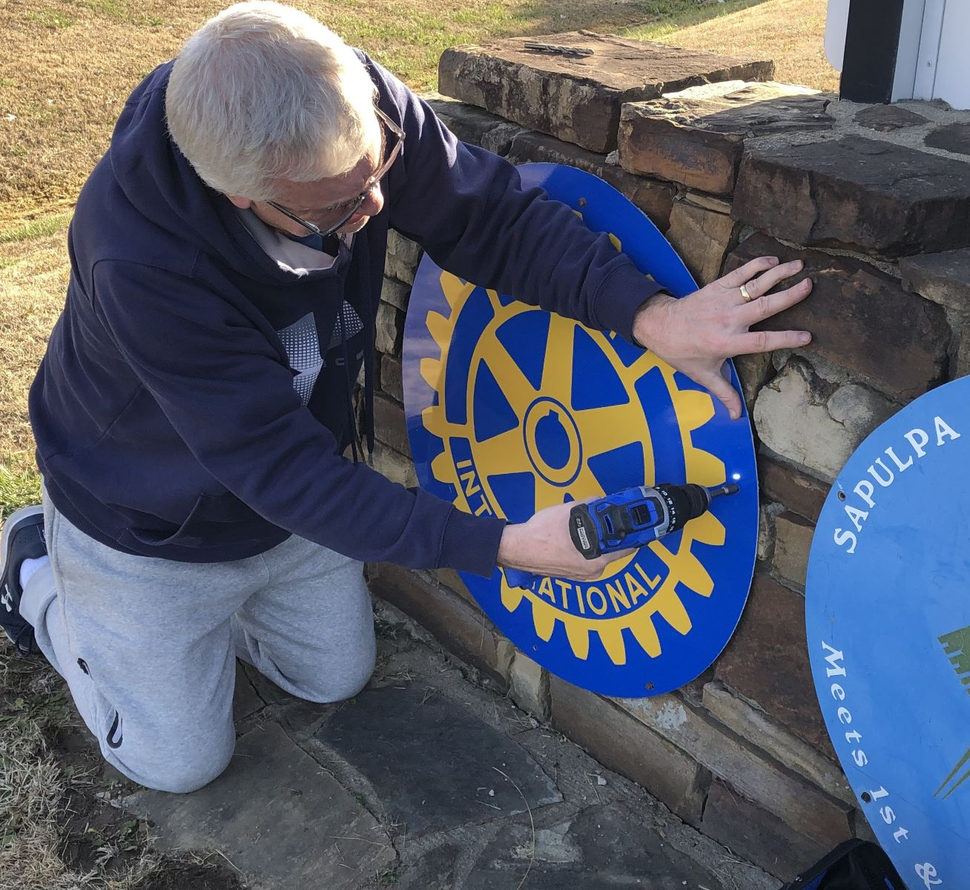
Celebrate
Sapulpa
New Sign!

Slide 37
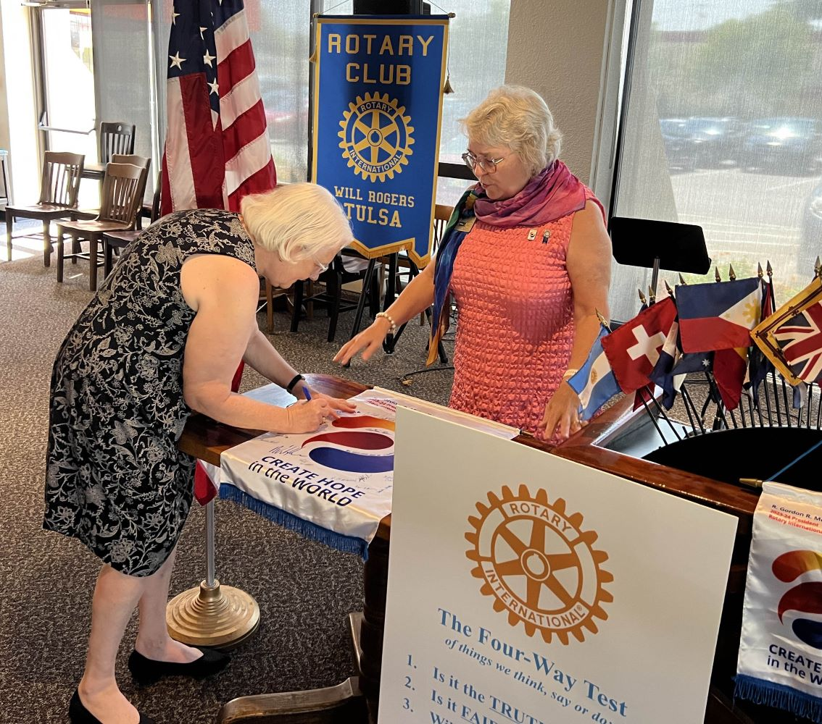
Celebrate DG Banner At Will Rogers!

Slide 38
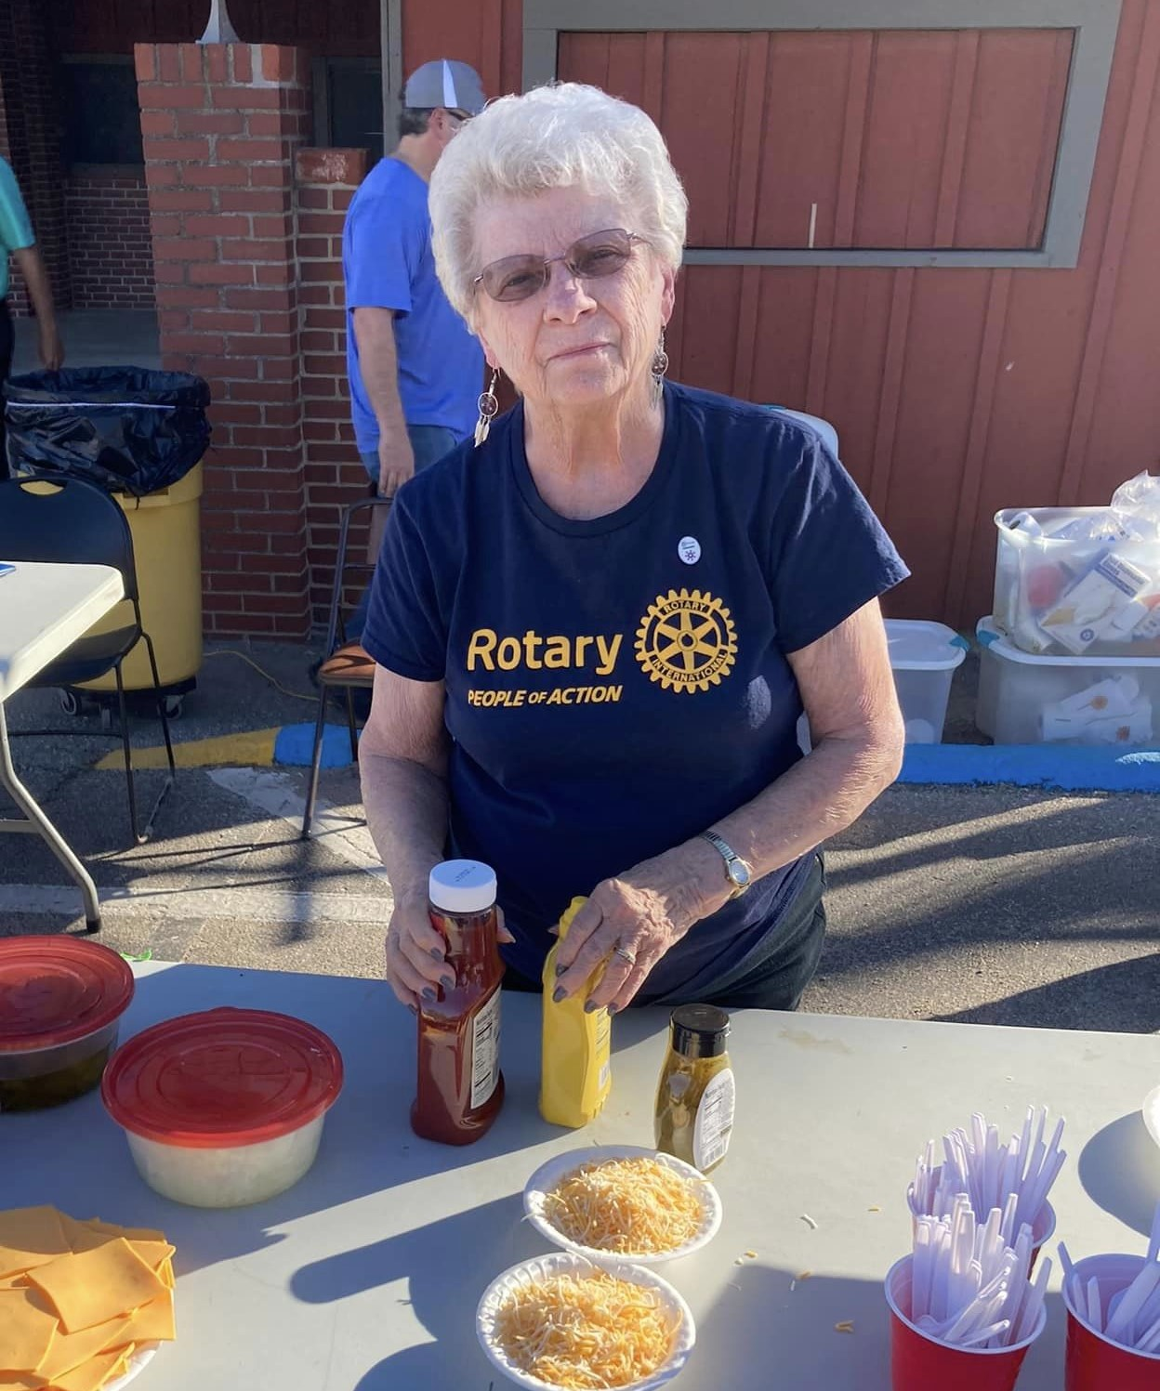
Celebrate
Fredonia Scholarships with the
Tailgate
Project at
Football
game!

Slide 39
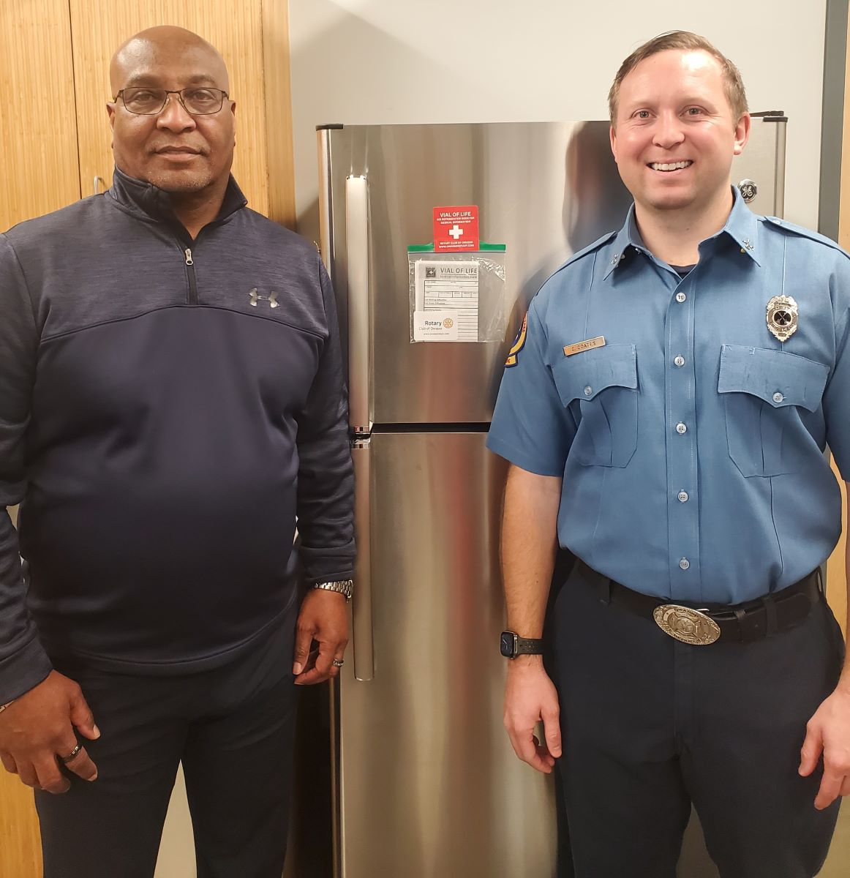
Celebrate
Owasso
Partners!

Slide 40
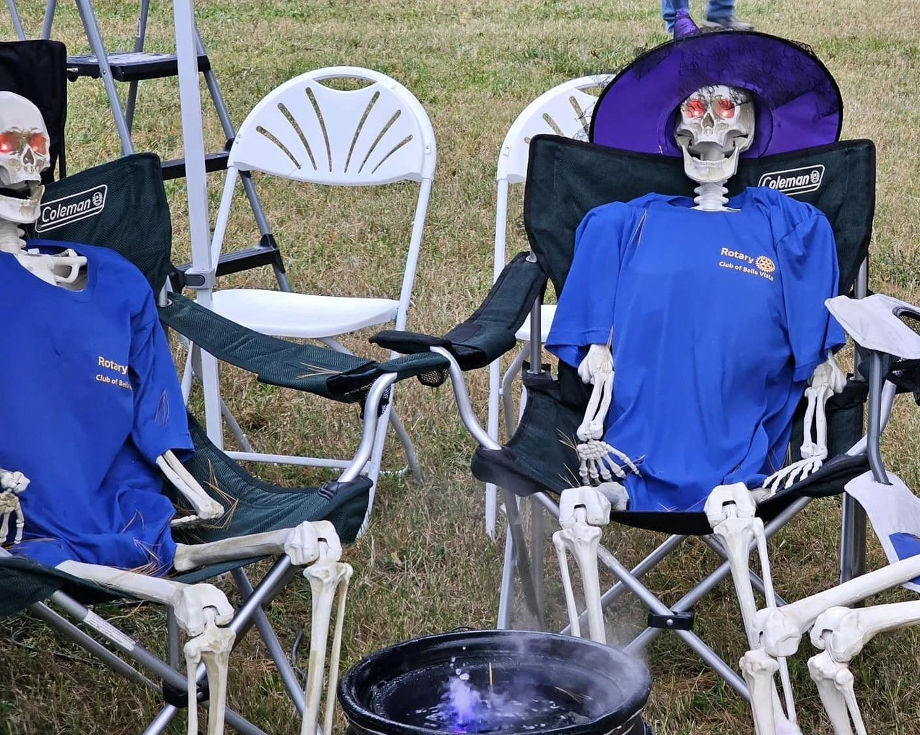
Celebrate?
Long Club Meetings!

Slide 41
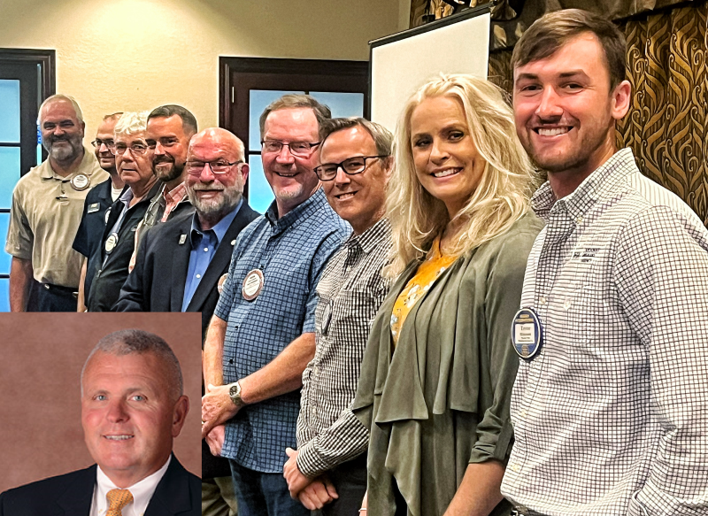
Celebrate
Ten New
Paul Harris Fellows at Mountain
Home!

Slide 42
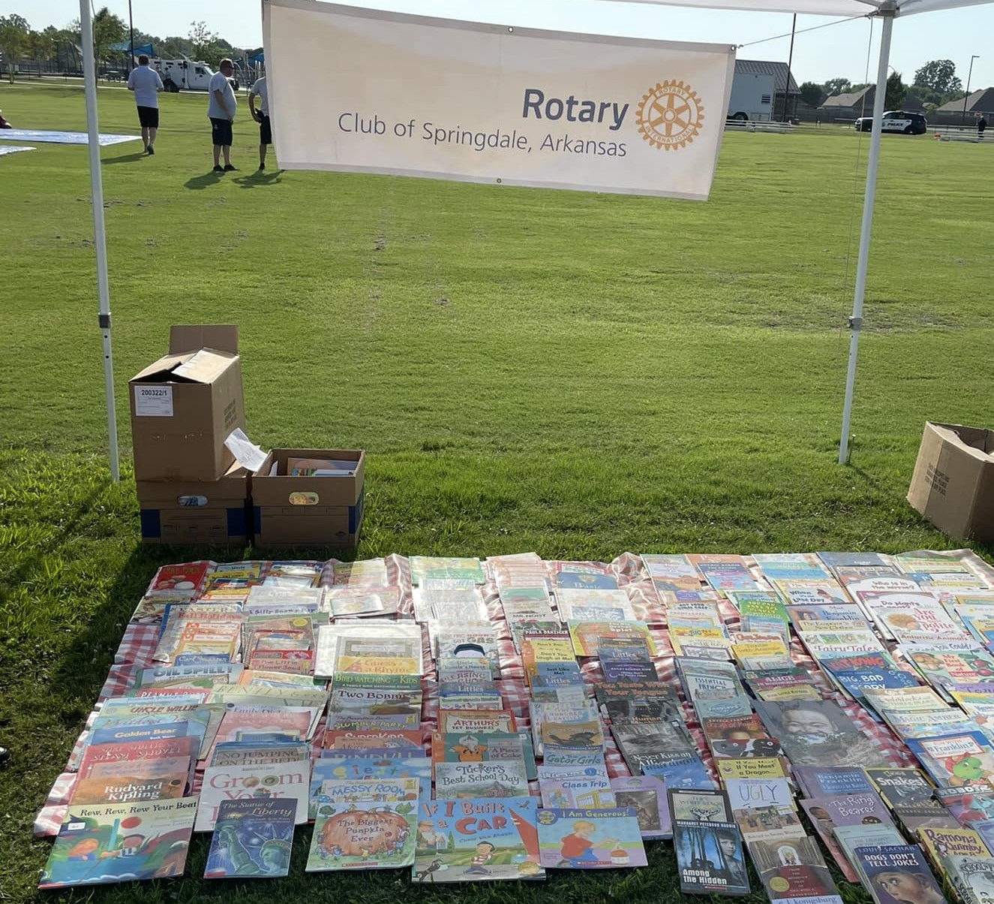
Celebrate
Literacy at Springdale!

Slide 43
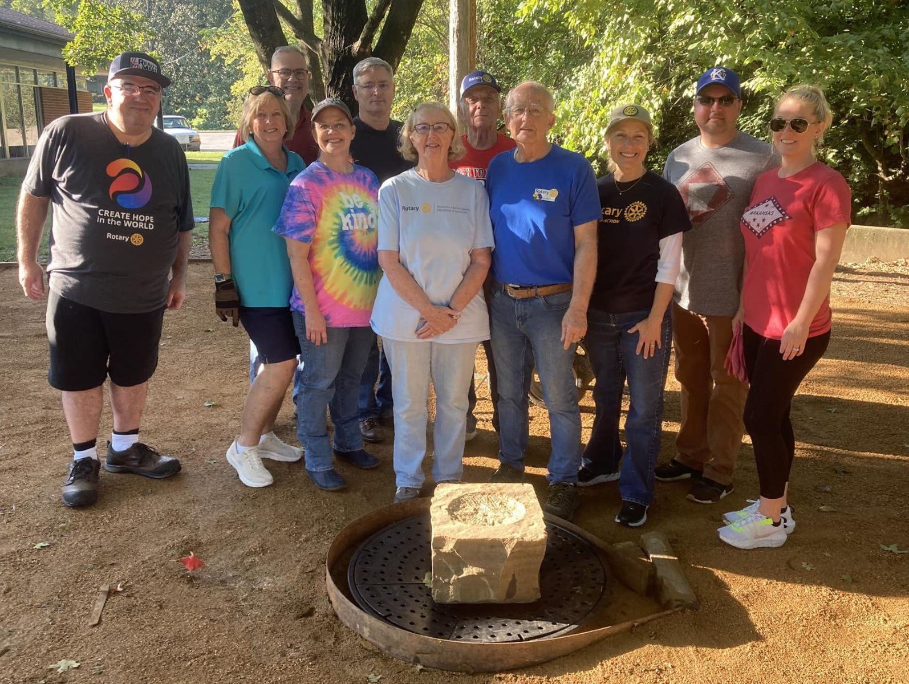
Celebrate
Siloam
Springs
Healing
Garden!

Slide 44
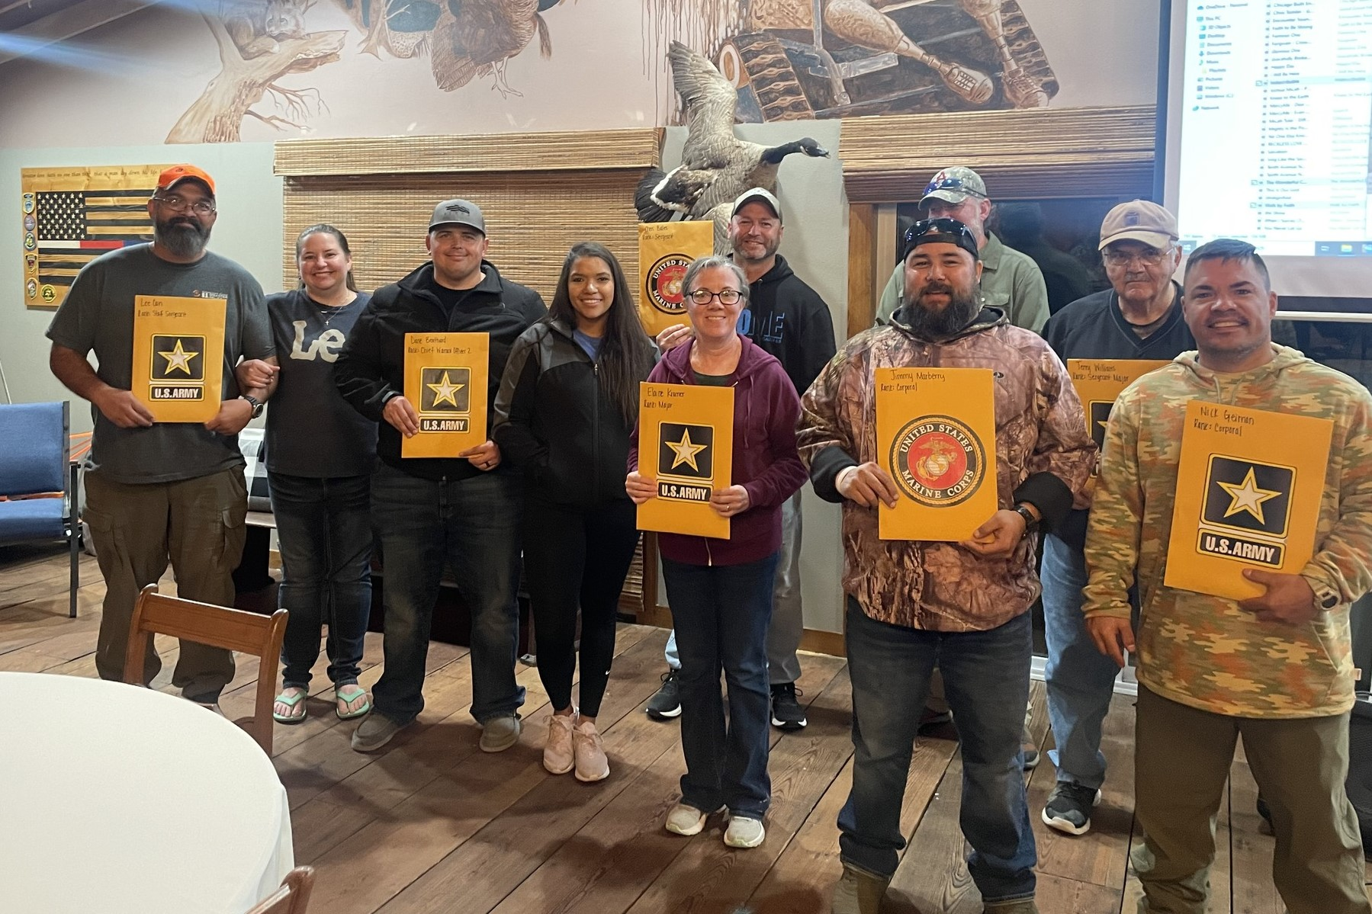
Celebrate
Webb City/
Carl Junction
Honors
Veterans!

Slide 45
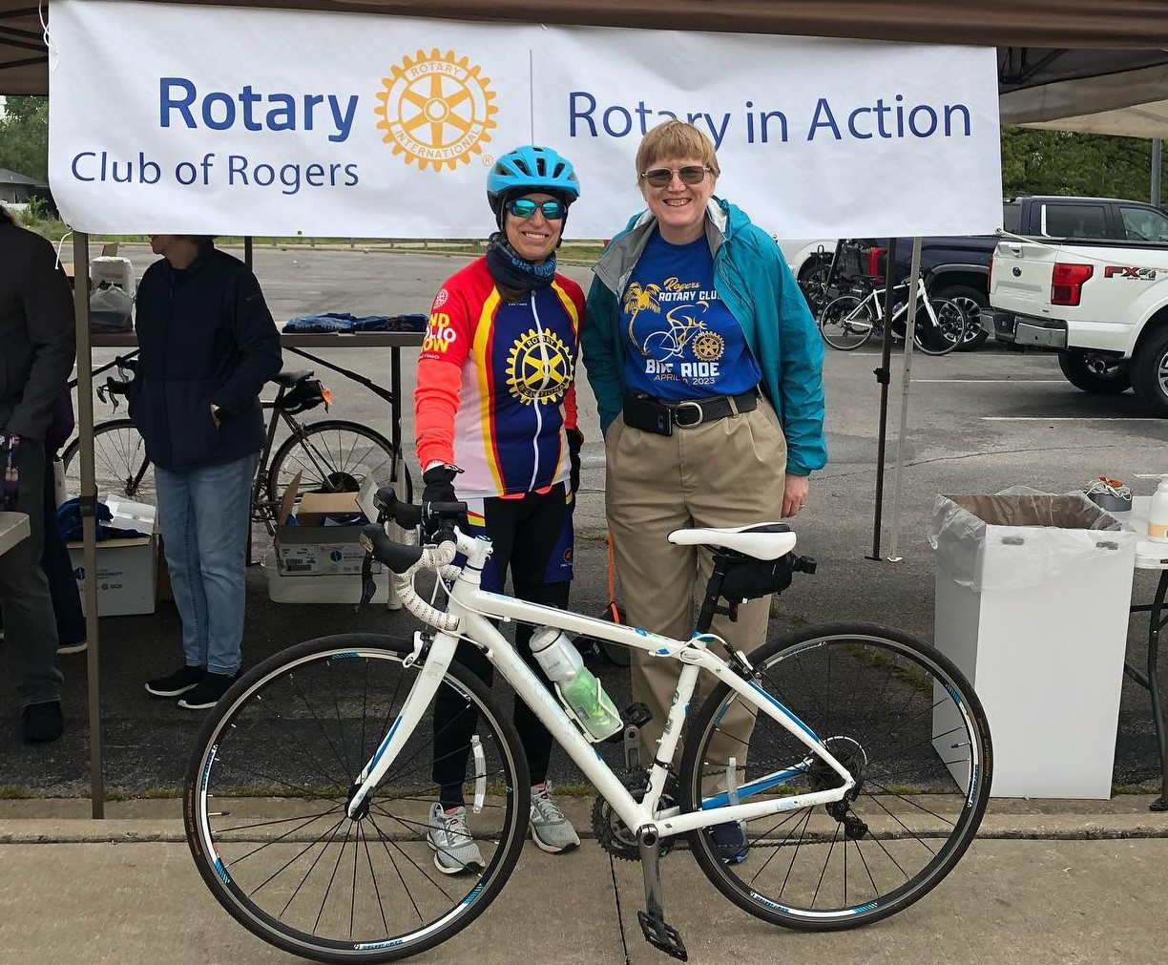
Celebrate
Rogers
Ride!

Slide 46
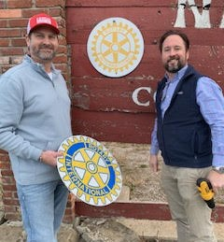
Celebrate Nevada
Update
Club Logo!

Slide 47
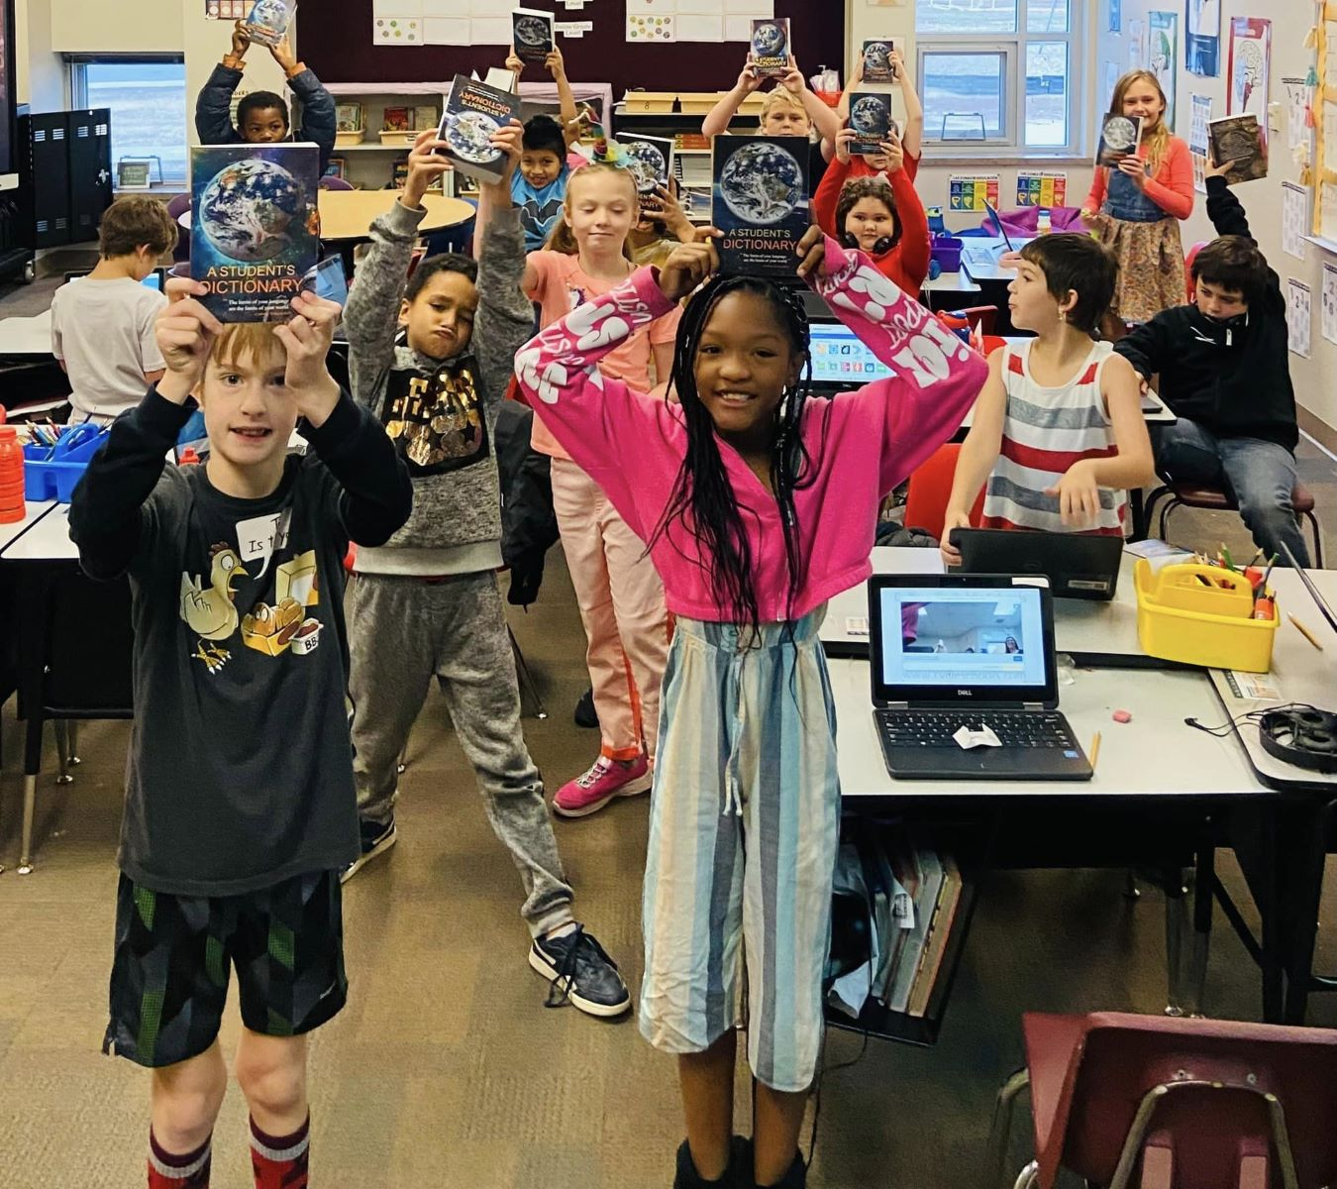
Celebrate
Coffeyville Literacy!

Slide 48
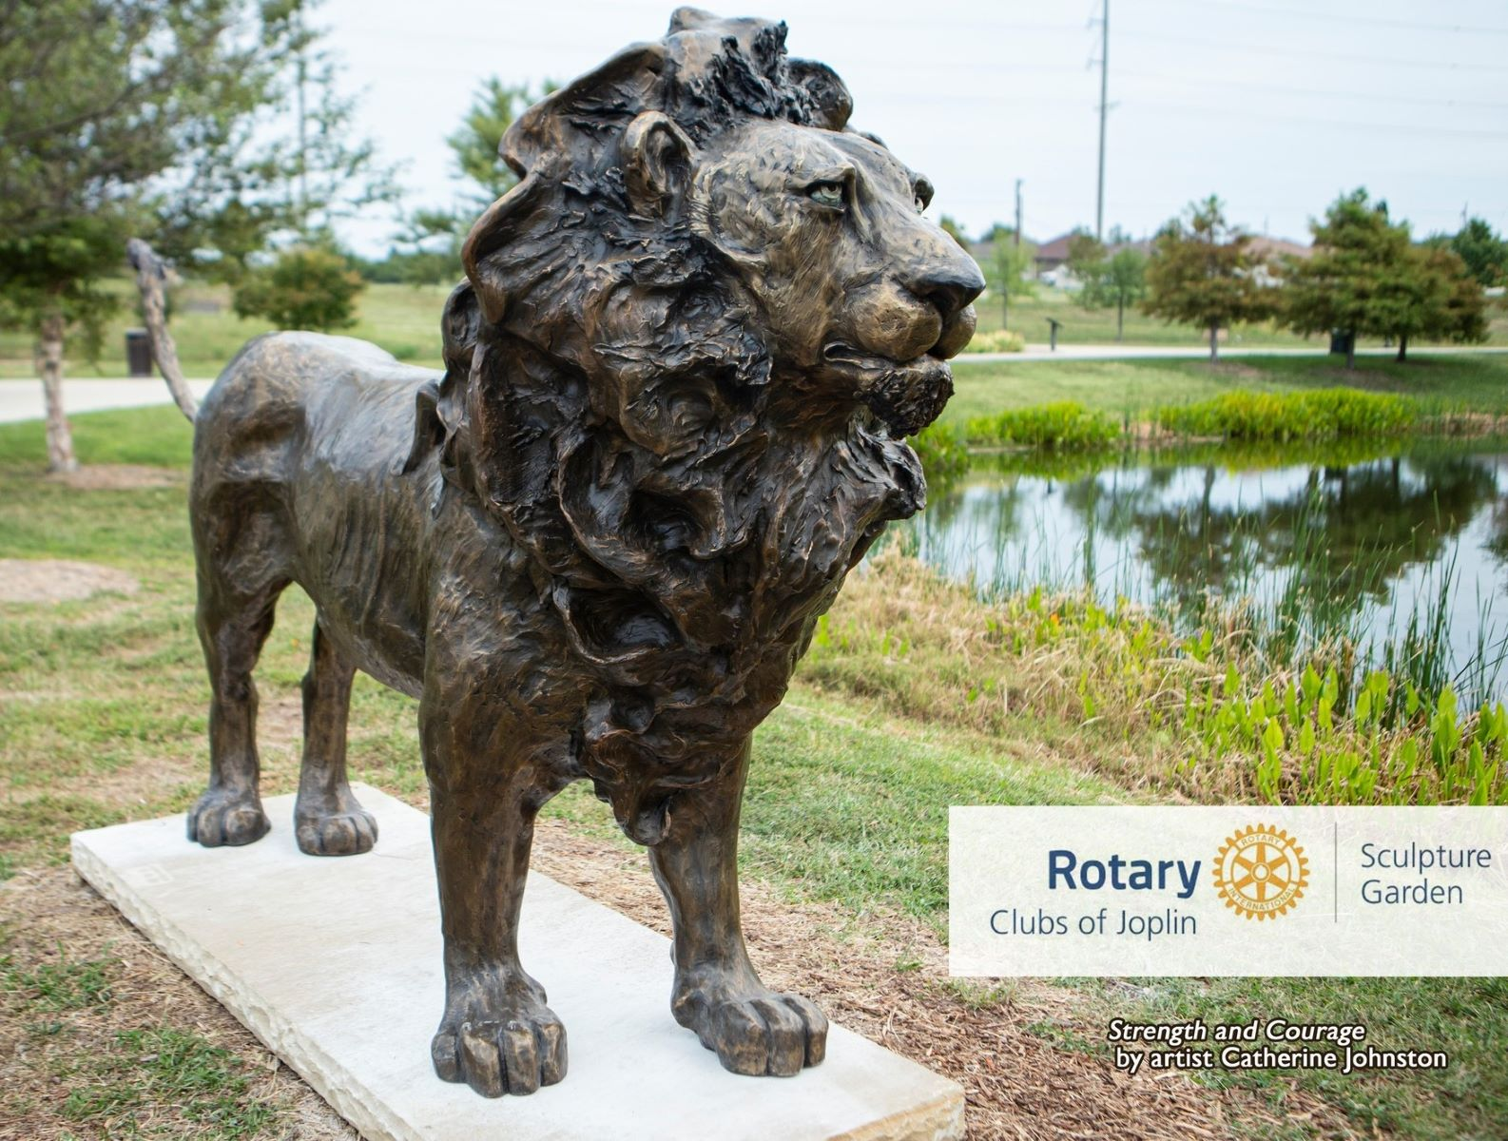
Celebrate Strength & Courage
Rotary Clubs of Joplin Sculpture Garden!

Slide 49
Celebrate
Tulsa
Fund
Raisers!

Slide 50
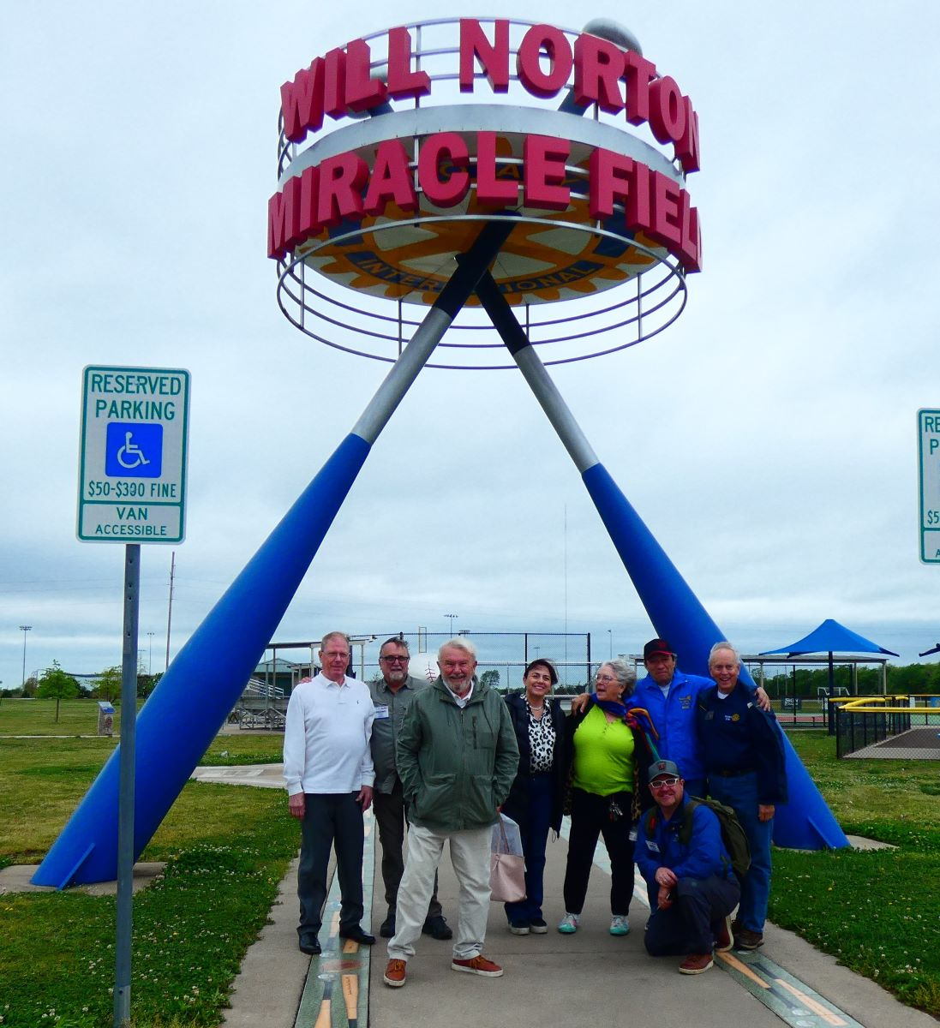
Celebrate
Chile D2D Rotarians
Visit
Joplin!

Slide 51
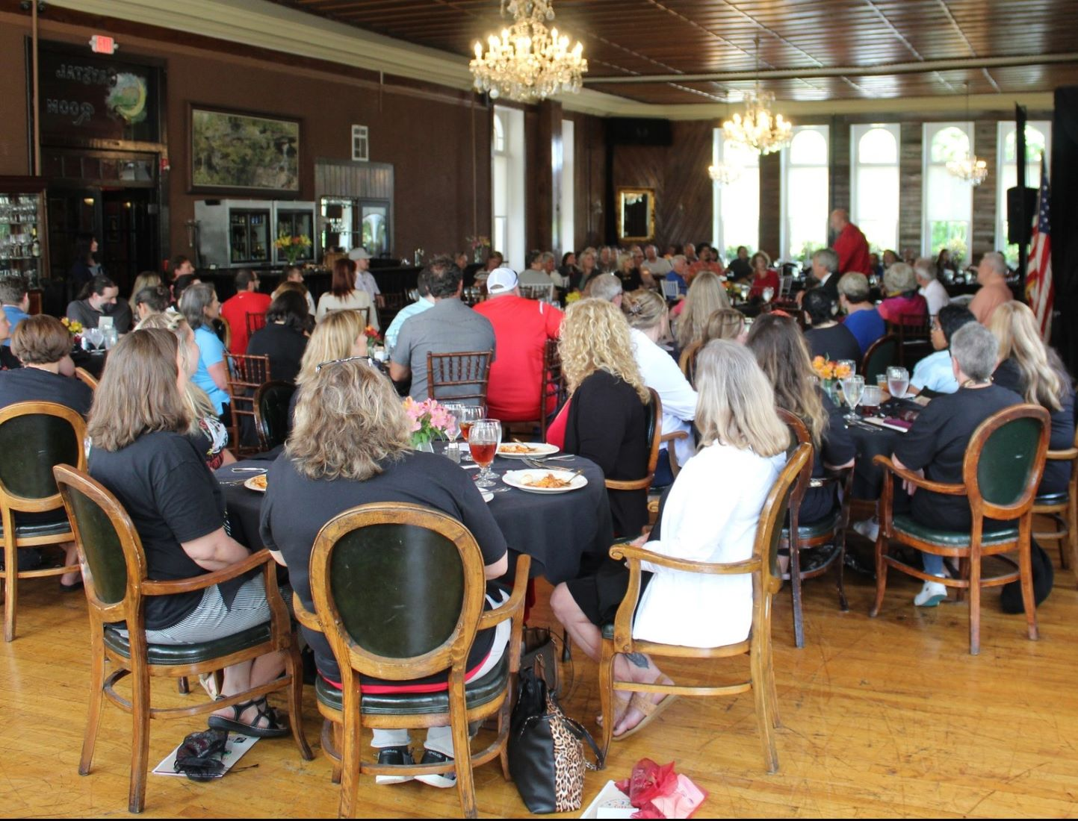
Celebrate Eureka
Teachers Honored

Slide 52
Celebrate
The End is Near!
(Of Polio,
not the
slide show)

Slide 53
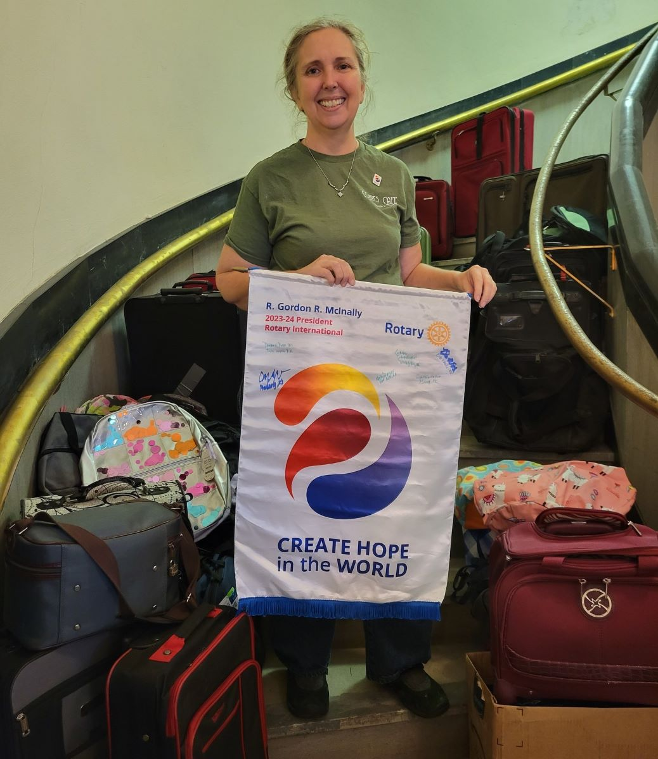
Celebrate
Fort Scott
Project

Slide 54
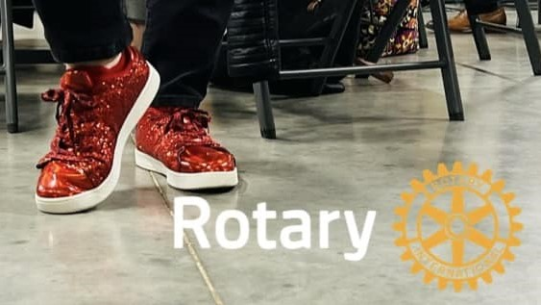
Celebrate
DG Pam’s
Wild Shoes

Slide 55
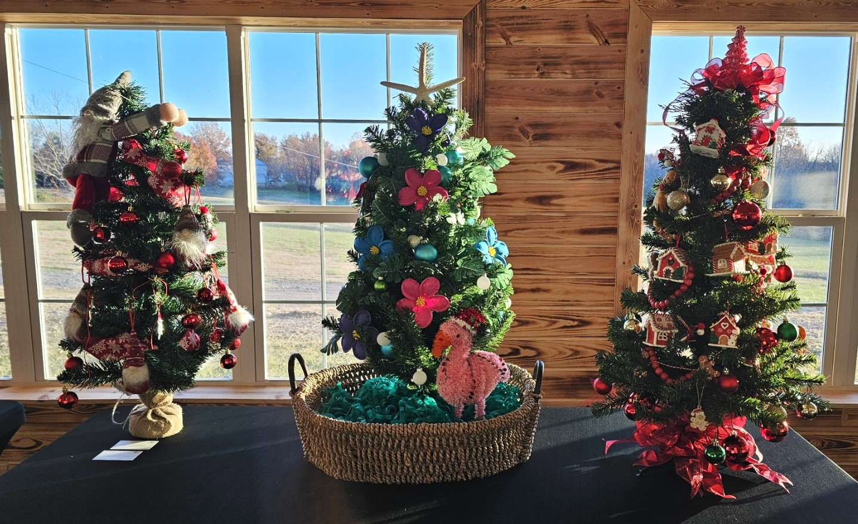
Celebrate Wagoner Tree Fund-Raiser
Forprojects!

Slide 56
Celebrate
Jenks Support
Of Local
Non-Profits!

Slide 57
Celebrate
Women In Rotary!

Slide 58
Celebrate Rotary:
People of Action!

Slide 59
Celebrate
Mid-Marion’s
Turkey-Trot
Festival Now
Run by
Rotary!

Slide 60
Celebrate
Siloam Springs New Member!

Slide 61
Celebrate
Van Buren Fellowship!

Slide 62
Celebrate Rogers
Racers!

Slide 63
Celebrate Wagoner Sign Update!

Slide 64
Celebrate Replacing
MSNI’s
Storm-Damaged door!

Slide 65
Celebrate Holiday Island Project

Slide 66
Celebrate Berryville
Trash
Pickup!

Slide 67
Celebrate D2D Chilean
Rotarians At
Bartlesville!

Slide 68
Celebrate
Laura Garrett
Work for
Alzheimers!

Slide 69
Celebrate
Tulsa Sunrise Project!

Slide 70
Celebrate
Pittsburg Sunrise
honoring Businesses!

Slide 71
Celebrate
Broken
Arrow
Bell
Ringers!

Slide 72
Celebrate
Van Buren Literacy!

Slide 73
Celebrate
Parsons
Chili
Fund-Raiser
(GREAT
SIGNAGE!)

Slide 74
Celebrate
Altus
Paul Harris
Fellow!

Slide 75
Celebrate
D2D
Outbound Exchange!

Slide 76
Celebrate
Mt Vernon
Apple Butter
Makin’ Days
Project!

Slide 77
Celebrate
Bentonville
Satellite
New Member!

Slide 78
Celebrate
Bentonville
Gives 6110 Check to Non Profit
for wining membership contest!

Slide 79
Celebrate
Bristow
Clean
Team 66!

Slide 80
Celebrate
Teaching
Service in
Fort Smith!

Slide 81
Celebrate
Northside Fayetteville
Youth
Exchange!

Slide 82
Celebrate
Fort Smith
Alzheimers
Walk –
and great signage!!

Slide 83
Celebrate
Rotary
Soccer
Ball Gift!

Slide 84
Celebrate
RYLA
Investors!

Slide 85
Celebrate
Ozark Scholarships!

Slide 86
Celebrate
Bartlesville
VIP
Benches!

Slide 87
Celebrate
Alden Buerge’s
Life of Service
With Joplin Daybreak

Slide 88
Celebrate
Neodesha
Food Truck!

Slide 89
Celebrate
Broken
Arrow
Service
Project!

Slide 90
Celebrate
Lamar Creating
Hope by supporting
Nathan’s Place!

Slide 91
Celebrate
Service in
Harrison!

Slide 92
Celebrate
Frontenac’s
Rotary Park!

Slide 93
Celebrate
MSNI
Ambassador!

Slide 94
Celebrate
Miami Projects Fund-Raiser!

Slide 95
Celebrate
Skiatook
New
Flag!

Slide 96
Celebrate
Kettle Corn
Fund-Raiser
In
Neosho!

Slide 97
Celebrate
Bartlesville Daybreak
Serving Building Bridges!

Slide 98
Celebrate
Pancakes
NEXT WEEK
In
Bull Shoals!

Slide 99
Celebrate
New
Paul Harris
Fellow
Brent
Westhoven
in Carthage!

Slide 100
Celebrate
MVP Students
In
Cassville!

Slide 101
Celebrate Emerging Leaders

Slide 102
Celebrate
Claremore Reveille club
Volunteering
at MSNI!

Slide 103
Celebrate Service!

Slide 104
Celebrate
Literacy
with
Dictionaries
in Coweta!

Slide 105
Celebrate
Fort Smith Southside Bowling Tournament!

Slide 106
Celebrate Coffeyville Playground Support!

Slide 107
Celebrate
Henryetta
Hot Cocoa
Fund Raiser!

Slide 108
Celebrate Octoberfest!

Slide 109
Celebrate
Literacy
With
Dictionaries
In Iola!

Slide 110
Celebrate
Student
Scholars
In
McAlester!

Slide 111
Celebrate
Bella Vista
New
Members!

Slide 112
Celebrate Massive
Park cleanup in Pryor!

Slide 113
Celebrate
Tahlequah’s
Fund-Raiser
NEXT WEEK!

Slide 114
Celebrate
Sand Springs Chili
Fund Raiser – teach service early!!

Slide 115
Celebrate Scholarships in North Tulsa!

Slide 116
Celebrate Southside Tulsa’s Literacy/Dictionary efforts!

Slide 117
Celebrate
Vinita City Cleanup –
Three
Semi loads!

Slide 118
Celebrate
District
Conference
And more!

