Slide 1

PUBLIC IMAGE
District 6110
Helping your club
tell your story
Title Page Option

Slide 2

subhead
Everyone in your city knows about Rotary – right?

Slide 3



What is Public Image?
External / outward facing
Not internal club & district communications
How Rotary is perceived by our communities and the world
Public image impacts membership and fundraising
Together we “Unite for Good!”
Notes:
Thank you, Joan.
During our conversations tonight, keep this in mind - public image is external and outward facing. It is not internal club & district communications. Good internal communication with clubs and members is very important but public image is how Rotary is perceived by our communities and the world. When done well, public image will positively impact membership and fundraising, so be sure to collaborate with your membership and foundation leaders. We all have a common aim in growing Rotary, and there is magic in working together!

Slide 4
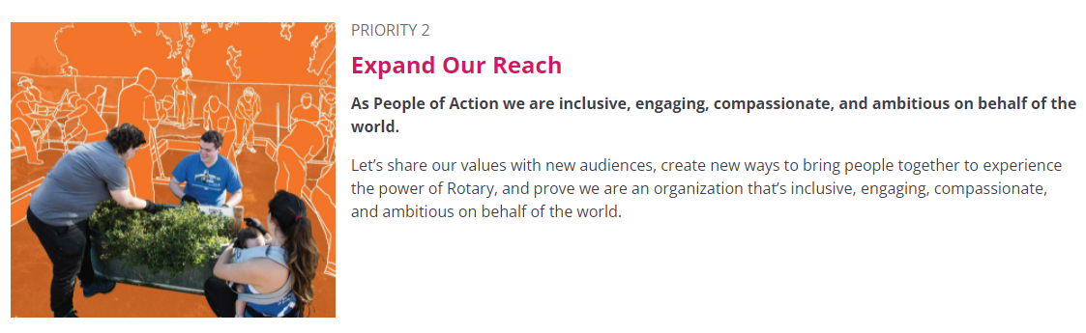

Expand Our Reach
Discuss ideas and ways to:
Share our values with new audiences
Bring people together to experience the power of Rotary
Demonstrate we are an organization that’s inclusive, engaging, compassionate, and ambitious on behalf of the world
Notes:
“Public image, membership and growing our Foundation are synergistically intertwined.” Very well said. As we discuss new public image ideas tonight, I encourage you to think about how these ideas can help grow our membership and foundation as well as promote Rotary.
As you know, expanding our reach is a significant part of the Rotary Action Plan. So, tonight, we are going to discuss ways and ideas to:
1. Share our values with new audiences
2. Bring people together to experience the power of Rotary
3. Demonstrate we are an organization that’s inclusive, engaging, compassionate, and ambitious on behalf of the world
We’re going to be sharing a lot of ideas with you to consider. Some districts and clubs are already doing some of this, so this may not be new for some of you. Be sure to jot down your own ideas as we go through these suggestions. There will be an opportunity later to share.
Joan – let’s talk about some new ideas and ways we can expand our reach with new audiences.

Slide 5
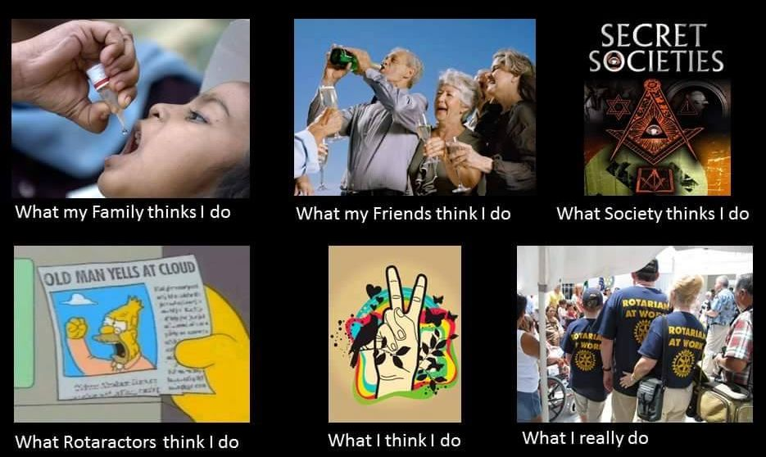

What are rotarians?

Slide 6

What I am going to talk about:
- What is the image of Rotary
- How to TELL YOUR STORY and what resources are available for your club (hint: LOTS!!)
- Using Social media to expand our reach
Rotary
People of Action...
but does anyone know about us?

Slide 7
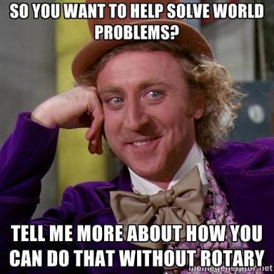

Rotary

Slide 8

The public is aware of Rotary, but unsure of what we do
(RI Survey 2010 by Siegel+Gale)
Houston, we have a problem

Slide 9
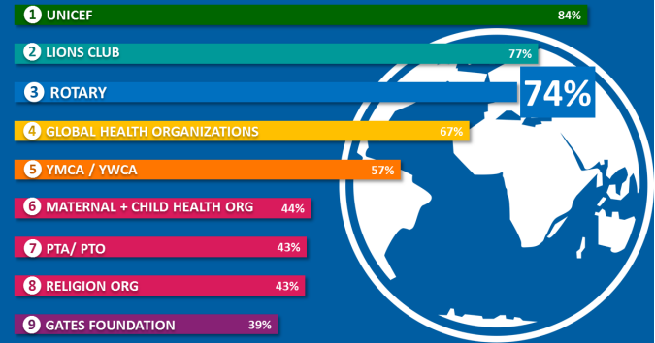

Rotary: 3rd best known organization in world

Slide 10

RI Surveyed the world in 2010
Here’s what people think about Rotary:
- Interest in joining is low
- Rotary is male dominated, mostly older
- Inconsistent message
- Viewed as charitable, respected, and caring
- Changes needed

Slide 11
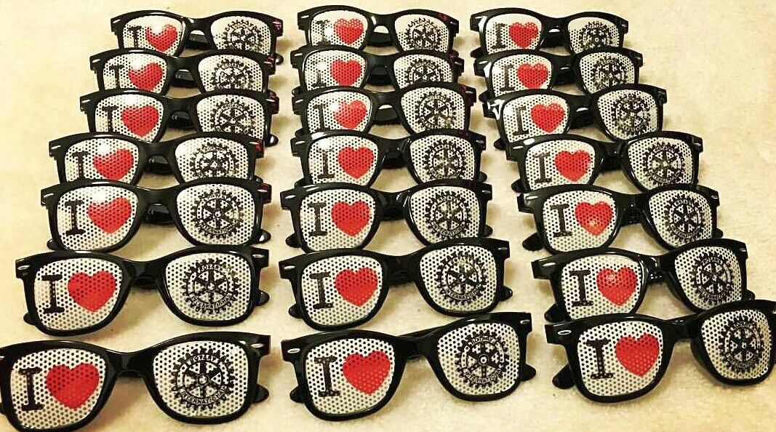

How do you look at rotary?

Slide 12


How RI changed – in 2013
A redesign and simplification of our logo, along with clear branding – and a new ad campaign – People of Action

Slide 13

CONSISTENCY AND REPETITION IS KEY
• Strengthens Rotary image and recognition
• Motivates and engages current Rotarians
• Attracts prospective members, donors
• Elevates the entire Rotary experience
• Note: your club logo is BEST image to use

Slide 14



Updated old friends – new terms
Here are some terms to use:
Masterbrand Signature Mark of Excellence CLUB LOGO – . USE THIS
MOST OF THE TIME

Slide 15



Examples of how to create your club’s own logo

Slide 16

And HOW not to use the logo

Slide 17







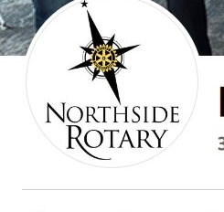
What Is confusing? (these are!)
- New logo (since 2013)
- Lack of standardization has confused the public and diminished the brand recognition.
- Incorrect usage “cheapens” the Masterbrand
Check prior templates!

Slide 18
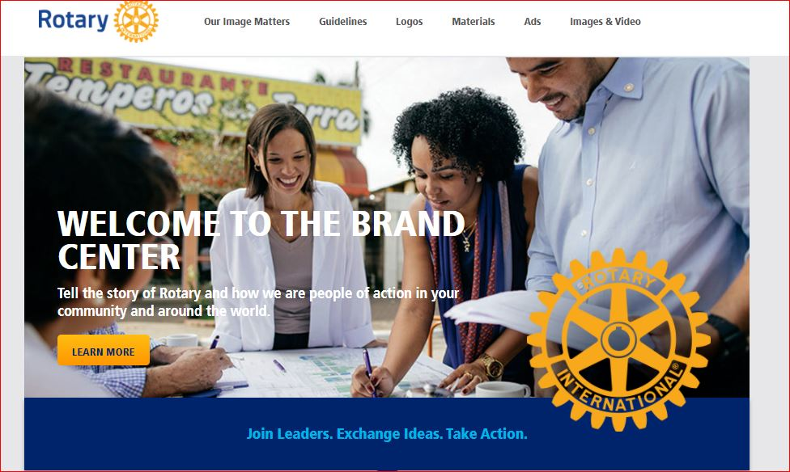

Where can we find resources?
We’ll show you more about the Brand Center and even where to find your club logo already made!

Slide 19
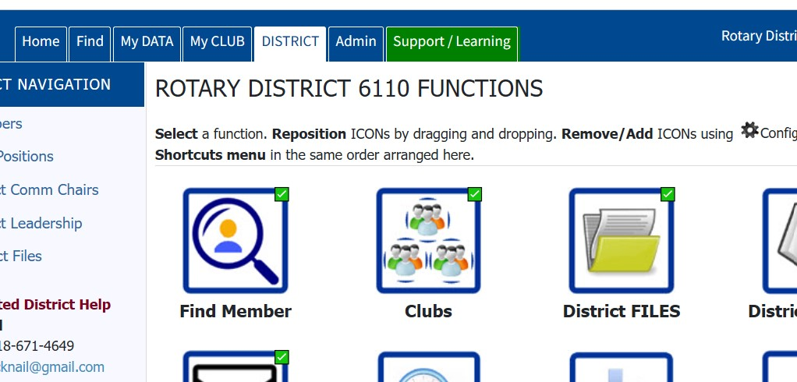
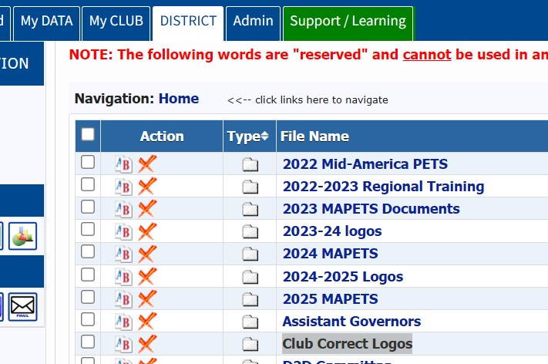

Find YOUR CLUB LOGO ON DACdb
<<<<Click District TAB at top, then: Click District Files
Click Club Correct Logos

Slide 20
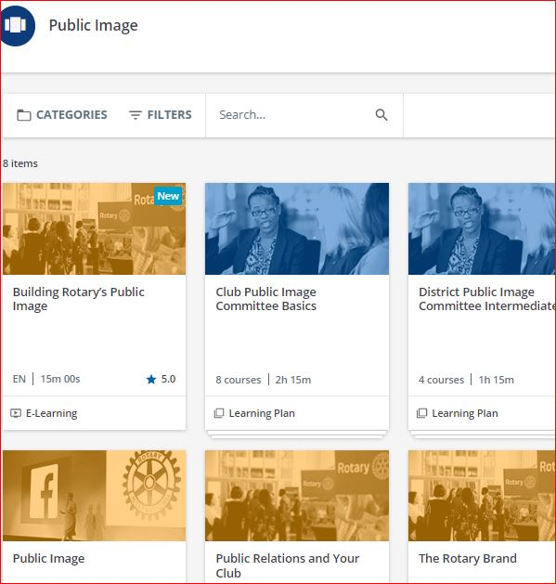

Here’s a BUNCH of resources
On the Rotary Zone 30-31 Website is a comprehensive list of great info:
https://www.rizones30-31.org/resources/rpic/
The Rotary Learning Center has several bite sized videos and courses re Public Image and your club:

Slide 21


Annual theme logo (GONE!) Why?:
Had been selected by the RI President to inspire us
INWARD FACING
Confusing: It changed every year.)
Distracts from Masterbrand
But we do have…

Slide 22



2025-2026 Theme (with no image)
Remember: INWARD FOCUS, not for external communications – why?

Slide 23
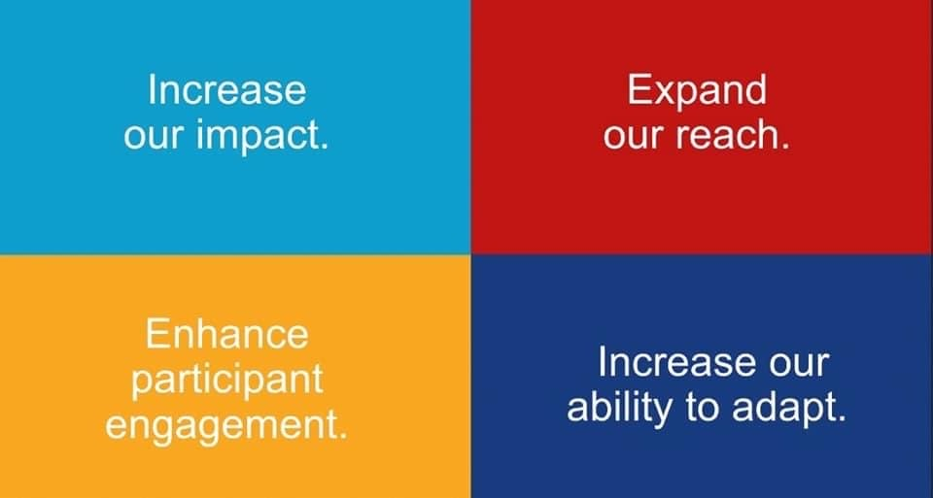

Rotary’s Action plan:

Slide 24

Engaging people - telling our story
Why tell people about Rotary?
- We have a great “product”
- We do great things
- More like-minded people get more done!
- More members = more Foundation support
- Which makes more good things happen

Slide 25
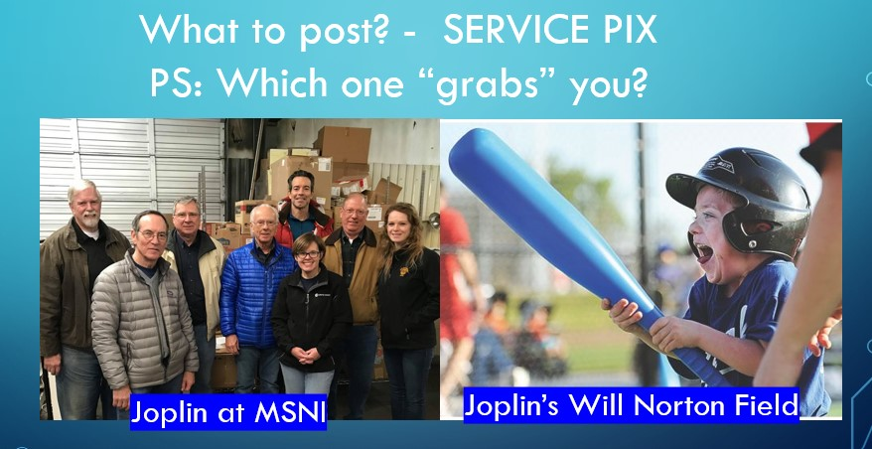

Engaging people – tell our story

Slide 26
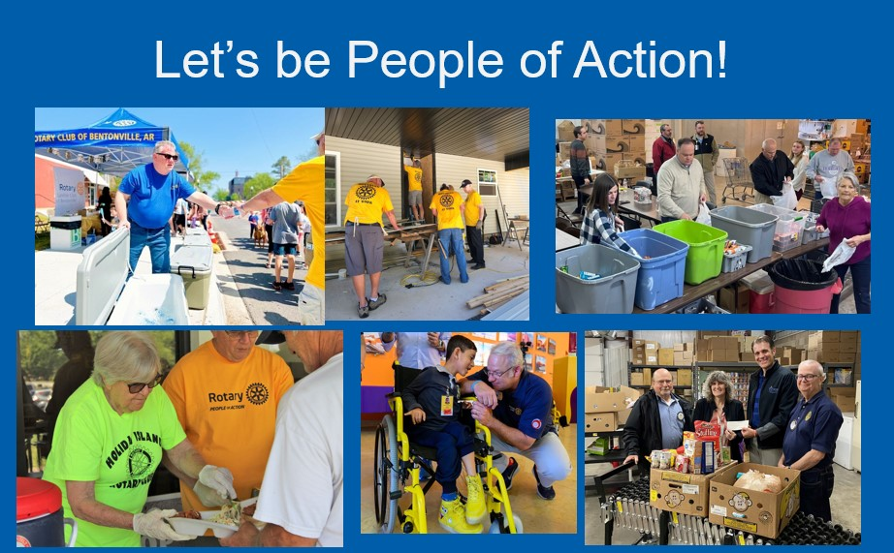

Engaging people – We Can DO IT!

Slide 27
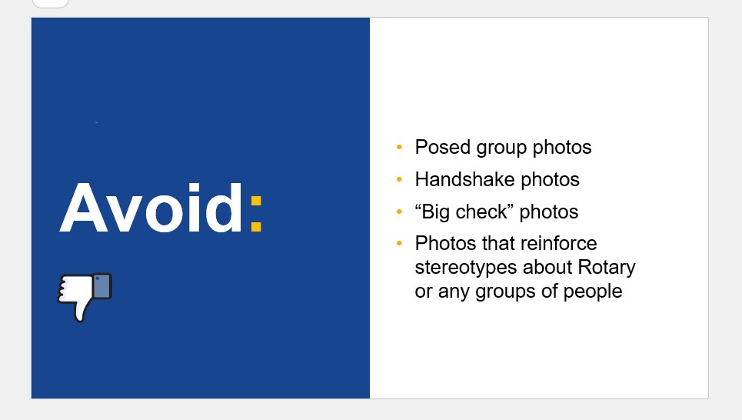

Compelling photos:
-

Slide 28
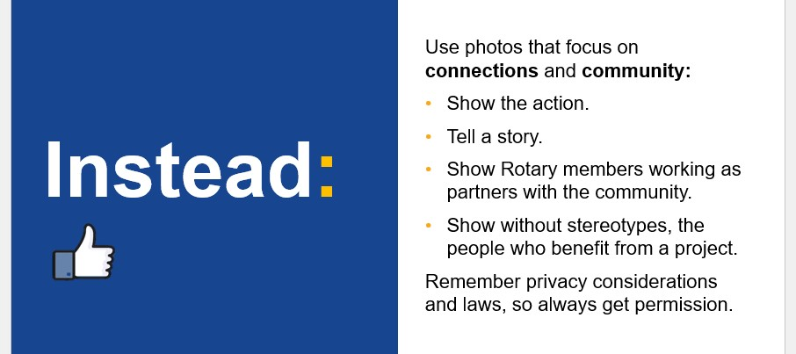

Compelling photos:
-

Slide 29


Compelling photos:
-

Slide 30


Compelling photos:
-

Slide 31


Compelling photos:

Slide 32


Compelling photos:

Slide 33


Telling your story
What is most important?
Start and Stop Your Story with What you Want People to Remember.
Make it Personable – Be Authentic
Make it Relatable – Don’t Use Jargon

Slide 34

Telling your story in the media
Know what your local journalists are looking for
:
Newsworthiness. How your club responded to a local need or natural disaster, or how it's observing World Polio Day,
Timeliness. Stories about upcoming, ongoing, or recently completed events or projects.
Prominence. Stories that involve local public figures, including elected officials, business leaders, and media personalities.
Human interest. Stories that elicit an emotional response. For example, stories about families who have been helped by your actions.

Slide 35
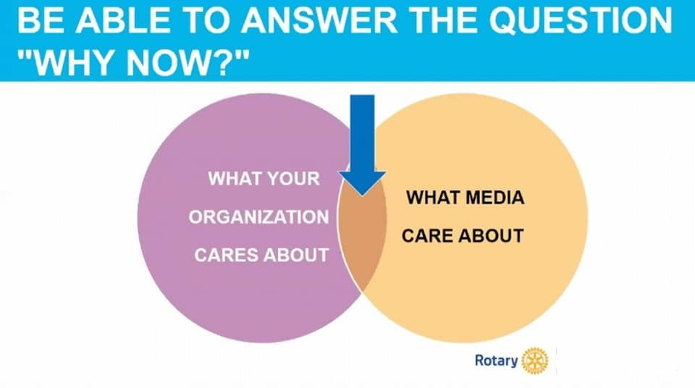

Focus on the Overlap

Slide 36
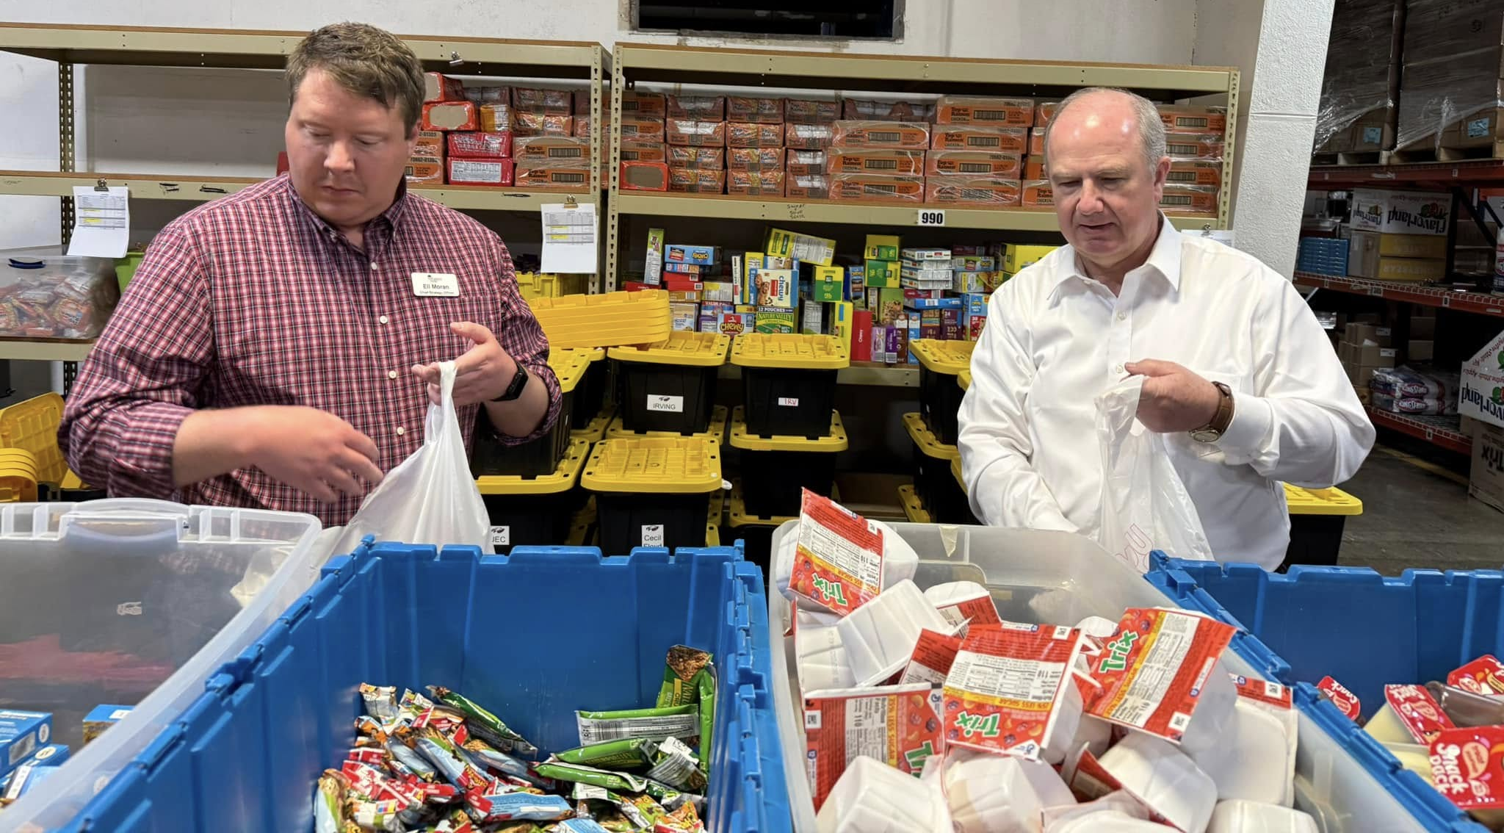

Telling your story
Visual impact. Images that are dramatic and action-oriented. For example, images of children drinking clean water from a well your club built or a member vaccinating a child against polio.
Supporting data. Statistics and research to support the story and demonstrate your project's impact.

Slide 37
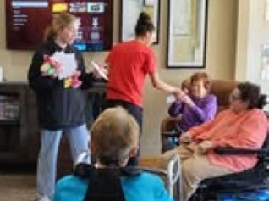

Use 3 Simple points:
1. Say what you did – why it was needed and how you did it.
2. Tell what you accomplished: how your action changed lives
3. Issue a Call to Action: Do you want people to donate, participate, or learn more?

Slide 38
VIDEO is ACTION
- With most cell phones, it is easy to start, just try it!
- Take short “ACTION SHOTS” – people doing a project, having fun
- 5 to 10 seconds of ACTION is enough to engage a viewer
- Post them and show the world that Rotary is made up of People of Action!
- Remember to have people talk briefly in the video
- Don’t try to go all Hollywood and add music – it might be taken down due to rights issues
- Videos get viewed more than photos, and
much more than just words.

Slide 39
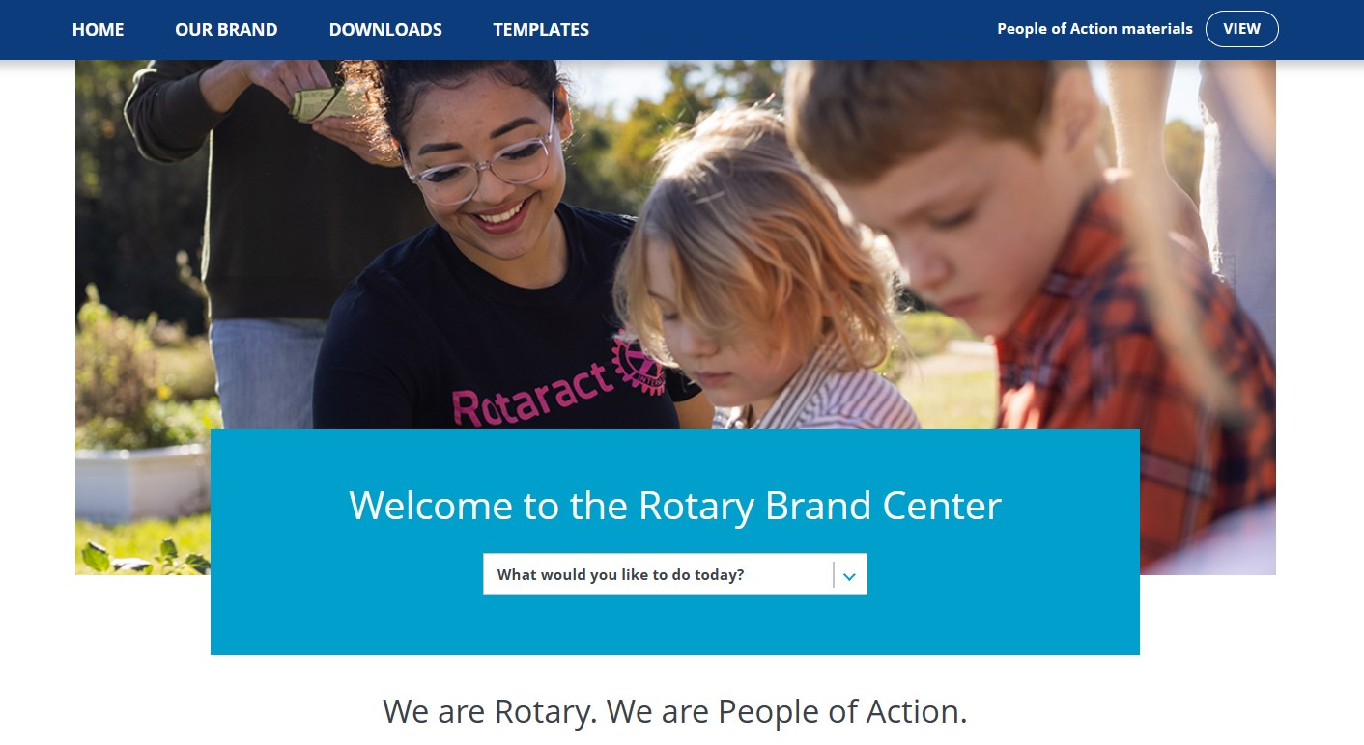

Major Resource: The Rotary Brand Center
https://brandcenter.rotary.org/
ANYONE can log on!

Slide 40
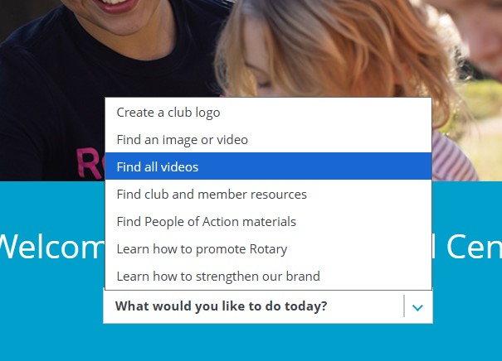
Find Rotary, Interact, Rotaract Logos

Slide 41
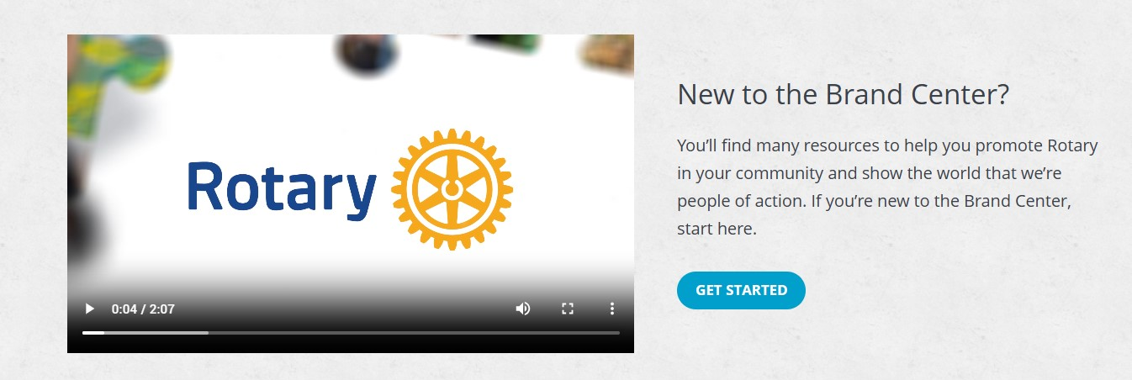

Take the 2-minute tour:

Slide 42
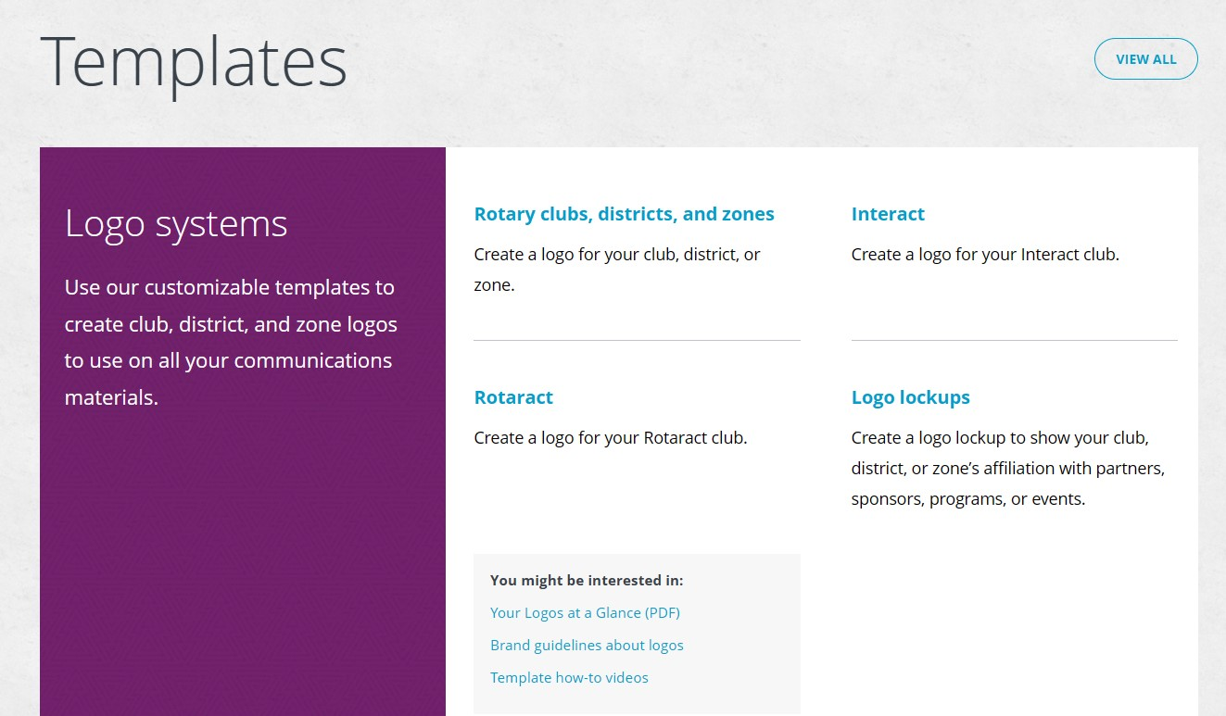

Template section: design your Club’s Logo & so much more

Slide 43
PowerPoint templates, Even Zoom backgrounds!
People of action sample posts: https://brandcenter.rotary.org/en-us/asset?id=161732360&lang=EN
Videos for use in a club meeting or presentation
Templates for brochures
TV Public Service Ads (PSAs)
Radio PSAs
Photos of Rotarians doing all sorts of projects
Even more!

Slide 44

ZOOM!

Slide 45
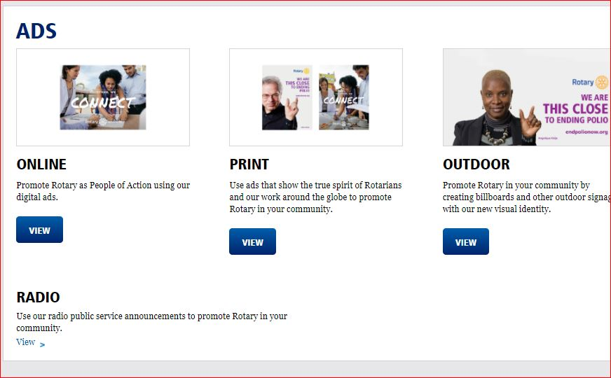

Premade ads – you can customize

Slide 46


How about a club billboard?

Slide 47

Ready-made Facebook images

Slide 48
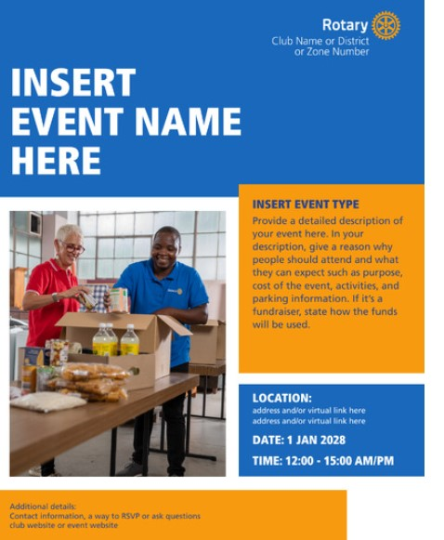
Ready-made event flyers
Here’s a template for an event.
Looks great and suggests what to say.
AND uses your club logo
( NOT THE Rotary International generic logo!)

Slide 49
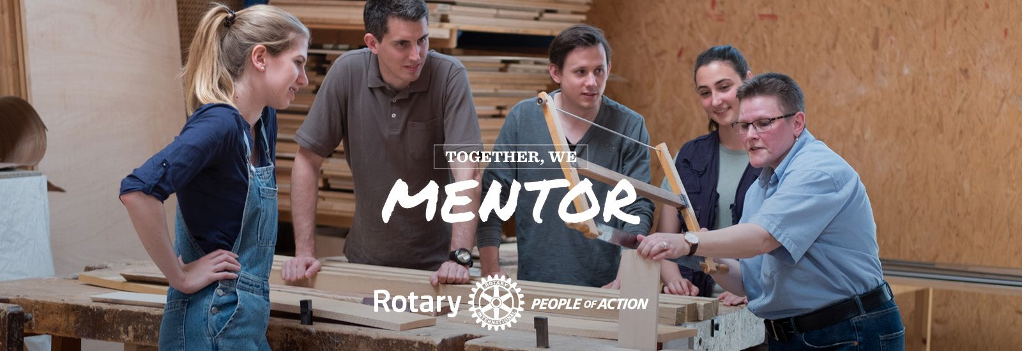

free at Rotary.org brand center

Slide 50
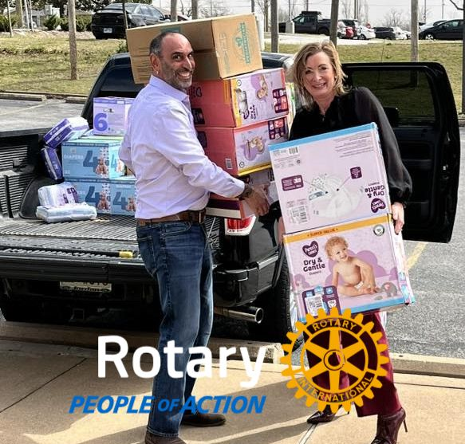

Extra Credit: (try it!)
Turn your own action photos
Into People of Action at
https://www.poaphotos.com/

Slide 51


Be proud of what you do!
Joplin’s Miracle Field

Slide 52

Tell your story on Social Media
Using Facebook and other Social Media to advance your Rotary Club’s
Public Image

Slide 53


Don’t forget Instagram, LinkedIn,
YouTube,
etc…

Slide 54

Social media’s value
Your Club can Use Social Media as another channel to let members
AND PROSPECTS
know about your club

Slide 55

Facebook Followers = prospects
Joplin Rotary FB Page has 697 “Followers” for a 75-member club - that’s 622 Prospects!
District 6110’s FB Page has 2016 “Followers” for 3200 members – need MORE!
facebook.com/District6110/

Slide 56

How do we get more followers?
Post often:
- 1 or even 2 times a day if possible
- Use built-in Schedulers for Facebook and Instagram.
- Post a mix of “real stuff”
and “fun stuff

Slide 57


- Real stuff

Slide 58


Be Bold!
Trick: Want bold or italic text in a Facebook/Instagram post?
Copy the words you want to be bold and go to
https://yaytext.com/bold-italic/
Insert, copy, and replace!

Slide 59
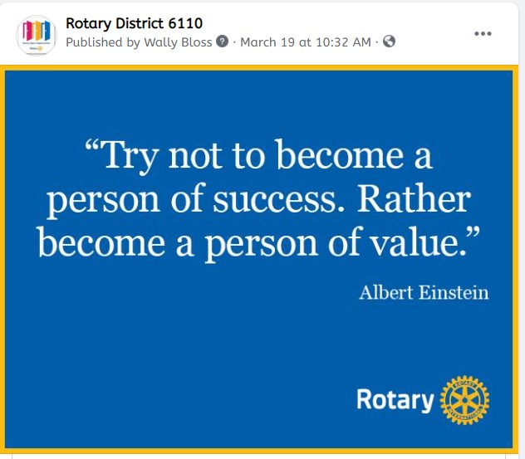


- Fun Stuff

Slide 60


More fun/inspirational stuff

Slide 61


The RI Brand center has lots you can use

Slide 62
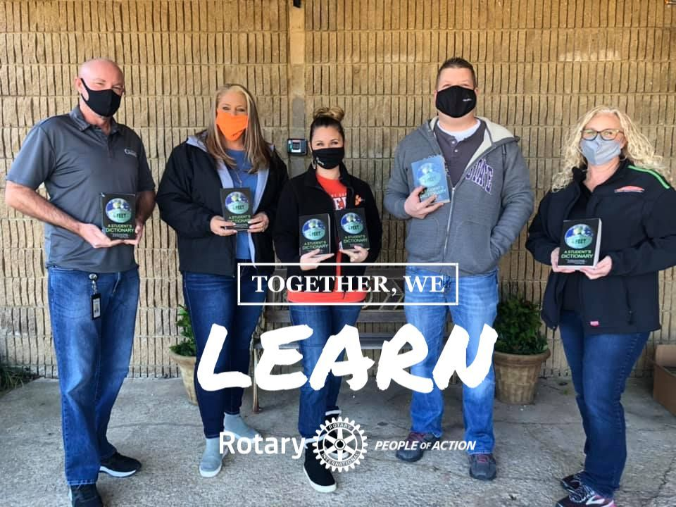

Or make your own
Coweta Dictionaries

Slide 63
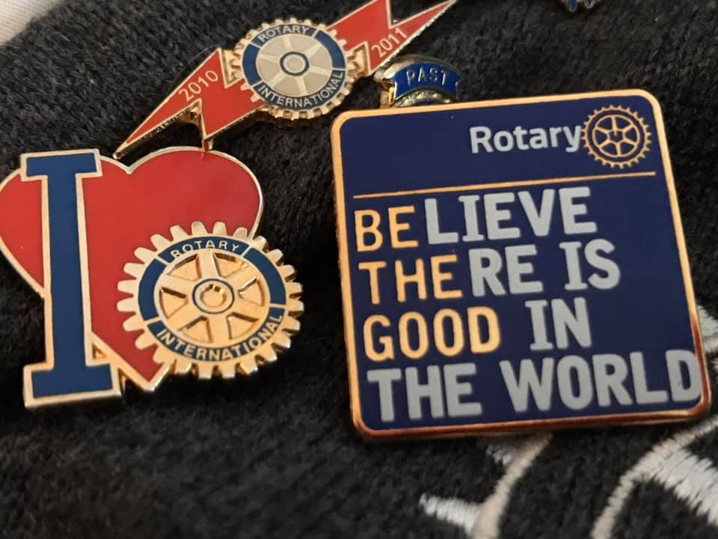

Fun/Inspirational drives people

Slide 64
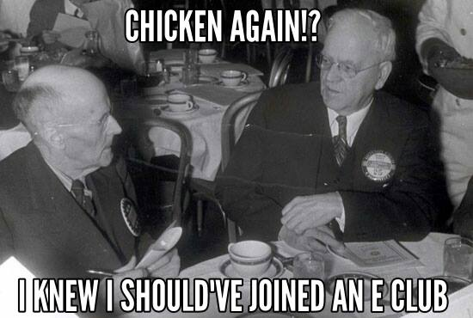

E club options – info!

Slide 65
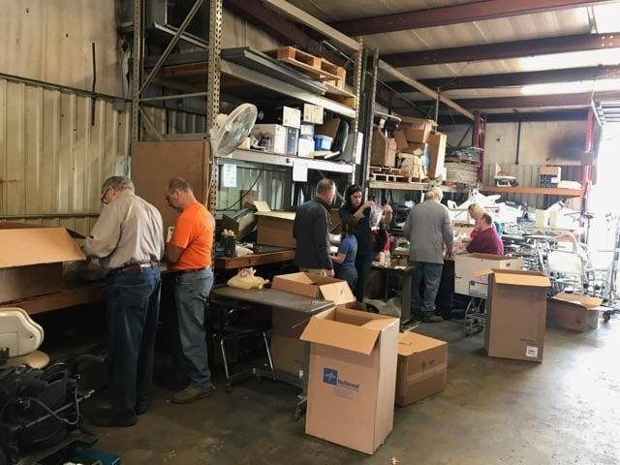

Post doing service – not static
Bartlesville Rotary @ MSNI – doing SERVICE!

Slide 66
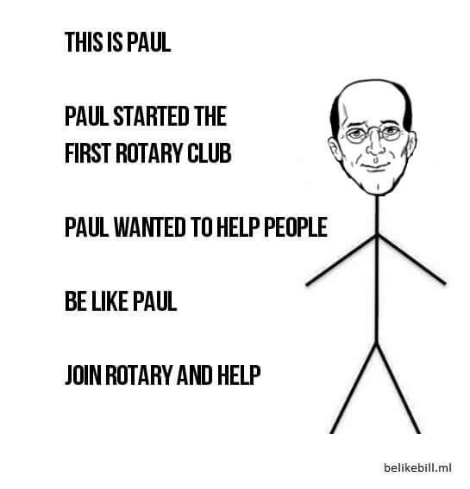

Have Fun!

Slide 67
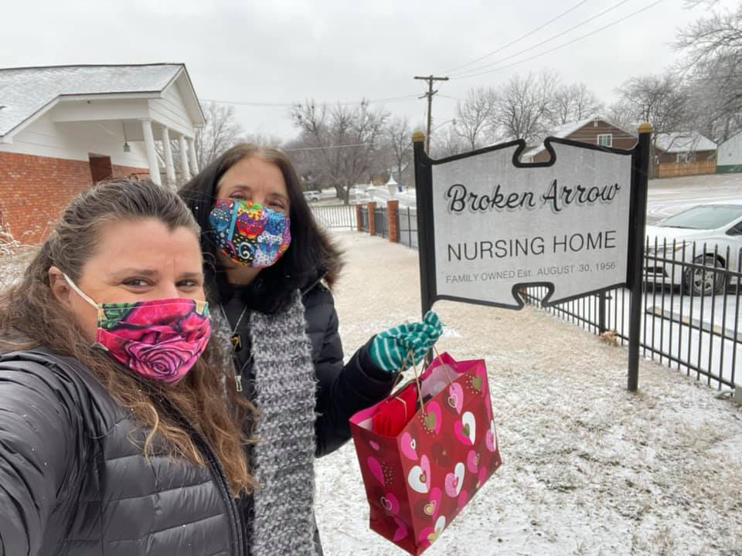

Doing service
Thanks, Broken Arrow Rotary

Slide 68
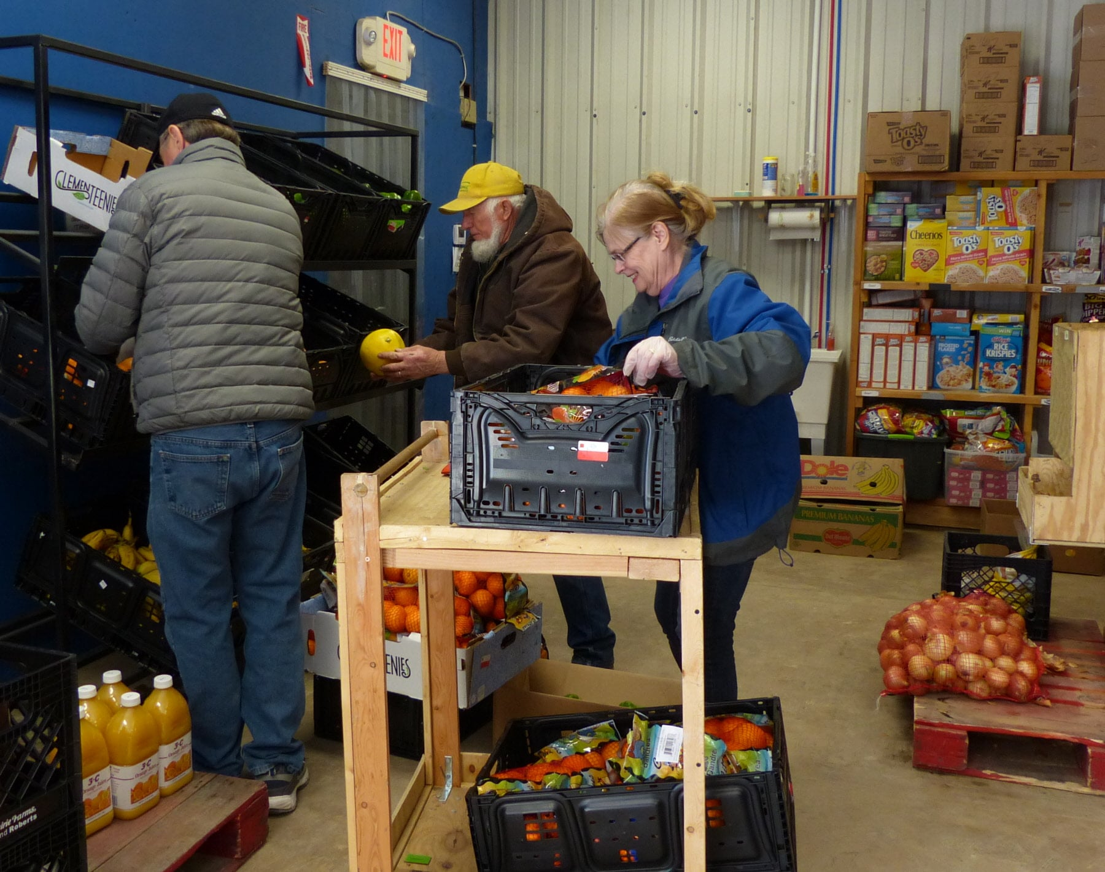

Service service service
Thanks, Pryor!

Slide 69


Inspirational

Slide 70


Humor!

Slide 71


There’s LOTS to use

Slide 72


Share Info

Slide 73


Rotary Voices – link to the blog

Slide 74


Talk about rotary

Slide 75
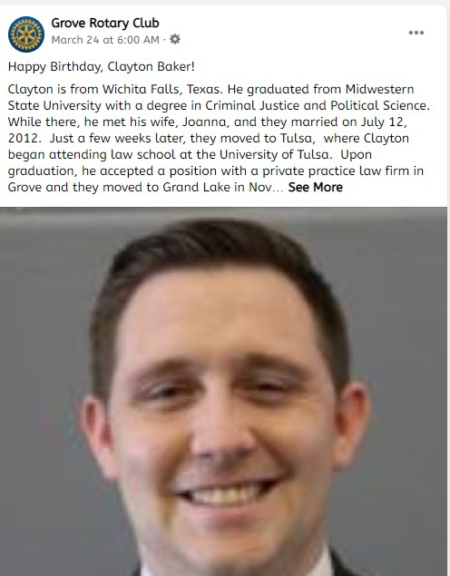
Highlight your members
Thanks, Grove!

Slide 76
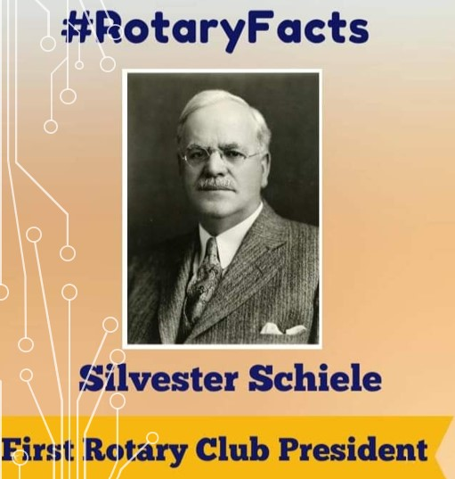

Or a bit of history

Slide 77
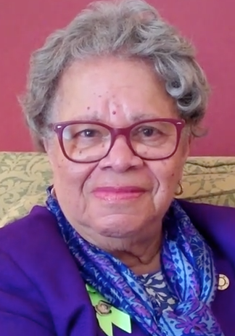

Be interactive – get people to respond
This is Sylvia Whitlock, of the Rotary Club of Duarte, California, the first female Rotary club president
Who was your club’s first female president?

Slide 78
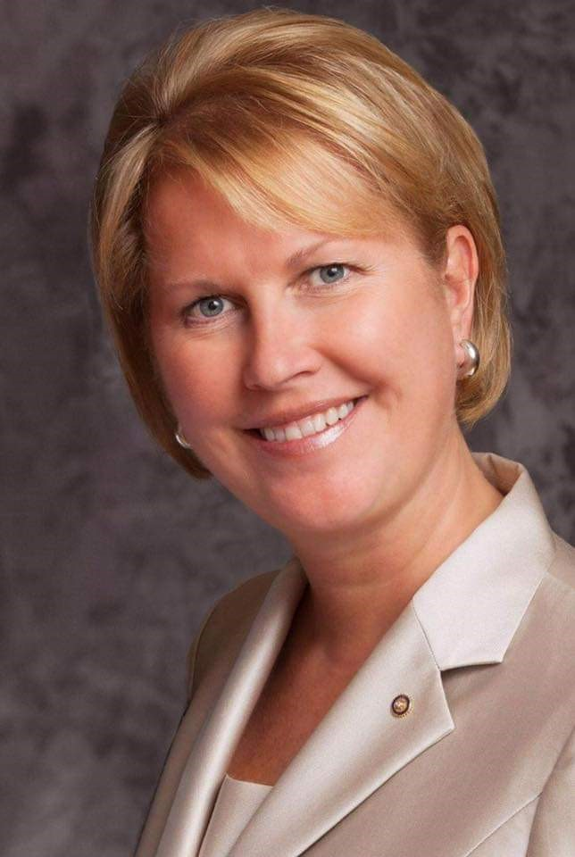

What club is the first female RI President from?
Jennifer Jones, member of the Windsor-Roseland, Ontario, Canada, Rotary Club RI’s first woman President

Slide 79
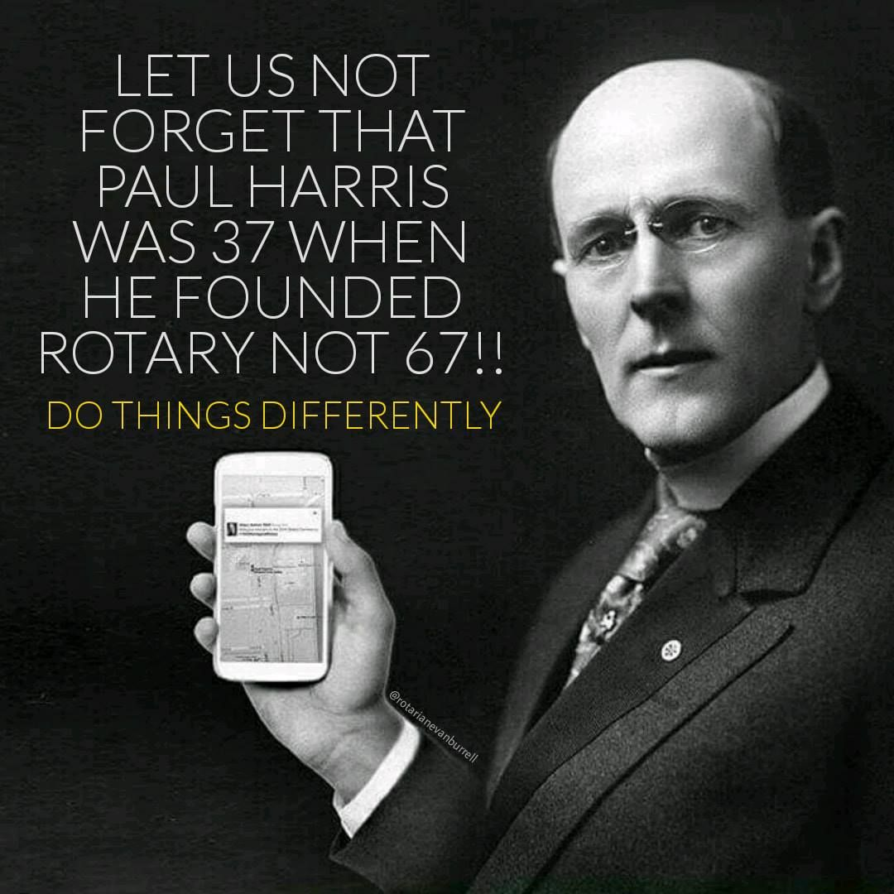

Fun!

Slide 80


So many

Slide 81


Personalize

Slide 82


Think outside the bus

Slide 83


Believe!

Slide 84


91,184
Speaking of viral:

Slide 85

SHARE 6110
And finally:
if you need content, SHARE the 6110 Facebook page post to YOUR CLUB’S page! It will help us both!

Slide 86
RESOURCES
https://www.rizones30-31.org/resources/rpic/
Facebook.com/Rotary and also Blog.Rotary.org
Facebook.com/RotarianEvanBurrell/
Facebook.com/District6110/
https://www.poaphotos.com/ - MAKE you own “Together We” pix
https://yaytext.com/bold-italic/
Facebook: Rotary Geeks
Facebook: Rotary District 6110 Club Presidents
Facebook: Rotary Club Members: Public Image, Graphics & Ideas Hub

Slide 87
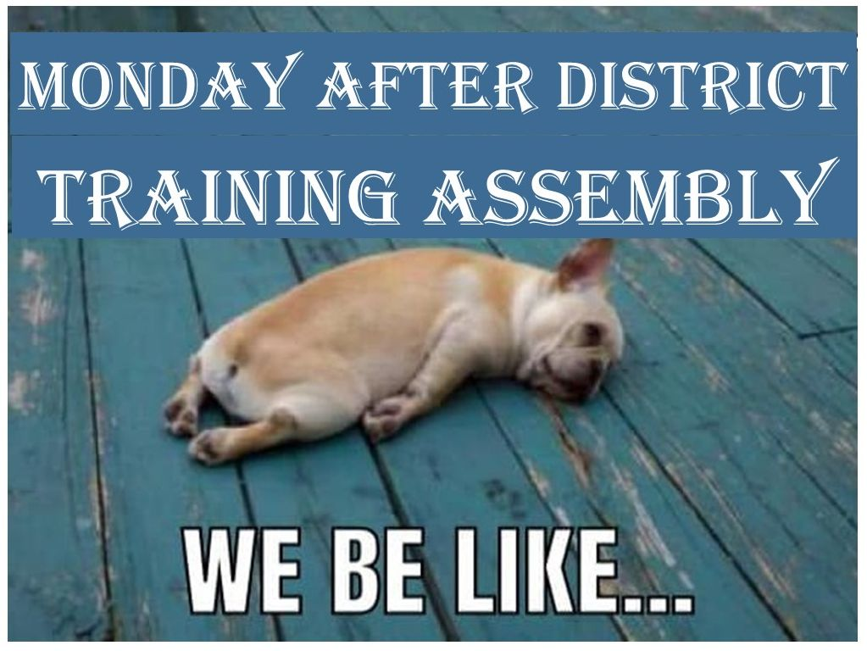
WHEW…

Slide 88
QUESTIONS

