Slide 1
Sergeant at Arms 101
“The Fun Job”

Slide 2
Agenda
Game Plan:
  The Role of the Sergeant at Arms
  Club Interaction
  Fun Ideas
  Group Discussion
(If we stay on track)

Slide 3
Sergeant At Arms
The two houses of the United States Congress maintain the position of sergeant-at-arms.
The sergeants are charged with the maintenance of order on the floor of the chamber (in the House, he may "display" the mace in front of an unruly member as an admonition to behave); they serve with the Architect of the Capitol on the commission that oversees the United States Capitol Police and security for the Congress, and they serve a variety of other functional and ceremonial roles

Slide 4
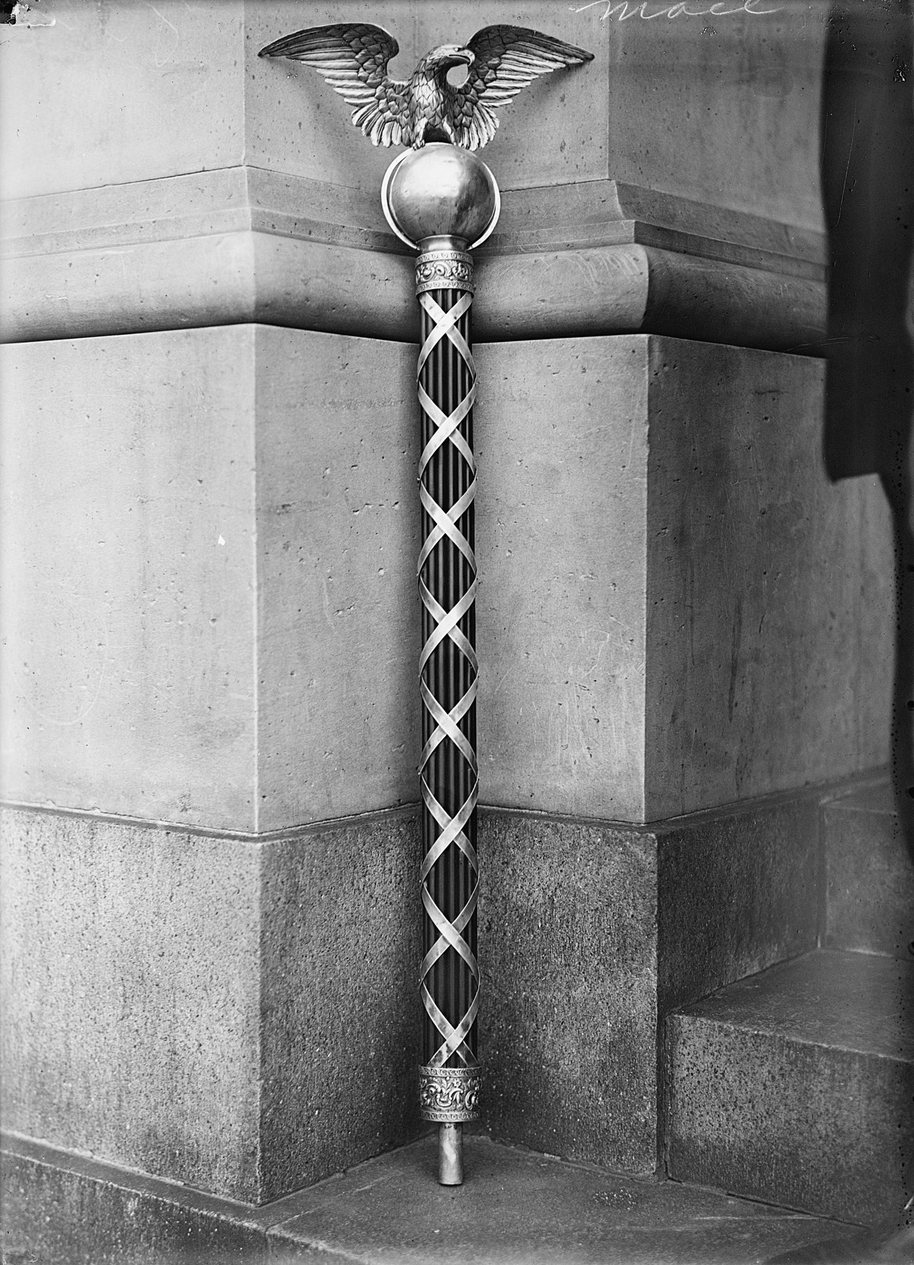
Sergeant At Arms mace

Slide 5
Primary Role of Sergeant At Arms
Maintain the dignity and prestige associated with Rotary Club by:
(a) Handling the physical preparations and the logistical aspects of the meeting.
    Flags Placed
    A/V Equipment
    Invocation and Pledge Leaders
(b) Unobtrusively guiding the general conduct of the meeting

Slide 6
Secondary Role
Club Interaction
    Birthdays and wedding anniversaries (monthly/weekly)
    Club anniversaries (monthly/weekly)
    FINES!
      Cell phone during presentation
      Name badge
      Talking during presentation
      Late arrival
      Early departure (prepay)
      Ideas?

Slide 7
Fun time Role
Club Clown
  Joke of the week
    Be politically sensitive.
  Guess the Rotarian
    Fun Questionnaire for all members upon induction.

Slide 8
Fun time role
What was your favorite food when you were a child?
What is one of your favorite quotes?
What’s your favorite indoor/outdoor activity?
What chore do you absolutely hate doing?
What is your favorite form of exercise?
What is your favorite time of day/day of the week/month of the year?
If you could paint a picture of any scenery you’ve seen before, what would you paint?
If you could choose to stay a certain age forever, what age would it be?
If you could choose anyone, who would you pick as your mentor?
If you could witness any event past, present or future, what would it be?

Slide 9
Fun Time Role
If you could learn to do anything, what would it be?
If you had to change your first name, what would you change it to?
If you could meet anyone, living or dead, who would you meet?
If you won the lottery, what is the first thing you would do?
If you could be any fictional character, who would you choose?
When you have 30 minutes of free-time, how do you pass the time?
What’s the best/worst gift you’ve ever given/received?
What do you miss most about being a kid?
What story does your family always tell about you?
Favorite vacation as a child?

Slide 10
Fun Time role
Where were you born?
Where have you lived?
When did you get married?
How many kids do you have?
Where did you graduate HS/College?
Favorite sports team?
What is a former job you held that few know?
At what age was your favorite summer?
What is your favorite band?
What is your favorite movie?
What is your favorite television show?

Slide 11
Interaction time! Questions?

