Slide 1
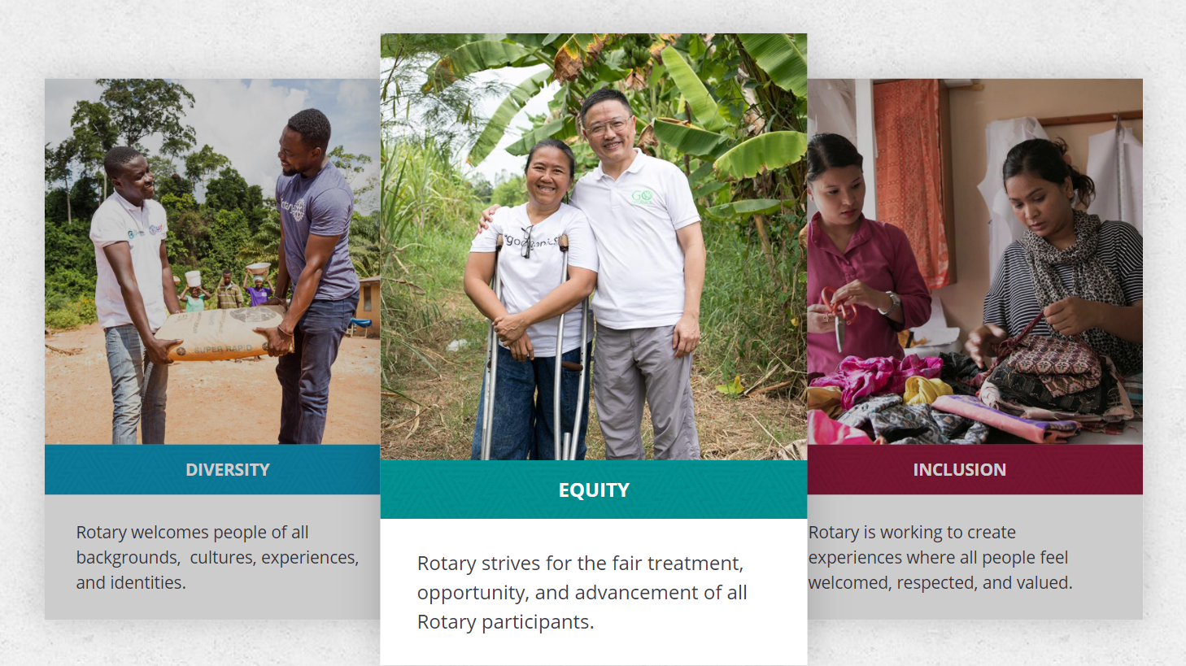
A top priority for Rotary is growing and diversifying our membership to make sure we reflect the communities we serve.
Layne Ragsdale, DEI Chairperson District 6110
Title Page Option

Slide 2

subhead
Reflection
ALL Backgrounds
    Cultures
    Experiences
    Identities

Slide 3
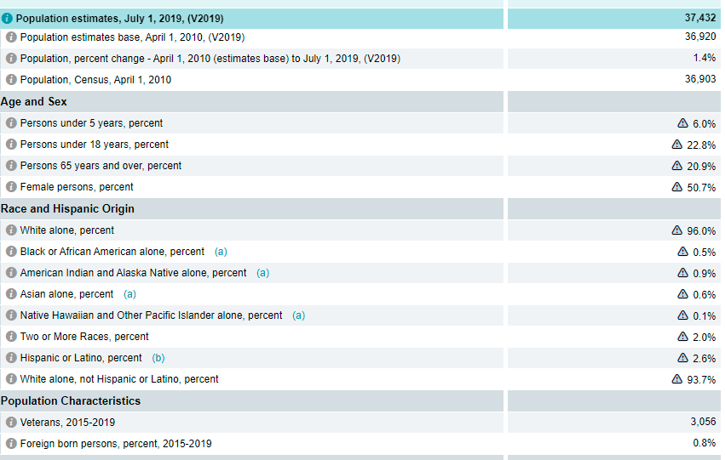
Do the Math
Census.gov Quickfacts
Population X % = ______
37,432 X 6% = 2,245

Slide 4


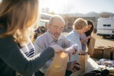

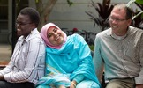
Image

Slide 5

Reality
FIND
WEEKLY PROGRAMS
HOUSES OF WORSHIP
ADVOCACY GROUPS
INTERESTING PEOPLE
COMMUNITY LEADERSHIP

Slide 6
Contact Information
Layne Ragsdale
870-715-9904
laynewheeler2@gmail.com
Harrison Community Task Force on Race Relations FB Page

