Slide 1
MEMBERSHIP
ESSENTIALS
PDG Jayne Lowe
District Membership Chair
Rotary Club of Bentonville, AR
District 6110 Training Assembly
Notes:
Good Morning…and Congratulations on being elected and agreeing to serve as Club President for the 2021-22 Rotary year! It’s a year that will enhance and change your life! I’ve done it twice and each time, I grew in Rotary as well as developed leadership skills that might not have happened otherwise. That included attending PETS, District Assemblies and Conferences. This PowerPoint presentation today will not be “pretty” and full of cute little animations, but is full of ideas, suggestions and links to websites that will guide you throughout your year as you Grow Rotary by bringing in new members and keeping them…..and your current members….engaged. There’s going to be a lot of talk about attraction and engagement throughout our time together today….and throughout the year! PS…Don’t worry about writing down all of the links that I’ll be sharing. This PowerPoint will be sent to all of you PE’s for future use… as you Serve To Change Lives CLICK

Slide 2
I LOVE Rotary
I Love what we do for our communities and the world
I Love the friends I’ve made
I Love my friend that sponsored me into Rotary 29 years ago.
What about you??
EACH ONE, BRING ONE!
Notes:
You know….I just LOVE Rotary! I LOVE what we do for our communities and the world. I LOVE the friends I’ve made within my club, around the District and around the world! I LOVE my friend that sponsored me into Rotary 29 years ago. I thank her all the time for sharing Rotary with me and thereby enhancing my life immensely!. What about you?? Aren’t you glad you’re a Rotarian? Hasn’t it been a joy to make new friends as well as give back to those in need? Wouldn’t you enjoy being the person who gives that opportunity to your friends and others in your community? RIPE Shekar is asking “Each one to bring one.” Just think how that would GROW ROTARY. It’s pretty amazing how many people have never sponsored a new member and given someone the opportunity to Serve to Change Lives and Do Good in the World. Keep this in mind today… and throughout your year as Club President…and share it with your club members. EACH ONE, BRING ONE. DGE Kevin would like to see 5 net new members in every club this year. Now, let’s look at ways that goal can be achieved. CLICK

Slide 3
Membership Resources
Membership Satisfaction Survey
 | Agree | Somewhat Agree | Neither Agree Or Disagree | Somewhat Agree | Disagree
My club does a good job involving new members
My club’s members care about one another
My club reflects the demographic profile of our area’s business, professional, and community leaders
My club actively seeks to involve all members in projects and activities according to their interests, skills, and availability
The amount of fundraising activities is appropriate
.
:
 | Agree | Somewhat agree | Neither agree nor disagree | Somewhat disagree
Notes:
As we all know, we’ve been through a lot the past year. Along with changes you’ve had to make in your business and personal lives, your club has also had to make adjustments. So, before you even take office, consider having your members complete the Membership Satisfaction Survey. We want to make sure that your current club members are happy with the way things are going in your club…or if there’s areas that need some tweaking. This is a quick 7 question survey that could be taken at a club meeting or sent to all club members electronically. A couple of the questions wouldn’t fit on the page and I know this is difficult to read, so here’s all the questions: 1. Overall, how satisfied are you with your membership in our Rotary Club? 2. Club meetings are a good use of my time. 3. My club does a good job involving new members. 4. My club’s members care about one another. 5. My club reflects the demographic profile of our area’s businesses,, professionals and our community. 6. My club actively seeks to involve all members in projects and activities according to their interests, skills and availability. 7. The # of fundraising activities is appropriate. To me, that 2nd question: Club meetings are a good use of my time…is so important! Everyone’s time is valuable. Members will ask themselves if Rotary brings value to their lives. What value ARE they being given? By letting your members express themselves through this survey….and then following up…you’re showing your openness to change and enabling members to craft an ideal Rotary experience, which will definitely increase engagement and retention. It will also invigorate them to bring in new members! CLICK

Slide 4
Membership Resources
Membership Initiative
3 – 5 club members
Choose no more than 3 ideas on how to attract members
Select no more than 3 ideas on how to engage and retain members
Create an Action Plan
Your AG will facilitate
Prospective member leads from RI
Notes:
OK…So, now that you know what your club’s thoughts are; how do you go about Engaging them so they want to stay in the club and be involved… as well as Attracting new members? There’s a program called the Membership Initiative that’s been around for a couple of years. Get your membership team or 3 – 5 of your club members together to begin this process which results in an Action Plan. You’ll have 12 Attraction & 12 Engagement strategies to choose from….or create your own! This is kind of like a mini club visioning with the focus solely on membership. I think we all know that when you have a written plan in place with what to do, how to do it, who will do it and timelines, you have a much higher chance of success. Your Assistant Governors have been trained to facilitate this program and can do so in person or virtually. Another VERY important asset to get new members is through the RI leads program. People that are interested in Rotary go to the RI website where they complete an inquiry form that includes their contact info, age range, city where they live and a brief reason for their interest in Rotary. RI sorts through all of these inquiries and sends them to the District to follow up. Either your AG or me will make the first contact to get more information and assess their interest. Then, your AG will contact you or your club membership chair with their contact information and and any other information gathered from the prospect, so you can reach out to them; give them additional details on your club and invite them to a meeting. PLEASE, PLEASE make sure you follow up on these leads!!! These are hot prospects! They are people who have actually searched out Rotary to learn more about it and want additional information on joining. Most of these prospects list ”giving back to their communities” as the reason they’re interested. More members means more new friends and more hands for service projects and fundraising!! CLICK

Slide 5
Membership Resources
Additional ways to attract members
Host a prospective members social
Select a “Person of the Month”
“Talk up Rotary” at your business networking events
Wear your Rotary pin
https://my.rotary.org/en/learning-reference/learn-topic/membership
Notes:
Here’s some other suggestions to attracting members. As everything starts opening up a bit, people are eager to get out and socialize. Host an event at a fun location like a local brewery, arcade, TopGolf, local country club. The Broken Arrow Club and the Bentonville Satellite Club have both hosted this type of event with great success. Select a Person of the Month from your community. Could be a Rotarian, but preferably a non-Rotarian. Give them an award for the service they do within your city. Hype it up through the press and on social media. That person may just join Rotary, and many others will obviously hear and read about it! Claremore Reveille as started a program like this. Mention Rotary during your business networking events. When I was working for the Chamber of Commerce, it seemed that there was always some where in our conversations that I could mention Rotary…whether it be a speaker we had atone of our meetings, something we were doing in the community or trying to sell tickets to a fundraiser. It made people curious about being a part of our club. Sometimes it took a while to get them in the door, but it DID happen! Wear your Rotary pin….even on days that you don’t have a Rotary meeting. This is another way for people to be inquisitive about what the pin is for and gives you the opportunity to talk about it! Be sure to have your elevator speech ready to go!!! Another terrific resource is found on My Rotary. Hopefully, you ALL have a My Rotary account! If not….please create it as soon as this training is over today. You’re missing out on a whole lot of great information if you don’t have access to MyRotary. It’s so easy. All you need is your email address and a password you create…..don’t need your RI ID# like you do to sign in to DaCdb. You also need to be able to get in to MyRotary to enter your goals for the year as well as the clubs accomplishments. In the link shown here, you’ll find NO LESS THAN FIFTY SEVEN items to assist you with membership. For instance; Finding new Club members; Enhancing the club experience; Connect members with opportunities to develop their professional skills and expand their network (great for younger members); strategies for attracting new members; Be a Vibrant Club; Introducing new members to Rotary – an orientation guide. CLICK

Slide 6
Membership Resources
New Member Orientation
What should it include?
Where and when to hold it?
Assign a mentor
https://learn.rotary.org/members/learn/course/internal/view/elearning/76/kick-start-your-new-member-orientation
Rotary Basics
https://my.rotary.org/en/learning-reference/learn-topic/membership
Notes:
And speaking of orientation…..if you don’t have a new member orientation in place, CREATE ONE! This can be what will get your new member engaged from the git go. Not only do they learn about Rotary, but your club specifically, - your service projects, fundraisers, culture & cost . And it should be an interactive session where you learn where the person’s passions lie. Where can you plug them in to take advantage of their skills and passion? As far as Rotary in general, Do they even have a clue what the 4 way test is all about and the ethics of our organization? What about the Rotary Foundation and all the good it does in our communities and around the world? Paul Harris Fellow? Polio eradication? Even though they’ve never been a Rotarian, they might have some great ideas on some changes that could be made, or a service project that would interest the club. Some clubs have their NMO’s before they even induct a new member. The prospects then know exactly what they’re getting in to and what to expect. Other clubs will hold a NMO once a month or once a quarter….depending on how many new members they’ve brought in. The NMO can be held at your meeting place prior to a meeting; or at your office if you have a conference room. A long standing tradition with NMO’s has been the Fireside Chat. This is where you would invite the prospects/new members to your home or another members home and provide some adult beverages and snacks. This creates a very relaxed atmosphere and some great interactive conversation. Assigning a mentor….someone OTHER than their sponsor, will give the new member another person to ask questions of, help them maneuver through the things that go on during a meeting, etc. AND make a new friend! The first link will give you all kinds of ideas on what to include in your new member orientation. Rotary Basics – this is available in a PDF to give to prospects OR as an online training course. Having prospects go through this will allow you to not have to include some of that information in your NMO. It covers such topics as How is Rotary structured; What we value; The Rotary Foundation, Rotary’s Image, An International Experience and Strengthening our youth. Truth be told, there’s probably current members who would benefit from and learn something from both your new member orientation AND the Rotary Basics piece. I really do believe you’ll find that giving your prospects/new members the orientation and Rotary Basics will give your club a Rotarian that will STAY a Rotarian for a long time. CLICK

Slide 7
Membership Resources
Flexibility and Adaptability
# of meetings per month
Location of meetings
Meeting times
Content of meetings
In person, Virtual or Hybrid
https://rotary6690.org/maintaining-engagement/.
https://my.rotary.org/en/club-flexibility
Notes:
You’ve all had to become flexible in so many areas over the past year. Your clubs should do the same! We all have the “We’ve always done it this way” or “There’s no way we can do it that way” people in our club…and needless to say, we always WILL have them. Rotary has given us so much flexibility over the past couple of years and if you haven’t already taken advantage of some of them, now is a great time to start! How many meetings do you have every month? If you’re meeting in person, is your location working for you? (I realize that in these times, finding a location can be difficult if you had to leave your previous location because they closed. Then, with social distancing, you might not be able to have as many people in the room….even if it IS in your previous location). Are you experimenting with some optional meeting times? Having a social once a month or one a quarter in place of a regular meeting… either virtually or in person? What about skipping a regular meeting and doing a service project that week? Are you taking advantage of getting amazing speakers since they can be with you virtually? Talk to other club Presidents to see who they’ve had as speakers. Or login in to clubs from anywhere in the country or even the world to get ideas on programs and speakers. Having interesting and entertaining programs will help keep your members engaged; as well as making them want to bring new people in to to share the experience! Are you meeting in person, totally virtually or hybrid? Are you even HAVING meetings?? As much as we want to gather in person, this darn pandemic has given us the option of meeting virtually. I have to tell you, there are times when I don’t want to make the one hour round trip drive to my club meeting, but I still get to see my fellow members, engage in the Pledge and the Four Way Test and hear the speaker…with or without makeup!!! ☺ If you aren’t meeting at all and aren’t tech savvy, like I am not, there are people that are willing to help you with that. I’m not trying to bust your chops if you aren’t meeting, but Gathering in ANY way….in person, virtually or hybrid will keep your club going; give your members the opportunity to see each other and interact. District 6690 in Ohio has done a magnificent job in putting together resources for their clubs and have given us permission to share this link for virtual and hybrid meeting resources. And here’s another link in My Rotary that will give you a ton of ideas on how your club can take advantage of the flexibility that’s available to us now and make your club more appealing to current and prospective members alike. CLICK

Slide 8
Membership Resources
Satellite Clubs
Different day/time
Cause based
Community close to yours
THINK OUTSIDE THE BOX
https://my.rotary.org/en/learning-reference/learn-topic/start-club
Notes:
While we’re on the subject of flexibility and adaptability; here’s something else you can consider. After you’ve had your members complete the member satisfaction survey, and you discover that most of them are happy with the way things are going in your club, but there are others that just can’t….or don’t want to… meet every week at noon or for breakfast. Perhaps they’re younger and their jobs just don’t allow them the flexibility to take 1 ½ - 2 hours for Rotary; of they’ve got young families that they need to get off to school. BUT, they still enjoy the camaraderie, the service projects and leadership development that comes along with being a Rotarian. How about starting a Satellite Club?? A satellite club is just an extension of your club. They can meet (and SHOULD meet) on a different day and time. Let’s say that you have members who would enjoy meeting after work, say 5:30 or 6. Maybe they don’t even want to have a meal….which would make it less expensive for members. They would create their own bylaws; have their own programs; service projects and fundraisers. Are there people in your community who are particularly interested in the environment? What about teachers who absolutely can’t get away for a meeting at lunch or breakfast. Is there a business in your town that you could support a Satellite Club? Is there a community that’s close to yours that doesn’t have a Rotary club and might not be able to get at least 20 people to start one? You could get Rotary in to their community via a Satellite Club! It only takes 8 people to start a Satellite Club, as opposed to 20 to start a regular Rotary club. Now, it’s possible you may get some pushback from your current club members!! They’ll be worried that people will leave your club and join the Satellite Club. But guess what? ALL members of the Satellite Club are members of the sponsoring club! So lets say that you find a group of 8 people that would enjoy meeting after work and you begin the process of starting the Satellite Club. As things progress, 3 members of your club decide they want to be in the after work club. YOUR club would still gain 8 new members! Sponsoring club members can attend the Satellite Club and vice versa. My home club is Bentonville, AR and I have to give a shout out to our Satellite Club. We started the Satellite Club about 5 years ago and they are a dynamic, very active, service-oriented and FUN group! I’m so proud of them! They meet at a local brewery on Monday nights at 5:30 (probably one of the reasons they have so much fun!!!!) They’re always coming up with some great fundraisers and service projects and in that regard, they really put our Noon club to shame! Randy Green, the incoming Chair of the Satellite Club, is on with us today and I want to give him and the other members of that club huge KUDOS for all they do. Currently, there are only TWO satellite clubs in our District……Bentonville and Springdale, AR. There’s plenty of room for more as well as many ideas on who to target. Current Governor Jay Craig is working on getting a Spanish speaking club started in the Tulsa area; there’s also a huge Marshallese community in Springdale that could serve that community. THINK OUTSIDE THE BOX! Satellite clubs are an excellent way to Grow Rotary in our District…..and add members to your clubs. And the possibilities of what the club culture would be are endless! Shown here is the link to answer all your questions about starting a Satellite Club. CLICK

Slide 9
The Learning Center
www.rotary.org/MyRotary
*Hover: over Learning & Reference
*Choose: Learn by Topic
*Click: on Membership
Notes:
The Learning Center is where the rubber meets the road on the RI website. Sign in to your MyRotary account; hover over Learning & Reference; Then choose Learn by Topic and click on membership. If you’ve never been in the Learning Center, you’ll find that you can choose to learn by your role (President. Committee Chair…even Assistant Governor!) You can also look at topics such as Public Image and Foundation. But, we want to focus on Membership today! I’ll tell you what, guys….it’s almost overwhelming all of the subjects you can choose to delve in to. We could probably spend the whole hour just digging in to the Membership topic alone! Nevertheless, here’s a few of the topics I thought might interest you. GO TO NEXT SLIDE

Slide 10
Topics in The Learning Center
Best Practices for Engaging Members
Improving your Member Retention
Engaging Younger Professionals
Finding New Club Members- A Prospective Member Exercise
Notes:
Best Practices for Engaging Members: How to develop strategies for engaging people at ALL stages of membership
Improving your Member Retention: Learn when and why members leave; generate strategies to help them stay
Engaging Younger Professionals: A digital kit that will help you rethink membership and bring emerging leaders in to the club
Finding New Club Members- A Prospective Member Exercise:
Try these strategies to attract qualified members

Slide 11
Even MORE Learning Center Topics
Guide to Corporate Membership
Kick Start your New Member Orientation
Be a Vibrant Club
Club Flexibility
Notes:
Guide to Corporate Membership: Learn hot to engage local businesses and offer a new membership type to them
Kick Start Your New Member Orientation: This course shows how to make your clubs new members feel welcome & valued. If you don’t have a New Member Orientation in place, please create one! Some clubs are even doing their NMO prior to inducting the member so they have a much better idea of what Rotary and the club is all about. It also lets them know what’s expected of them!.
Be a Vibrant Club: 10 best practices by clubs worldwide as well as regional versions featuring local success stories
Club Flexibility: Learn about flexible membership and meeting options. We discussed this earlier, but does your club charge for meals whether the member is there or not? Mine does and, quite frankly, it’s kind of a fundraiser for us. However, you might want to consider discontinuing that practice….maybe just for your younger members….to make it more economical for them to join the club.

Slide 12
Membership Contest?!?!
Just finished one
Maybe another one in the fall?
Make sure you’re identified as the Membership Chair in DaCdb
Notes:
12. Were you aware of the membership contest that the District conducted from January 1st to March 31st? Well….we had one and the top 3 clubs with the highest percentage of new members will win a cash prize and will be announced at the virtual District Conference on May 1st. AND, a little birdie told me that DGE Kevin just may do another membership contest sometime this fall. Keep your eyes open for details! If you want to make sure that you hear about it, make sure that you….or another person in your club…are identified as the Membership Chair in DaCdb. That way you’ll be sure that you’re receiving any and all emails surrounding any potential membership contest.

Slide 13
Membership Contest?!?!
Just finished one
Maybe another one in the fall?
Make sure you’re identified as the Membership Chair in DaCdb
Notes:
12. Were you aware of the membership contest that the District conducted from January 1st to March 31st? Well….we had one and the top 3 clubs with the highest percentage of new members will win a cash prize and will be announced at the virtual District Conference on May 1st. AND, a little birdie told me that DGE Kevin just may do another membership contest sometime this fall. Keep your eyes open for details! If you want to make sure that you hear about it, make sure that you….or another person in your club…are identified as the Membership Chair in DaCdb. That way you’ll be sure that you’re receiving any and all emails surrounding any potential membership contest.

Slide 14
Key Takeaways
EACH ONE, BRING ONE!
Conduct the membership satisfaction survey
Create a New Member Orientation
Check out all the great information in MyRotary and The Learning Center
Use Social Media to promote your club
Be Flexible! Think Outside the Box!
Have FUN and enjoy Loving Rotary!
Notes:
Here’s some Key Takeaways from this session: RIPE Shekar’s request that EACH ONE, BRING ONE! Pass this on to your members and not just once, but all the time!
Choose a membership chair for your club. Get THEM involved with growing your membership. Have THEM do the Each One, Bring One mantra!
Conduct the new membership satisfaction survey in the very near future. Find out what your club thinks about what’s going on in your club. Make sure you’re bringing value to your membership.
Create a NMO. Give those new members the opportunity to find out more about your club and Rotary in general. You’ll be helping them become a great Rotarian!
Share this PowerPoint with your Membership team so they can check out all the helpful suggestions and ideas in MyRotary and The Learning Center. No need to Recreate the Wheel!
We didn’t really touch on Social Media today, but it’s obviously a great way to create interest in your club and the activities that you’re doing. AG Wally Bloss is our District Public Image Chair and I know he’d be more than happy to assist you in any way; especially to use the People of Action campaign.
Take advantage of the flexibility we can take in our club meetings. Make your meetings meaningful and fun. Socialize, whenever possible. Be creative and Think outside the box. This may include looking in to starting a Satellite Club!
Most of all….Have FUN! Enjoy being a Rotarian. Encourage your members to attend the District Training Assembly and District Conference where they can learn and meet new people, even if it’s virtual! CLICK

Slide 15
My Best Advice……
Stop recruiting…….Start Attracting!
Get ‘em in
Plug ‘em in
Keep ‘em in

Slide 16
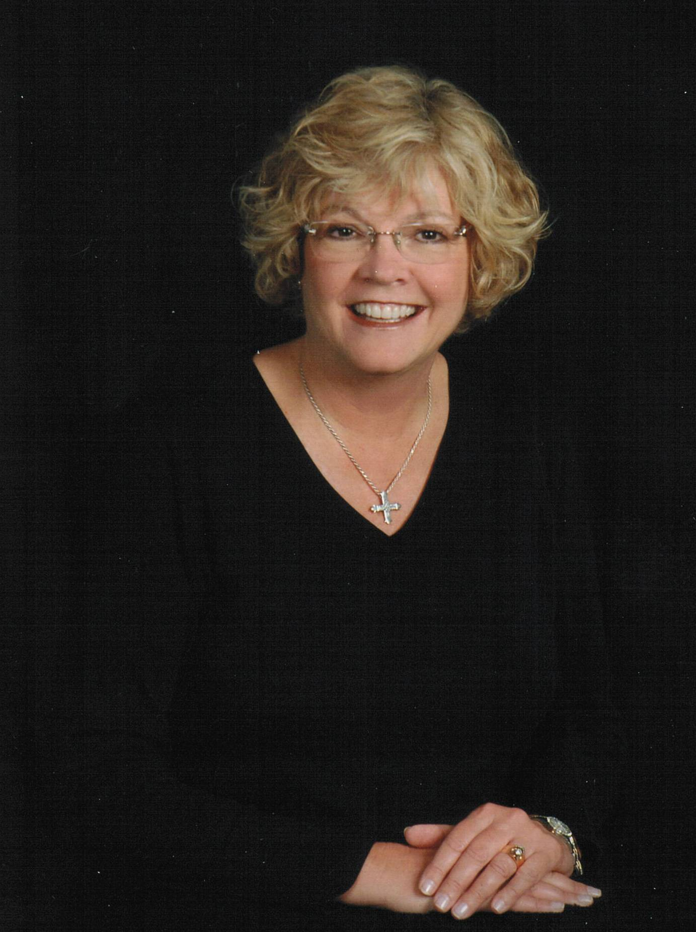
District Resource
Questions? Looking for ideas? Have successes to share? Contact me! I’m here to help!
PDG Jayne Lowe
District Membership Chair
jaynerotary@gmail.com
479.644.6576
Notes:
You’ve had a lot of information thrown at you for the past 90 minutes with more to come. It can be a little overwhelming, but just remember that your AG’s and the District Committee Chairs are here to help you! You don’t have to go it alone! I’m so excited for all of you as you plan to take the gavel and lead your club. Bring in those new members! Engage them along with your current members. Be the inspiration to them as well as to your community. Thank you so much for your attention and don’t hesitate to call on me with any questions, suggestions or ideas. Best of Luck to each and every one of you. SERVE TO CHANGE LIVES!

