Slide 1
Finance Module – Overview
Mike Bibby
Treasurer
Rotary Club of Tulsa Sunrise
Title Page Option

Slide 2

Finance Module – Overview
DACdb’s Finance module is a premium (optional) module best described as a Rotary-friendly, inclusive financial management system. Four major components make up the module, with several key features that can expedite your club’s billing process, track payments and balances for members and club, and generate reports to support accounting functions. DACdb’s Finance module will also enhance your club’s transparency and assists with smoother transitions of treasurers.

Slide 3
Finance Module – Overview
DACdb’s Finance module is a premium (optional) module best described as a Rotary-friendly, inclusive financial management system. Four major components make up the module, with several key features that can expedite your club’s billing process, track payments and balances for members and club, and generate reports to support accounting functions. DACdb’s Finance module will also enhance your club’s transparency and assists with smoother transitions of treasurers.

Slide 4
Finance Module – Overview
Invoices: DACdb has streamlined the invoicing process, making it possible to get your invoices out the door in minutes.
Accounting: Track invoices, issue statements to members for amounts owed and record and track all transactions in and out of your bank account. Includes Budgeting, Checkbook Reconcile and Check Printing
Reports: Over 20 reports are available to help you track your clubs finances.
Chart of Accounts: Choose a predefined chart of accounts to set up a general ledger system for your club. All available options for a chart of accounts may be tailored to meet individual club needs.

Slide 5
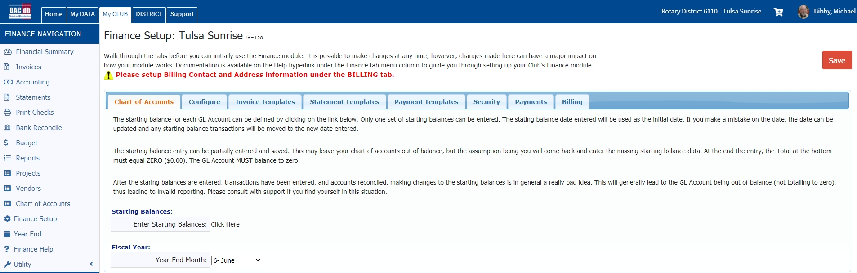
GETTING STARTED
Choose a Chart of Accounts Template:
On the Finance tab, click on the Setup hyperlink.

Slide 6
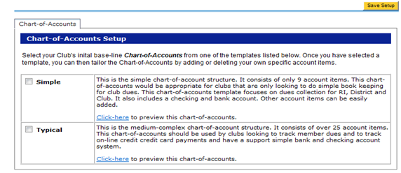
There are two template options. Use the “Click here” hyperlinks available to preview each. Both templates allow for extensive customization. Choose the template that is the best starting point for your club. Click the Save Setup button in the upper right corner.
I recommend the Typical setup.

Slide 7
CHART OF ACCOUNTS – CONFIGURE TAB
ASSET ACCOUNTS
Checking Account
Accounts Receivable
Other Assets
Fixed Assets
LIABILITY ACCOUNTS
Current
Long-term
EQUITY ACCOUNTS
Retained Earnings
INCOME ACCOUNTS
Dues and meals
Meetings
Miscellaneous Income
EXPENSE ACCOUNTS
District and International Expenses
Areas of Service
(Club service, Vocational service, etc.)
Membership
General Club Expenses
Other Expense

Slide 8
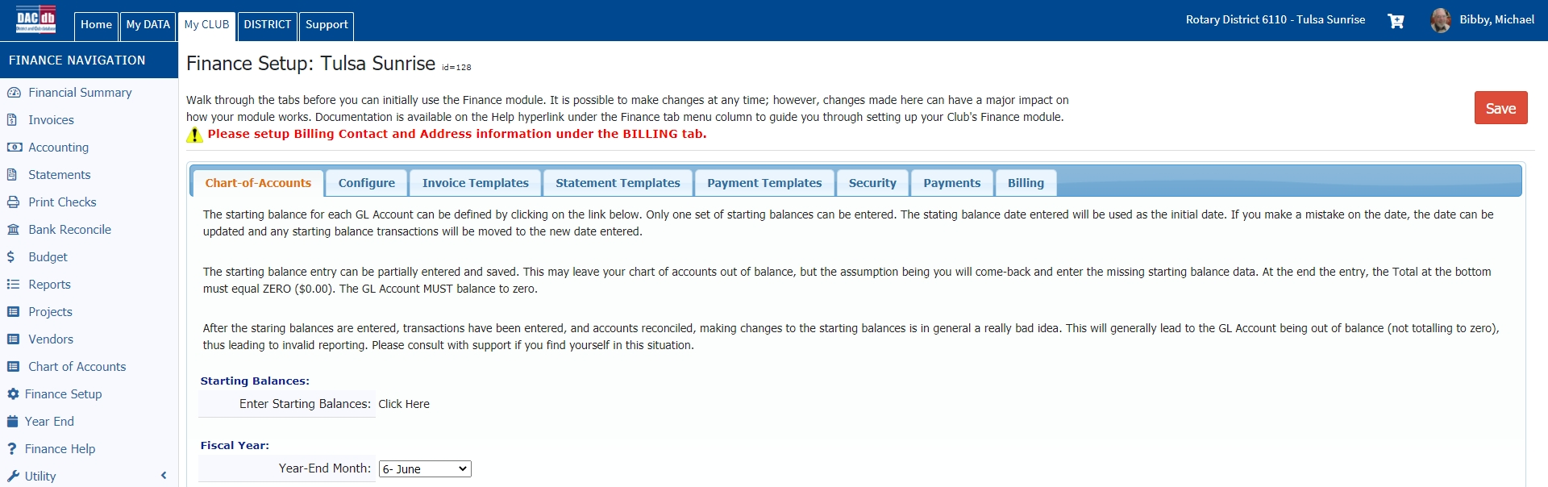
CHART OF ACCOUNTS
Work through each tab on this setup. Not everything has to be set up initially. Do the first four and return to the rest when appropriate.

Slide 9
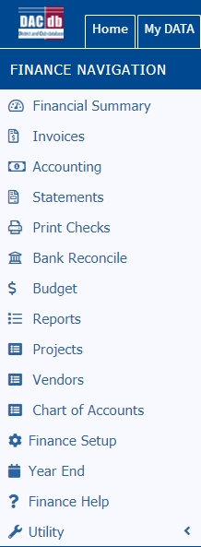
FINANCE HELP
Go to My Club >
Club Finance >
Finance Help

Slide 10
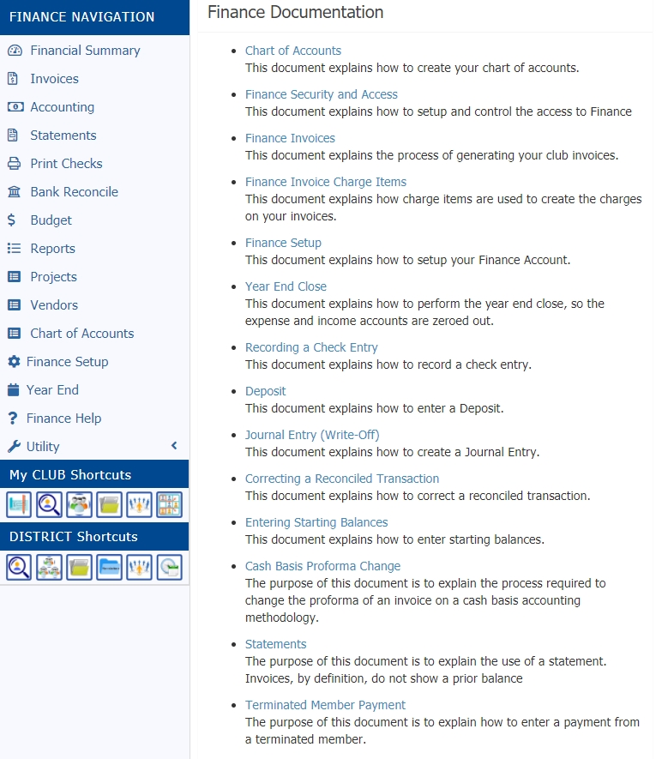
FINANCE HELP
Documentation is available for most features of the Finance module

Slide 11
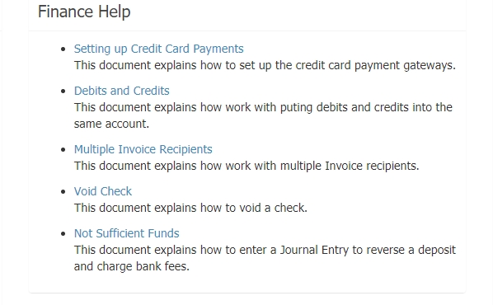
FINANCE HELP
More

Slide 12
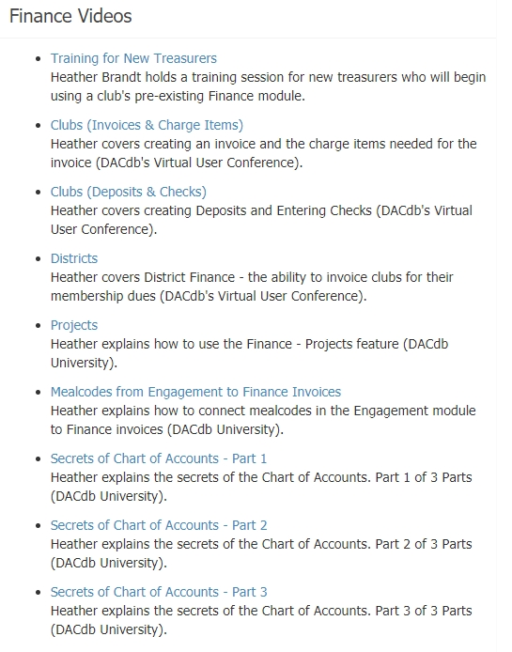
FINANCE HELP

Slide 13
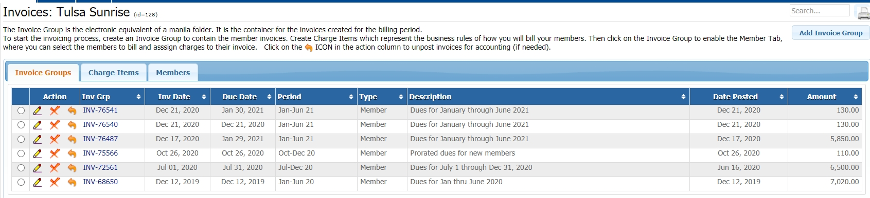
INVOICES TAB
This is where you set up and post invoices. When posted, it creates an Accounts Receivable listing for each person invoiced, and you can print invoices individually or as a group. Can print to a PDF so invoices can be printed or individually mailed.

Slide 14
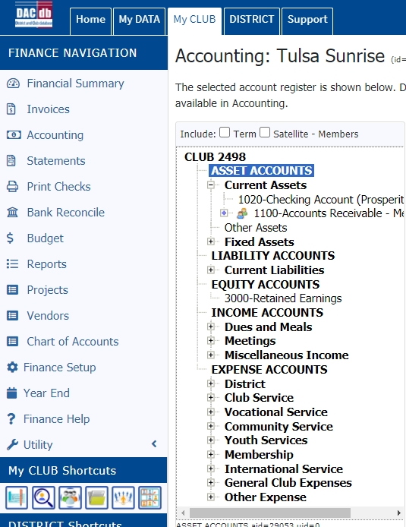
ACCOUNTING TAB
This is where you post checks written in the checking account and deposits made to the account.
You can also view all activity in every account and make journal entries to move amounts around.
Most of your activity will be here.

Slide 15
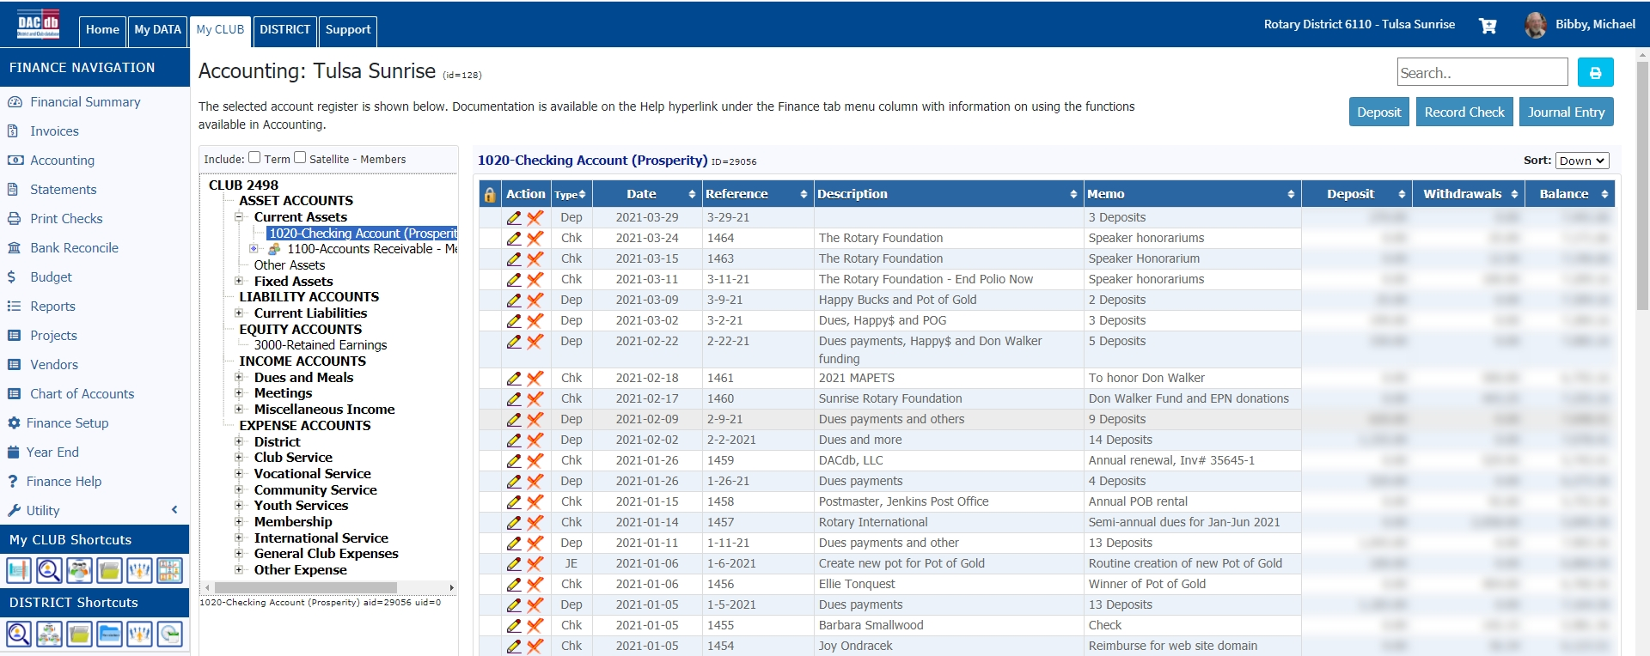
ACCOUNTING TAB – CURRENT ASSETS
Checking Account shows all activity. Note you can record checks and deposits plus make journal entries to transfer among accounts.

Slide 16
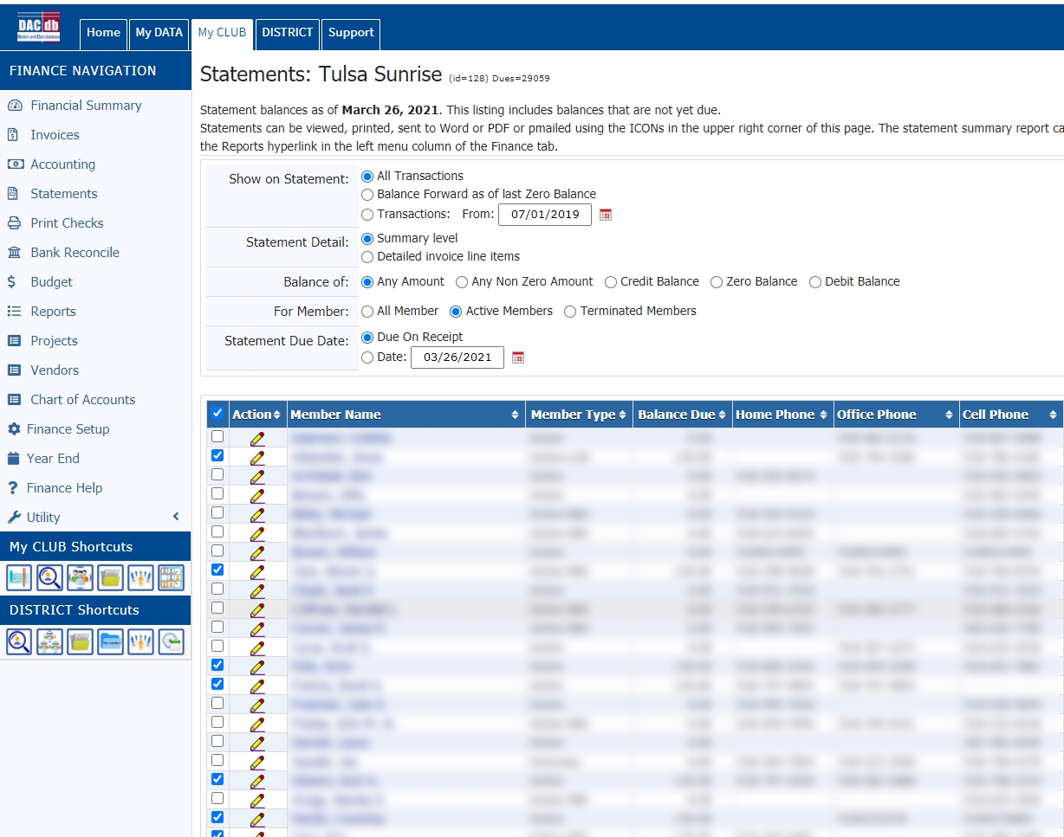
STATEMENTS TAB
Here you can view any balances in Accounts Receivable

Slide 17
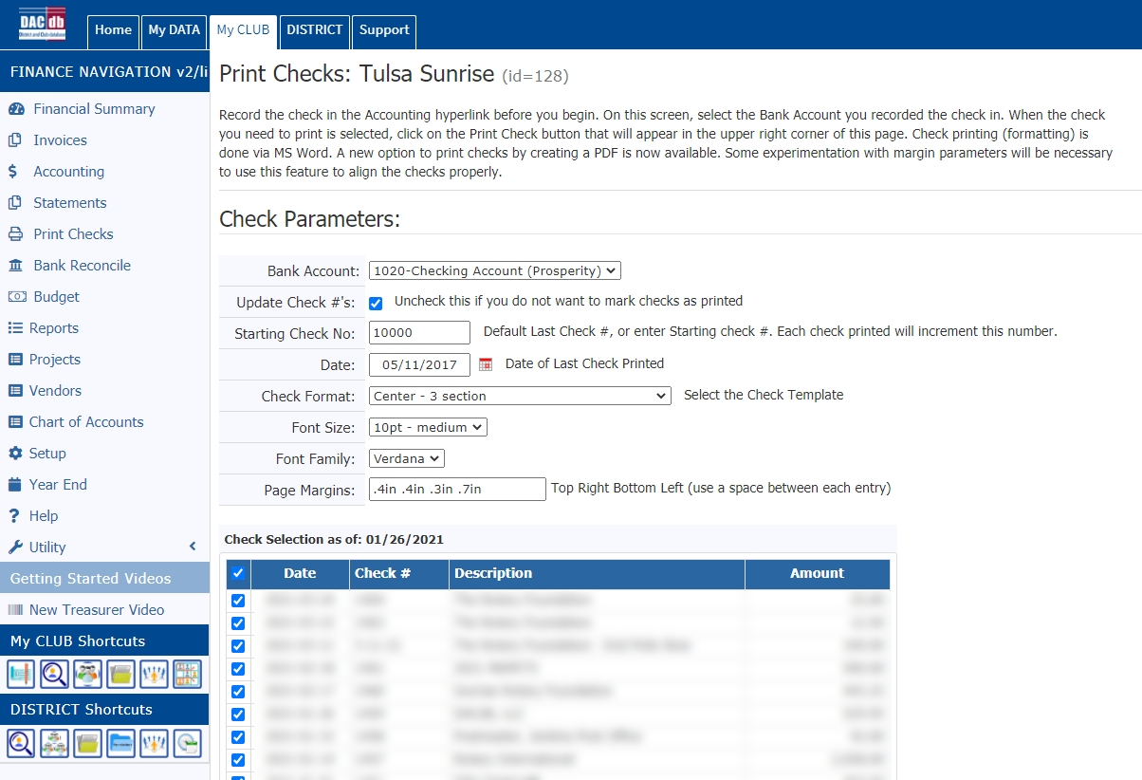
PRINT CHECKS TAB
If you want to print checks, this section allows you to do so. Best to use
pre-printed checks.
Will require considerable setup and uses Microsoft Word.

Slide 18
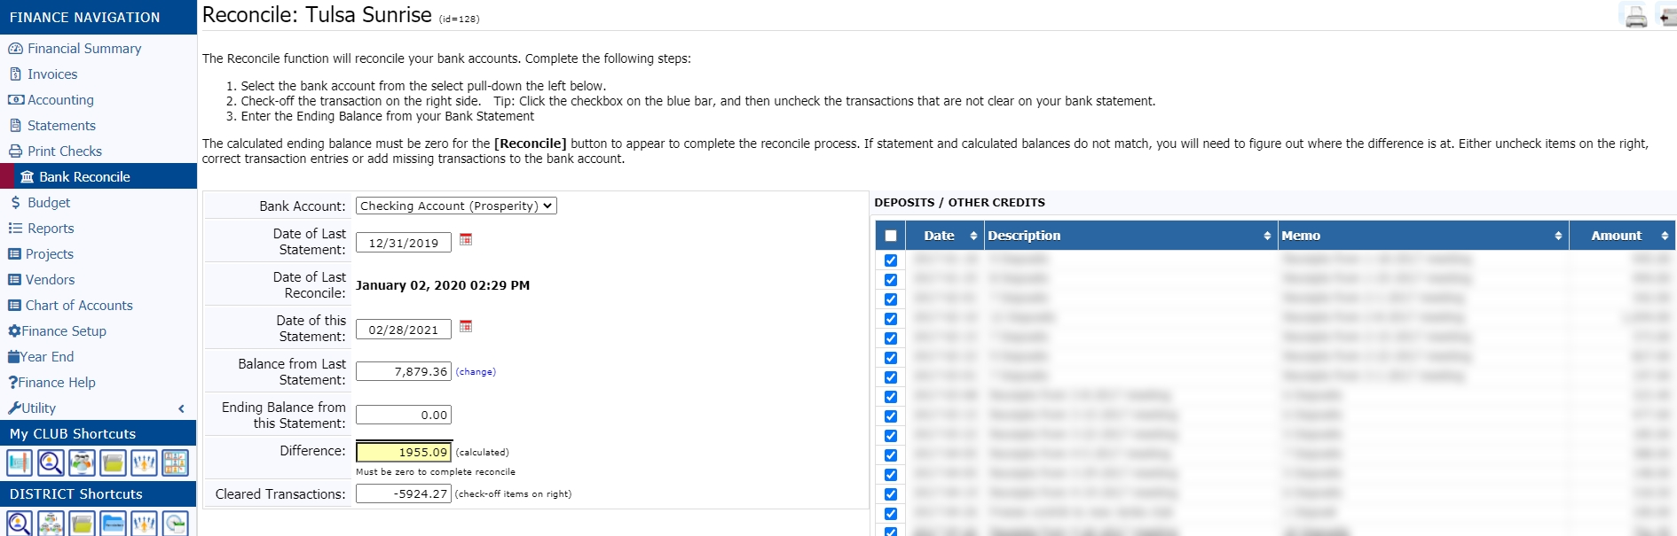
BANK RECONCILE TAB
Done monthly when the bank statement comes in. Useful if done monthly. Helps find transactions (checks/deposits) you forgot to enter .

Slide 19
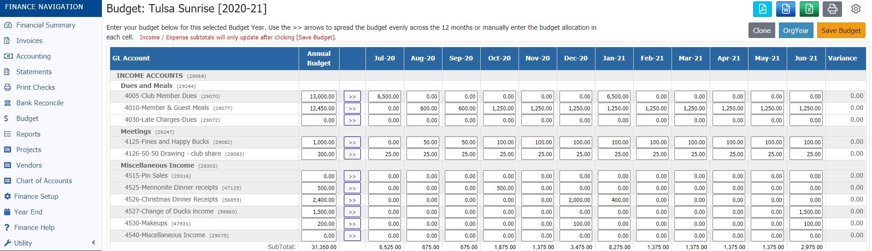
BUDGET TAB
Very useful planning tool. It helps to have a record of prior years income and expenses before setting up. Do your budgeting in the spring as part of the new president’s planning process. Budget reports will help keep track of expenses.

Slide 20
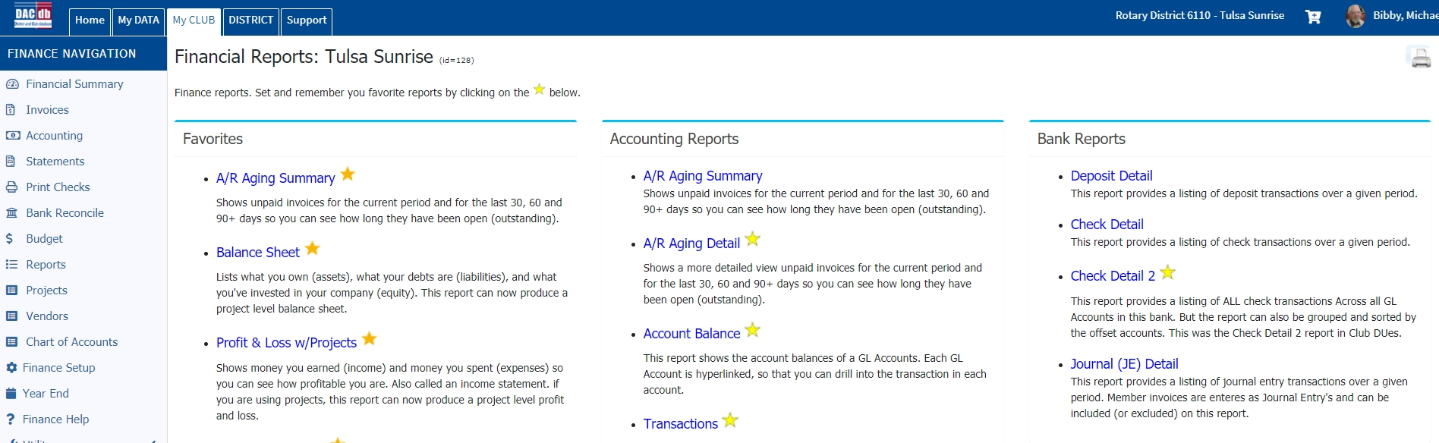
REPORTS
Favorites, Accounting Reports, Bank Reports, Budget Reports, Invoice Reports, Statement Reports, Tax Reporting, Utility Reports and Other Reports.

Slide 21
PROJECT REPORTS
If you create projects.

Slide 22
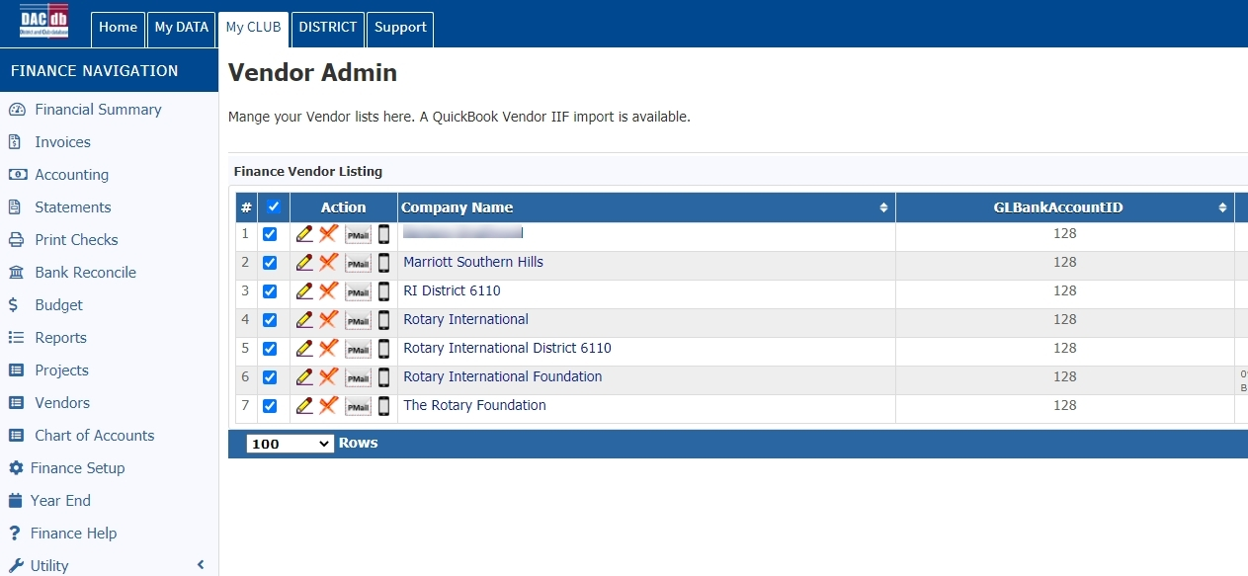
VENDOR ADMIN
Set up vendors you frequently use to use when writing checks

Slide 23
YEAR END CLOSE
The year-end processing is designed to zero out all the INCOME and EXPENSE accounts by entering a year-end balance transaction into each account which will bring each account down to zero (but retains the history in each account), with the corresponding offset going into the RETAINED EARNINGS account. If you would like, you can change the Close date to be past years (e.g., June 30, 2021). As part of the process, DACdb will then lock down (optional -- but *highly* recommended) all the transactions prior to (and including) the fiscal year-end, so that
they cannot be changed. You will still be able to view the transaction detail -- but will not be able to make any
updates once the data is locked.

Slide 24
REPORTS TO CLUB BOARD
My monthly treasurer’s report to the club board consists of the following:
*Checkbook Reconcile
*Bank Statement (edited to remove account information and check copies)
*Check Detail Report
*Deposit Detail Report
*Profit & Loss Report
*Budget Report
*Balance Sheet

Slide 25
Finance Module – Overview
Mike Bibby
Contact Info:
918-240-0460 (cell)
hogfanman@cox.net

