Slide 1
PUBLIC IMAGE
District 6110
Title Page Option

Slide 2
subhead
Everyone in your city knows about Rotary – right?

Slide 3
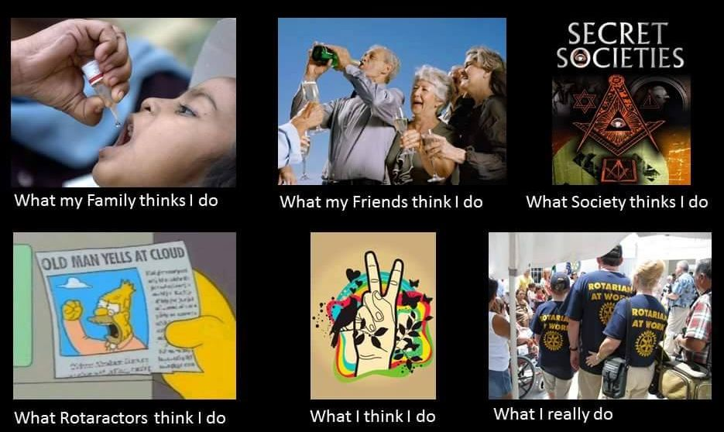
What are rotarians?

Slide 4
Rotary
What I am going to talk about:
- What is the image of Rotary
- What resources are available for your club – maybe a new program
- Social media thoughts
People in Action...
but does anyone know about us?

Slide 5
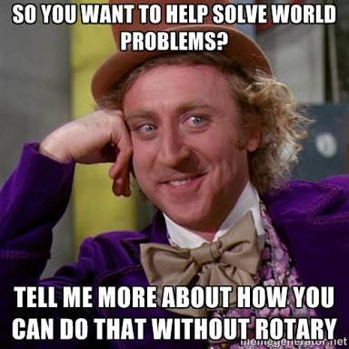
Rotary

Slide 6
The public is aware of Rotary, but unsure of what we do
(RI Survey 2010 by Siegel+Gale)
Houston, we have a problem

Slide 7
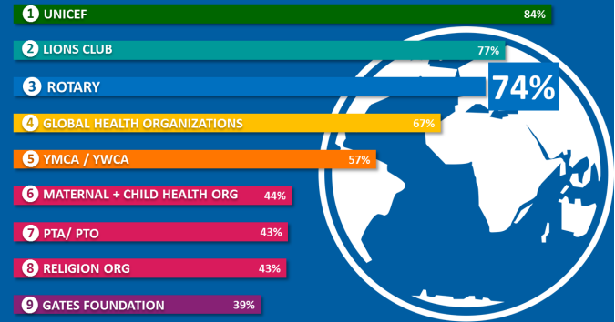
Rotary: 3rd best known organization in world

Slide 8
RI Surveyed the world in 2010
Here’s what they found:
- Interest in joining is low
- Rotary is Male dominated, mostly older
- Inconsistent message
- Viewed as charitable, respected, and caring
- Changes needed

Slide 9
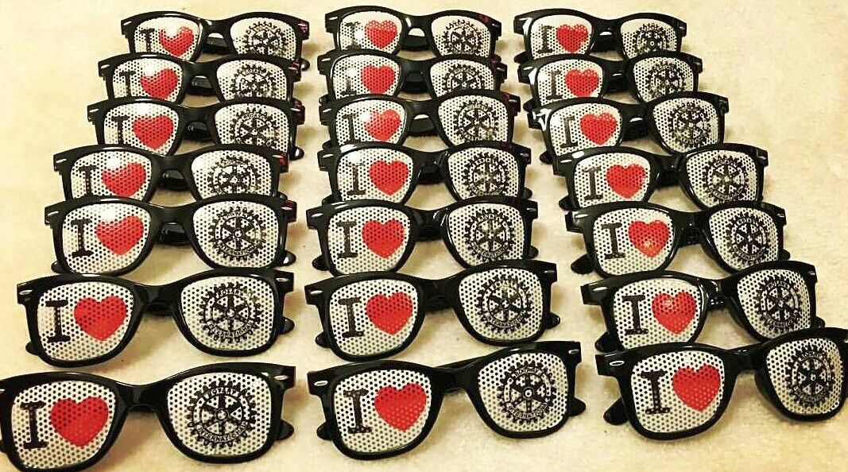
How do you look at rotary?

Slide 10

How RI changed – in 2013
A redesign and simplification of our logo, along with clear branding – and a new ad campaign – People of Action

Slide 11
CONSISTENCY AND REPETITION IS KEY
• Strengthens Rotary image and recognition
• Motivates and engages current Rotarians
• Attracts prospective members, donors
• Elevates the entire Rotary experience

Slide 12


Updated old friends – new terms
Here’s some new terms to use:
Masterbrand Signature Mark of Excellence

Slide 13


Examples of how to create your club’s own logo

Slide 14
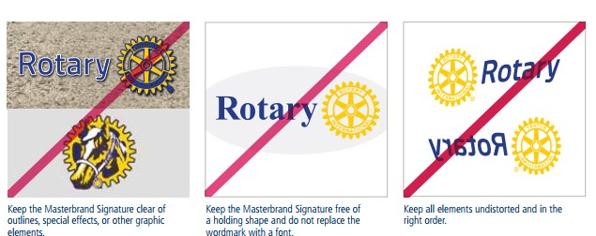
And HOW not to use the logo

Slide 15



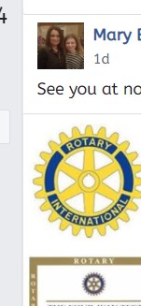

What Is confusing? (these are!)
- New logo (since 2013) not fully used
- Lack of standardization has confused the public and diminished the brand recognition.
- Incorrect usage “cheapens” the masterbrand

Slide 16
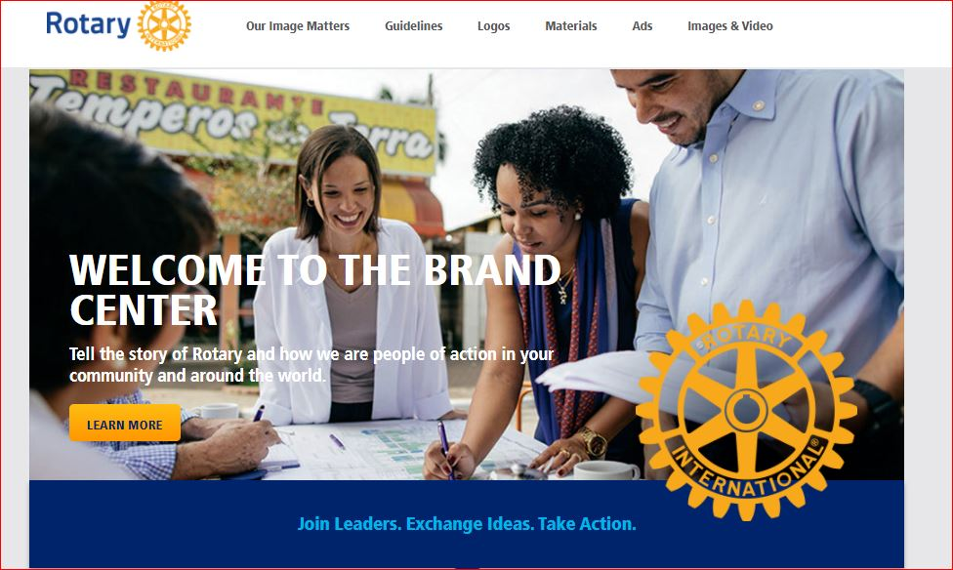
Where can we find resources?
We’ll show you more about the Brand Center later

Slide 17
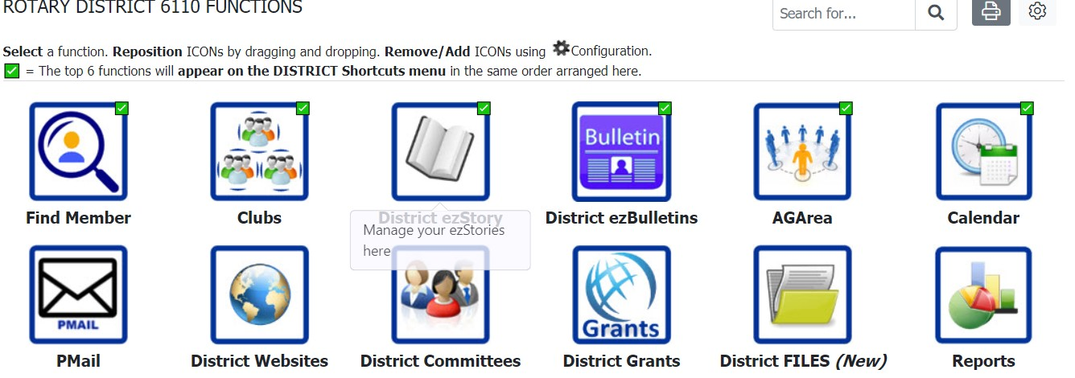
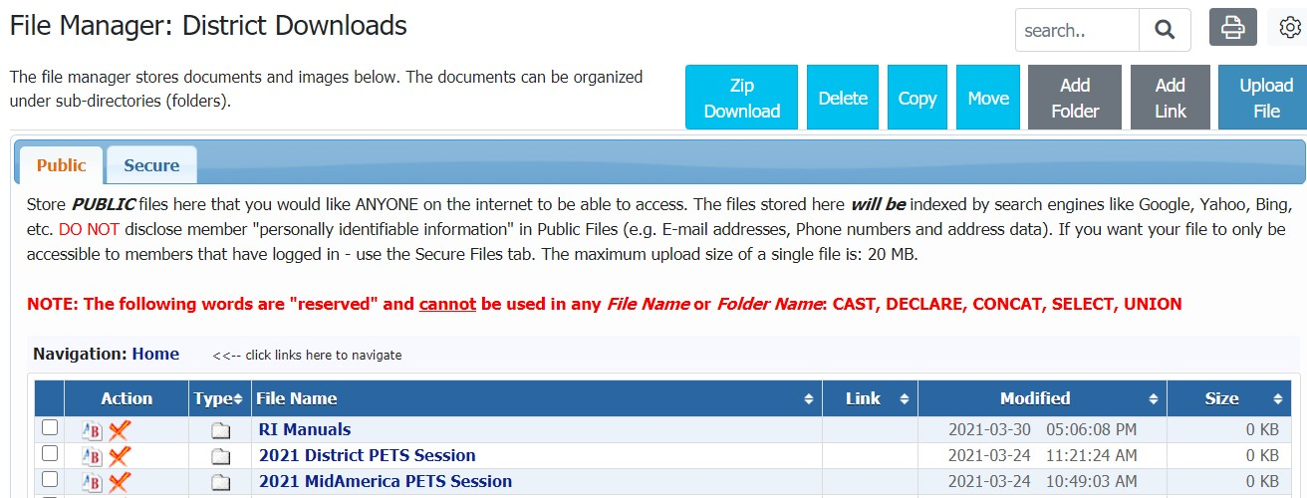
Find the info ON DACdb
<<<<DACdb: Click District Files
DACdb: Click RI Manuals>>>>>>

Slide 18
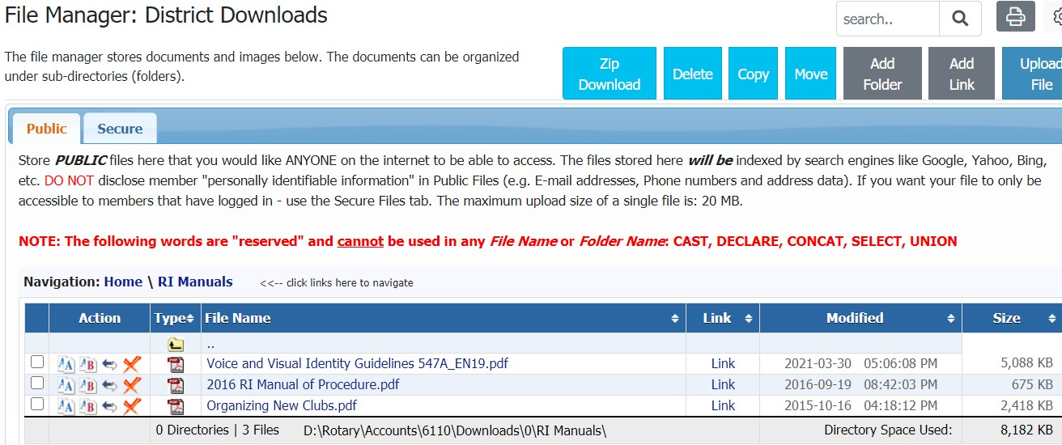
Download the pdf
Download “Voice and Visual Identity Guidelines” for a lot more details on how to properly use the Rotary marks>>>>>

Slide 19

Guidelines for use

Slide 20
NOW you will be able to
- Know how to use the Masterbrand correctly on all your printed material and websites, social media, shirts, etc.
- Insure consistent, compliant use of the Rotary marks
- Clean up old social media issues
- Be the “go to” person for how to “do it right.”
(Extra Credit: what is the ONLY instance when the old blue wheel is allowed?)

Slide 21
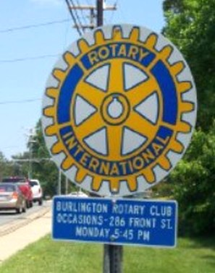



Cross your fingers…
Do you have a Rotary Sign when you enter your city?
Is it the OLD Blue wheel?>>>>>>>>>>>>>>>>>>>>>>>>>>>
We are working on a program where the District may be able to offset part of the cost for a new compliant sign for your club!
We are working with a District 6110 Rotarian-owned company WiseChoiceawards.com, a Licensed Rotary vendor to make new signs for those that want to let people know ROTARY is active in their community!

Slide 22
Guiding Principals
- Motto: Service Above Self (and One Profits Most Who Serves Best)
- The Object of Rotary is to encourage and foster the ideal of service as a basis of worthy enterprise
- The Four-Way Test
- Avenues of Service
DO YOU KNOW THE NEW VISION STATEMENT:

Slide 23

Rotary Vision STatement
Why not recite this also?

Slide 24

Annual theme logo:
- Selected by RI President to inspire existing Rotarians
- Confusing: It changes every year – 8+ clubs have an older one on their FB page (Drumright, Muskogee, Poteau, B’Ville Daybreak, Chanute, Neodesha, Siloam, MtVernon, )
- Distracts from master brand
- Should be used WITH the master brand – see above

Slide 25

Themes – how many do you remember?

Slide 26
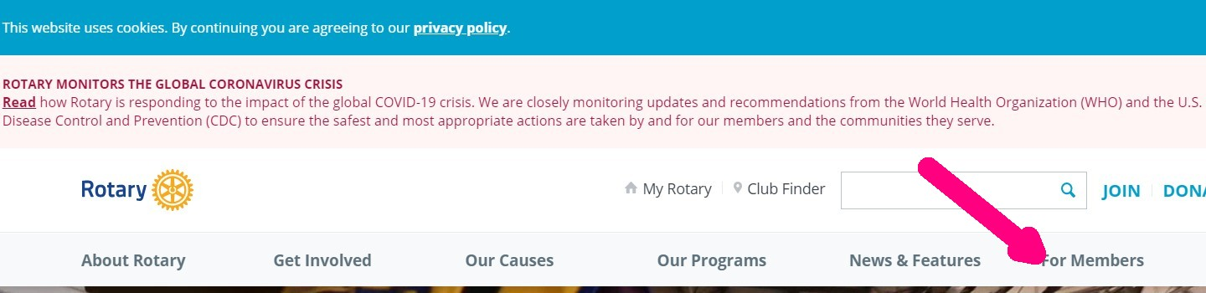
LOTS More resources – Rotary.org
Rotary International really has 2 websites
- Rotary.org – the public-facing site
- My Rotary (My.Rotary.org)– the member facing website
- How to get to My Rotary – click “for members”:

Slide 27
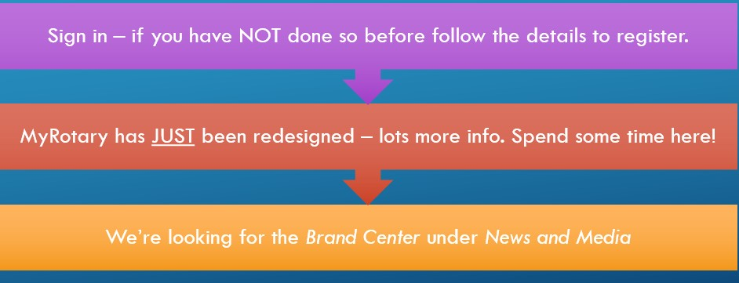
Sign into My ROtary

Slide 28
The Rotary Brand Center

Slide 29
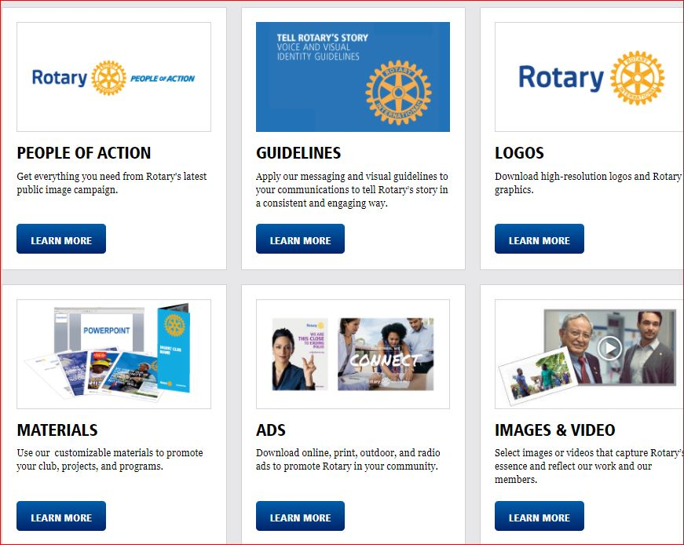
Lots to do: here:

Slide 30
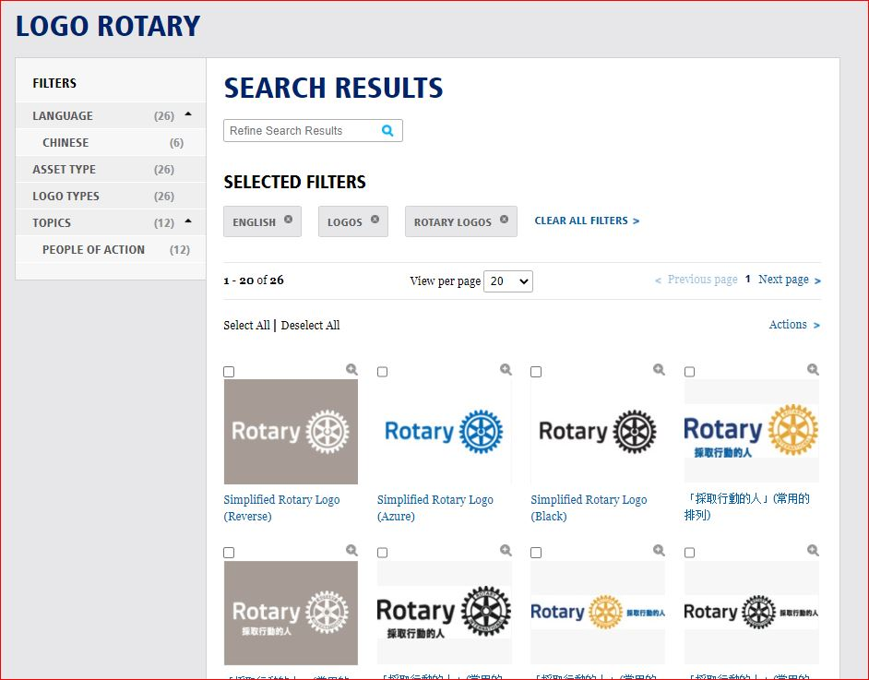
Find Rotary, Interact, Rotaract Logos

Slide 31
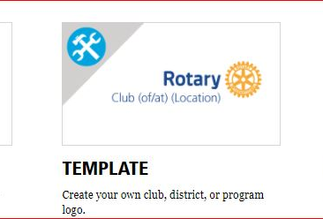

Template section: design your Club’s Logo & download it

Slide 32
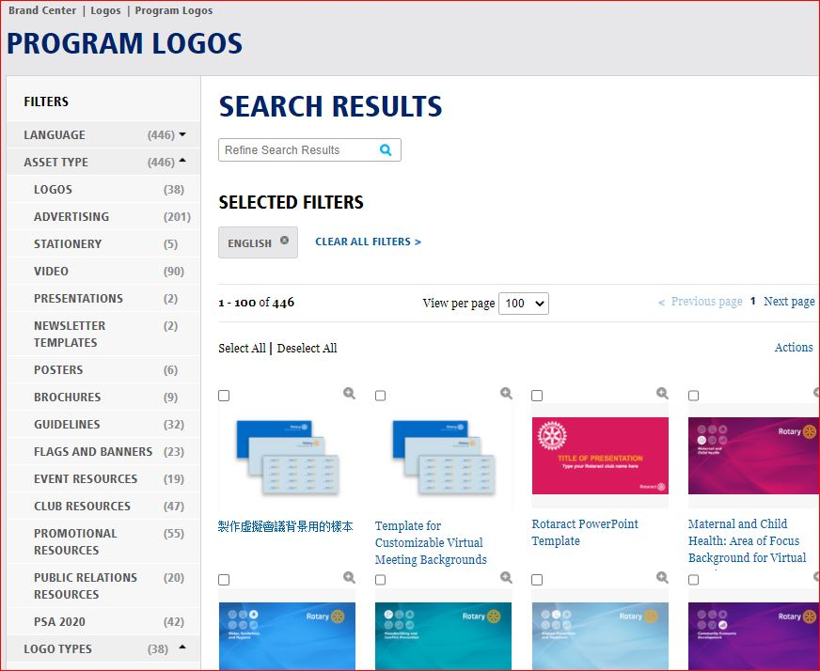
PowerPoint templates, Even Zoom backgrounds!

Slide 33

ZOOM!

Slide 34
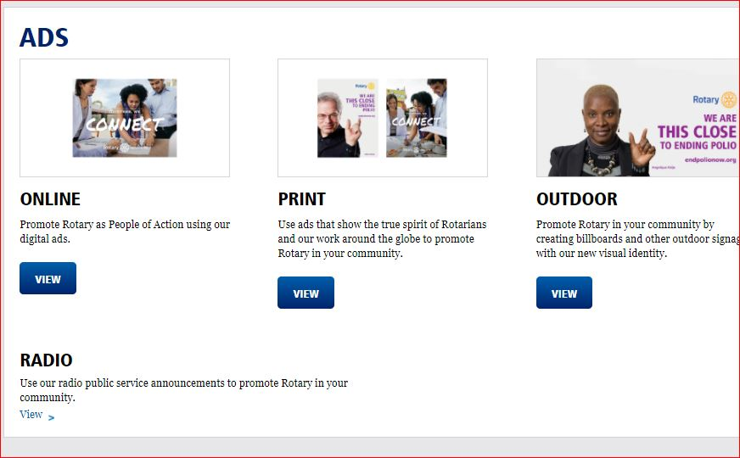
Premade ads – you can customize

Slide 35

How about a club billboard?

Slide 36
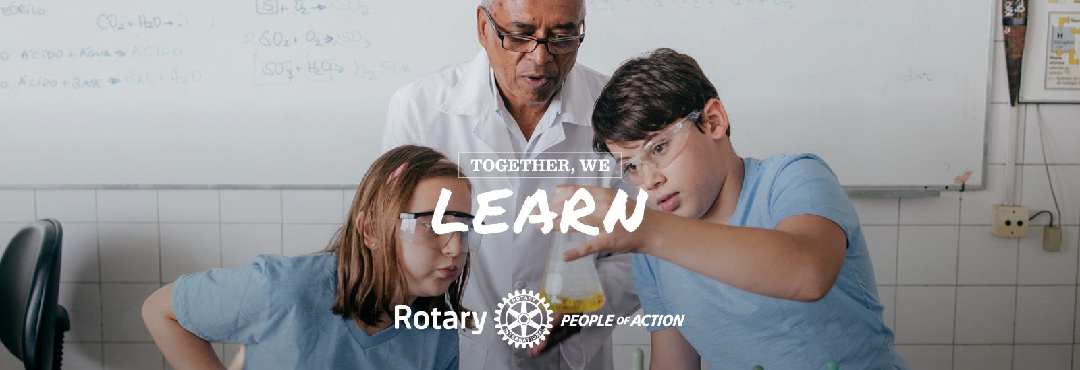
Ready-made Facebook images

Slide 37
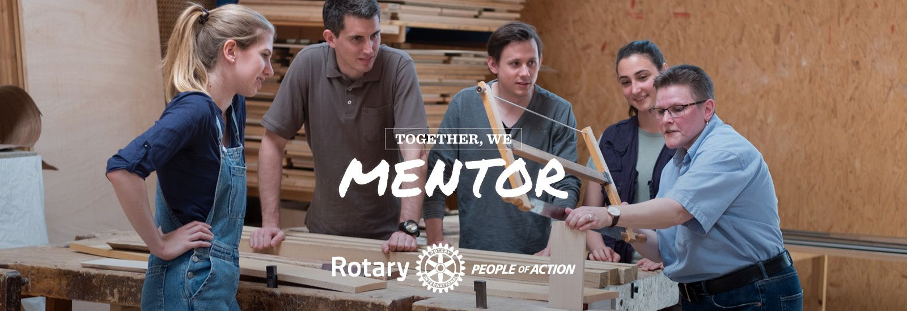
free at Rotary.org brand center

Slide 38

Extra Credit: (try it!)
Turn your own action photos into a “Together We” at https://www.poaphotos.com/
Joplin Club at MSNI

Slide 39
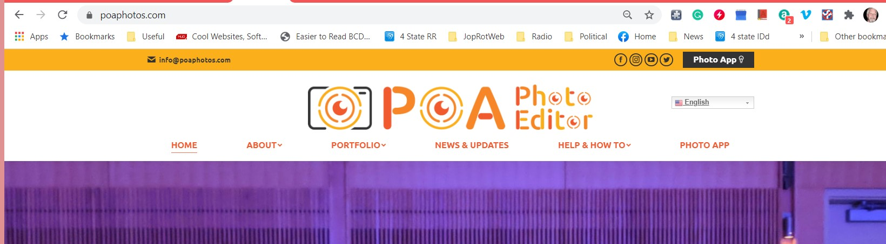
POA photo editor
First read the short “Help and How to” then click on the Photo Ap and do it!

Slide 40

Be proud of what you do!
Joplin’s Miracle Field

Slide 41
Thoughts re Social Media
Using Facebook and other Social Media to advance your Rotary Club’s
Public Image

Slide 42


Slide 43
Social media’s value
Your Club can Use Social Media as another channel to let members
AND PROSPECTS
know about your club

Slide 44
Facebook Followers = prospects
Joplin Rotary FB Page has 433 “Followers” for a 80-member club - that’s 353 Prospects!
District 6110’s FB Page has 1689 “Followers” for 3750 members – need MORE!
facebook.com/District6110/

Slide 45
How do we get more followers?
Post often:
- 1 or 2 times a day if possible
- Use FB’s built in Scheduler
- Post 1/3 “real stuff”
- and 2/3 “fun stuff

Slide 46

1/3 Real stuff

Slide 47

Be Bold!
Trick: Want bold or italic text in a Facebook post?
Copy the words you want to be bold and go to
https://yaytext.com/bold-italic/
Insert, copy and replace!

Slide 48
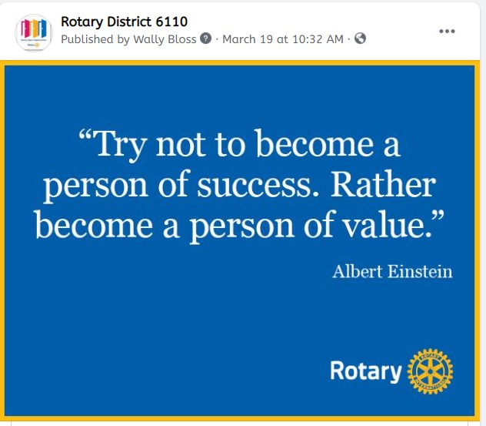

2/3 Fun Stuff

Slide 49
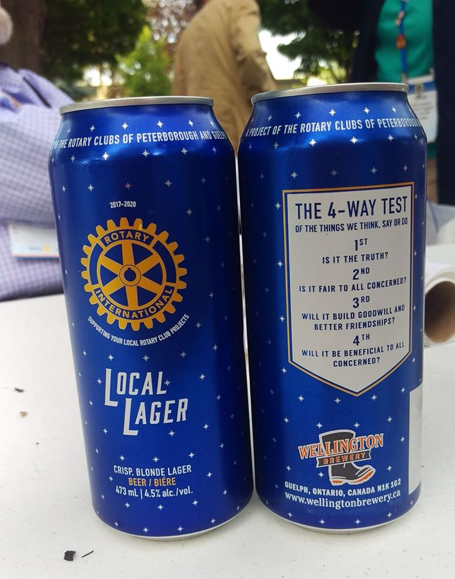
Fun stuff
FUN or Inspirational STUFF – it drives people to the page and then they see the “real” stuff -1,100 reach!
they see the “real” stuff -1,100 reach!

Slide 50

More fun/inspirational stuff

Slide 51

The RI Brand center has lots you can use

Slide 52
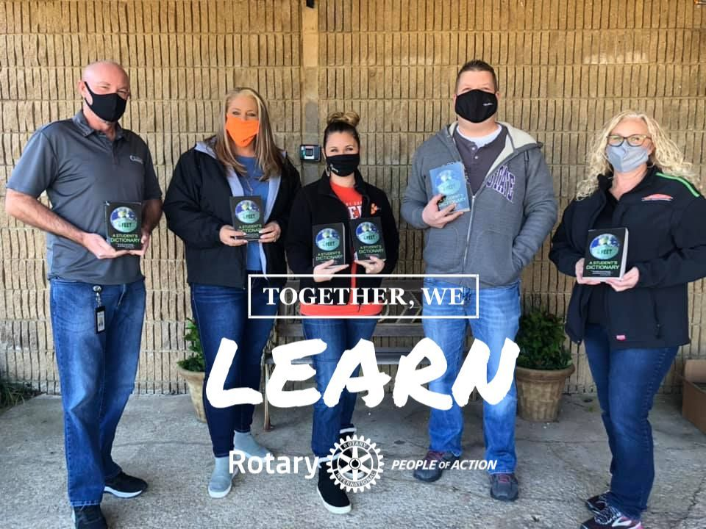
Or make your own
Coweta Dictionaries

Slide 53
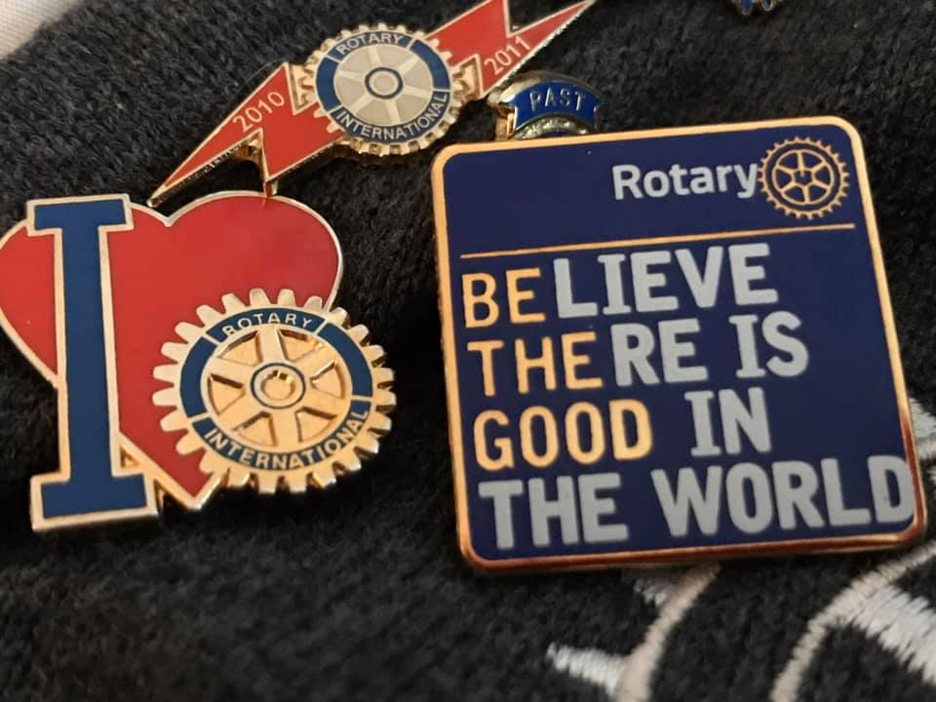
Fun/Inspirational drives people

Slide 54
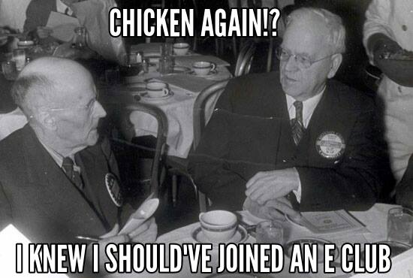
E club options – info!

Slide 55
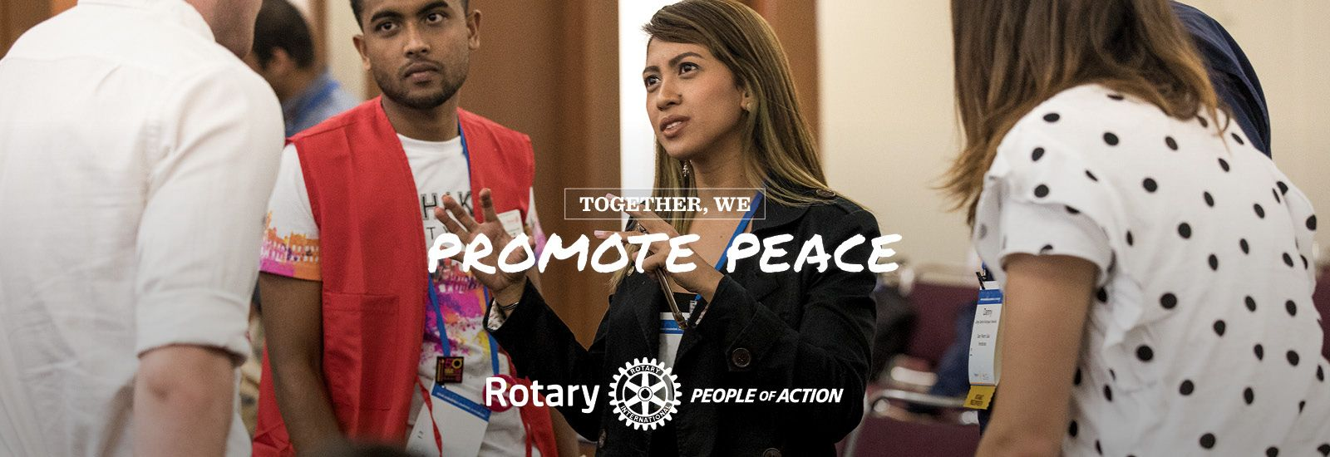
Brand center– sized for facebook

Slide 56
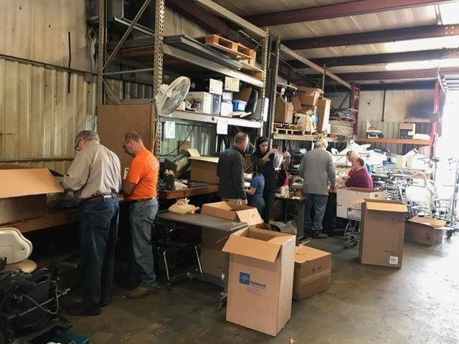
Post doing service – not static
Bartlesville Rotary @ MSNI – doing SERVICE!

Slide 57
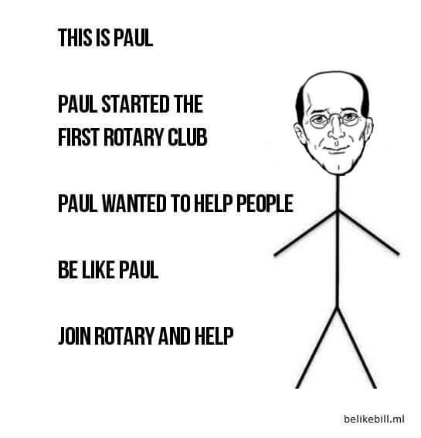
Have Fun!

Slide 58
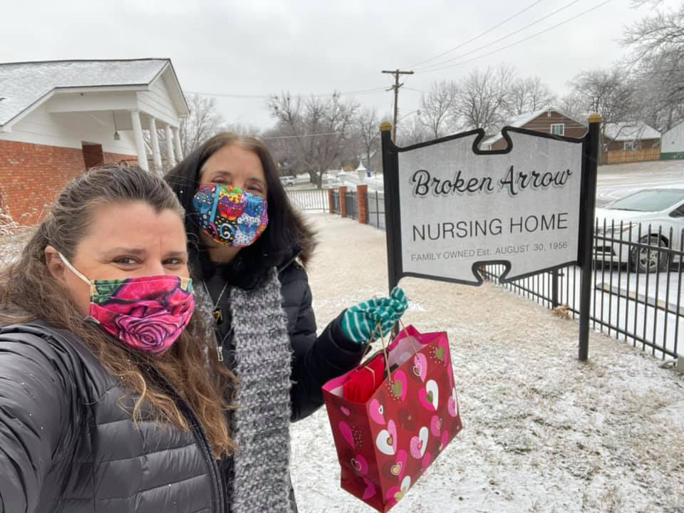
Doing service
Thanks, Broken Arrow Rotary

Slide 59
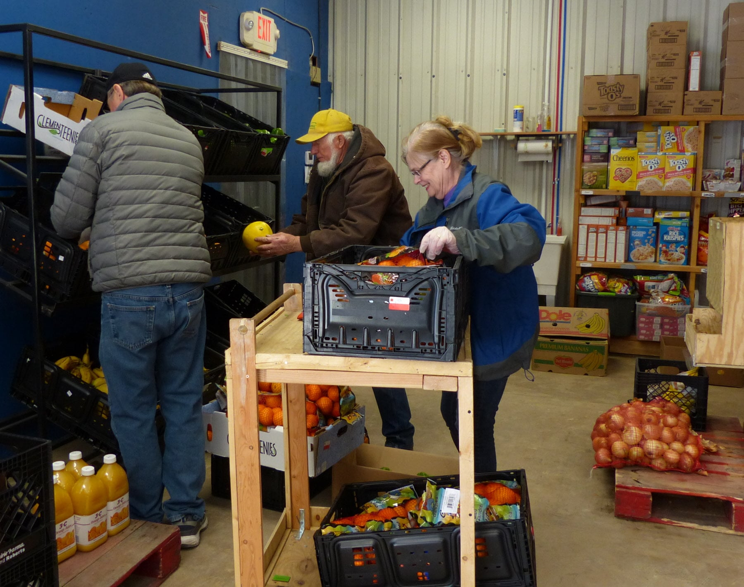
Service service service
Thanks, Pryor!

Slide 60

Inspirational

Slide 61
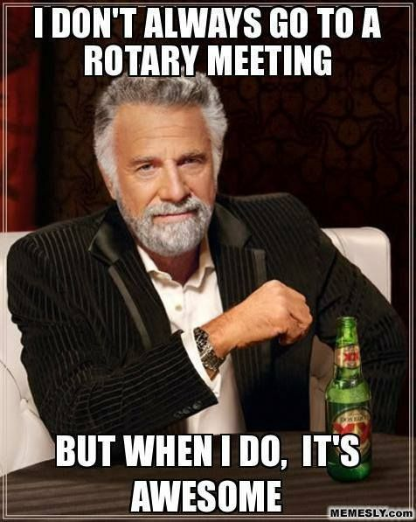
Humor!

Slide 62

There’s LOTS to use

Slide 63

Share Info

Slide 64

Rotary Voices – link to the blog

Slide 65

Talk about rotary

Slide 66
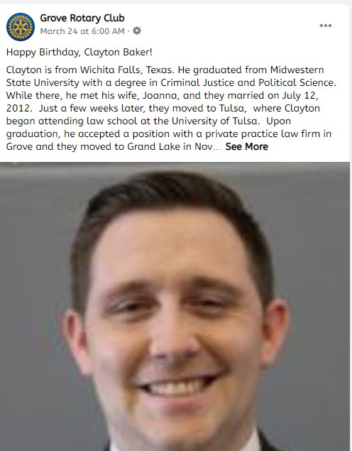
Highlight your members
Thanks, Grove!

Slide 67
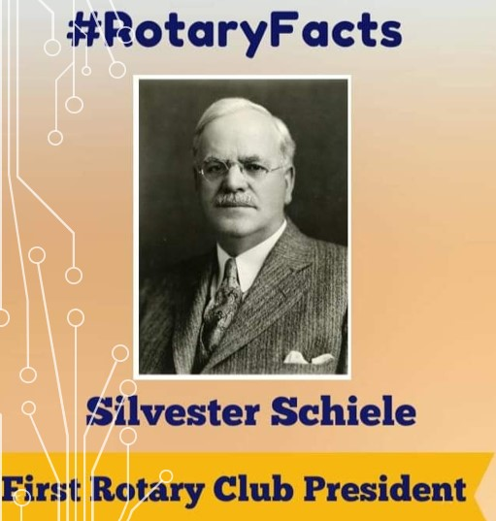
Or a bit of history

Slide 68
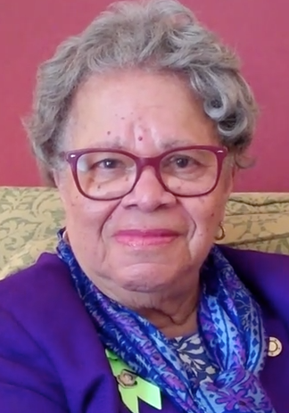
Be interactive
This is Sylvia Whitlock, of the Rotary Club of Duarte, California, the first female Rotary club president
Who was your club’s first female president?

Slide 69
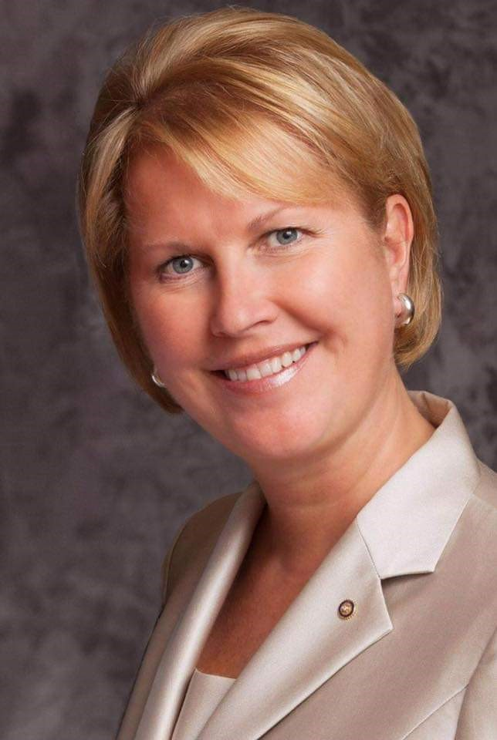
What club is the first female RI President from?
Jennifer Jones, member of the ???? club, will become Rotary International's president for 2022-23

Slide 70
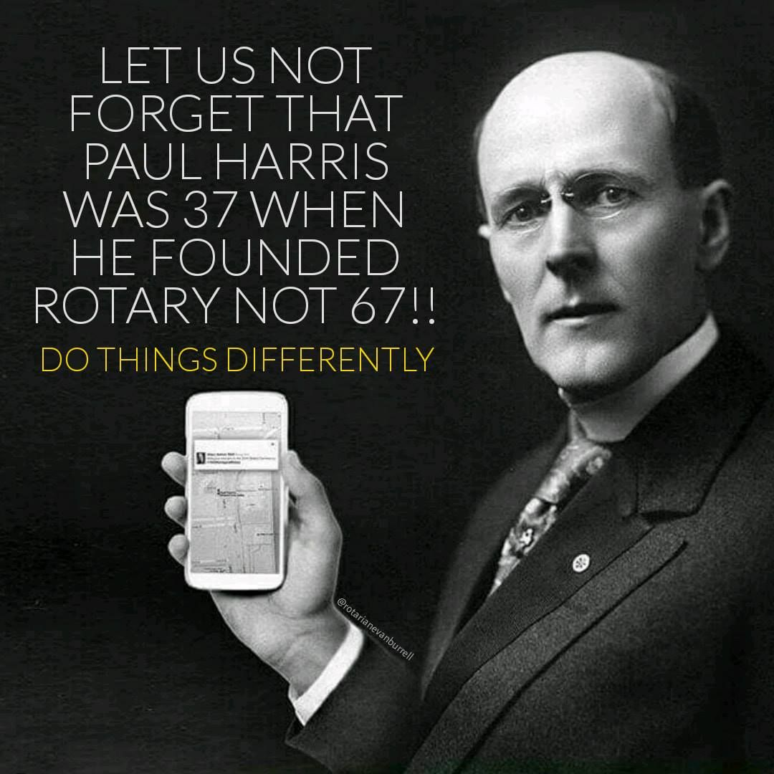
Fun!

Slide 71

So many

Slide 72

Personalize

Slide 73
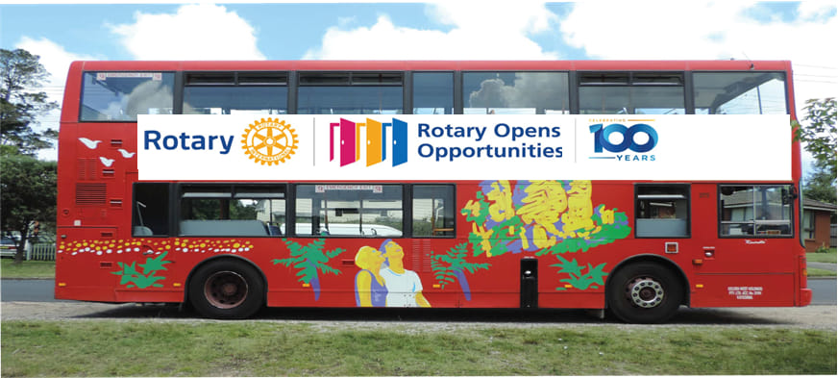
Think outside the bus

Slide 74

Believe!

Slide 75
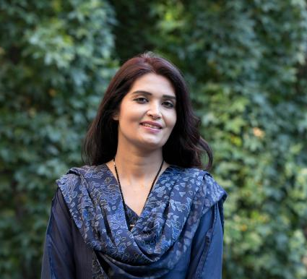
What to post? Find Interesting Stories on rotary.org
Virus Hunter

Slide 76

91,184
Speaking of viral:

Slide 77
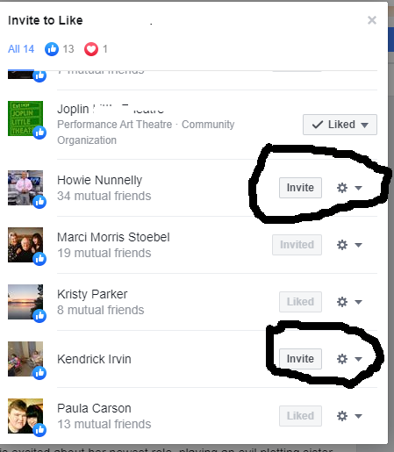
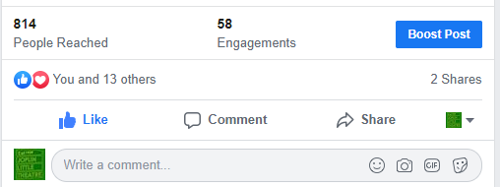
If someone LIKES a post, ask them to LIKE your PAGE:

Slide 78
SHARE 6110
And finally:
if you need content, SHARE the 6110 Facebook page post to YOUR CLUB’S page!

Slide 79
OTHER RESOURCES
Facebook.com/Rotary
Facebook.com/RotarianEvanBurrell/
Facebook.com/District6110/
https://www.poaphotos.com/ - MAKE you own “Together We” pix
Blog.Rotary.org
https://yaytext.com/bold-italic/
Facebook: Rotary Geeks: A place to join leaders, exchange ideas & take action!
Facebook: Rotary District 6110 Club Presidents
Facebook: Rotary Club Members: Public Image, Graphics & Ideas Hub

Slide 80
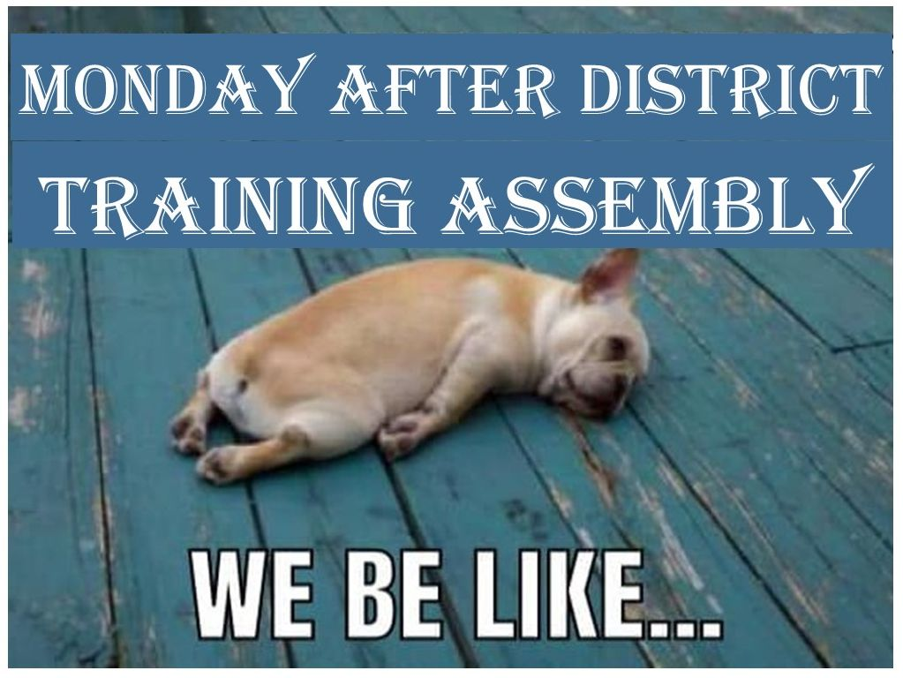
WHEW…

Slide 81
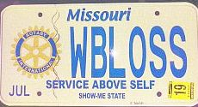
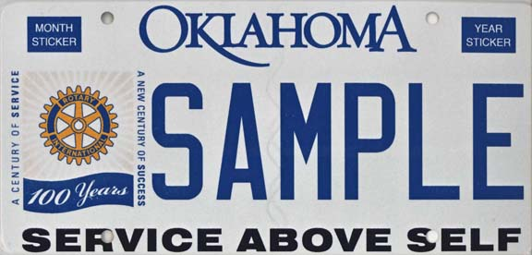
Rolling Billboards…
No time left: I’m Wally Bloss
Joplin Rotary Club
Facebook.com/JoplinRotaryClub/
Wbloss@Gmail.com
MO Rotary Plate $15
OK: $20
AR: no
KS: no

Slide 82
QUESTIONS

