Slide 1
Club Secretary
Presented by Cathy Webster–District Visioning Chair
cathywebster@gmail.com
(918) 625-5720
++

Slide 2
District Administrator Cole Adamson District office, Rotary District 6110 8209 E. 63rd Place Tulsa, OK 74133 Office: (918) 481-6110 Cell: (918) 807-4088 Fax Number: (918) 481-6010 districtadministrator@district6110.org

Slide 3
Club Secretary Responsibilities
Attend the District Training Assembly and the District Conference
Meet with the outgoing secretary and receive club records
Meet with incoming board of directors
Create a My Rotary account on Rotary.org if you don’t already have one
Update your Club’s records and member list on My Rotary as changes occur
Make sure the Treasurer receives the club invoices, due in July and January
Serve on the club board and club administration committee
Take minutes at club and board meetings and club assemblies
Update club and officer information for Rotary’s records

Slide 4
Club Secretary Responsibilities
Manage club correspondence, responding to emails and messages
Keep promotional items, name badges, and other materials used at meetings
Take attendance and submit monthly attendance reports in DACdb
Preserve your club’s historical records
Write an annual report at the end of the Rotary year
Assist the club president, treasurer, and committees as needed.
Meet with your successor and hand over club records

Slide 5
Club Secretary Training
You are responsible for keeping your club’s member lists up-to-date!
Through your My Rotary Account
Through DACdb (See Cole Adamson or Rachelle Parker or me for assistance)

Slide 6
Club Secretary Training
You are a team with your club Treasurer for keeping your club information up-to-date!
Work to together and help each other.

Slide 7
Club Secretary Training
Silly things:
DOB
Picture
Correct Email
ICE Contact
Put Member Induction Date Immediately
Terminate Member Immediately
Keep Attendance / Submit Attendance

Slide 8
Our reference guide is:
Rotary International
2019 Manual of Procedure
Updated every 3 years
Find here: https://my.rotary.org/en/document/manual-procedure-035

Slide 9
2019 RI Manual of Procedure – Membership Categories
Dual Membership:
No person shall simultaneously hold active membership in this and another club* other than a satellite of this club. No person shall simultaneously be a member and an honorary member in this club.
*This includes membership in other civic organizations, such as: Kiwanis International and Lions Clubs International.

Slide 10
2019 RI Manual of Procedure – Membership Categories
Honorary Membership:
(a) Eligibility for Honorary Membership.
Persons who have distinguished themselves by meritorious service in the furtherance of Rotary ideals and those persons considered friends of Rotary for their support of Rotary’s cause may be elected to honorary membership in this club.
The term of such membership shall be as determined by the board.
Persons may hold honorary membership in more than one club.

Slide 11
2019 RI Manual of Procedure – Membership Categories
Honorary Membership:
(b) Rights and Privileges.
Honorary members shall be exempt from the payment of dues, shall have no vote, and shall not be eligible to hold any office in this club.
Such members shall not hold classifications but shall be entitled to attend all meetings and enjoy all the other privileges of this club.
No honorary member of this club is entitled to any rights and privileges in any other club, except for the right to visit other clubs without being the guest of a Rotarian.

Slide 12
2019 RI Manual of Procedure – Membership Categories
Rule of 85
A club member’s absence shall be excused if:
A member is an active member
The aggregate of the member’s years of age and years of membership in one or more clubs is 85 years or more
The member notifies the club secretary in writing of the member’s desire to be excused from attendance and the board has approved.

Slide 13
2019 RI Manual of Procedure – Membership Categories
Other Club Defined Membership Types
Corporate memberships
Family memberships
Associate memberships
Young professional memberships
Rotary International currently recognizes Active and Honorary memberships

Slide 14
2019 RI Manual of Procedure – Rotary Mark
Use of the Rotary Marks by Rotary Clubs,
Rotary Districts and other Rotary Entities
The Rotary name, Rotary emblem and other Rotary marks should not be altered or modified or obstructed in any way or reproduced other than in their complete form.
The mark may not be overwritten (watermarked, printed, screened, or embossed, provided the Rotary mark is not partially covered or obstructed.)

Slide 15
Rotary International Dues
Invoices will be emailed to club officers by the end of
July and January from RI.
Clubs are required to pay the balance upon receipt
of the invoice.
Verify that your Club Treasurer gets the invoices.

Slide 16
District Dues
Billed semi-annually in both July and January.
Annual dues are based on the June 30th membership census. This figure cannot be changed.
The first half dues are payable at one-half per member upon receipt of your invoice sent from the District 6110 Office.
Payment of dues is sent to RI District 6110, 7122 S. Sheridan Rd, Suite 2-162, Tulsa OK 74133
Mid-America President Elect Training Seminar (MAPETS) fees for your club’s President Elect are included in the first half dues.

Slide 17
Free Secretary
Training Materials

Slide 18
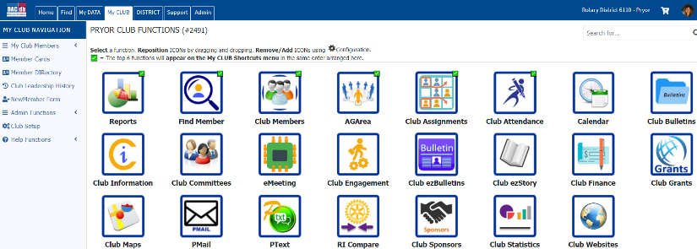
DACdb Help

Slide 19
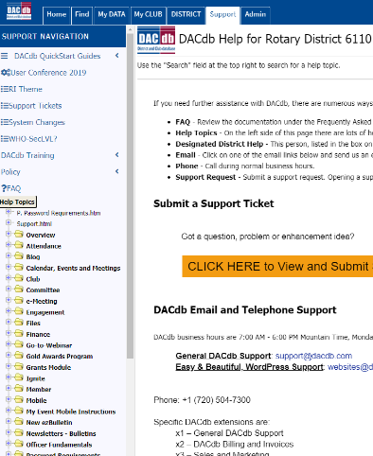
DACdb Help

Slide 20
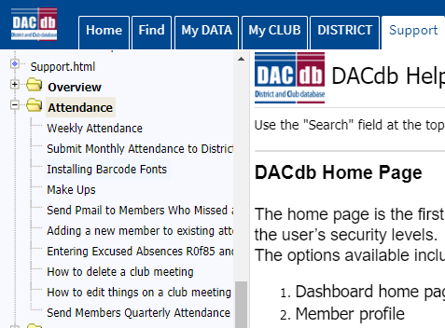
DACdb Help

Slide 21
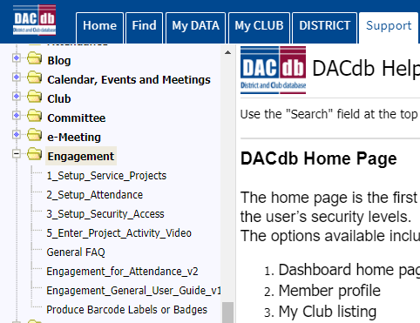
DACdb Help

Slide 22
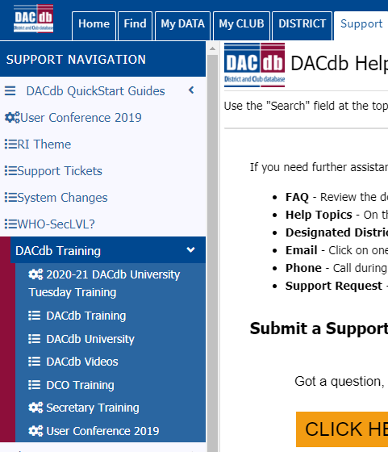
DACdb Help

Slide 23
DACdb Help

Slide 24
DACdb Help

Slide 25
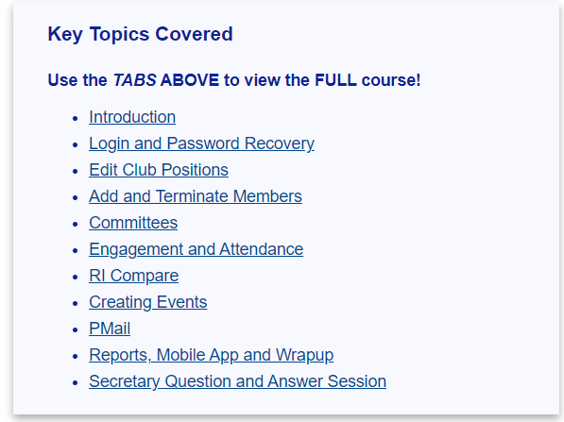
DACdb Help

Slide 26
DACdb Help

Slide 27
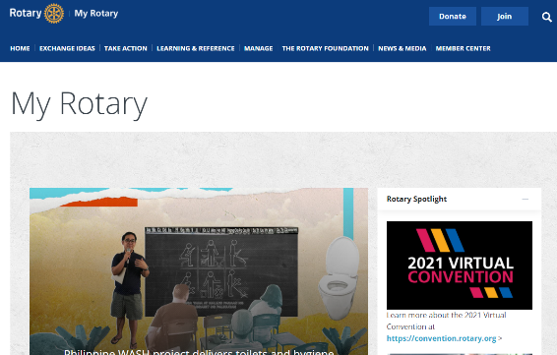
My Rotary Help

Slide 28
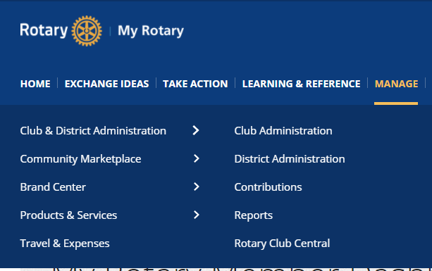
My Rotary Help

Slide 29
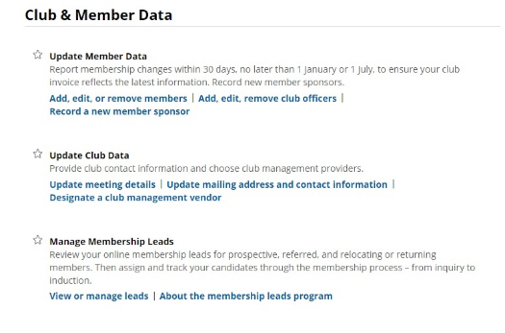
My Rotary Help

Slide 30
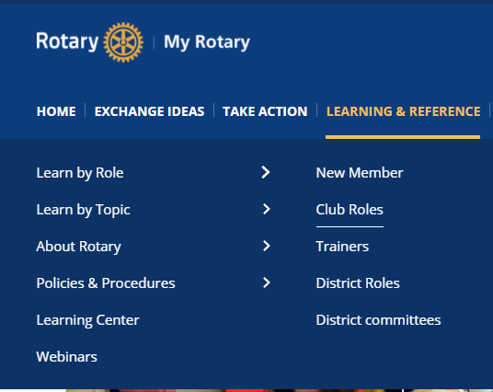
My Rotary Help

Slide 31
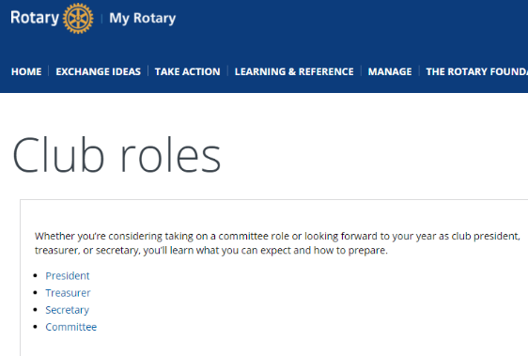
My Rotary Help

Slide 32
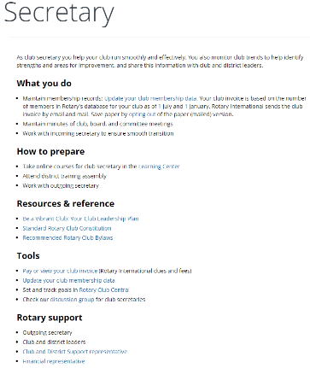
My Rotary Help
The description
includes several
live links to more detailed information.

Slide 33
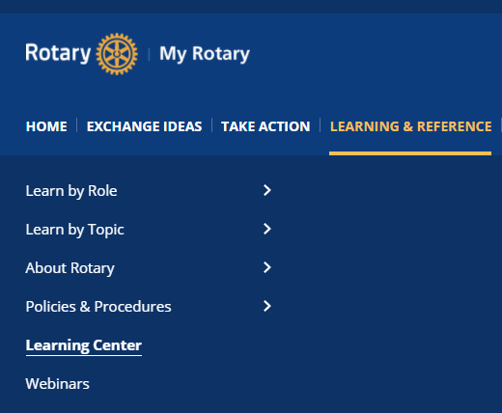
My Rotary Help

Slide 34
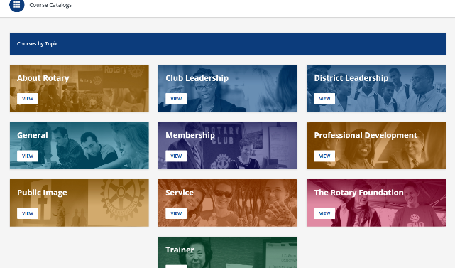
My Rotary Help

Slide 35
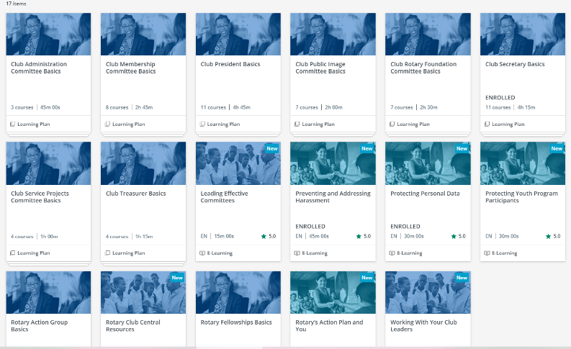
My Rotary Help

Slide 36
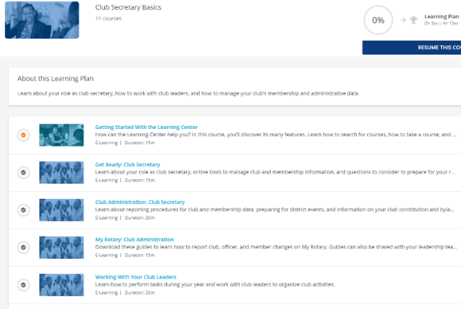
My Rotary Help
It is free,
learn at your own pace
and your
own
schedule!

Slide 37
Thank you for accepting the adventure of being your club’s Secretary!

Slide 38
Questions?

